Slide 1
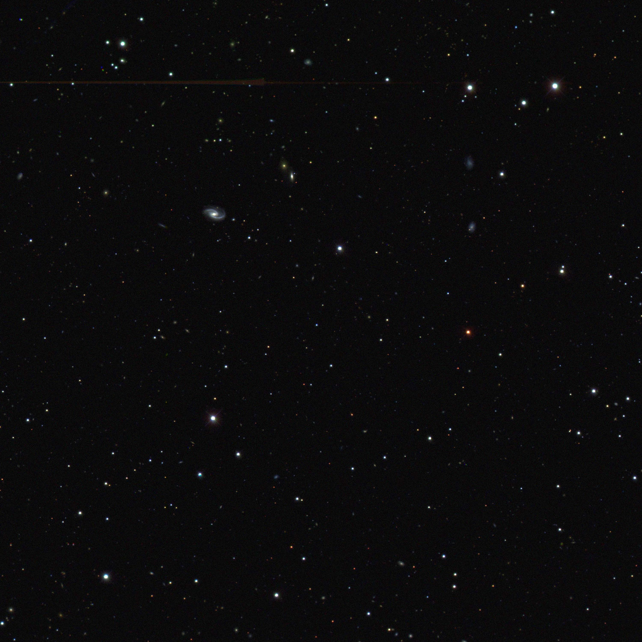
Cosmology with Supernovae: Lecture 3
Josh Frieman
I Jayme Tiomno School of Cosmology, Rio de Janeiro, Brazil
July 2010

Slide 2
Hoje
VI. Fitting SN Ia Light Curves & Cosmology
VII. Systematic Errors in SN Ia Distances
VIII. Host-galaxy correlations
IX. SN Ia Theoretical Modeling
X. Testing models with Future Surveys: Photometric classification, SN Photo-z’s, & cosmology

Slide 3
Fitting SN Ia Light Curves
Multi-color Light Curve Shape (MLCS2k2)
Riess, etal 96, 98; Jha, etal 2007
SALT-II
Guy, etal 05,08

Slide 4
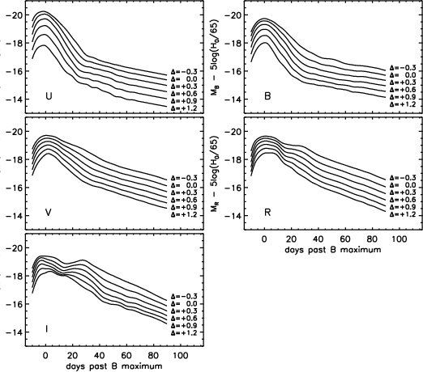
MLCS2k2
Light-curve
Templates
in rest-frame j=UBVRI;
built from ~100
well-observed, nearby SNe Ia
∆ <0: bright, broad
∆ >0: faint, narrow,
redder
time-dependent model “vectors”
trained on Low-z SNe
observed
passband
fit parameters
Time of maximum distance modulus host gal extinction stretch/decline rate

Slide 5
SALT-II Light-curve Fits
Guy et al
Fit each light curve using rest-frame spectral surfaces:
Light curves fit individually, but distances only estimated globally:
Differences from MLCS: not trained just on low-redshift data; flat priors on model parameters; color variations not assumed only from dust. If dust, then β=R_{V}+1. Find β~2.5 empirically.
light-curve shape
color term
Global fit parameters, determined along with cosmological parameters by fit to Hubble diagram (so in principle you should not use SALT distance tables to test some other cosmological model)

Slide 6
SALT-II
templates
for
x₁=-2,0,2

Slide 8
red
broad
blue
narrow

Slide 10
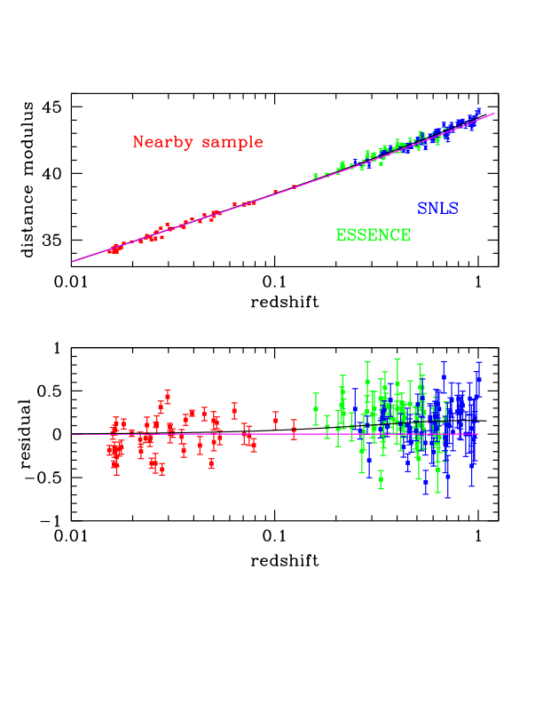
Hubble Diagram
~45 SNe Ia
~120 SNe

Slide 11
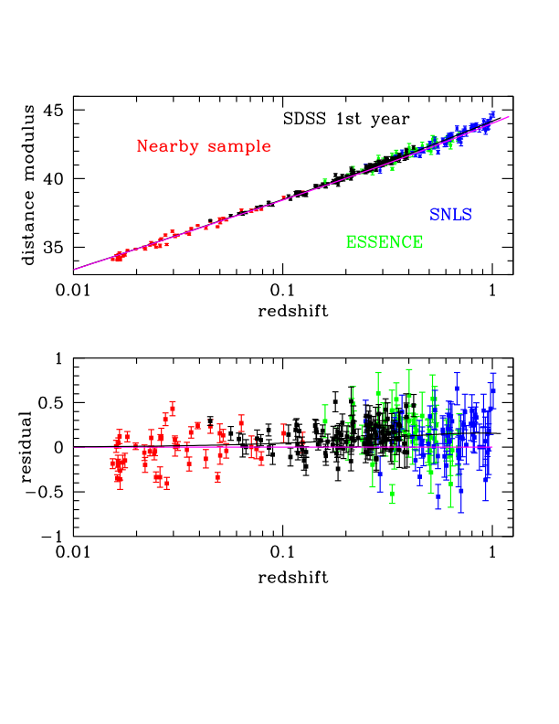
Hubble Diagram
with SDSS SNe
103 SNe Ia from first season that pass stringent light-curve quality cuts
Kessler etal (2009)
Lampeitl etal (2009)
Sollerman etal (2009)
~45 SNe Ia
~120 SNe

Slide 12
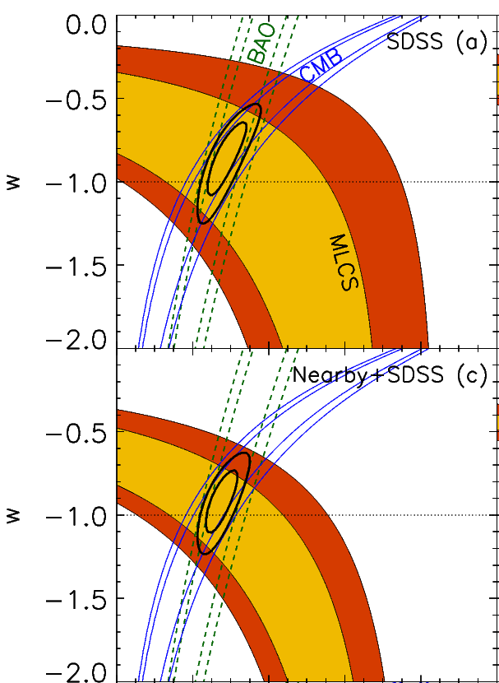
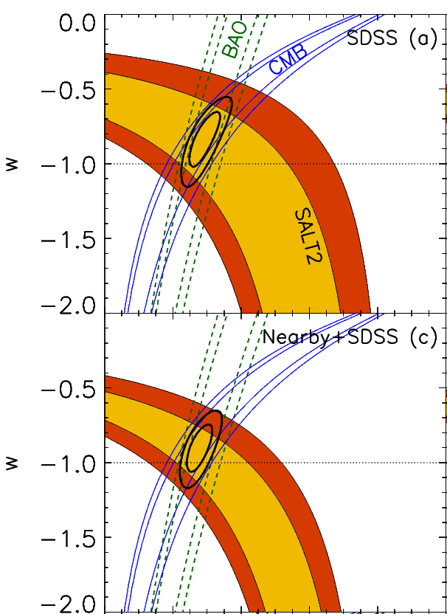
MLCS
SALT
SDSS only:
Nearby+SDSS:
MLCS
SALT

Slide 13
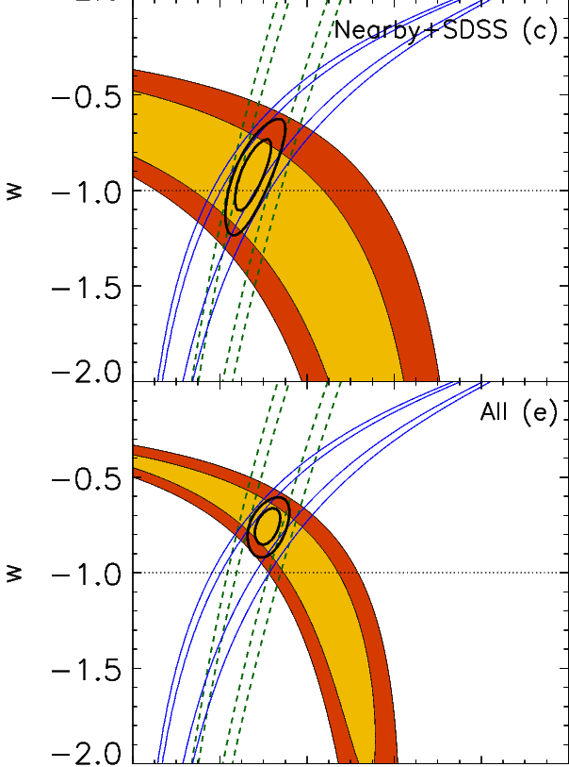
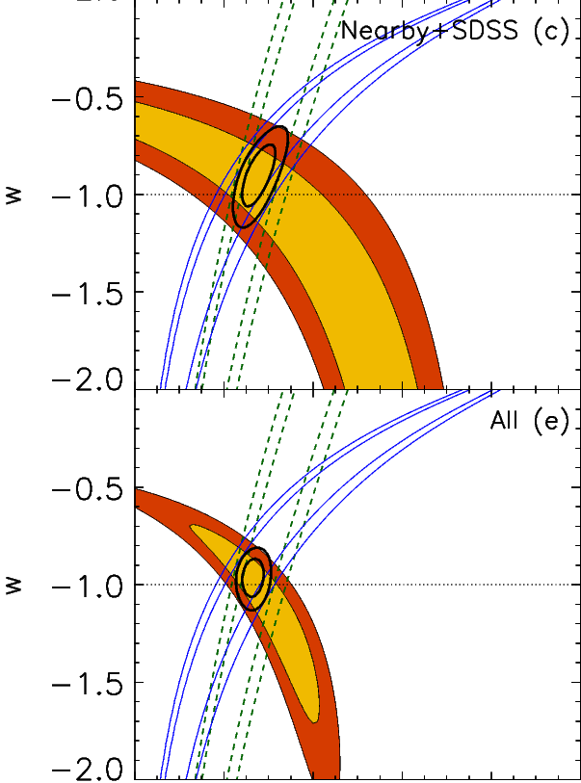
MLCS
SALT
Nearby+SDSS:
Nearby+SDSS+SNLS+ESSENCE+HST:
MLCS
SALT

Slide 15
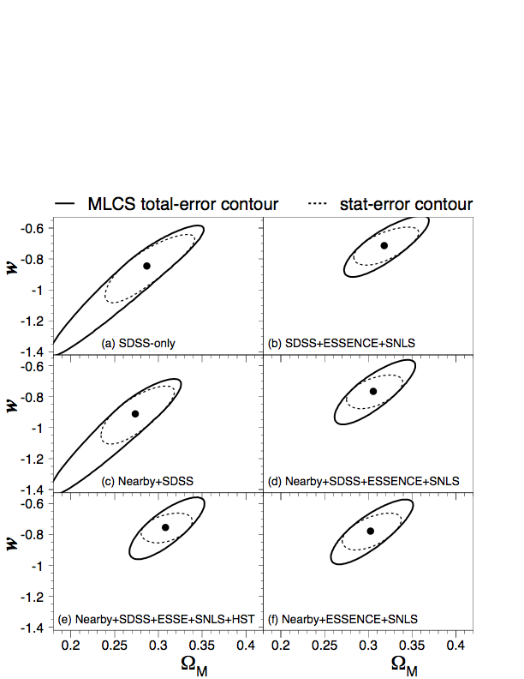
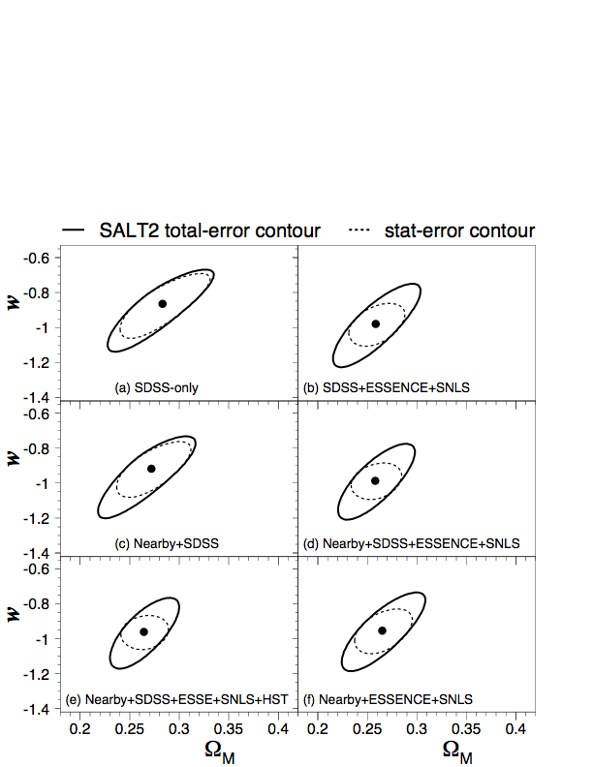
Include internal Systematic Error estimates
MLCS vs. SALT discrepancy NOT associated with SDSS SNe
SN+BAO+CMB constraints

Slide 16
What changed in MLCS?

Slide 17
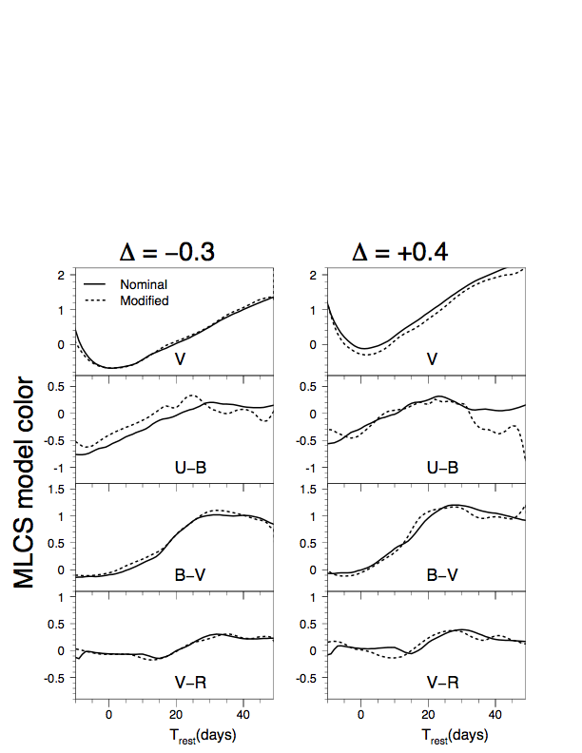
SALT vs MLCS template light curves
MLCS
“SALT”
Diagnosis:
Large difference in Light-curve model in U-band
Use of prior on extinction in MLCS

Slide 18
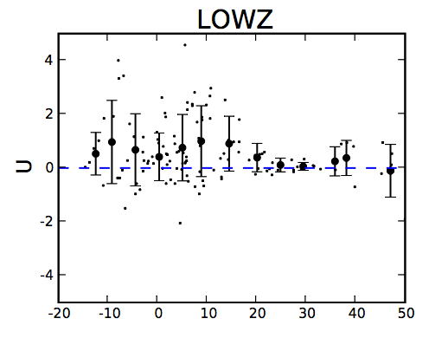
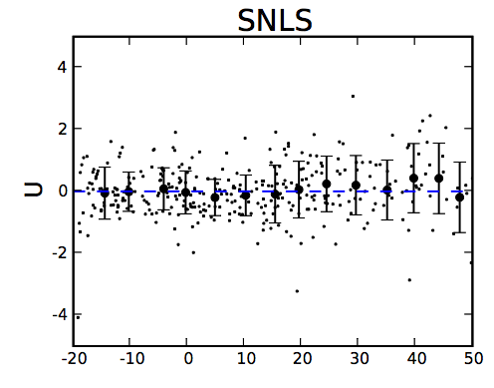
Issues with rest-frame U band
epoch
Data vs. SALT2 Model Residuals
Opposite Low-z vs. High-z discrepancy seen in MLCS
MLCS trained only on Low-z, SALT2 model dominated by SNLS
Similar differences seen in rest-frame UV spectra? (Foley et al)

Slide 19
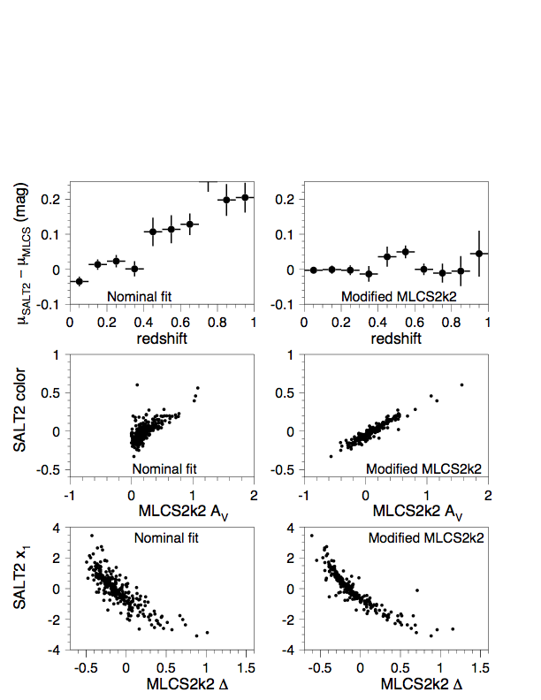
SALT vs MLCS parameters
Modified MLCS2k2:
Use ``SALT” light-curve templates and remove informative dust prior (A_{V}>0) in MLCS

Slide 20
A Tale of Two Fitters
MLCS:
U-band model trained only on low-redshift (observer-frame) U-band data (calibration, atmospheric variations)
Assumes all excess color due to dust extinction (some of it must be); dust prior dominates at high-redshift
SALT:
Global fit for color/dust parameter β: minimizing Hubble-scatter can lead to bias
Trend toward bluer colors at high-z: if allow β(z), see strong trend with redshift
Retrain and refine the models with newer data

Slide 21
SALT Parameters vs. Redshift

Slide 22
See also Conley et al 2007:
treatment of dust & SN colors

Slide 23
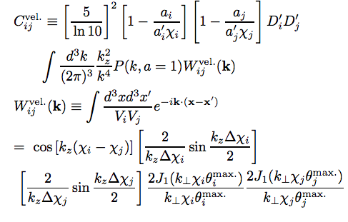
Coherent Peculiar Velocities
Hui & Greene
Cooray & Caldwell
Physically,
Quantitatively,
where
More
important
for larger
data sets
Mass power
spectrum
for circular survey

Slide 24
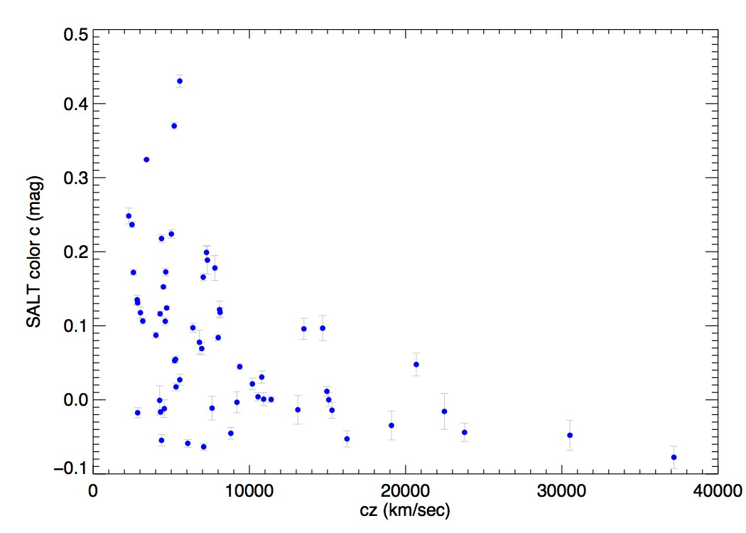
Colors of Low-z SNe
Conley etal 2007

Slide 25
Vary minimum redshift

Slide 26
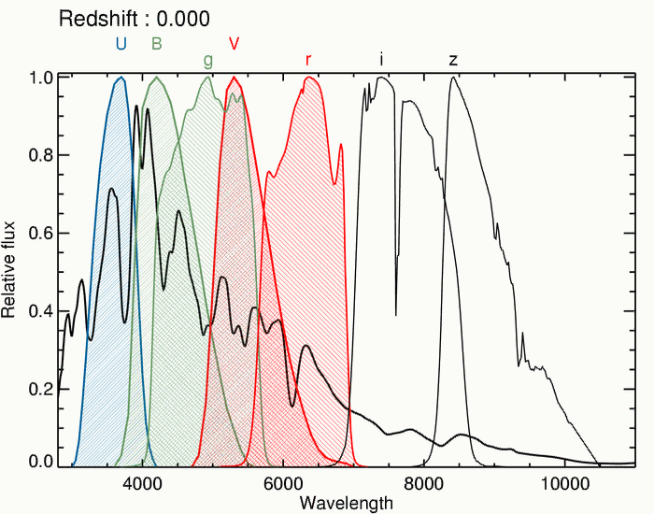
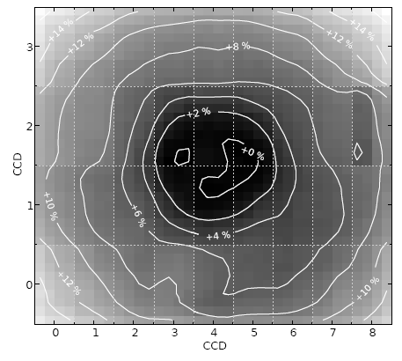
1% Photometry is Hard
K-correction: transform observed (g,r,i,z) fluxes into rest-frame (U,B,V) fluxes using mean spectrum: M_{B}
Need to know the following very well:
g, r, i, z:
Observed CFHT MegaCam filters, and the zero points (from faint standard stars), as a function of position on the detector
U, B, V:
Landolt (historical) filters that must be transformed to (to compare with low-z SNe)
and the zero points for those old observations
AND the definition of the historical (Landolt/Vega) magnitude system
Regnault, etal

Slide 27
Constraints from SDSS data only
Lampeitl, Nichol, Seo, etal 2009
SDSS SN (MLCS)
SDSS SN
BAO
2dF, SDSS BAO
Agreement between SN and BAO distances:
consistency between d_{L} and d_{A}

Slide 28
Constraints on Exotic Models
Sollerman, etal 2009
SALT
MLCS
DGP (modified gravity) Models
LTB (inhomogeneous) Models
Results sensitive to SALT-MLCS differences

Slide 29
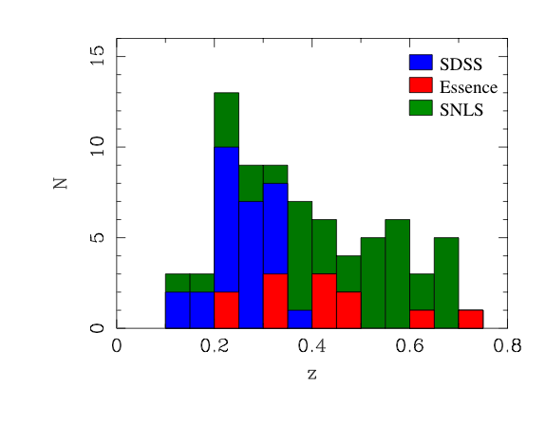
Carnegie Supernova Project: High-z
Goal: ~75 SN Ia in redshift range 0.2 - 0.7
Photometry in Y + J using Magellan + PANIC
Gives rest-frame i-band flux near max.
Constrain cosmological model
Reduce systematics due to dust extinction.
Intrinsic spread of SNIa luminosities lower in NIR
Notes:
High-z dataset is focused on following up Sne from other surveys (SNLS, SDSS, Essence) in the NIR in order to get light-curves in the rest-frame I-band. All our source surveys are now completed, so our final sample is 75 (we had counted on SNLS going another season to get to 100). Observing in the NIR has the advantage of reducing the effects of reddening by a factor of 2. SNIae are also better standard candles in the NIR bands (stretch-correction is smaller).

Slide 30
SDSS+CSP
Light Curves

Slide 31
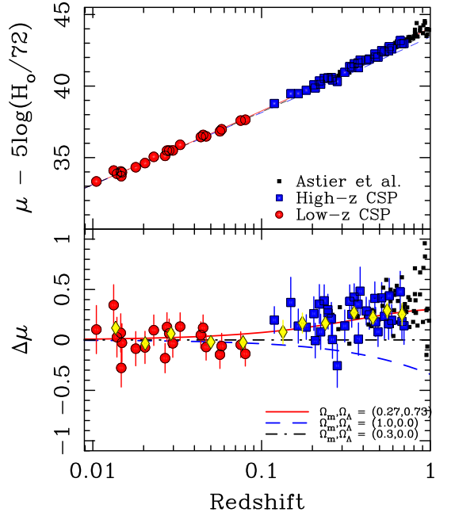
First Rest-frame i-band Hubble Diagram to z=0.7
Freedman et al. (2009)
Notes:
This graph shows the first rest-frame I-band Hubble diagram based on CSP observations only. Red points are from the low-z campaign and blue are from the high-z campaign. Several cosmological models are shown. Bottom panel shows residuals from the Omega_matter=0.3, Omega_lambda=0 model. Yellow points are binned data. Black points are from SNLS (Astier et. al)

Slide 32
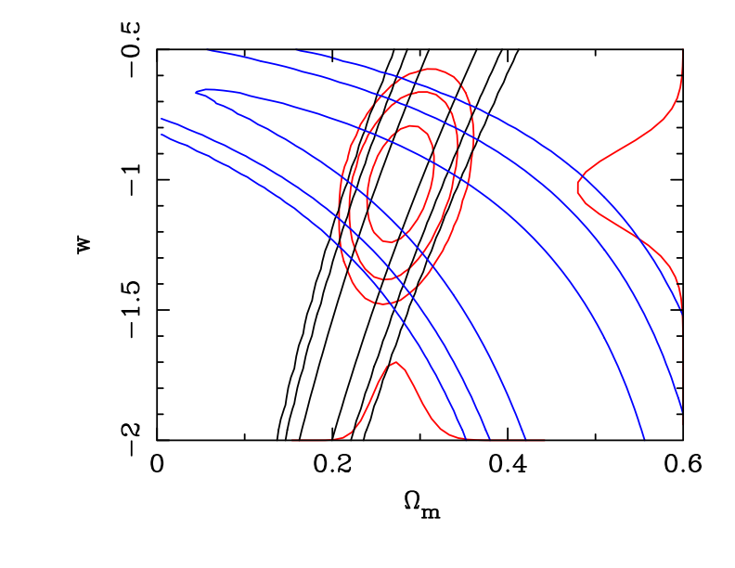
CSP Dark Energy Constraints
Freedman et al. (2009)
w = -1.05 ± 0.13(stat)±0.09(sys)
(assuming k=0 and BAO)
Notes:
Using the CSP Snia sample if 34 low-z and 25 high-z Sne, we obtain the following confidence contours on w. The final error of 0.13 is statistical and will decrase by a factor of ~ sqrt(2) when the whole sample is analyzed.

Slide 33
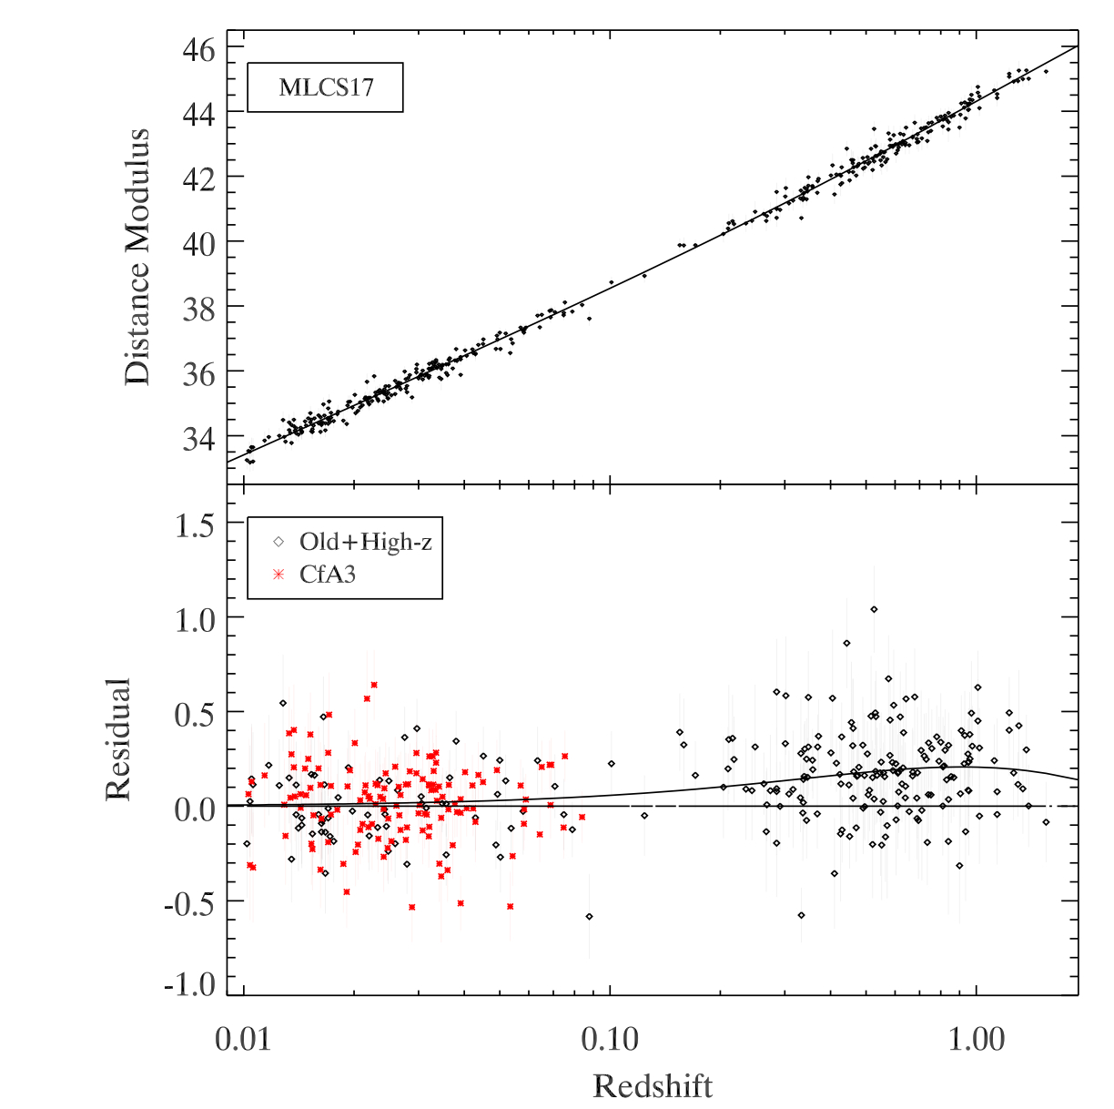
CfA3: New Distances at Low Redshift
Low:
CfA3
187 new low-z light curves
(Hicken et al 2009a,b)
High:
ESSENCE
SNLS
Higher-Z

Slide 34
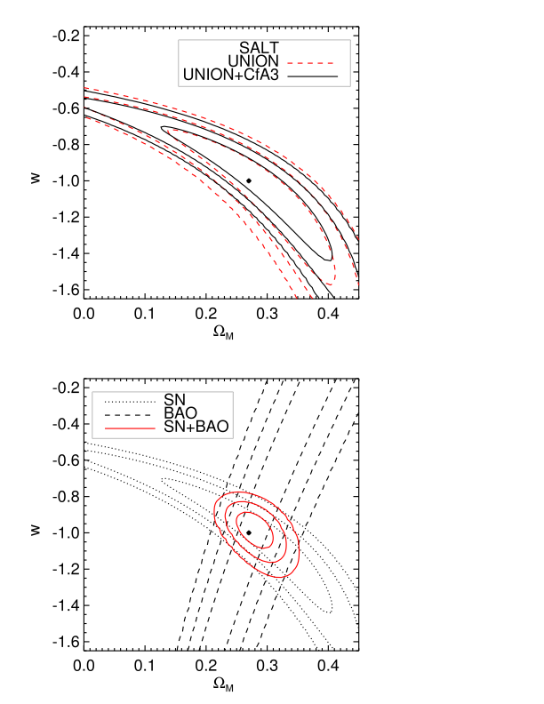
Dark Energy Constraints
Find best-fit R_{V}=1.7 by minimizing scatter in the Hubble diagram (analogous to SALT)
Similar R_{V} result from CSP Low-z
Hicken etal

Slide 35
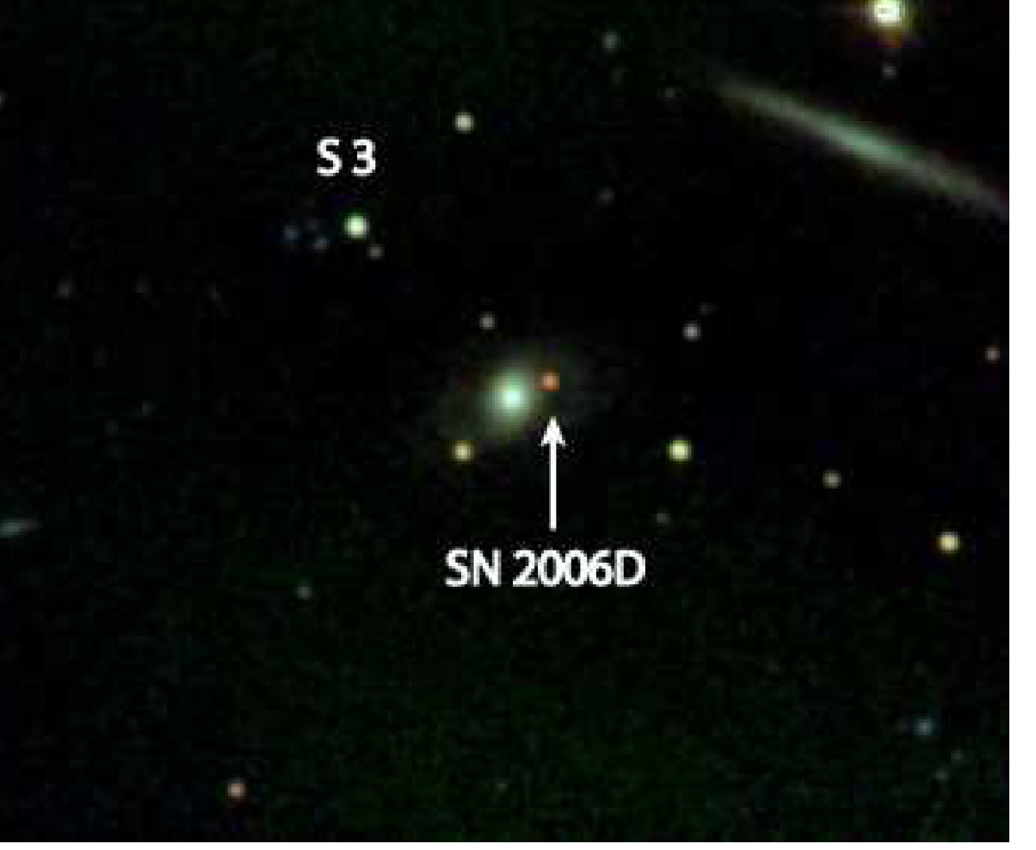
J, H, K_{s} image from PAIRITEL
Infrared Observations: less sensitive to dust

Slide 36
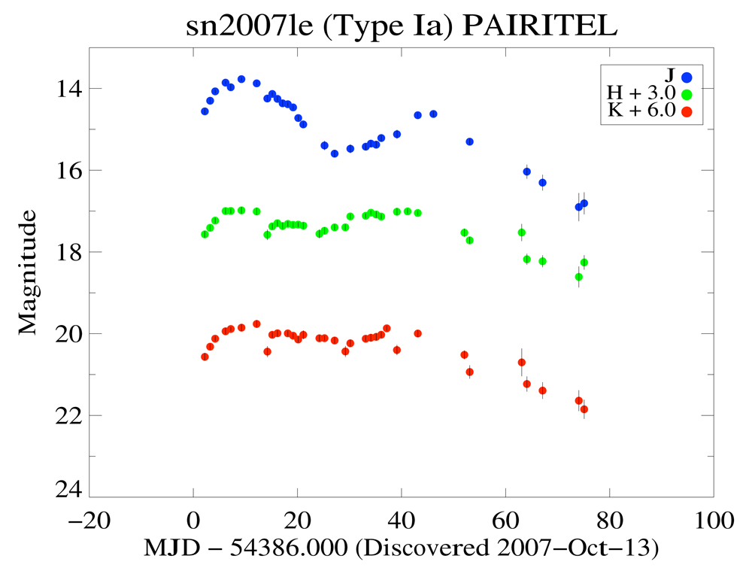
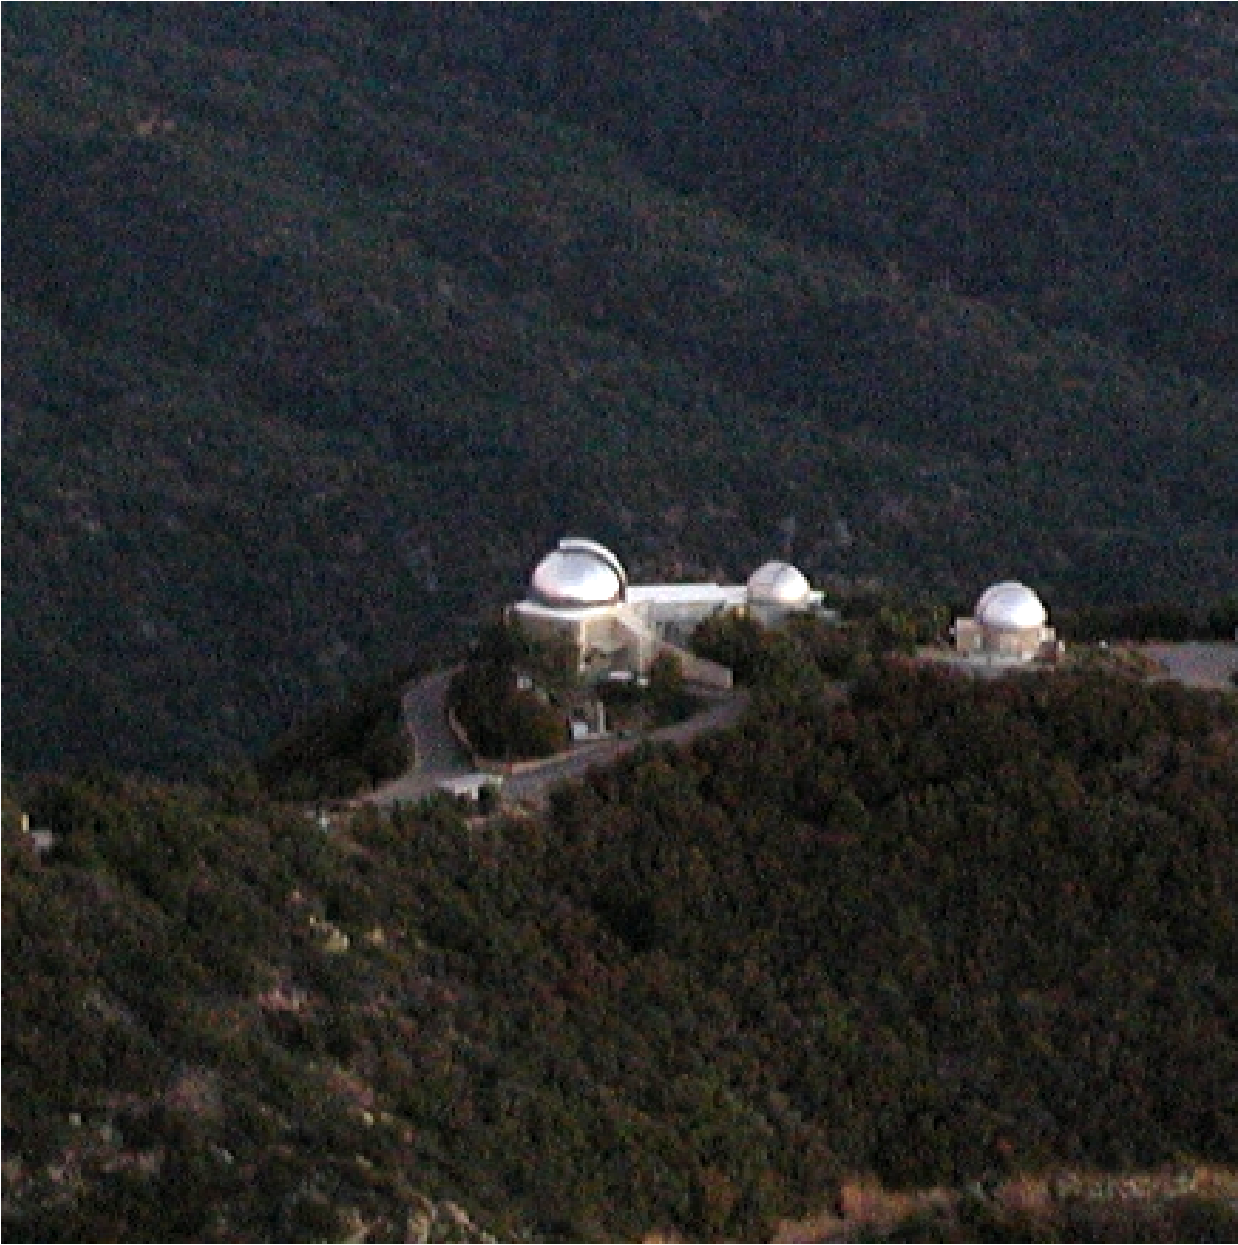
Mt. Hopkins
Robotic NIR telescope

Slide 37
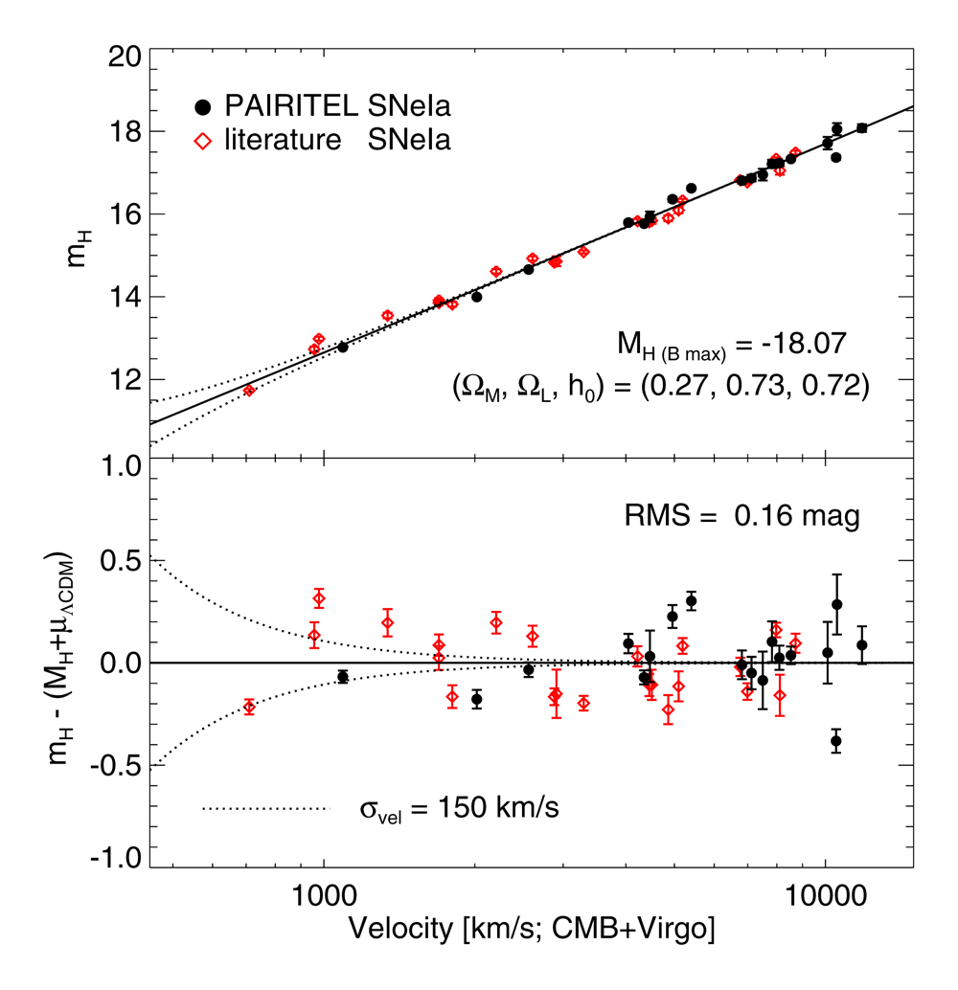
Wood-Vasey et al. (2008) Type Ia Supernovae are Good Standard Candles in the Near Infrared Shown without correction for light curve shape or extinction

Slide 38
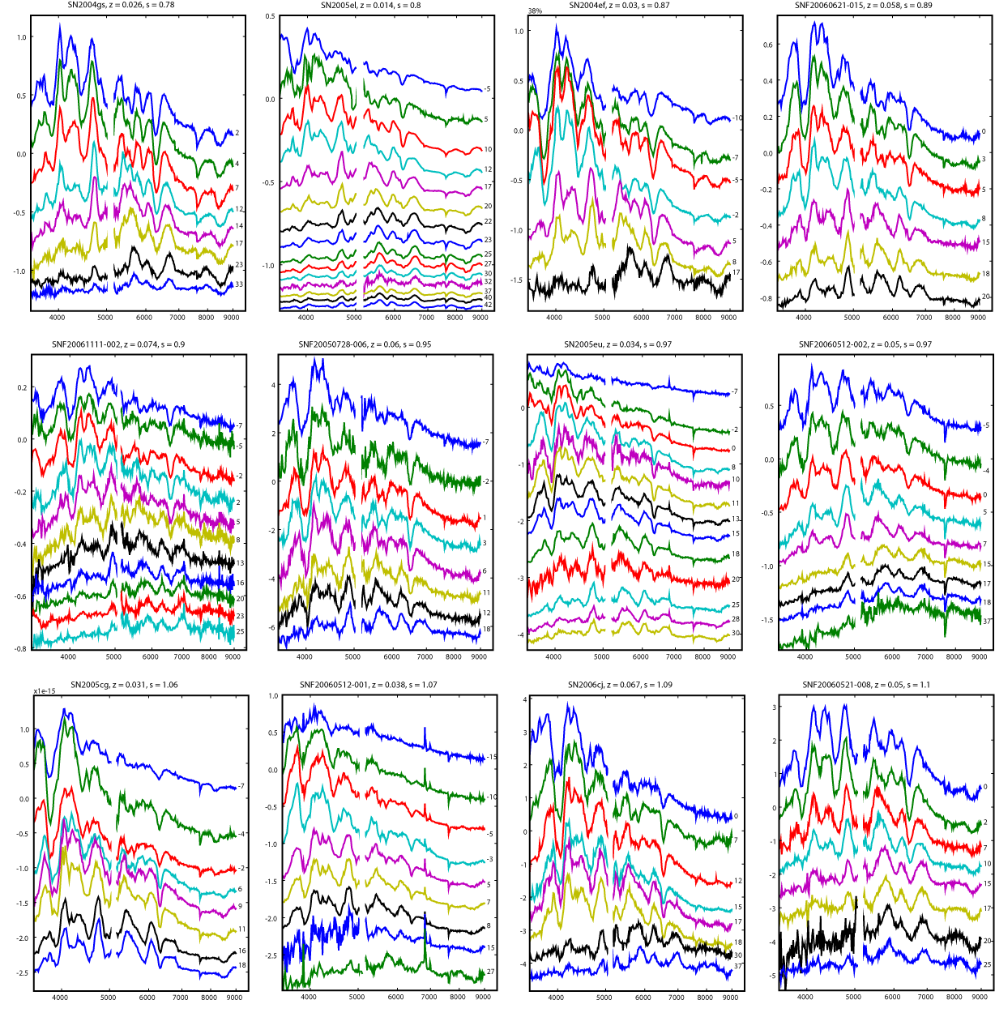
Nearby Supernova Factory
More than 1000 SNe in ~28 months of searching
during 2005-2008,
500 spectroscopically confirmed
185 many-epoch time series of Type Ia SN spectra

Slide 39
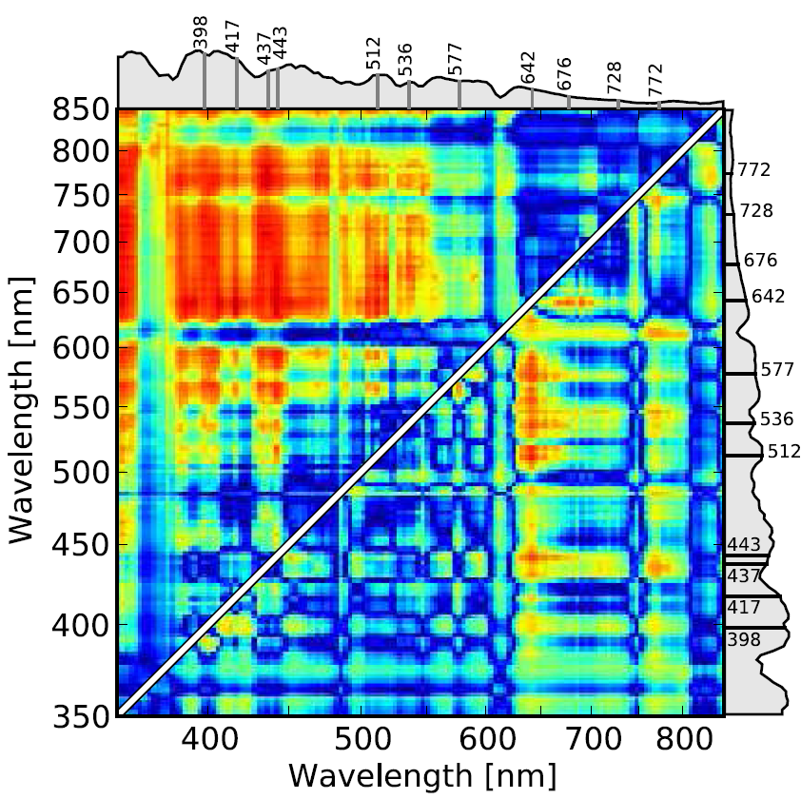
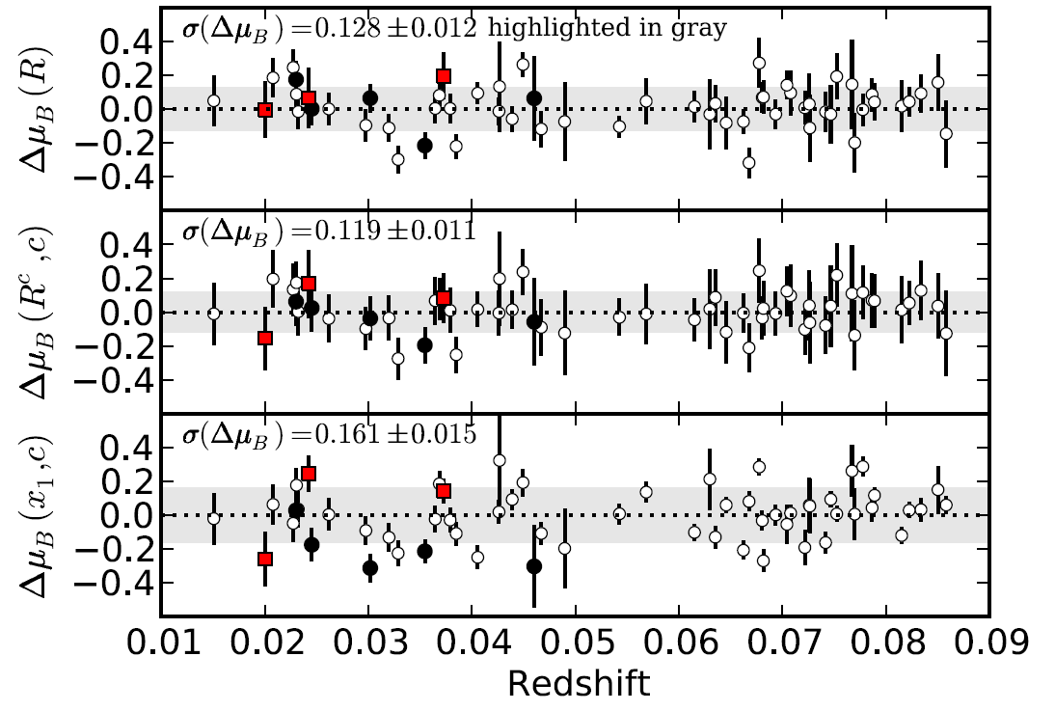
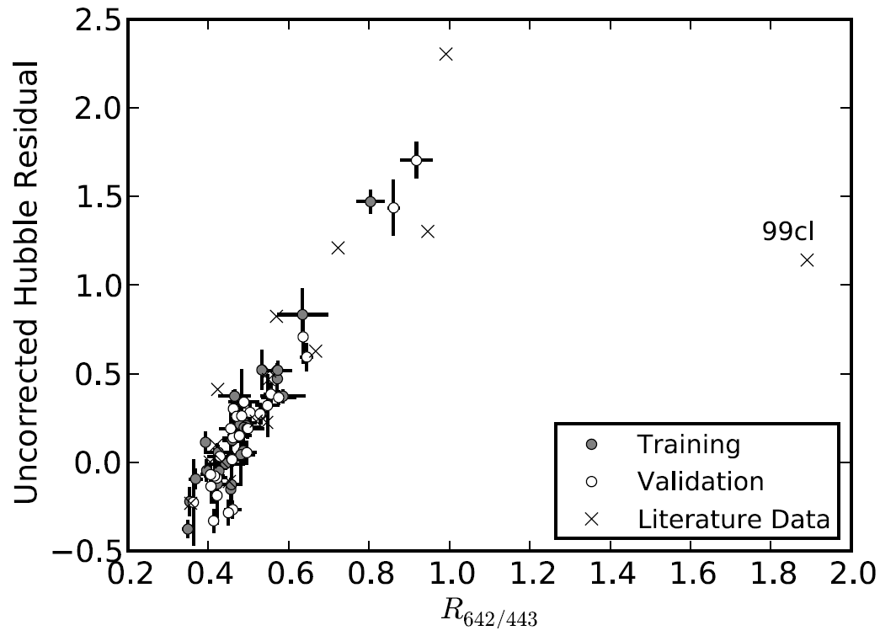
Nearby SN Factory: Spectroscopic Standardization
Bailey et al, 09
6% distance accuracy from a single spectrum
Hubble Residuals
R_{642/443}
R_{642/443} +color
SALT2
R_{642/443}

Slide 40
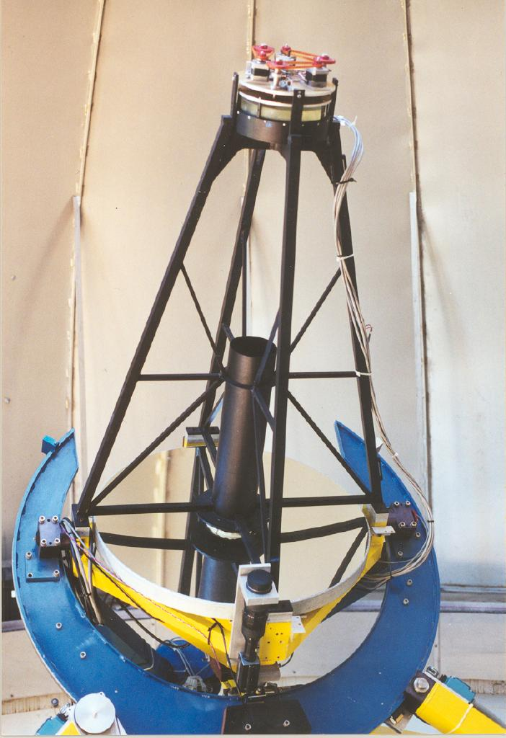
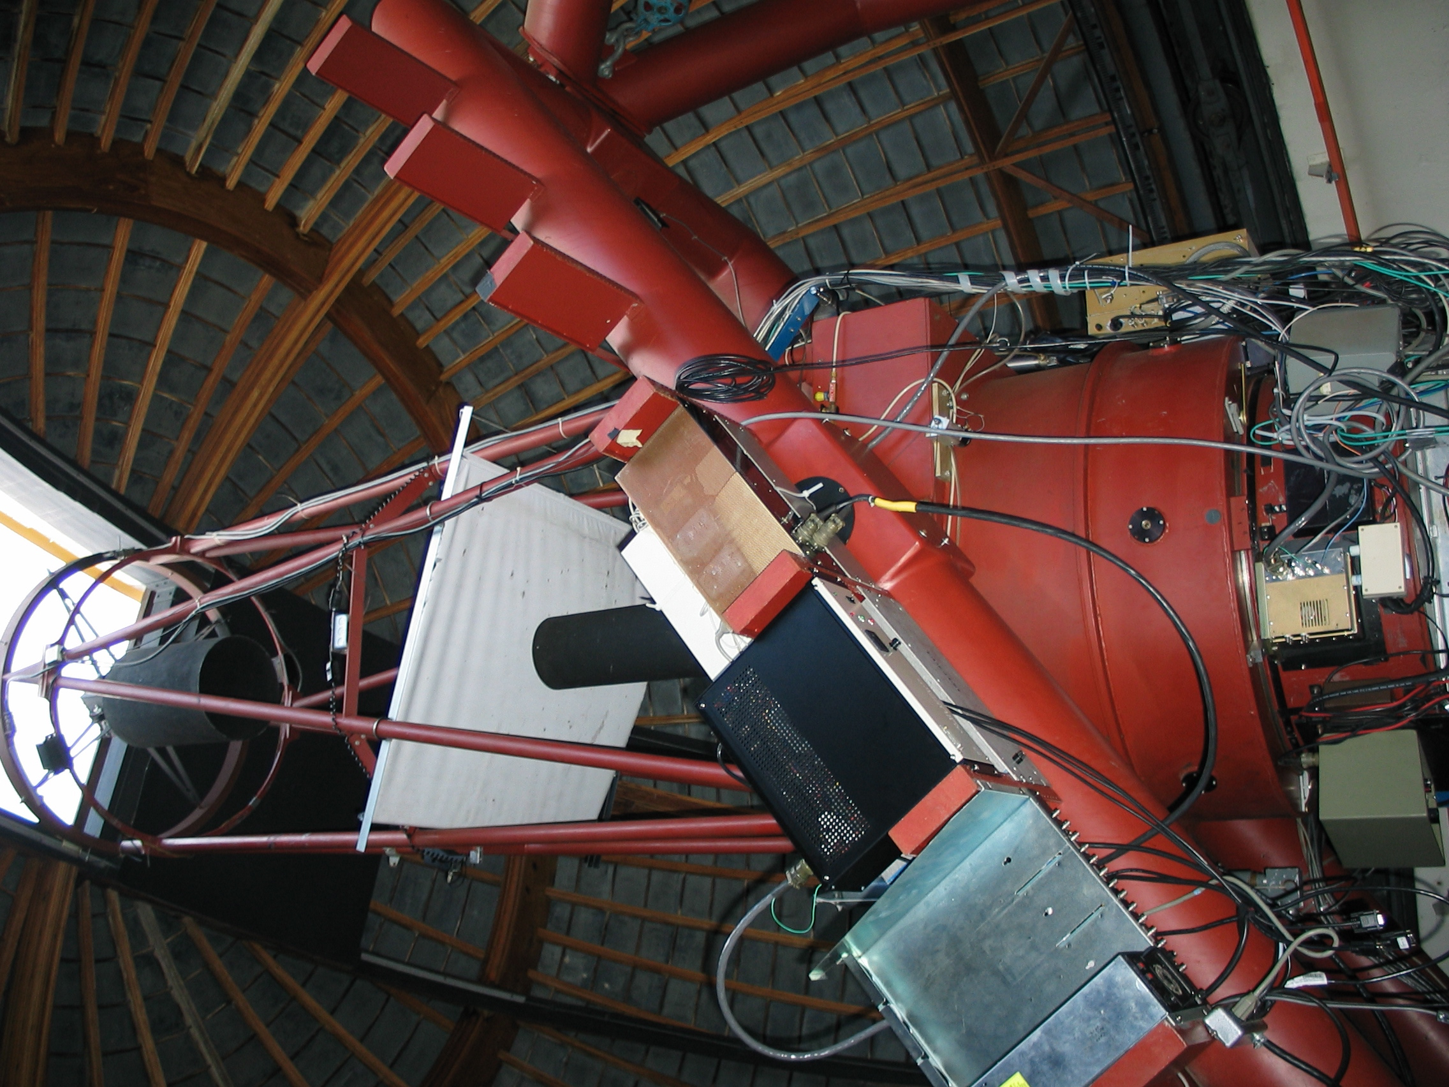
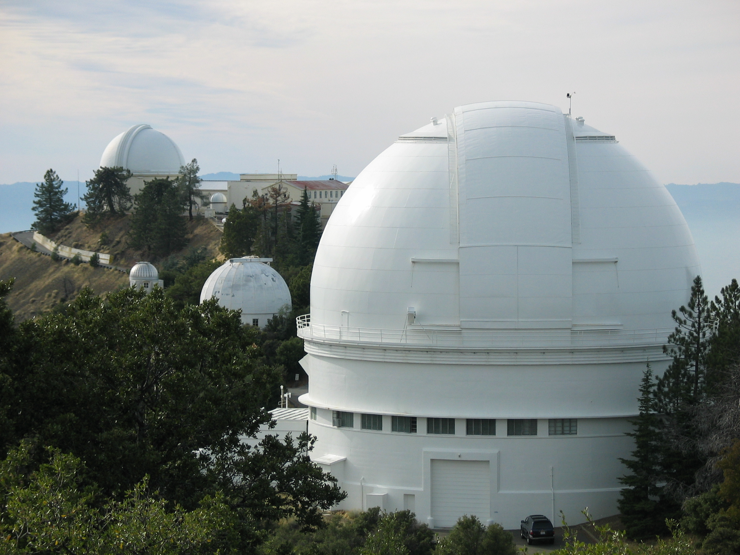
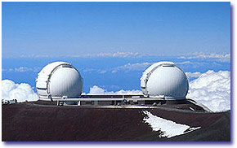
Lick Observatory Supernova Search (LOSS)
Prompt alerts to 80 astronomers/SN observers
Feed CfA Supernova program (Kirshner et al.)
Feed Carnegie Supernova Program (Phillips et al.)
Follow up with own telescope network
KAIT
Lick 1-m
Lick 3-m
Keck I/II 10-m
10-20% of time
Photometry;
calibration
6-9 nights/mon
Calibration;
photometry
2-3 nights/mon
spectroscopy
Occasional
spectroscopy
Filippenko, et al
Notes:
We promptly tell other astronomers about our discoveries, providing coordinates and charts. Some end up collaborating with us, some competing. This is good for science. Anyone who requests to be on our list is included. We also do a lot of our own follow-up observations.

Slide 41
(KAIT + Jha et al. 2007)
Notes:
Our sample of SNe Ia, added to the Jha et al. (2007) sample of SNe Ia. We have roughly doubled the existing sample, though our objects have a lower average redshift. Error bars are large at low redshifts due to peculiar motions.

Slide 42
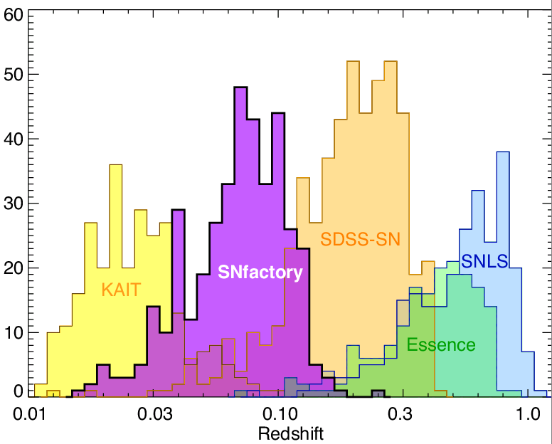
Number of Type Ia Supernova Discoveries
N_{SNe}

Slide 43
Correlations of SN Ia and Host-galaxy Properties

Slide 44
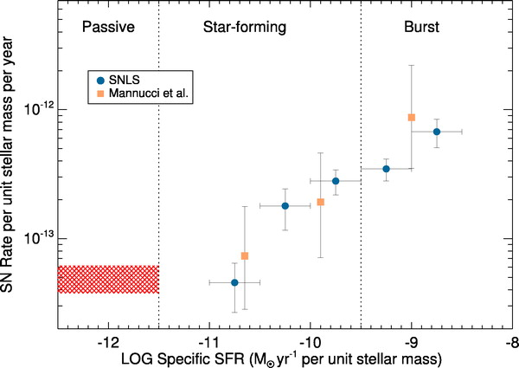
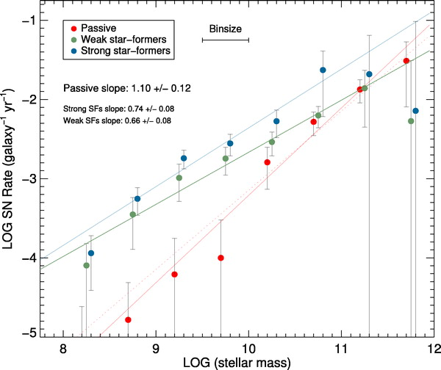
Progenitor Systems: Two-component Model
Prompt component: Delayed component:
- delay time ~ 50 Myr - delay time ~ 2-4 Gyr
- proportional to recent SF in host - proportional to stellar mass of host
- relatively bright - relatively faint
Sullivan et al. (2006), Mannucci etal,
Scanapieco & Bildsten, Smith etal 10

Slide 45
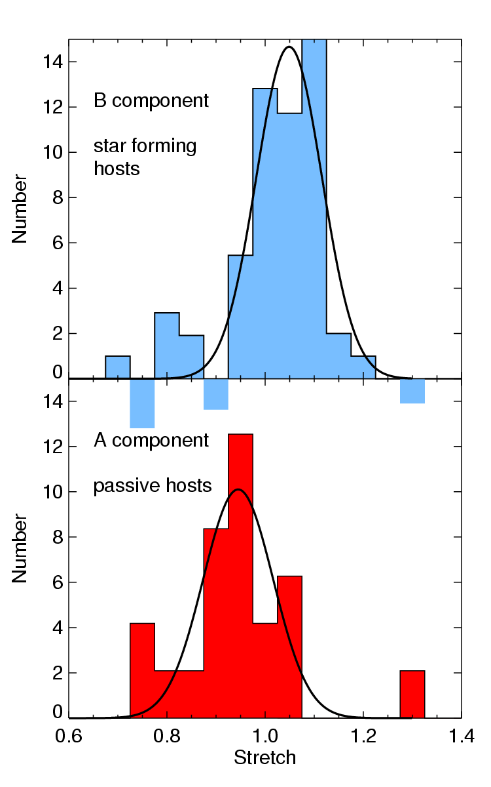
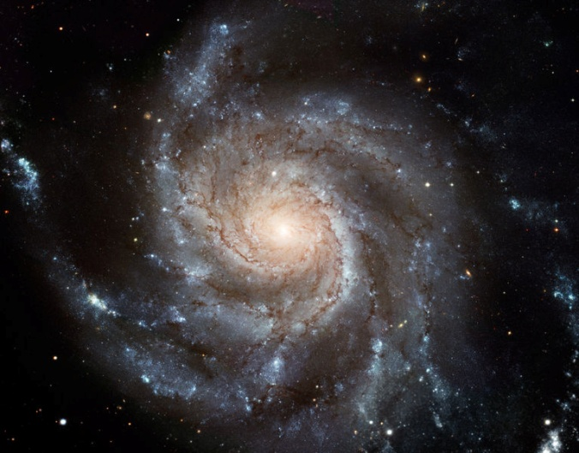
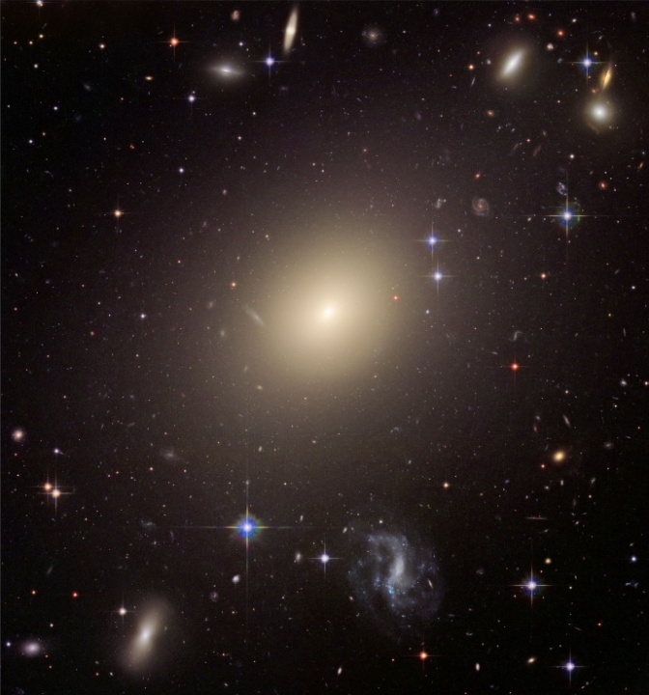
fainter brighter
Host Population correlated with SN Ia Luminosity
Sullivan et al. 2006, Howell et al. 2007, Jha etal 2007
"Prompt"
Prompt,
Star forming
Brighter
SNe
"Delayed"
Delayed,
Passive hosts
Fainter
SNe
Also brighter SNe in lower-stellar-mass hosts

Slide 46
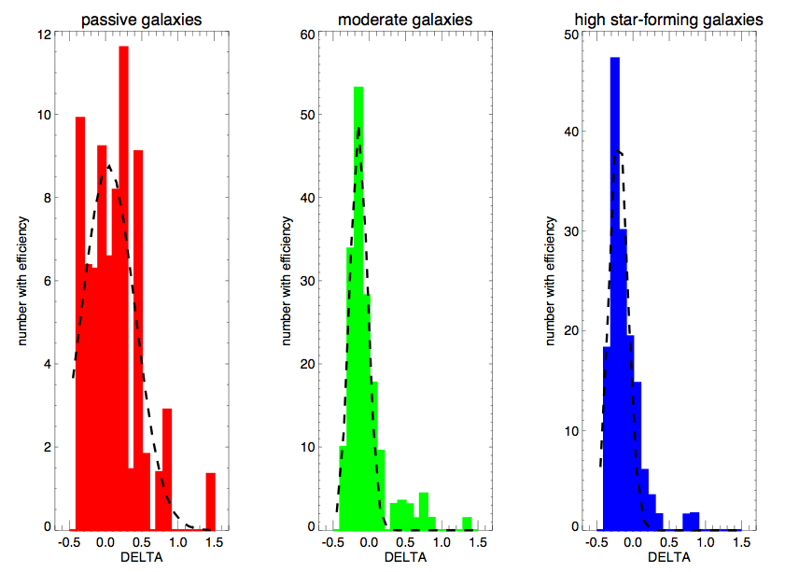
SN Ia Luminosity correlates with Host Galaxy Type
SDSS
Bright SN Luminosity/Decline Rate Faint
Smith et al

Slide 47
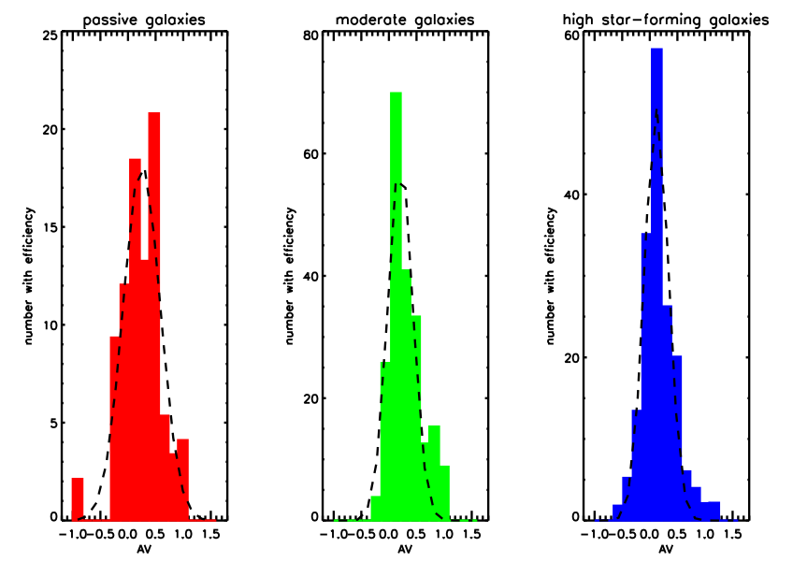
SN Ia Color doesn’t correlate strongly with Host Galaxy Type
Why aren’t `spirals’ dustier than `ellipticals’?
Color/reddening
Smith et al

Slide 48
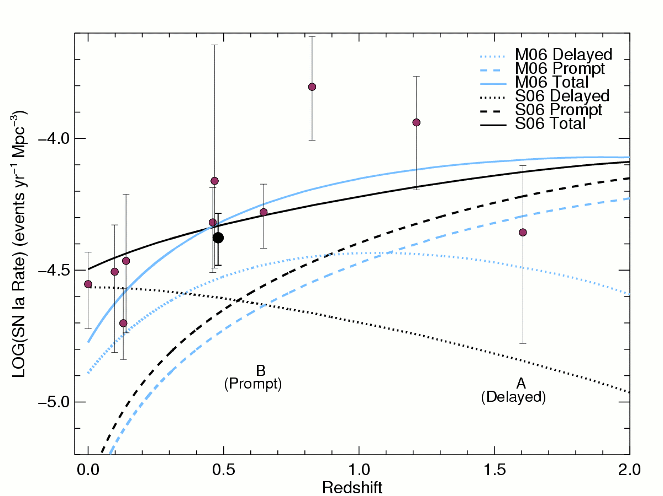
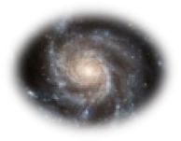
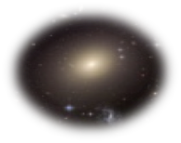
SN Rates vs. redshift
Sullivan et al. 2006, Howell et al. 2007
"Prompt" SNe follow declining cosmic star formation history (Hopkins & Beacom 2006), "Delayed" SNe follow growing stellar mass distribution
Predict relative contribution from each component vs. redshift

Slide 49
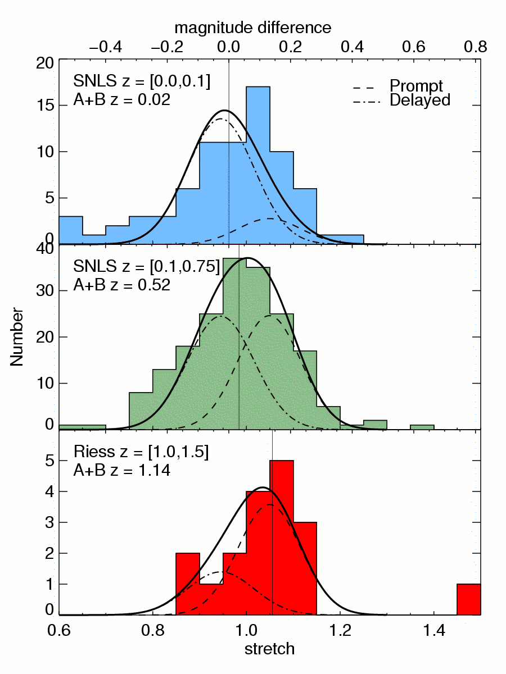
SN population drift vs. z
Howell et al. 2007
Histograms: data
Gaussians: prediction from rates
Conclusion: Average stretch, and thus average observed brightness of SNe Ia evolves with redshift.
Average SN Ia was 12% brighter at z > 1.
However, if stretch correction works, this population evolution should not affect cosmology

Slide 50
Hubble Residuals vs. Host Galaxy Specific Star Formation Rate
Events of same light-curve shape and color are ~0.08 mag brighter (after LCS correction) on avg. in galaxies with low star-formation rate (or high stellar mass): opposite to pre-correction trend Sullivan etal 10

Slide 51
Events of same light-curve shape and color are ~0.08 mag brighter (after LCS correction) on avg. in galaxies with low star-formation rate (or high stellar mass): opposite to pre-correction trend: metallicity effect? Sullivan etal 10
Fit cosmology with 2 populations of M_{B}: shifts w by~0.04-0.08 with BAO prior

Slide 52
Same trend seen in low-redshift SN Ia sample Kelly etal 09

Slide 53
SDSS SN
Lampeitl etal 10
SFR
Passive
blue
red

Slide 54
SDSS SN
Lampeitl etal 10

Slide 55
Systematic Errors (and Controls)
Dust and SN color variation (multi-λ, NIR, high S/N)
U-band model discrepancy (retrain with better rest-frame U-band data, e.g., from SDSS SN g-band)
Minimum redshift effect (model coherent flows; larger, better, low-redshift samples)
Selection effects (artificial SNe, Monte Carlo simulations)
Population evolution (SN properties vs host environment)
Photometric calibration (system response calibration & cross-calibration of systems)
Sample purity (spectroscopy at least for subsample)
All (subdivide large samples to cross-check)

Slide 56
The Future is (Mostly) Photometric
Pan-STARRS, Dark Energy Survey, LSST: thousands to tens of thousands of multi-band light curves to z~1
Limited spectroscopic resources for follow-up, replace spectroscopic with photometric SN classification
Very large samples will enable subdivision to study correlations and control systematics
Photometric-redshift precision at high-z does not critically impact DE constraints but degrades (SN-type) sample purity
SN spectroscopic subsamples (both Ia and non-Ia) required to quantify purity and define SN Ia color selection. SDSS SN test of photometric classifier: ~92% complete, 5% impurity (M. Sako)

Slide 57
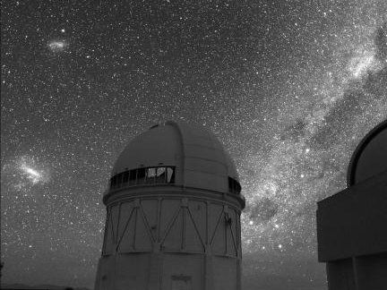
The Dark Energy Survey
Study Dark Energy using
4 complementary* techniques:
I. Cluster Counts
II. Weak Lensing
III. Baryon Acoustic Oscillations
IV. Supernovae
• Two multiband surveys:
5000 deg² g, r, i, z,Y
15 sq deg area repeat (SNe)
• Building new 3 deg² camera
and Data management sytem
Survey 2012-2017 (525 nights)
Blanco 4-meter at CTIO
*in systematics & in cosmological parameter degeneracies
*geometric+structure growth: test Dark Energy vs. Gravity

Slide 58
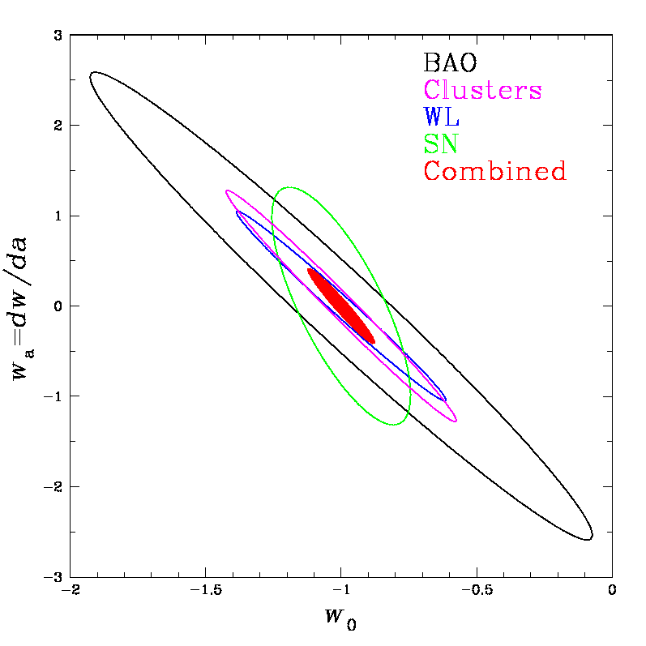
DES Science Program
Four Probes of Dark Energy
Galaxy Clusters
~100,000 clusters to z>1
~10,000 with SZE measurements from SPT
Sensitive to growth of structure and geometry
Weak Lensing
Shape measurements of 300 million galaxies
Sensitive to growth of structure and geometry
Baryon Acoustic Oscillations
300 million galaxies to z = 1 and beyond
Sensitive to geometry
Supernovae
15 sq deg time-domain survey
~3000 well-sampled SNe Ia to z ~1
Sensitive to geometry
Forecast Constraints on DE Equation of State

Slide 59
The DES Collaboration
Fermilab
University of Illinois at Urbana-Champaign
University of Chicago
Lawrence Berkeley National Lab
NOAO/CTIO
DES Spain Consortium
DES United Kingdom Consortium
University of Michigan
Ohio State University
University of Pennsylvania
DES Brazil Consortium
Argonne National Laboratory
UC Santa Cruz+Stanford/SLAC consortium
Ludwig Maximilian University Texas A&M

Slide 60
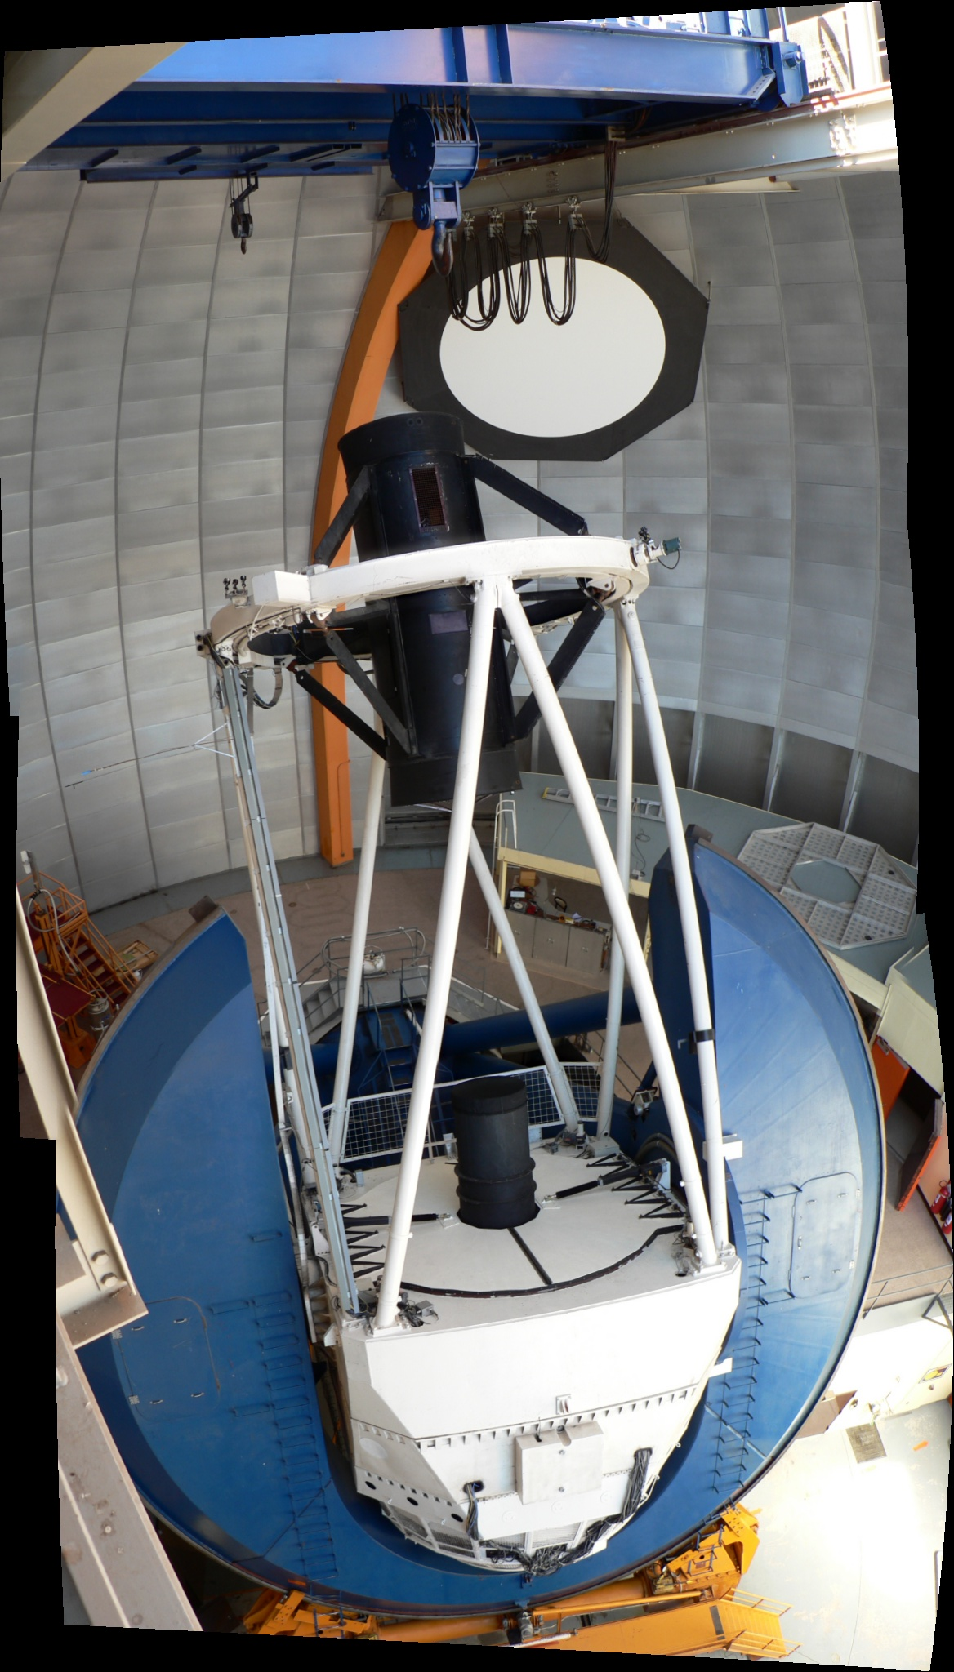
DES Instrument: DECam
Mechanical Interface of DECam Project to the Blanco
CCD
Readout
Filters
Shutter
Hexapod
Optical
Lenses

Slide 61
DECam Construction & Testing
Focal plane of Multi-CCD Test Vessel partially filled with non-science grade CCDs
DECam Imager Vessel

Slide 62
Telescope Simulator
http://decamlaba.fnal.gov

Slide 63
DES SN Simulated Light Curves

Slide 64
DES + VISTA VIDEO NIR

Slide 65
DES simulation:
~3000 well-measured
SNe Ia with
<z>~0.6
DES will obtain host spectroscopic redshifts (improves typing); photo-z cosmology more relevant for LSST

Slide 66
Supernova Photo-z’s
Include redshift as a light-curve fit parameter
Kessler, et al 2010
LSST Simulation

Slide 67
Development of Photometric SN Classification Techniques
Blind SN Classification Challenge:
Simulated DES light curves of different
SN types
Host photo-z’s
Spectroscopically confirmed subsample
for training
Cuts: purity vs completeness
Kessler etal 10

Slide 68
Cosmology for Photometric SN samples
Cosmology fits generalized to include
probability that a given event is a SN Ia,
based on some photometric classification technique.
Will improve results from current SN surveys by including their larger photometric SN Ia datasets
Will be necessary for future surveys, for which spectroscopic classification will be available for only a small fraction of events
Places a premium on characterizing non-Ia populations
Hlozek etal 2010

Slide 69
Understanding Type Ia Supernovae
Thermonuclear explosions of White Dwarf stars
White Dwarf accretes mass from or merges with a companion star, growing to a critical mass~1.4M_{sun}
A violent explosion is triggered at or near the center, and the star is completely incinerated within seconds
In the core of the star, light elements are burned in fusion reactions to form Nickel.
The radioactive decay of Nickel and Cobalt makes it shine for a couple of months

Slide 70
Chandrasekhar Mass Models
WD accretes H or He from non-degenerate companion, burns
on the surface to C+O (alternate: WD binary merger)
When M = M_{Ch}, compressional heating--> thermonuclear
instability: C, O burn explosively to ⁵⁶Ni (n=p) in the core
→ explosion driven by E_{kin} released from fusion reactions
in a few seconds. Free expansion of unbound ejecta thereafter,
with velocities ~10⁴ km/sec.
Outer regions burn to Si, S, Ca,… seen in early spectra.
Radioactive decays: ⁵⁶Ni → ⁵⁶Co → ⁵⁶Fe + MeV photons
γ’s downscatter, `thermalize’and escape as
optical/NIR light: light curve
0th order homogeneity: M_{Ch} fully burned → M_{Ni} ~ 0.6 M_{sun}
→ `fixed’ L_{peak}
days
months

Slide 71
Chandrasekhar Mass Models
1st order diversity: spread in progenitor (pre-WD) Mass (1– 7 M_{sun})
→ spread in WD C/O → spread in M_{Ni} produced & E_{kin}
→ spread in L_{max}
Other diversity factors: varying accretion rates, rotation speeds,
magnetic fields, metallicity
Correlation between L_{peak} and decline rate (Δm₁₅, LCS, stretch)
Increase M_{Ni} → increase L
Increase M_{Ni} → increase T → increase opacity → increase
photon diffusion time → longer decline

Slide 72
Type Ia Supernovae
Popular Explosion model
Deflagration: Subsonic burning turbulent, pre-expands WD, allowing production of intermediate-mass elements (in addition to Ni)
Delayed Detonation: Supersonic burning leads to layered chemical structure
Khoklov, Hoflich, etal

Slide 73
Chemical Structure after Explosion
Asymmetric ignition, off-center detonation: structure depends on viewing angle
Si, S, Ca
Ni
Fe group elements
Kasen etal 09

Slide 74
Predicted Luminosity-Shape Relation

Slide 75
Predicted Dependence on Metallicity

Slide 76
Four Current Models of Type Ia Supernovae
Central Ignition
(single or multiple
Ignition points)
Off-Center Ignition
(single or multiple
Ignition points)
Pure
Deflagration
Gravitationally
Confined
Detonation
Deflagration
To Detonation
Transition (DDT)
Reineke et al. (1999, 2002);
Schmidt et al. (2006)
Plewa, Calder, Lamb (2004);
Townsley et al. (2007);
Jordan et al. (2007)
Pulsationally
Driven DDT
Khokhlov (1991);
Gamezo et al.
(2004, 2005)
Khokhlov (1991)

Slide 77
3D Simulations of GCD Model for Single-Bubble Initial Conditions
Jordan et al. (2008)

Slide 78
Comparison of Predicted and Observed Light Curves and Spectra
Comparison of U, V, B, R light curves predicted by GCD model and obs. of Type Ia
Supernova SN 2001el
Comparison of spectra predicted by GCD model and obs. of Type Ia supernova SN 1994D
Kasen &
Plewa (2006)
Moving into an era where comparisons of high-fidelity, 3D, whole-star stimulations and high-quality observations will allow us to discriminate among proposed explosion mechanisms

Slide 79
Conclusions
Robust evidence for cosmic acceleration from Supernovae, now confirmed by other probes
Systematic errors temporarily pose challenges to reaching greater precision in dark energy properties, but
We have data in hand to partially resolve these issues for SNe: retrain light-curve models using SDSS, CSP, CfA, SNF,…
Future experiments will/must be designed to control systematic errors and exploit complementarity of multiple probes: DES, PanSTARRS, LSST, JDEM, augmented by new low-redshift surveys: PanSTARRS, Palomar Transit, Quest,…

