Slide 1
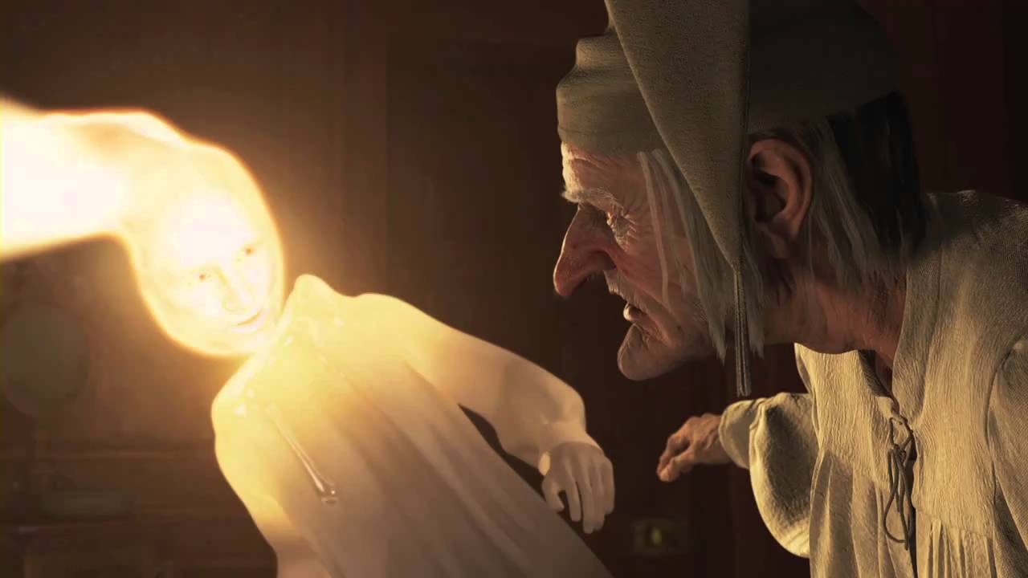
Cosmology at Chicago: Past, Present, and Future

Slide 2
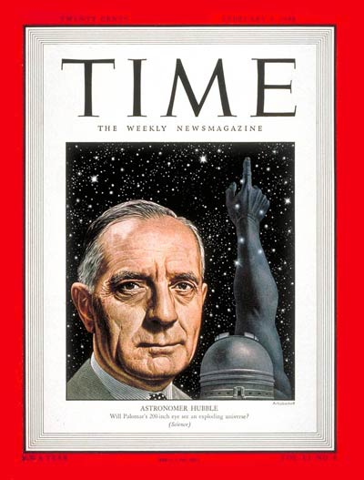
Edwin Hubble
S.B. ’10, Ph.D. ‘17
Hubble constant
Hubble law
Hubble diagram
Hubble age
Hubble classification
Hubble radius
Hubble sequence
Hubble flow
Hubble volume
….
Pretty much invented observational cosmology & branding & ushered in long, glorious era of Chicago athletic prowess

Slide 3
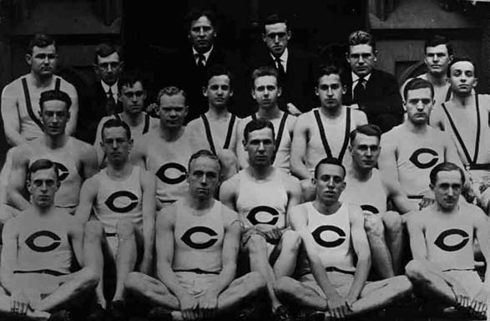
University of Chicago 1909 Track and Field Team

Slide 4
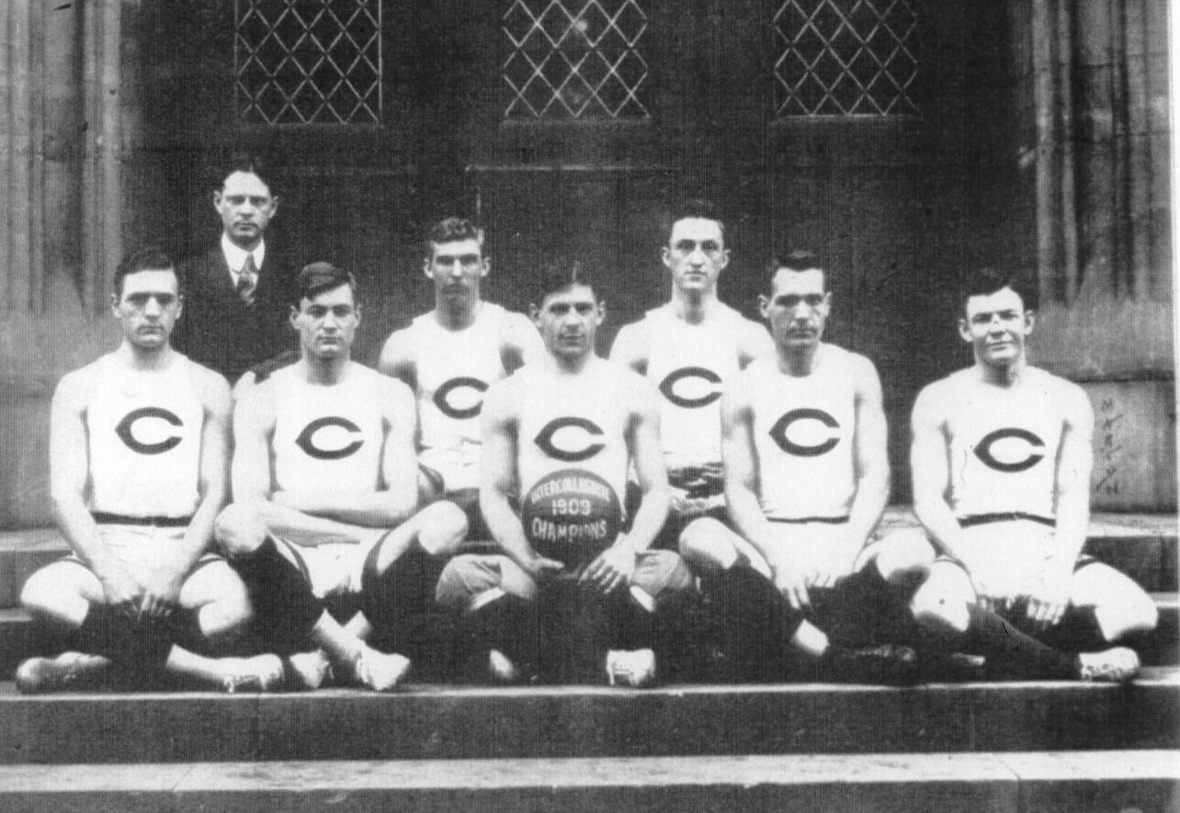
Edwin
Hubble
University of Chicago 1909 National Champions

Slide 5
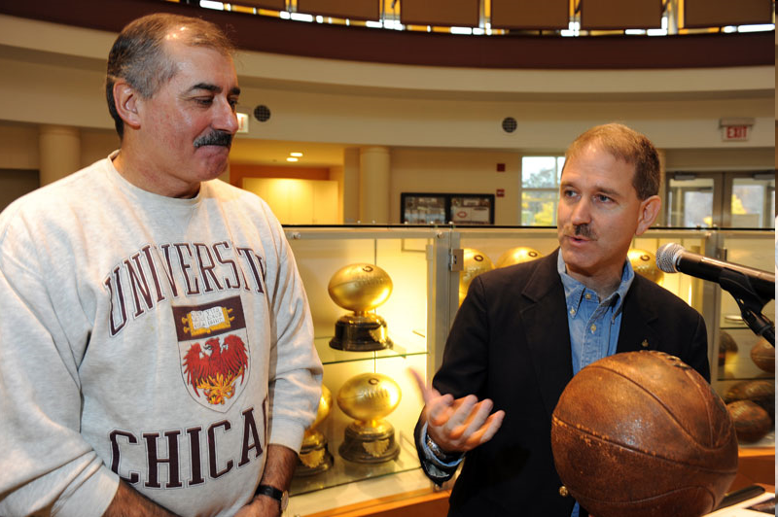

Slide 6
“Pretty sure I could take John in one-on-one”

Slide 7
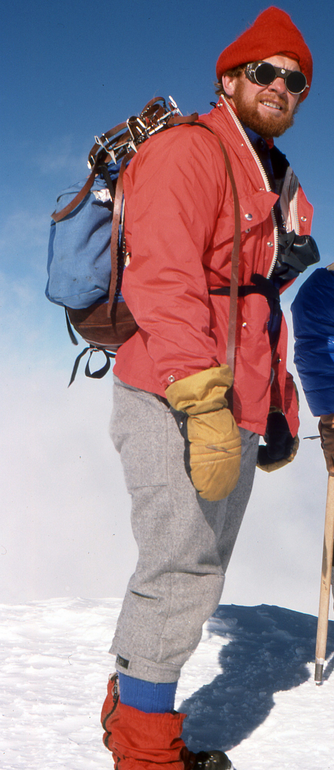
Inner Space/Outer Space Early 1980’s
David Schramm, founds Fermilab Astrophysics Center, leads development of early universe theory and particle cosmology, continues Hubble tradition of combining cosmology with championship sports (wrestling)
Big Bang Nucleosynthesis
Baryogenesis
Inflation & Structure Formation
Particle Dark Matter
Dark Energy
Astrophysics as Particle Physics Laboratory
…..
Notes:
Our new Dean should not get any ideas from

Slide 8
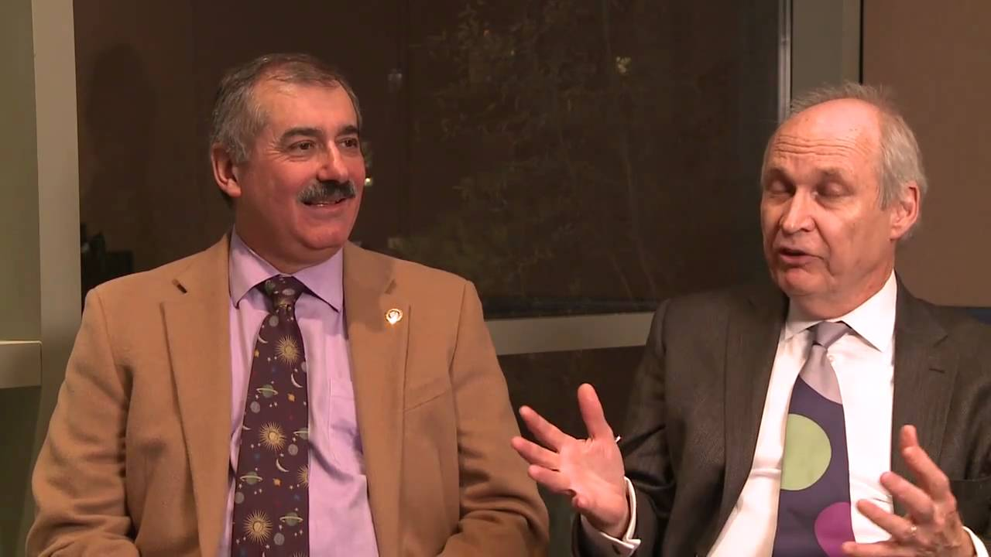
Inner Space/Outer Space Early 1980’s
David Schramm, founds Fermilab Astrophysics Center, leads development of early universe theory and particle cosmology, brings two young cosmology theorists to Chicago/Fermilab,
“Click”
“Clack”
Not so good at branding: WIMPs, dark energy. Why not Chicago WIMPs?
Notes:
Our new Dean should not get any ideas from

Slide 9
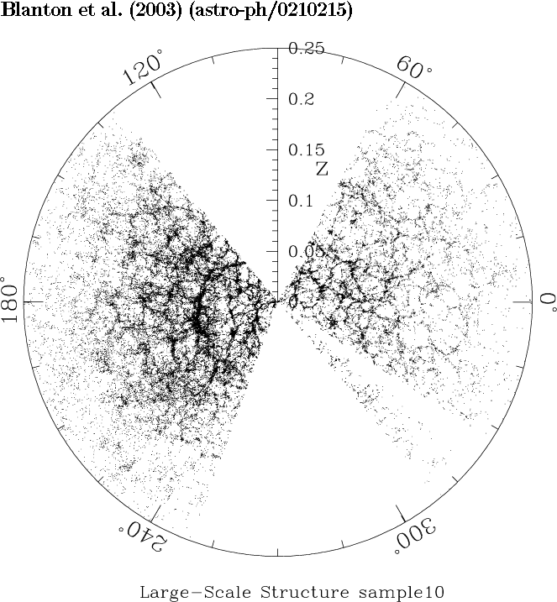
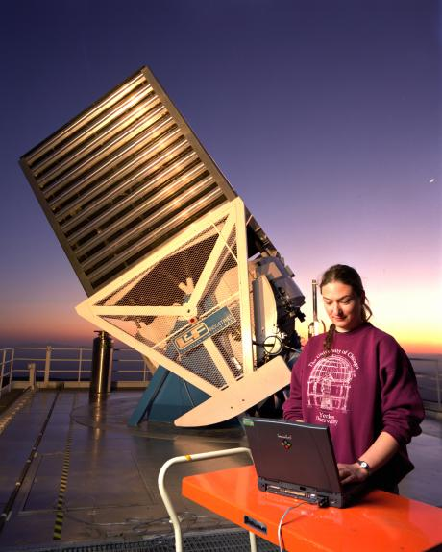
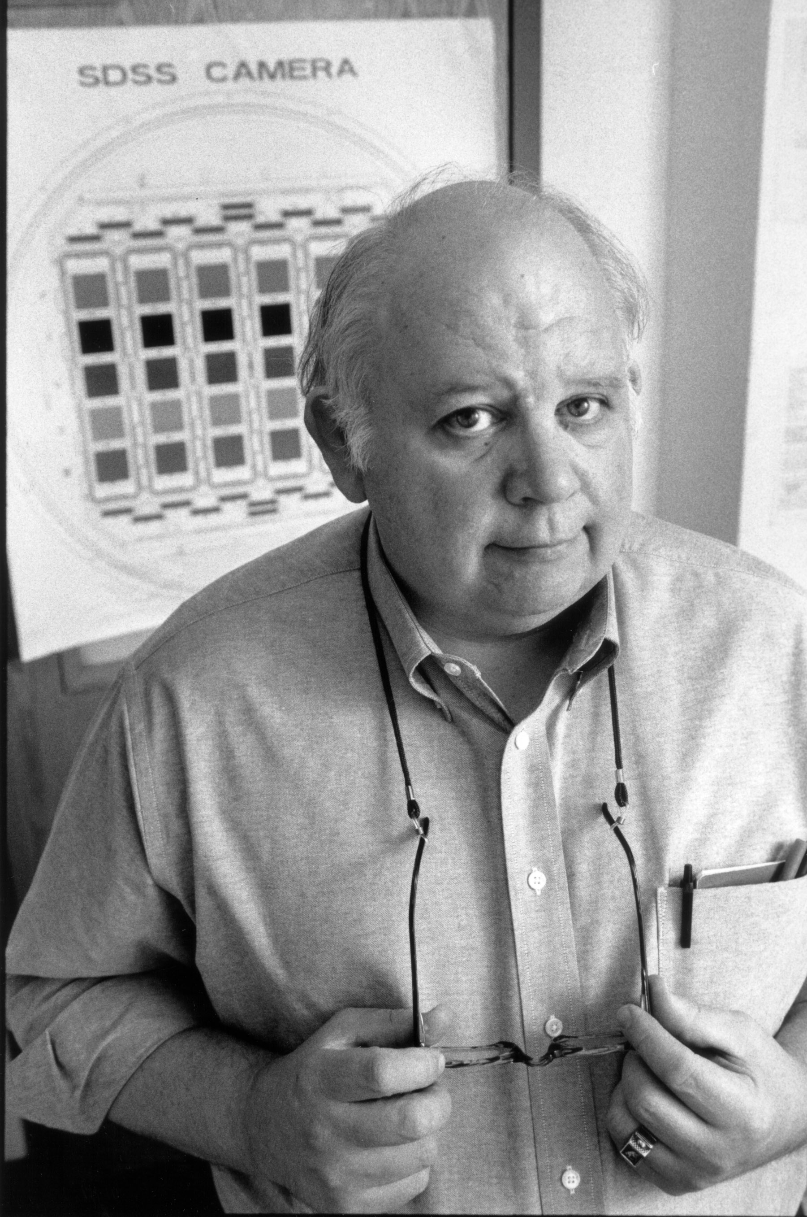
Sloan Digital Sky Survey
1990’s
Return of observational cosmology to Chicago

Slide 10
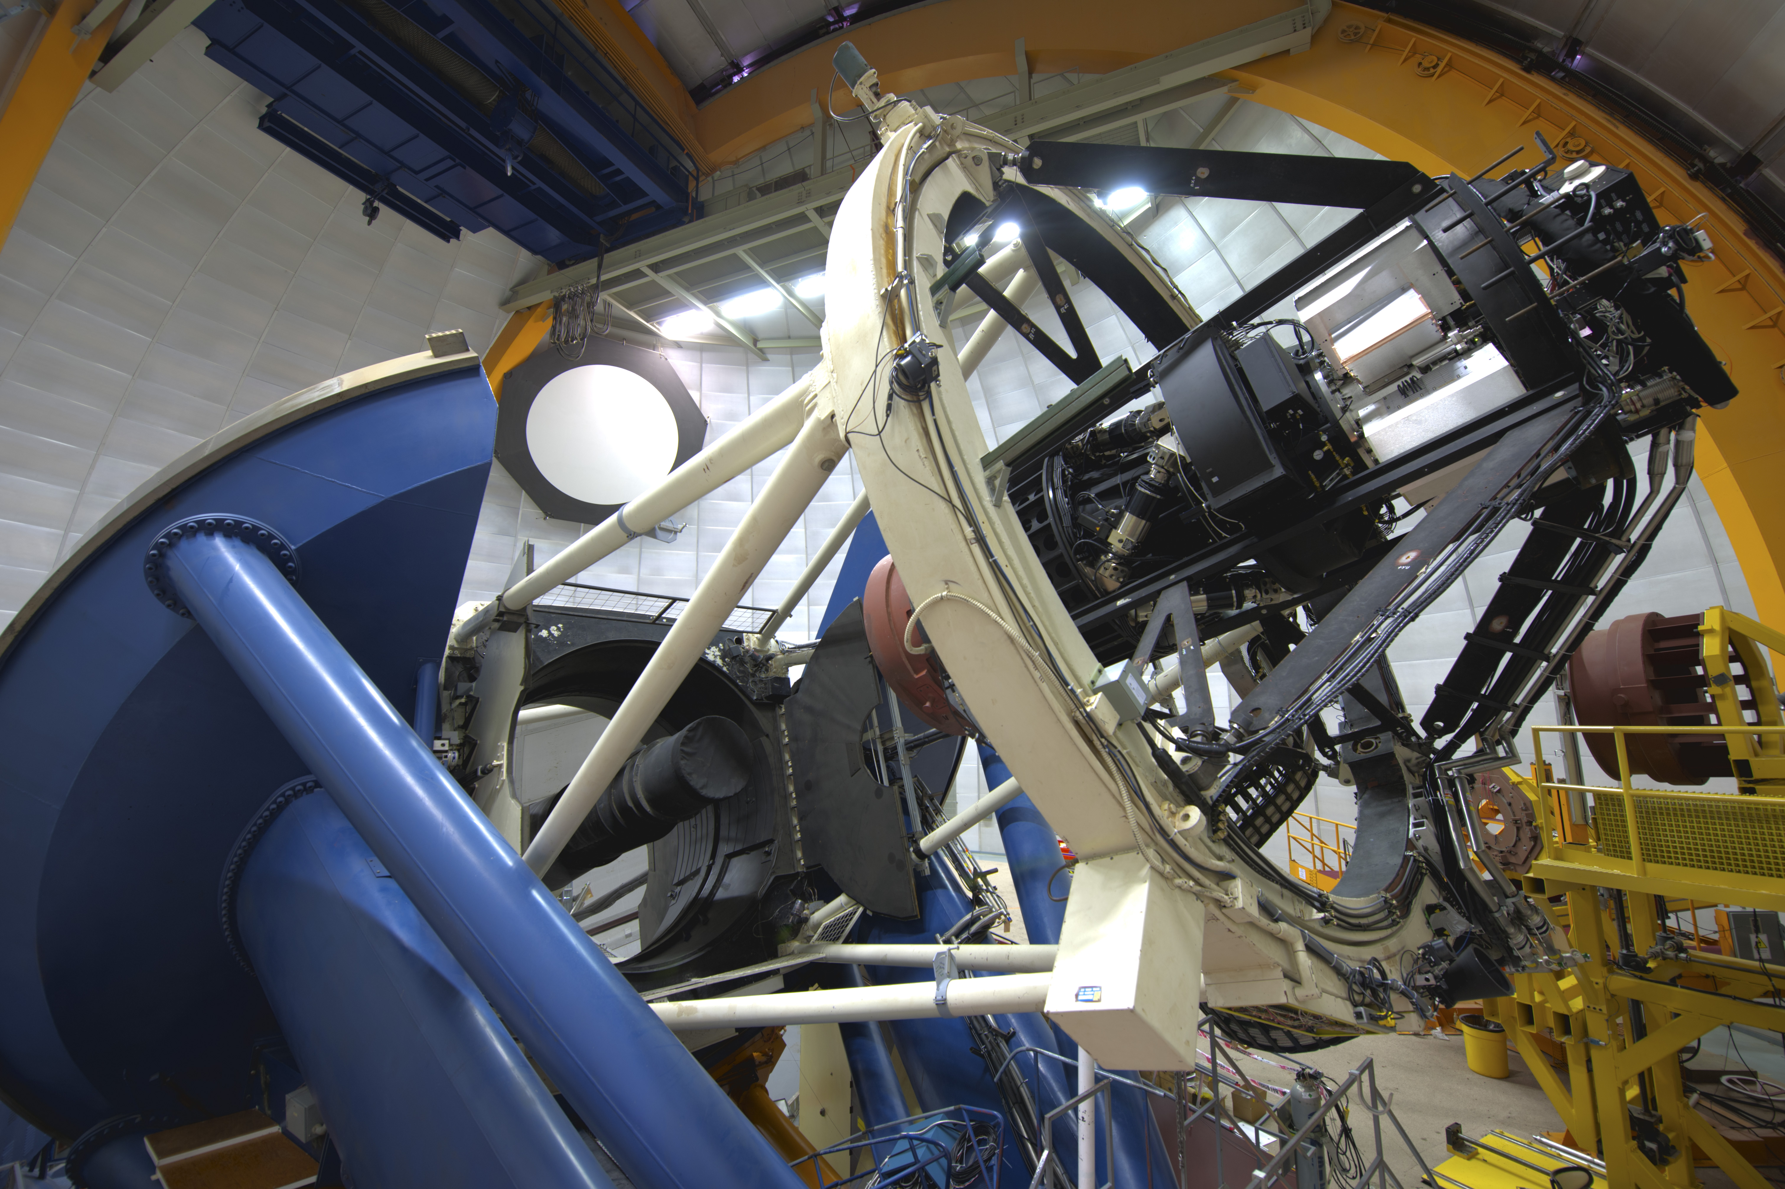
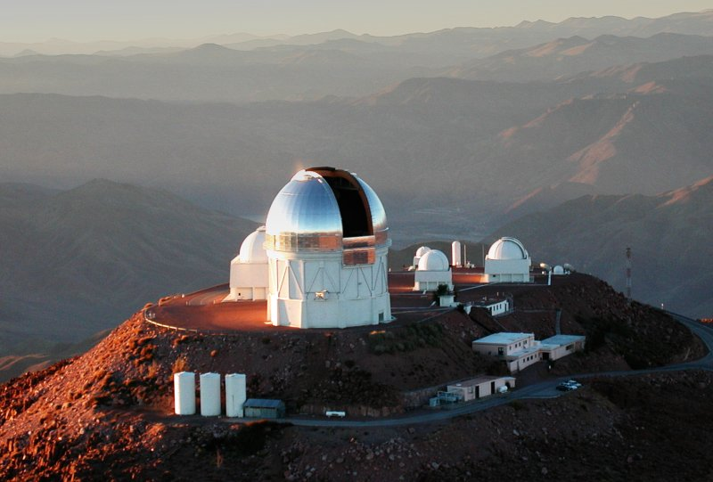
Dark Energy Survey
The tradition continues….
Dark Energy Camera
on the CTIO Blanco
Telescope

Slide 11
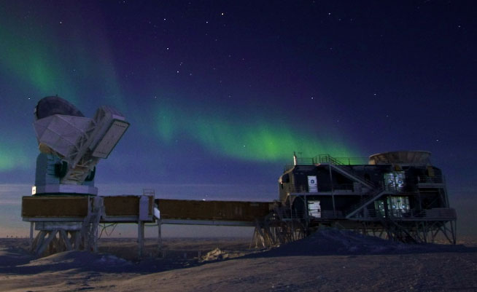
Golden age of Chicago-led CMB Experiments
COBE, MSAM-TOPHAT, DASI, EDGE, TPX, WMAP, Planck, CARMA, SZE, SZA, SPT, SPT-POL, SPT-3G, BICEP,…

Slide 12
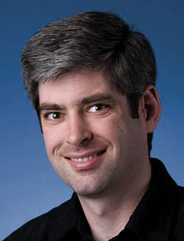
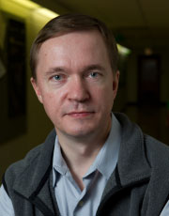
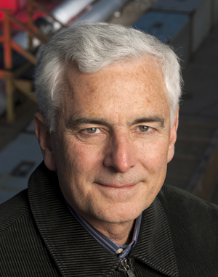
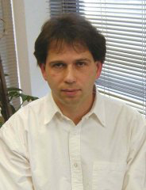
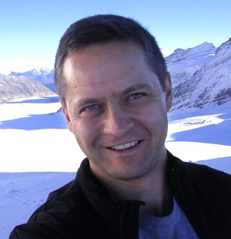
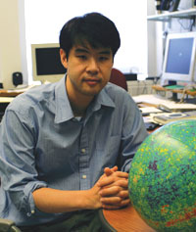
Cosmology Theory Blossoms

Slide 13
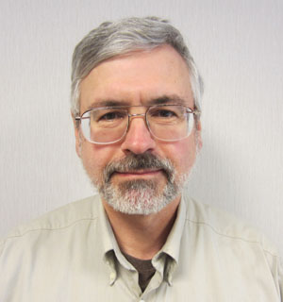
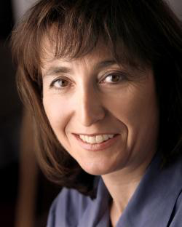
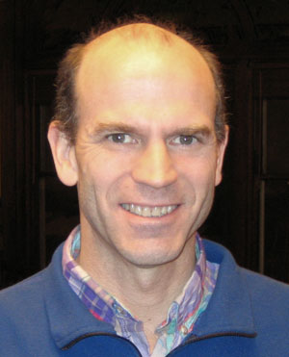
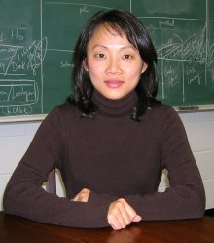
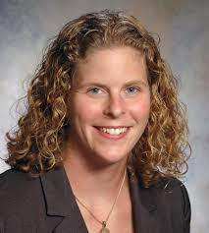
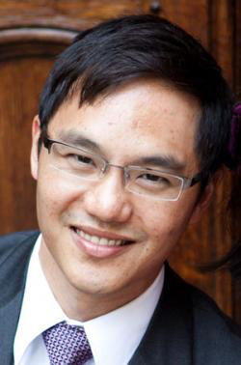
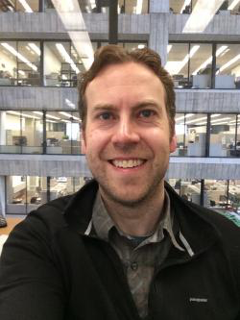
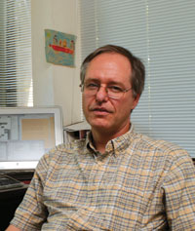
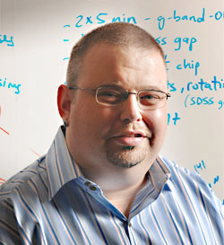
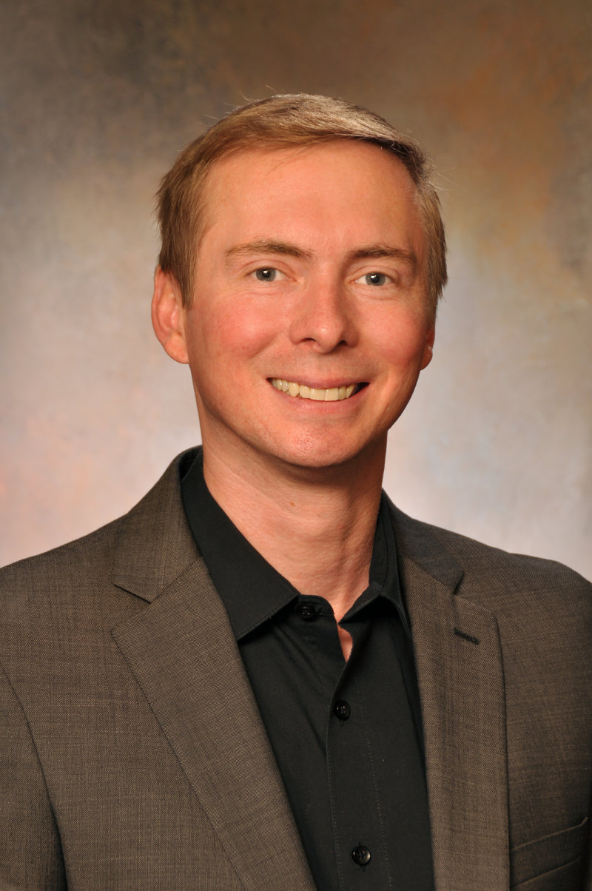
Observational Cosmology Blossoms

Slide 14
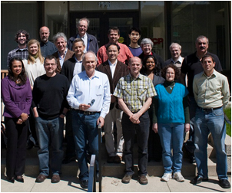
Kavli Institute for Cosmological Physics
Thanks Bruce!

Slide 15
Cosmology at Chicago: 2042
First light for GMT! (reconstructed after mag 9 quake)
JWST launches!
WFIRST only 2 years from launch!
LSST confirms DES discovery that w<−1
CMB S-8 improves constraint on tensors: r < 10⁻⁶; KICP hosts “Cyclic Universe ’42” conference
10th generation Dark Matter experiments begin (detector=RI)
Holometer discovers “it’s turtles all the way down to the Planck scale”
LHC celebrates 30th anniversary of Higgs, 10th anniversary of extra dimensions, still no SUSY
KICP PFC-10 funded: “Pushing Cosmology way over the Edge”
Astro2040 recommends SKA; UC considers 21cm
Astrobotany classes begin at UChicago-Mars campus
A&A and KICP share 5th floor broom closet unused by IME
Mid-term election setback for President Malia Obama

Slide 16
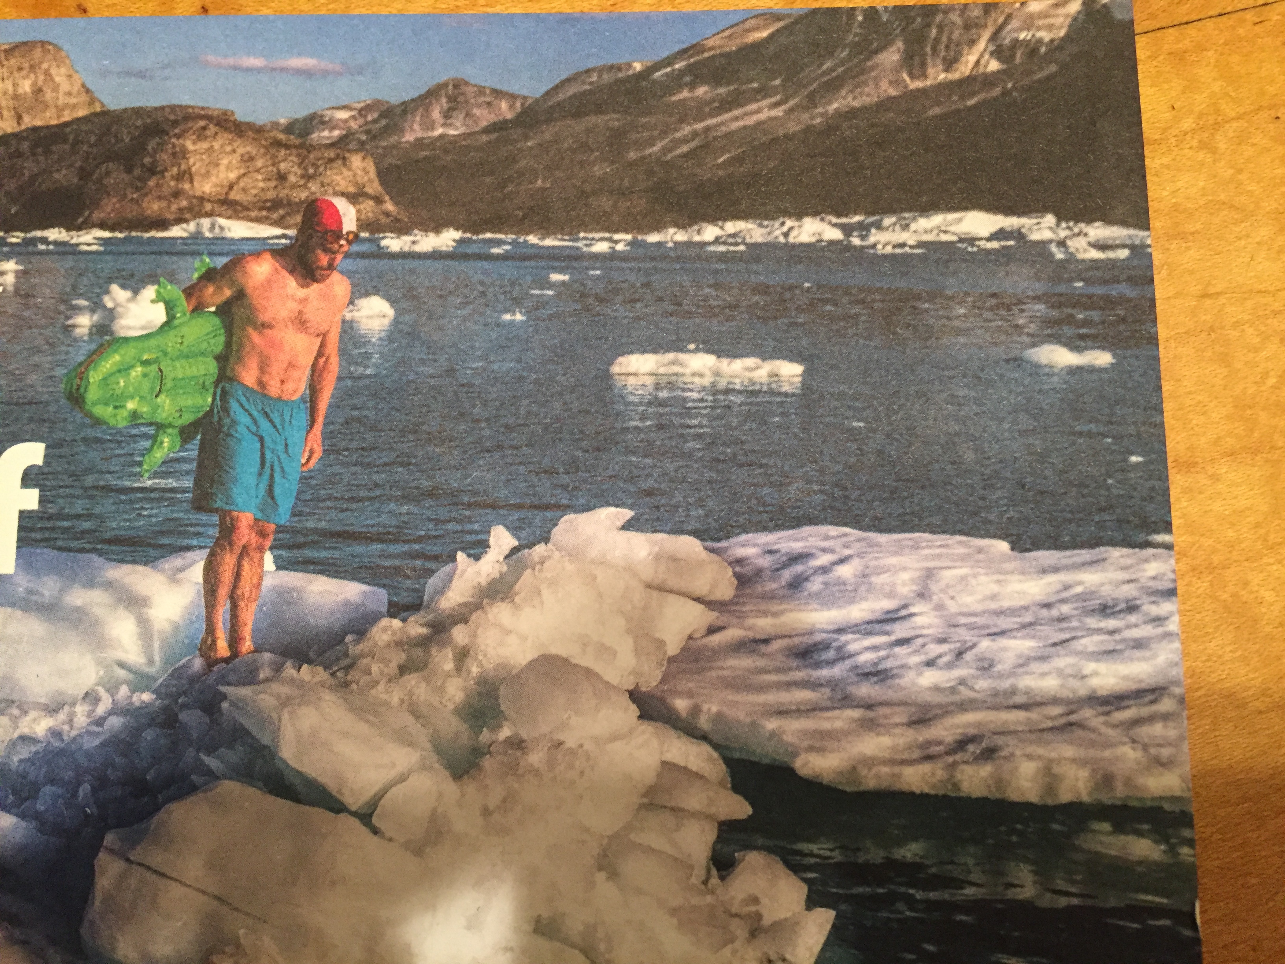
Cosmology at Chicago: 2042
Climate change causes mount problems for SPT-9G, but eases access to ICECUBE PMTs

Slide 17
Cosmology at Chicago: 2015

Slide 18
Cosmology at Chicago: 2042
19, 2042
9:30 AM – 10:30 AM

