Slide 1
The Dark Energy Survey
Josh Frieman
DES Project Director
Fermilab and the University of Chicago
Cooks Branch Supernova Workshop
April 13, 2012

Slide 2
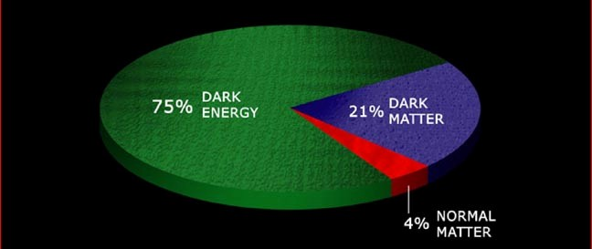
Dark Energy
What is the physical cause of cosmic acceleration?
Dark Energy or modification of General Relativity?
If Dark Energy, is it Λ (the vacuum) or something else?
What is the DE equation of state parameter w?

Slide 3
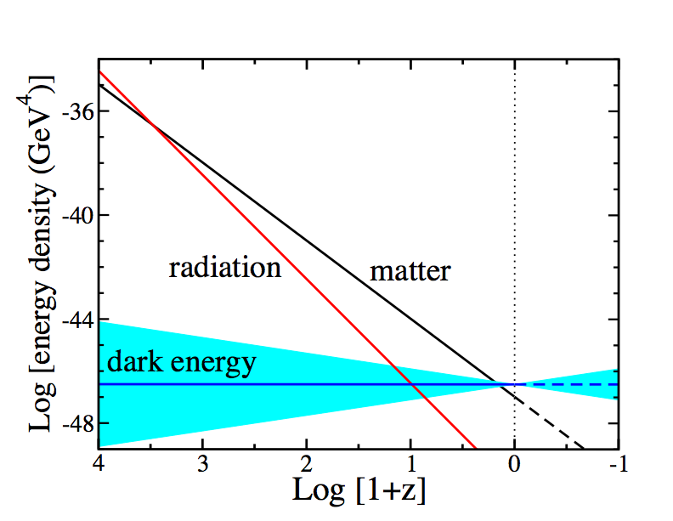
Equation of State parameter w determines Cosmic Evolution
Conservation of Energy-Momentum
=Log[a₀/a(t)]
Notes:
Energy-momentum conservation determines how the densities of different components scale with time. Before a few hundred thousand years after the BB, radiation or relativistic particles dominated, followed by non-relativistic matter, followed at ~8 Gyr by dark energy. In order for dark energy to cause cosmic speed-up, its equation of state must be such that its energy density scales slowly compared to matter and radiation. Thus, we expect dark energy to be important only at recent cosmic epochs.

Slide 4
The Dark Energy Survey
www.darkenergysurvey.org
Blanco 4-meter at CTIO
Survey project using 4 complementary techniques:
I. Cluster Counts
II. Weak Lensing
III. Large-scale Structure
IV. Supernovae
• Two multiband surveys:
5000 deg² grizY to 24th mag
30 deg² repeat (SNe)
• New 3 deg² FOV camera
and Data management system
Survey 2012-2017 (525 nights)
Facility instrument for Blanco

Slide 5
The DES Collaboration
Fermilab
University of Illinois at Urbana-Champaign/NCSA
University of Chicago
Lawrence Berkeley National Lab
NOAO/CTIO
DES Spain Consortium
DES United Kingdom Consortium
University of Michigan
Ohio State University
University of Pennsylvania
DES Brazil Consortium
Argonne National Laboratory
SLAC-Stanford-Santa Cruz Consortium
Universitats-Sternwarte Munchen
Texas A&M University
plus Associate members at: Brookhaven National Lab,
U. North Dakota, Paris, Taiwan
Over 120 members
plus students & postdocs
Funding: DOE, NSF; UK: STFC, SRIF; Spain Ministry of Science, Brazil: FINEP, Ministry of Science, FAPERJ; Germany: Excellence Cluster; collaborating institutions

Slide 6
Project Structure & Timeline
3 Construction Projects:
DECam (hosted by FNAL; DOE supported)
Data Management System (NCSA; NSF support)
CTIO Facilities Improvement Project (NSF/NOAO)
NOAO Blanco Announcement of Opportunity 2003
DECam R&D 2004-8
Camera construction 2008-11
All major components now on the mountain
Installation on telescope began Feb. 20
Old Prime Focus Cage removal began this week
First light DECam on telescope: ~Aug. 15
Commissioning and Science Verification: Aug.-Oct.
Survey operations begin: Nov. 2012

Slide 7
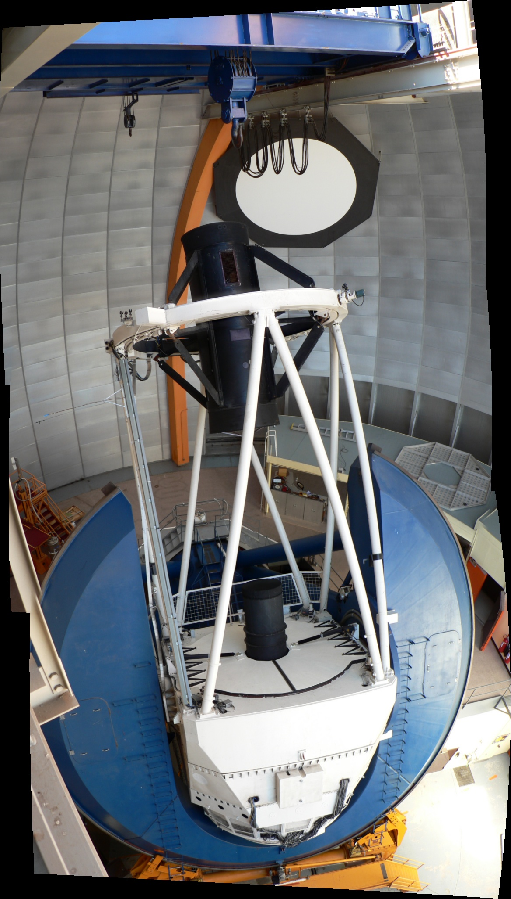
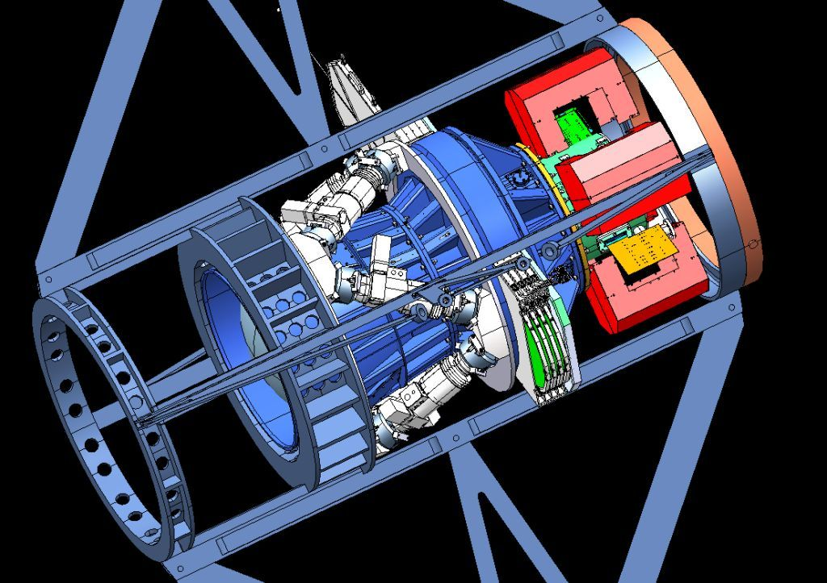
Dark Energy Camera
Mechanical Interface of DECam Project to the Blanco
CCD
Readout
Optical
Corrector
Lenses
Hexapod: optical alignment
Filters &
Shutter

Slide 8
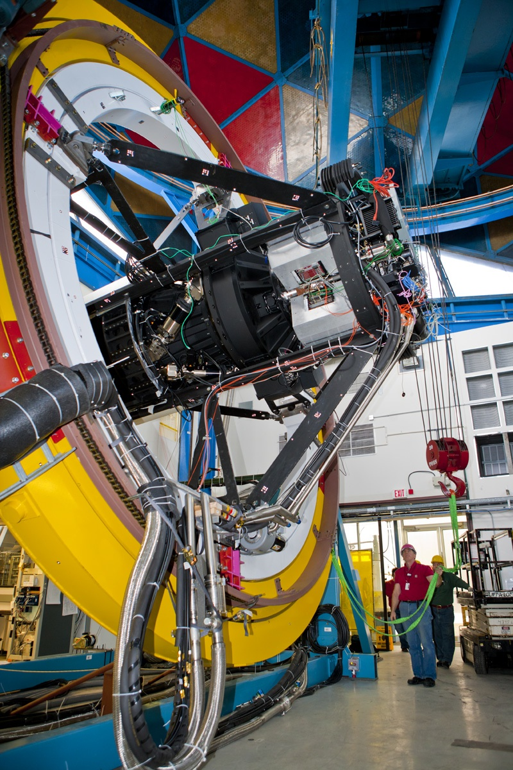
Dark Energy Camera
Mechanical Interface of DECam Project to the Blanco
CCD
Readout
Optical
Corrector
Lenses
Hexapod: optical alignment
Filters &
Shutter
DECam mounted on
Telescope Simulator
at Fermilab in early 2011

Slide 9
Webcam
shot

Slide 10
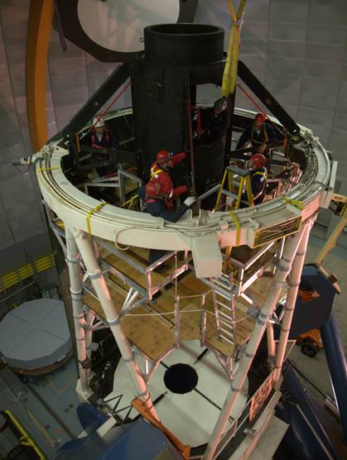
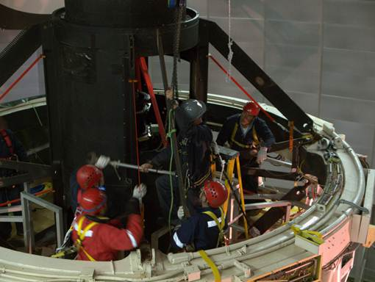
First PFC fins removed yesterday

Slide 11
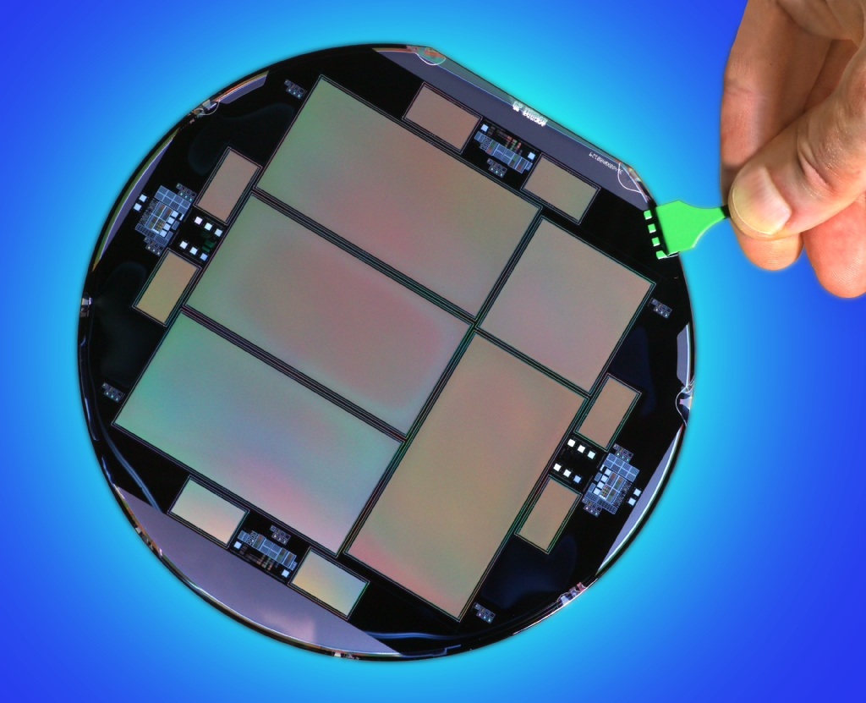
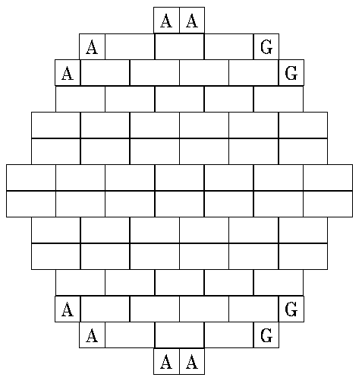
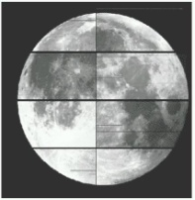
DECam CCDs
62 2kx4k fully depleted CCDs: 520 Megapixels, 250 micron thick, 15 micron (0.27”) pixel size
12 2kx2k guide and focus chips
Excellent red sensitivity
Developed by LBNL

Slide 12
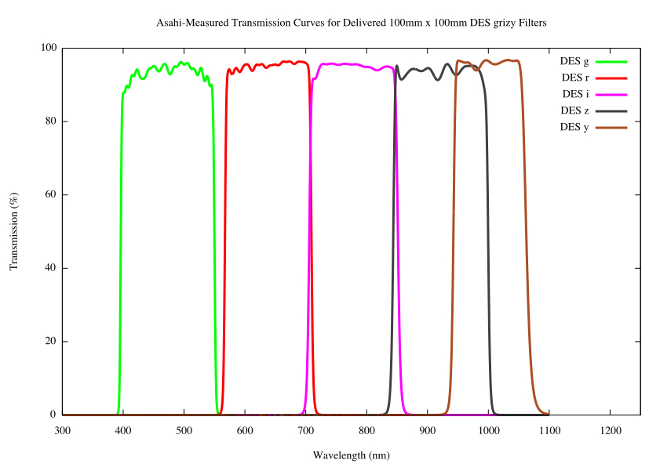
DECam CCDs
62 2kx4k fully depleted CCDs: 520 Megapixels, 250 micron thick, 15 micron (0.27”) pixel size
12 2kx2k guide and focus chips
Excellent red sensitivity
g r i z Y
Asahi filters

Slide 13
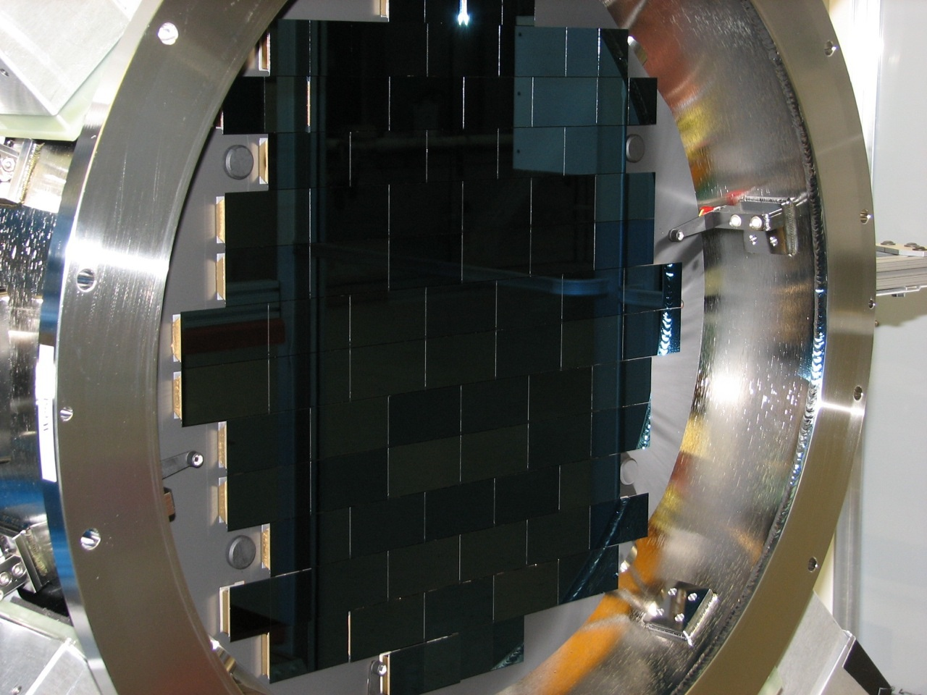
DECam mounted on Telescope Simulator at Fermilab in early 2011
DECam both DES survey instrument and CTIO facility instrument

Slide 14
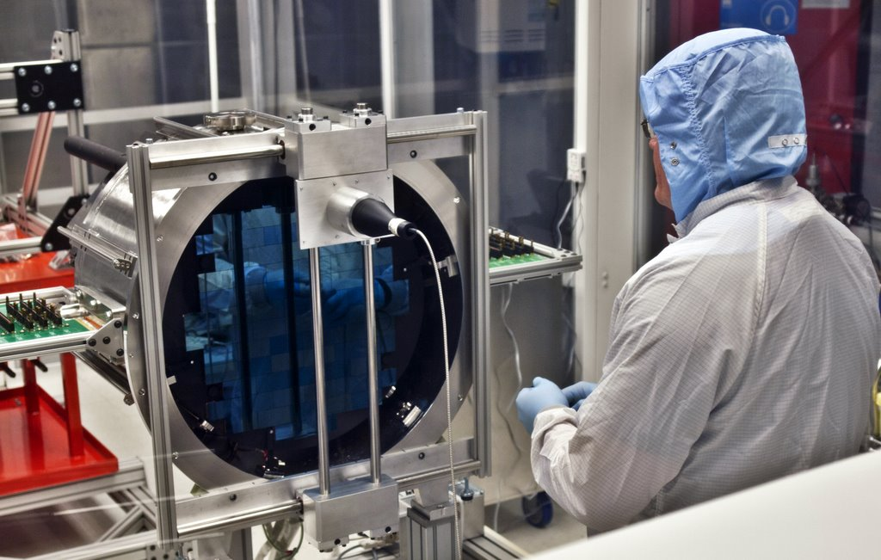
DECam in Chile

Slide 15
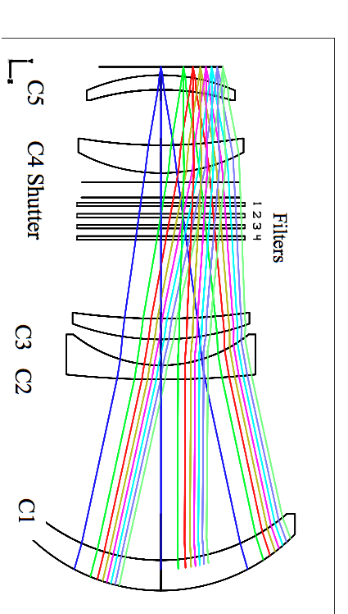
Optics
Field of view: 2.2º diameter
Good image quality across FOV
Optical elements aligned at UCL
C4
Filters &
Shutter
S. Kent (FNAL)

Slide 16
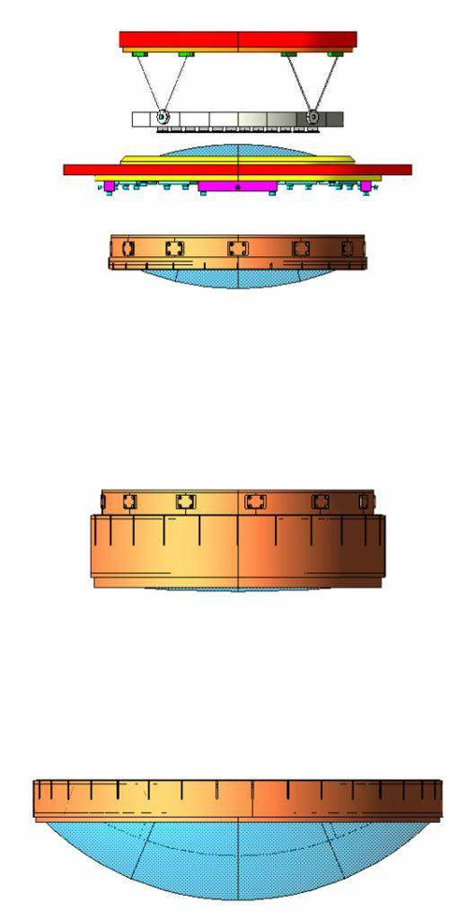
Optics
Field of view: 2.2º diameter
Good image quality across FOV
Optical elements aligned at UCL
Attachment ring
Bipods
Focal plane
C5, vacuum window
C4
Filters &
Shutter
C2 - C3
S. Kent (FNAL)
C1

Slide 17
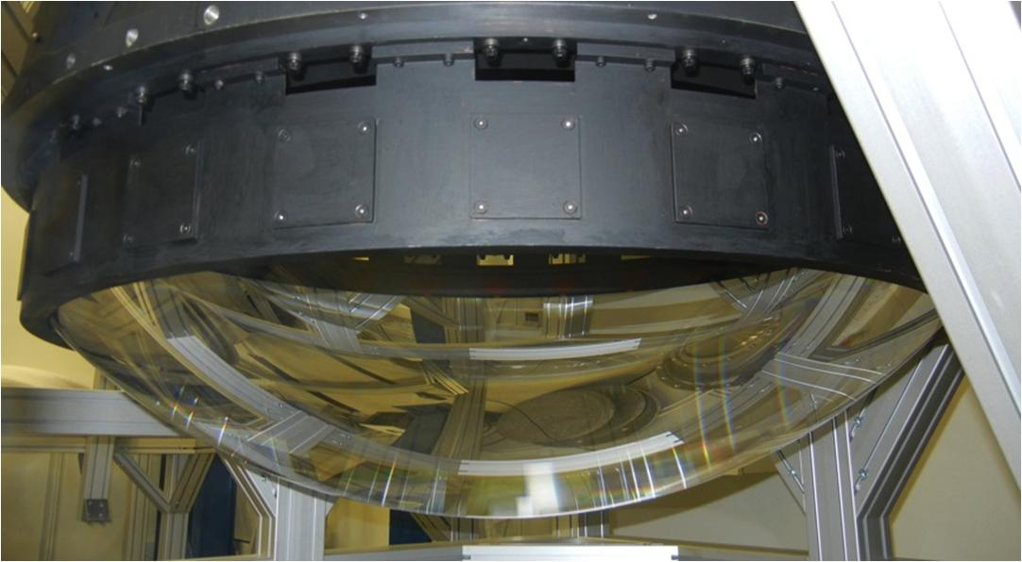
Optics
Field of view: 2.2º diameter
Good image quality across FOV
Optical elements aligned at UCL
Attachment ring
Bipods
Focal plane
C5, vacuum window
C4
Filters &
Shutter
C2 - C3
S. Kent (FNAL)
C1

Slide 18
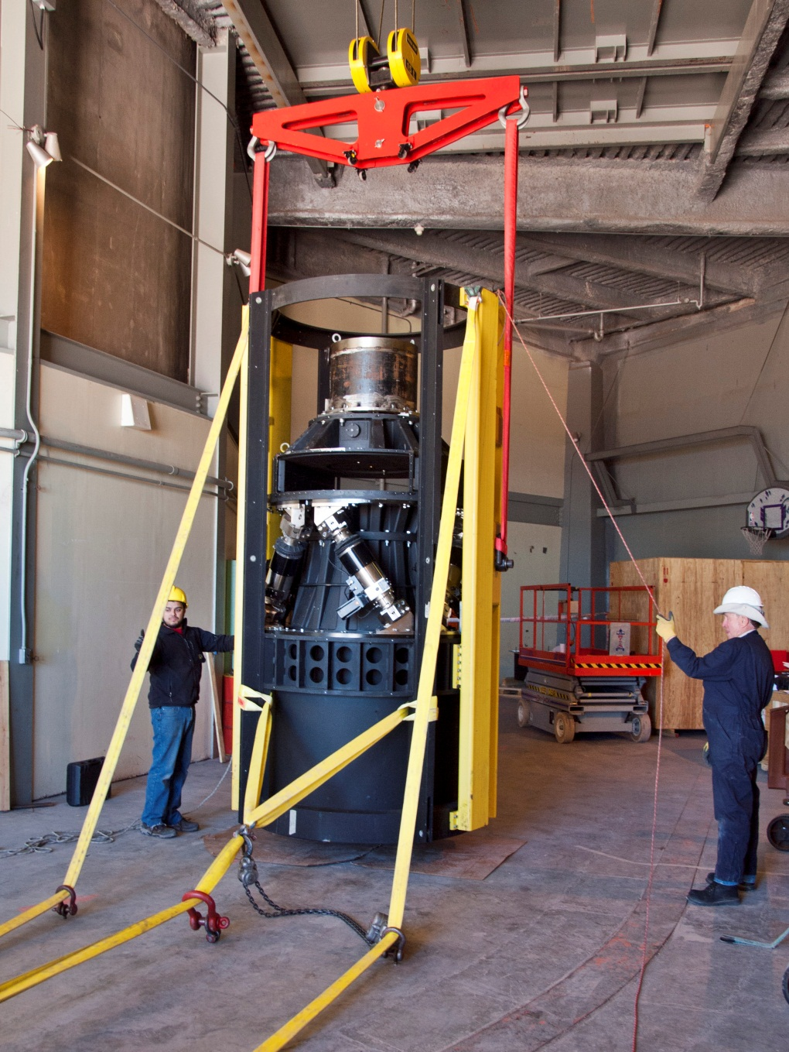
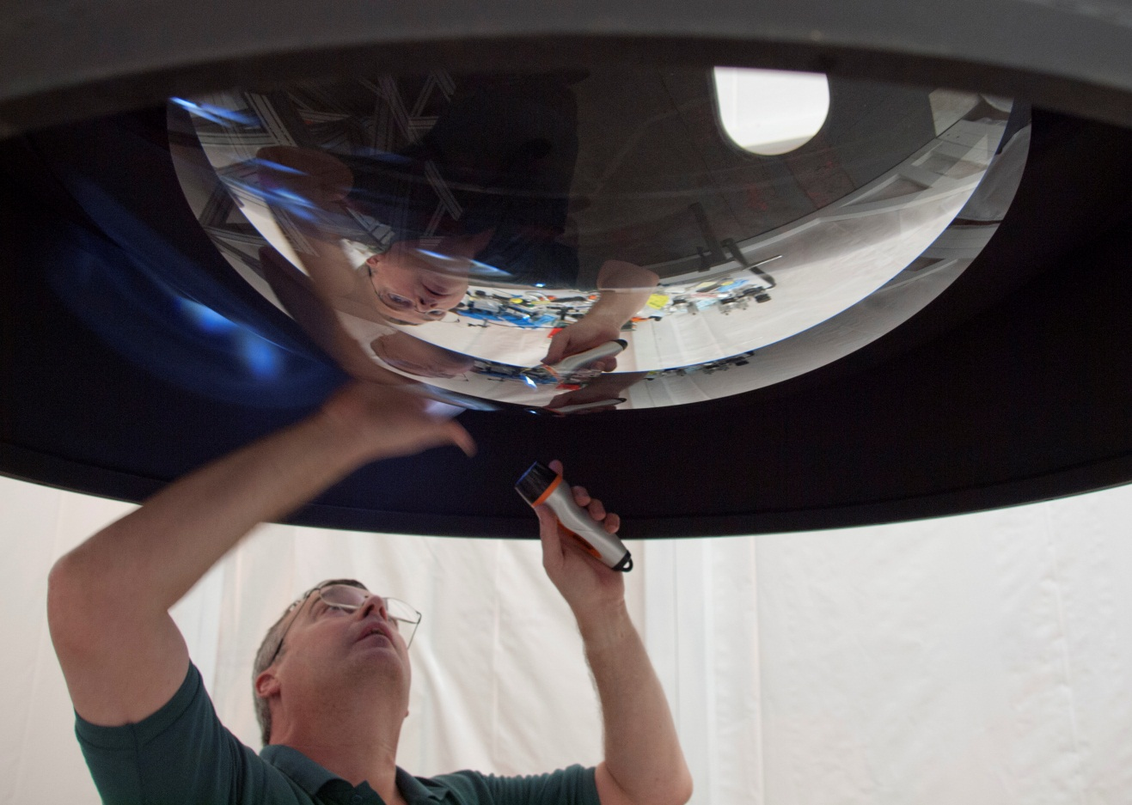
Preparations at CTIO

Slide 19
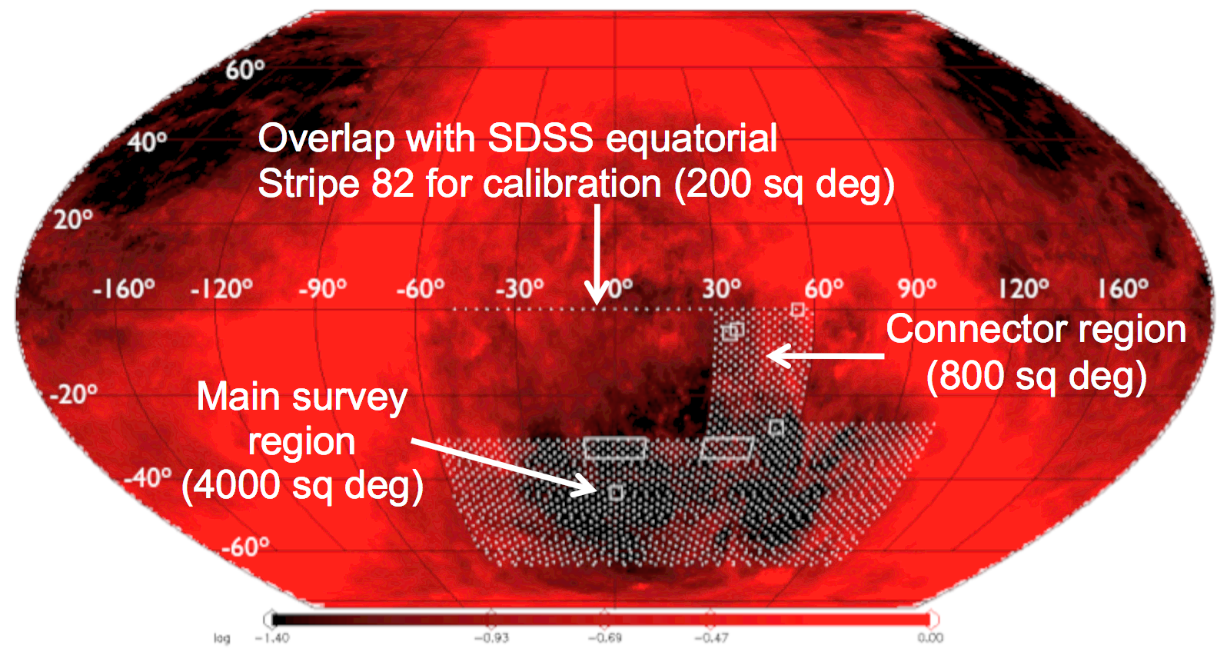
DES Observing Strategy
Sept-Feb observing seasons
80-100 sec exposures (wide)
2 filters per pointing (typically)
gr in dark time
izy in bright/grey time
Photometric calibration: overlap tilings, standard stars, spectrophotometric calibration system, preCAM
2 survey tilings/filter/year
Interleave 10 SN fields in griz if PSF>1.1” or time gap>7 days (aim for ~5 day cadence)
Survey Area
5000 sq deg
Overlap with SDSS equatorial
Stripe 82 for calibration (200 sq deg)
2 tilings
3 tilings

Slide 20
DES Calibration Plan
Instrumental Calibration (Nightly & Periodic): Create biases, dome flats, linearity curves, cross-talk coefficients, system response maps.
Photometric Monitoring: Monitor sky with new 10μm All-Sky Cloud Camera.
Nightly and Intermediate Calibrations: Observe standard star fields with DECam during evening and morning twilight and at least once in the middle of the night; fit photometric equation; apply the results to the data.
Global Relative Calibrations: Use the extensive overlaps between exposures over multiple tilings to tie together the DES photometry onto an internally consistent system across the entire DES footprint.
Global Absolute Calibrations: Use DECam observations of spectro-photometric standards in combination with periodic measurements of the full DECam system response map (DECal system from TAMU) to tie the DES photometry onto an AB magnitude system.
PreCam Survey: Use grizy standards from PreCam Survey for nightly calibrations and calibrated PreCam fields to improve the DES Global Relative Calibrations.
Atmospheric monitoring: GPS system; exploring 4-filter camera on small telescope

Slide 21
Plans for First Season
Deep SN fields
Shallow SN fields
500 sq deg to full DES depth

Slide 22
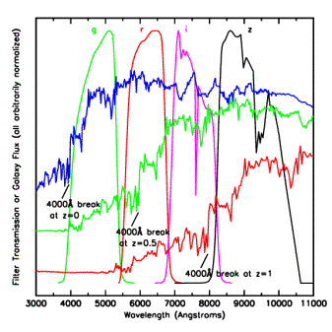
Photometric Redshifts
• Measure relative flux in
multiple filters:
track the 4000 A break
• Estimate individual galaxy
redshifts with accuracy
σ(z) < 0.1 (~0.02 for clusters)
• Precision is sufficient
for Dark Energy probes,
provided error distributions
well measured.
Challenge: spectroscopic
training & validation sets to
flux limit of imaging survey
(24th mag DES, 25.5 LSST)
Elliptical galaxy spectrum

Slide 23
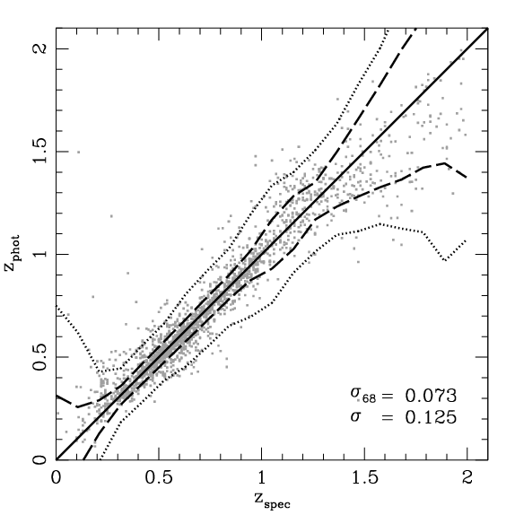
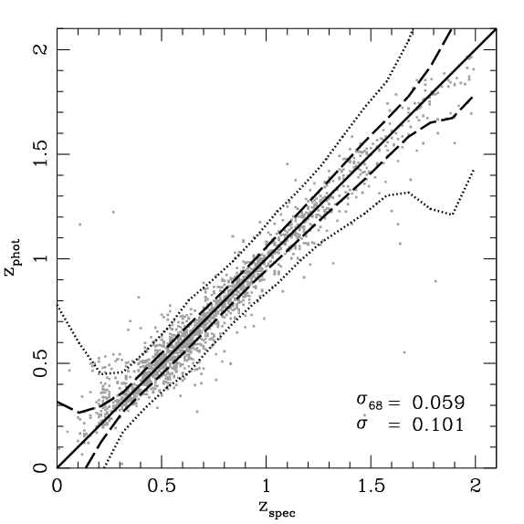
Galaxy Photo-z Simulations
+VHS*
DES
DES griz
DES griZY
+VHS JHKs on
ESO VISTA 4-m
enhances science reach
10σ Limiting Magnitudes
g 24.6
r 24.1
i 24.0
z 23.8
Y 21.6
+2% photometric calibration
error added in quadrature
Spectroscopic training sets comparable to DES depth exist
J 20.3
H 19.4
Ks 18.3
*Vista Hemisphere Survey

Slide 24
DES Science Summary
Four Probes of Dark Energy
Galaxy Clusters
~100,000 clusters to z>1
Synergy with SPT, VHS
Sensitive to growth of structure and geometry
Weak Lensing
Shape measurements of 300 million galaxies
Sensitive to growth of structure and geometry
Baryon Acoustic Oscillations
300 million galaxies to z = 1 and beyond
Sensitive to geometry
Supernovae
30 sq deg time-domain survey
~4000 well-sampled SNe Ia to z ~1
Sensitive to geometry
Current Constraints on DE Equation of State
Sullivan, etal

Slide 25
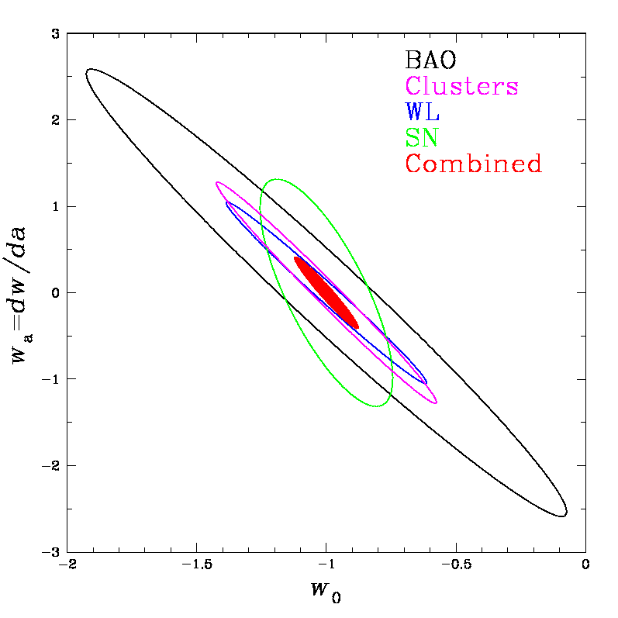
DES Science Summary
Forecast Constraints on DE Equation of State
Four Probes of Dark Energy
Galaxy Clusters
~100,000 clusters to z>1
Synergy with SPT, VHS
Sensitive to growth of structure and geometry
Weak Lensing
Shape measurements of 300 million galaxies
Sensitive to growth of structure and geometry
Baryon Acoustic Oscillations
300 million galaxies to z = 1 and beyond
Sensitive to geometry
Supernovae
30 sq deg time-domain survey
~4000 well-sampled SNe Ia to z ~1
Sensitive to geometry
DES
Planck prior assumed
Factor 3-5 improvement over
Stage II DETF Figure of Merit

Slide 26
DES Science Summary
Forecast Constraints on DE Equation of State
Four Probes of Dark Energy
Galaxy Clusters
~100,000 clusters to z>1
Synergy with SPT, VHS
Sensitive to growth of structure and geometry
Weak Lensing
Shape measurements of 300 million galaxies
Sensitive to growth of structure and geometry
Baryon Acoustic Oscillations
300 million galaxies to z = 1 and beyond
Sensitive to geometry
Supernovae
30 sq deg time-domain survey
~4000 well-sampled SNe Ia to z ~1
Sensitive to geometry
DES
Planck prior assumed
Factor 3-5 improvement over
Stage II DETF Figure of Merit

Slide 27
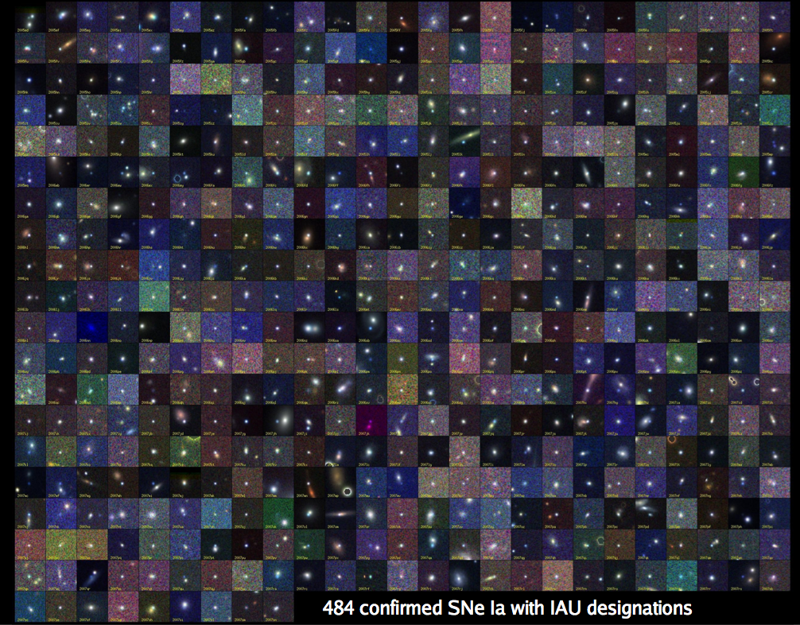
Supernovae
B. Dilday
SDSS-II: 500 spectroscopically confirmed SNe Ia, >1000 with host redshifts from SDSS-III

Slide 28
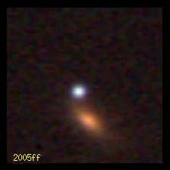
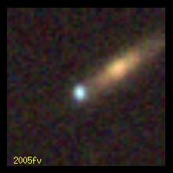
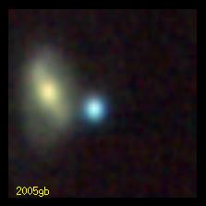
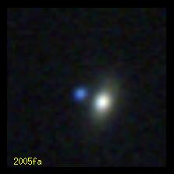
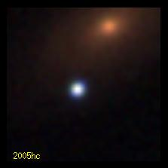
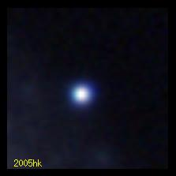
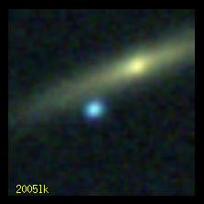
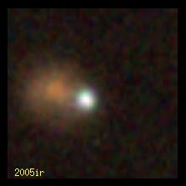
B. Dilday
SDSS-II: 500 spectroscopically confirmed SNe Ia, >1000 with host redshifts from SDSS-III

Slide 29
7200
900
Bernstein etal 11

Slide 30
2 deep, 8 shallow 3 sq deg fields

Slide 31
1 filter S/N_{max}>10, 2 others S/N_{max}>5,
>5 epochs, pre- and post-max epochs

Slide 32
Cadence Distribution

Slide 33
Supernovae in DES
Simulated Light Curves
Bernstein et al
Higher S/N in red passbands than SNLS
NIR from VISTA VIDEO for ~100 SNe
Factor ~10x statistics vs. current samples
Challenges: photometric calibration, dust extinction, population evolution, sample contamination with limited spectroscopy

Slide 34
Open to collaboration with SN community

Slide 35
Supernova Hubble Diagram
Distance modulus (log of distance)
Kessler et al 2009

Slide 36
Supernova Hubble Diagram
DES Simulation:
~4000 well-measured
SN Ia light curves
Distance modulus (log of distance)
Kessler et al 2009

Slide 37
Blind
SN Photometric
Challenge:
Kessler etal
1008.1024

Slide 38
Slides from Masao Sako

Slide 44
Photometric SN Cosmology
Hubble diagram of SDSS SNe Ia: spectroscopic plus those classified photometrically that have host-galaxy redshifts measured by BOSS (use host redshift as prior)
SDSS-II SN
preliminary
Campbell, etal

Slide 45
Fold in SN classification probability into likelihood instead of cuts

Slide 47
SN Cosmology in the Era of Large Photometric Surveys
Photometric Classification: Purity vs. Efficiency
How best to construct spectroscopic subsamples?
Selection criteria for SN follow-up
Train, validate classifiers vs. direct science
Host galaxies
Cross-calibration issues
Systematics floor

Slide 48
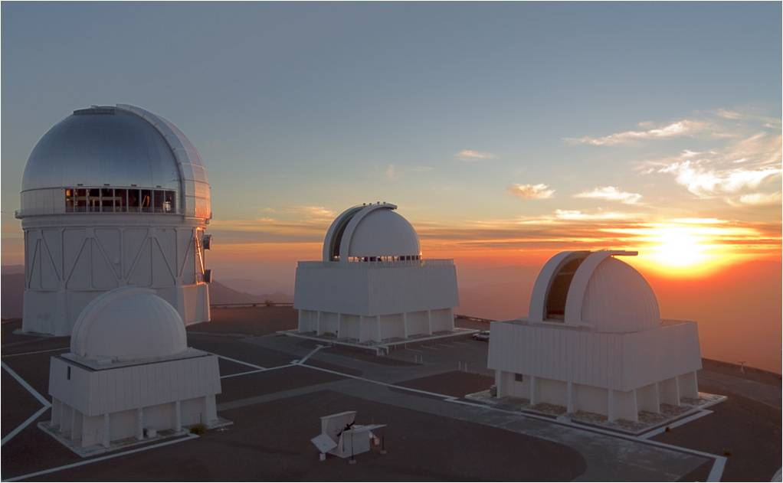
Stay tuned!

