Slide 1
The Dark Energy Survey
Josh Frieman
DES Project Director
Fermilab and the University of Chicago
Aspen Inflation Workshop
February 1, 2012

Slide 2
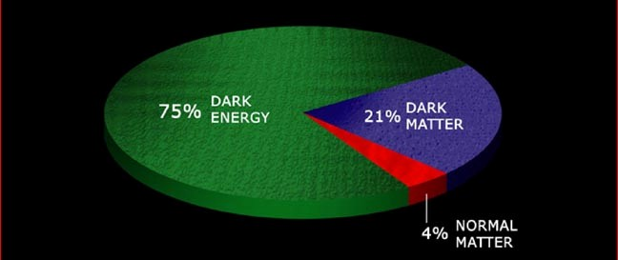
Dark Energy
What is the physical cause of cosmic acceleration?
Dark Energy or modification of General Relativity?
If Dark Energy, is it Λ (the vacuum) or something else?
What is the DE equation of state parameter w?

Slide 3
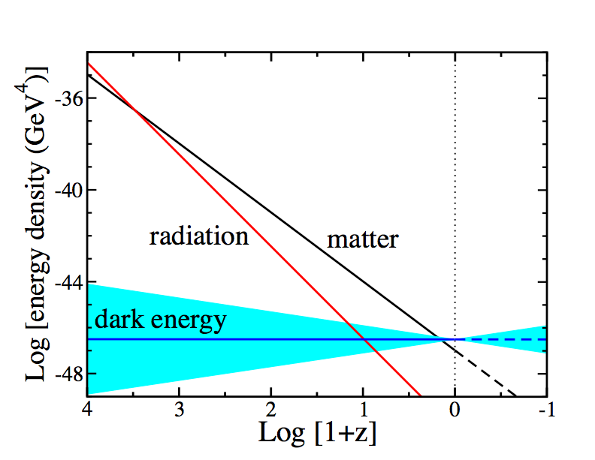
Equation of State parameter w determines Cosmic Evolution
Conservation of Energy-Momentum
Inflation: 1+w=2ε/3
=Log[a₀/a(t)]
Notes:
Energy-momentum conservation determines how the densities of different components scale with time. Before a few hundred thousand years after the BB, radiation or relativistic particles dominated, followed by non-relativistic matter, followed at ~8 Gyr by dark energy. In order for dark energy to cause cosmic speed-up, its equation of state must be such that its energy density scales slowly compared to matter and radiation. Thus, we expect dark energy to be important only at recent cosmic epochs.

Slide 4
The Dark Energy Survey
www.darkenergysurvey.org
Blanco 4-meter at CTIO
Survey project using 4 complementary techniques:
I. Cluster Counts
II. Weak Lensing
III. Large-scale Structure
IV. Supernovae
• Two multiband surveys:
5000 deg² grizY to 24th mag
30 deg² repeat (SNe)
• New 3 deg² FOV camera
and Data management system
Survey 2012-2017 (525 nights)
Facility instrument for Blanco

Slide 5
The DES Collaboration
Fermilab
University of Illinois at Urbana-Champaign/NCSA
University of Chicago
Lawrence Berkeley National Lab
NOAO/CTIO
DES Spain Consortium
DES United Kingdom Consortium
University of Michigan
Ohio State University
University of Pennsylvania
DES Brazil Consortium
Argonne National Laboratory
SLAC-Stanford-Santa Cruz Consortium
Universitats-Sternwarte Munchen
Texas A&M University
plus Associate members at: Brookhaven National Lab,
U. North Dakota, Paris, Taiwan
Over 120 members
plus students & postdocs
Funding: DOE, NSF; UK: STFC, SRIF; Spain Ministry of Science, Brazil: FINEP, Ministry of Science, FAPERJ; Germany: Excellence Cluster; collaborating institutions

Slide 6
Project Structure & Timeline
3 Construction Projects:
DECam (hosted by FNAL; DOE supported)
Data Management System (NCSA; NSF support)
CTIO Facilities Improvement Project (NSF/NOAO)
NOAO Blanco Announcement of Opportunity 2003
DECam R&D 2004-8
Camera construction 2008-11
All major components now on the mountain
Installation on telescope begins Feb. 20
First light DECam on telescope: Aug. 1
Commissioning and Science Verification: Aug.-Oct.
Survey operations begin: ~Oct 2012

Slide 7
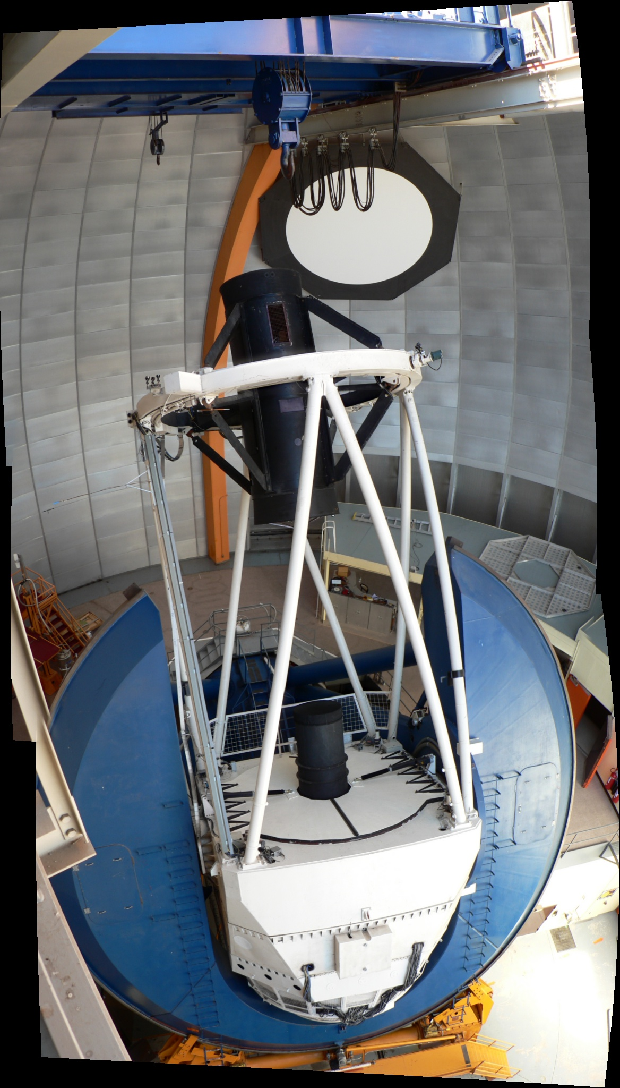
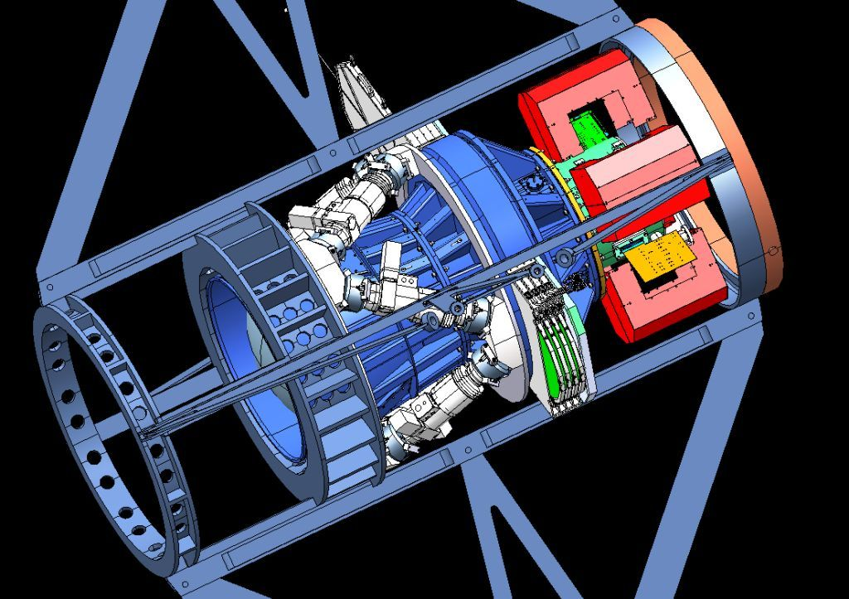
Dark Energy Camera
Mechanical Interface of DECam Project to the Blanco
CCD
Readout
Optical
Corrector
Lenses
Hexapod: optical alignment
Filters &
Shutter

Slide 8
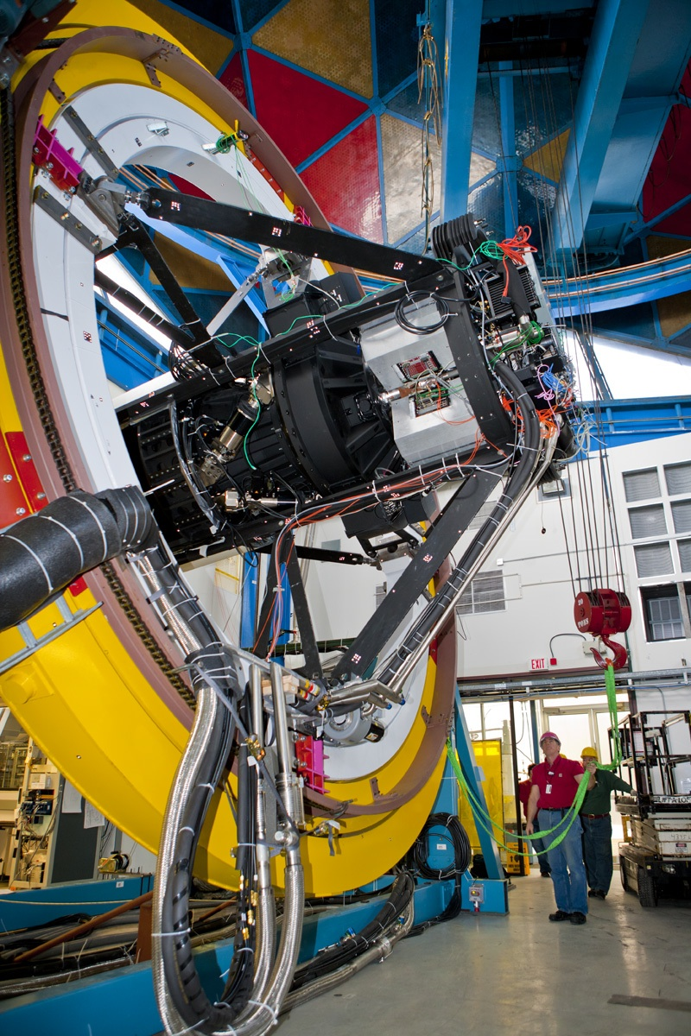
Dark Energy Camera
Mechanical Interface of DECam Project to the Blanco
CCD
Readout
Optical
Corrector
Lenses
Hexapod: optical alignment
Filters &
Shutter
DECam mounted on
Telescope Simulator
at Fermilab in early 2011

Slide 9
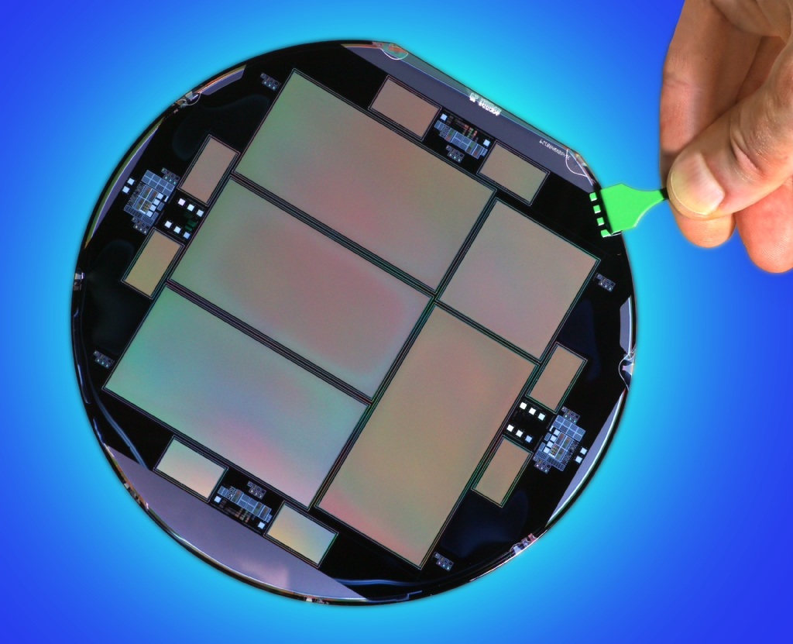
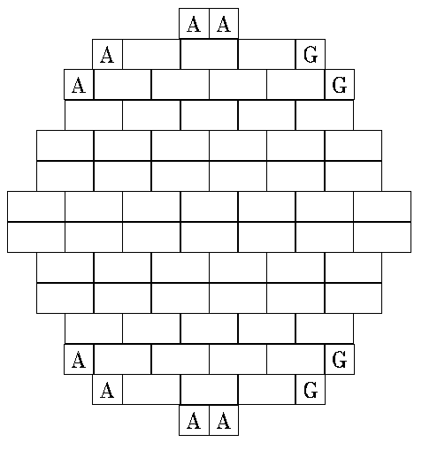
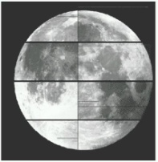
DECam CCDs
62 2kx4k fully depleted CCDs: 520 Megapixels, 250 micron thick, 15 micron (0.27”) pixel size
12 2kx2k guide and focus chips
Excellent red sensitivity
Developed by LBNL

Slide 10
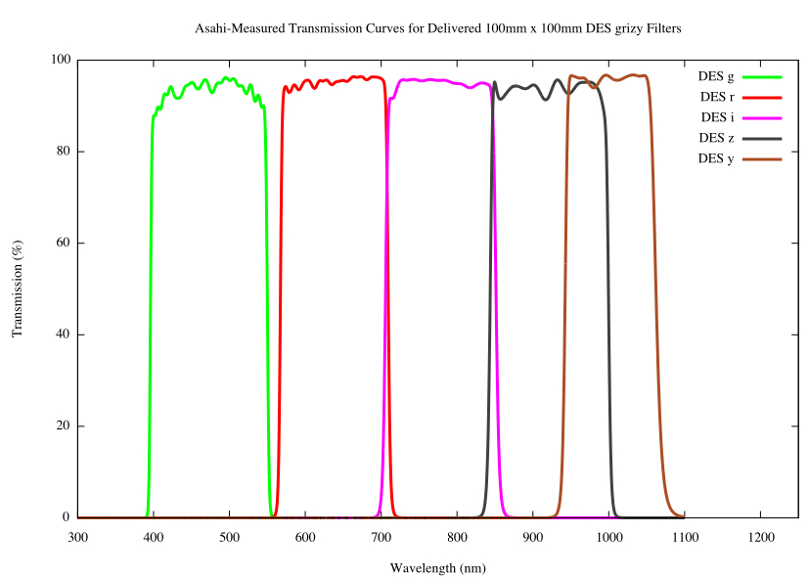
DECam CCDs
62 2kx4k fully depleted CCDs: 520 Megapixels, 250 micron thick, 15 micron (0.27”) pixel size
12 2kx2k guide and focus chips
Excellent red sensitivity
g r i z Y
Asahi filters

Slide 11
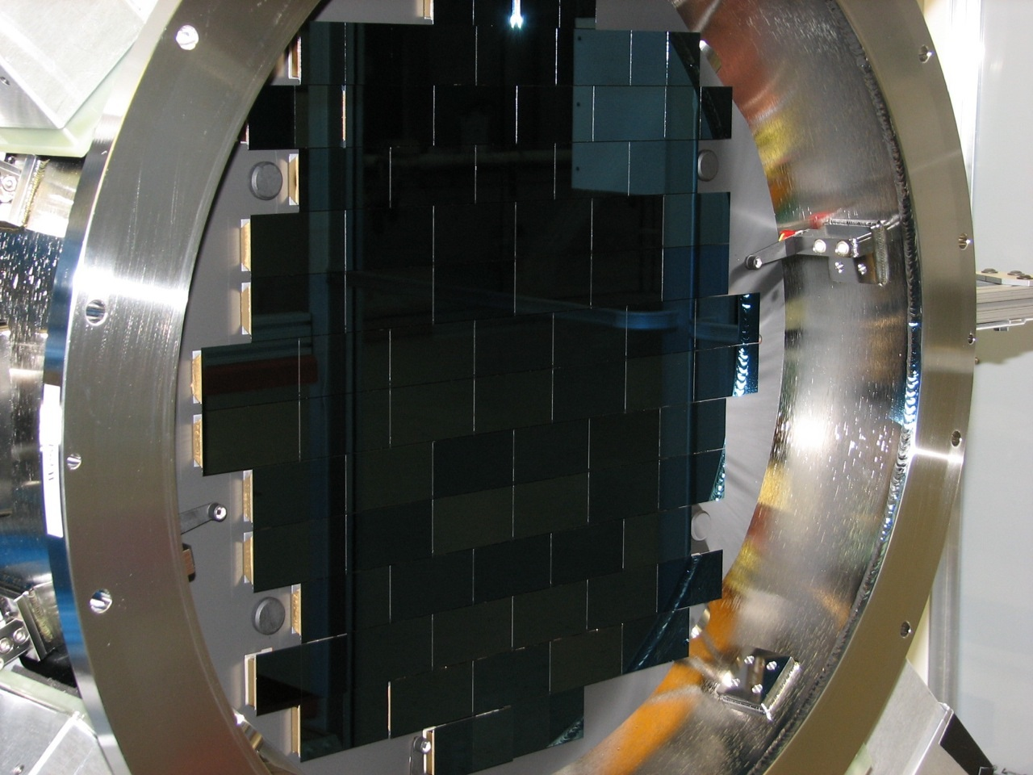
DECam mounted on Telescope Simulator at Fermilab in early 2011
DECam both DES survey instrument and CTIO facility instrument

Slide 12
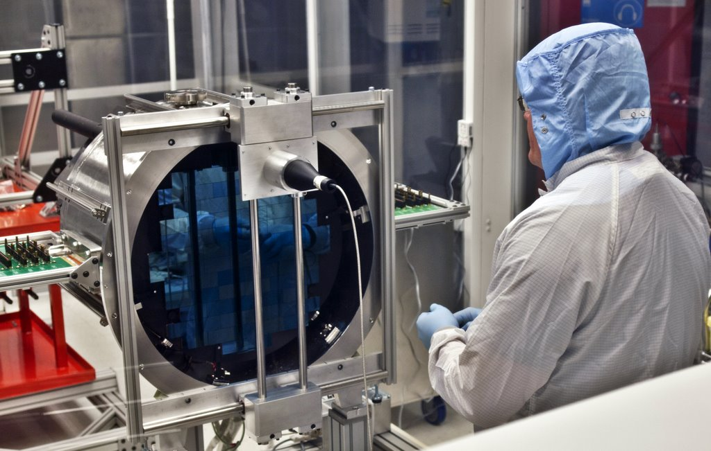
DECam in Chile

Slide 13
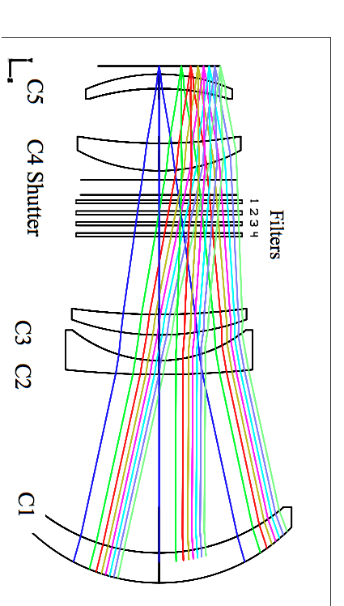
Optics
Field of view: 2.2º diameter
Good image quality across FOV
Optical elements aligned at UCL
C4
Filters &
Shutter
S. Kent (FNAL)

Slide 14
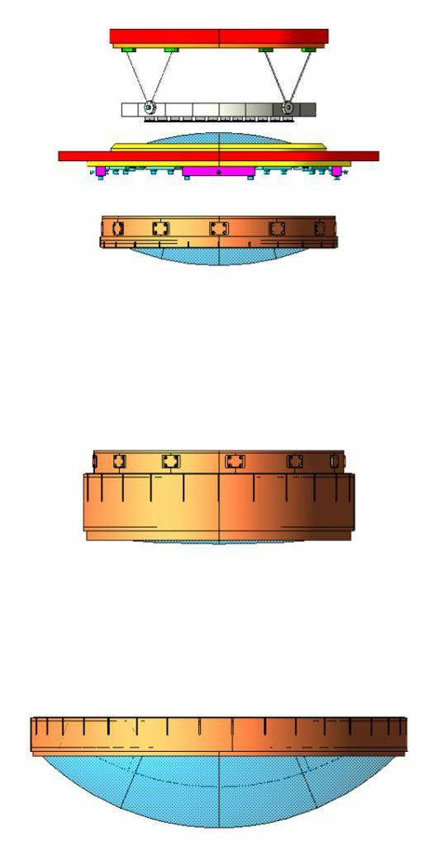
Optics
Field of view: 2.2º diameter
Good image quality across FOV
Optical elements aligned at UCL
Attachment ring
Bipods
Focal plane
C5, vacuum window
C4
Filters &
Shutter
C2 - C3
S. Kent (FNAL)
C1

Slide 15
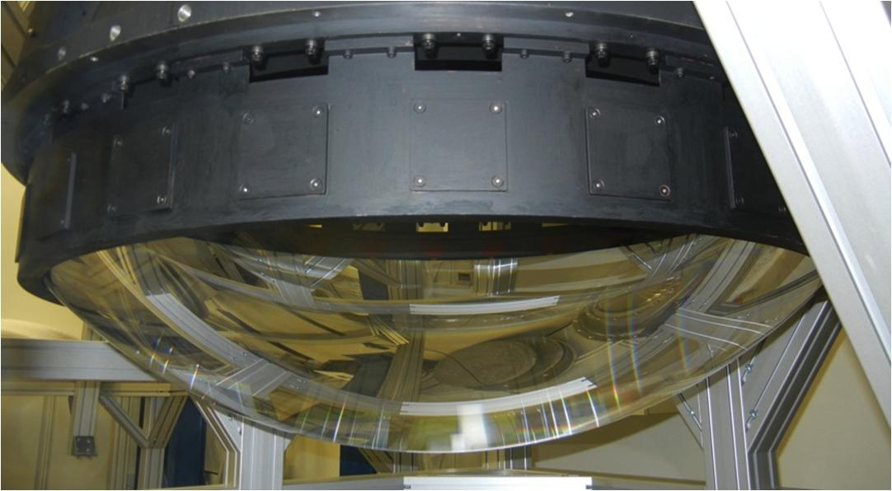
Optics
Field of view: 2.2º diameter
Good image quality across FOV
Optical elements aligned at UCL
Attachment ring
Bipods
Focal plane
C5, vacuum window
C4
Filters &
Shutter
C2 - C3
S. Kent (FNAL)
C1

Slide 16
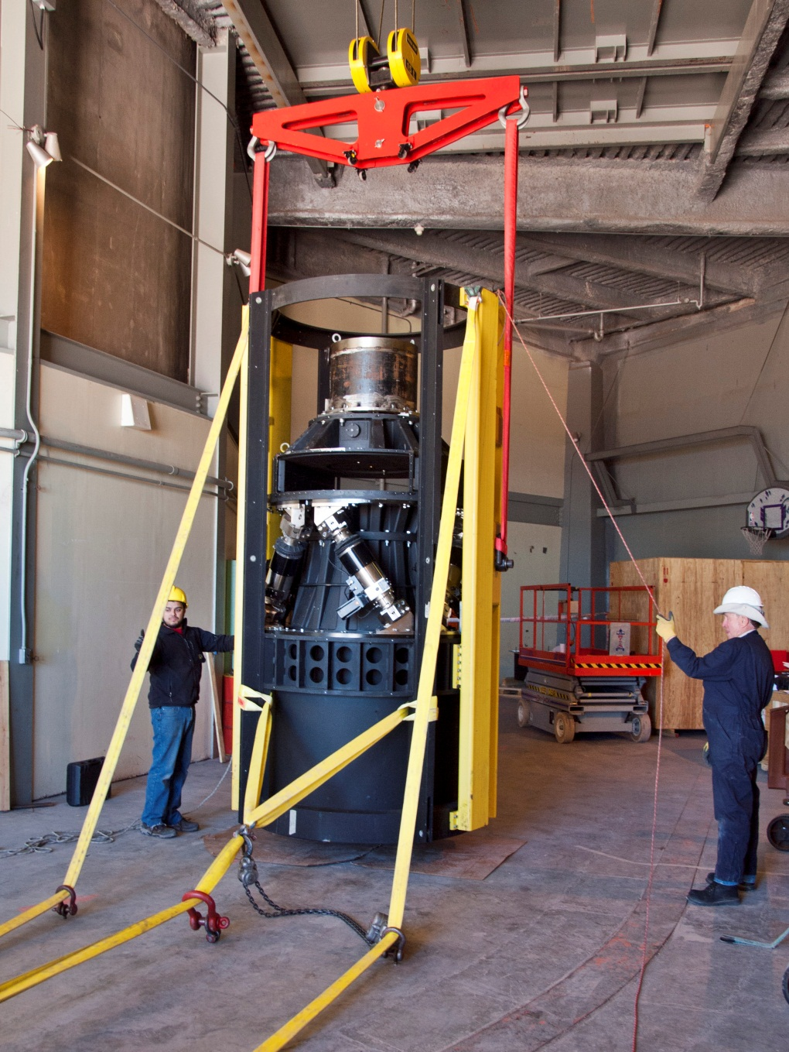
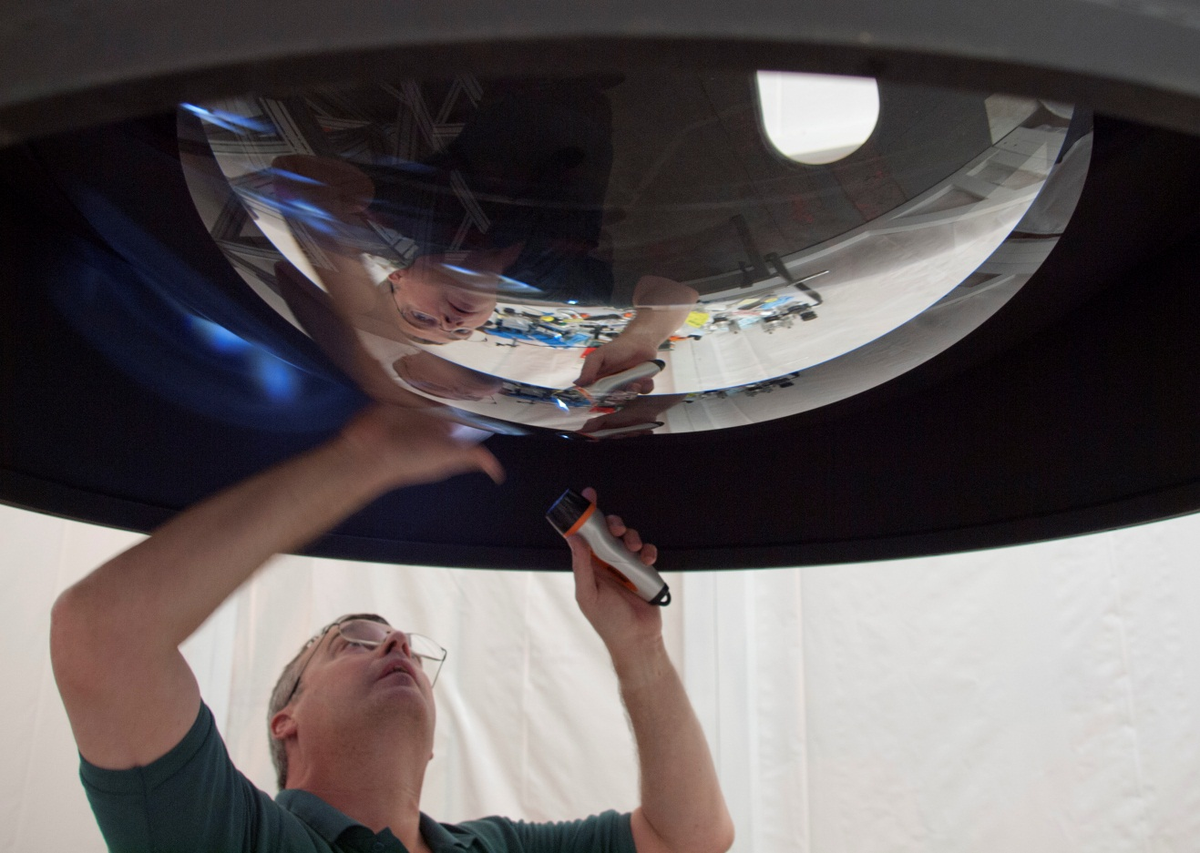
Preparations at CTIO

Slide 17
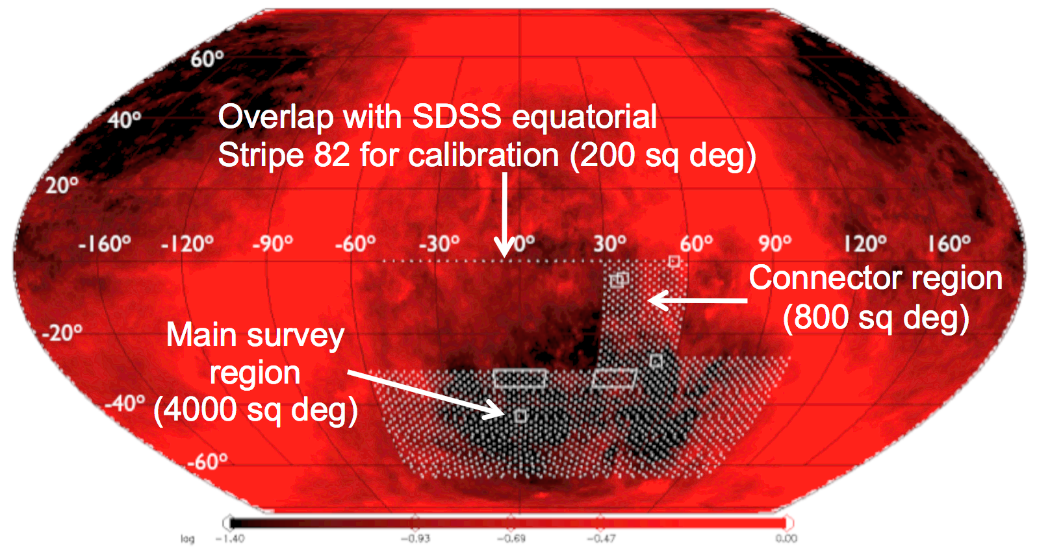
DES Observing Strategy
Sept-Feb observing seasons
80-100 sec exposures
2 filters per pointing (typically)
gr in dark time
izy in bright/grey time
Photometric calibration: overlap tilings, standard stars, spectrophotometric calibration system, preCAM
2 survey tilings/filter/year
Interleave 10 SN fields in griz if non-photometric or bad seeing or time gap (aim for ~5 day cadence)
Survey Area
5000 sq deg
Overlap with SDSS equatorial
Stripe 82 for calibration (200 sq deg)
2 tilings
3 tilings

Slide 18
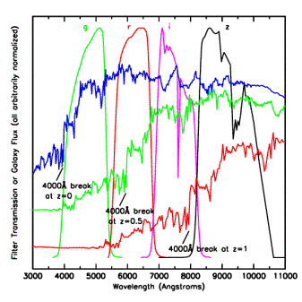
Photometric Redshifts
• Measure relative flux in
multiple filters:
track the 4000 A break
• Estimate individual galaxy
redshifts with accuracy
σ(z) < 0.1 (~0.02 for clusters)
• Precision is sufficient
for Dark Energy probes,
provided error distributions
well measured.
Challenge: spectroscopic
training & validation sets to
flux limit of imaging survey
(24th mag DES, 25.5 LSST)
Elliptical galaxy spectrum

Slide 19
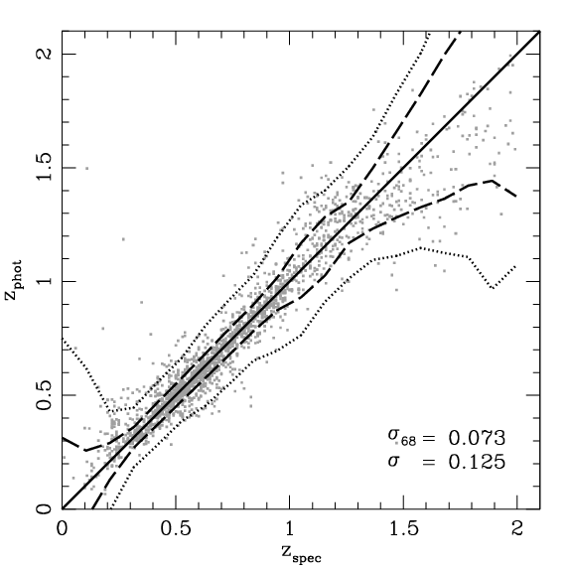
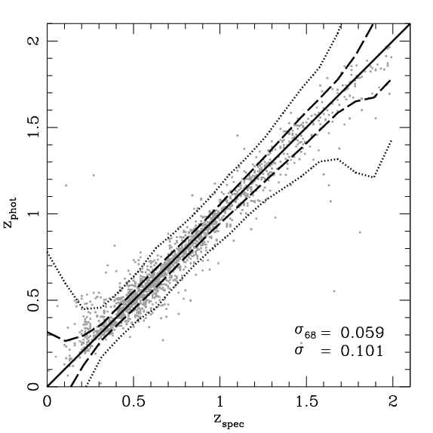
Galaxy Photo-z Simulations
+VHS*
DES
DES griz
DES griZY
+VHS JHKs on
ESO VISTA 4-m
enhances science reach
10σ Limiting Magnitudes
g 24.6
r 24.1
i 24.0
z 23.8
Y 21.6
+2% photometric calibration
error added in quadrature
Spectroscopic training sets comparable to DES depth exist
J 20.3
H 19.4
Ks 18.3
*Vista Hemisphere Survey

Slide 20
DES Science Summary
Four Probes of Dark Energy
Galaxy Clusters
~100,000 clusters to z>1
Synergy with SPT, VHS
Sensitive to growth of structure and geometry
Weak Lensing
Shape measurements of 300 million galaxies
Sensitive to growth of structure and geometry
Baryon Acoustic Oscillations
300 million galaxies to z = 1 and beyond
Sensitive to geometry
Supernovae
30 sq deg time-domain survey
~4000 well-sampled SNe Ia to z ~1
Sensitive to geometry
Current Constraints on DE Equation of State
Sullivan, etal

Slide 21
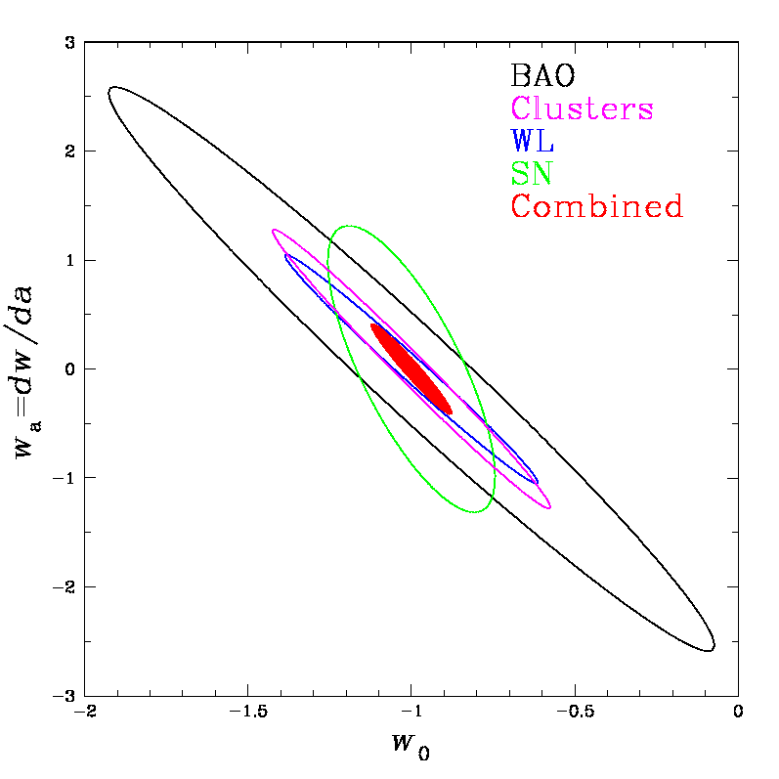
DES Science Summary
Forecast Constraints on DE Equation of State
Four Probes of Dark Energy
Galaxy Clusters
~100,000 clusters to z>1
Synergy with SPT, VHS
Sensitive to growth of structure and geometry
Weak Lensing
Shape measurements of 300 million galaxies
Sensitive to growth of structure and geometry
Baryon Acoustic Oscillations
300 million galaxies to z = 1 and beyond
Sensitive to geometry
Supernovae
30 sq deg time-domain survey
~4000 well-sampled SNe Ia to z ~1
Sensitive to geometry
DES
Planck prior assumed
Factor 3-5 improvement over
Stage II DETF Figure of Merit

Slide 22
DES Science Summary
Forecast Constraints on DE Equation of State
Four Probes of Dark Energy
Galaxy Clusters
~100,000 clusters to z>1
Synergy with SPT, VHS
Sensitive to growth of structure and geometry
Weak Lensing
Shape measurements of 300 million galaxies
Sensitive to growth of structure and geometry
Baryon Acoustic Oscillations
300 million galaxies to z = 1 and beyond
Sensitive to geometry
Supernovae
30 sq deg time-domain survey
~4000 well-sampled SNe Ia to z ~1
Sensitive to geometry
DES
Planck prior assumed
Factor 3-5 improvement over
Stage II DETF Figure of Merit

Slide 23
Probing Inflation with DES: Constraining Non-Gaussianity
Primordial non-Gaussianity generates scale-dependent bias of dark halos on large scales
Test with Observations:
Covariance of Cluster Counts
Halo Power Spectrum
Weak Lensing
Dalal, Dore, Huterer,
Shirokov 2008
Cunha, Huterer, Dore 2010
Shandera, Dalal, Huterer 2010
Park & Dodelson 2012

Slide 24
Covariance of Cluster Counts
DES
forecast
Forecast constraints robust to uncertainties in cluster mass-observable relation, halo bias, and photo-z errors
Cunha, Huterer, Dore 2010

Slide 25
Constraints on non-Gaussianity vs. scale
Shandera, Dalal, Huterer 2010

Slide 26
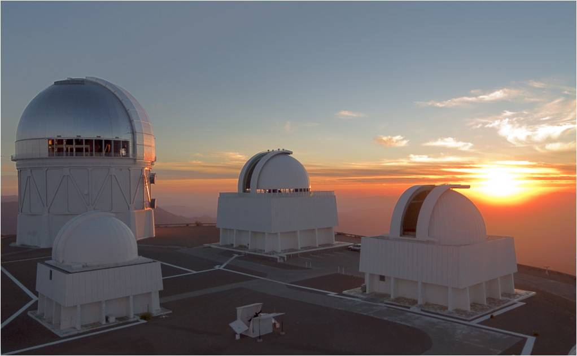
Stay tuned for early DES results in 2013

Slide 27
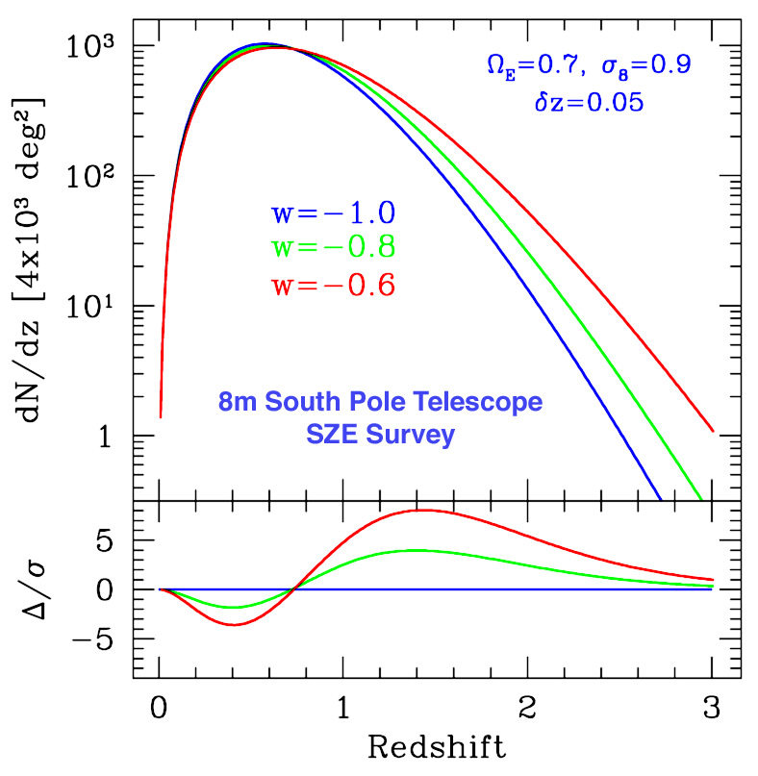
I. Clusters
Clusters are proxies for massive halos and can be identified optically to redshifts z>1
Galaxy colors provide photometric redshift estimates for each cluster
Observable proxies for cluster mass: optical richness (DES), SZ flux decrement (SPT,ACT), weak lensing mass (DES), X-ray flux (eRosita)
Cluster spatial correlations help calibrate mass estimates
Challenge: determine mass-observable relation p(O|M,z) with sufficient precision
Number of clusters above mass threshold
Dark Energy
equation of state
Mohr
Volume Growth

Slide 28
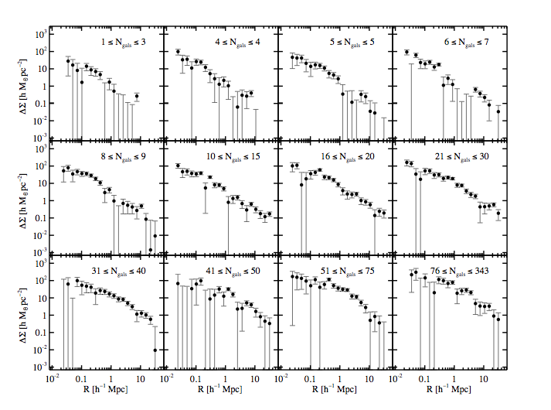
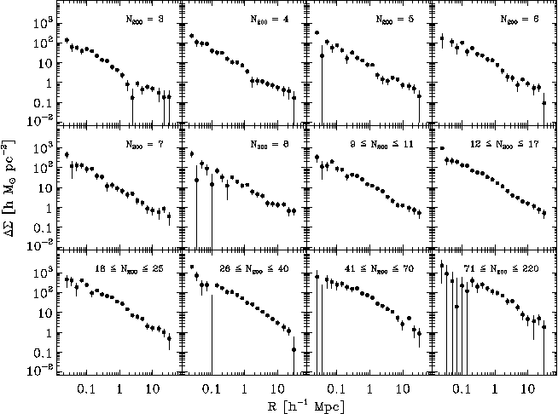
Statistical Weak Lensing by Galaxy Clusters
Mean Tangential Shear Profile in Optical Richness (N_{gal}) Bins to
30 h⁻¹Mpc
Sheldon,
Johnston, etal
SDSS

Slide 29
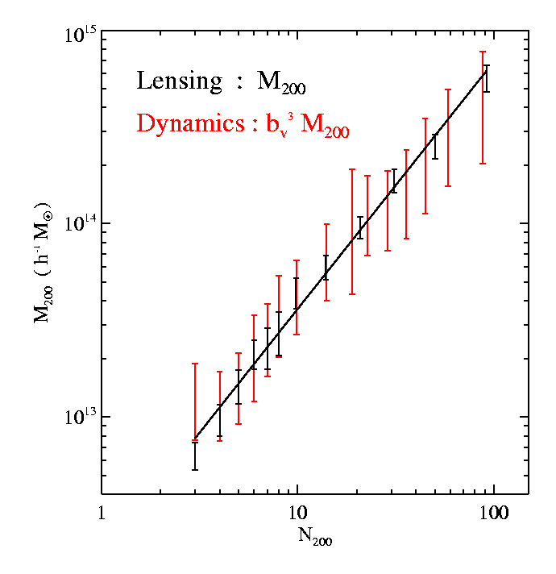
Statistical Weak Lensing Calibrates
Cluster Mass vs. Observable Relation
Statistical
Lensing
controls
projection effects
of individual
cluster mass
estimates
Improved red-sequence richness estimator reduces scatter in mass vs optical richness to ~20-30%
Rykoff etal
SDSS Data
z<0.3
Cluster Mass
vs. Number
of galaxies they
contain (richness)
Johnston, Sheldon, etal

Slide 30
II. Weak Lensing: Cosmic Shear
Background
sources
Dark matter halos
Observer
Spatially coherent shear pattern, ~1% distortion
Radial distances depend on geometry of Universe
Foreground mass distribution depends on growth of structure
Notes:
Cosmic Web – bottom up scenario – clusters then filaments then walls (membranes).
Note that filaments not well traced by galaxies & too ephemeral to emit x-rays, so lensing only way to detect.

Slide 31
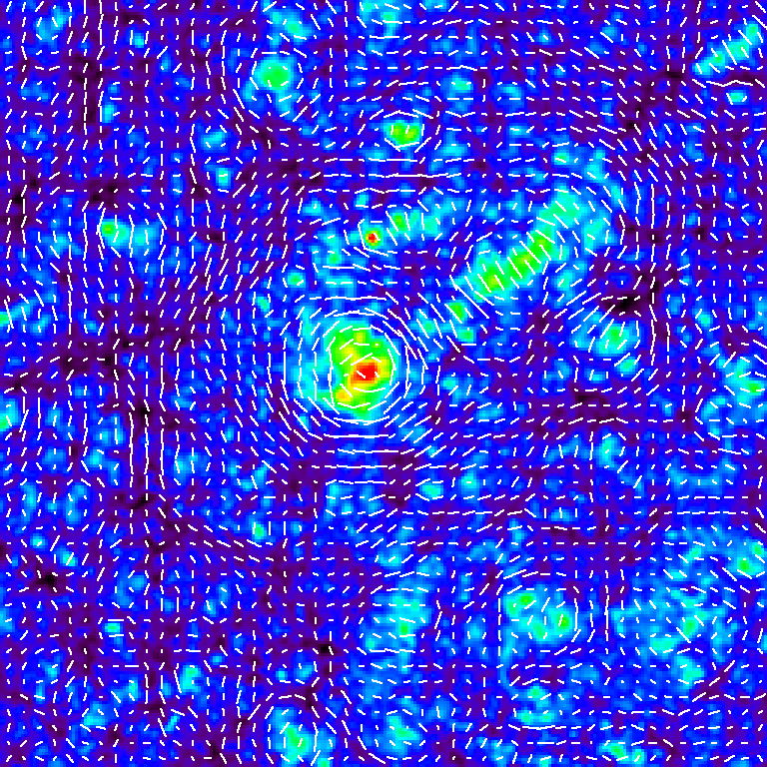
Weak lensing: shear and mass
Weak Lensing Mass and Shear
Takada

Slide 32
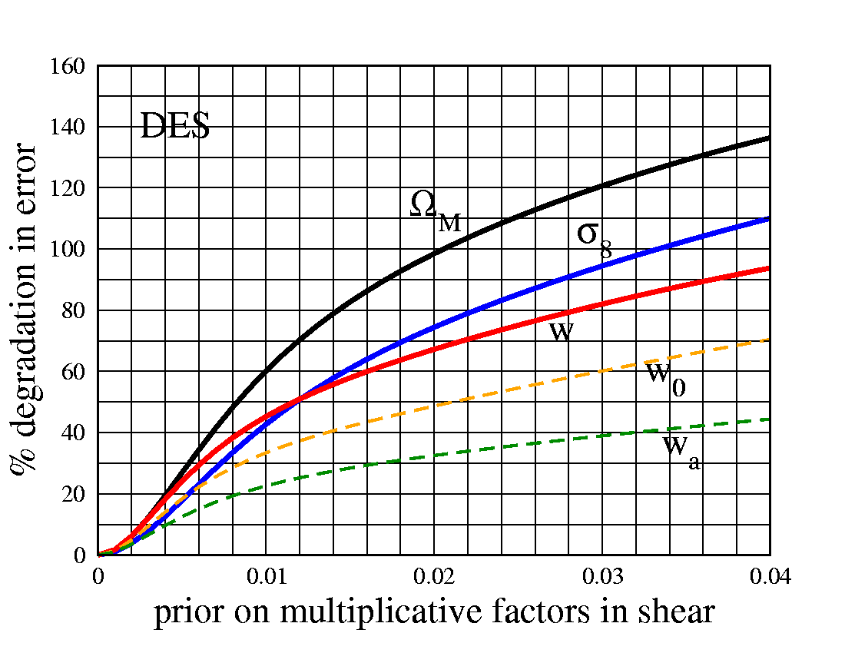
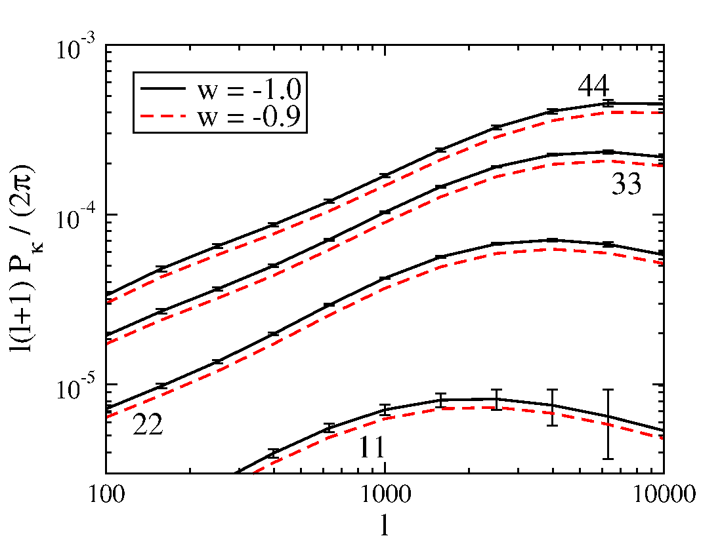
Weak Lensing Tomography
Huterer etal
Cosmic Shear Angular Power Spectrum in
Photo-z Slices
Shapes of ~300 million well-resolved galaxies,
⟨z⟩ = 0.7
Challenges:
photo-z’s, intrinsic alignments, PSF anisotropy,
shear calibration, nonlinear+baryon P(k) effects
Extra info in bispectrum & galaxy-shear: robust
Statistical errors
shown
Expect n_{eff}~10/arcmin² for median 0.9” PSF

Slide 33
III. Large-scale Structure

Slide 35
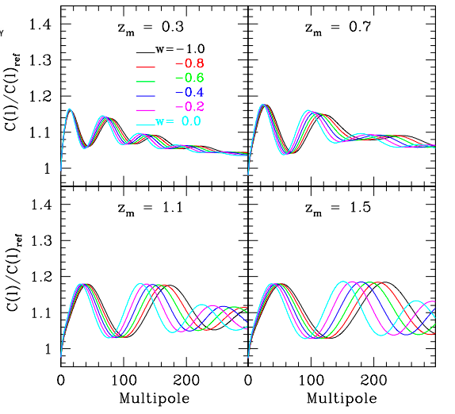
Baryon Acoustic Oscillations
Galaxy angular
power spectrum
in photo-z bins (relative to model without BAO)
Photometric surveys provide angular measure
Radial modes require spectroscopy
Fosalba & Gaztanaga

Slide 36
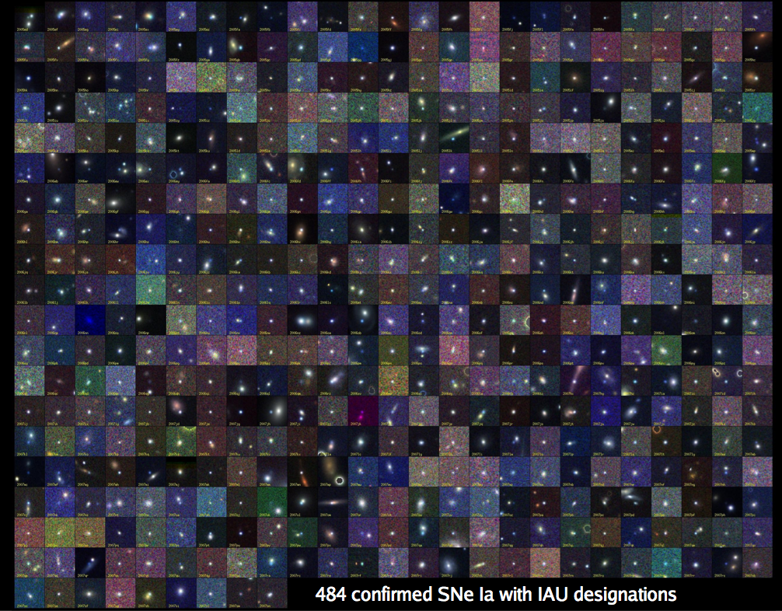
IV. Supernovae
B. Dilday
SDSS-II: ~500 spectroscopically confirmed SNe Ia, >1000 with host redshifts from SDSS-III

Slide 37
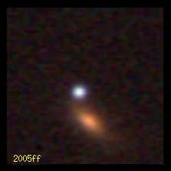
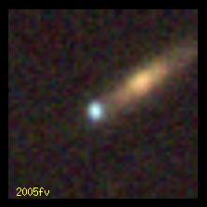
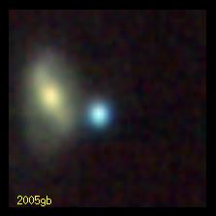
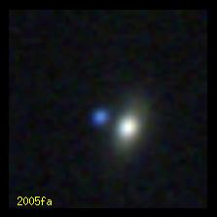
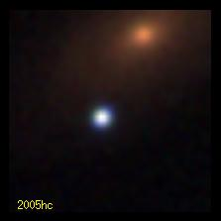
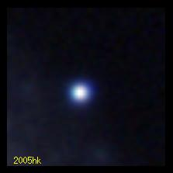
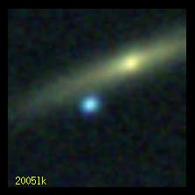
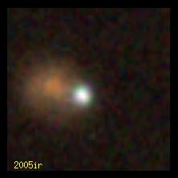
B. Dilday
SDSS-II: 500 spectroscopically confirmed SNe Ia, >1000 with host redshifts from SDSS-III

Slide 38
Supernova Hubble Diagram
Distance modulus (log of distance)
Kessler et al 2009

Slide 39
Supernova Hubble Diagram
DES Simulation:
~4000 well-measured
SN Ia light curves
Distance modulus (log of distance)
Kessler et al 2009

