Slide 1
Dark Energy MA
Leaders: Josh Frieman & Wayne Hu
Goal: To address whether or not cosmic acceleration requires a modification of Einstein’s General Relativity, and if not, to probe the nature of the dark energy that is driving acceleration and that makes up 70% of the universe.
Activities: SPT SZ Survey, DES, Theory; Joint Analysis Hub (SPT-DES), Supernova Hub (SDSS, DES, LSST)

Slide 2
Dark Energy People
Faculty: Benson, Frieman, Hu, Carlstrom, Chang, Dodelson, Gladders, Habib, Heitmann, Holz, Kravtsov, Meyer, Turner
Senior: Tom Crawford, Rick Kessler, Erik Leitch, Kathryn Schaffer
Fellows & Associate Fellows: Suman Bhattacharya*, Keith Bechtol, Jason Gallicchio, Will High*, Stephen Hoover, Elise Jennings, Ryan Keisler*, Adam Mantz, Jared Mehl*,Tom Plagge*, Reina Reyes*, Chris Sheehy
Graduate Students: Zubair Abdulla, Eric Baxter, Matt Becker*, Lindsey Bleem*, Ross Cawthorn, Abby Crites*, Benedikt Diemer, Daniel Dutcher, Chris Greer*, Jennifer Helsby, Yin Li, James McElveen, Alessandro Manzotti, Vinicius Miranda, Monica Mocanu, Pavel Motloch, Tyler Natoli, Zhaodi Pan, Youngsoo Park, Kyle Story, Alan Zablocki, Kat Ziegler
*departed KICP in the last year

Slide 3
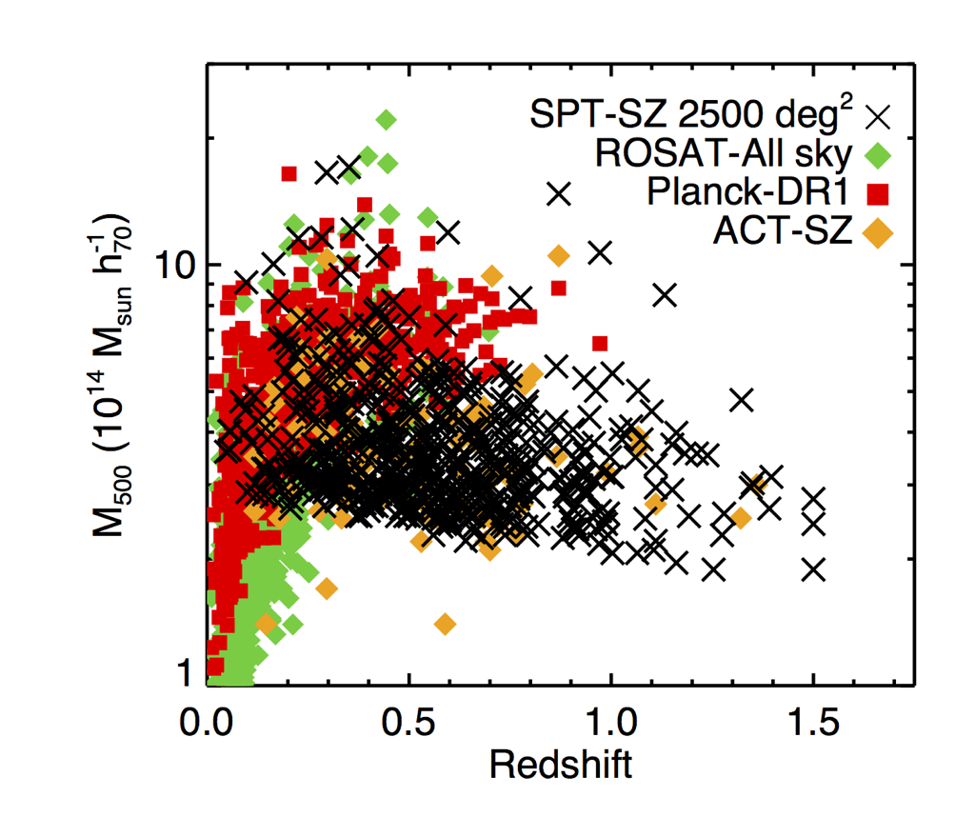
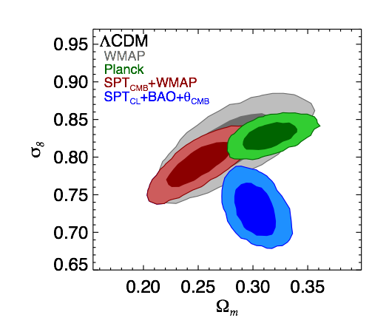
SPT-SZ 2500 deg² Cluster Survey
Preliminary
524 clusters detected at S/N > 4.5, with redshifts; 75% are new discoveries!
Cosmological constraints from SPTCL: ~3x fewer clusters than predicted by Planck
First SZ-discovered cluster in 2008 (SPT, Staniszewski et al); now over 1300 SZ-
identified clusters from Planck + SPT!

Slide 4
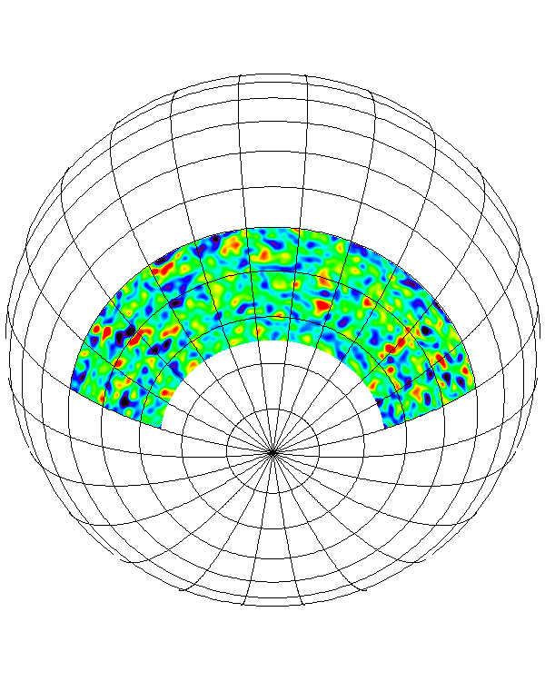
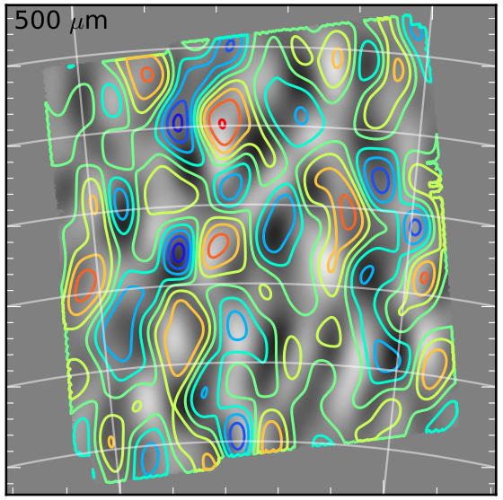
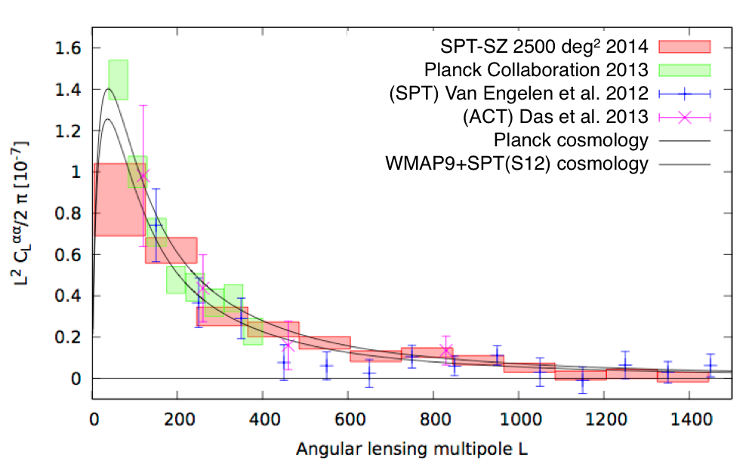
SPT-SZ 2500 deg² CMB Lensing
CMB lensing
100 deg²
SPT x Herschel
2500 deg²
CMB lensing map constrains linear bias of:
  Herschel cosmic infrared background; 9σ detection
  (Holder et al. 2013)
  WISE quasar catalog; 7σ detection (Geach et al. 2013)
20σ detection of CMB lensing power
spectrum
  improves on previous SPT result by factor of ~4
  best-measurement of lensing spectrum at l > 400
Preliminary

Slide 5
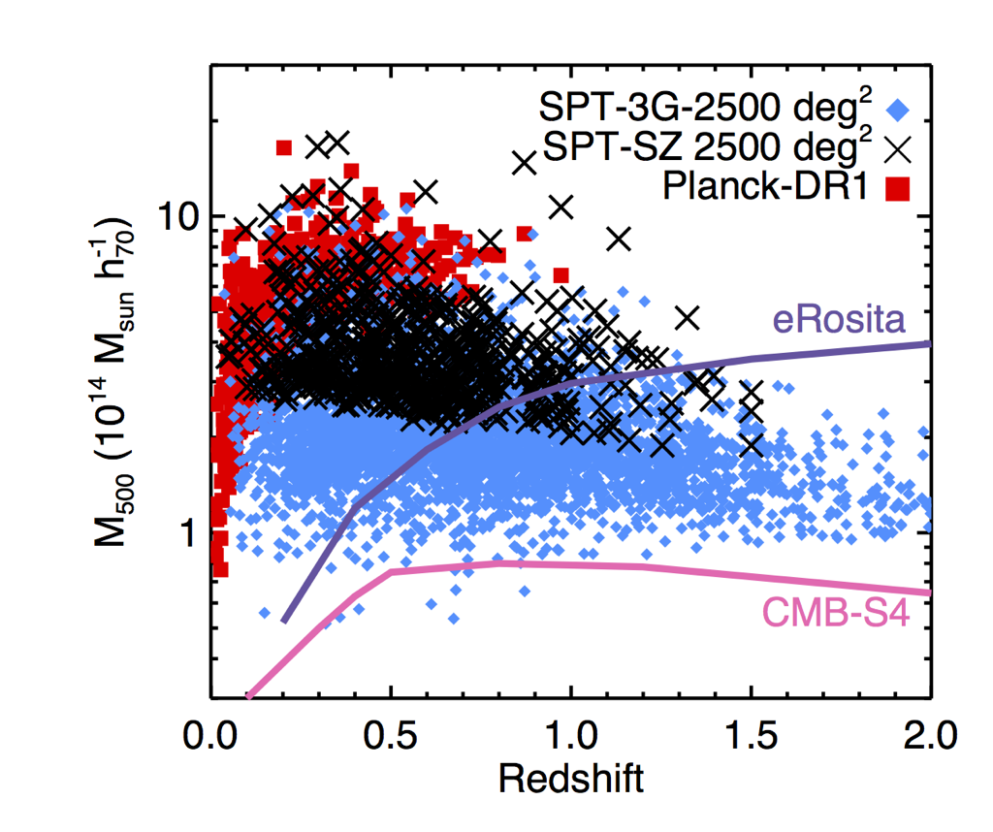
Future: SPT-3G and CMB-S4
Cluster counts scale roughly as number of CMB detectors:
SPT-SZ/pol: Nclust ~ 1,000
SPT-3G: Nclust ~ 10,000
CMB-S4: Nclust ~ 100,000+
Deep CMB data enables CMB cluster lensing as a competitive mass calibration tool for cluster DE:
  SPT-3G: 𝝈(M) ~ 3%
  CMB-S4: 𝝈(M) < 0.1%
Especially promising tool for cluster masses at z > 1

Slide 6
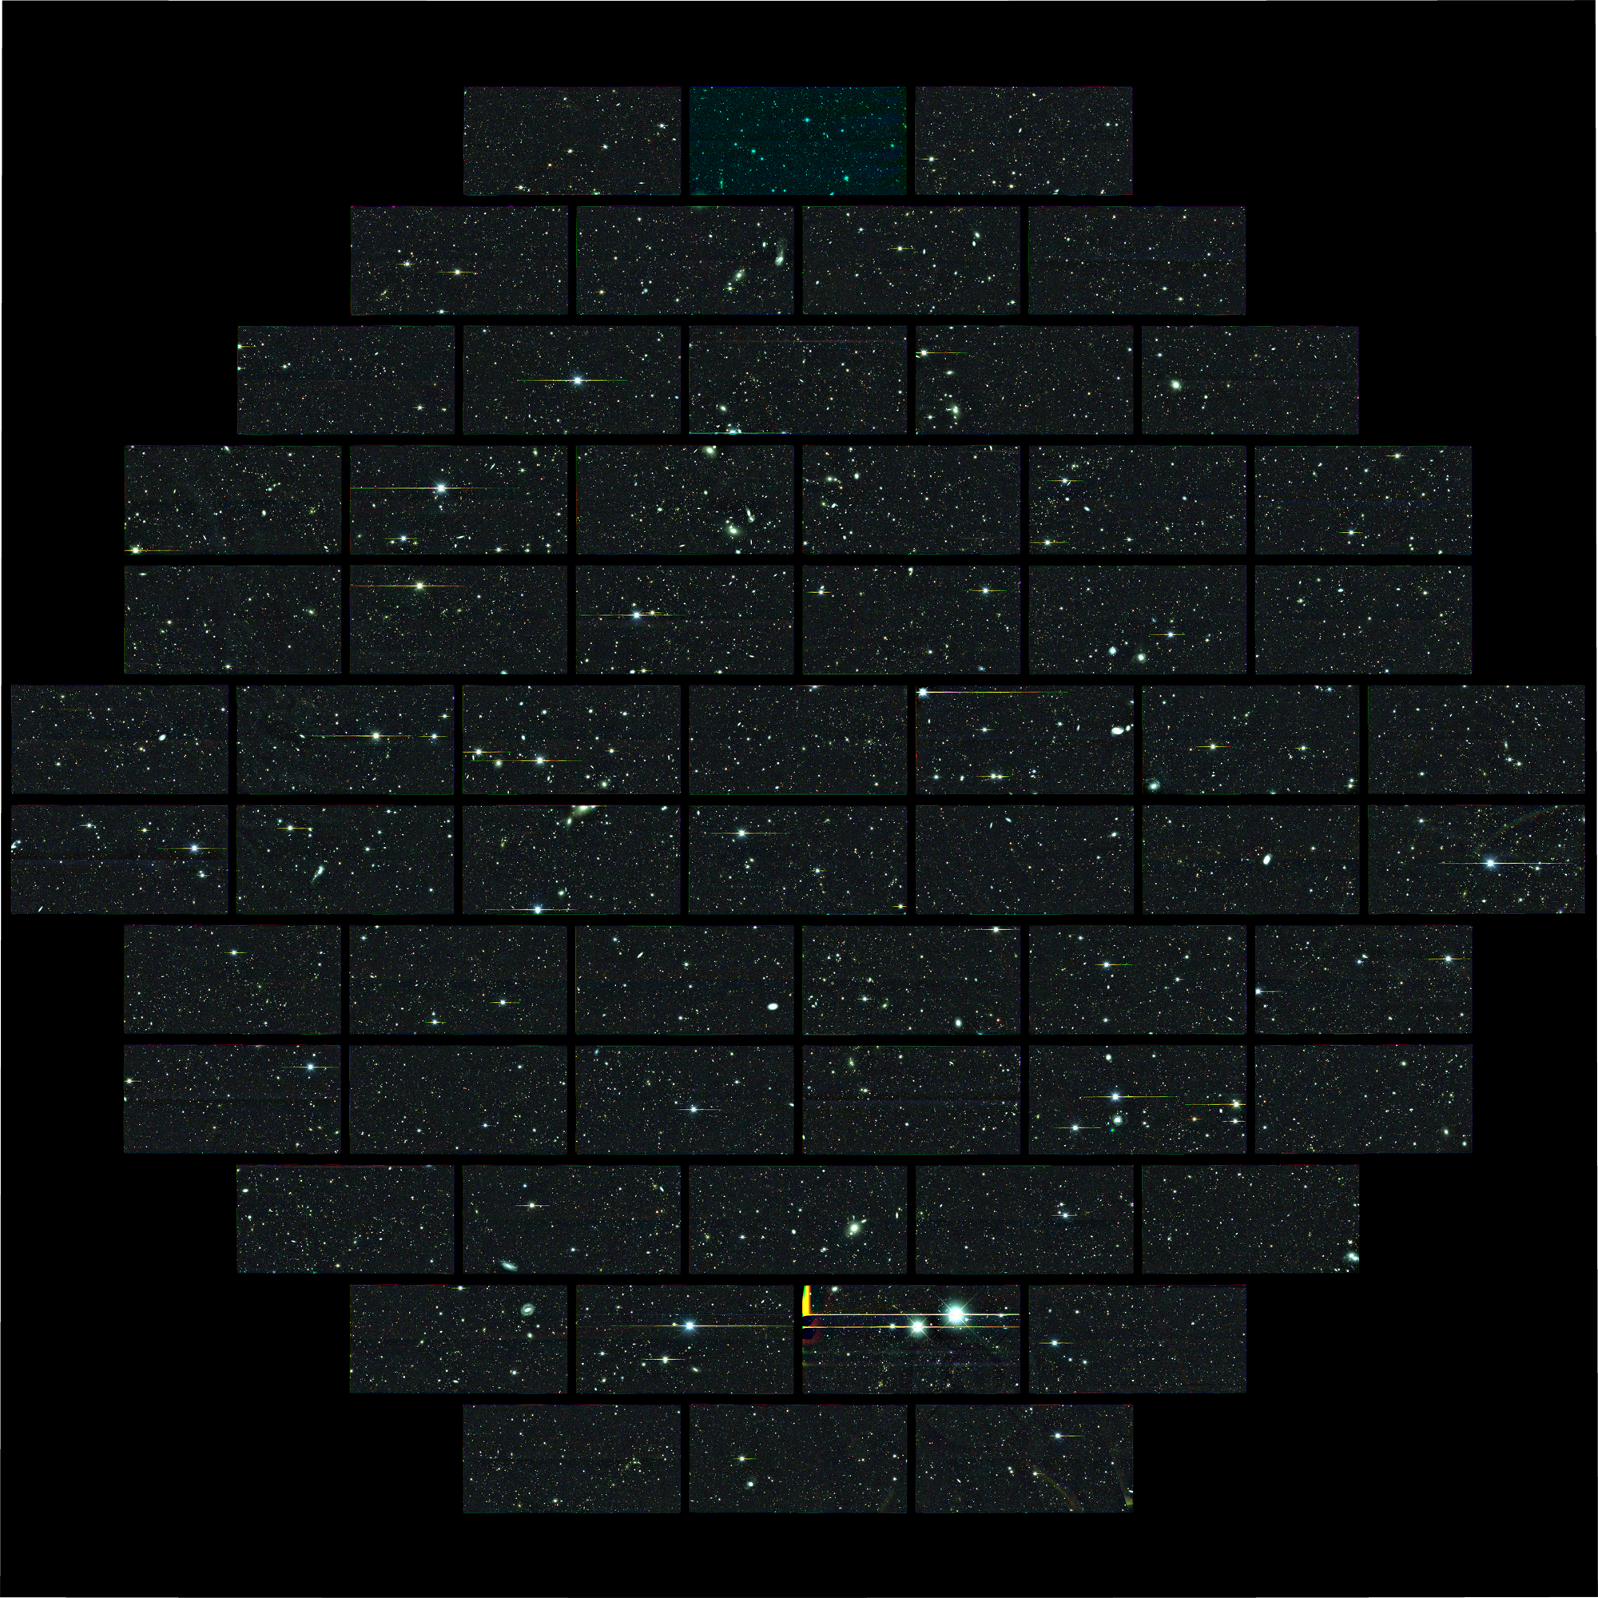
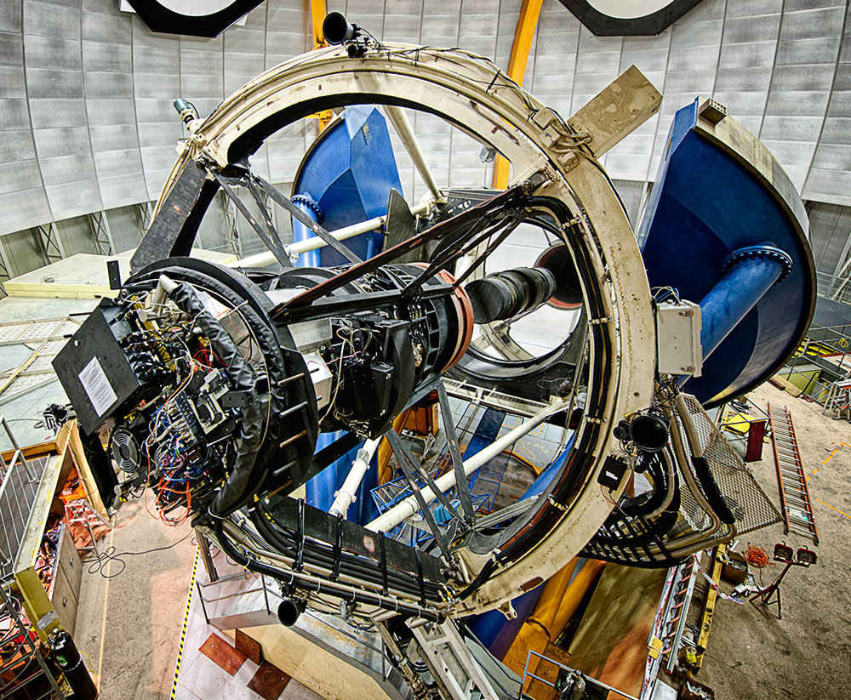
DES Completes First Season
105 nights from Aug. 31, ‘13-Feb. 9, ‘14 (1st of 5)
14,340 survey-quality exposures over 2000 sq. deg., images processed within ~2 days
30 sq. deg. supernova fields imaged every 6 nights
First publications based on earlier (Nov. ‘12-Feb. ‘13) Science Verification data underway
Demonstrated discovery of high-z supernovae, high-z clusters, high-z QSOs (z=6.1), galaxy angular clustering, weak lensing by galaxies and clusters,…
Season 2 will cover complementary 3000 sq. deg.
Expect early DE results from 1st 2 seasons

Slide 7
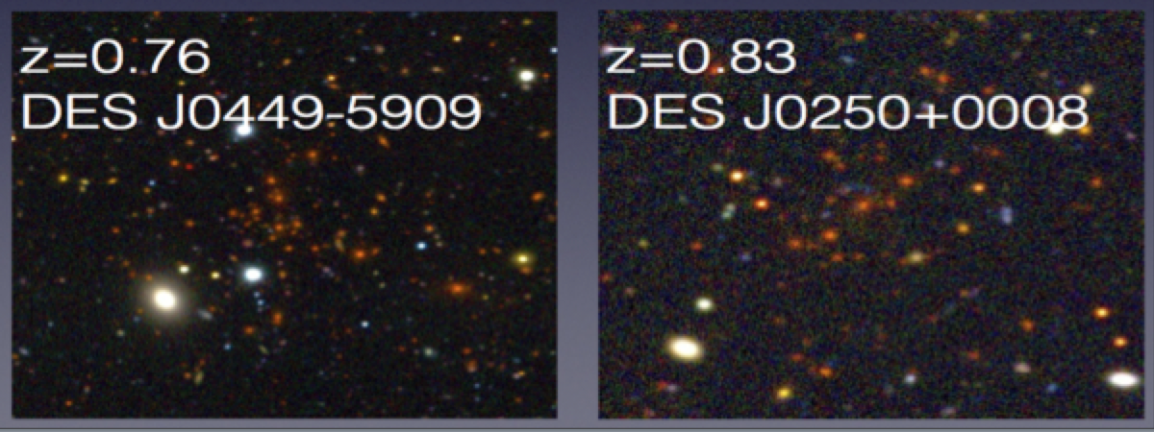
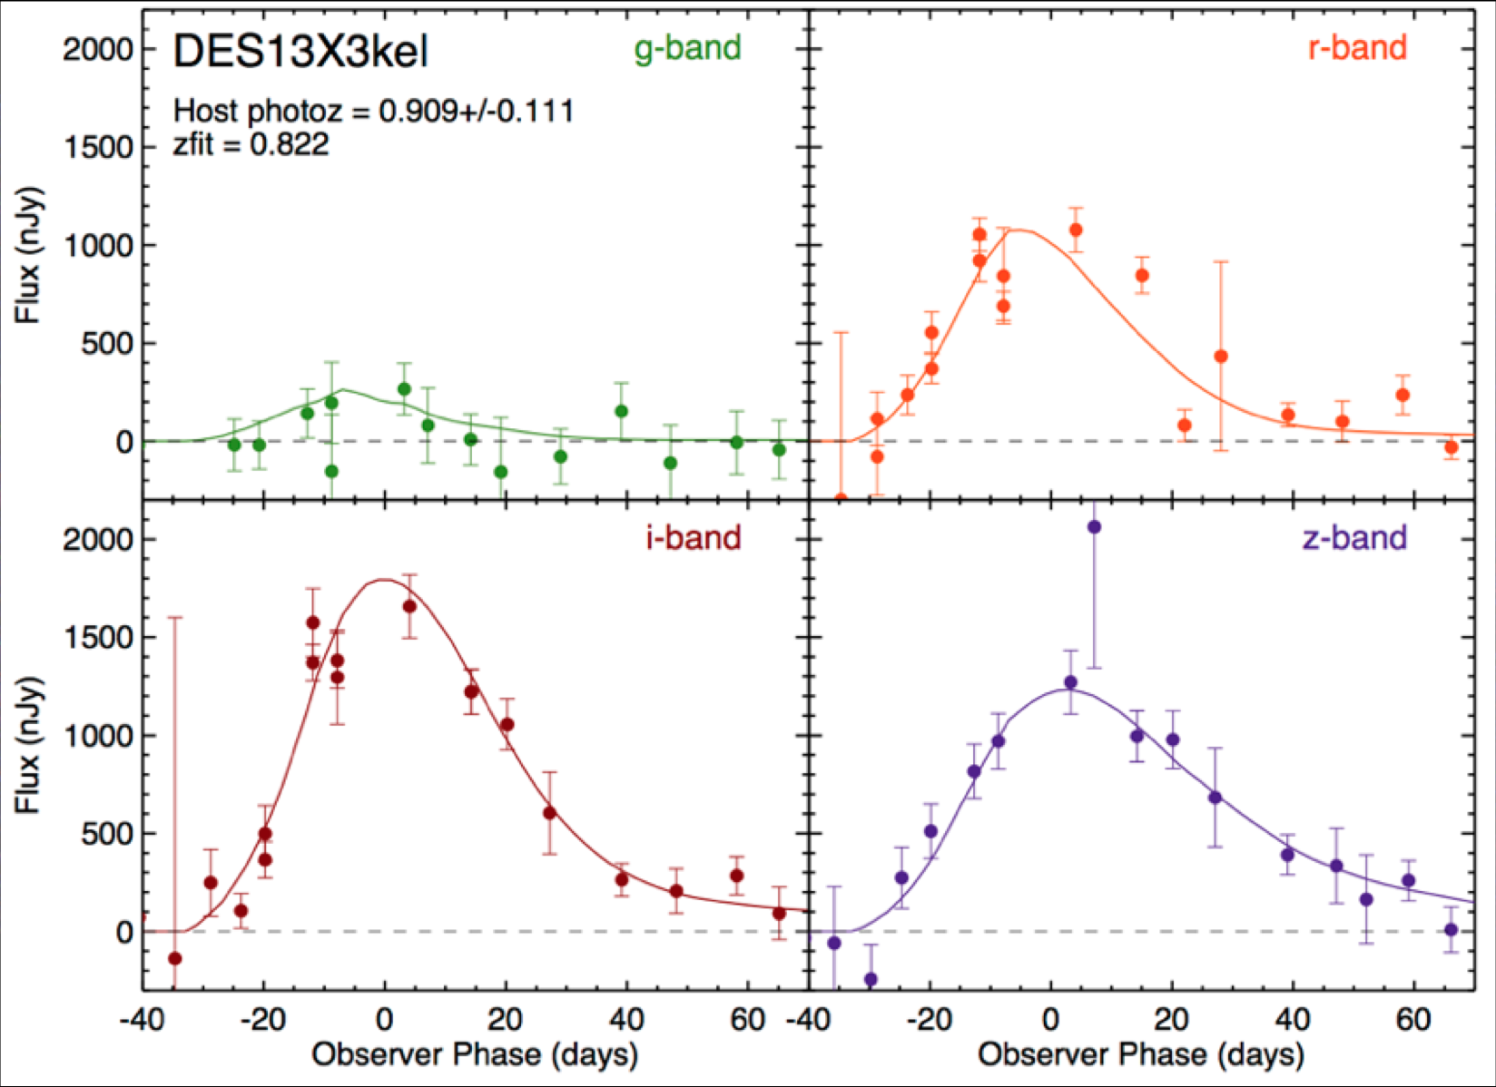
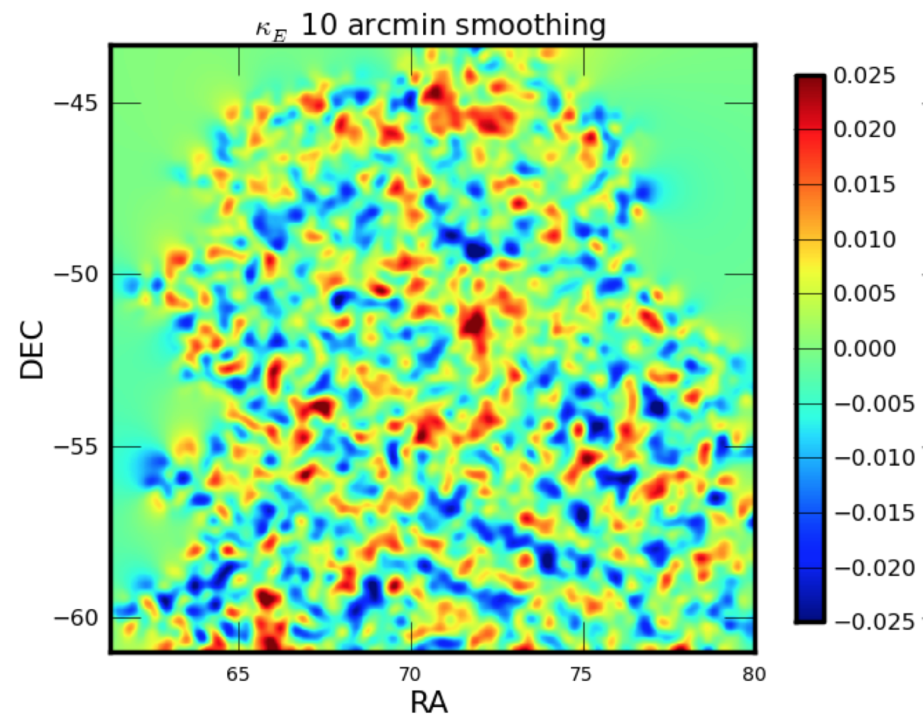
DES Preliminary Results
High-redshift clusters
High-redshift supernovae
High-redshift supernova
Weak Lensing

Slide 8
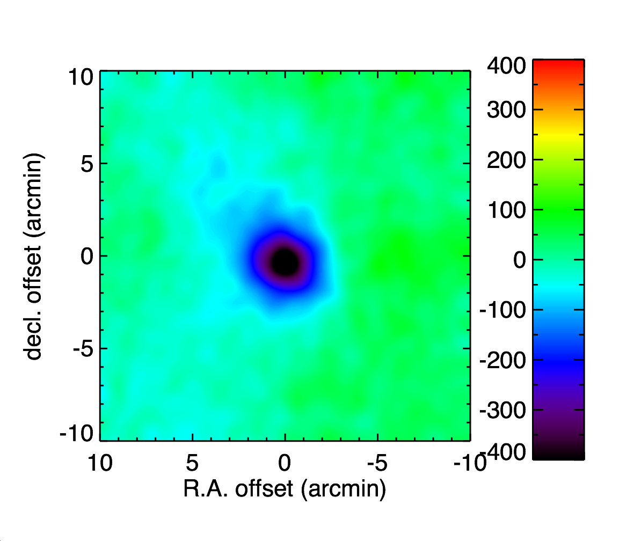
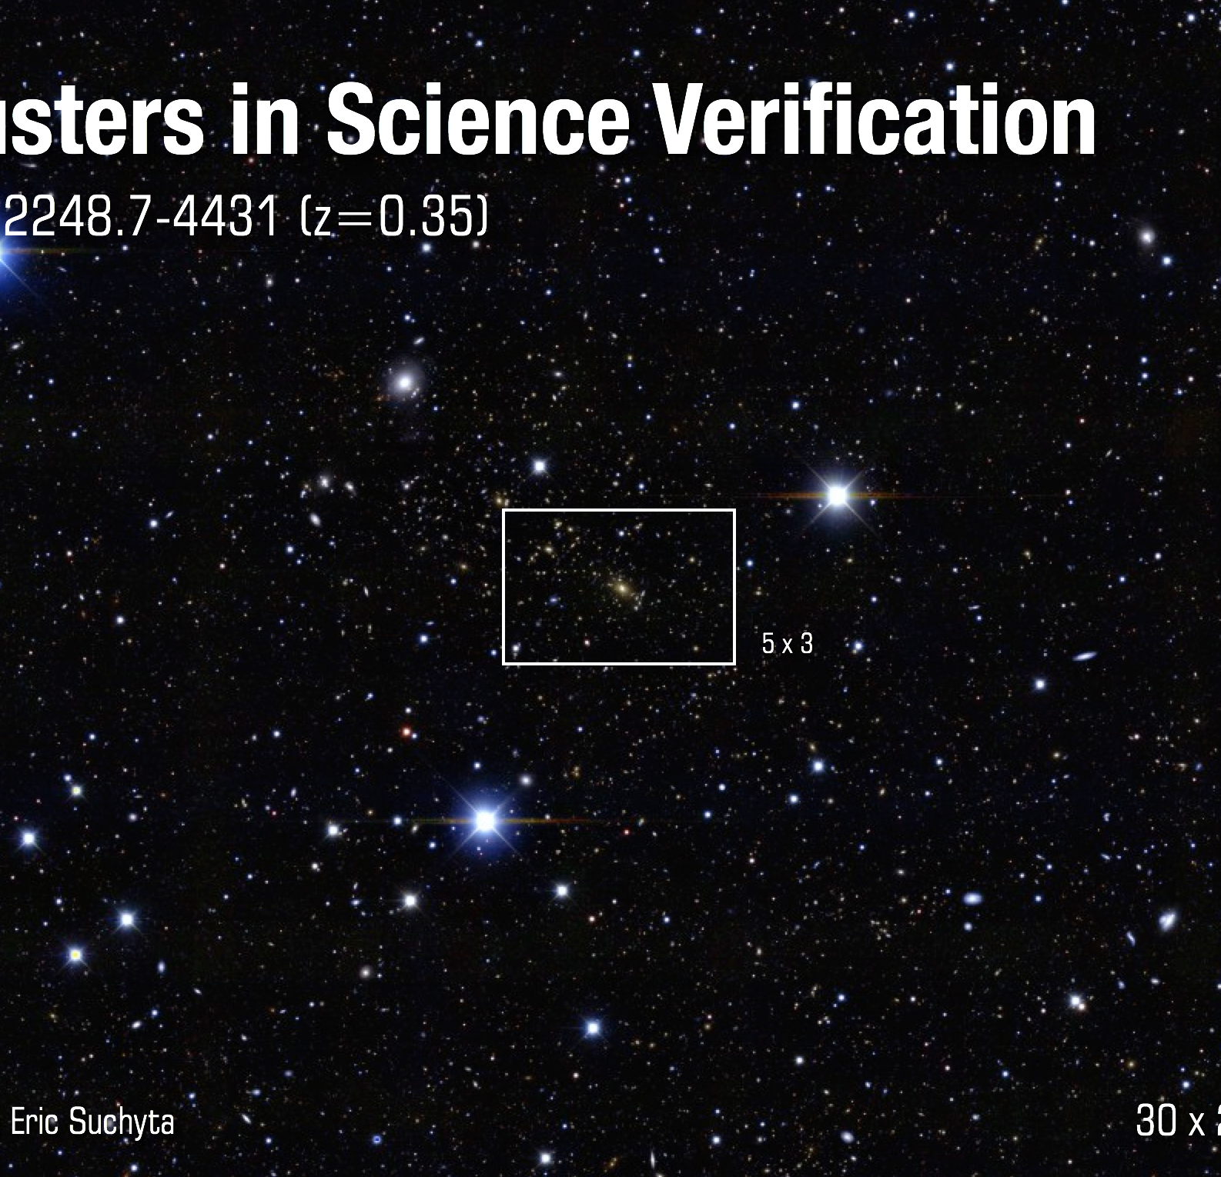
DES-SPT Joint Analysis Hub
SPT-SZ Image
SPT-CL J2248.7-4431
20 x 20 arcmin

Slide 9
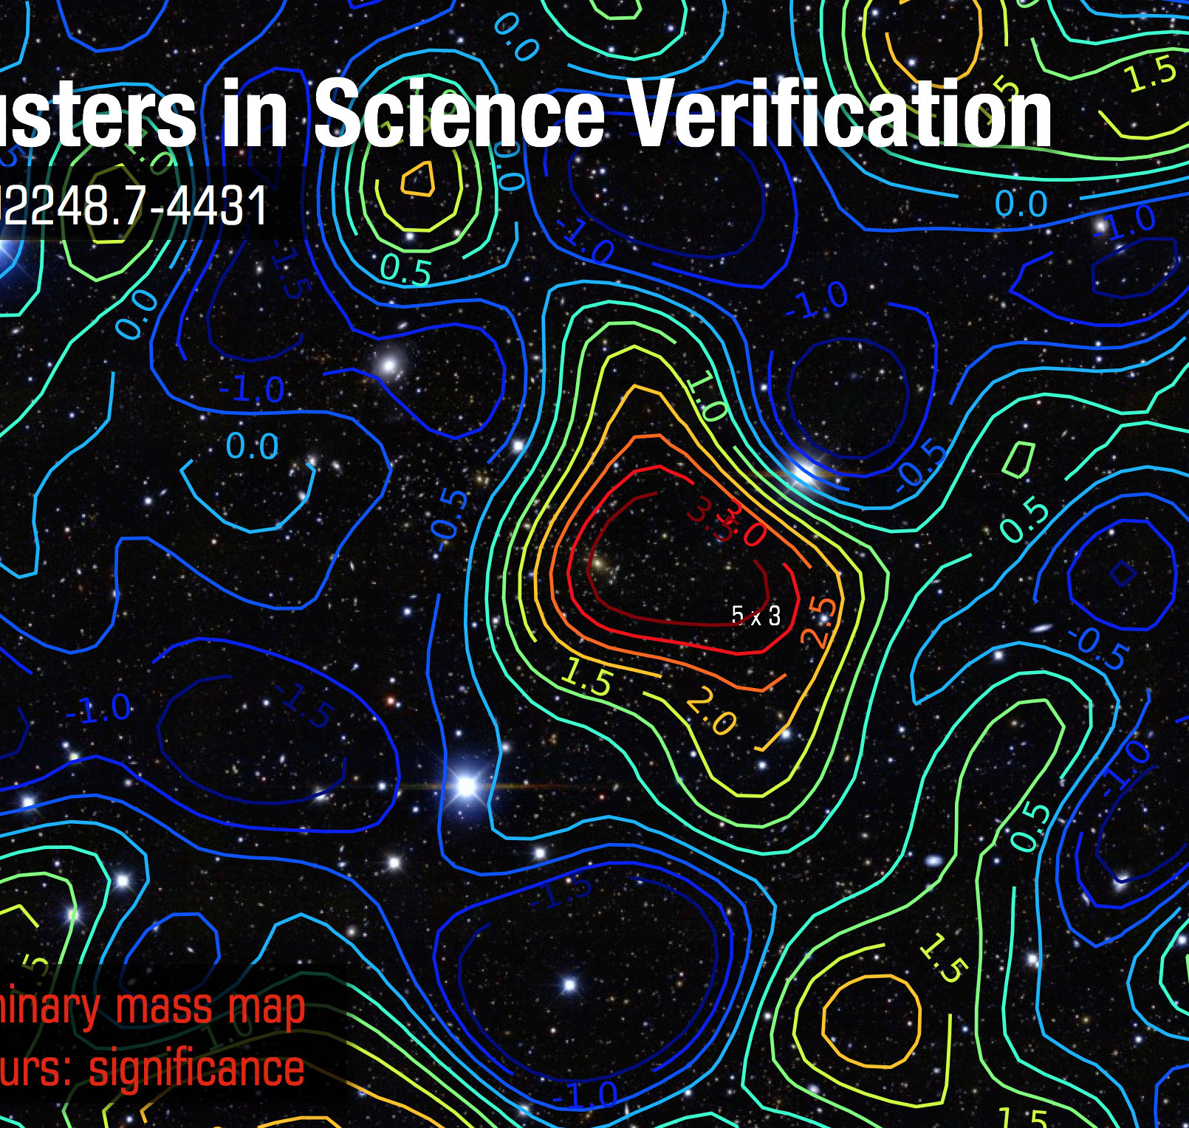
DES-SPT Joint Analysis Hub
SPT-SZ Image
SPT-CL J2248.7-4431
20 x 20 arcmin

Slide 10
DES-SPT Joint Analysis Hub
SPT-SZ Image
SPT-CL J2248.7-4431
20 x 20 arcmin

Slide 11

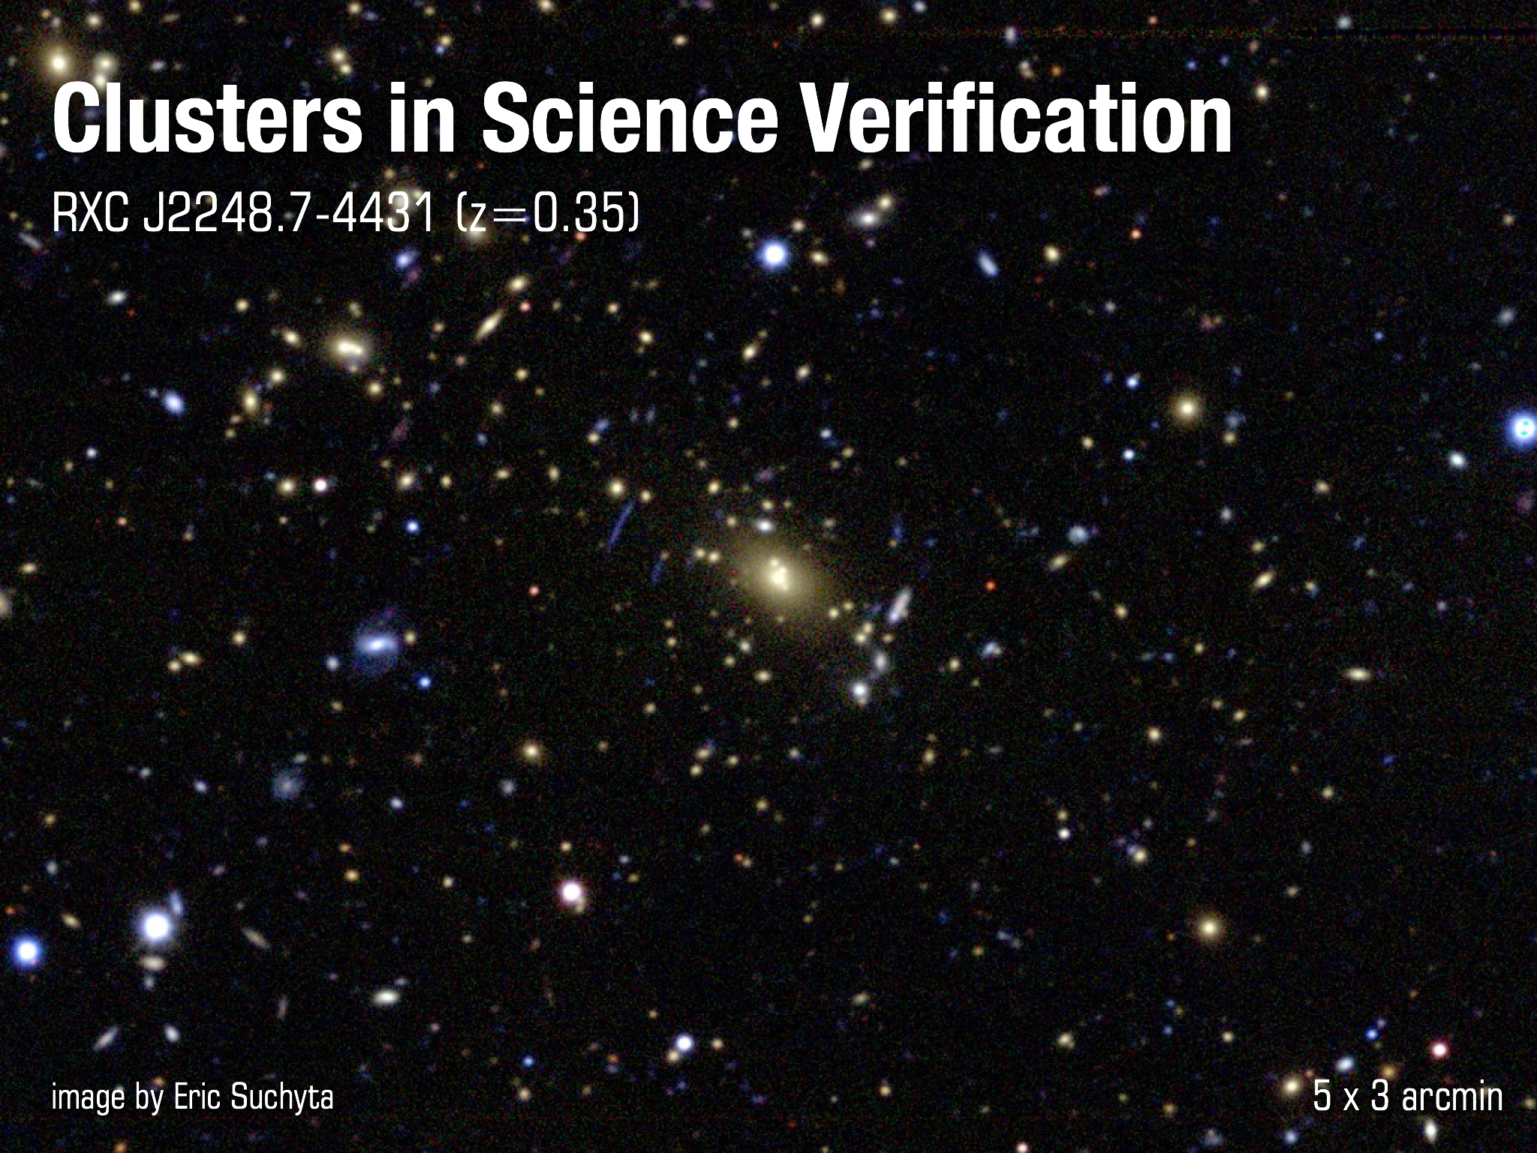
DES-SPT Joint Analysis Hub
SPT-SZ Image
SPT-CL J2248.7-4431
20 x 20 arcmin

Slide 12
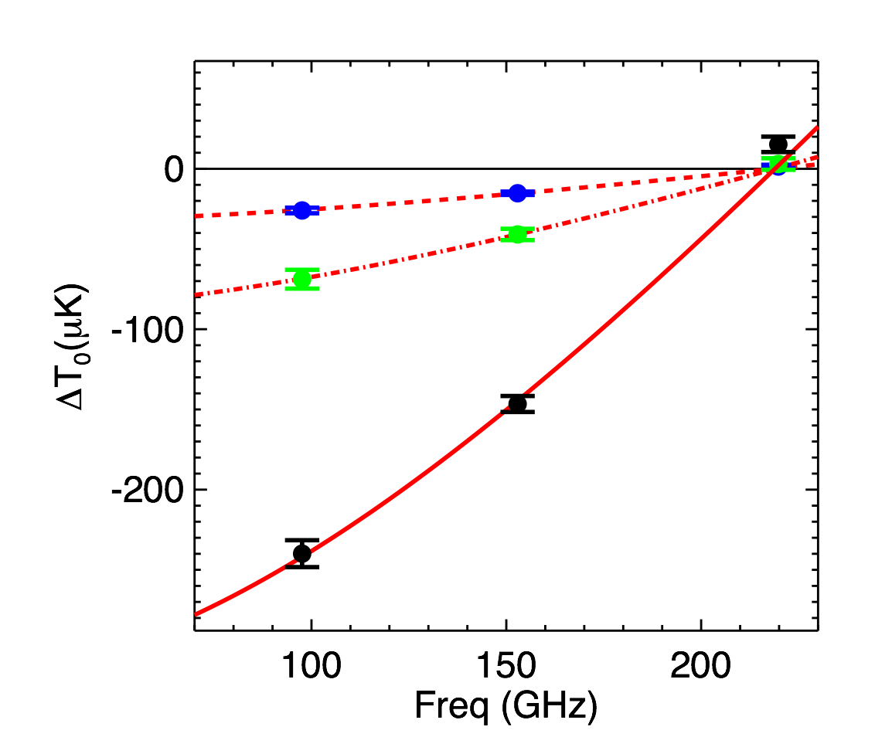
DES-SPT Joint Analysis Hub
Stack SPT-SZ data on 602 DES-selected clusters over 150 sq deg
220 GHz flux implies dusty sources are <3% of SZ signal at 150 GHz for richness 𝜆 > 20 (cluster mass > ~10¹⁴ Msun)
SZ Spectrum
low-𝜆 (20-50)
med-𝜆 (50-70)
CMB Decrement (𝜇K)
high-𝜆 (>70)
Frequency (GHz)

Slide 13
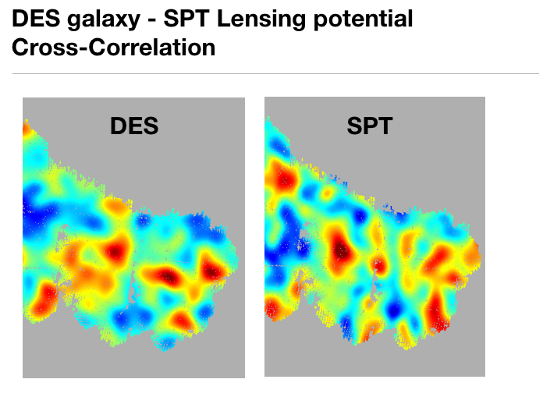
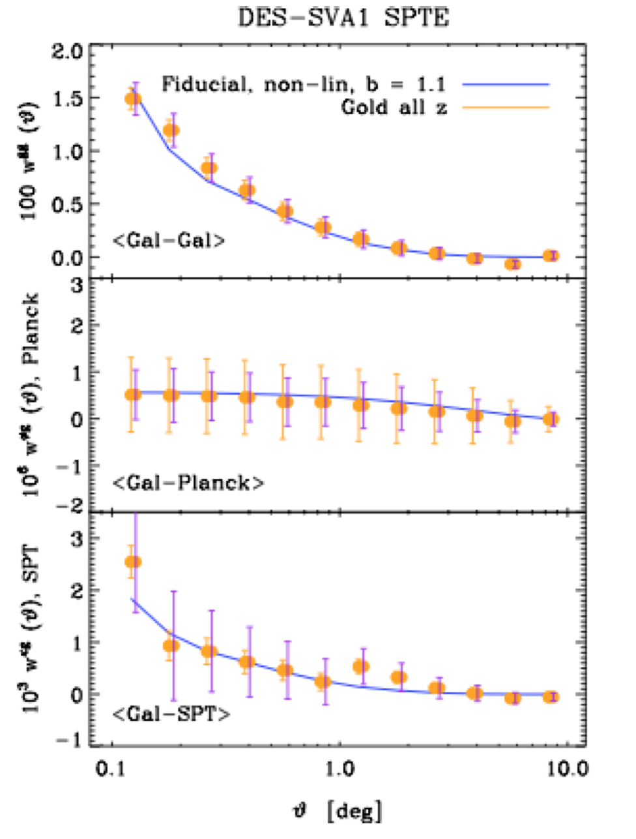
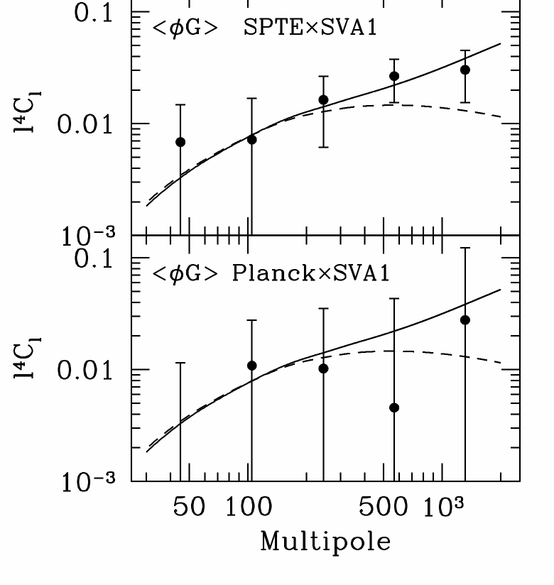
DES-SPT Joint Analysis Hub
DES galaxies responsible for some of the lensing of the CMB

Slide 14
Supernova Hub
Joint analysis (JLA) of SDSS+SNLS
(4 papers), leading to tightest constraints on
w to date (arXiv: 1401.4064)
DES SN operations (GPS monitoring PWV)
Hosting multiple working meetings of JLA and of DES SN groups
Simulations of LSST SN

Slide 15
Theory
f(R), galileon, massive gravity models
  Nonlinear screening mechanisms
    N-body simulations
    Nonlinear self interactions
      Apparent equivalence principle violation
      Strong coupling scale of chameleon screening
  Self-accelerating massive and bi gravity
Super sampling effects (impact of modes larger than survey)
  Covariance of dark energy observables
  Bias and recovery of dark energy parameters
New probes of Modified Gravity
  Voids, solar system tests

Slide 16
Dark Energy MA Accomplishments & Goals
Accomplishments:
  SPT-SZ Cluster Constraints on Dark Energy plus Detection (and Cross-Correlation with Galaxy Surveys) of CMB Lensing, with results from full 2500 sq deg survey coming this year.
  Start of DES survey, demonstrated discovery of high-z supernovae, high-redshift clusters, weak lensing, and galaxy clustering, first science results this year
  World-leading constraints on DE from SDSS+SNLS Supernovae
  Studies of and Predictions from Modified Gravity Theories of Cosmic Acceleration (Massive Gravity, Galileons, Brane worlds, non-local gravity models)
Goals:
  Joint DES-SPT Analysis results: stacked SPT clusters, cross-correlations
  First DE Results from DES
  SPT-3G Clusters with improved DE constraints

