Slide 1
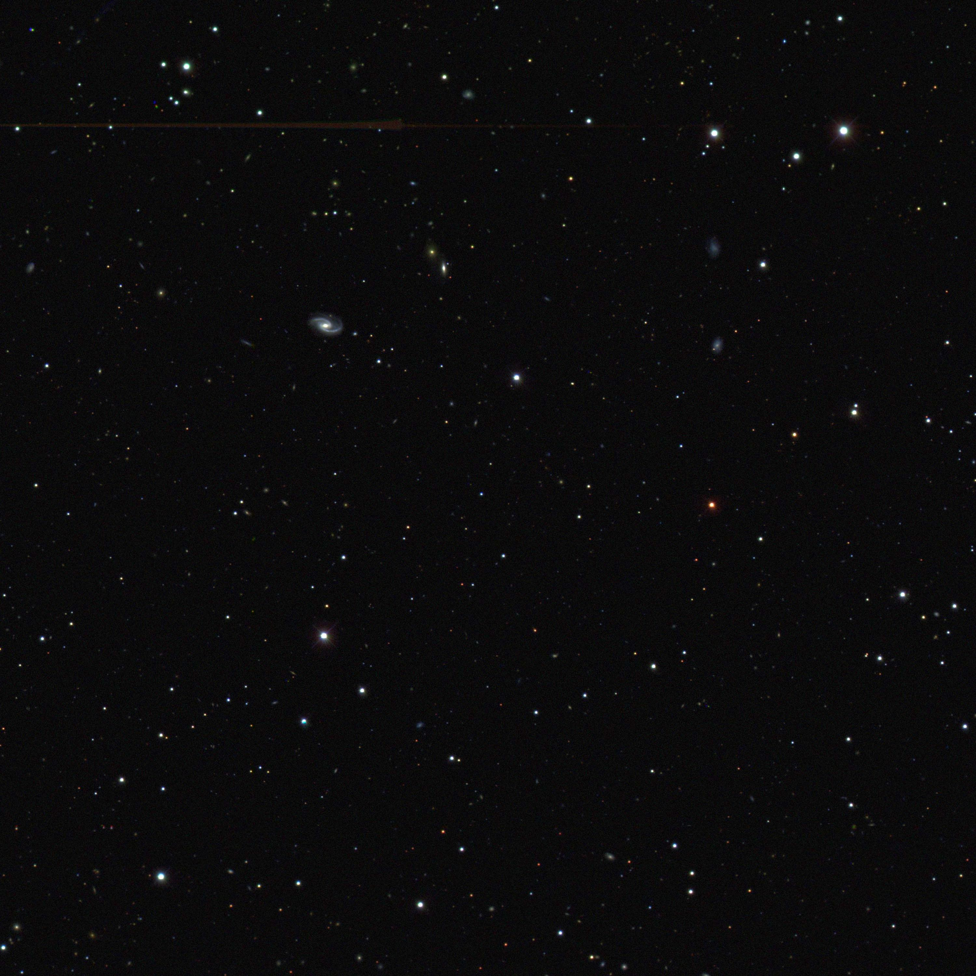
Science of the Dark Energy Survey
Josh Frieman
Fermilab and the University of Chicago
Astronomy 41100
Lecture 3, Oct. 29, 2010

Slide 2
1998-2010 SN Ia Synopsis
Substantial increases in both quantity and quality of SN Ia data: from several tens of relatively poorly sampled light curves to many hundreds of well-sampled, multi-band light curves from rolling surveys
Extension to previously unexplored redshift ranges: z>1 and 0.1<z<0.3
Extension to previously underexplored rest-frame wavelengths (Near-infrared)
Vast increase in spectroscopic data
Identification of SN Ia subpopulations (host galaxies)
Entered the systematic error-dominated regime, but with pathways to reduce systematic errors

Slide 3
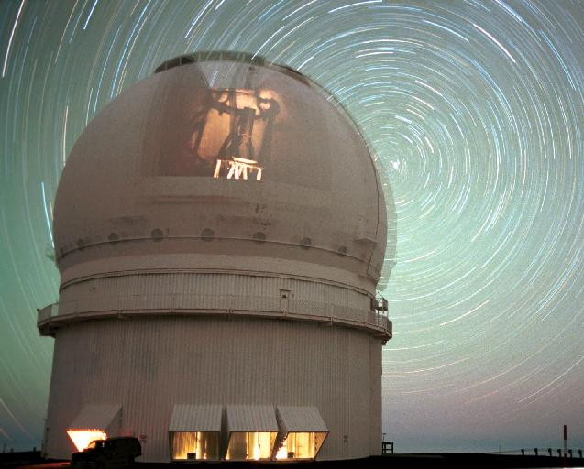
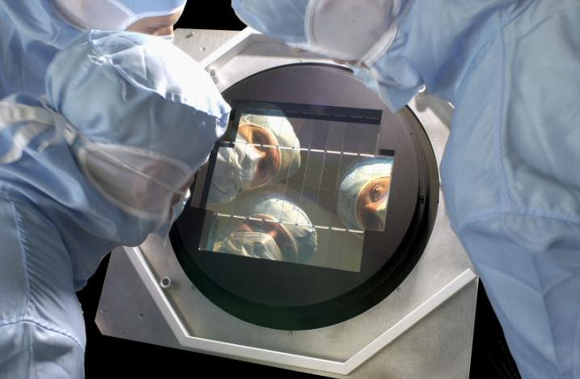
Supernova Legacy Survey (2003-2008)
Observed 2 1-sq deg regions every 4 nights
~400+ spectroscopically confirmed SNe Ia to measure w
Used 3.6-meter CFHT/“Megacam”
36 CCDs with good blue response
4 filters griz for good K-corrections and color measurement
Spectroscopic follow-up on 8-10m telescopes
Megaprime Mosaic CCD camera

Slide 4
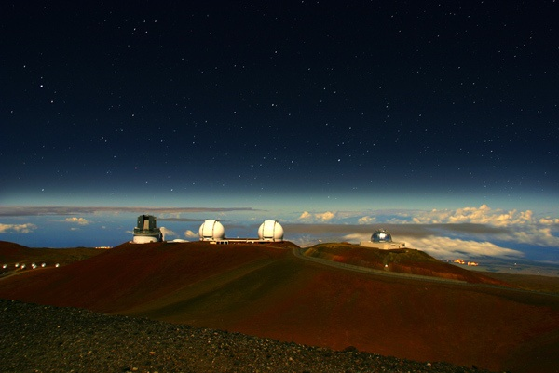
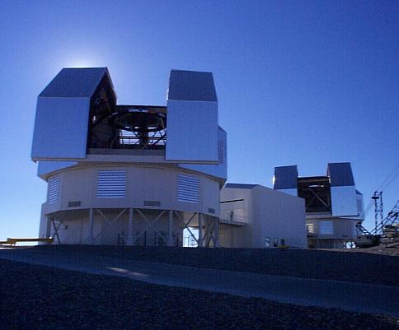
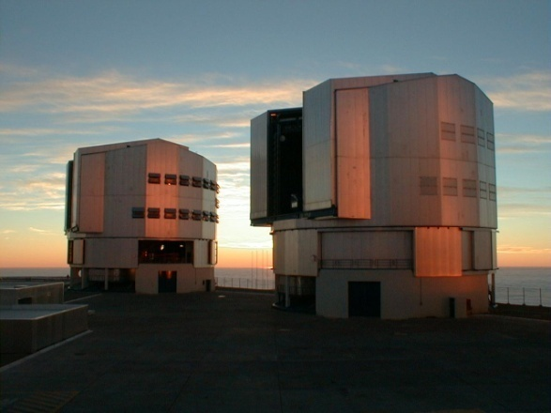
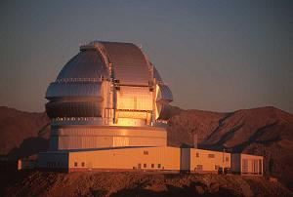
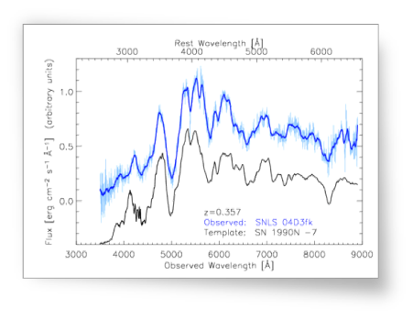
Magellan
VLT
Spectra
SN Identification
Redshifts
3 nights/yr: Toronto
IMACS for host redshifts
120 hr/yr: France/UK
FORS 1&2 for types, redshifts
Gemini
Keck
8 nights/yr:
LBL/Caltech
DEIMOS/LRIS for types, intensive study, cosmology with SNe II-P
120 hr/yr: Canada/US/UK
GMOS for types, redshifts

Slide 5
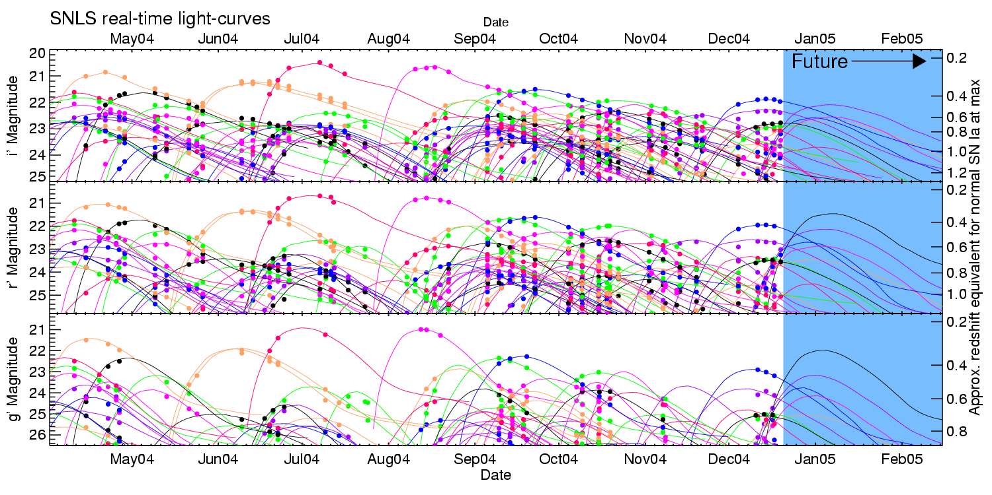
Power of a Rolling Search
SNLS Light curves
Notes:
Reynald saysz=0.4-0.7
Aug Sep Oct 2003
can see 12 day gaps due to lun ation

Slide 6
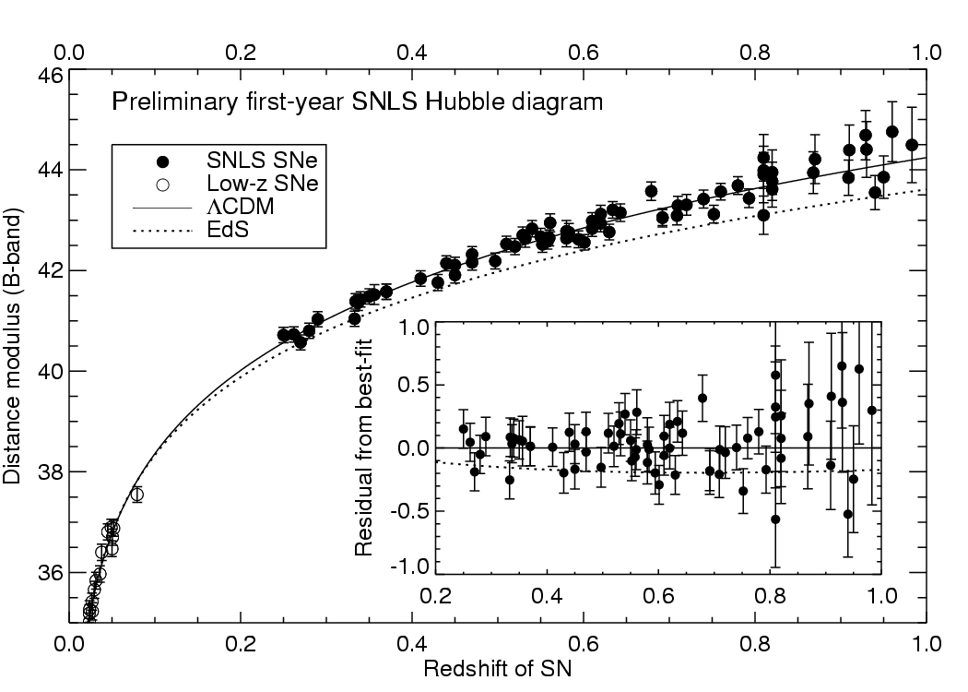
SNLS 1st Year Results
First-Year SNLS Hubble Diagram
Astier et al. 2006
Using 72 SNe
from SNLS
+40 Low-z

Slide 7
Wood-Vasey, etal (2007), Miknaitis, etal (2007):
results from ~60 ESSENCE SNe (+Low-z)

Slide 8
60 ESSENCE SNe
72 SNLS SNe

Slide 9
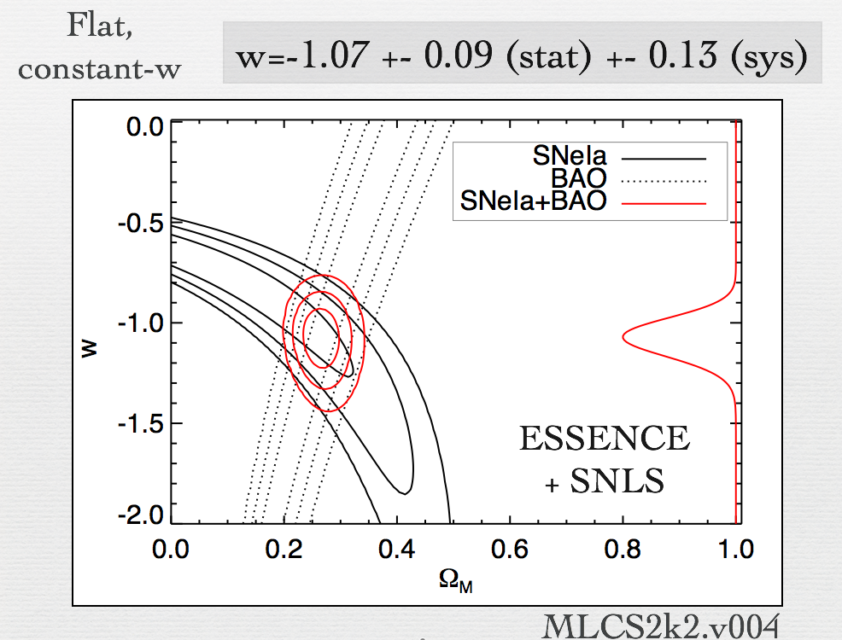

Slide 10
Higher-z SNe Ia from ACS
Z=1.39
Z=0.46
Z=0.52
Z=1.23
Z=1.03
50 SNe Ia, 25 at z>1 Riess, etal

Slide 11
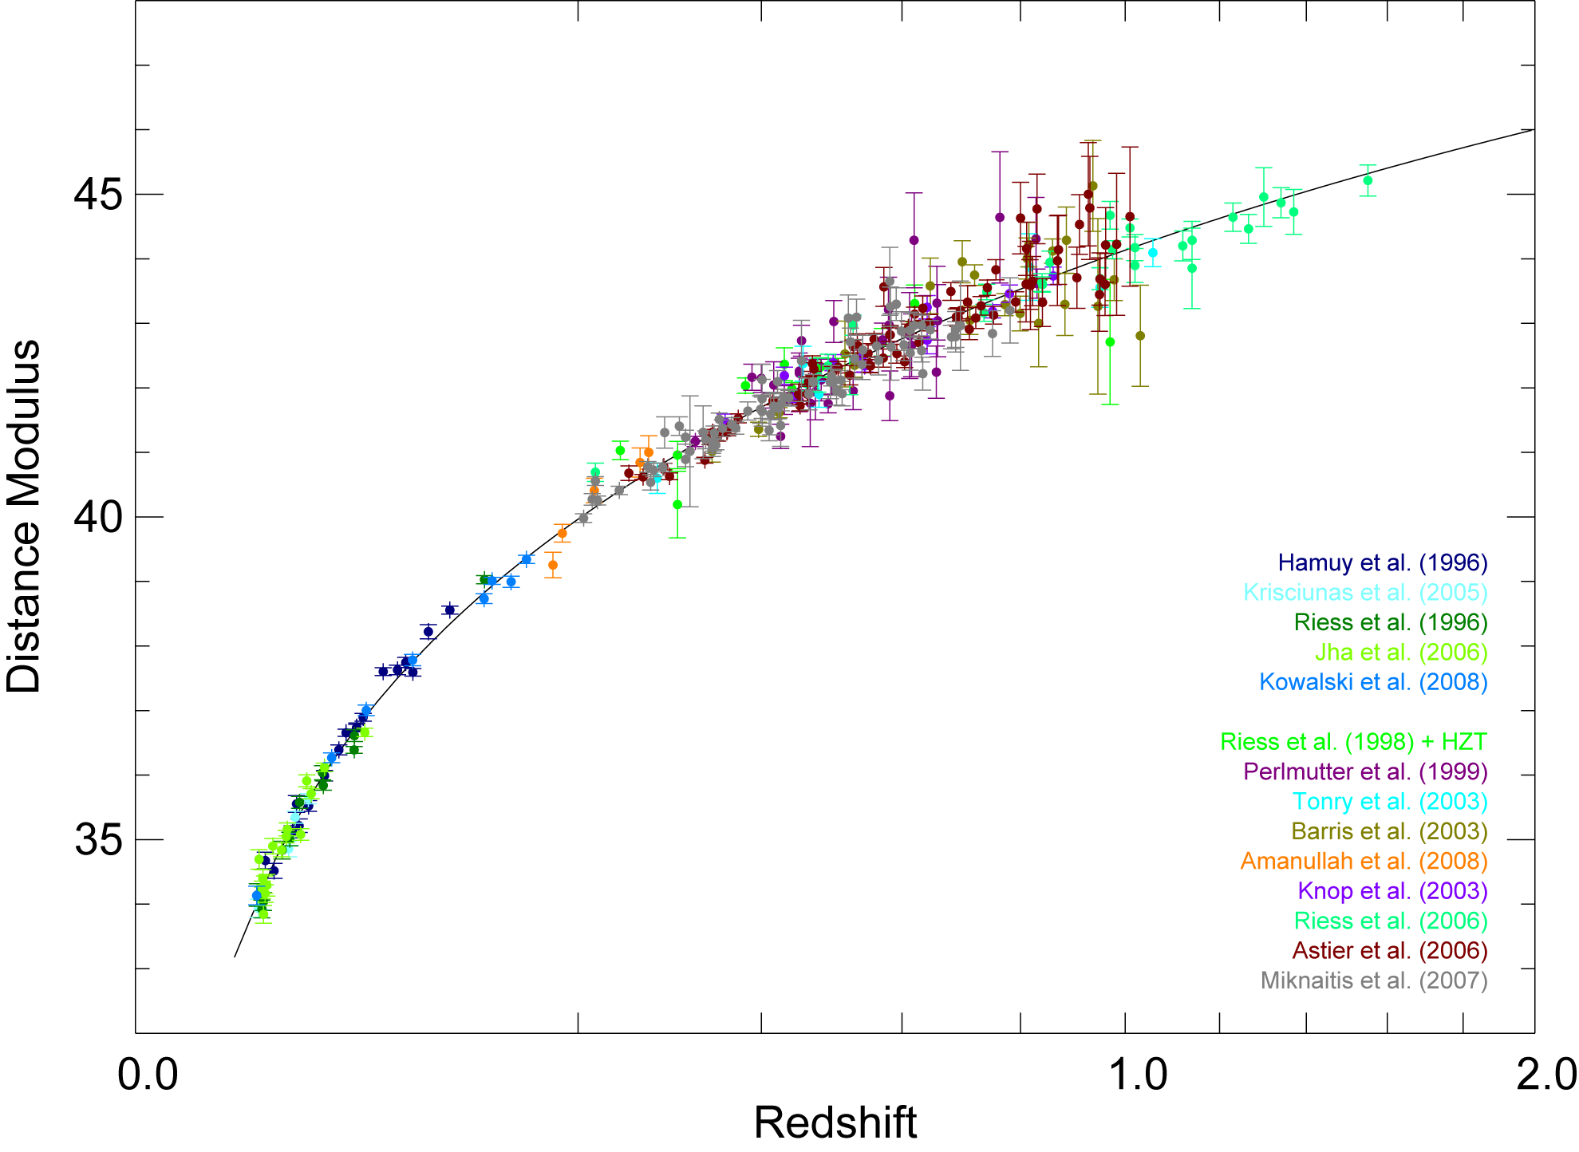
Supernova Cosmology Project SN Ia Union Compilation
Kowalski et al., ApJ, 2008
Data tables and updates at http://supernova.lbl.gov/Union

Slide 12
Likelihood
Analysis with
BAO and CMB
Priors

Slide 13
Recent Dark Energy Constraints
Improved SN constraints
Inclusion of constraints from WMAP Cosmic Microwave Background Anisotropy and SDSS Large-scale Structure (Baryon Acoustic Oscillations)
Only statistical errors shown
assuming w = −1

Slide 14
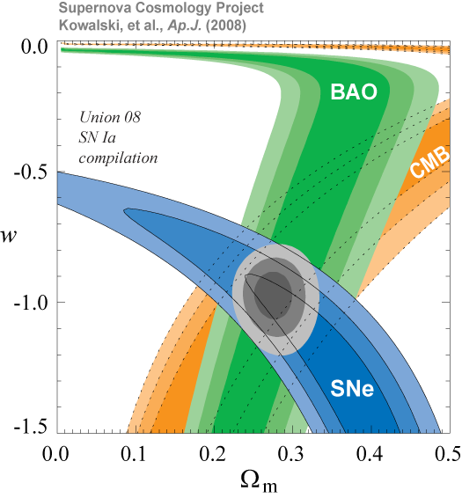
assuming flat Univ. and constant w
Only statistical errors shown

Slide 15
SNLS Preliminary 3rd year Hubble Diagram
Conley et al, Guy etal (2010): results with ~252 SNLS SNe
Independent analyses with 2 light-curve fitters: SALT2, SiFTO

Slide 16
Frieman, et al (2008); Sako, et al (2008)
Results published from 2005 season
Kessler, et al 09; Lampeitl et al 09; Sollerman et al 09

Slide 17
SDSS II Supernova Survey Goals
Obtain few hundred high-quality* SNe Ia light curves in the `redshift desert’ z~0.05-0.4 for continuous Hubble diagram
Probe Dark Energy in z regime complementary to other surveys
Well-observed sample to anchor Hubble diagram, train light-curve fitters, and explore systematics of SN Ia distances
Rolling search: determine SN/SF rates/properties vs. z, environment
Rest-frame u-band templates for z >1 surveys
Large survey volume: rare & peculiar SNe, probe outliers of population
*high-cadence, multi-band, well-calibrated

Slide 18
Spectroscopic follow-up telescopes
R. Miquel, M. Molla, L. Galbany

Slide 19
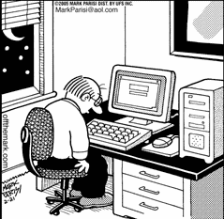
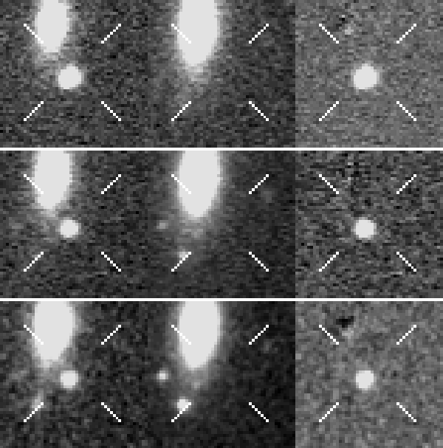
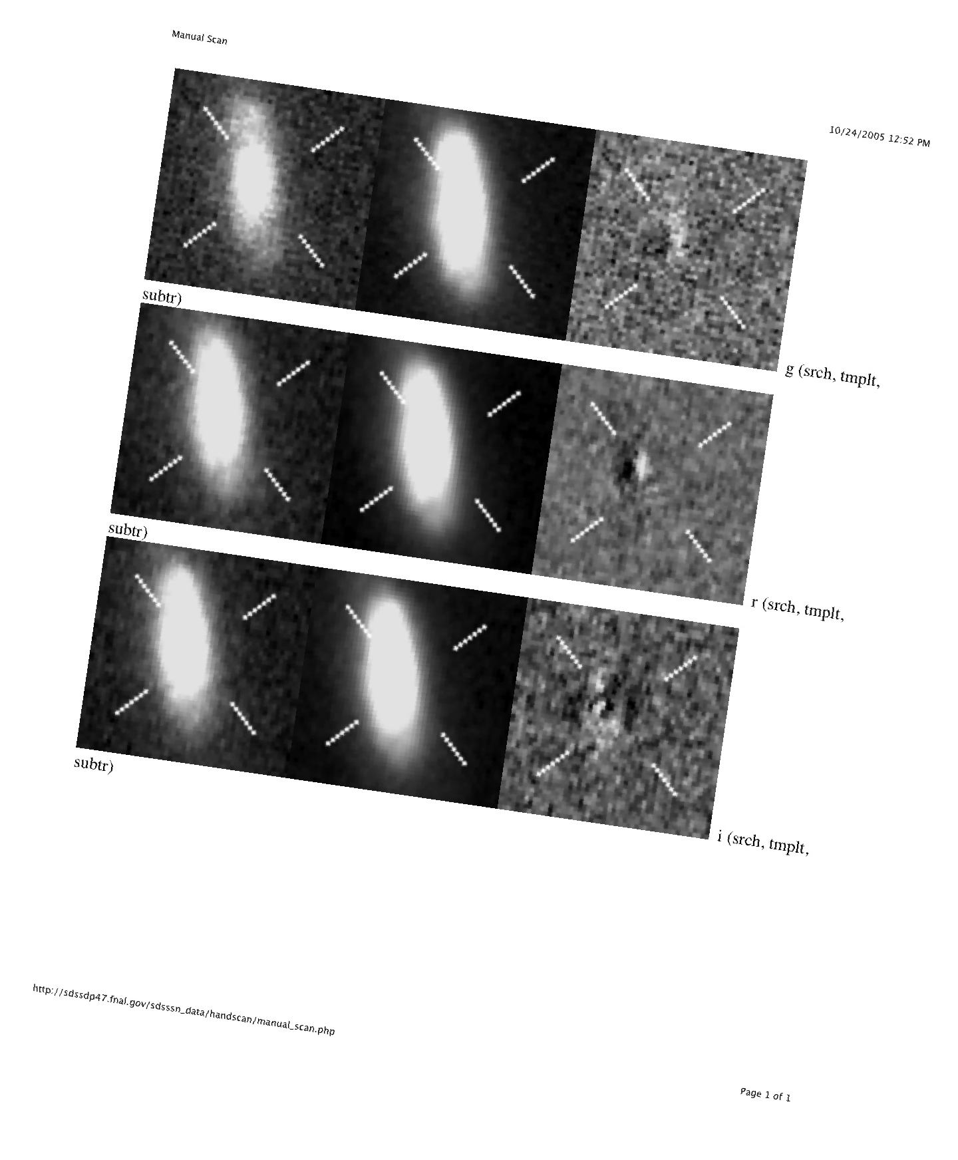
Searching For Supernovae
Search Template Difference
2005
190,020 objects scanned
11,385 unique candidates
130 confirmed Ia
2006
14,441 scanned
3,694 candidates
193 confirmed Ia
2007
175 confirmed Ia
g
r
i
Positional match to remove movers
Insert fake SNe to monitor efficiency

Slide 20
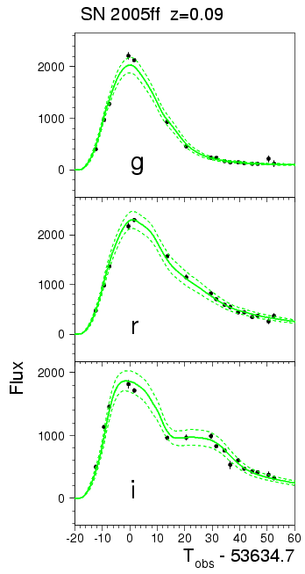
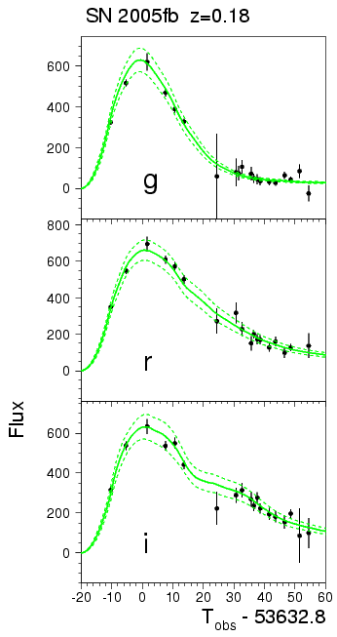
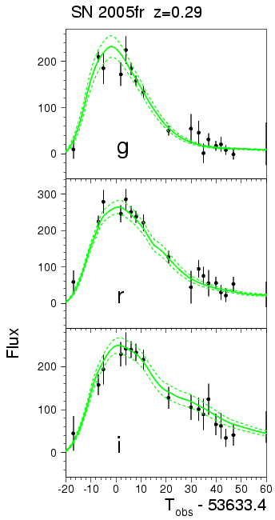
SDSS SN Photometry
Holtzman etal (2008)

Slide 21
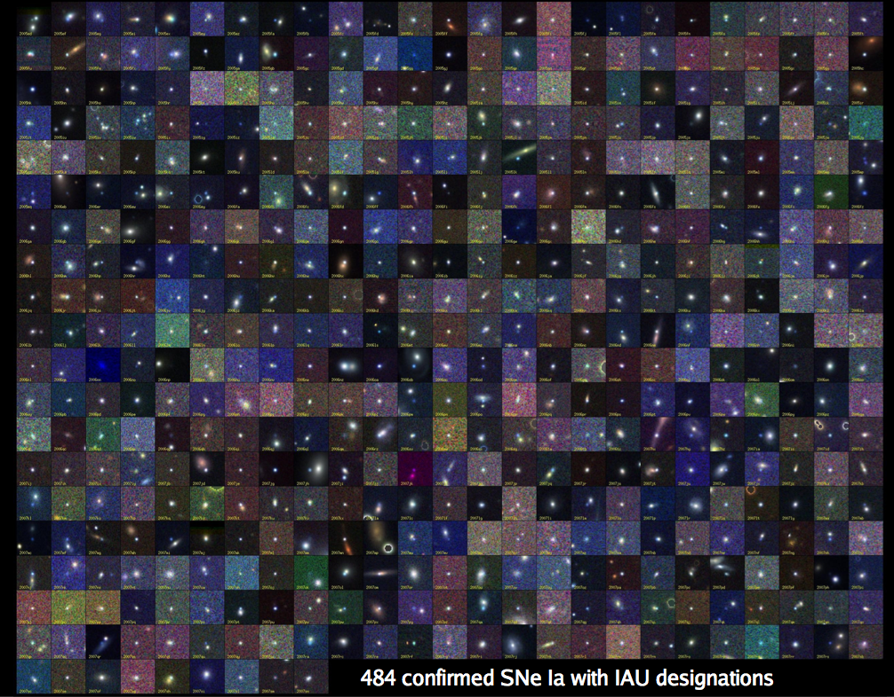
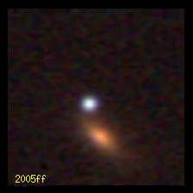
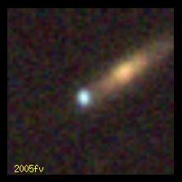
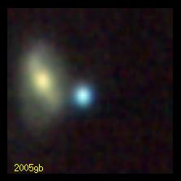
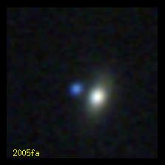
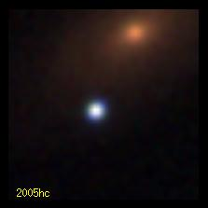
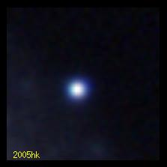
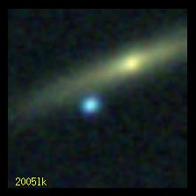
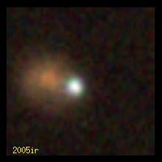
B. Dilday
500+ spec confirmed SNe Ia + 87 conf. core collapse plus >1000 photometric Ia’s with host z’s

Slide 22
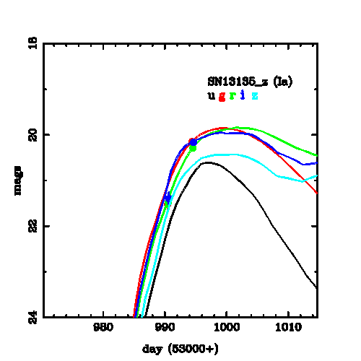
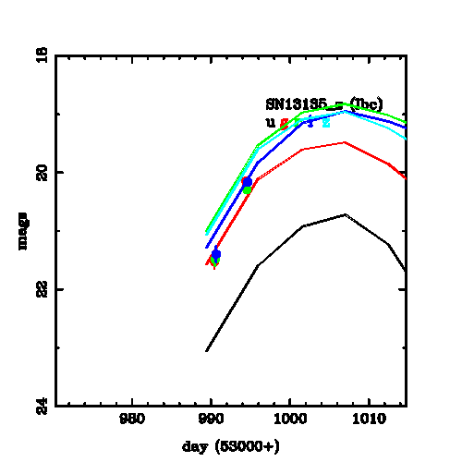
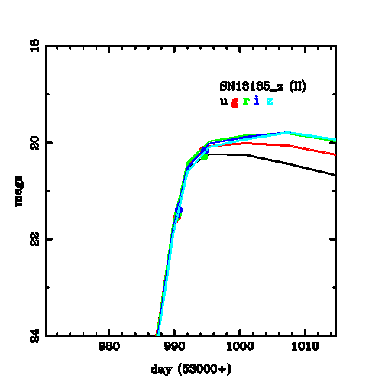
Spectroscopic Target Selection
2 Epochs
SN Ia Fit
SN Ibc Fit
SN II Fit
Sako etal 2008
Notes:
Talk by Masao
Poster by Ben
chi2 high because there is no model uncertianty
and no zpt (systematic) contribution to data pts

Slide 23
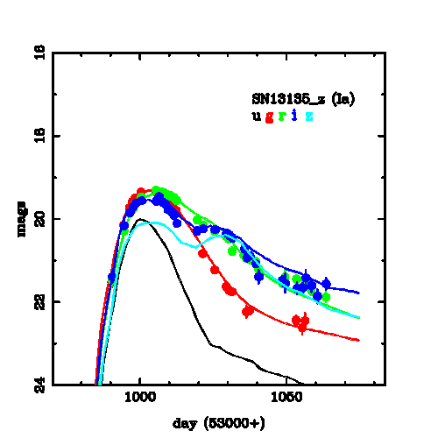
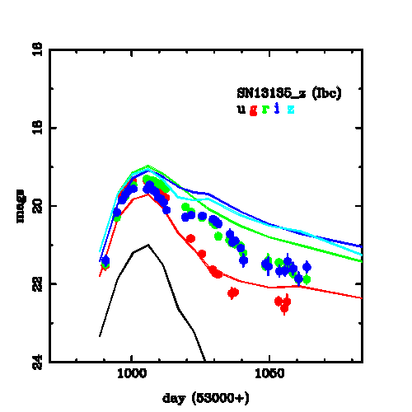
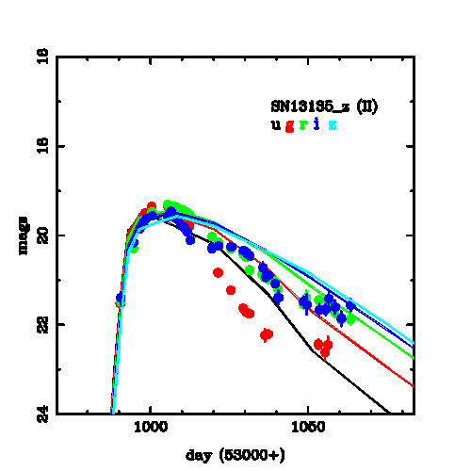
Spectroscopic Target Selection
2 Epochs
SN Ia Fit
SN Ibc Fit
SN II Fit
31 Epochs
SN Ia Fit
SN Ibc Fit
SN II Fit
Fit with
template
library
Classification
>90%
accurate after
2-3 epochs
Redshifts
5-10%
accurate
Sako etal 2008
Notes:
Talk by Masao
Poster by Ben
chi2 high because there is no model uncertianty
and no zpt (systematic) contribution to data pts

Slide 24
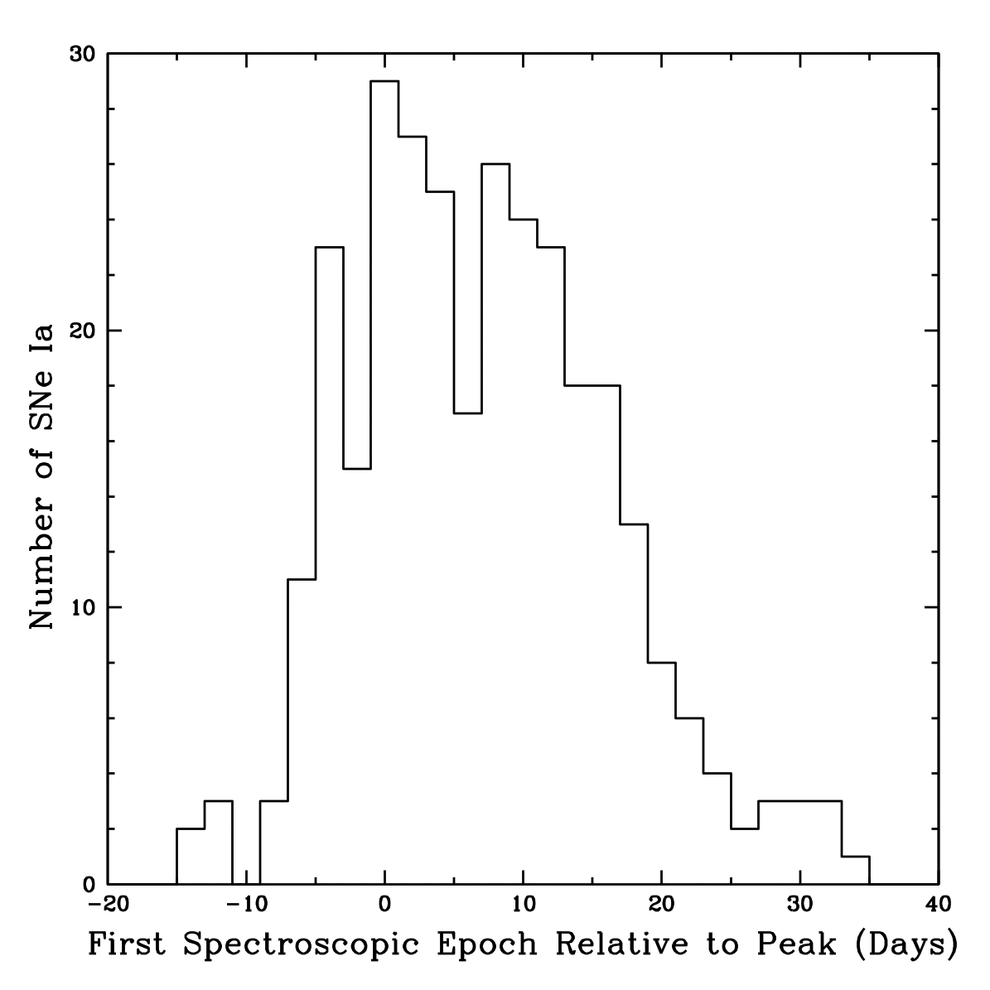
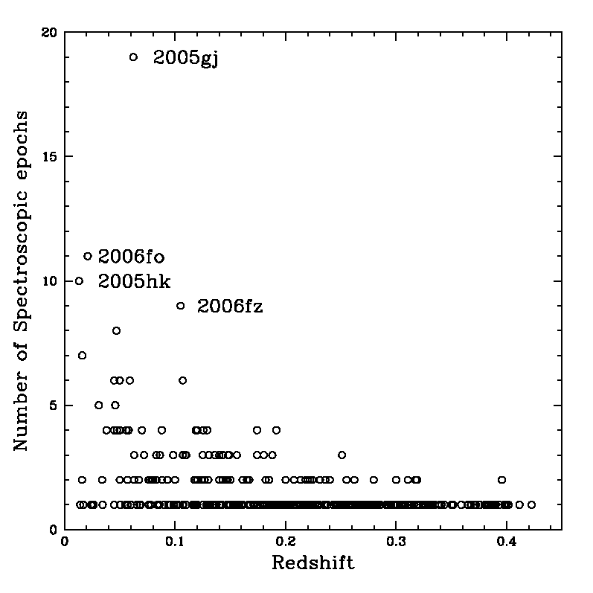
SN and Host Spectroscopy
MDM 2.4m
NOT 2.6m
APO 3.5m
NTT 3.6m
KPNO 4m
WHT 4.2m
Subaru 8.2m
HET 9.2m
Keck 10m
Magellan 6.5m
TNG 3.5m
SALT 10m SDSS 2.5m
2005+2006
Determine SN Type and Redshift
Notes:
Until we have photo-z for supernovae, need spec followup.

Slide 25
Fitting SN Ia Light Curves
Multi-color Light Curve Shape (MLCS2k2)
Riess, etal 96, 98; Jha, etal 2007
SALT-II
Guy, etal 05,08

Slide 26
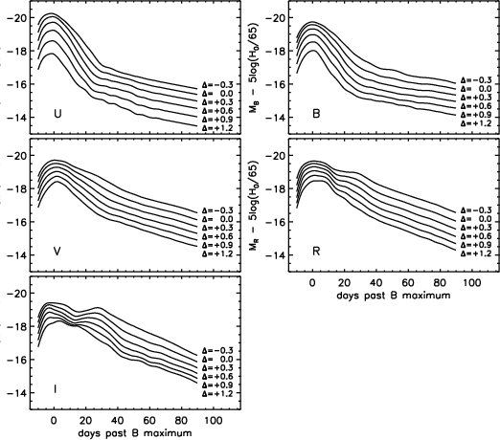
MLCS2k2
Light-curve
Templates
in rest-frame j=UBVRI;
built from ~100
well-observed, nearby SNe Ia
∆ <0: bright, broad
∆ >0: faint, narrow,
redder
time-dependent model “vectors”
trained on Low-z SNe
observed
passband
fit parameters
Time of maximum distance modulus host gal extinction stretch/decline rate

Slide 27
Host Galaxy Dust Extinction
Extinction:
Empirical Model for wavelength dependence:
MLCS: A_{V} is a fit parameter, but R_{V} is usually fixed to a global value (sharp prior) since it’s usually not well determined SN by SN
Cardelli etal 89 (CCM)

Slide 28
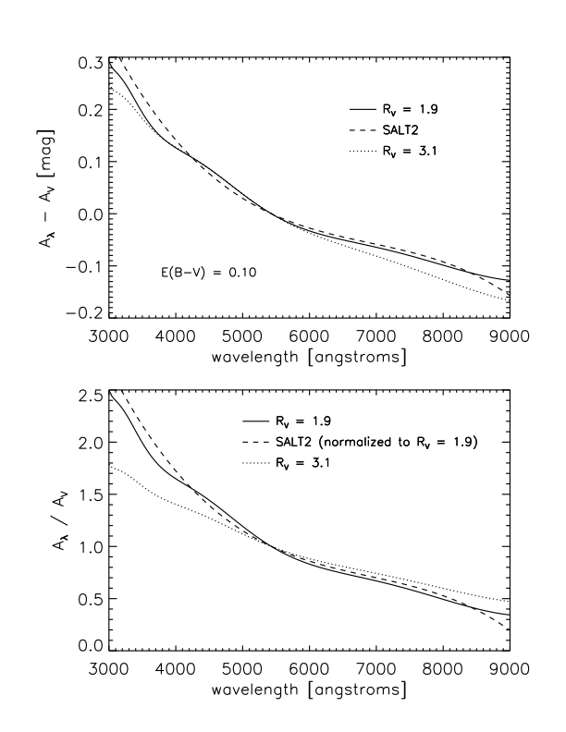
Host Galaxy Dust Extinction
Historically, MLCS used Milky Way average of R_{V}=3.1
Growing evidence that this doesn’t represent SN host galaxy population well
Milky Way avg.
Jha

Slide 29
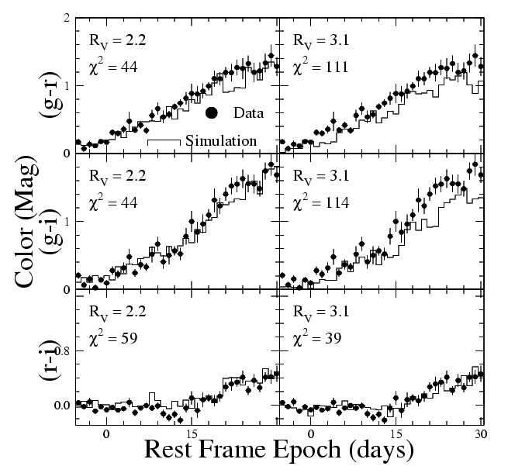
Extract R_{V} by matching colors of SDSS SNe to MLCS simulations
Use nearly complete (spectroscopic + photometric) sample
MLCS previously used Milky Way avg R_{V}=3.1
Lower R_{V} more consistent with SALT color law and other recent SN R_{V} estimates
D. Cinabro

Slide 30
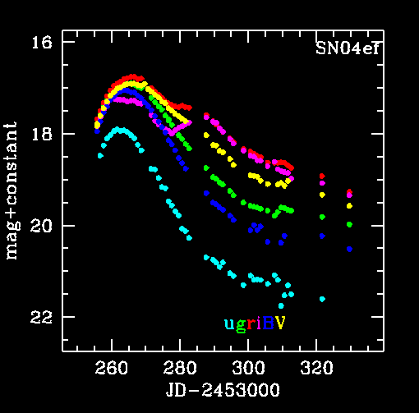
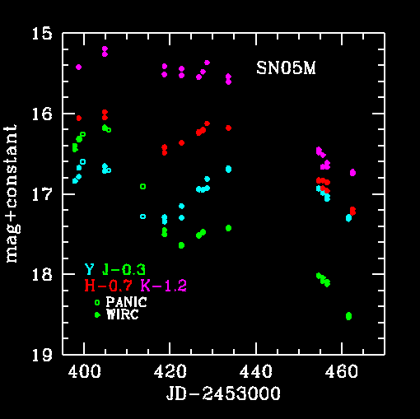
Carnegie Supernova Project: Low-z
CSP is a follow-up project
Goal: optical/NIR light-curves and spectro-photometry for
> 100 nearby SNIa
> 100 SNII
> 20 SNIbc
Filter set: BV + u’g’r’i’ + YJHK
Understand SN physics
Use as standard candles.
Calibrate distant SN Ia sample
Notes:
The low-z campaign is focused on getting high-quality, densely sampled light-curves in both the optical and NIR.

Slide 31
CSP Low-z Light Curves
Folatelli, et al. 2009
Contreras, et al. 2009: 35 optical light curves (25 with NIR)

Slide 32
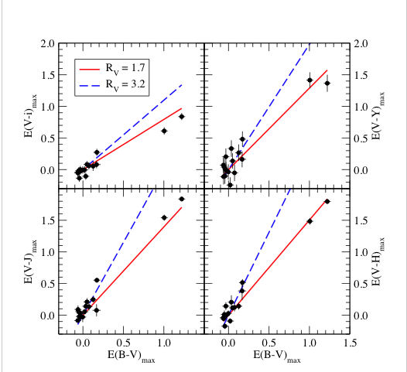
Varying Reddening Law?
2005A
2006X
Folatelli et al. (2009)
Notes:
By comparing pairs of colors (or extinctions), we can try to emprically determine the reddening law, without needing to know the distances. There appears to be a dichotomy: when using moderately reddened objects (E(B-V) < 0.5), the reddening law comes out to Rv = 3.2, which is consistent with typical Milky-way reddening. However, we have two very reddened objects (E(B-V) > 1) that prefer a smaller reddening law (Rv = 1.7). Even more puzzling: if we solve for Rv by minimizing scatter in the Hubble diagram (I.e., using distances), all the Sne are consistent with Rv = 1.7.

Slide 33
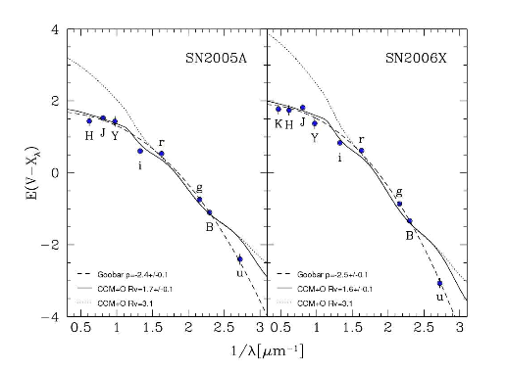
Local Dust?
Goobar (2008): higher density of dust grains in a shell surrounding the SN: multiple scattering steepens effective dust law
(also Wang)
Two Highly Reddened SNe
Folatelli et al. (2009)
Notes:
One possible explanation for the low Rv in the highest reddened objects is that the dust is not inter-stellar, but local to the SN. In the plots above, E(B-X) is plotted as a function of wavelength). ISM dust with Rv=3.1 fails to fit all but E(V-r) and E(V-g). Rv=1.7 does a better job, but fails to expain E(V-u). A rather simplistic model by Goobar (2008) consisting of a shell surrouding the SN produces very good fits to all the extinctions, including u-band. However, this model fails to explain why minimizing the Hubble scatter leads to Rv = 1.7.

Slide 34
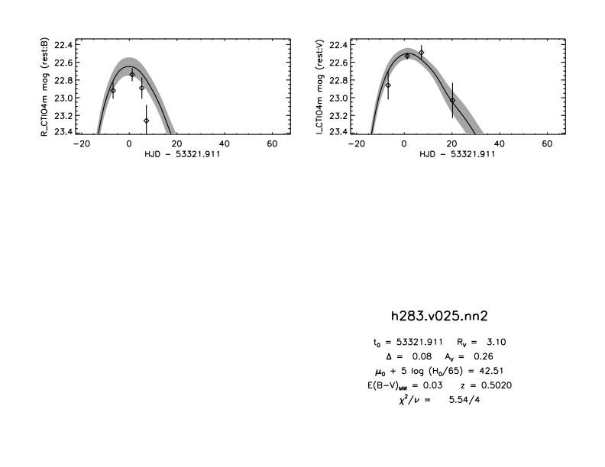
Show likelihood plots for MLCS
MLCS fit to one of the
ESSENCE SNe

Slide 35
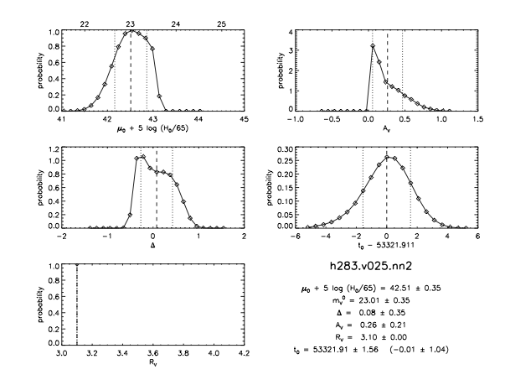
Marginalized PDFs
prior
μ distribution approximated by Gaussian for cosmology fit

Slide 36
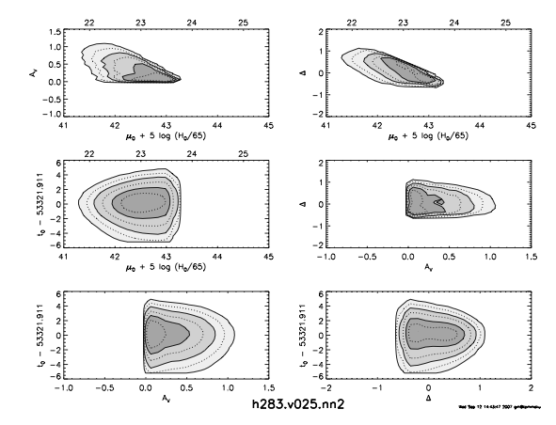
MLCS Likelihood Contours for this object

Slide 37
SALT-II Light-curve Fits
Guy et al
Fit each light curve using rest-frame spectral surfaces:
Light curves fit individually, but distances only estimated globally:
Differences from MLCS: not trained just on low-redshift data; flat priors on model parameters; color variations not assumed only from dust. If dust, then β=R_{V}+1. Find β~2.5 empirically.
light-curve shape
color term
Global fit parameters, determined along with cosmological parameters by fit to Hubble diagram (so in principle you should not use SALT distance tables to test some other cosmological model)

Slide 38
SALT-II
templates
for
x₁=-2,0,2

Slide 40
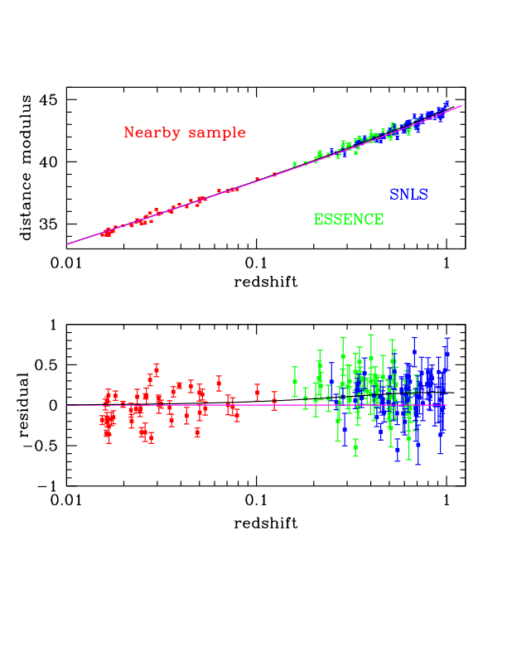
Hubble Diagram
~45 SNe Ia
~120 SNe

Slide 41
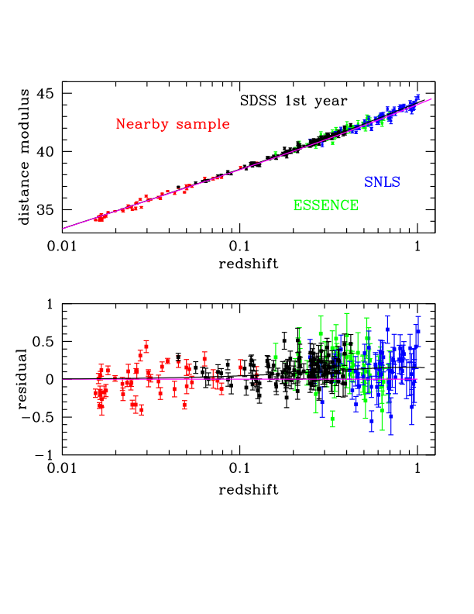
Hubble Diagram
with SDSS SNe
103 SNe Ia from first season that pass stringent light-curve quality cuts
Kessler etal (2009)
Lampeitl etal (2009)
Sollerman etal (2009)
~45 SNe Ia
~120 SNe

Slide 42
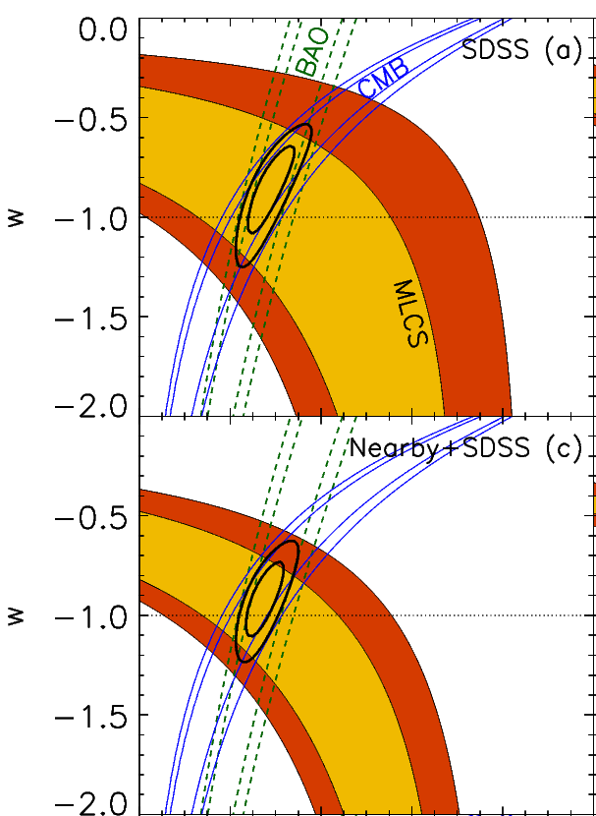
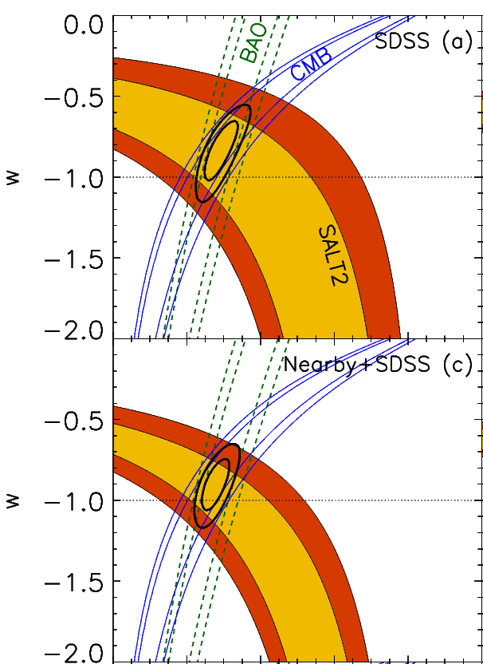
MLCS
SALT
SDSS only:
Nearby+SDSS:
MLCS
SALT

Slide 43
MLCS
SALT
Nearby+SDSS:
Nearby+SDSS+SNLS+ESSENCE+HST:
MLCS
SALT

Slide 44
SALT vs MLCS template light curves
MLCS
“SALT”
Diagnosis:
Large difference in Light-curve model in U-band
Use of prior on extinction in MLCS

Slide 45
A Tale of Two Fitters
MLCS:
U-band model trained only on low-redshift (observer-frame) U-band data (calibration, atmospheric variations)
Assumes all excess color due to dust extinction (some of it must be); dust prior dominates at high-redshift
SALT:
Global fit for color/dust parameter β: minimizing Hubble-scatter can lead to bias
Trend toward bluer colors at high-z: if allow β(z), see strong trend with redshift
Retrain and refine the models with newer data

Slide 46
SALT Parameters vs. Redshift

Slide 47
See also Conley et al 2007:
treatment of dust & SN colors

Slide 48
Vary minimum redshift

Slide 49
Correlations of SN Ia and Host-galaxy Properties

Slide 50
fainter brighter
Host Population correlated with SN Ia Luminosity
Sullivan et al. 2006, Howell et al. 2007, Jha etal 2007
"Prompt"
Prompt,
Star forming
Brighter
SNe
"Delayed"
Delayed,
Passive hosts
Fainter
SNe
Also brighter SNe in lower-stellar-mass hosts

Slide 51
SN Ia Luminosity correlates with Host Galaxy Type
SDSS
Bright SN Luminosity/Decline Rate Faint
Smith et al

Slide 52
SN Ia Color doesn’t correlate strongly with Host Galaxy Type
Why aren’t `spirals’ dustier than `ellipticals’?
Color/reddening
Smith et al

Slide 53
SN Rates vs. redshift
Sullivan et al. 2006, Howell et al. 2007
"Prompt" SNe follow declining cosmic star formation history (Hopkins & Beacom 2006), "Delayed" SNe follow growing stellar mass distribution
Predict relative contribution from each component vs. redshift

Slide 54
SN population drift vs. z
Howell et al. 2007
Histograms: data
Gaussians: prediction from rates
Conclusion: Average stretch, and thus average observed brightness of SNe Ia evolves with redshift.
Average SN Ia was 12% brighter at z > 1.
However, if stretch correction works, this population evolution should not affect cosmology

Slide 55
Hubble Residuals vs. Host Galaxy Specific Star Formation Rate
Events of same light-curve shape and color are ~0.08 mag brighter (after LCS correction) on avg. in galaxies with low star-formation rate (or high stellar mass): opposite to pre-correction trend Sullivan etal 10

Slide 56
Events of same light-curve shape and color are ~0.08 mag brighter (after LCS correction) on avg. in galaxies with low star-formation rate (or high stellar mass): opposite to pre-correction trend: metallicity effect? Sullivan etal 10
Fit cosmology with 2 populations of M_{B}: shifts w by~0.04-0.08 with BAO prior

Slide 57
Same trend seen in low-redshift SN Ia sample Kelly etal 09

Slide 58
SDSS SN
Lampeitl etal 10
SFR
Passive
blue
red

Slide 59
SDSS SN
Lampeitl etal 10

Slide 60
Systematic Errors (and Controls)
Dust and SN color variation (multi-λ, NIR, high S/N)
U-band model discrepancy (retrain with better rest-frame U-band data, e.g., from SDSS SN g-band)
Minimum redshift effect (model coherent flows; larger, better, low-redshift samples)
Selection effects (artificial SNe, Monte Carlo simulations)
Population evolution (SN properties vs host environment)
Photometric calibration (system response calibration & cross-calibration of systems)
Sample purity (spectroscopy at least for subsample)
All (subdivide large samples to cross-check)

Slide 61
The Future is (Mostly) Photometric
Pan-STARRS, Dark Energy Survey, LSST: thousands to tens of thousands of multi-band light curves to z~1
Limited spectroscopic resources for follow-up, replace spectroscopic with photometric SN classification
Very large samples will enable subdivision to study correlations and control systematics
Photometric-redshift precision at high-z does not critically impact DE constraints but degrades (SN-type) sample purity
SN spectroscopic subsamples (both Ia and non-Ia) required to quantify purity and define SN Ia color selection. SDSS SN test of photometric classifier: ~92% complete, 5% impurity (M. Sako)

Slide 62
DES SN Simulated Light Curves

Slide 63
DES + VISTA VIDEO NIR

Slide 64
DES simulation:
~3000 well-measured
SNe Ia with
<z>~0.6
DES will obtain host spectroscopic redshifts (improves typing); photo-z cosmology more relevant for LSST

Slide 65
Supernova Photo-z’s
Include redshift as a light-curve fit parameter
Kessler, et al 2010
LSST Simulation

Slide 66
Development of Photometric SN Classification Techniques
Blind SN Classification Challenge:
Simulated DES light curves of different
SN types
Host photo-z’s
Spectroscopically confirmed subsample
for training
Cuts: purity vs completeness
Kessler etal 10

Slide 67
Cosmology for Photometric SN samples
Cosmology fits generalized to include
probability that a given event is a SN Ia,
based on some photometric classification technique.
Will improve results from current SN surveys by including their larger photometric SN Ia datasets
Will be necessary for future surveys, for which spectroscopic classification will be available for only a small fraction of events
Places a premium on characterizing non-Ia populations
Hlozek etal 2010

