Slide 1
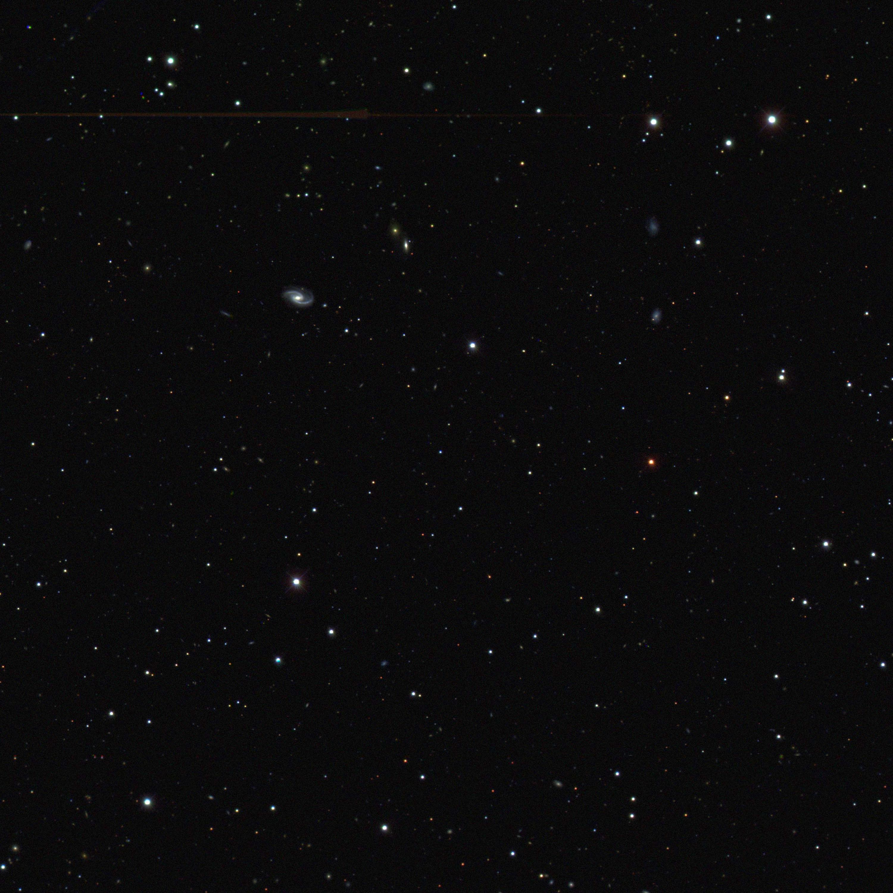
Science of the Dark Energy Survey
Josh Frieman
Fermilab and the University of Chicago
Astronomy 41100
Lecture 1, Oct. 1 2010

Slide 2
The Dark Energy Survey
www.darkenergysurvey.org
Study Dark Energy using
4 complementary* techniques:
I. Cluster Counts
II. Weak Lensing
III. Baryon Acoustic Oscillations
IV. Supernovae
• Two multiband surveys:
5000 deg² g, r, i, z, Y to 24th mag
15 deg² repeat (SNe)
• Build new 3 deg² FOV camera
and Data management sytem
Survey 2012-2017 (525 nights)
Camera available for community use the rest of the time (70%)
Blanco 4-meter at CTIO
*in systematics & in cosmological parameter degeneracies
*geometric+structure growth: test Dark Energy vs. Gravity

Slide 3
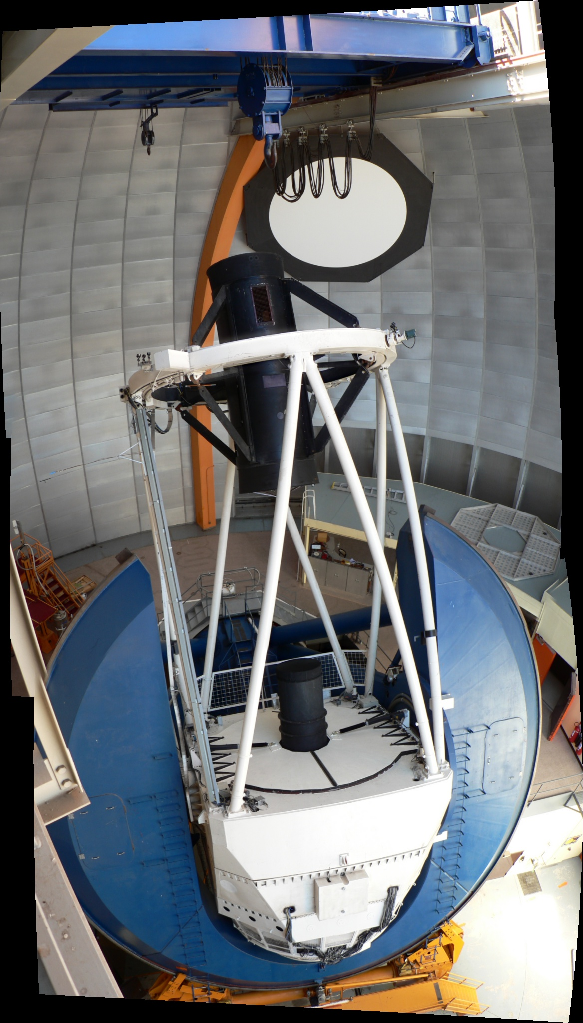
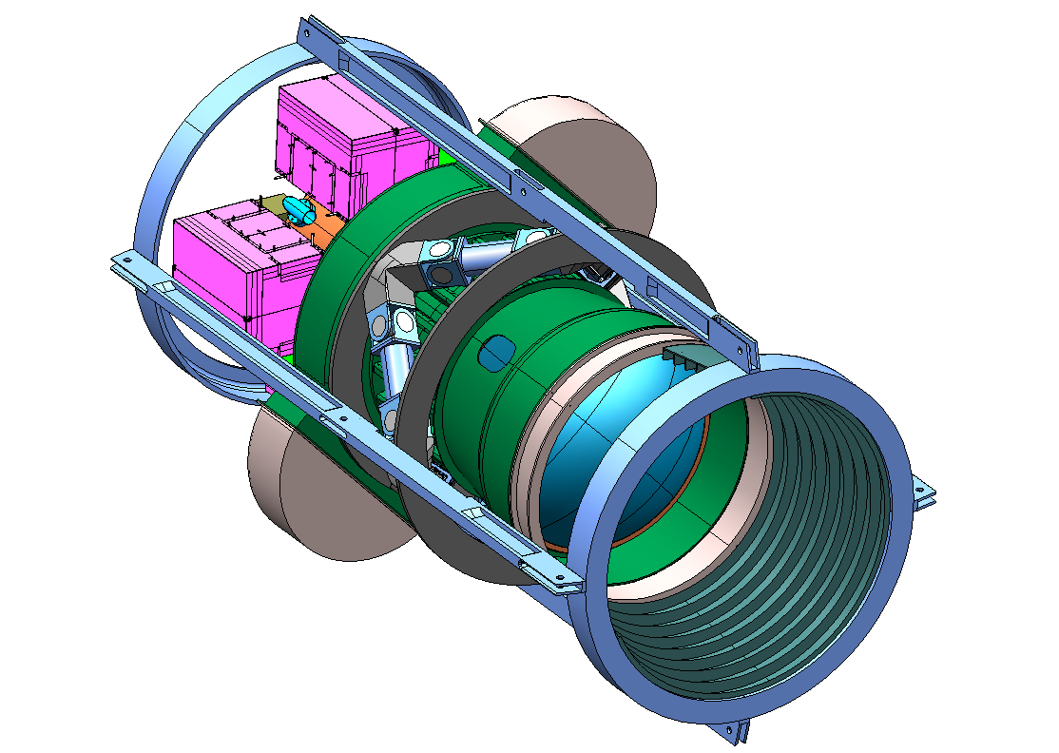
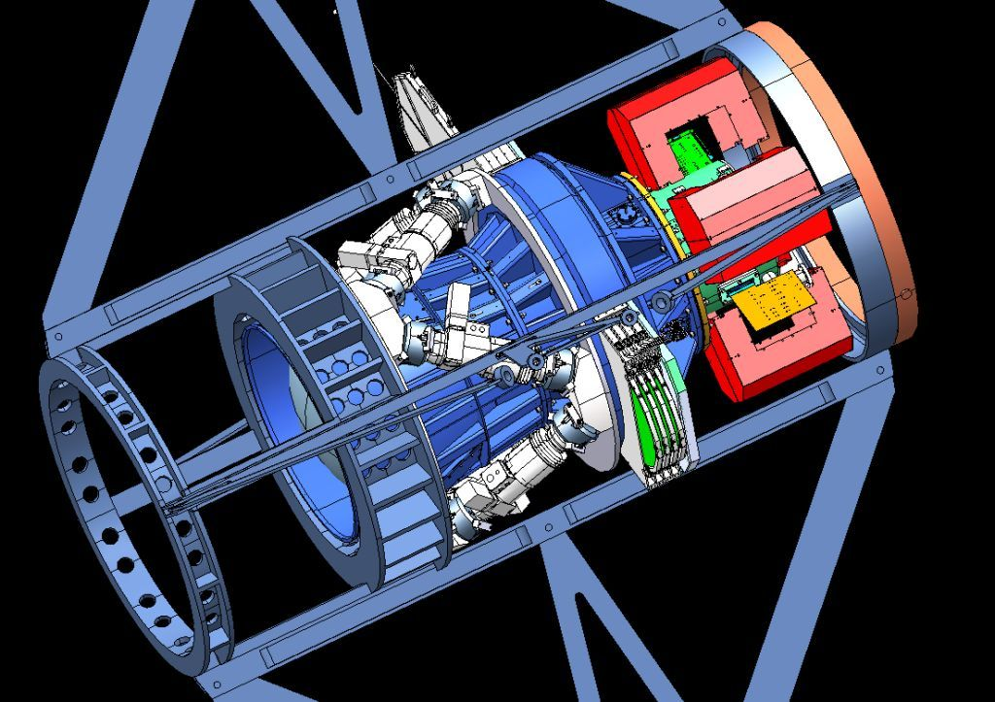
DES Instrument: DECam
Mechanical Interface of DECam Project to the Blanco
CCD
Readout
Filters
Shutter
Hexapod
Optical
Lenses
Designed for improved image quality compared to current Blanco mosaic camera

Slide 4
Cosmic Microwave Background Radiation
The Universe is filled with
a bath of thermal radiation
COBE map of the
CMB temperature
On large scales, the CMB temperature is nearly isotropic around us (the same in all directions): snapshot of the young Universe, t ~ 400,000 years
T = 2.728 degrees
above absolute zero
Temperature fluctuations
δT/T~10⁻⁵

Slide 5
The Cosmological Principle
We are not priviledged observers at a special place in the
Universe.
At any instant of time, the Universe should appear
ISOTROPIC
(averaged over large scales) to all Fundamental
Observers (those who define local standard of rest).
A Universe that appears isotropic to all FO’s is
HOMOGENEOUS
the same at every location (averaged over large scales).

Slide 6
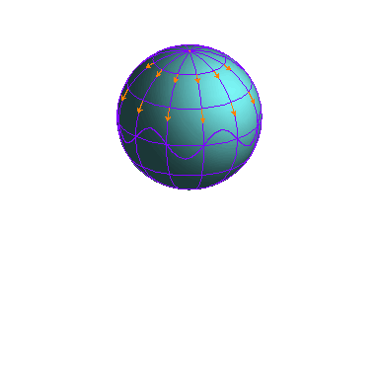
The only mode that preserves homogeneity and isotropy is overall expansion or contraction:
Cosmic scale factor
Model completely specified by a(t) and sign of spatial curvature

Slide 7
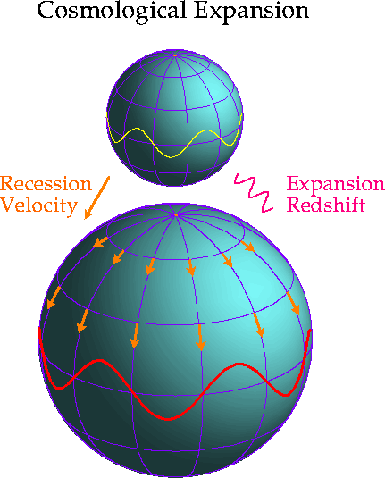
On average, galaxies are at rest in these expanding
(comoving) coordinates, and they are not expanding--they are gravitationally bound.
Wavelength of radiation scales with scale factor:
Redshift of light:
indicates relative size of Universe directly

Slide 8
Distance between galaxies:
where
fixed comoving distance
Recession speed:
Hubble’s Law (1929)

Slide 9
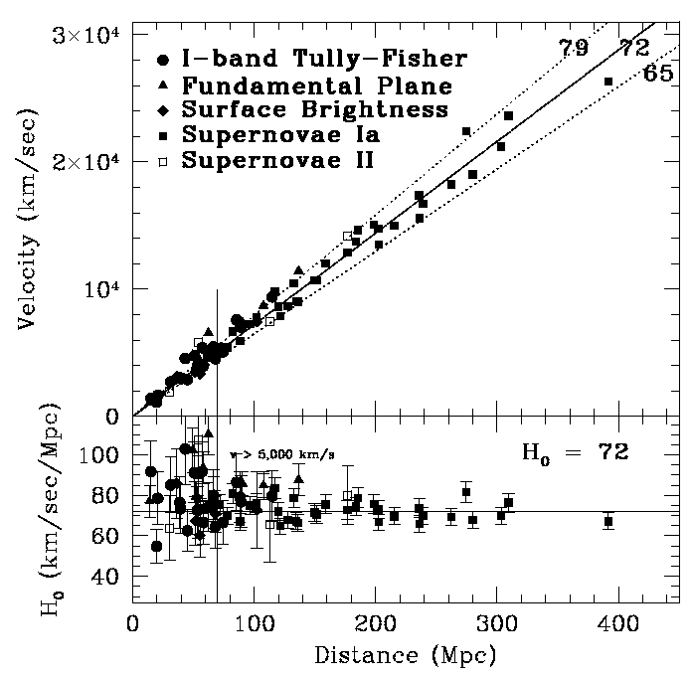
Modern
Hubble
Diagram
Hubble
Space
Telescope
Key
Project
Hubble parameter
Freedman etal

Slide 10
Expansion Kinematics
Taylor expand about present epoch:
where , and
Recent expansion history completely determined by
H₀ and q₀

Slide 11
How does the expansion of the Universe change over time?
Gravity:
everything in the Universe attracts everything else
expect the expansion of the Universe should slow
down over time

Slide 12
Cosmological Dynamics
How does the scale factor of the Universe evolve?
Consider a homogenous ball of matter:
Kinetic Energy
Gravitational Energy
Conservation of Energy: Birkhoff’s theorem
Substitute and to find
K interpreted as spatial curvature in General Relativity
M
m
d
1st order Friedmann
equation

Slide 13
Local Conservation of Energy-Momentum

Slide 14
2nd Order Friedmann Equation

Slide 15
Cosmological Dynamics
Spatial curvature: k=0,+1,-1
Friedmann
Equations
Density Pressure
Notes:
In our Newtonian derivation of cosmology, we implicitly assumed that the energy content of the Universe was dominated by the rest-mass of the particles, i.e., that the particles are slowly moving: non-relativistic. In Einstein’s General Relativity, stress-energy, e.g., pressure, gravitates, and it becomes significant in the relativistic regime. In order to drive accelerated expansion, there must be a component with negative pressure comparable to the energy density: this is the defining feature of Dark Energy.

Slide 17
Einstein-de Sitter Universe: a special case
Non-relativistic matter: w=0, ρ_{m}~a⁻³
Spatially flat: k=0 → Ω_{m}=1
Friedmann:

Slide 18
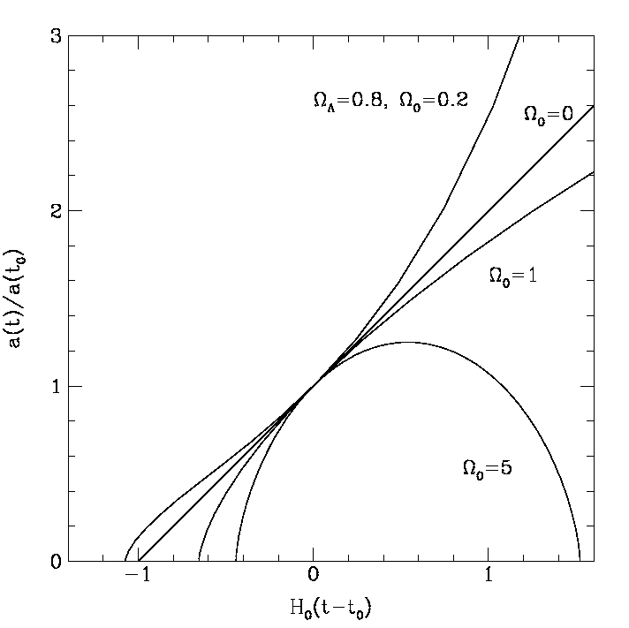
Empty
Size of the
Universe
In these cases,
decreases with time,
: ,
expansion decelerates
due to gravity
Today
-2/3
Cosmic Time

Slide 19
p = −ρ (w = −1)
Accelerating
Empty
Size of the
Universe
Today
Cosmic Time

Slide 20
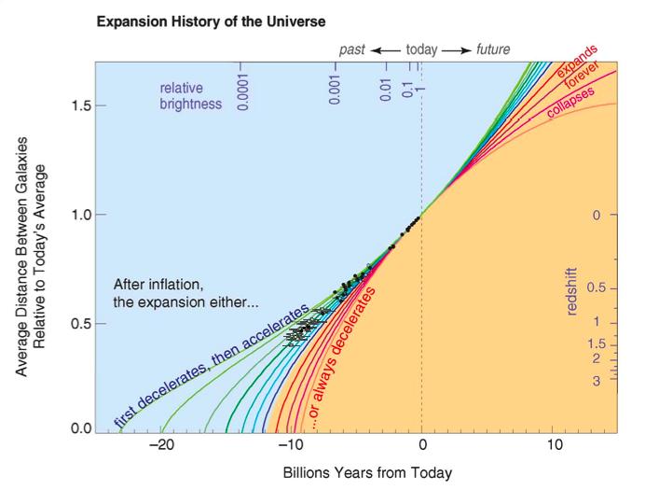
``Supernova Data”

Slide 21
Supernova Data (1998)

Slide 22
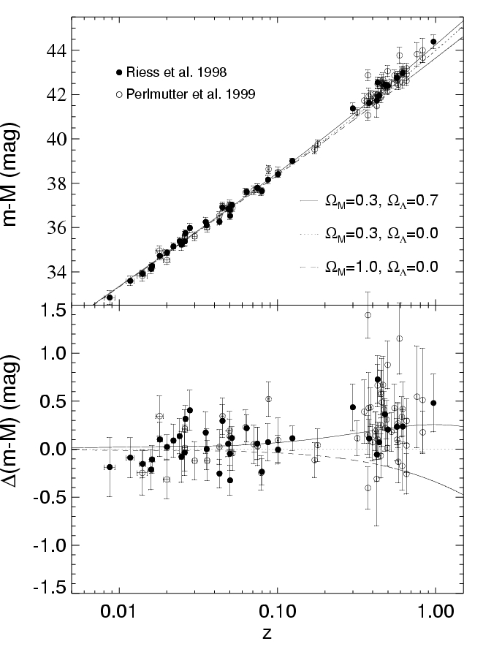
Log(distance)
Discovery of Cosmic Acceleration from
High-redshift
Supernovae
Type Ia supernovae that exploded when the Universe was 2/3 its present size are ~25% fainter than expected
Accelerating
Ω_{Λ} = 0.7
Ω_{Λ} = 0.
Ω_{m} = 1.
Not accelerating
redshift

Slide 23
Cosmological Dynamics
Friedmann
Equations
Notes:
In our Newtonian derivation of cosmology, we implicitly assumed that the energy content of the Universe was dominated by the rest-mass of the particles, i.e., that the particles are slowly moving: non-relativistic. In Einstein’s General Relativity, stress-energy, e.g., pressure, gravitates, and it becomes significant in the relativistic regime. In order to drive accelerated expansion, there must be a component with negative pressure comparable to the energy density: this is the defining feature of Dark Energy.

Slide 24
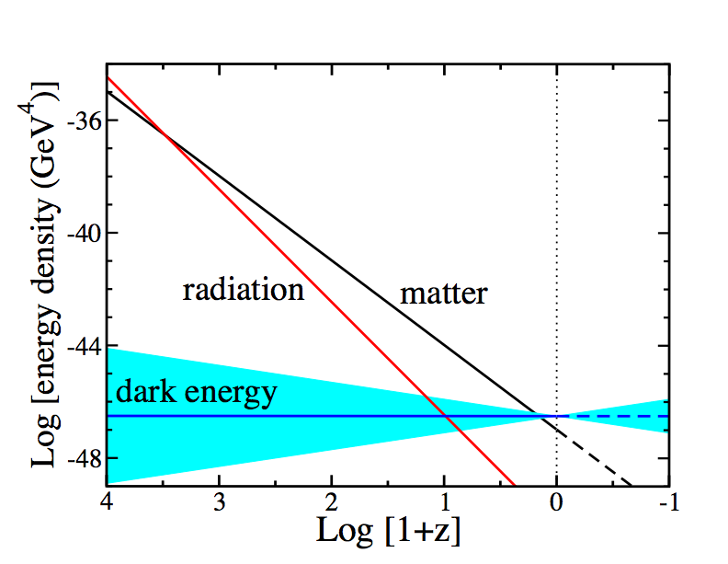
Equation of State parameter w determines Cosmic Evolution
Conservation of Energy-Momentum
=Log[a₀/a(t)]
Notes:
Energy-momentum conservation determines how the densities of different components scale with time. Before a few hundred thousand years after the BB, radiation or relativistic particles dominated, followed by non-relativistic matter, followed at ~8 Gyr by dark energy. In order for dark energy to cause cosmic speed-up, its equation of state must be such that its energy density scales slowly compared to matter and radiation. Thus, we expect dark energy to be important only at recent cosmic epochs.

Slide 25
Early 1990’s: Circumstantial Evidence
The theory of primordial inflation successfully accounted for the large-scale smoothness of the Universe and the large-scale distribution of galaxies.
Inflation predicted what the total density of the Universe should be: the critical amount needed for the geometry of the Universe to be flat: Ω_{tot}=1.
Measurements of the total amount of matter (mostly dark) in galaxies and clusters indicated not enough dark matter for a flat Universe (Ω_{m}=0.2): there must be additional unseen stuff to make up the difference, if inflation is correct.
Measurements of large-scale structure (APM survey) were consistent with scale-invariant primordial perturbations from inflation with Cold Dark Matter plus Λ.

Slide 26
Cosmic Acceleration
This implies that increases with time: if we could watch the same galaxy over cosmic time, we would see its recession speed increase.
Exercise 1: A. Show that above statement is true. B. For a galaxy at d=100 Mpc, if H₀=70 km/sec/Mpc =constant, what is the increase in its recession speed over a 10-year period? How feasible is it to measure that change?

Slide 27
What is the evidence for cosmic acceleration?
What could be causing cosmic acceleration?
How do we plan to find out?

Slide 28
Cosmic Acceleration
What can make the cosmic expansion speed up?
The Universe is filled with weird stuff that gives
rise to `gravitational repulsion’. We call this
Dark Energy
Einstein’s theory of General Relativity is wrong on cosmic distance scales.
3. We must drop the assumption of homogeneity/isotropy.

Slide 29
Cosmological Constant as Dark Energy
Einstein:
Zel’dovich
and Lemaitre:

Slide 30
Recent Dark Energy Constraints
Constraints from Supernovae, Cosmic Microwave Background Anisotropy (WMAP) and Large-scale Structure (Baryon Acoustic Oscillations, SDSS)

Slide 31
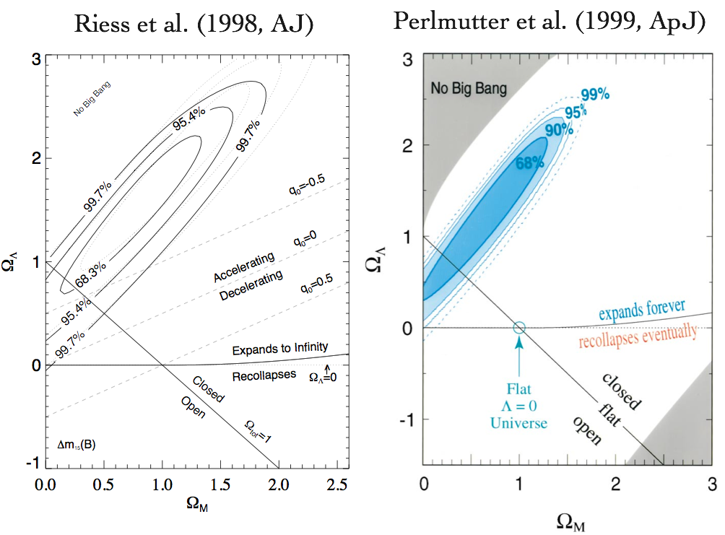
Progress over the last decade

Slide 32
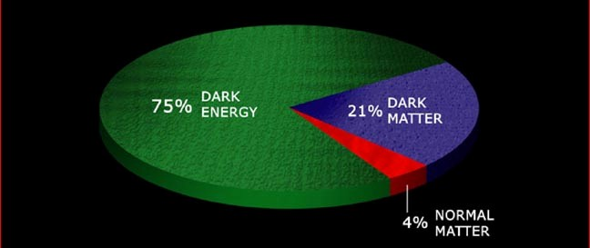
Dark Matter: clumps, holds galaxies and clusters together Dark Energy: smoothly distributed, causes expansion of Universe to speed up
Components of the Universe
Notes:
In recent years, we’ve developed a coherent picture of the constituents of the Universe. 4% is in baryons, the particles of the Standard Model of which we’re made, about 25% dark matter, which dominates the mass in galaxies and clusters of galaxies, and about 70% dark energy, which is nearly uniformly distributed throughout the Universe and which is the leading candidate for explaining why the Universe is speeding up. But how did we arrive at this picture and why do we believe it?

Slide 33
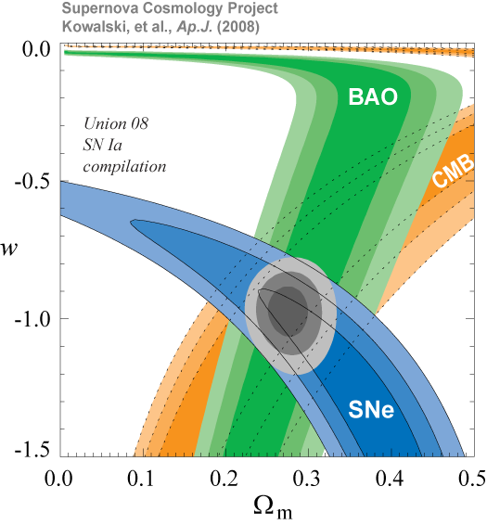
assuming flat Univ. and constant w
Only statistical errors shown

Slide 34
History of Cosmic Expansion
Depends on constituents of the Universe:

Slide 35
Cosmological Observables
Friedmann-
Robertson-Walker
Metric:
where
Comoving distance:

Slide 36
Age of the Universe

Slide 37
Exercise 2:
A. For w=−1(cosmological constant Λ) and k=0:
Derive an analytic expression for H₀t₀ in terms of Plot
B. Do the same, but for
C. Suppose H₀=70 km/sec/Mpc and t₀=13.7 Gyr. Determine in the 2 cases above.
D. Repeat part C but with H₀=72.

Slide 38
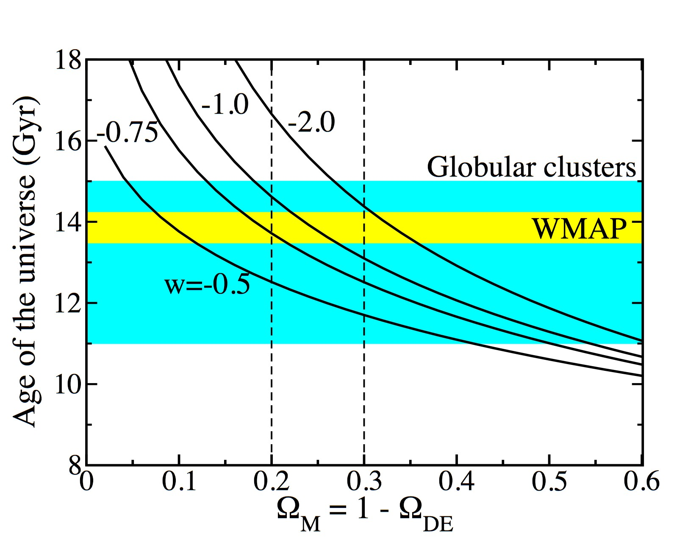
Age of the Universe
×(H₀/72)
(flat)

Slide 39
Angular Diameter Distance
Observer at r =0, t₀ sees source of proper diameter D at coordinate distance r =r₁ which emitted light at t =t₁:
From FRW metric, proper distance across the source is
so the angular diameter of the source is
In Euclidean geometry, so we define the
θ
D
r =0
r =r₁
Angular Diameter Distance:

Slide 40
Luminosity Distance
Source S at origin emits light at time t₁ into solid angle dΩ,
received by observer O at coordinate distance r at time t₀, with
detector of area A:
Proper area of detector given by the metric:
Unit area detector at O subtends solid angle
at S.
Power emitted into dΩ is
Energy flux received by O per unit area is
S
A
θ
r

Slide 41
Include Expansion
Expansion reduces received flux due to 2 effects:
1. Photon energy redshifts:
2. Photons emitted at time intervals δt₁ arrive at time
intervals δt₀:
Luminosity Distance
Convention: choose a₀=1

Slide 42
Worked Example I
For w=−1(cosmological constant Λ):
Luminosity distance:

Slide 43
Worked Example II
For a flat Universe (k=0) and constant Dark Energy equation of state w:
Luminosity distance:
Note: H₀d_{L} is independent of H₀

Slide 44
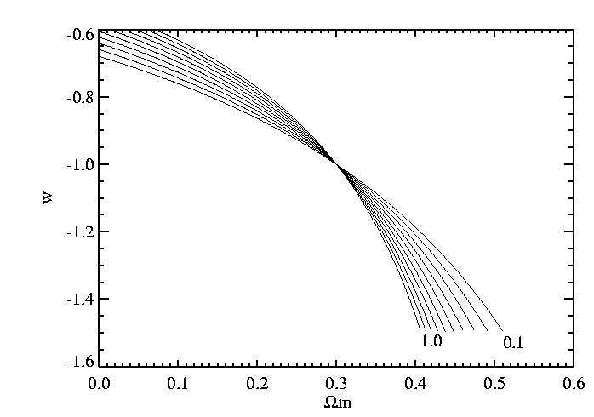
Dark Energy Equation of State
Curves of
constant d_{L}
at fixed z
Flat Universe
z =

Slide 45
Exercise 3
Make the same plot for Worked Example I: plot curves of constant luminosity distance (for several choices of redshift between 0.1 and 1.0) in the plane of , choosing the distance for the model with as the fiducial.
In the same plane, plot the boundary of the region between present acceleration and deceleration.
Extra credit: in the same plane, plot the boundary of the region that expands forever vs. recollapses.

Slide 46
Bolometric Distance Modulus
Logarithmic measures of luminosity and flux:
Define distance modulus:
For a population of standard candles (fixed M), measurements of μ vs. z, the Hubble diagram, constrain cosmological parameters.
flux measure redshift from spectra

Slide 47
Exercise 4
Plot distance modulus vs redshift (z=0-1) for:
Flat model with
Flat model with
Open model with
Plot first linear in z, then log z.
Plot the residual of the first two models with respect to the third model

Slide 48
Log(distance)
Discovery of Cosmic Acceleration from
High-redshift
Supernovae
Type Ia supernovae that exploded when the Universe was 2/3 its present size are ~25% fainter than expected
Accelerating
Ω_{Λ} = 0.7
Ω_{Λ} = 0.
Ω_{m} = 1.
Not accelerating
redshift

Slide 49
Distance and q₀

Slide 50
Distance and q₀
Recall

Slide 51
Distance and q₀
Recall

