Slide 1
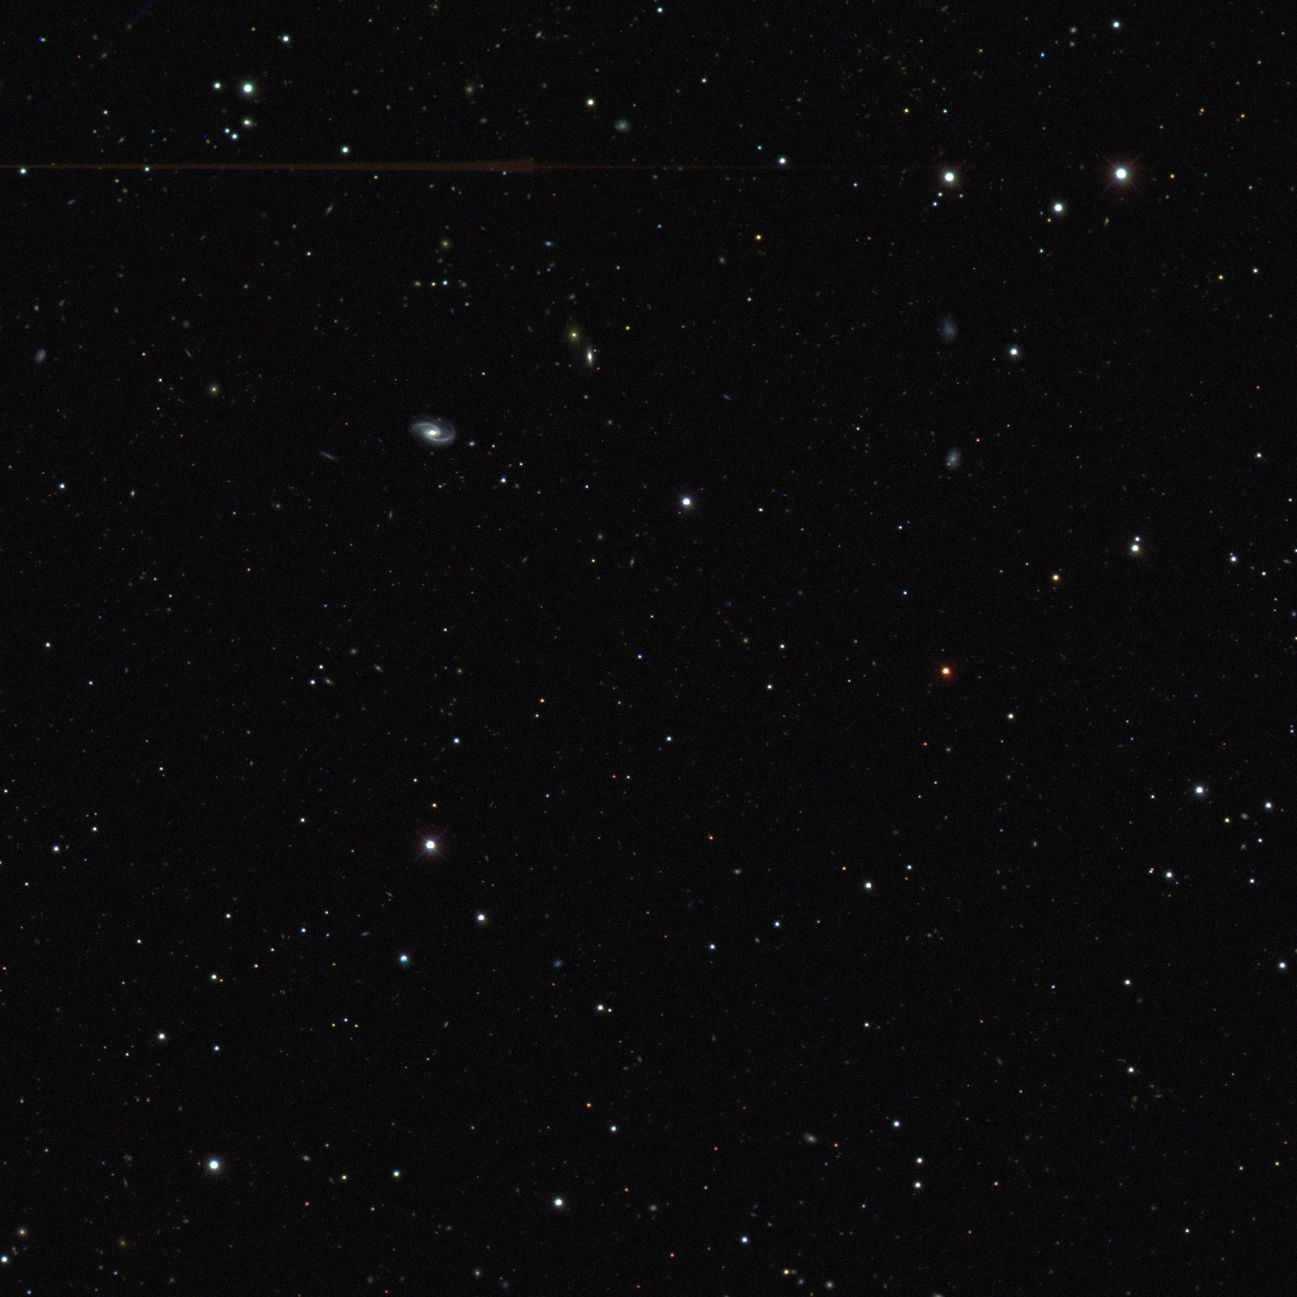
Science of the Dark Energy Survey
Josh Frieman
Astronomy 41100
Lecture 5, Fall 2016

Slide 2
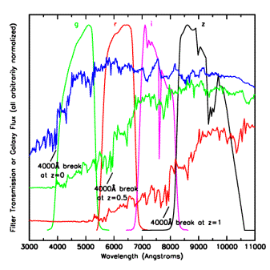
Photometric Redshifts
• Measure relative flux in multiple
filters (colors)
• Fit colors to template spectra or
use spectroscopic data to train
empirical z=f(colors) relation.
• Estimate galaxy redshifts with
accuracy σ(z) < 0.1 (~0.01 for
clusters)
• Precision is sufficient for Dark
Energy probes, provided error
distributions well measured.
Challenge: spectroscopic data
not complete to depth of survey
Elliptical galaxy spectrum

Slide 3
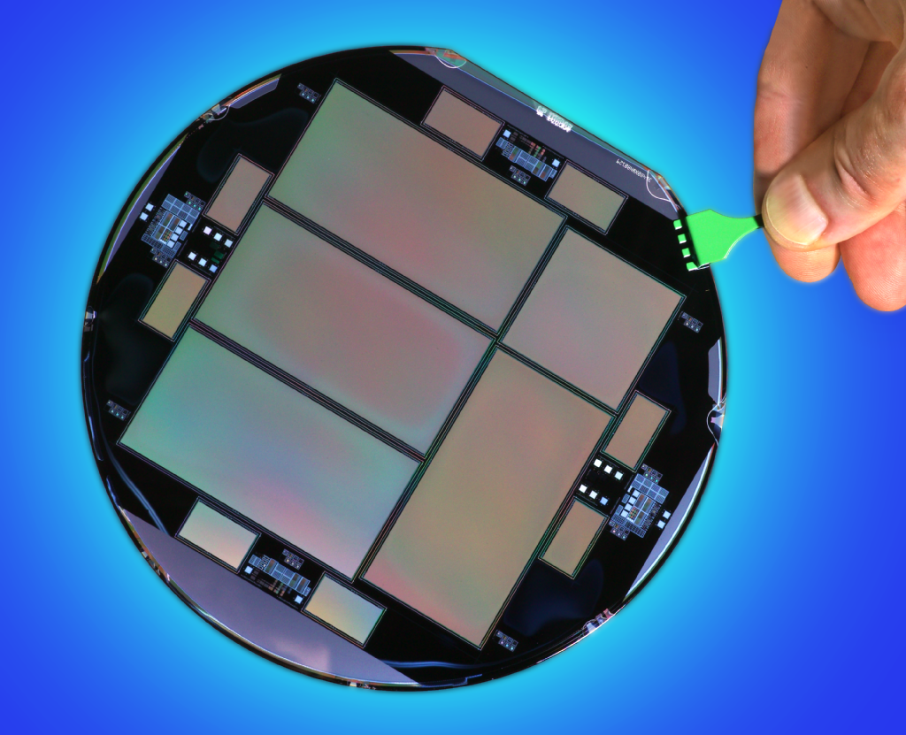
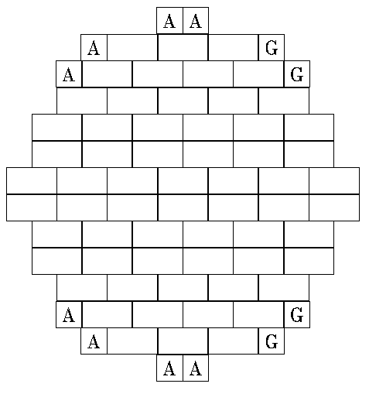
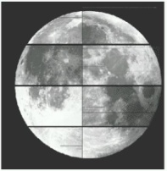
DECam CCDs
62 2kx4k fully depleted CCDs: 520 Megapixels, 250 micron thick, 15 micron (0.264”) pixel size
12 2kx2k guide and focus chips
Excellent red sensitivity
Developed by LBNL, packaged and tested at FNAL
Total 570 Megapixels
2.2 deg

Slide 4
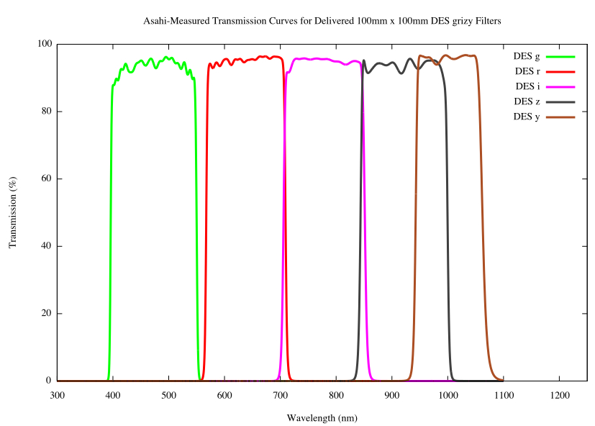
DECam CCDs
62 2kx4k fully depleted CCDs: 520 Megapixels, 250 micron thick, 15 micron (0.264”) pixel size
12 2kx2k guide and focus chips
Excellent red sensitivity
Developed by LBNL, packaged and tested at FNAL
Total 570 Megapixels
g r i z Y
DES filters
2.2 deg

Slide 5
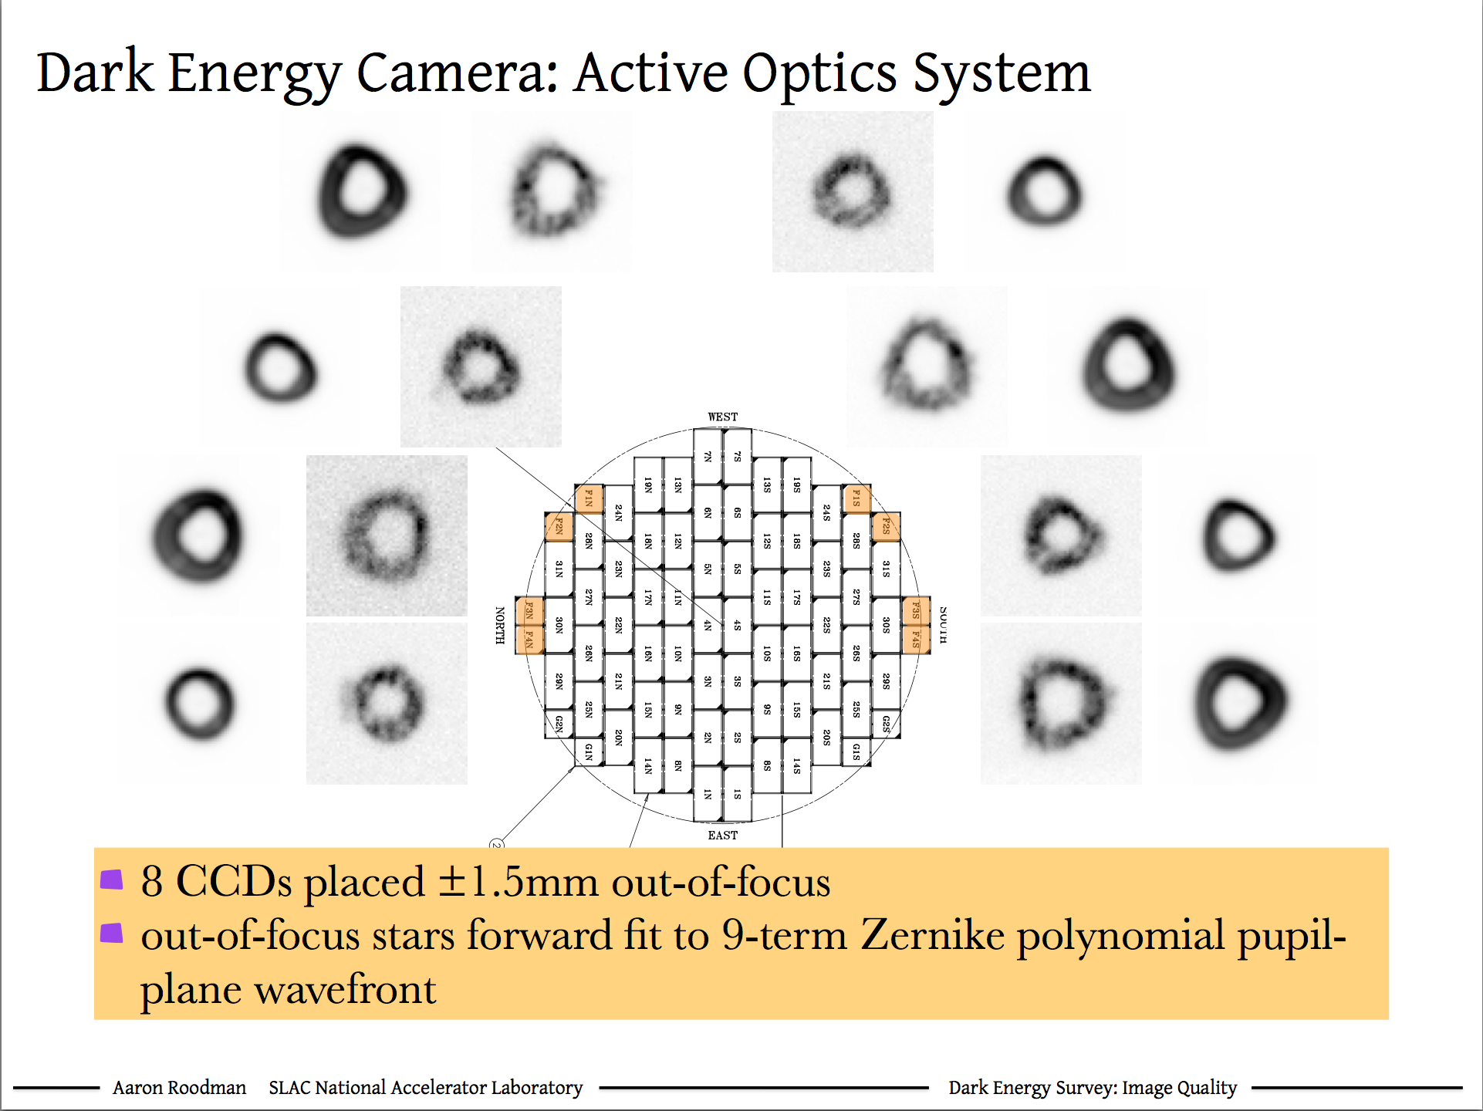

Slide 6
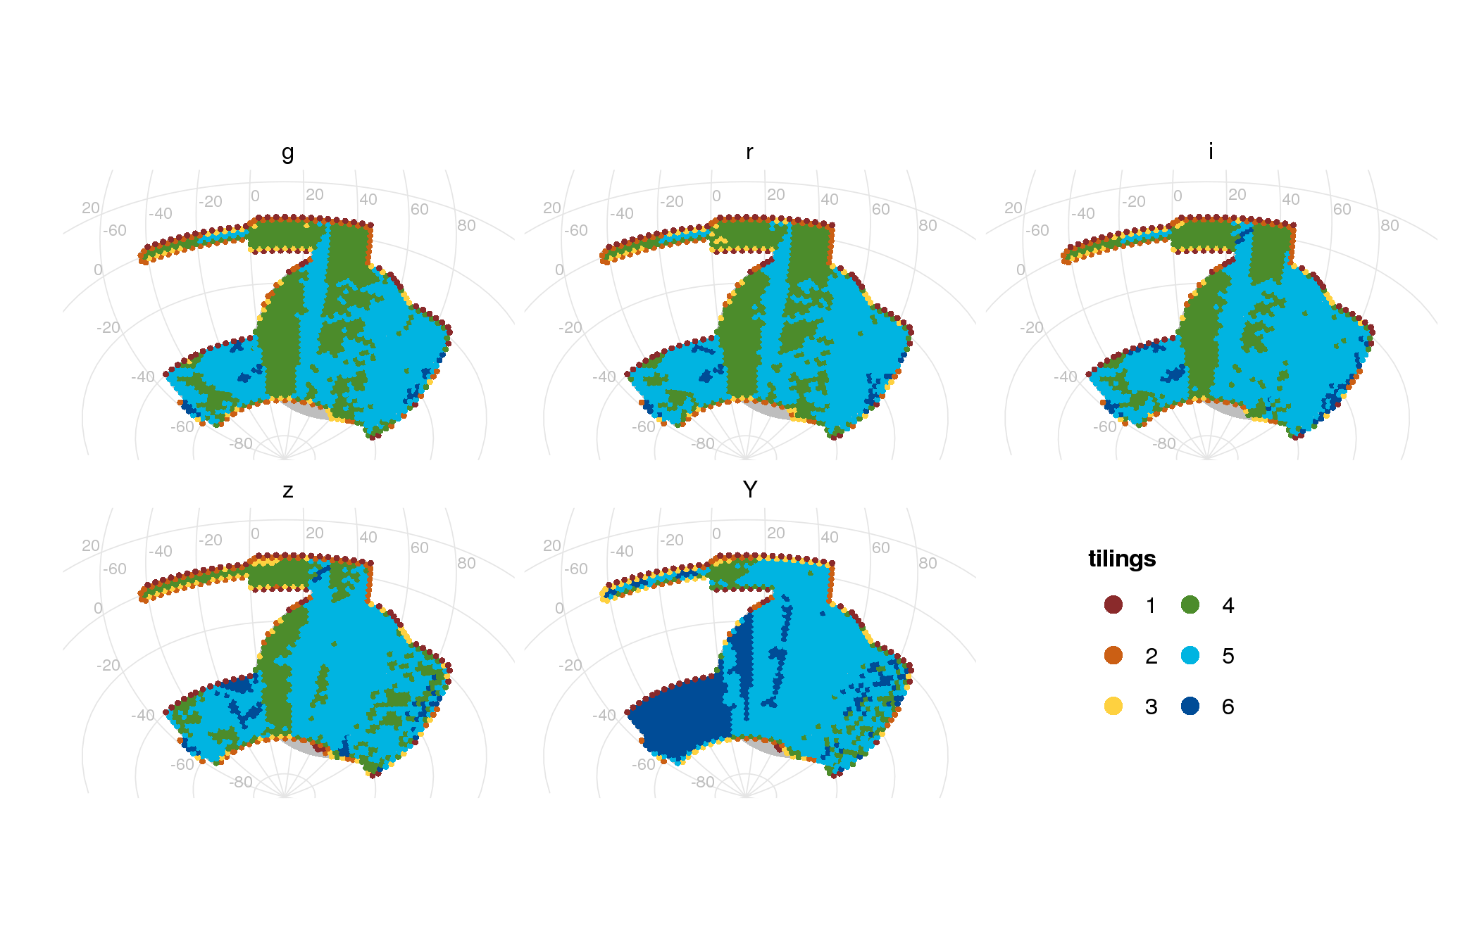
Current DES Survey Progress
Tiling=One 90 sec exposure over entire footprint
Galactic plane
SPT
region
5000 sq. deg.
Baseline goal was 6 tilings after 3 years
At end of Year 3 (Feb. 2016), following major El Nino

Slide 7
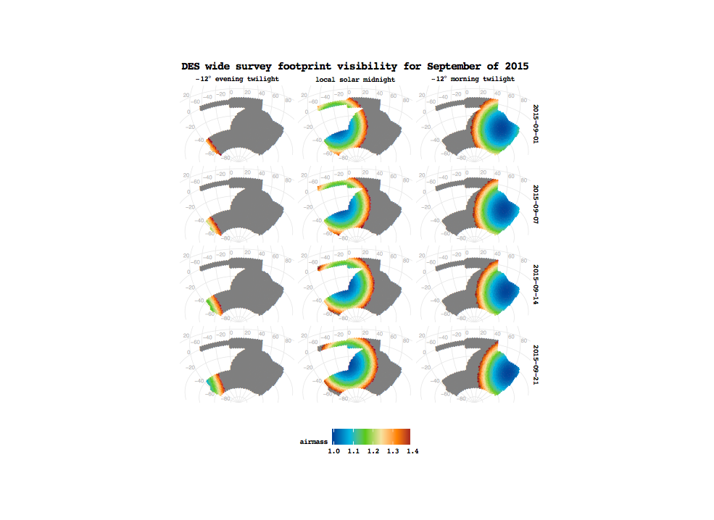

Slide 8
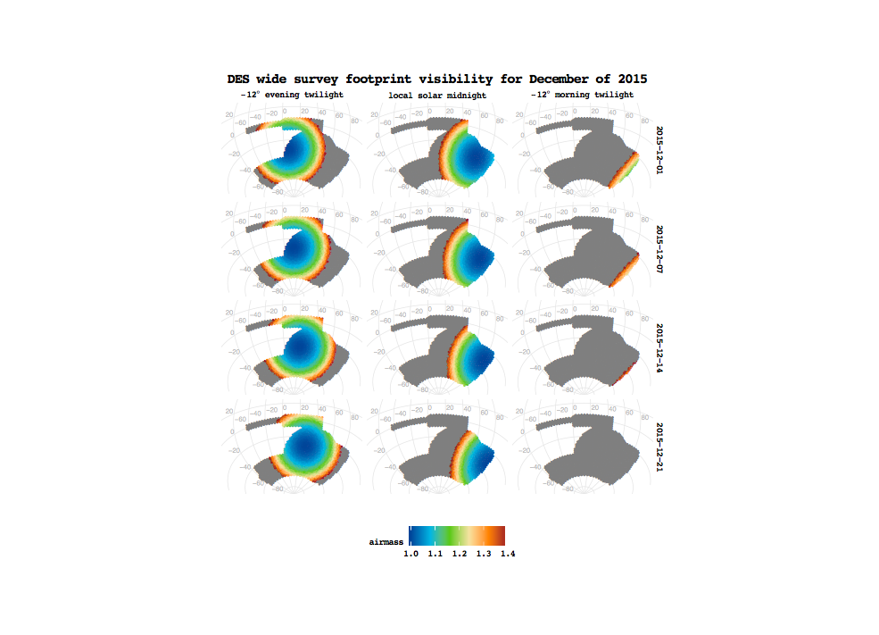

Slide 9
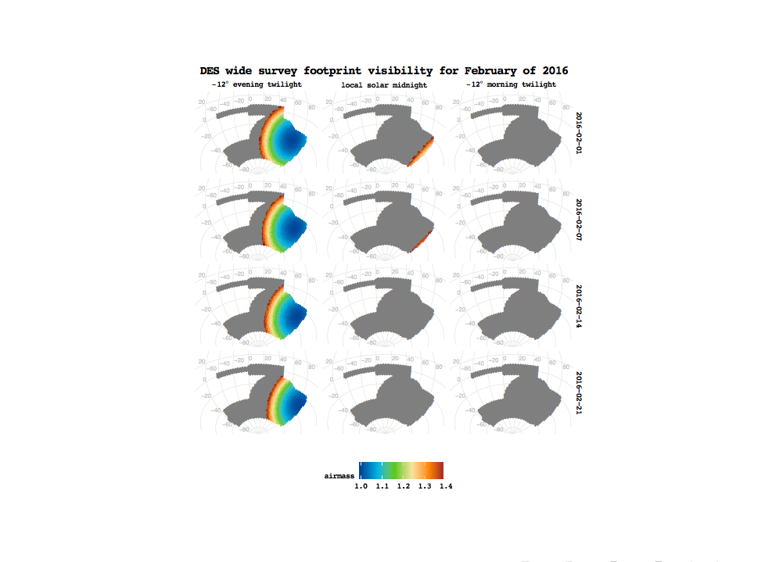

Slide 10
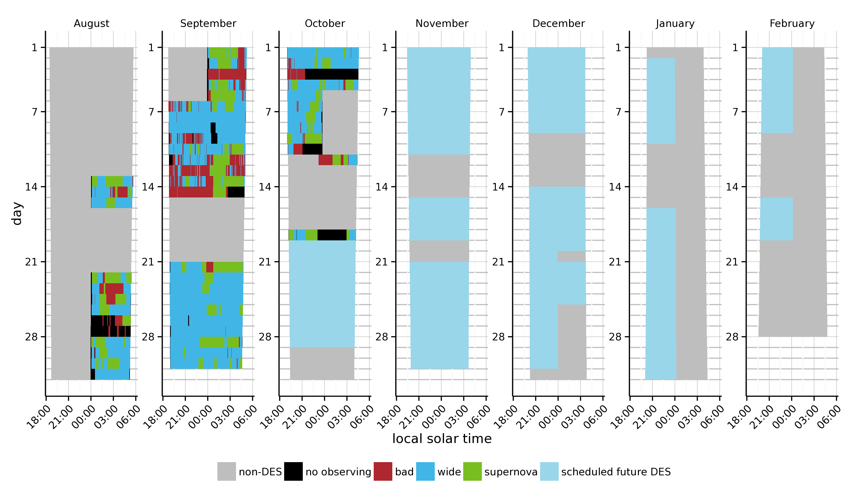

Slide 11
Survey Tactics (simplified)
E. Neilsen
Use time with poorer seeing for supernova, but do supernova when not done for a week to maintain cadence.
Use time when the moon is up for redder filters, because moonlight is blue.

Slide 12
DES Image Quality
DECam signals and noise are within few % of forecasts
Median delivered FWHM in riz is close to 0.90” specified for weak lensing
Accepted riz wide-area exposures
(first two seasons)
Galactic plane
Number of Exposures
SPT
region
Median 0.92”
5000 sq. deg.
Delivered FWHM (arcsec)
12

Slide 14
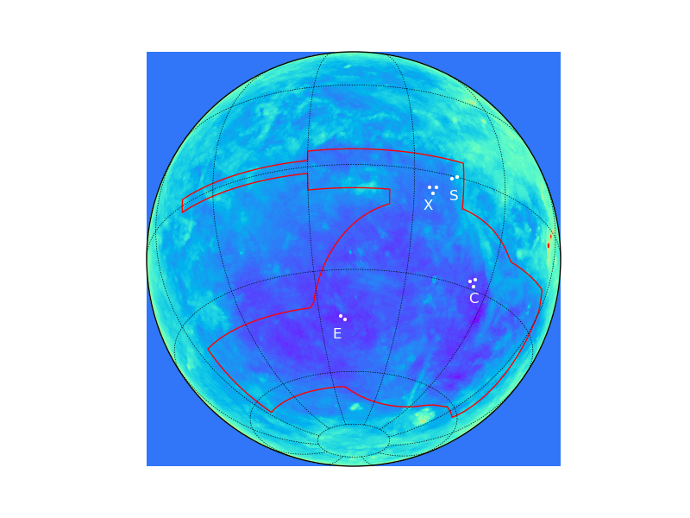
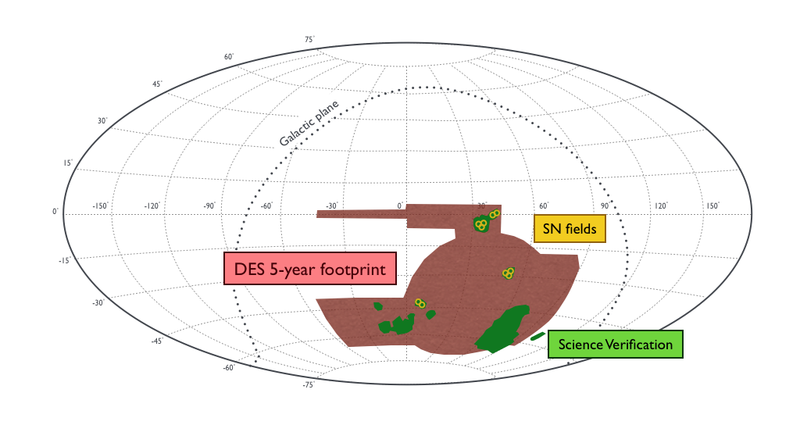
DES Survey Footprint
Milky Way
dust
10 SN
Fields, each observed every ~6 nights
Galactic plane
5000 sq deg
SPT-E region:
Focus of early
Science analyses
SPT
region
5000 sq. deg.
Science Verification region used for early papers:
~150 sq. deg. to ~full depth (3% of DES survey area)

Slide 15
DES SV Galaxy Distribution
2.3M galaxies
used in LSS analysis,
0.2<z<1.2
i<22.5
115 sq deg after cuts
SPT
region

Slide 16
DES Year 1 Galaxy Distribution
SPT
region
SV area
First Year of Data: ~1500 square degrees

Slide 17

DES Mass Map from Weak Lensing
Galaxy clusters
SZ Spectrum
Clusters
30 Mpc
high-𝜆 (>70)
Chang, et al
Vikram, et al

Slide 18
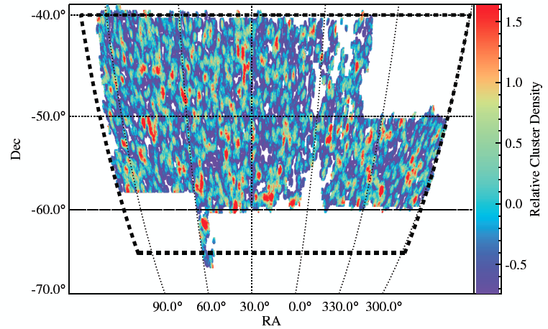
Cluster Catalogs
  redMAPPer: identify clusters and determine richness (λ) & redshift via sequence of red cluster galaxies (Rykoff, et al)
SV: ~800 clusters Year 1: ~8400 clusters
to z~0.9 with richness λ>20 (M>10¹⁴ M_{sun})

Slide 19
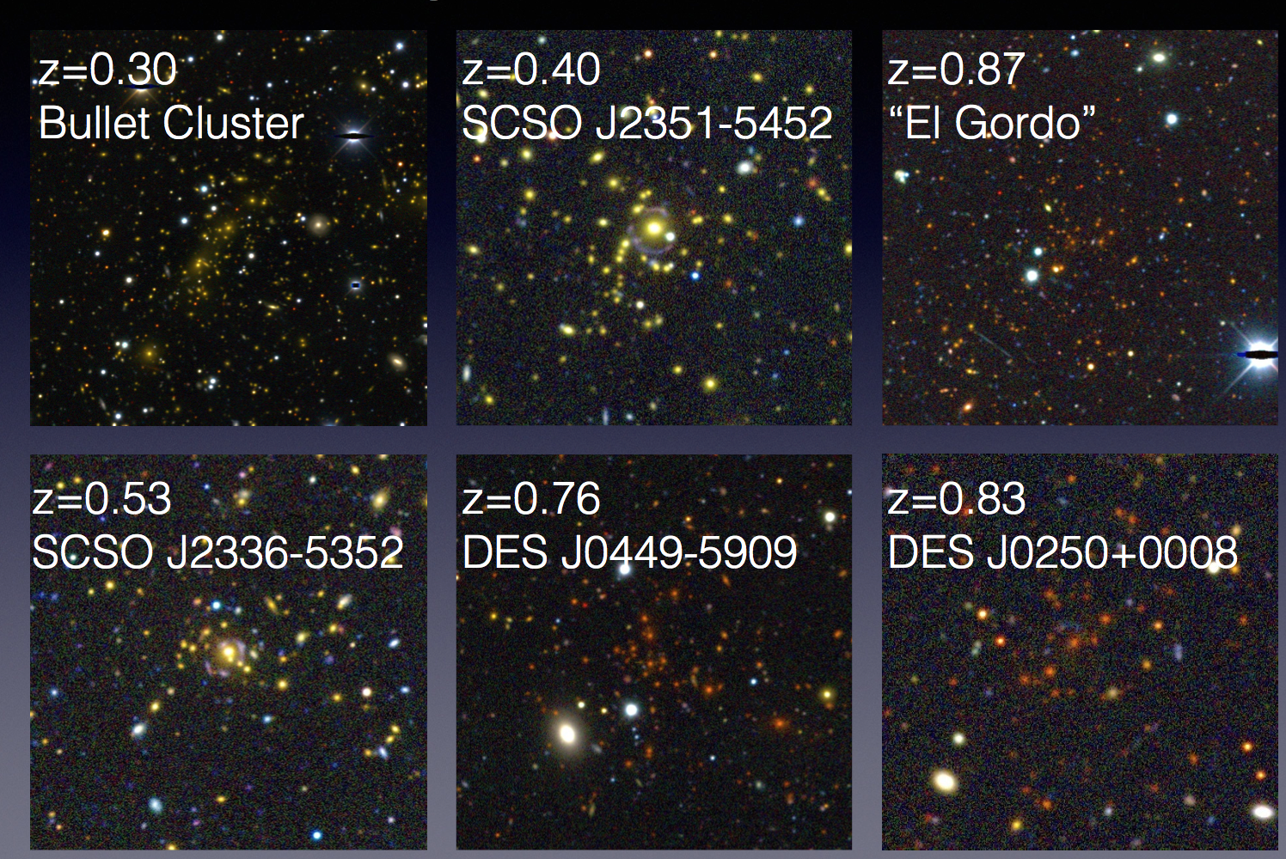
Galaxy Clusters in SV
Slide from E. Rykoff

Slide 20
Galaxy Clusters in SV

Slide 21
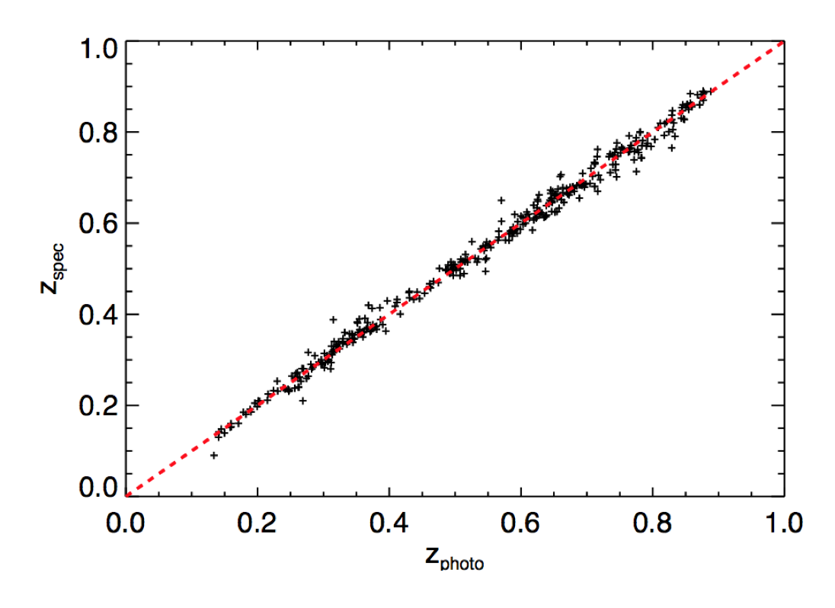
DES Cluster Photometric Redshifts
Redshifts from SDSS, OzDES, VVDS, SPT follow-up
Rykoff, Rozo, etal

Slide 22
DES Dark Energy Probes
Galaxy Clusters
  Tens of thousands of clusters to z~1
Weak Lensing
  Shape measurements of 200 million galaxies
Galaxy Clustering
  300 million galaxies to z ~ 1
Supernovae
  3000 well-sampled SNe Ia to z ~1
Strong Lensing
  ~30 QSO lens time delays
  Arcs with multiple source redshifts
Cross-correlations
  Galaxies, WL x CMB lensing
DES forecast
(T. Eifler, E. Krause)

Slide 23
Weak Lensing
Background
sources
Dark matter halos
Observer
Spatially coherent shear pattern, ~1% distortion
Radial distances depend on expansion history of Universe
Foreground mass distribution depends on growth of structure

Slide 24
Gravitational Lensing
A simple scattering experiment:
α
Observer
Galaxy cluster/lens
Background source

Slide 25
Gravitational Lensing
S
α
θ_{I}
θ_{s}
L
O
Lens equation:
The deflection α is sensitive to all mass, luminous or dark. Thus, lensing probes the dark matter halos of distant galaxies
and clusters.

Slide 26
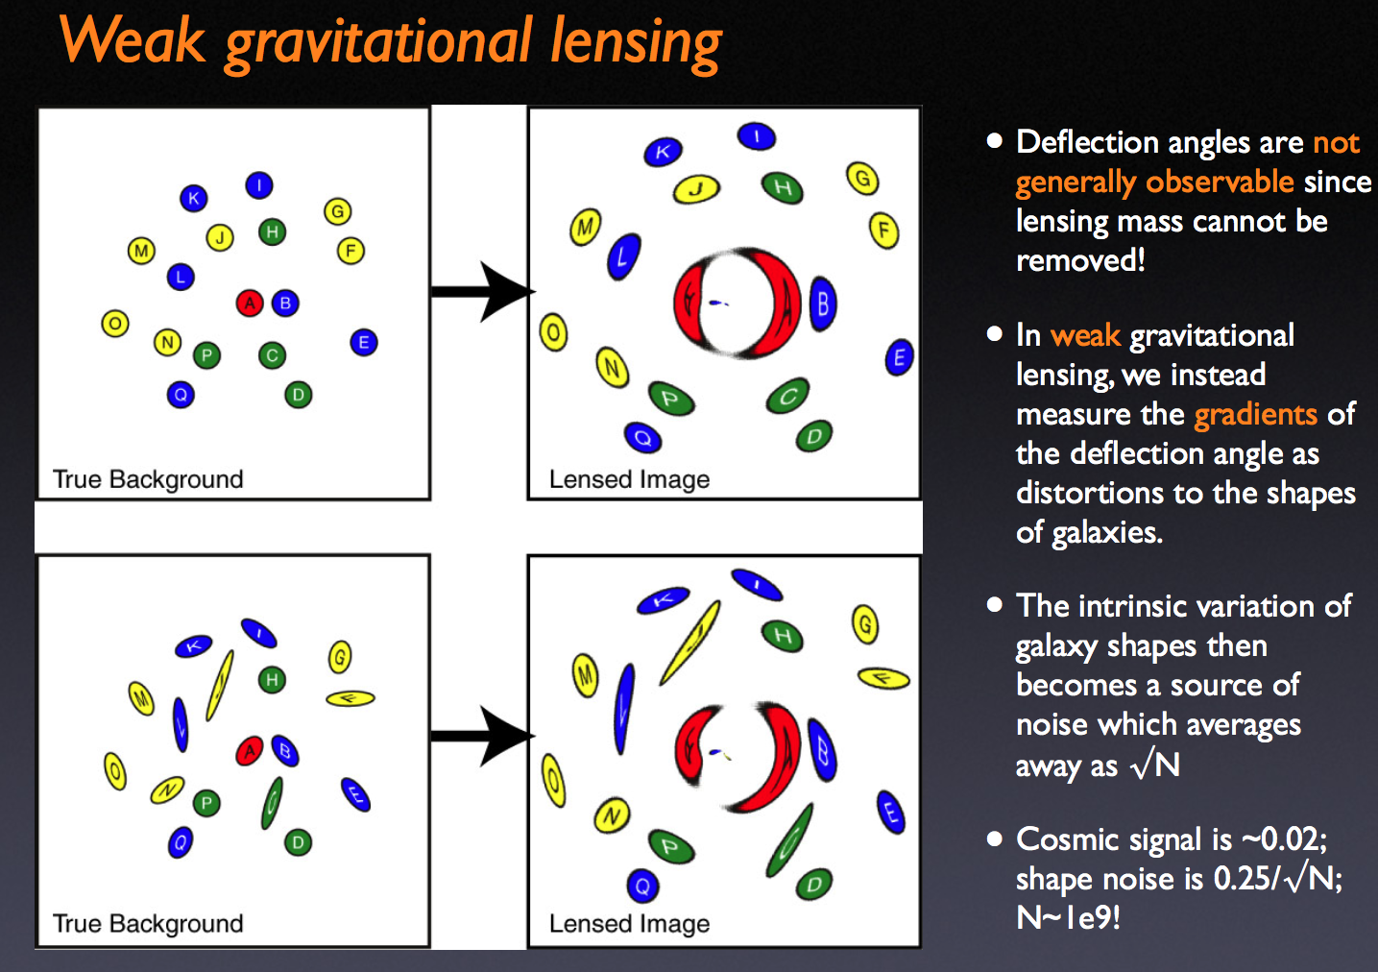

Slide 27
Lensing Tomography
z_{l1}
z_{l2}
z₁
lensing mass
z₂
Shear at z₁ and z₂ given by integral of growth function & distances over lensing mass distribution.

Slide 28

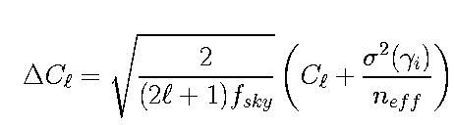
Weak Lensing Tomography
• Shear-shear & galaxy-shear correlations probe distances &
growth rate of perturbations: angular power spectrum
• Galaxy correlations determine galaxy bias priors
Statistical errors on shear-shear correlations:
cosmic variance shape noise
Requirements: Sky area, depth, image quality & stability

Slide 29
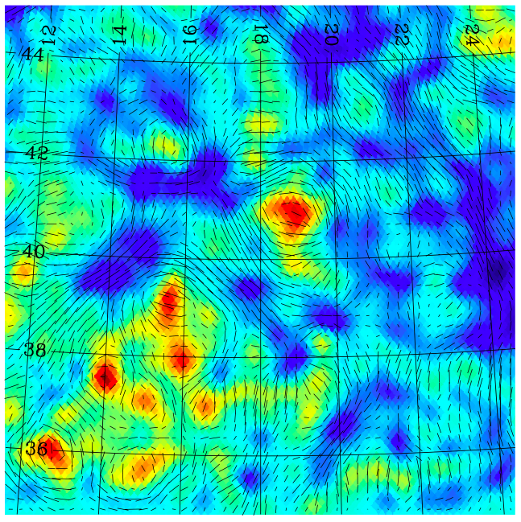
Weak Lensing Mass and Shear
DES Simulation
Tick marks: shear
Colors: projected
mass density
Becker, Kravtsov, etal

Slide 30
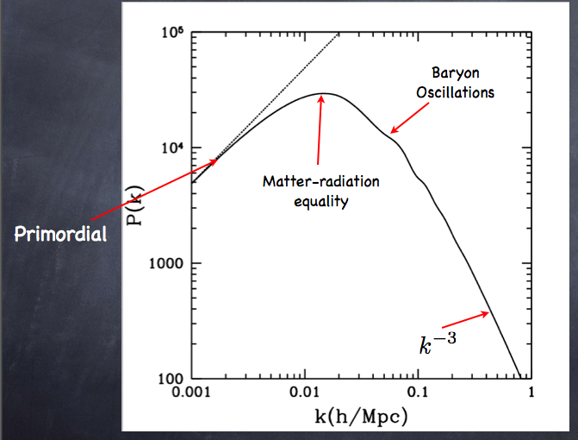
Cold Dark Matter Models
Power Spectrum
of the Mass Density

Slide 31
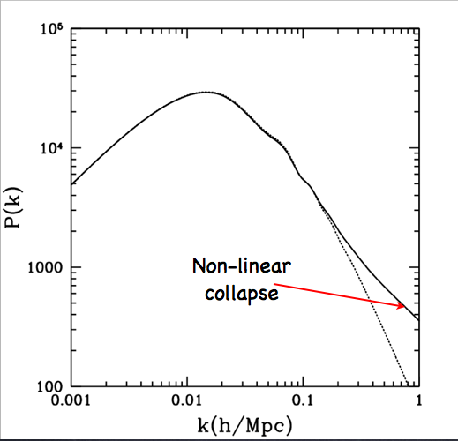

Slide 32
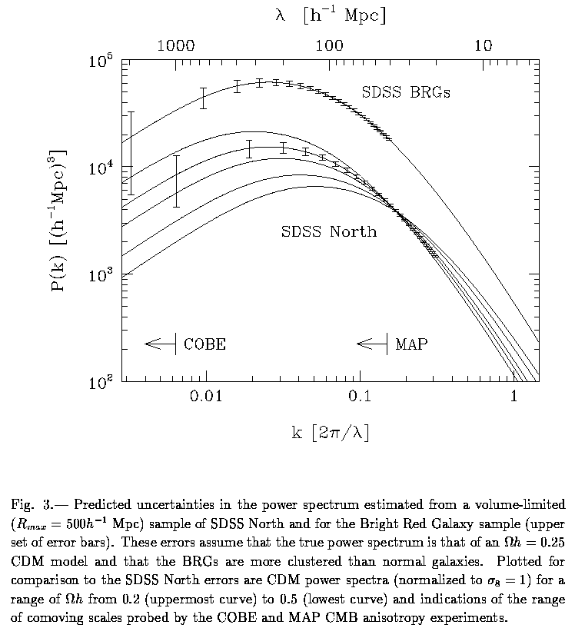
Cold Dark Matter
Models
Theoretical
Power Spectrum
of the Mass Density
P ~ k^{n}
Ω_{m}h =0.2
P ~ k^{–3}
Ω_{m}h =0.5
k_{eq} ~ Ω_{m}h
Power spectrum measurements probe cosmological parameters
Linear
Non-linear
h/Mpc

Slide 33
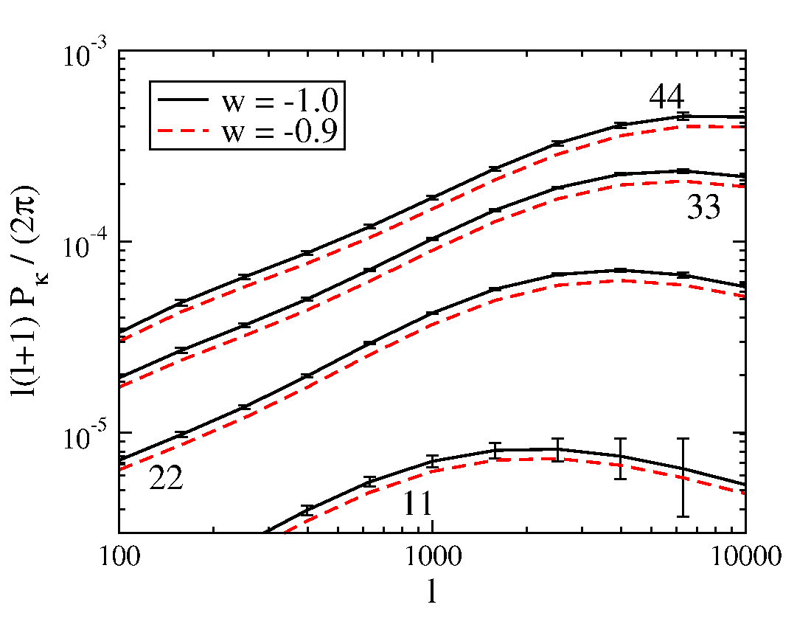
Weak Lensing Tomography
Huterer etal
Cosmic Shear Angular Power Spectrum in 4
Photo-z Slices
Shapes of ~200 million well-resolved galaxies,
⟨z⟩ = 0.7
Systematics Challenges:
photo-z’s, intrinsic alignments, PSF anisotropy, shear calibration, nonlinear+baryon P(k) effects
DES forecast
Statistical errors
shown
Non-linear regime
33

Slide 34
Weak Lensing Systematics
Shear calibration errors
PSF anisotropy correction errors
Intrinsic alignments
Photometric redshift errors

Slide 35
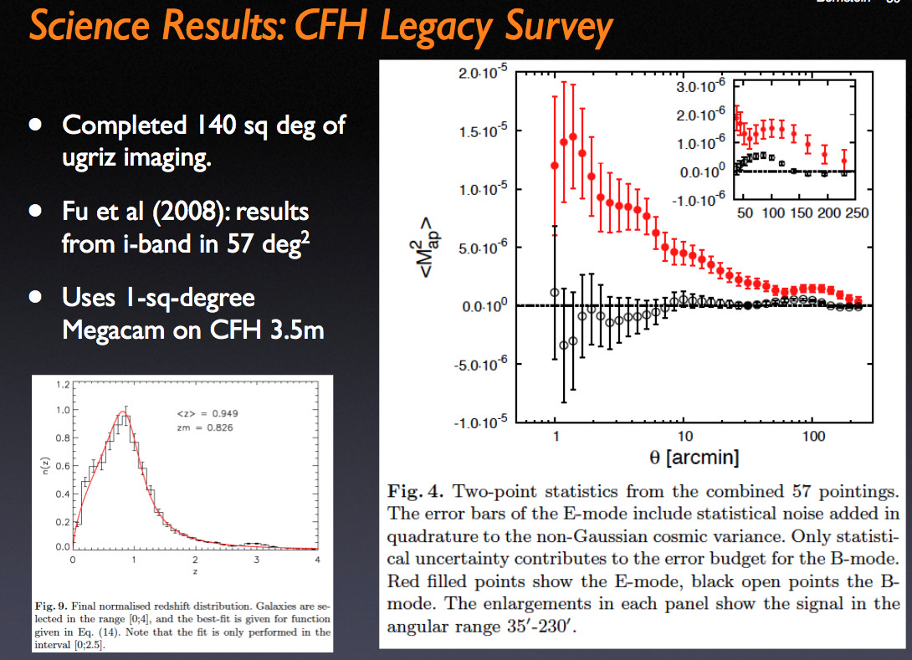

Slide 36
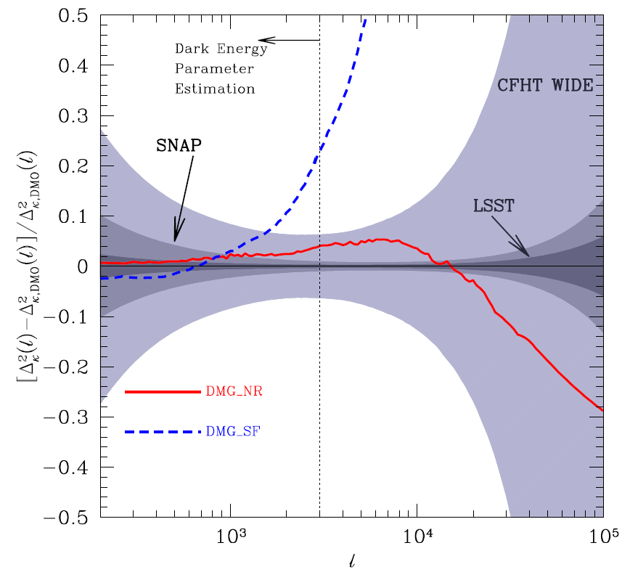
Theory Uncertainty in P(k) and WL
Residual of the shear convergence power spectrum relative to simulation with dark matter only
WL data can be used
to self-calibrate baryon
impact
Zentner, Rudd, Hu, Kravtsov

Slide 37
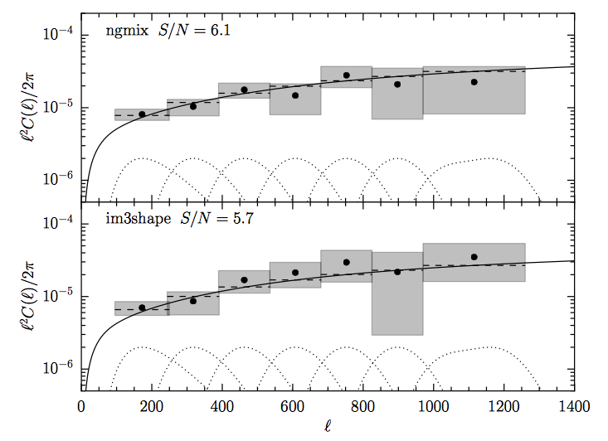
SV Weak Lensing Cosmic Shear
Shear-shear angular power spectrum
Two independent shear pipelines used.
Becker, et al, Jarvis et al

Slide 38
Cosmology from DES SV Cosmic Shear
Clustering amplitude
Matter density
DES collaboration 2015

Slide 39
Cosmology from DES SV Cosmic Shear
Dark Energy Equation of State
DES collaboration 2015

Slide 40
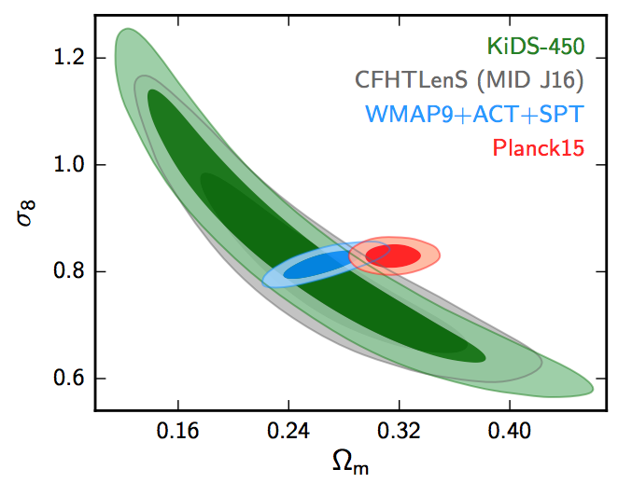
WL Cosmic Shear vs. Planck?
150 sq deg of early DES data: 3% of full survey
Clustering amplitude
DES collaboration 2015
Hildebrandt, etal 2016
Heymans etal 2013, Joudaki, etal 2016

Slide 41
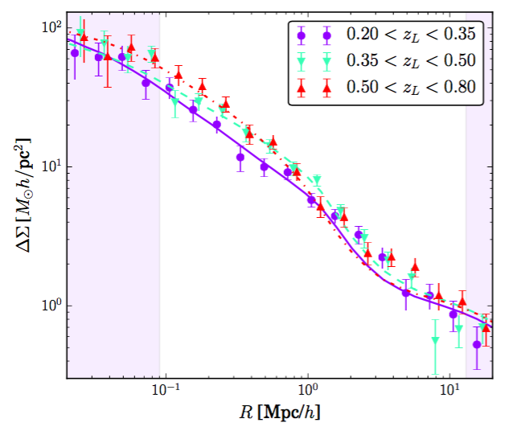
DES SV Galaxy-galaxy Lensing
Mean galaxy mass profiles from stacked tangential shear of background sources
Halo model
Clampitt, et al

Slide 42
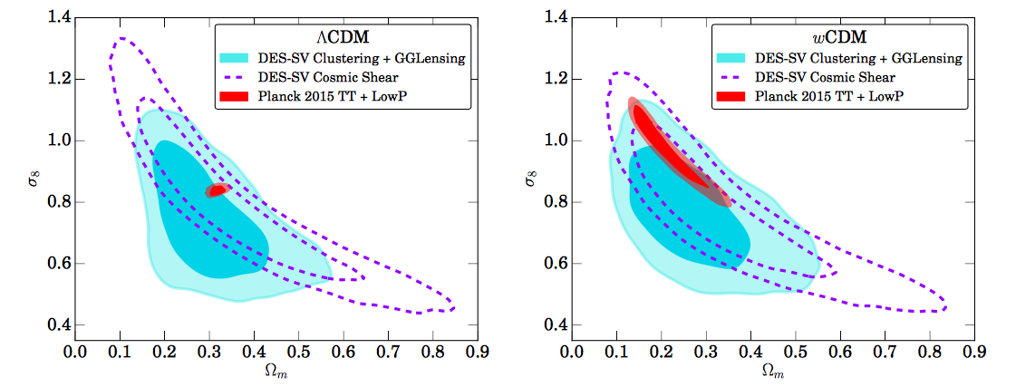
Cosmology Constraints: Galaxy-galaxy Lensing+Galaxy Clustering in SV
Kwan, et al
Clampitt, et al
Crocce, et al
Near future: Clustering+GGLensing+Cosmic Shear from Y1

Slide 43
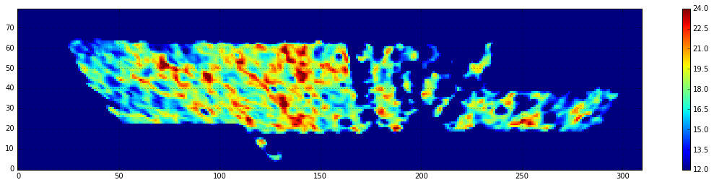
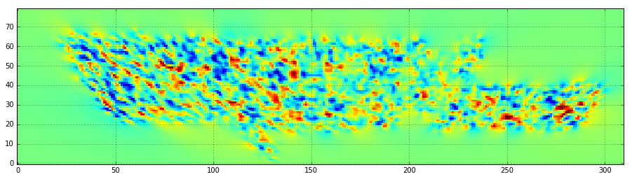
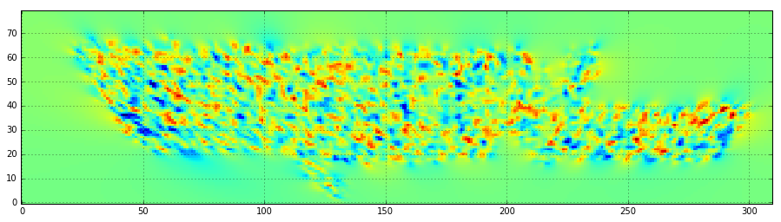
DES Year 1 Galaxy and WL Maps
Galaxies
Kappa E
SPT
region
Kappa B
First Year of Data: ~1000 square degrees
43

Slide 44
III. Large-scale Structure
MICE N-body simulation from DES Barcelona group

Slide 45
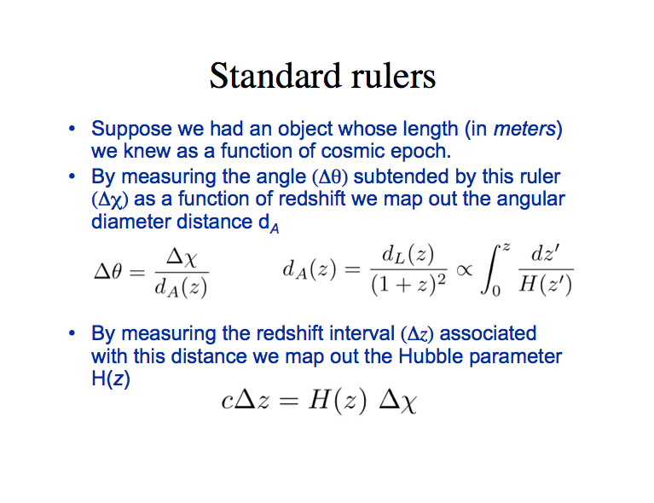

Slide 46
CMB: Sound Waves in the Early Universe
Before recombination:
  Universe is ionized.
  Photons provide enormous pressure and restoring force.
  Photon-baryon perturbations oscillate as acoustic waves.
After recombination:
  Universe is neutral.
  Photons can travel freely past the baryons.
  Phase of oscillation at t_{rec} affects late-time amplitude.
Recombination &
Last scattering
z ~ 1000
~400,000 years
Ionized
Neutral
Today
Time

Slide 47
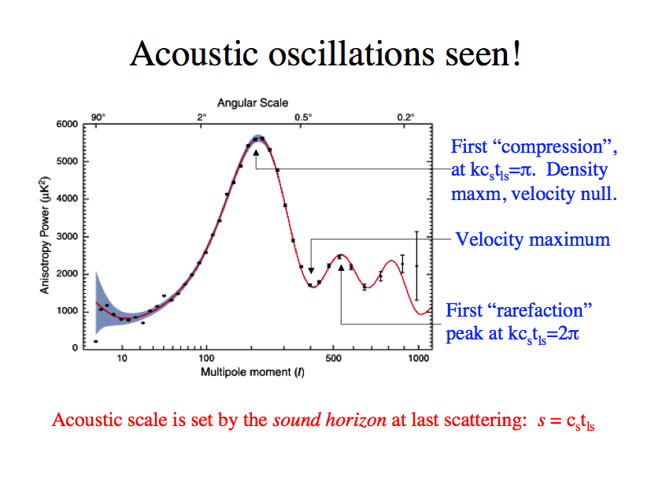
WMAP

Slide 48
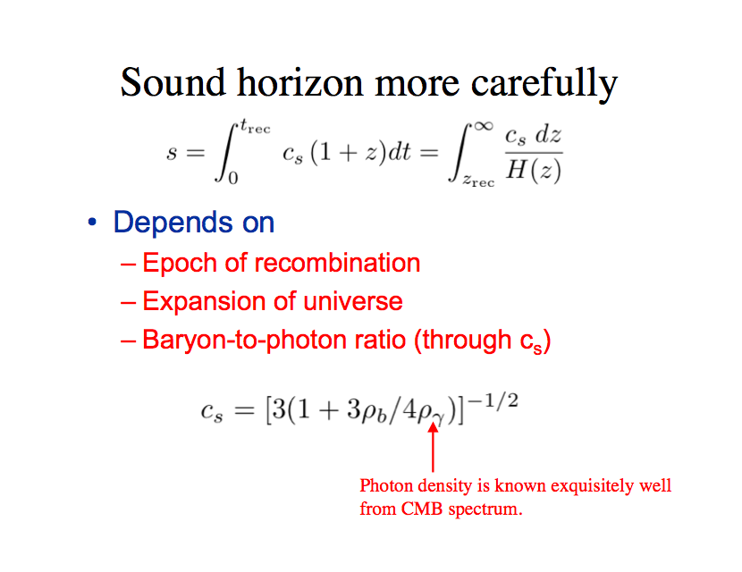
Standard ruler

Slide 49
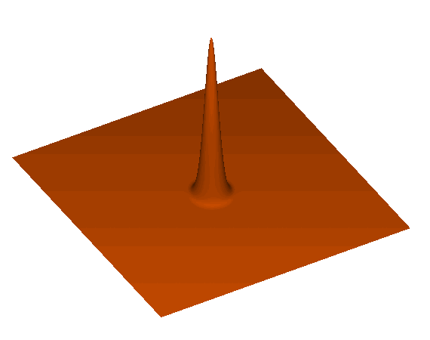
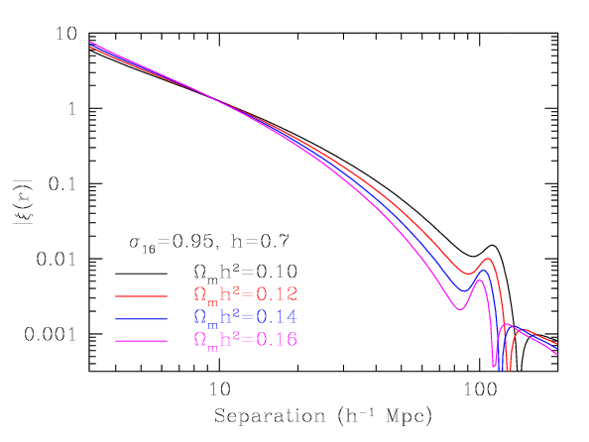
Baryon Acoustic Oscillations
Each initial overdensity (in dark matter & gas) is an overpressure that launches a spherical sound wave.
This wave travels outwards at 57% of the speed of light.
Pressure-providing photons decouple at recombination. CMB travels to us from these spheres.
Sound speed plummets. Wave stalls at a radius of 150 Mpc.
Overdensity in shell (gas) and in the original center (DM) both seed the formation of galaxies. Preferred separation of 150 Mpc.
Galaxy correlation
function
Eisenstein

Slide 50
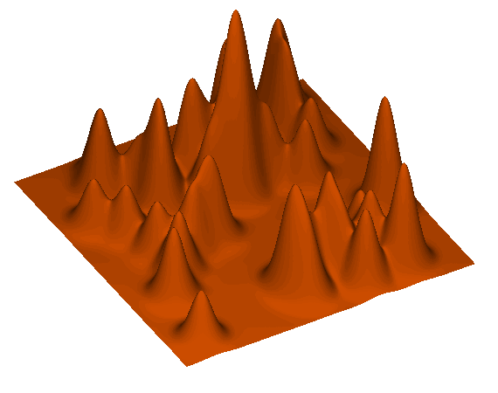
A Statistical Signal
The Universe is a super-position of these shells.
The shell is weaker than displayed.
Hence, you do not expect to see bulls’ eyes in the galaxy distribution.
Instead, we get a 1% bump in the correlation function.

Slide 51
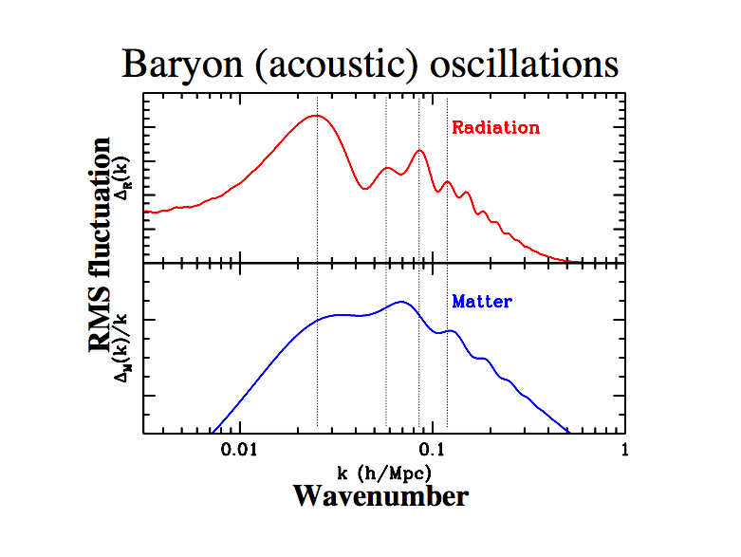

Slide 52
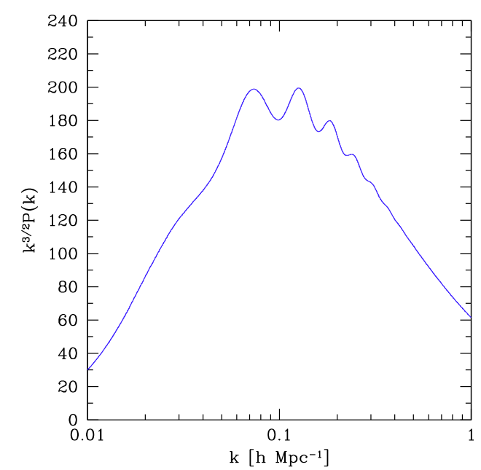
Power Spectrum

Slide 53
Galaxy
CMB
Slide from
E. Gaztanaga,
DES Spain

Slide 54
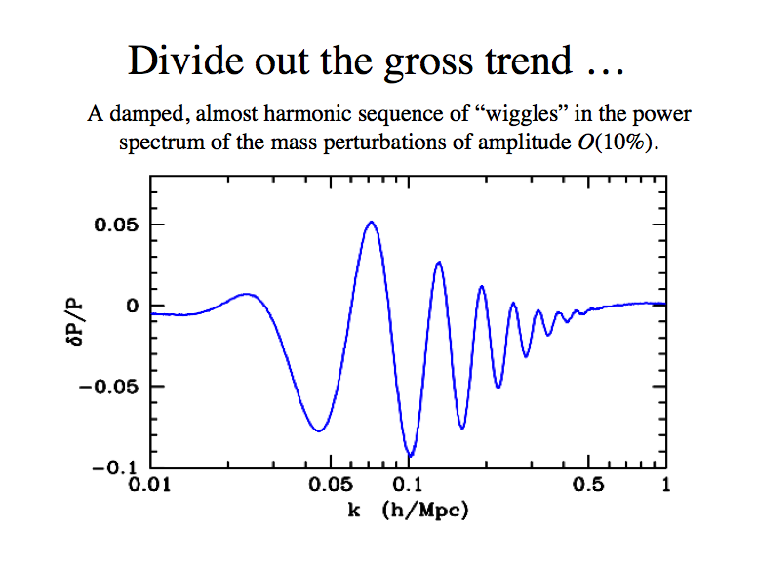
k_{A}=2π/s

Slide 55
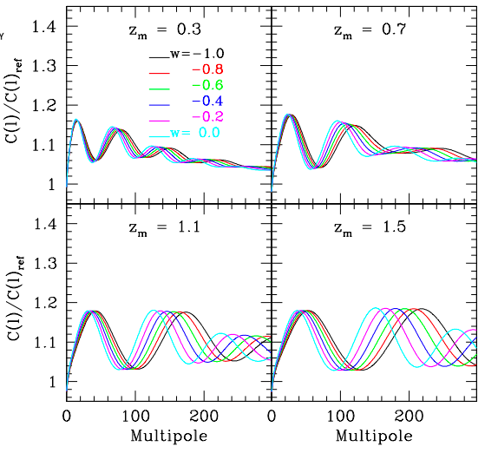
Galaxy Clustering & BAO
Galaxy angular
power spectrum
in photo-z bins (relative to model without BAO)
Fosalba & Gaztanaga

Slide 56
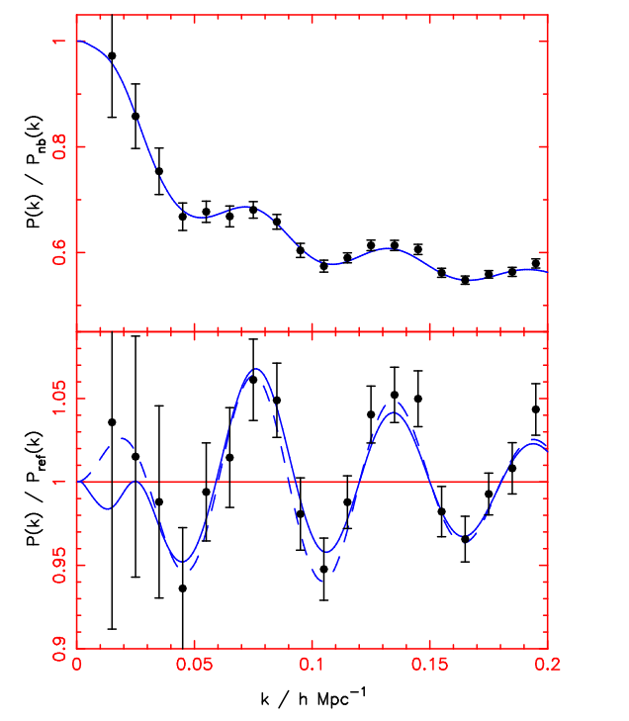
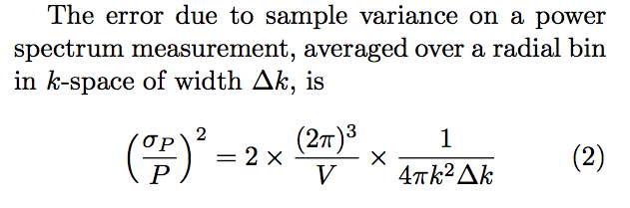
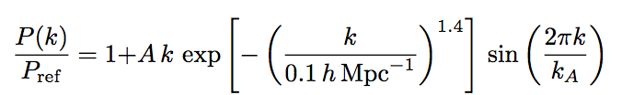
Statistical Errors
plus Poisson errors: multiply by (1+1/nP)²
Assumes Gaussian errors (linear theory)
Fit with::

Slide 57
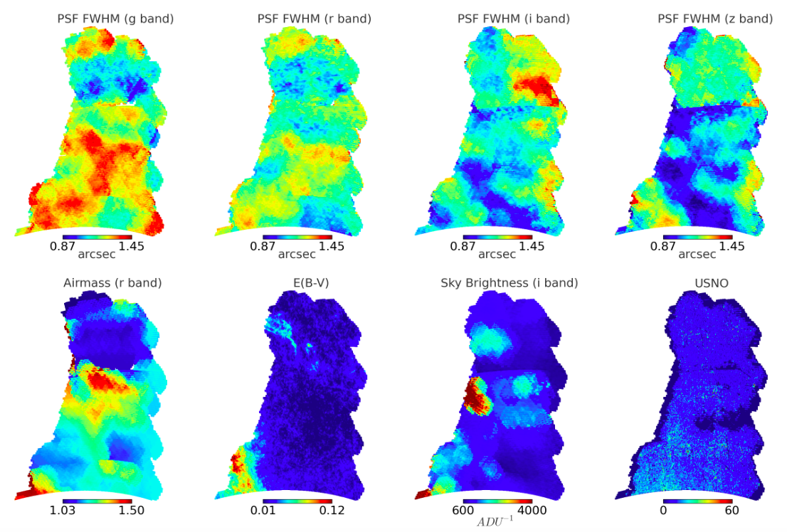
SV Systematics Maps for LSS
SPT
region
Leistedt, et al

Slide 58
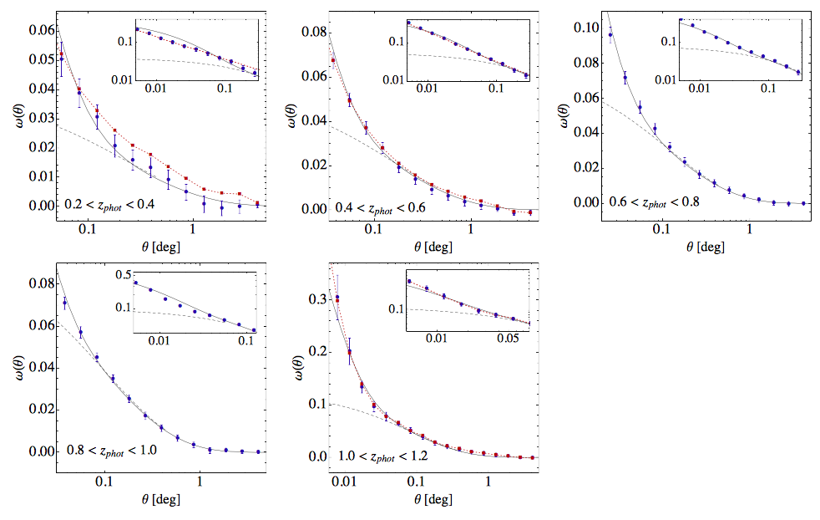
DES SV Galaxy Clustering
Curves:
Planck cosmology (dashed: linear theory,
solid: non-linear)
with 1 free bias parameter per z bin
(red: uncorrected for systematics)
Angular separation
Crocce, et al

Slide 59
DES SV Galaxy Clustering
Curves:
Planck cosmology (dashed: linear,
solid: non-linear)
with 1 free bias parameter
Galaxy-shear correlation function
high-𝜆 (>70)
Crocce, et al

Slide 60
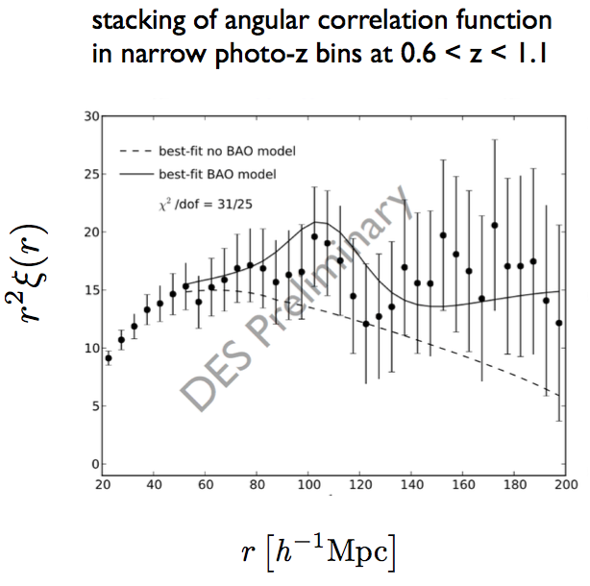
Preliminary DES Y1 BAO Results
Red galaxies: high bias, good photo-z’s
Expect 4.5% angular diameter distance measurement at z~0.8 in Y1

Slide 61
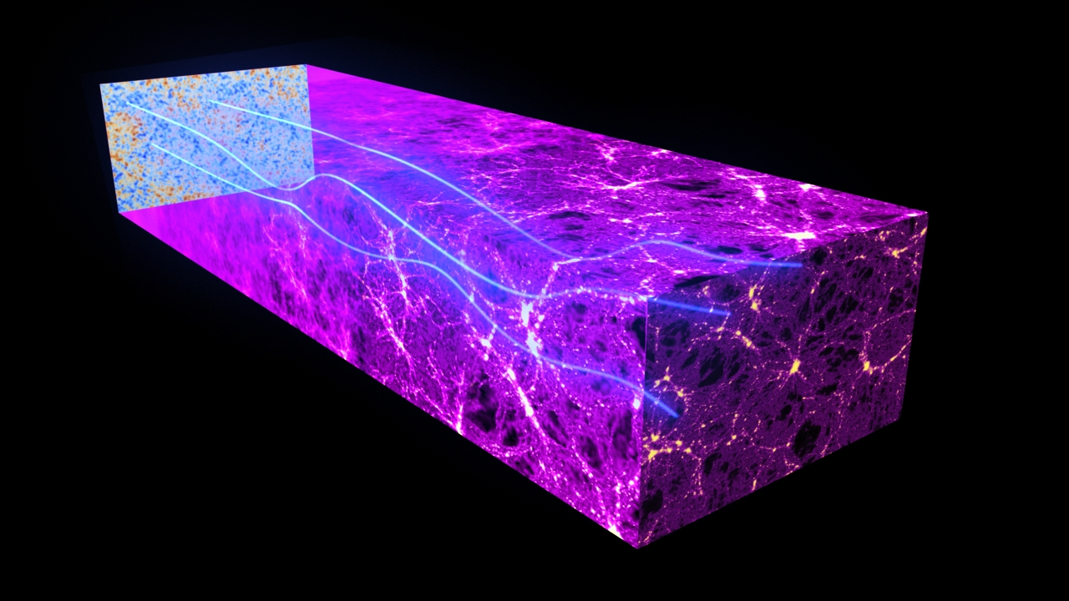
CMB Lensing
CMB map from Planck or SPT
Structure associated with DES galaxies

Slide 62


DES galaxies X CMB lensing
SZ Spectrum
galaxies
CMB lensing
high-𝜆 (>70)
Giannantonio, Fosalba, Cawthon, et al

Slide 63

DES galaxies X CMB lensing
SZ Spectrum
Smoothed maps show clear correlations: DES galaxies associated with projected mass partly responsible for CMB lensing
galaxies
CMB lensing
low-𝜆 (20-50)
med-𝜆 (50-70)
high-𝜆 (>70)
Giannantonio, Fosalba, Cawthon et al

Slide 64
DES-CMB Joint Analysis
Giannantonio, Fosalba, Cawthon et al

Slide 65
DES-CMB Joint Analysis
DES galaxies associated with the projected mass partly responsible for CMB lensing

Slide 66
Constraining the Growth Function of Perturbations
DES SV galaxies X CMB lensing
Giannantonio, Fosalba, Cawthon, et al

Slide 67
Constraining the Growth Function of Perturbations
Forecast
S. Bocquet
Powerful test of ΛCDM and GR
(plus Redshift Space Distortions)

