Slide 1
Strong Gravitational Lensing
Elizabeth Buckley-Geer
Fermilab

Slide 2
What is Gravitational Lensing
General Relativity predicts that light rays are deflected by gravity
A light ray that tangentially grazes the Sun should be deflected by 1.7”
This was confirmed in 1919 by Eddington during a total solar eclipse
Eddington noted that under certain conditions there can be multiple light paths connecting a source and observer and hence you would get multiple images of a single source
Lensing became interesting in 1937 when Zwicky pointed out that galaxies can split images of sources by a large enough angle to be observed
He calculated that the probability of lensing by galaxies would be about 1% for a source at reasonably large redshift
The first lensed quasars were observed in 1979 and the first arcs in galaxy clusters on 1986/87

Slide 3
Why is gravitational lensing useful?
We can study the mass distribution of foreground matter without making dynamical assumptions about the state of that matter, e.g., velocity dispersion measurements of clusters assume that the cluster has virialized
Lensing doesn’t care whether the mass is luminous or dark as long as it interacts gravitationally
  We can learn about the dark matter content of the universe
The magnification of the sources in strong lensing allows us to study sources with smaller telescopes than would normally be possible
Combining strong and weak lensing in clusters allows us to constrain both mass distribution in the cluster core as well as the halo
Lensed quasars allow us to measure the Hubble parameter, H₀

Slide 4
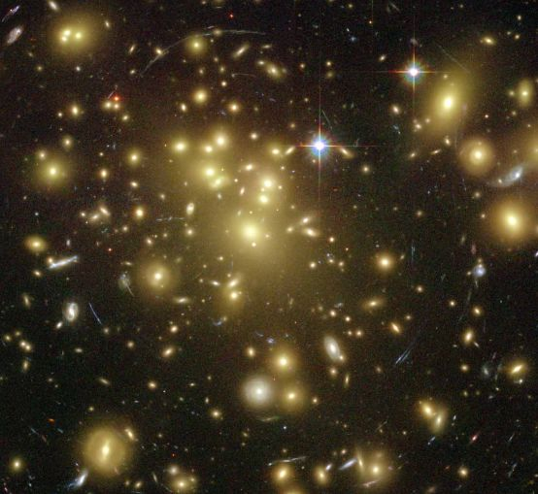
Abell 1689 – HST image
Cluster redshift z = 0.18
θ_{E} = 45”
34 multiply imaged systems
M₂₀₀ = 1.32±0.2 × 10¹⁵ h⁻¹ M

Slide 5
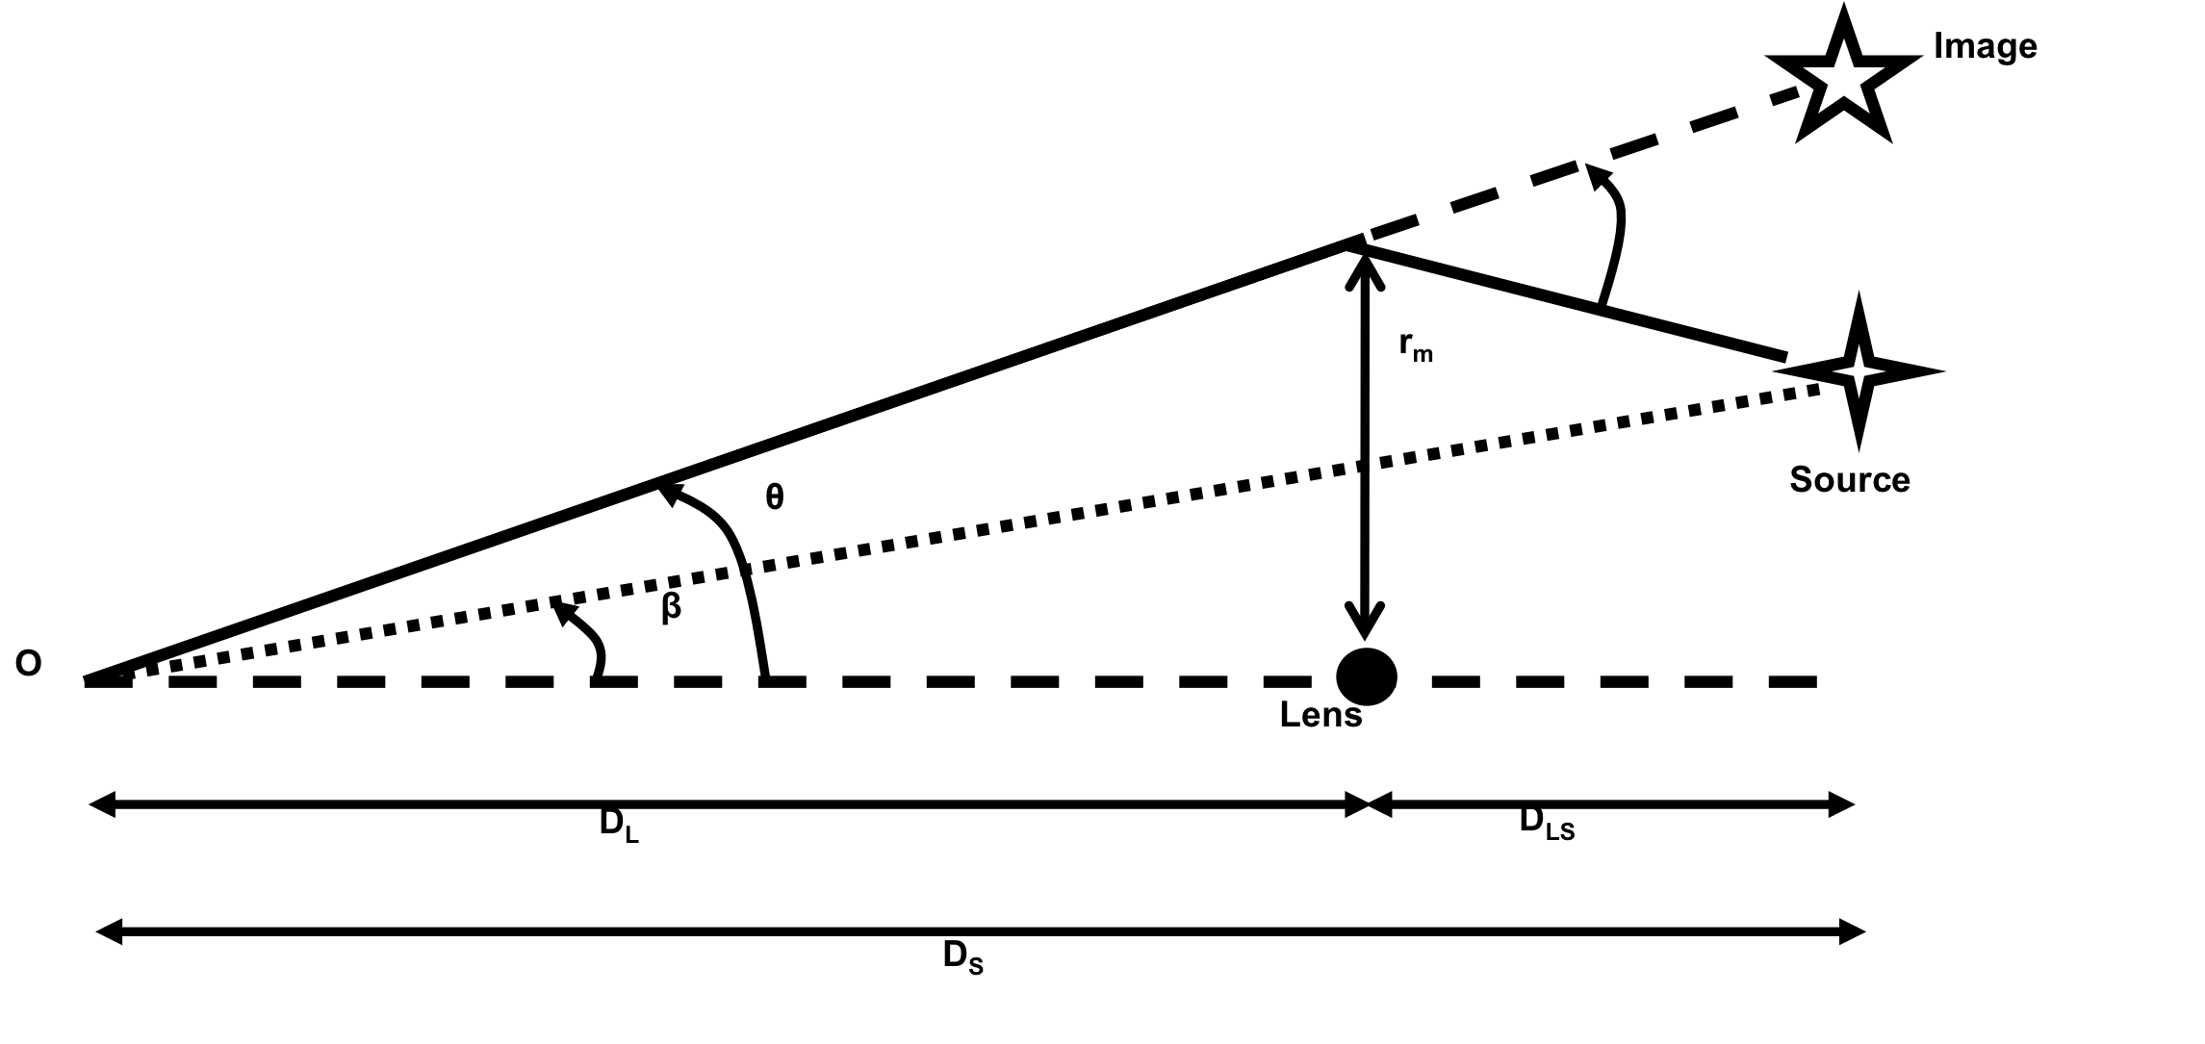
Point-like lens
D = angular diameter distance (ratio of an object’s physical transverse size to its angular size
θ = angle of observed position of image
O = observer
β = actual angle of source wrt axis( unobservable)
ξ
Defining distances in this way allows us to write the lensing equation using Euclidean geometry.
Important to note that D_{s} ≠ D_{L}+D_{LS}

Slide 6
Thin lens approximation
The deflection occurs over a distance z which is small compared to the distances between the D_{LS} and D_{L so} the lens can be considered thin compared to
the total light path and is represented by the lens plane
It has a surface mass density
The deflection angle at ξ is the sum of all the deflection angles in the plane

Slide 7
Lensing Equation
The deflection of the light ray is given by
We introduce the reduced angle
So the lens equation becomes
This can be rewritten as
θ_{E} is referred to as the Einstein angle.

Slide 8
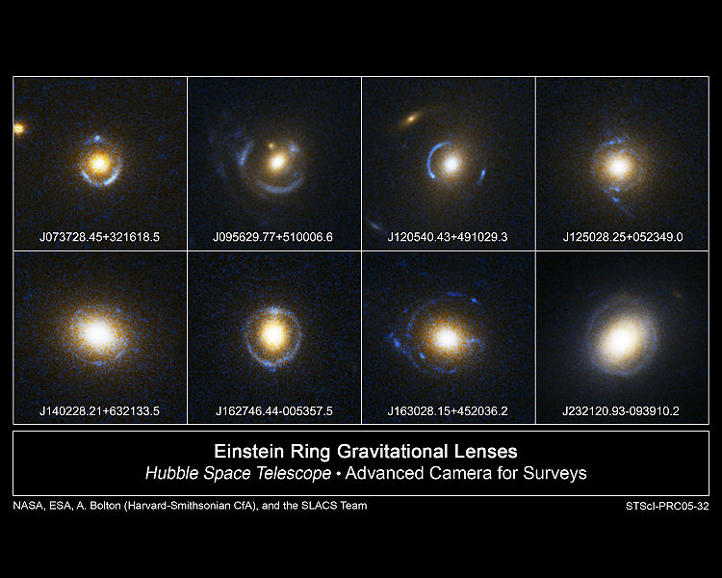
Einstein Rings
When β = 0 then
the lens and the
source are
perfectly aligned
and we get an
Einstein Ring
This is fairly rare

Slide 9
Extended lenses
In reality the lens is an extended object such as a galaxy or a cluster
In this case the lens equation becomes vectorial
ξ is the two dimensional vector indicating the position in the lens plane
After some substitutions we can write the lens equation as
This equation in non-linear in so for some source positions there may be multiple solutions of the lens equation. This corresponds to the formation of multiple images in the so-called strong lensing regime

Slide 10
Source Magnification
The surface brightness of the source is not changed by the deflection of light due to gravity
However the source shape and solid angle subtended change
This leads to amplification of the source brightness
We can define a mapping matrix T (κ and γ_{1,2} are related to the angles β and θ)
Observed solid angle
Actual solid angle in the absence of the lens

Slide 11
Source Magnification
κ is called the convergence. It changes the size of the source but not the shape
Σ(θ) is the surface mass density
γ is the shear. It distorts the shape of the object
The magnification is written as
To get multiple images requires κ(θ) > 1 - γ
Convergence alone
Convergence + Shear
Source

Slide 12
Caustics and Critical Lines
The magnification of the source can be infinite for certain source positions (only strictly true for point sources)
These locations are known as caustics.
The images of these caustics are known as the critical lines – the directions in the image plane along which a source would be infinitely magnified.
When a source crosses a caustic, images appear and disappear in pairs.
The total number of images produced by a transparent lens is always odd – Burke’s theorem
This is true for non-singular lenses but does not always hold for singular ones.
For lenses with multiple images at least one of the images has negative parity, meaning its image is inverted

Slide 13
Some elliptical lens topologies
Tangential caustic
Radial caustic
Tangential critical
line
Image Plane
Source Plane

Slide 14
Time delays
We can rewrite the lensing equation as
The geometrical time delay is
The total time delay is
For multiple images the light travel time for each image is different
The ratio of the angular diameter distances
From Treu & Marshall 2016

Slide 15
Quasar Lenses
Quasars are galaxies with variable active galactic nuclei (AGN), usually a black hole
They appear point-like in ground-based observations because the AGN is so bright that it dominates the light output of the galaxy
The flux from the AGN varies over time
Due to the different light travel times for each image these variations show up at different times for each image
So you can measure δt between pairs of images and combine it with a model of the lens to infer H₀
Suyu et al 2014
Tewes et al 2013

Slide 16
How to find lenses in DES
Visual scans – examine images to look for lensing topologies, use samples such as RedMaPPer Clusters
Catalog searches – look for blue features in association with red galaxies
Automated feature searches – run various algorithms on the images and look for arcs, rings
Machine learning – Neural networks, Gaussian mixture models, convolutional neural nets
All the methods require visual scanning of candidates to weed out false positives

Slide 17
Examples found with catalog searches

Slide 18
Follow-up data for lenses
We have to measure the redshift of both the lens and the source to confirm that the source is behind the lens. The sources are typically star-forming gaalxies and have emission lines such as Lyα, [OII], Hβ,Hγ
For the lens we can initially use photometric redshifts but ultimately one needs spectroscopic redshifts as the redshift errors propagate into the quantities we are interested in measuring such as the mass of the lens.
For DES we have used Gemini South, Magellan and the New Technology Telescope to confirm lensed systems.
For the lensed quasars we also need photometric monitoring to measure the variations in the flux and determine the time delays
Detailed modeling of the systems requires high resolution images either using ground-based adaptive optics systems of telescopes or else images from space using HST
This is NOT a lens,
the blue objects are
in the foreground
This is a lens,
the blue objects are
in the background

Slide 19
Spectrum of a DES lens system
Only see one emission line, the measured wavelength and the absence of
other lines suggests that this is Lyα at a rest wavelength of 1215Å so
z=2.7251

Slide 20
Spectrum of a DES lens system
Only see one emission line, the measured wavelength and the absence of
other lines suggests that this is [OII] at a rest wavelength of 3727Å so
z=1.4541

Slide 21
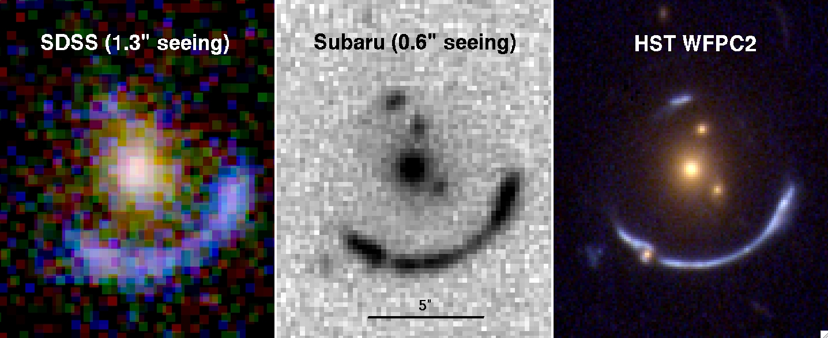
Comparison of SDSS, Subaru and HST Data for J120602.09+514229.5

Slide 22
Confirmed lenses from Science Verification data
z= 2.7251
z= 1.2081
z= 0.7963,1.2976
z= 1,4541
z= 3.2086
z= 1.1528,0.8972

Slide 23
Confirmed Lensed Quasars from Y1 data
We expect about 120 lensed quasars in the full DES footprint with about 100 being double images and about 20 with 4 images – quads are more useful because there are more time delays between the pairs of images
Agnello et al 2015
Ostrovski et al 2016
Lin et al 2016,
in prep

Slide 24
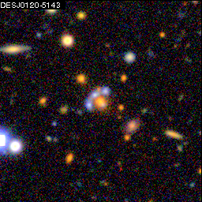
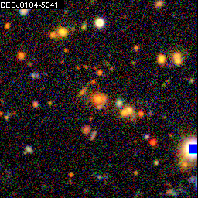
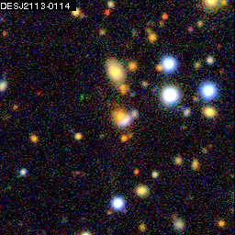
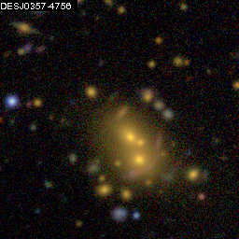
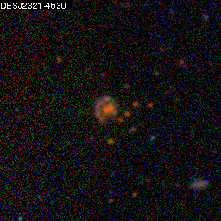
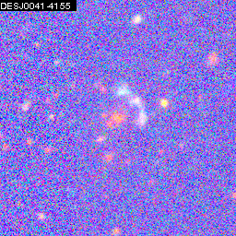
Confirmed Lenses from Y1
Z=1.2957
Z=1.232
Z=0.7943
Z=0.9166
Z=1.748
Z=2.559

Slide 25
Lens Modeling
Various methods exist for modeling lenses
Some just use the x,y positions of the components and a model for the mass distribution (lensmodel – Keeton astro-ph/0102340 http://www.physics.rutgers.edu/~keeton/gravlens/2012WS/; LensTool - https://projets.lam.fr/projects/lenstool). They work best for cases where the source is not very extended but one can often have a issue with the number of fit parameters exceeding the number of input paramaters if the model tries to be too complex).
Others use the full image and a mass model to create an model image which is convolved with the point-spread function (PSF) and compared to the data. They also predict the shape of the source. They usually do a better job because there are many more input parameters, namely all the image pixels, and the model must reproduce the actual image topology and not just an x,y position (Lensed - http://glenco.github.io/lensed/; internal code developed by DES collaborator Tom Collett). They usually incorporate the ability to fit a model for the light from the lens galaxy and other galaxies in the vicinity.

Slide 26
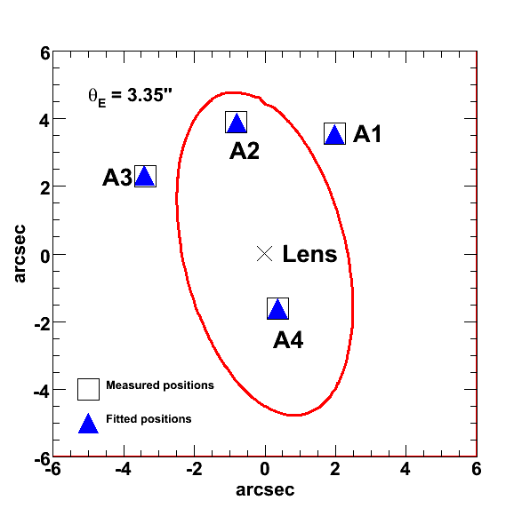
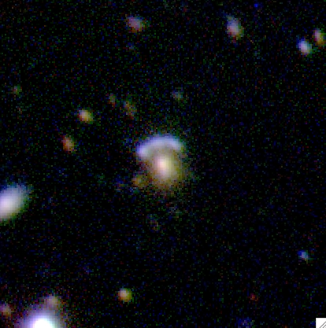
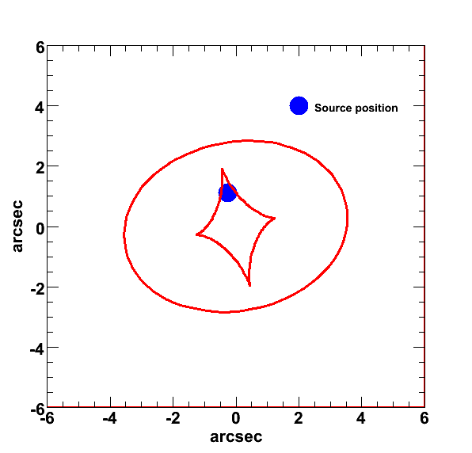
Example of modeling with x,y positions
J002240.91+143110.4
“8 o’clock arc”
z_{l} = 0.38
z_{s} = 2.73
Fit a Singular Isothermal Ellipse
θ_{EIN} = 3.35”
ε = 0.53
PA = 12.8 deg
χ²/dof = 1.04
σ = 392 km s⁻¹
R_{EIN} = 12.2 h⁻¹ kpc
M_{EIN} = 1.4 x 10¹² h⁻¹ M
M/L (rest frame g-band) = 13.8 h M /L
Total Magnification = 12.8

Slide 27
Some useful references
Treu –Strong Lensing by Galaxies Annu. Rev. Astron. Astrophys. 2010. 48:87–125 https://arxiv.org/abs/1003.5567
Kochanek - The Saas Fee Lectures on Strong Gravitational Lensing https://arxiv.org/abs/astro-ph/0407232
Narayan & Bartelmann – Lectures on Gravitational lensing https://arxiv.org/abs/astro-ph/9606001
Mollerach & Roulet – Gravitational lensing and Microlensing World Scientific ISBN 981-02-4852-0
Schneider, Ehlers & Falco – Gravitational Lenses Springer-Verlag ISBN 0-387-97070-3 (a bit heavy going)
Treu & Marshall – Time Delay Cosmography https://arxiv.org/abs/1605.05333

