Slide 1
Flash Center High-Energy Density Physics
Initiative
Don Q. Lamb
Flash Center for Computational Science
University of Chicago
Seminar
STFC Central Laser Facility
Rutherford Appleton Laboratory
11 October 2011

Slide 2
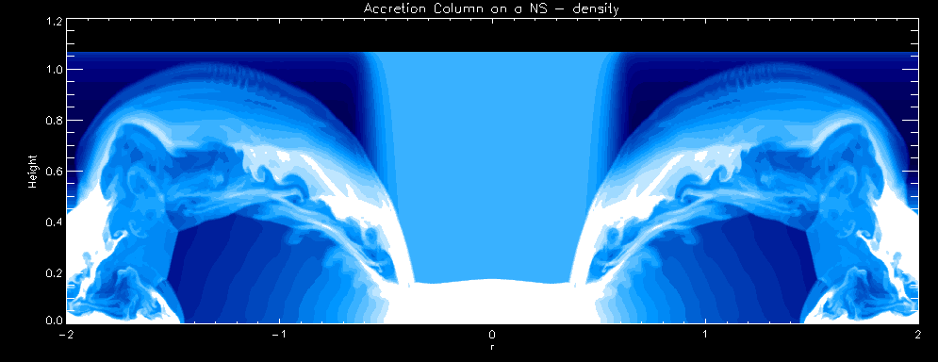
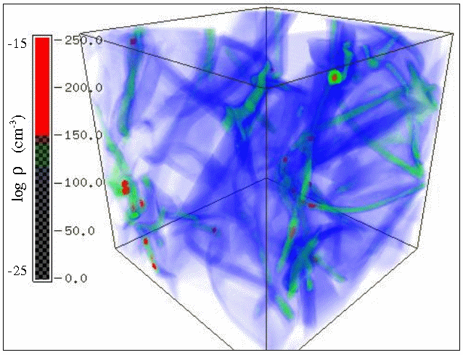
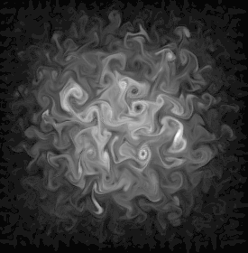
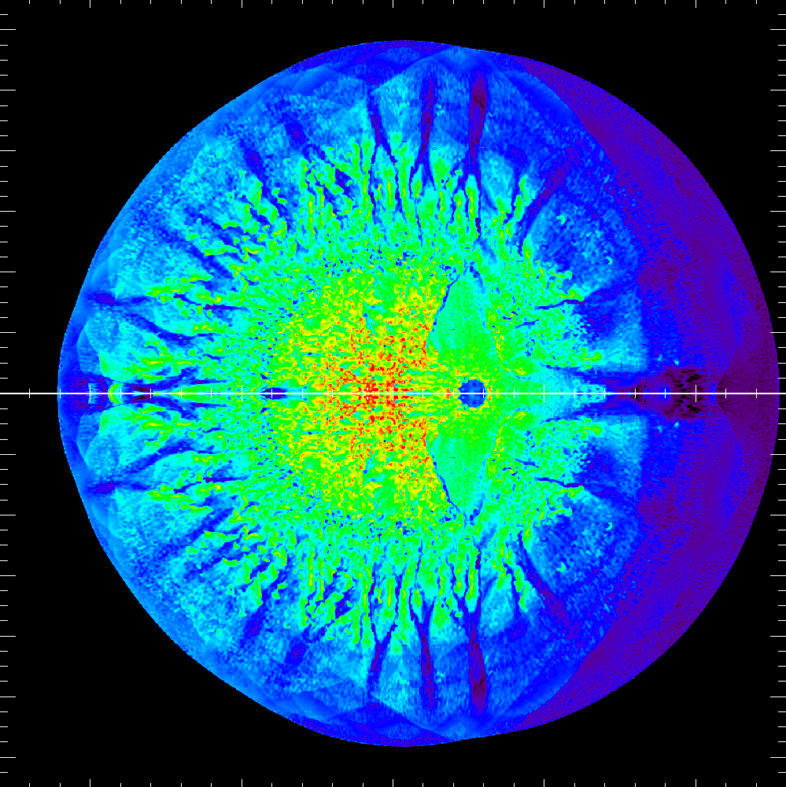
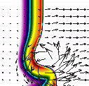
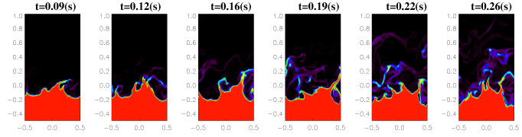
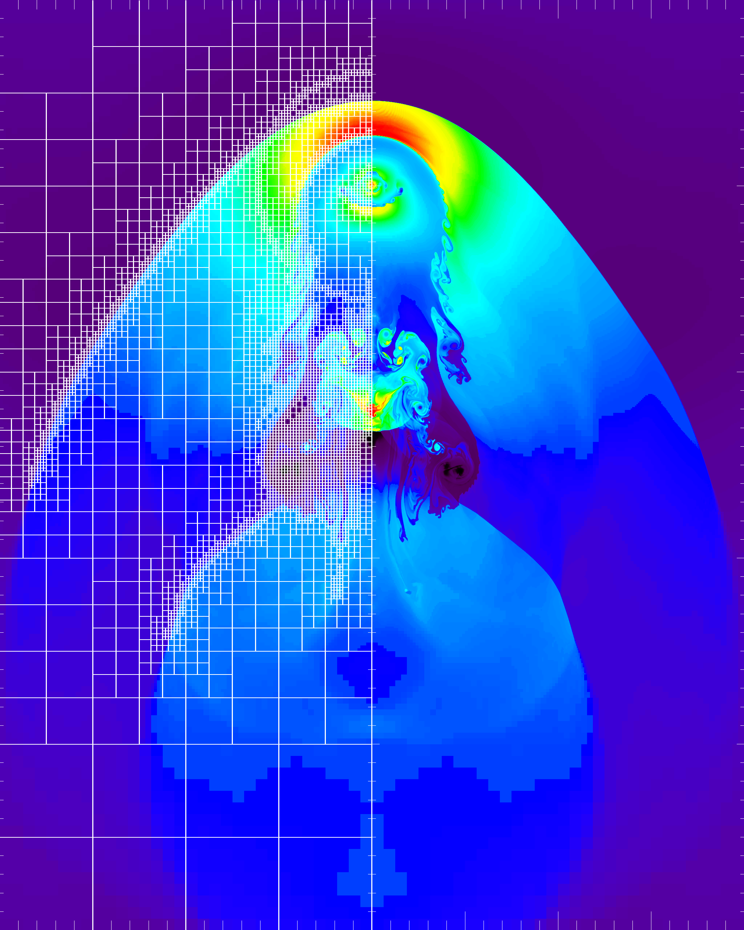
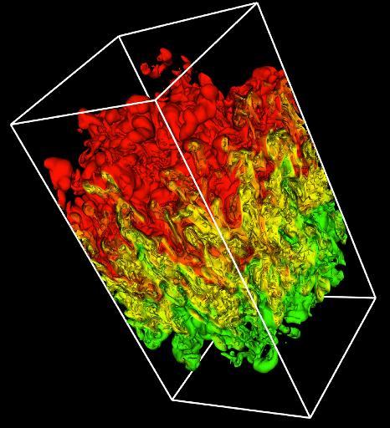
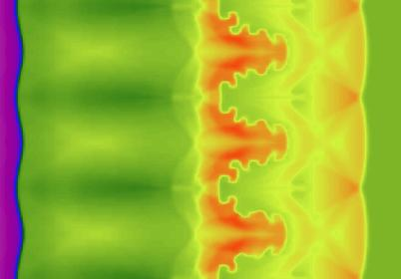

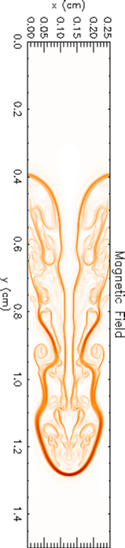
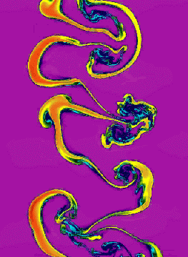
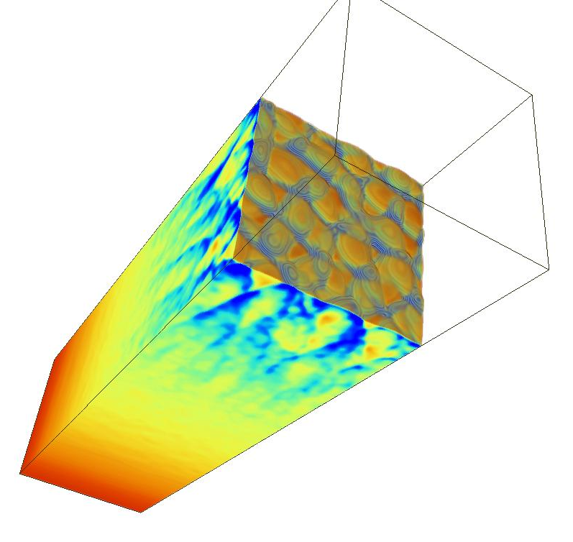
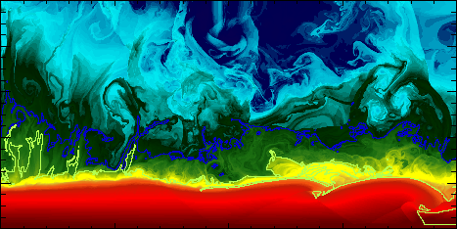
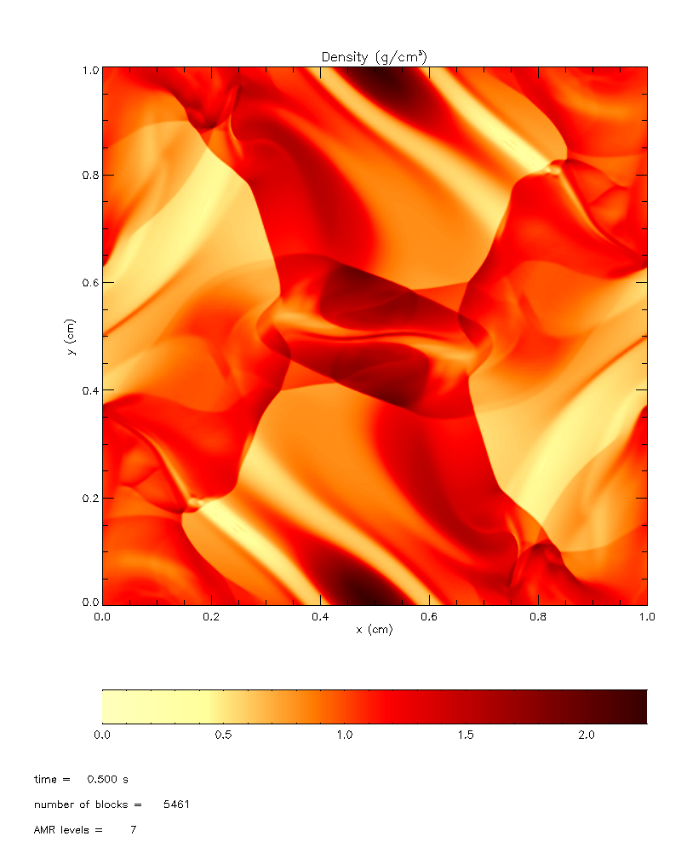
FLASH capabilities span a broad range…
FLASH
Parallel, adaptive-mesh refinement (AMR) code
Block structured AMR; block is the unit of computation
Originally designed for compressible reactive flows
Can solve a broad range of (astro)physical problems
Incompressible Navier-Stokes solver with embedded boundaries and fluid-structure interactions is being added to handle a larger range of CFD problems
High-energy density physics capabilities are being added to make it an open code for academic HEDP community
Portable: runs on many massively-parallel systems
Scales and performs well up to 160K processors
Fully modular and extensible: components can be combined to create many different applications
Rigorous verification and software development processes make development possible while it is being used for production
Shortly: Relativistic accretion onto NS
Flame-vortex interactions
Compressed turbulence
Type Ia Supernova
Gravitational collapse/Jeans instability
Wave breaking on white dwarfs
Laser-driven shock instabilities
Intracluster interactions
Nova outbursts on white dwarfs
Rayleigh-Taylor instability
Helium burning on neutron stars
Orzag/Tang MHD
vortex
Magnetic
Rayleigh-Taylor
Cellular detonation
Richtmyer-Meshkov instability

Slide 3
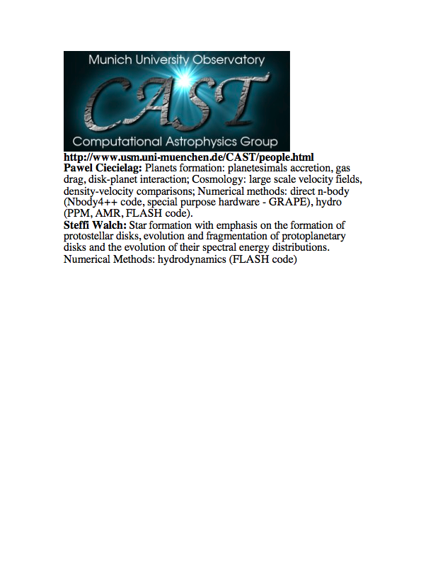
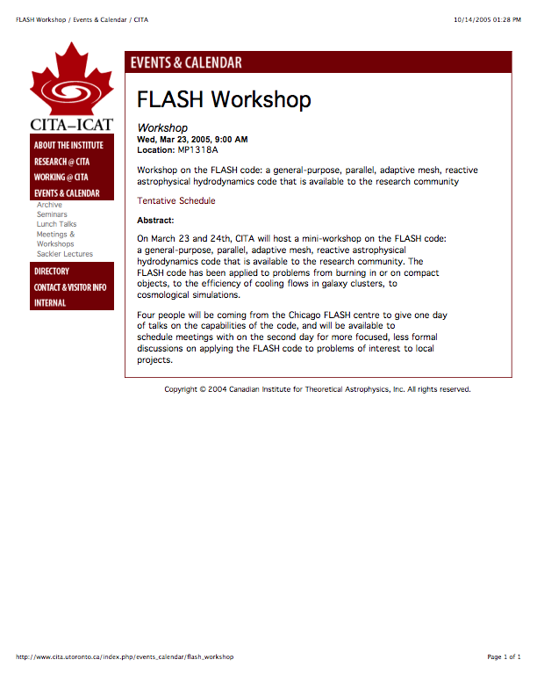
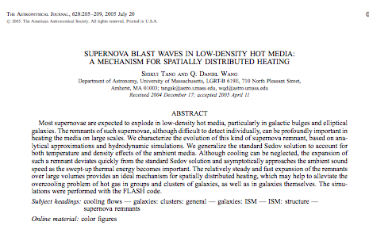
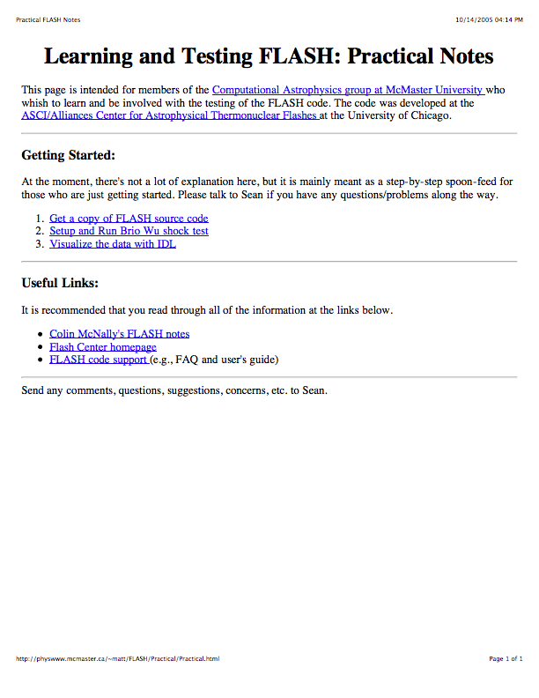
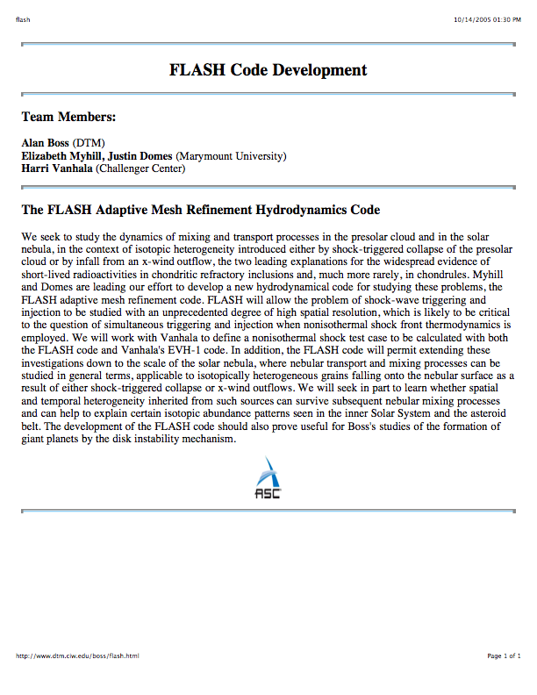
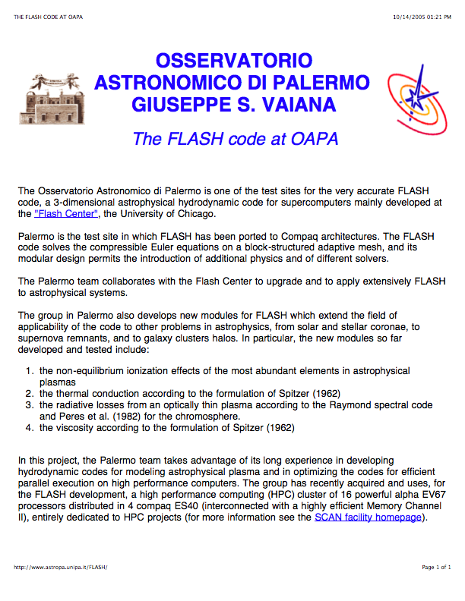
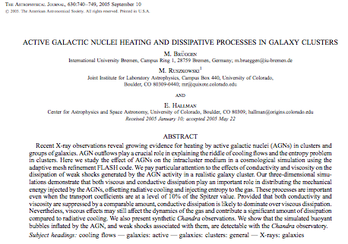
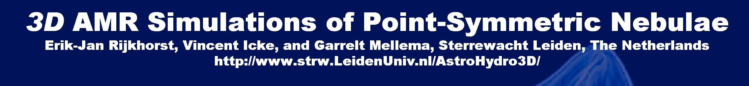
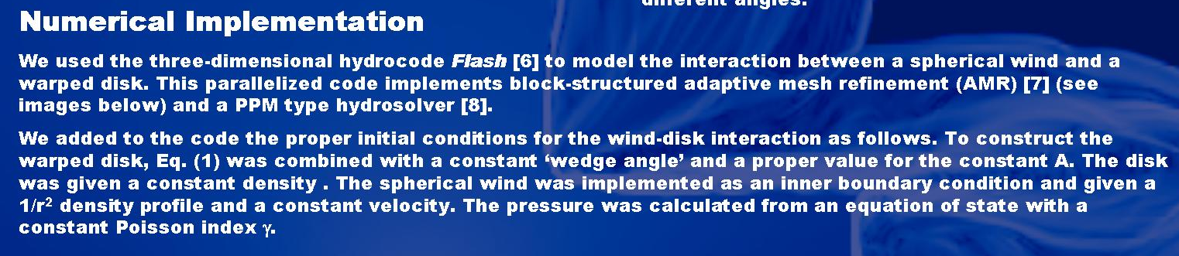
FLASH is being used by groups throughout the world
Germany
US
Canada
FLASH is being used by over 700 scientists around the world to do simulations in astrophysics, cosmology, computational fluid dynamics, high-energy density physics, plasma physics... ; to do scaling studies, software development, etc.; and was a key acceptance test for the IBM BG/P at ANL
Canada
US
Italy
Germany
Netherlands
Monthly Notices of the Royal Astronomical Society
Volume 355 Issue 3 Page 995 - December 2004
doi:10.1111/j.1365-2966.2004.08381.x
Quenching cluster cooling flows with recurrent hot plasma bubbles
Claudio Dalla Vecchia¹, Richard G. Bower¹, Tom Theuns^{1,2}, Michael L. Balogh¹, Pasquale Mazzotta³ and Carlos S. Frenk¹
UK

Slide 4
FLASH is being used by groups throughout the world
Germany
US
Canada
Canada
US
Italy
Germany
Netherlands
Monthly Notices of the Royal Astronomical Society
Volume 355 Issue 3 Page 995 - December 2004
doi:10.1111/j.1365-2966.2004.08381.x
Quenching cluster cooling flows with recurrent hot plasma bubbles
Claudio Dalla Vecchia¹, Richard G. Bower¹, Tom Theuns^{1,2}, Michael L. Balogh¹, Pasquale Mazzotta³ and Carlos S. Frenk¹
UK

Slide 5
The Flash Center currently has three major projects
High-Energy Density Physics Initiative
(ASC Program in DOE NNSA)
Petascale Computing of Thermonuclear
Supernova Explosions (NSF Astronomy
& Astrophysics Program)
Petascale Algorithms for Multi-Body,
Fluid-Structure Interactions in Incompressible
Flows (NSF CyberInfrastructure PetaApps Program)

Slide 6
The Flash Center HEDP Group
and collaborators
FLASH Center HEDP Group:
  Don Lamb (lead), Milad Fatenjad (deputy lead),
  Anshu Dubey, Norbert Flocke, Carlo Graziani,
  Shravan Kumar, Dongwook Lee, Klaus Weide
HEDP Group, Ohio State University
  Christopher Orban
  Douglass Schumacher
CRASH Radiative Shock Experiment:
  John Wohlbier, Chris Fryer, LANL
  Marty Marinak, Steve Libby, Brian Wilson, LLNL
  Gregory Moses, University of Wisconsin-Madison
  Bruce Fryxell, Eric Myra, Center for Radiative Shock Hydrodynamics (CRASH), University of Michigan
Gianluca Gregori’s Group, University of Oxford

Slide 7
Summary
The development of powerful lasers and pulsed-power machines has made possible exciting discoveries about matter in the High Energy Density (HED) regime. Experiments using these facilities are relevant to many areas of research including astrophysics, fusion energy, and material science.
FLASH is an open-source code being developed at the Flash Center for Computational Science. New capabilities are being added to FLASH to enable simulations of High Energy Density Physics (HEDP) experiments in support of the academic community.
The Center is collaborating with groups at Ohio State University, University of Michigan, and University of Oxford to design, analyze, and interpret HEDP experiments using FLASH.

Slide 8
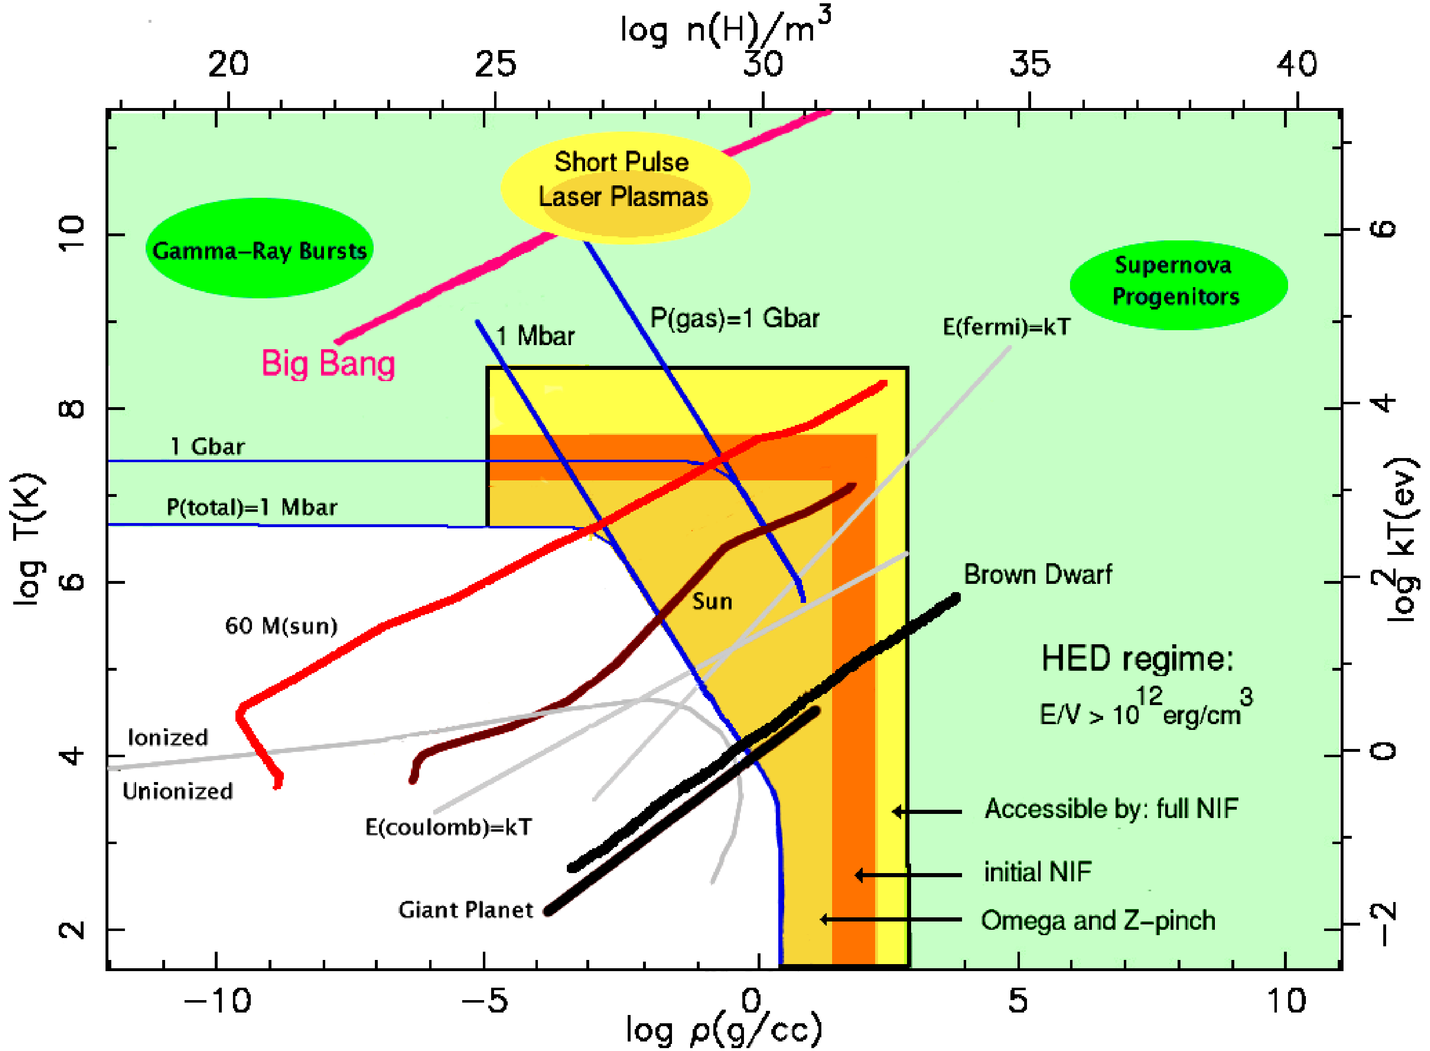
HEDP involves pressures above 1 Mbar
(10¹¹ J/m³)
Source: Frontiers in High Energy Density Physics: The X-Games of Contemporary Science,
National Academies Press (2003)

Slide 9
Many experimental facilities exist which can produce HEDP relevant conditions
FLASH is currently being used to study laser-driven HEDP experiments, where high power lasers with wavelengths ≤ 1 μm are used to create HEDP plasmas
  Short Pulse Lasers:
    Pulse length ≤ 10 ps
    Intensity 10¹⁹ to 10²² W/cm²
  Long Pulse Lasers:
    Pulse length ≥ 1 ns
    Intensity ~10¹⁵ W/cm²
These laser systems typically include more than one beam which can allow for a great deal of flexibility in designing experiments
Other techniques exist for generating HEDP plasmas. For example, Z-pinches work by driving mega-amp currents through a wire array

Slide 10
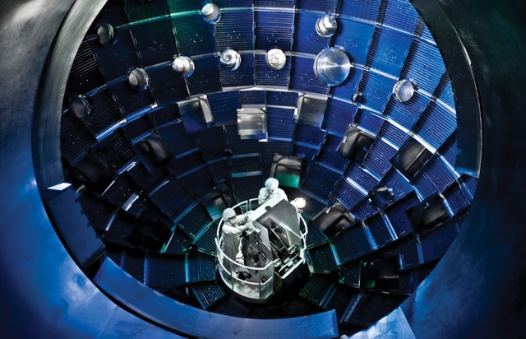
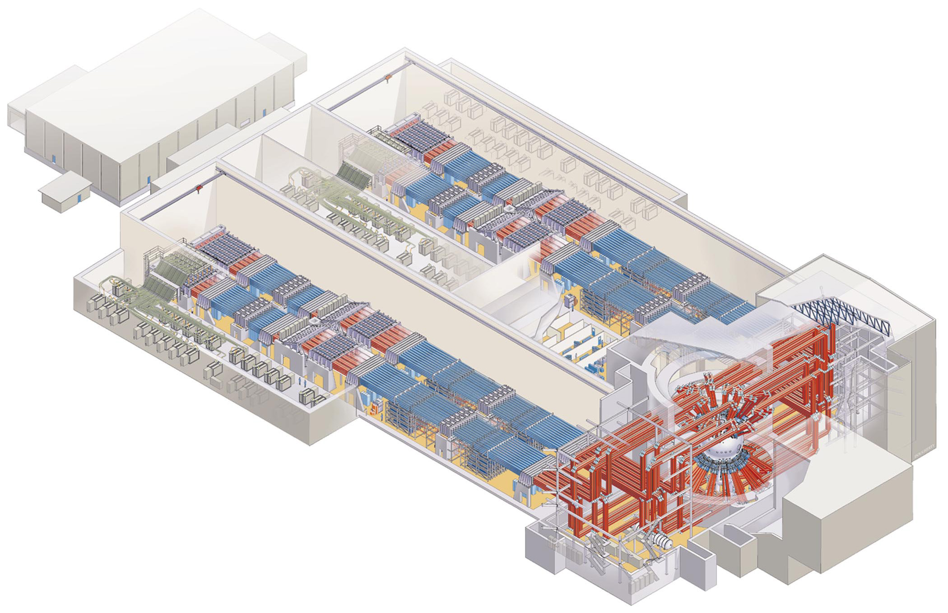
Many experimental facilities exist
that can produce HEDP conditions
The largest laser facility is the National Ignition Facility (NIF). It can deliver ~2 MJ of laser energy with an intensity of ~10¹⁵ W/cm² a target using 192 long-pulse beams
300 meters

Slide 11
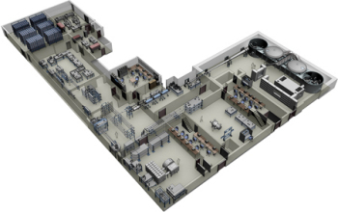
Many experimental facilities exist
that can produce HEDP conditions
The Central Laser Facility at the Rutherford Appleton Laboratory has a short-pulse laser that can deliver ~500 J of energy with intensities of up to ~10²¹ W/cm² in a pulse lasting ~500 fs, and a long-pulse laser that can deliver 2.6 kJ of energy in a pulse lasting ~ 1 ns.

Slide 12
Simulations play a critical role in designing and understanding HEDP experiments
HEDP experiments can be expensive to field and difficult to diagnose
Simulations are used to design experiments in order to:
  Demonstrate that they have a reasonable chance of producing interesting results
  Help to calibrate diagnostics
  Ensure that the experiment will not damage the facility
After the experiment has been performed, simulations are used to:
  Demonstrate an understanding of the physics involved
  Analyze physics which is difficult to directly measure using diagnostics

Slide 13
The FLASH Code is being extended to support
the academic HEPD community
Most of the codes with the physics required to study
HEDP experiments are developed at national labs
and their use is restricted, making it difficult for the
academic HEDP community to use them
The overarching goal of the initiative is to help create
an active and intellectually vibrant academic HEDP
community by
  Making FLASH a highly capable open HEDP code for the
  academic community, and
  Supporting the use of FLASH by the academic community
  to design, execute, and analyze new HEDP experiments

Slide 14
HEDP Capabilities in FLASH
2T + Radiation
Implicit AMR Conduction/Radiation Diffusion
Multi-Group Flux-Limited Radiation Diffusion
Mesh Replication for Multi-Group Radiation Diffusion
Multi-Materials Tabular EOS' and Opacities
Laser Energy Deposition Using Ray Tracing
Quiet Start
Particle In Cell (uniform grid)
3D Staggered Mesh MHD
Multiple Split/Unsplit Hydro Solvers
— These capabilities are part of FLASH 4.alpha, which was released
on April 29, 2011

Slide 15
The FLASH code is being used to model several HEDP experiments
Experiments FLASH is simulating include:
  Short-pulse experiments being conducted at Ohio State University using their SCARLET laser system
  Radiative shock experiments being conducted by the Center for Radiative Shock Hydrodynamics (CRASH) at the University of Michigan using the OMEGA laser facility
  Experiments to understand the generation of magnetic fields being conducted by Gianluca Gregori at the University of Oxford using the LULI laser facility

Slide 16
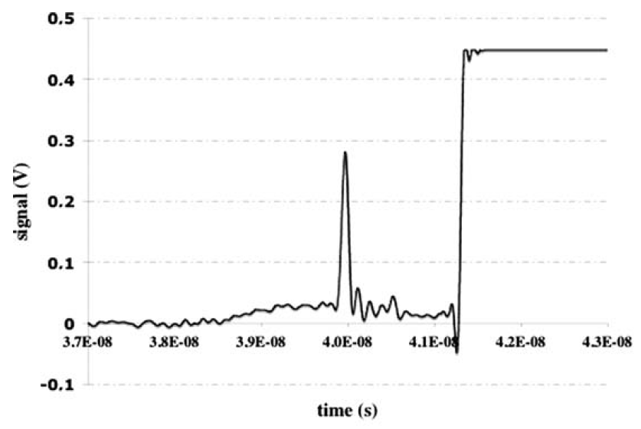
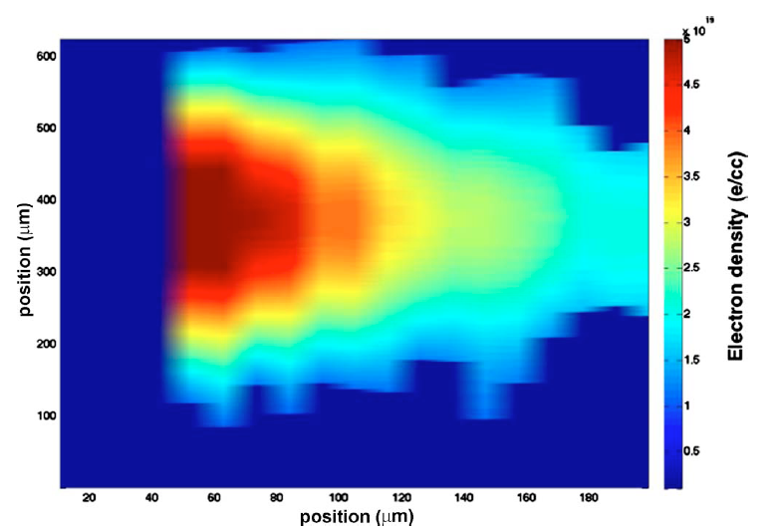
OSU is using FLASH to model the “pre-formed plasma” in their short-pulse laser experiments
All laser systems have a “pre-pulse” lasting several nano-seconds during which laser light “leaks” through the optics ahead of the main pulse and preheats the target
The pre-pulse will create a pre-formed plasma that can affect the experiment
Aluminum
Single Short-Pulse Laser Beam
Peak Intensity 10¹⁹ W/cm²
150 J in 700 fs (0.0007 ns)
Pre-Pulse
Main
Pulse
Image Source: Le Pape, et al. Optics Letters, 2997, 34 (2009)

Slide 17
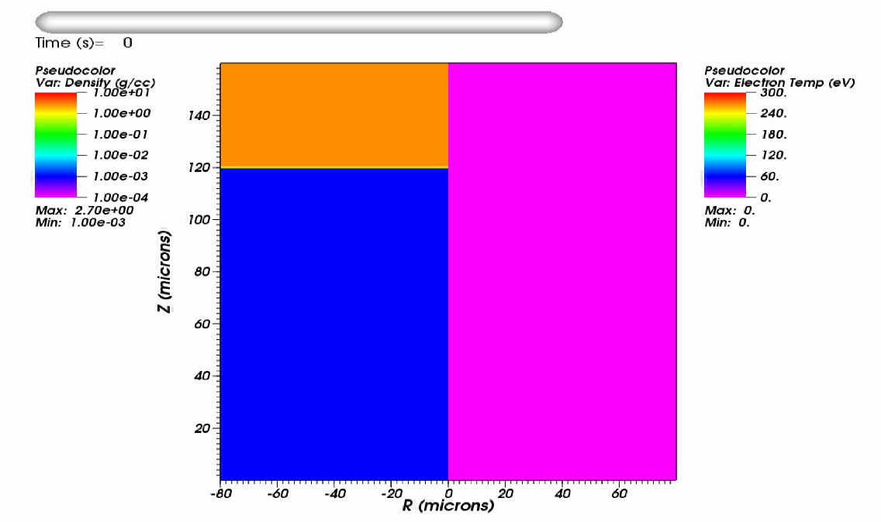
FLASH simulation
of the formation of a pre-formed plasma

Slide 18
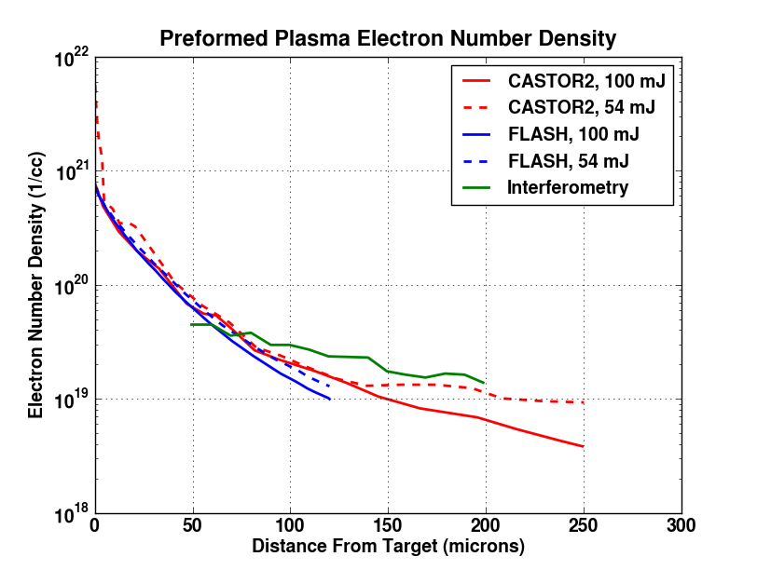
Density profiles of the pre-formed plasma predicted by CASTOR2 and FLASH compared to experimental data

Slide 19
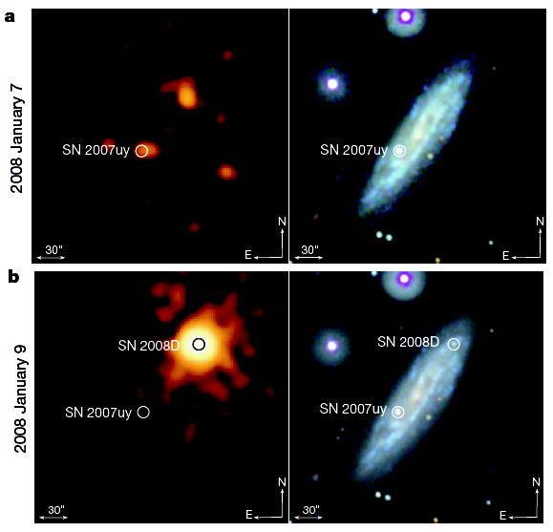
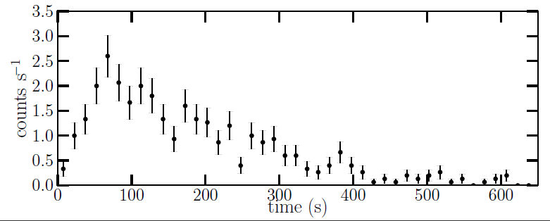
The CRASH experiments study radiative shocks which are prevalent in astrophysics
Ensman & Burrows ApJ92
Soderberg, et al. (2008)
SN 1987A
CRASH
Couch, et al. (2011)

Slide 20
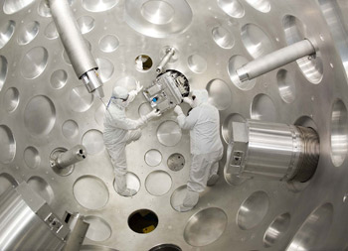
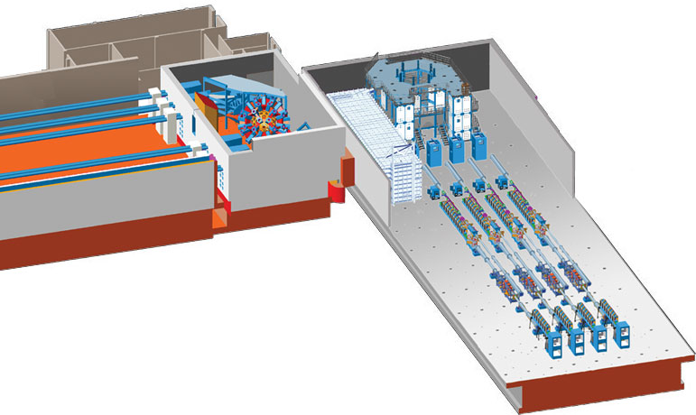
The OMEGA laser is another experimental facility that can produce HEDP conditions
The OMEGA laser can deliver 30 kJ of laser energy with an intensity of ~10¹⁶ W/cm² using 60 long pulse beams
A separate set of beams is available in the OMEGA-EP facility which can deliver 2.6 kJ of energy with an intensity of ~10²⁰ W/cm² using two beams

Slide 21
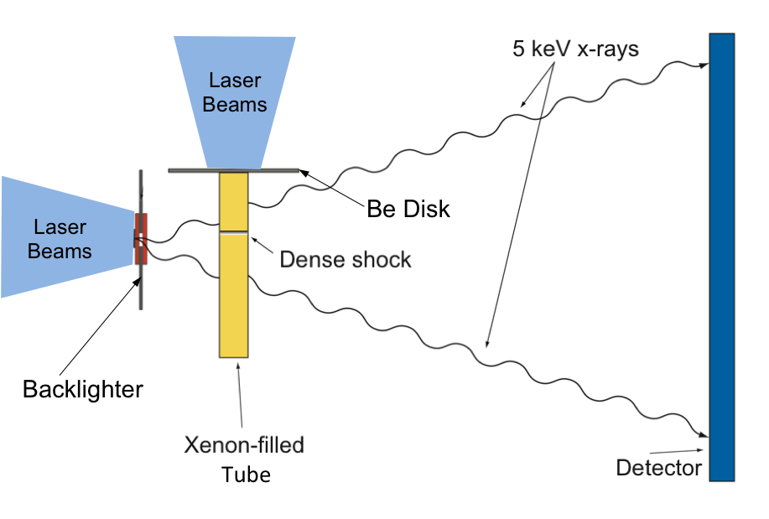
The CRASH experiments use 10 long-pulse OMEGA beams to drive a radiative shock through Xenon
3.8 kJ

Slide 22
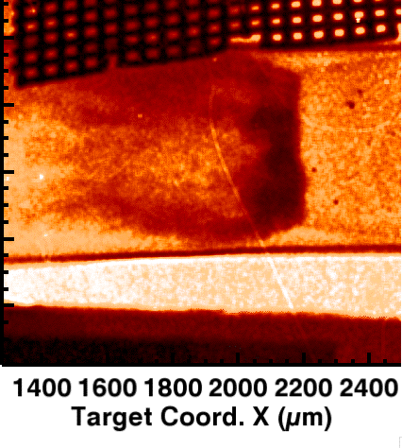
Radiography is used to image the radiative shock
Gold Reference Grid
t = 14 ns
Wall Shocks
Be
Tube Wall
Compressed Xe
Primary Radiative Shock
Image Source: F. Doss, et al., HEDP 6, 157 (2010)

Slide 23
Several robust validation metrics are extracted from the radiograph
Wall Shock Size
Gold Reference Grid
t = 14 ns
Compressed Xenon Thickness
Be
Radiative Shock Position
Image Source: F. Doss, et al., HEDP 6, 157 (2010)

Slide 24
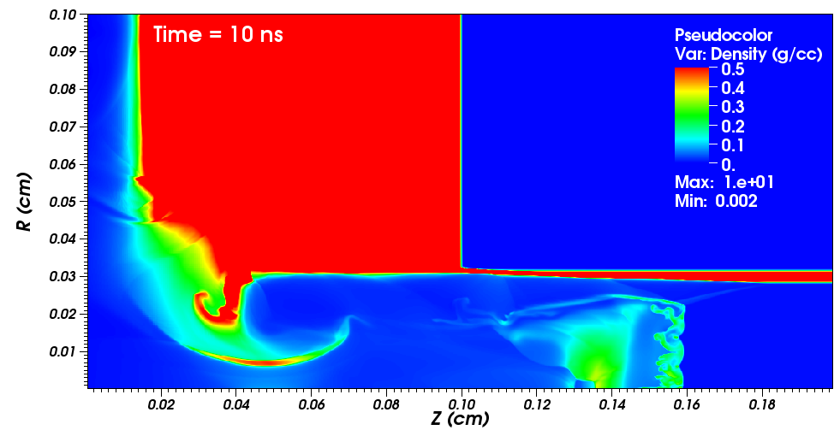
FLASH reduced materials simulation
of CRASH radiative shock experiment

Slide 25
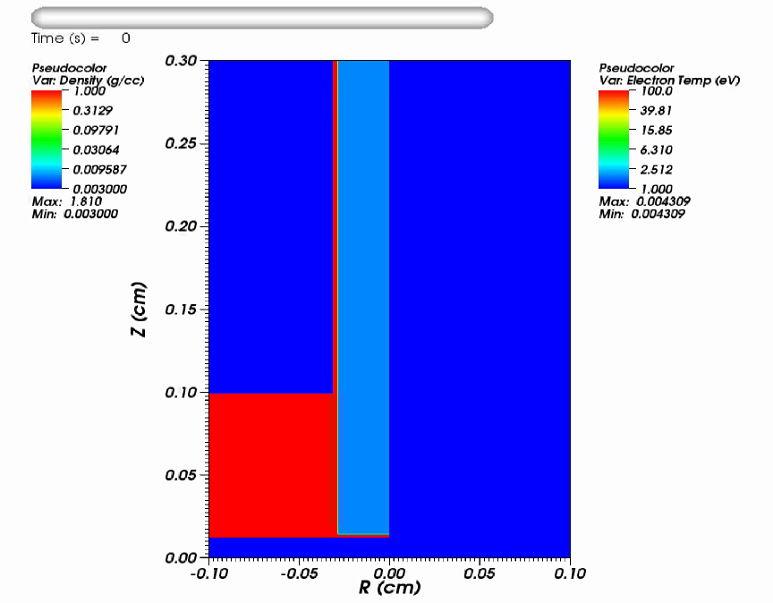
FLASH reduced materials simulation
of CRASH radiative shock experiment

Slide 26
The Center is doing rigorous, systematic verification
and validation of the HEDP capabilities in FLASH
The collaboration involves 4 institutions and 5 codes:
  LANL → RAGE, CASSIO
  LLNL → HYDRA
  University of Michigan → CRASH
  University of Chicago → FLASH
The goals of the collaboration are to...
  Perform code-to-code comparisons to verify the HEDP capabilities in FLASH code
  Validate the RAGE, CASSIO, CRASH, and FLASH codes using the CRASH experiment

Slide 27
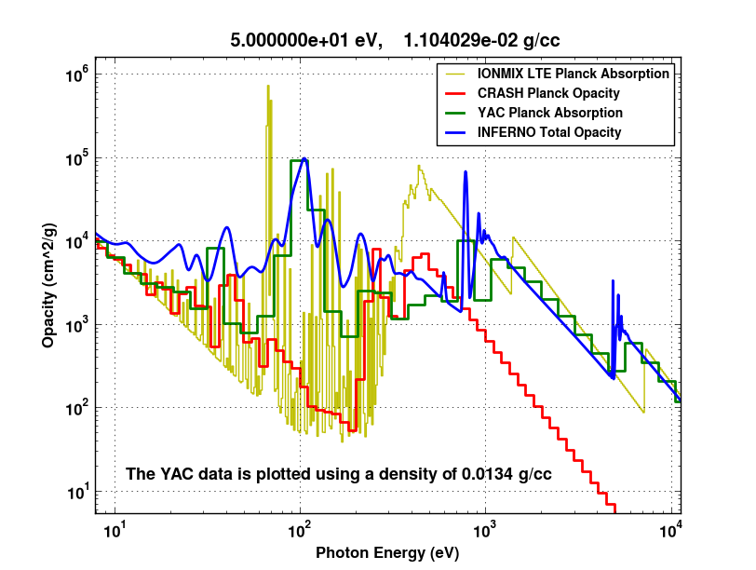
Significant differences exist between Xenon opacities in important energy ranges

Slide 28
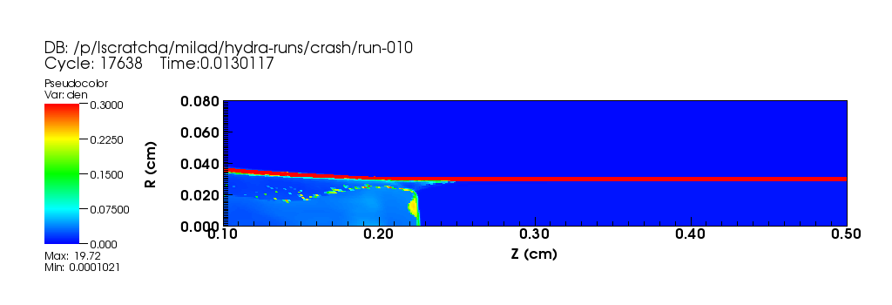
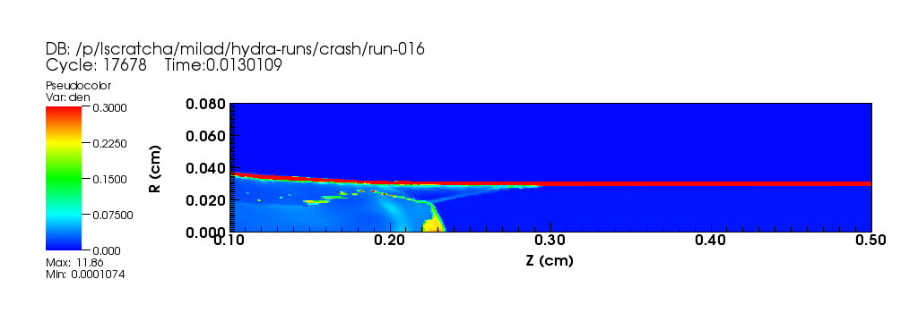
HYDRA simulations show that the shock front shape is sensitive to the opacity
Xenon Opacity Reduced by Factor of 10

Slide 29
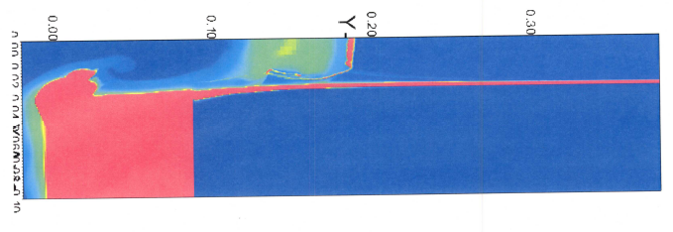

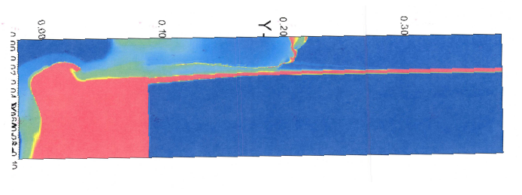

Comparisons with RAGE/CASSIO allow us to study
the effect of using diffusion vs. transport (IMC) theory
t = 13 ns, IMC
t = 13 ns,MGD

Slide 30
Comparisons of Modern Alternating Lagrangian- Eulerian and Finite-Volume Eulerian Codes
The Flash Center is studying the relative ease or difficulty that modern alternating Lagrangian-Eulerian (ALE) and finite-volume Eulerian codes have in treating various aspects of the CRASH radiative shock experiment, in collaboration with LANL and LLNL
Insights so far include:
  ALE codes can place resolution where it is needed and cells can have varying aspect ratios, which make it relatively easy to place resolution where it is needed in the CRASH experiment; AMR Eulerian codes can also place resolution where it is needed, but perhaps not so easily
  Eulerian codes can deal relatively easily with ablation (e.g., of the Be disk by the laser) whereas ablation can be more challenging for ALE codes
  Accurate simulation of the wall shock is crucial to simulating the CRASH experiment with high fidelity; under-resolving the surface layer of the polyimide tube in which the radiation field deposits energy has opposite effects in ALE and Eulerian codes: in ALE codes, blow-off may be artificially suppressed, whereas in Eulerian codes, blow-off may be artificially enhanced

Slide 31
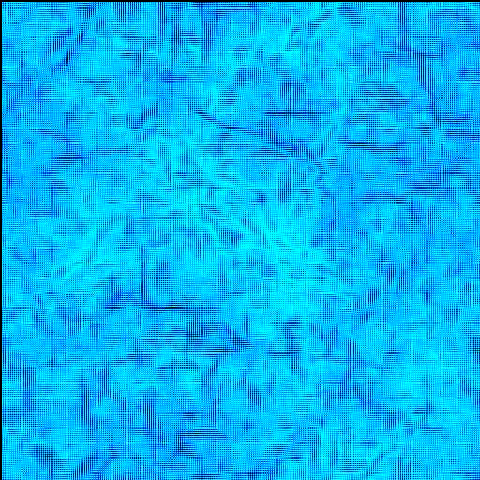
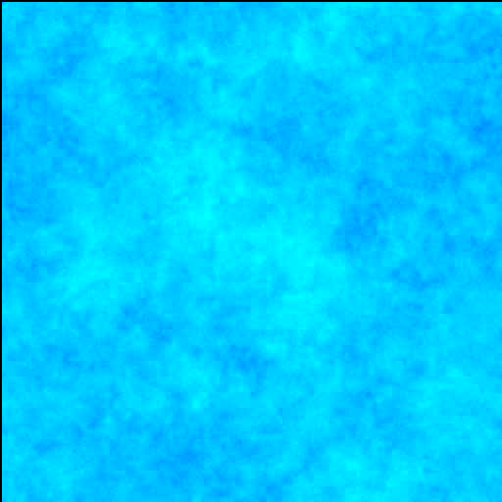
Magnetic fields are generated during formation of large-scale structure in the universe
Curved shocks produce magnetic fields
via the Biermann battery mechanism
Dark Matter
Gas

Slide 32
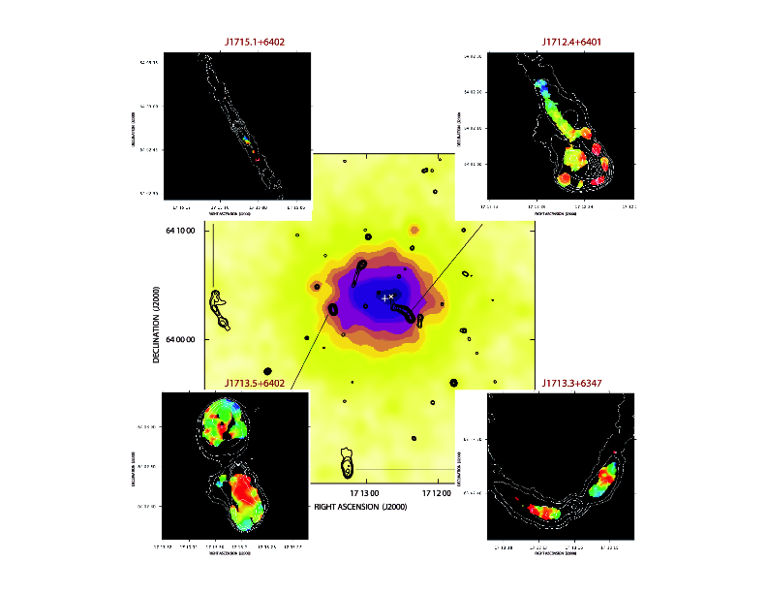
Magnetic fields are ubiquitous
in the intergalactic medium
Image Source:
Govoni et al., Astronomy & Astrophysics 260, 425 (2006)

Slide 33
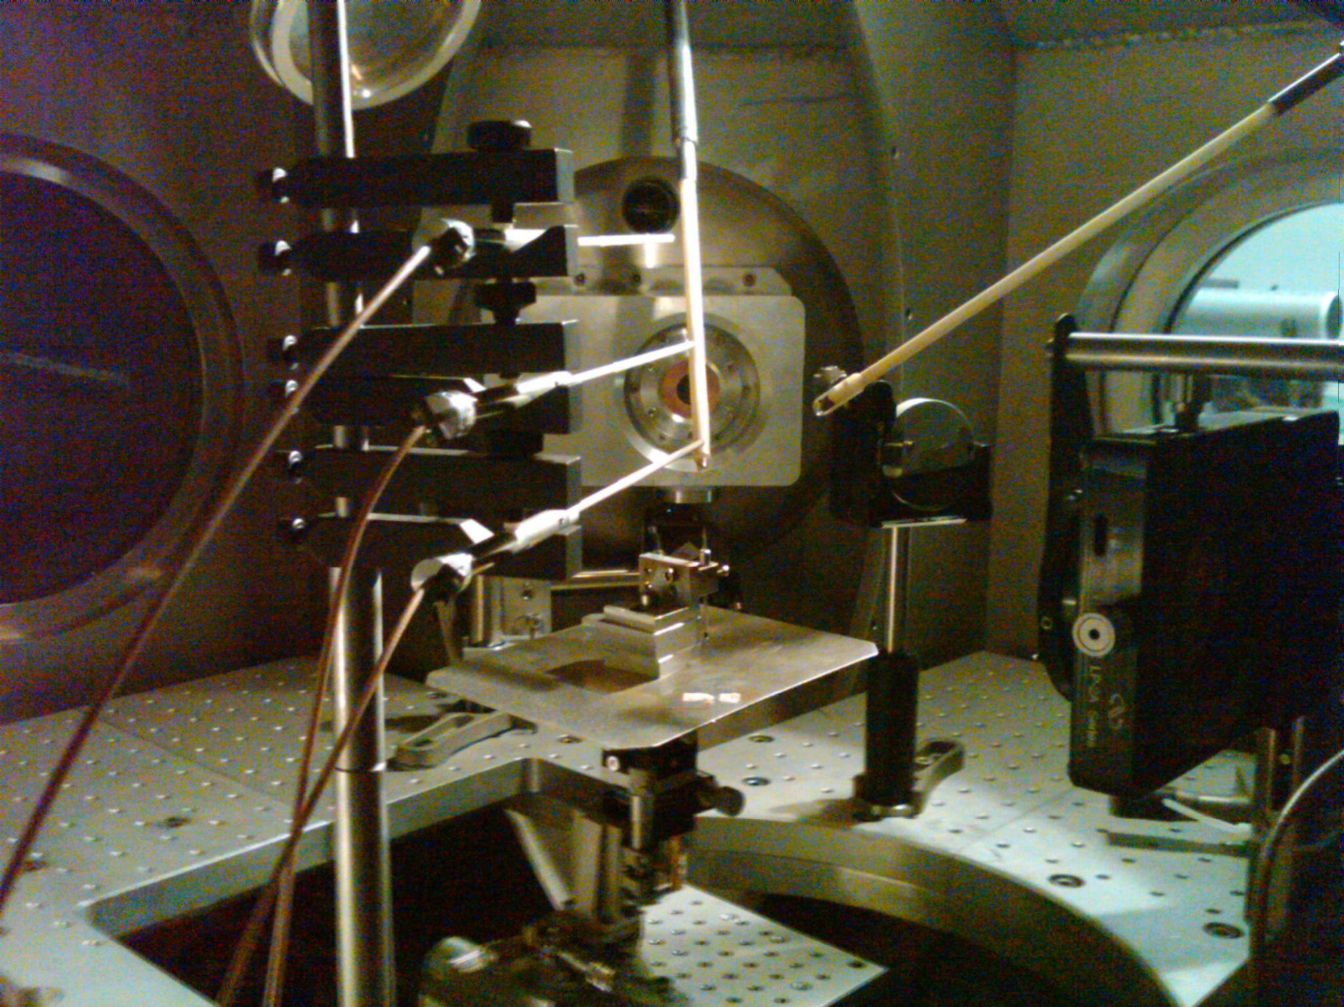
LULI Laser Facility (Paris)
Photo Courtesy of Gianluca Gregori

Slide 34
Experiments being conducted by Gianluca’s group
study the generation of magnetic fields in the IGM
Chamber filled with low density Helium
Gregori et al., submitted to Nature (2011)

Slide 35
Experiments being conducted by Gianluca’s group
study the generation of magnetic fields in the IGM
End-to-end FLASH MHD simulations will be performed to model the laser drive and late-time blast wave
The simulations will be used to determine whether the magnetic fields measured in the experiment are
  Generated at the shock wave or
  Generated by the laser-target interaction and advected with the fluid
Gregori et al., submitted to Nature (2011)

Slide 36
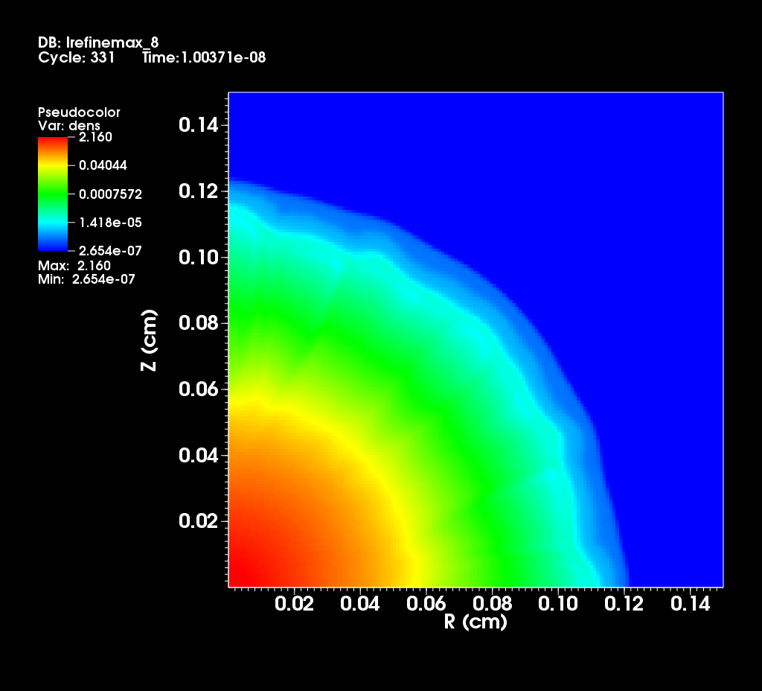
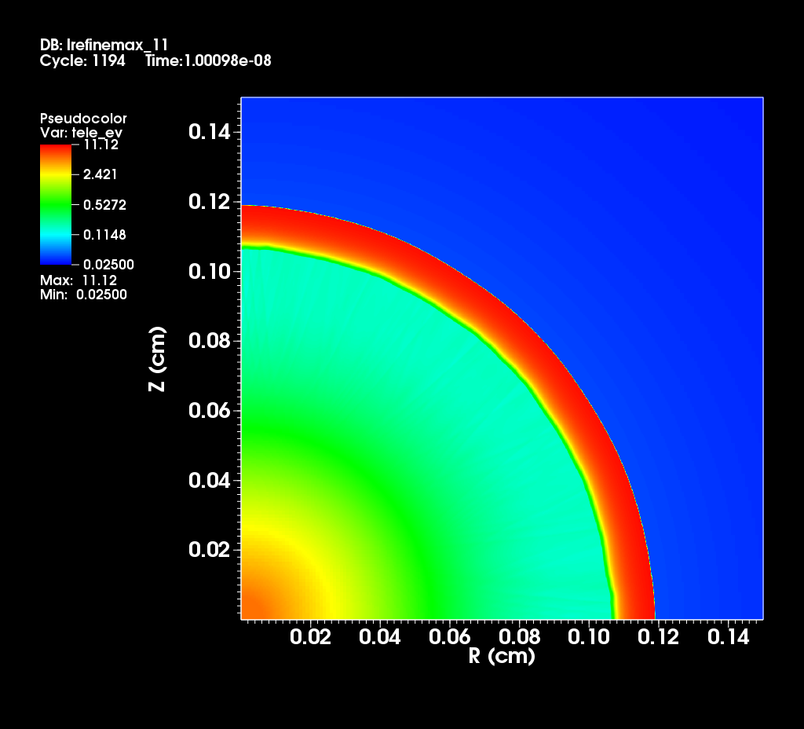


We have carried out a study of the resolution
that will be required to simulate the LULI experiments

Slide 37


We have carried out a preliminary simulation
of laser heating of the LULI graphite target
Time t = 0 s
Time t = 1.14 x 10⁻⁹ s

Slide 38

Fatenejad has devised an elegant verification test
of the Biermann battery mechanism

Slide 39


The FLASH simulation of the magnetic field produced by the Biermann battery mechanism matches the analytic solution

Slide 40
Conclusions
The Flash Center is adding HEDP capabilities to FLASH to make it a highly capable open code for the academic HEDP community; many of these capabilities are in FLASH 4-alpha, which was released on April 29, 2011
The Center is conducting a rigorous, systematic verification and validation of these capabilities in collaboration with U. Michigan, LANL, and LLNL
The Center is studying the relative ease and difficulty with which modern Alternating Lagrangian-Eulerian (ALE) and finite-volume Eulerian codes can simulate various aspects of the CRASH radiative shock experiment
The Center is collaborating with groups at the University of Michigan, the University of Wisconsin, and the University of Oxford to design, analyze, and interpret HEDP experiments

