Slide 1
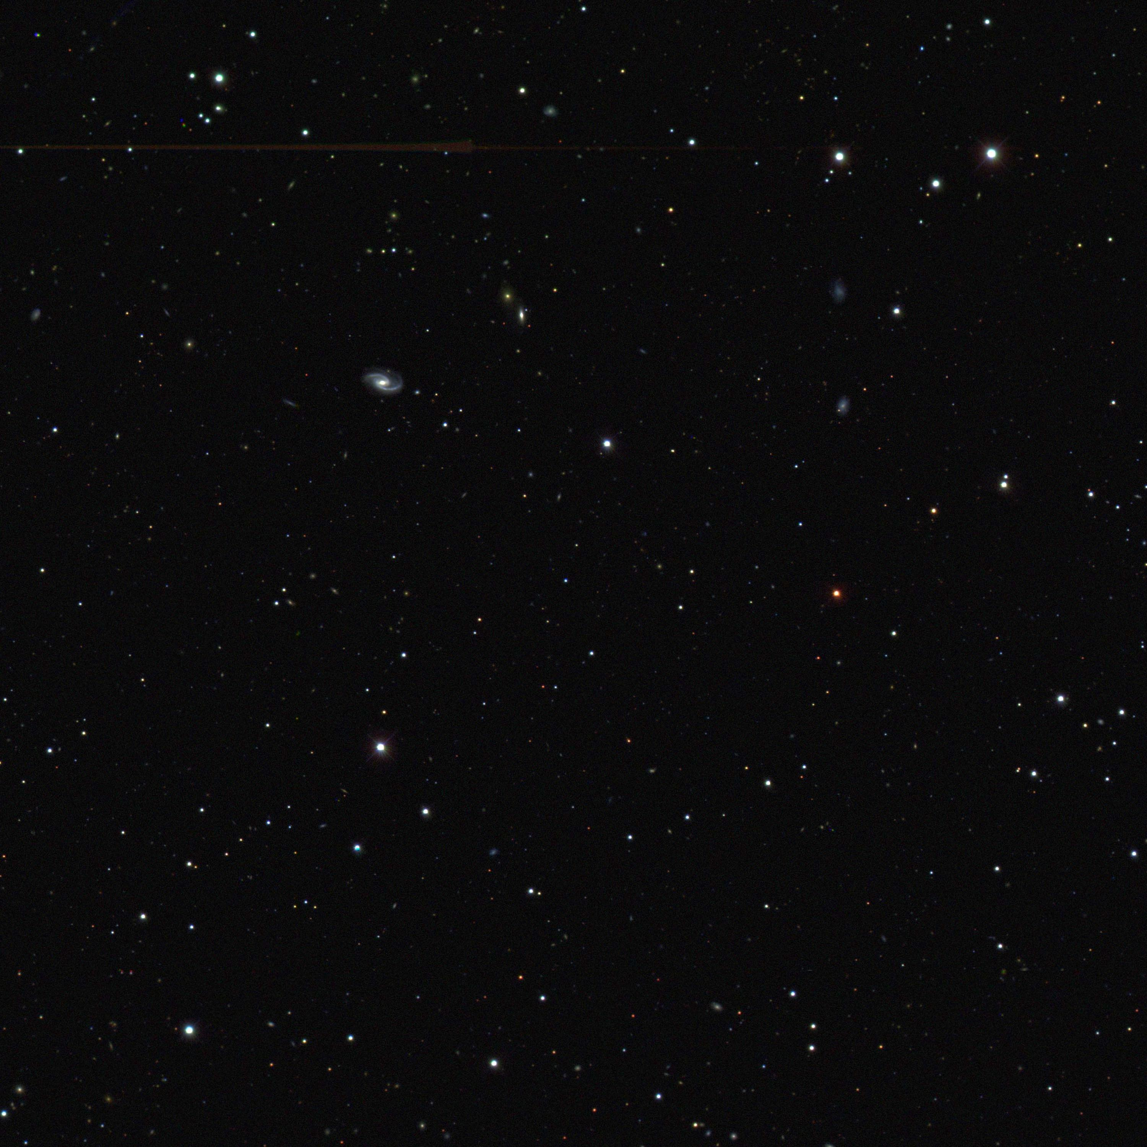
Probing The Dark Universe
Josh Frieman
Fermilab & The University of Chicago
Link to Learn, May, 2011

Slide 2
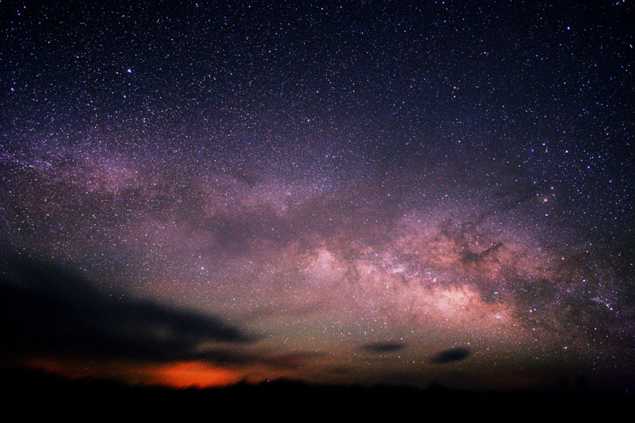
The Milky Way: stars are not distributed
isotropically around us: we live in a galaxy

Slide 3
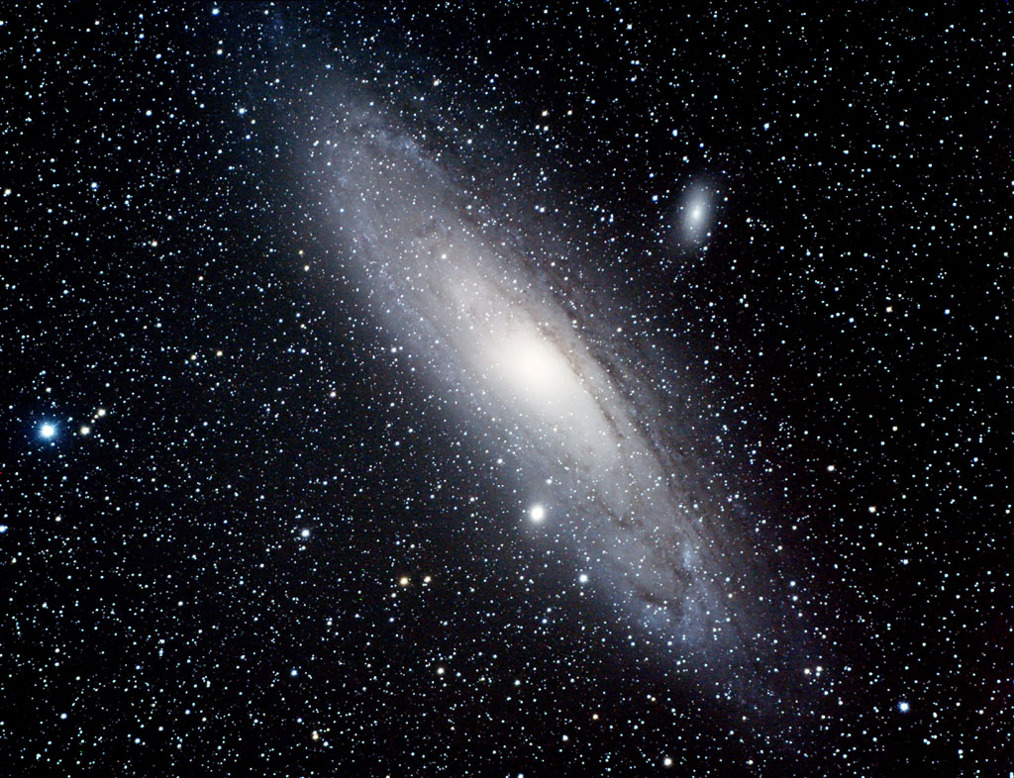
Galaxies: Size ~ 10²² cm ~ 60,000 light-years Mass ~ 1 trillion M_{sun}
Self-gravitating systems of stars, gas, and dark matter
Andromeda Galaxy: similar to what Milky Way would look like from outside

Slide 4
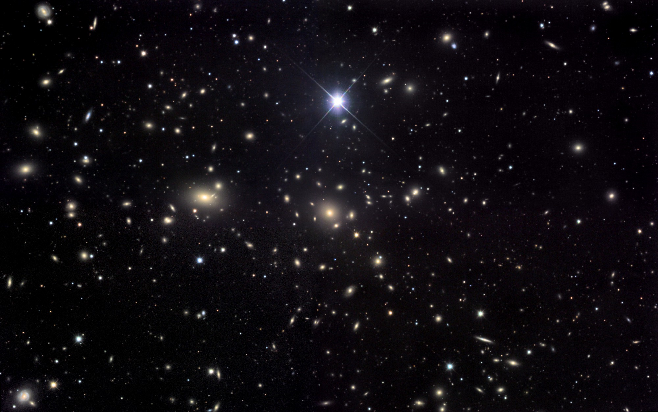
Clusters of Galaxies: Size ~ few Million light years
Mass ~ 1 quadrillion (1000 x 1 trillion) M_{sun}
Coma Cluster: `constellation’ of many galaxies

Slide 5
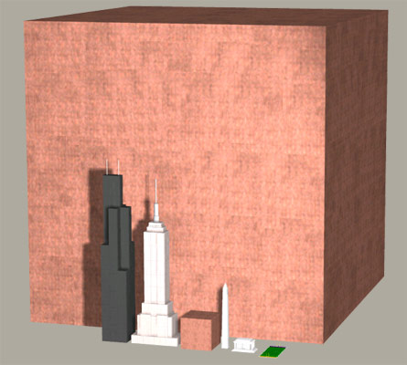
One
Quadrillion
pennies

Slide 6
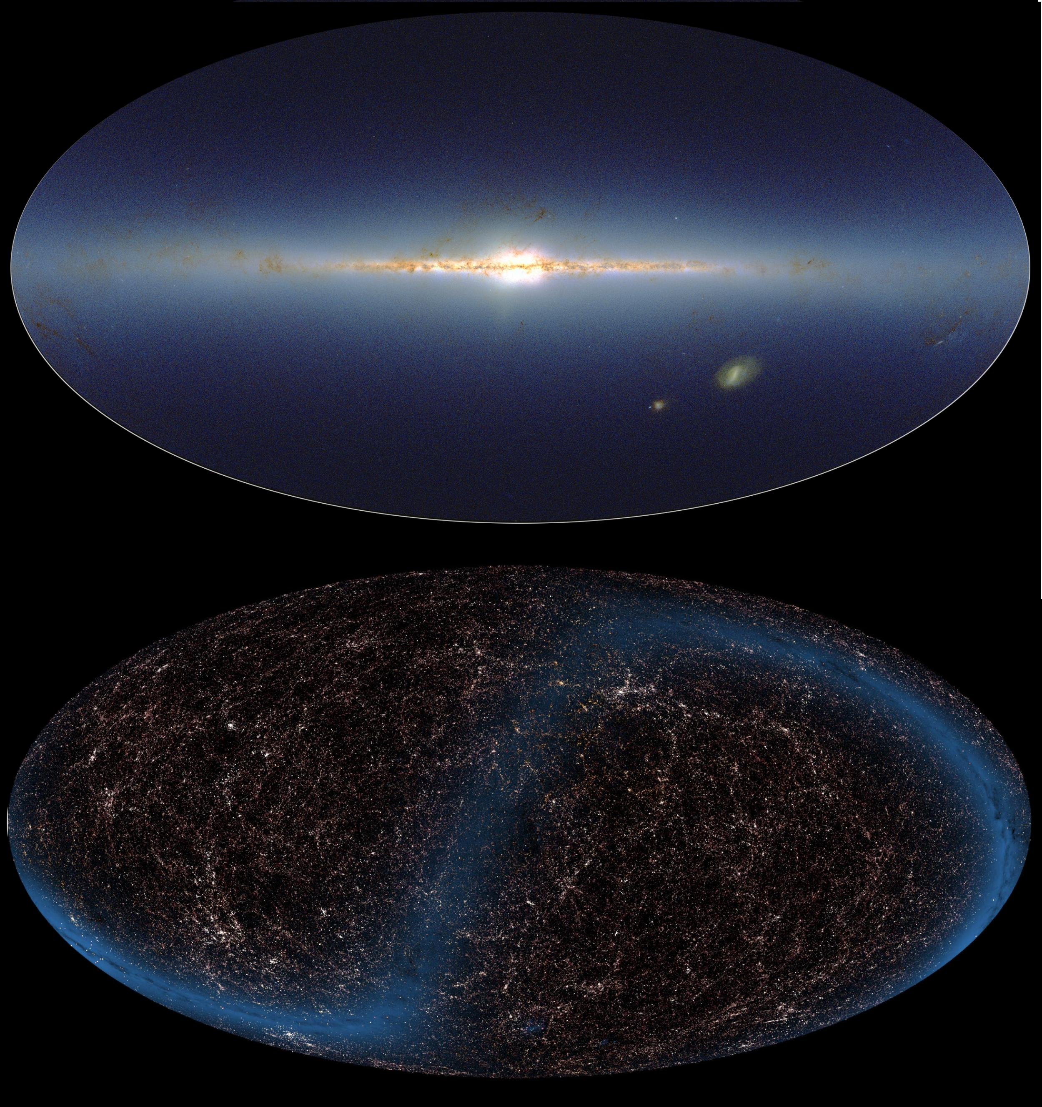
2MASS Infrared Sky Survey
Large-scale Structure: patterns in the distribution of galaxies

Slide 7
Each point
is a galaxy

Slide 8
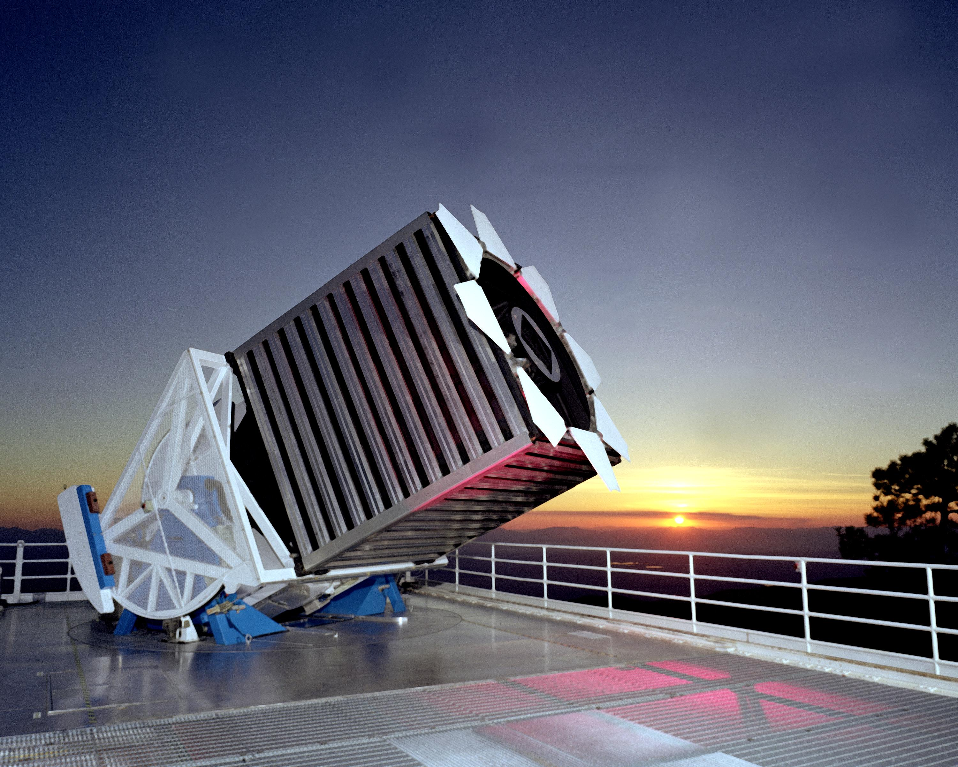
Sloan Digital Sky Survey:
2.5-meter telescope in southern New Mexico

Slide 9
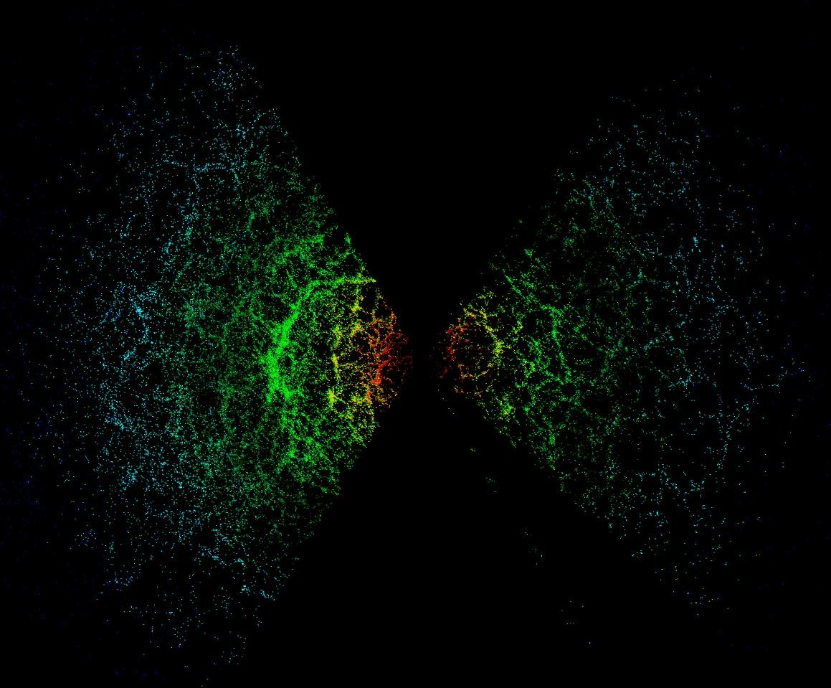

Slide 10
DR4 Movie

Slide 11
Large-scale Structure
The Universe contains a hierarchy of structure, from people to planets, stars, galaxies, clusters of galaxies, and larger structures (filaments, voids, walls).
Where did all this structure come from?
How did it form?

Slide 12
Large-scale Structure
The Universe contains a hierarchy of structure, from people to planets, stars, galaxies, clusters of galaxies, and larger structures.
Where did all this structure come from?
How did it form?
What happened in the Universe’s earliest moments?
What is it made of?

Slide 13
Cosmic Microwave Background Radiation
2.73002
WMAP
2.72998
Temperature: 2.73 degrees above absolute zero
Temperature variations: 1 part in 100,000
Snapshot of the young Universe when it was only 400,000 years old

Slide 14
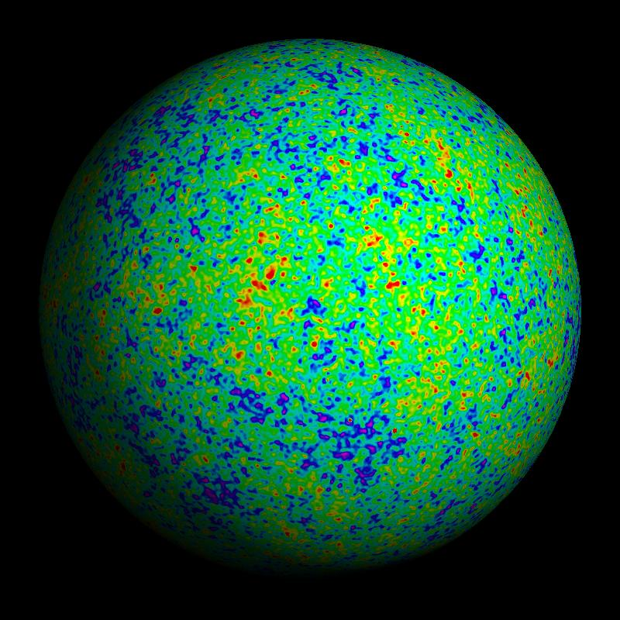
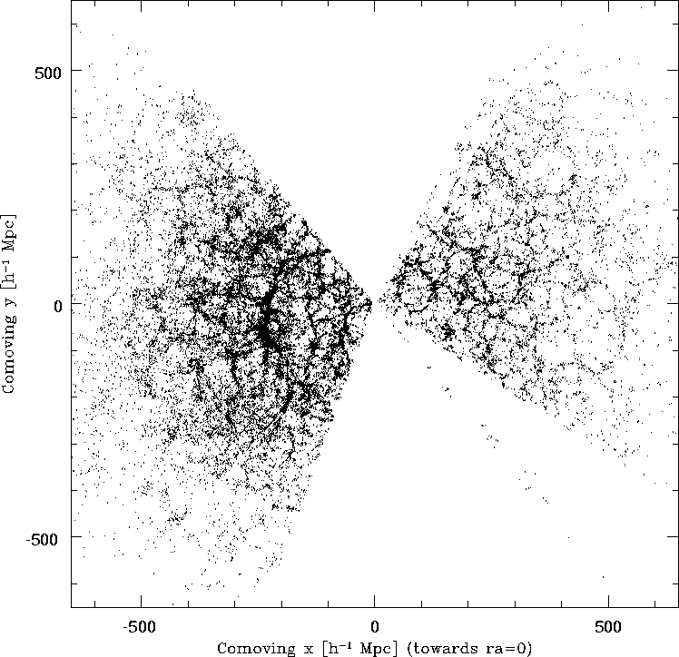
Cosmic Microwave Background
Early Universe was relatively smooth (small ripples in CMB).
Present Universe is lumpy (galaxies, large-scale structure)
Galaxies today
Universe at 400,000 years
These tiny fluctuations in temperature
and density evolved under gravity to
form all the structure we see today

Slide 15
Does the expansion of the Universe change over time?
Gravity:
everything in the Universe attracts everything else
the expansion of the Universe should slow down
over time

Slide 16
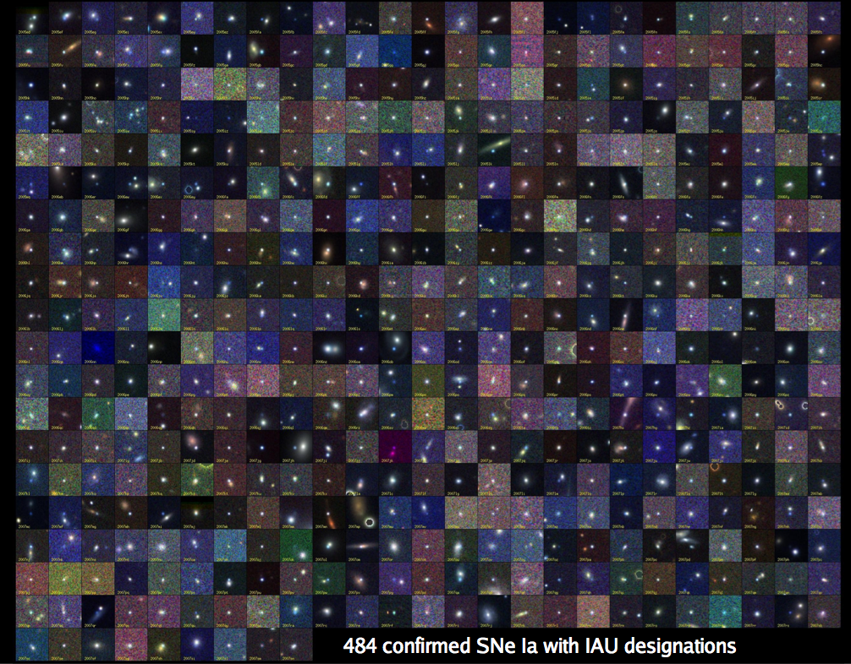
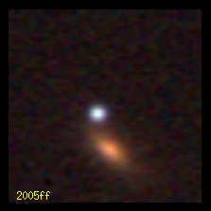
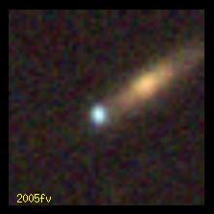
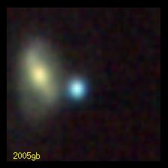
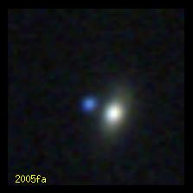
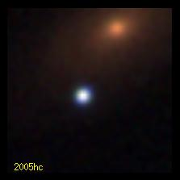
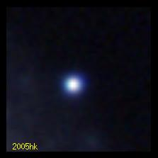
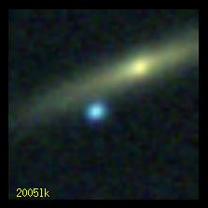
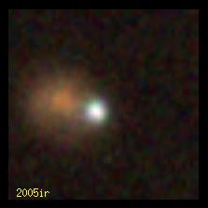
Supernovae: Exploding Stars
B. Dilday
They indicate that expansion is speeding up, not slowing

Slide 17
What causes Cosmic Speed-up?
Two possibilities:
The Universe is filled with stuff that gives
rise to `gravitational repulsion’. We now call this
Dark Energy
Einstein’s theory of General Relativity (gravity) is wrong on cosmic distance scales.
Notes:
We’ll come back to this question of what’s causing the acceleration later on.

Slide 18
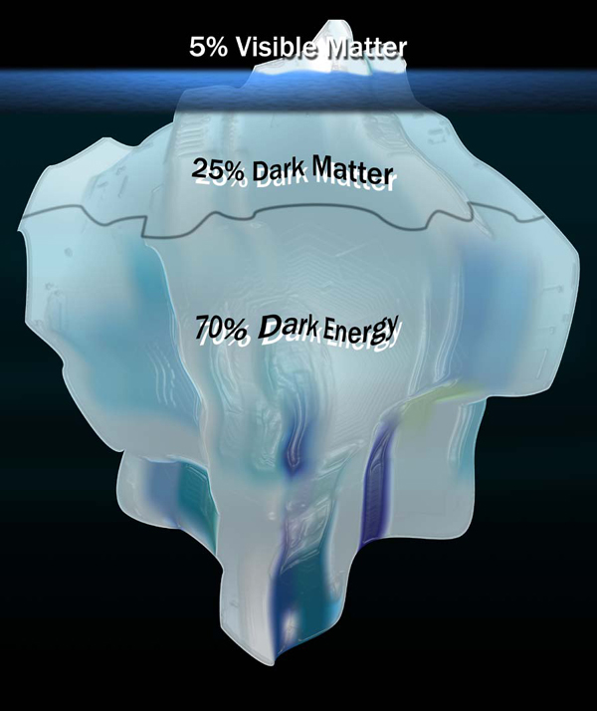
Everything we can see -- people, plants, planets, stars (stuff made of atoms)… – makes up only 5 % of the universe.

Slide 19
Computer Simulation of Galaxy Formation in a Universe with Dark Matter & Dark Energy

Slide 20
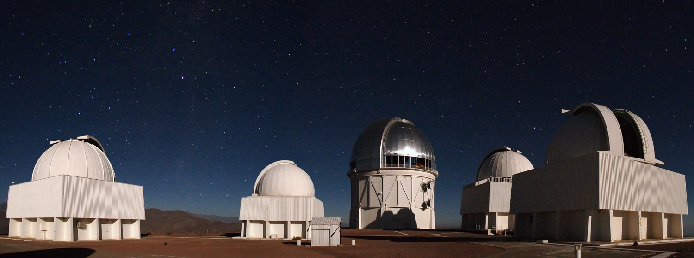
Blanco 4-meter telescope
Cerro Tololo Inter-American Observatory in Chilean Andes

Slide 21
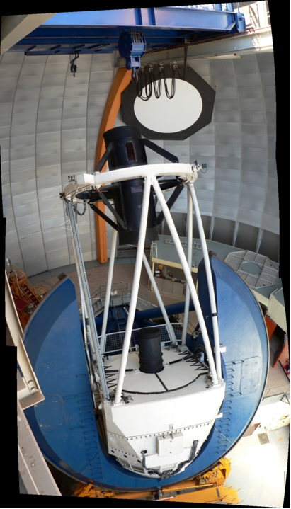
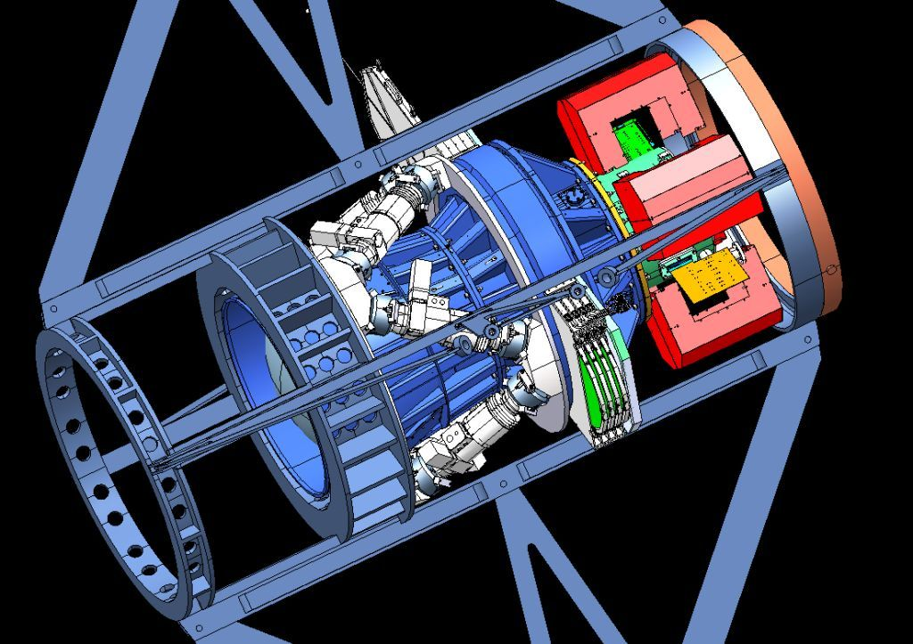
Dark Energy Survey
Dark Energy Camera

Slide 22
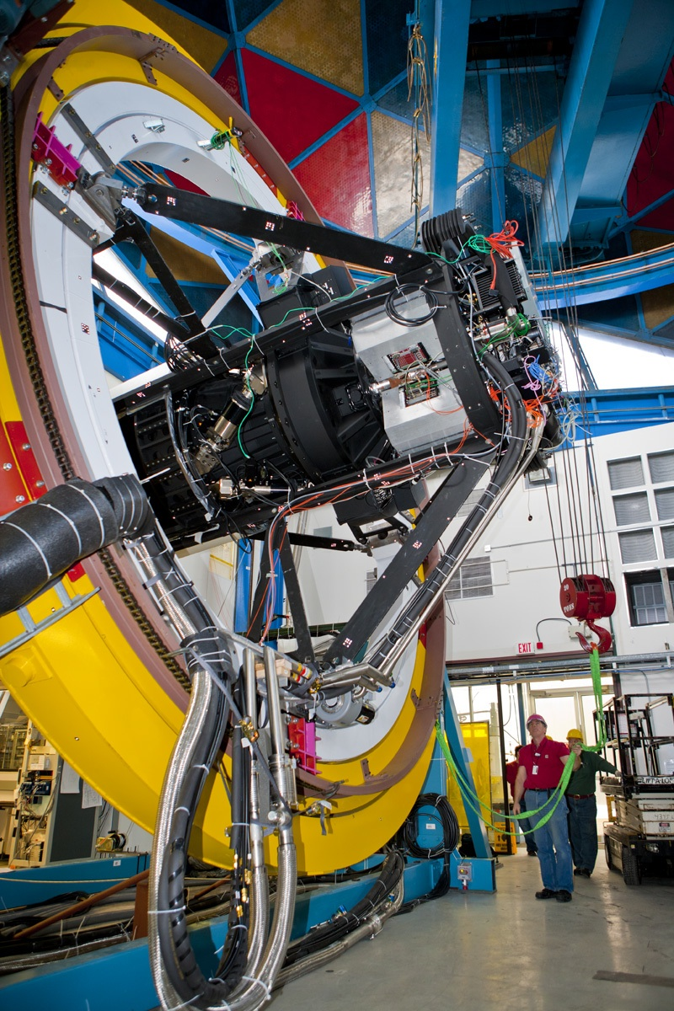
Dark Energy Camera mounted on a Telescope Simulator at Fermilab in Illinois in early 2011
We will ship it to Chile this summer and use it to survey 300 million galaxies over 5 years.

Slide 23
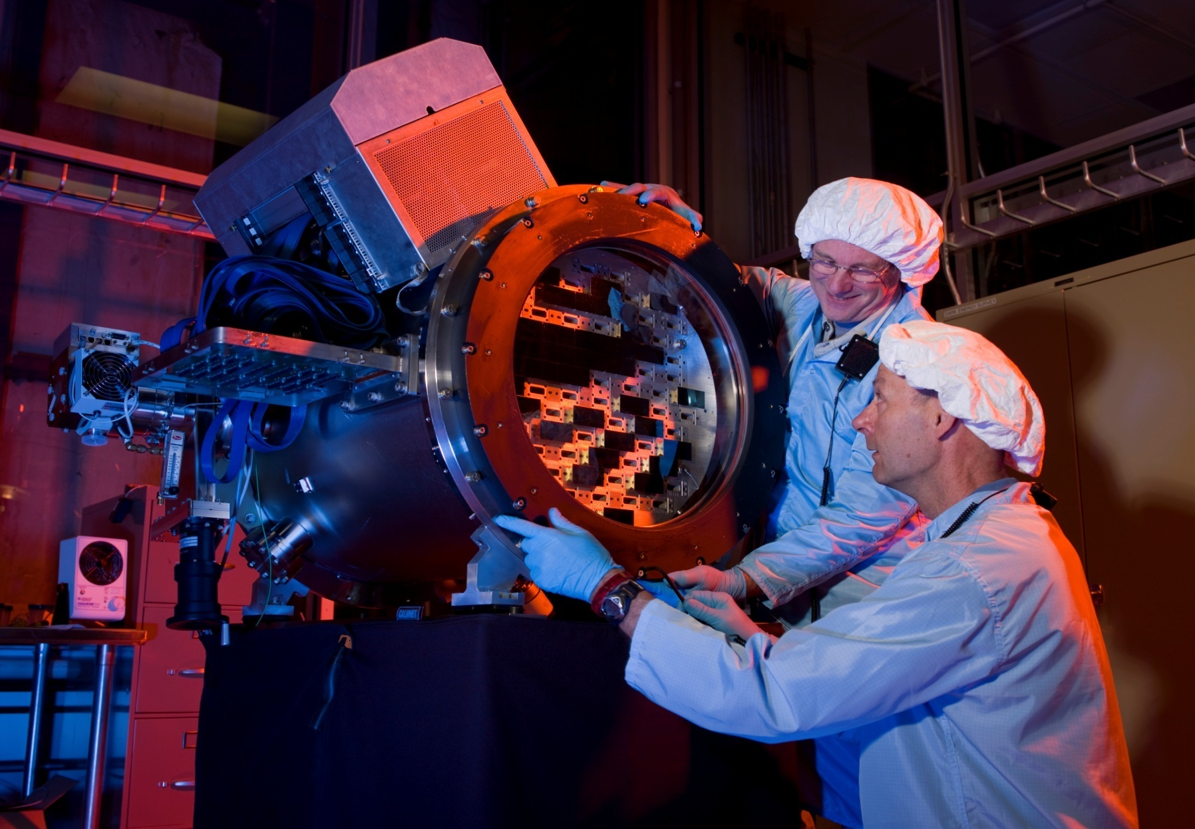
570 Megapixel camera

Slide 24
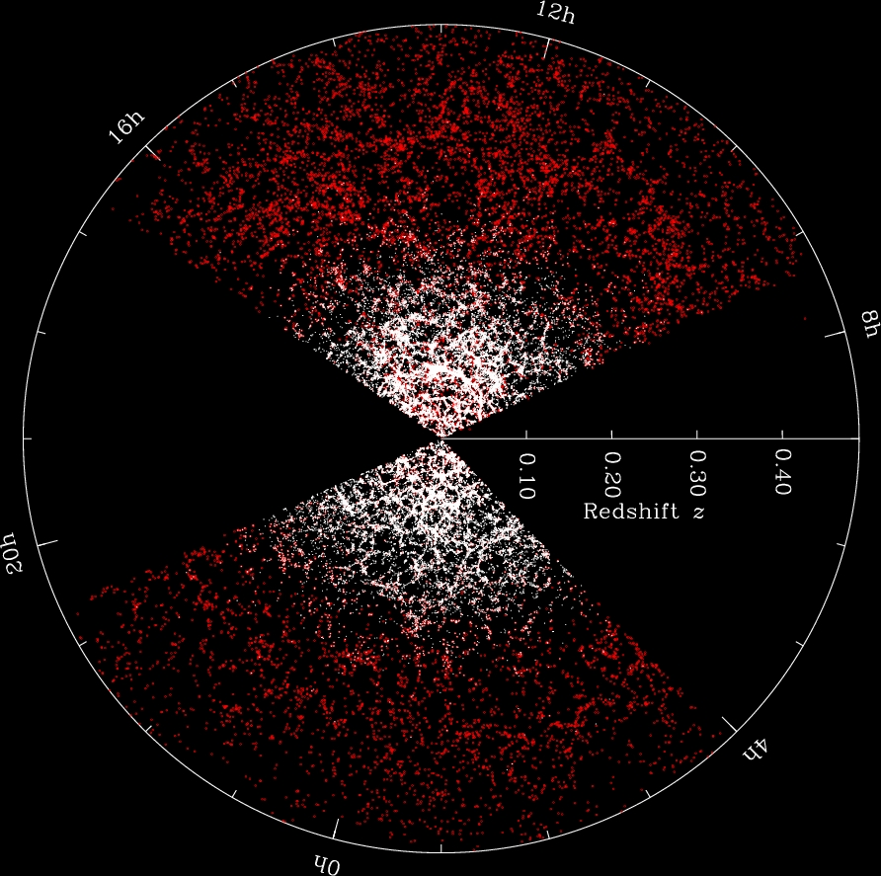
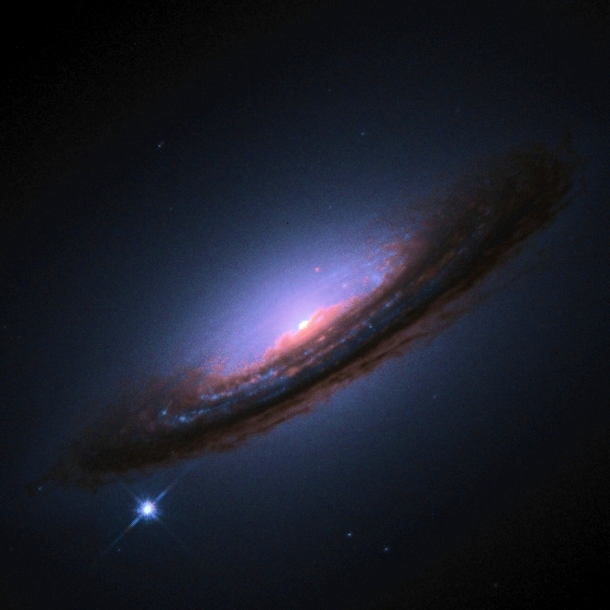
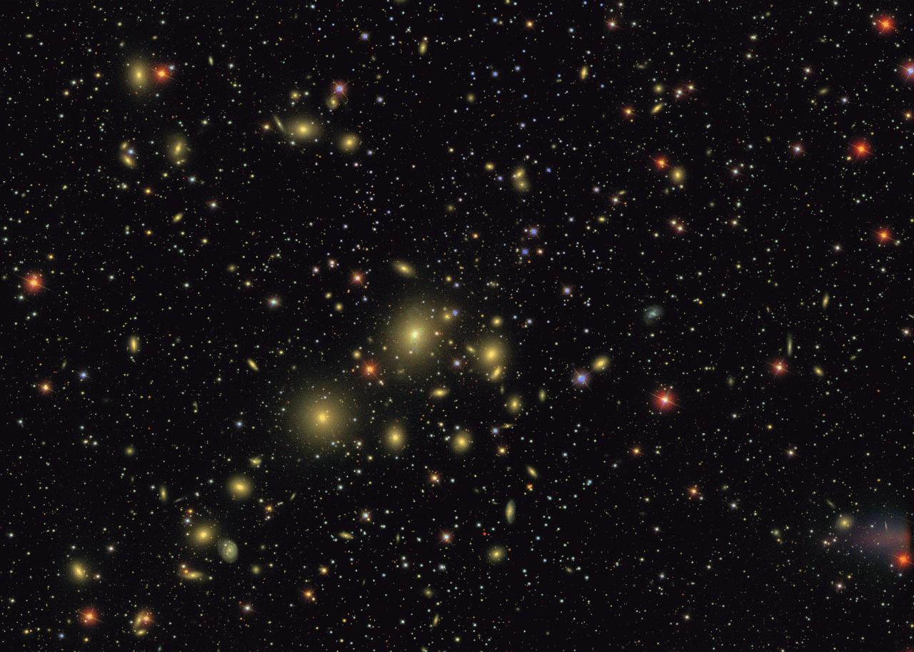
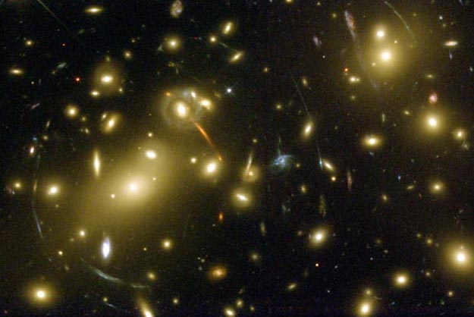
Dark Energy Survey will amass 2 million Gigabytes of data:
Supernovae
Large-scale structure
Gravitational Lensing
Clusters

