Slide 1
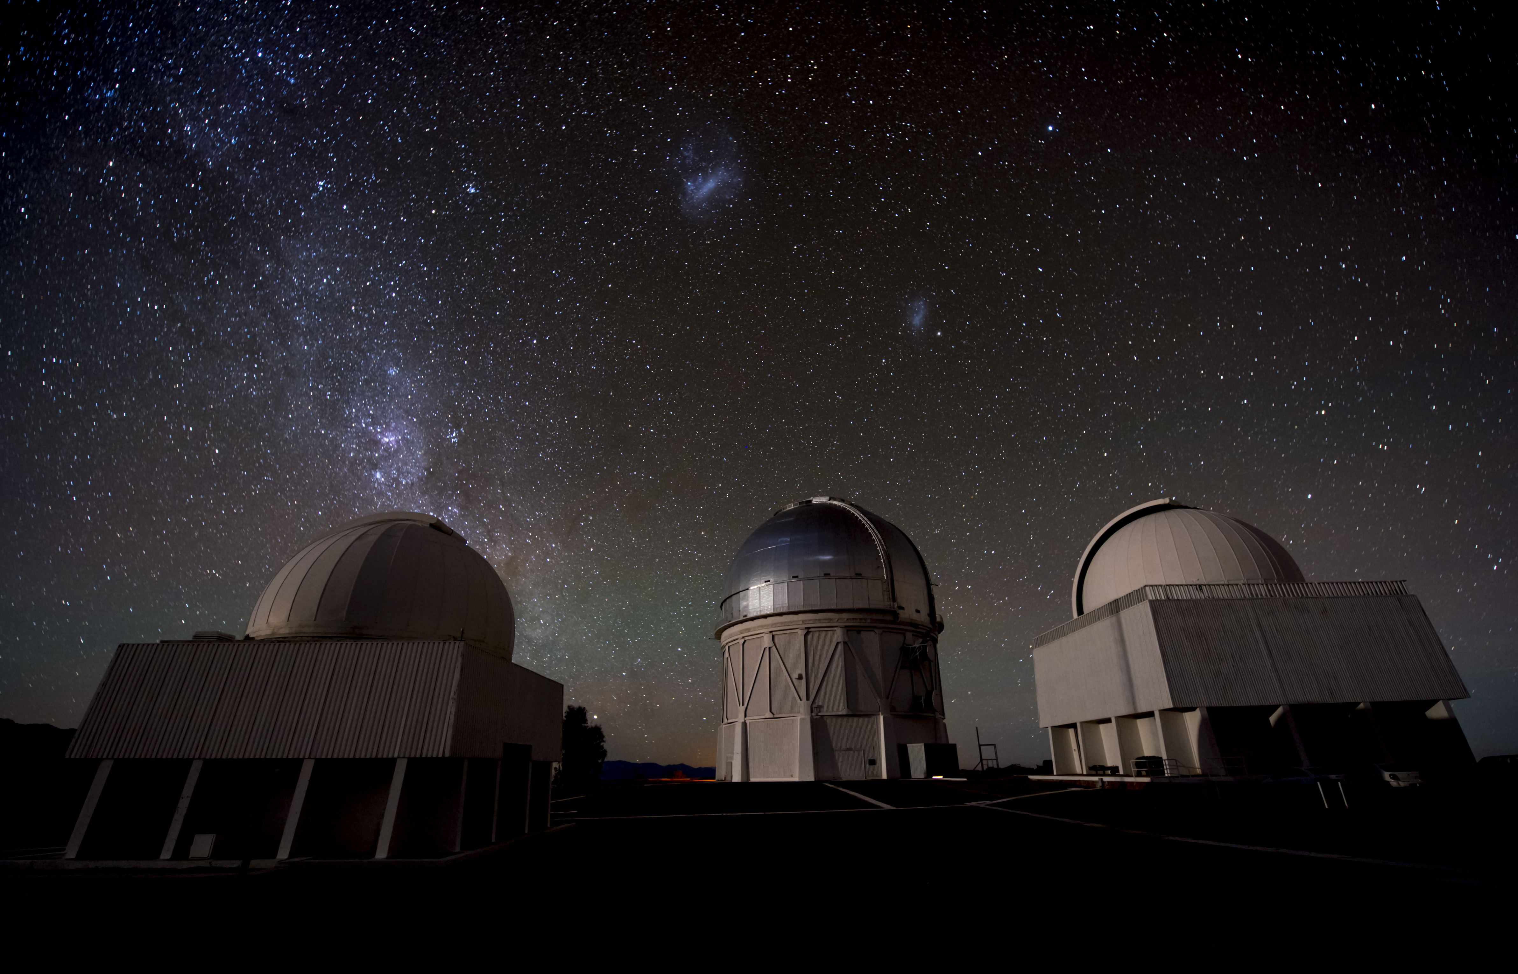
Dark Energy Survey
Year 1 Results
Josh Frieman
DES Project Director
Fermilab, U. Chicago
HEPAP Meeting
Sept. 26, 2017

Slide 2
Cosmology 2017: ΛCDM
A well-tested (6-parameter) cosmological model:
  Universe is expanding from hot, dense early phase (Big Bang) 13.8 Gyr ago.
  Early epoch of accelerated expansion (inflation) produced nearly flat & smooth spatial geometry and generated large-scale density perturbations from quantum fluctuations
  From these, structure formed from gravitational instability of cold dark matter (CDM, 25%) in currently Λ-dominated (70%) universe, which is again accelerating.
Consistent with all data from the CMB, large-scale structure, lensing, supernovae, clusters, light element abundances (BBN), …

Slide 3
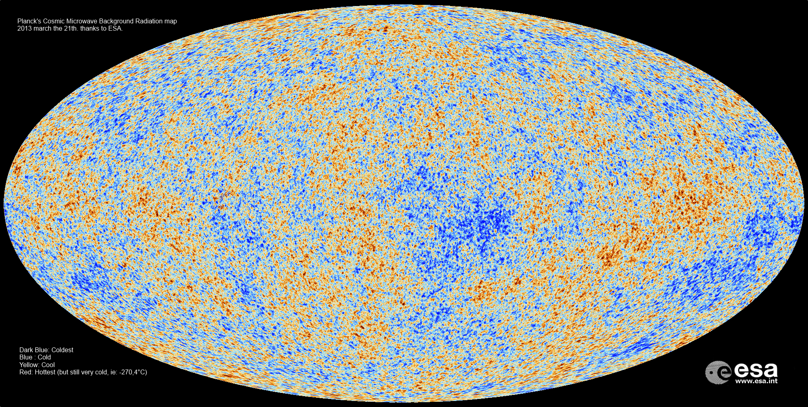
Planck CMB Temperature Map
Fluctuations ~1 part in 10⁵ at 380,000 years

Slide 4
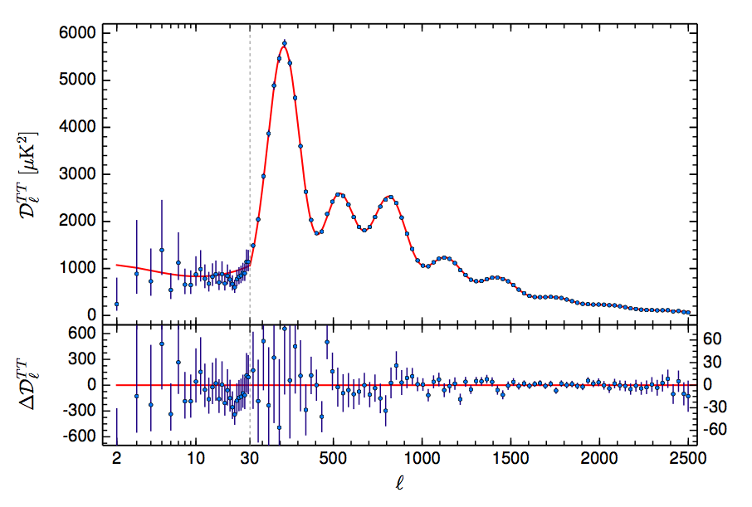
Planck 2015 Results
6-parameter ΛCDM fit:
Ω_{Λ}=0.692±0.012
Ω_{m}=0.301±0.012
n_{s}=0.968±0.006
H₀=67.8±0.9 km/sec/Mpc
σ₈=0.815±0.009
Ω_{b}h²=0.02226±0.00023
(TT+lowP+lensing)

Slide 5
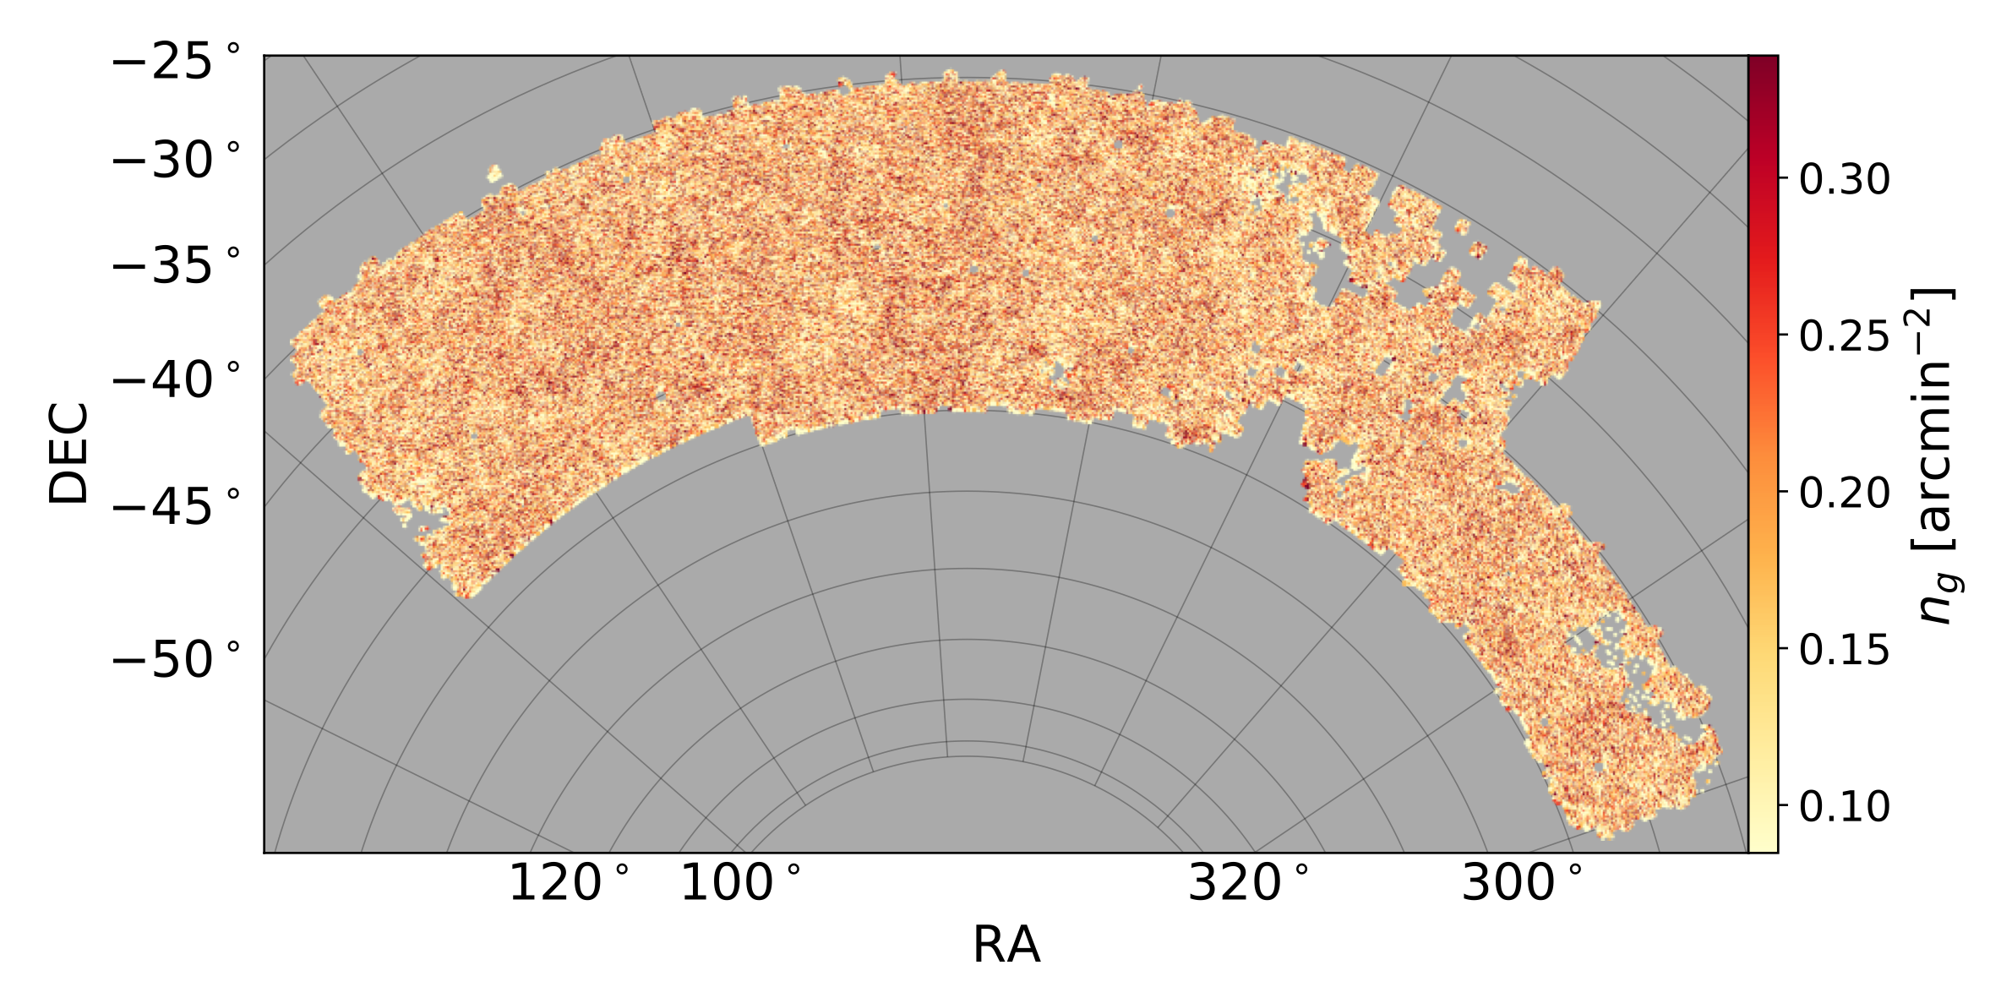
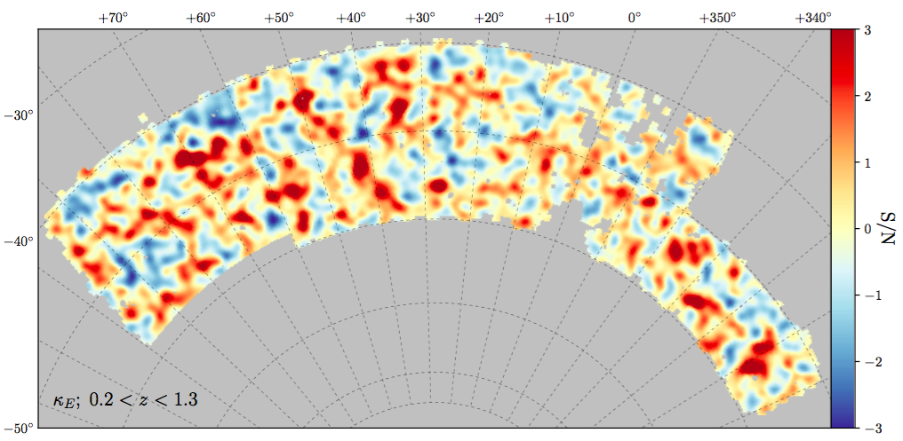
DES Year 1 Maps of Cosmic Structure
Weak lensing mass map based on shapes of 26 million source galaxies
(Chang, et al)
660,000 red galaxies with precise photometric redshifts
(Elvin-Poole, et al)
SPT
region
SV area previously
analyzed
First Year of Data: ~1800 sq. deg. out of 5000 for full survey

Slide 6
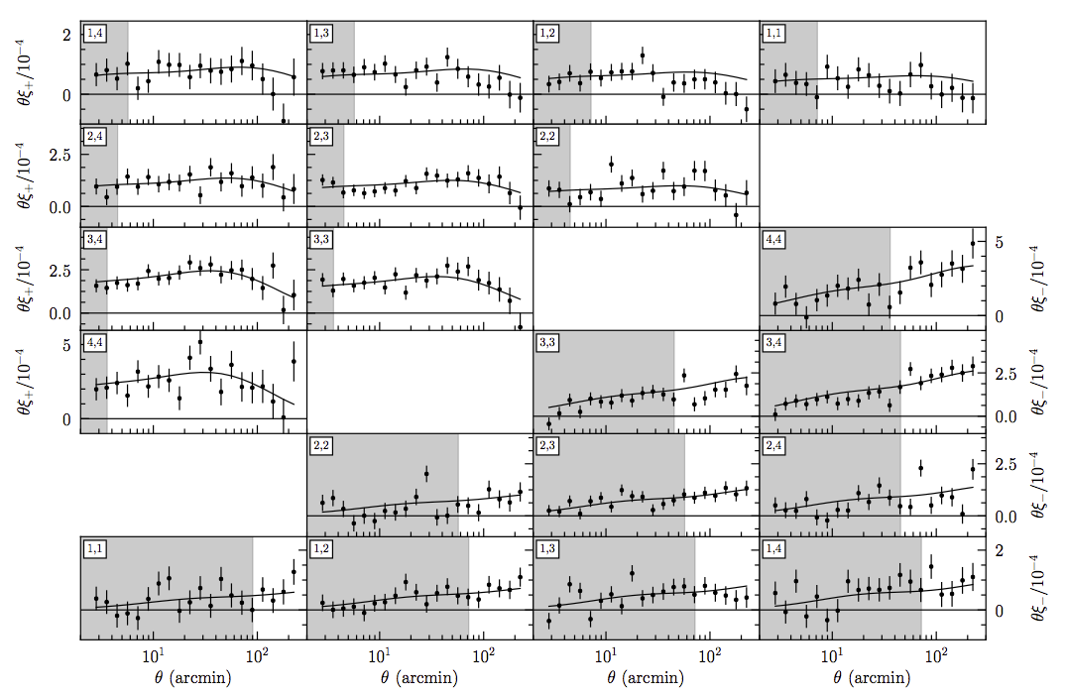
DES Year 1 Cosmic Shear Results
Best-fit ΛCDM model shown
6
Fluctuations ~1 at 10 Gyr
Troxel, et al

Slide 7
Probing the Cosmological Paradigm
ΛCDM rests on physics beyond the Standard Model:
  Inflation, dark energy, dark matter
Understanding this physics constitutes 2 of the P5 science drivers (they bundled two of them).
Are these 6 parameters all we need?
  spatial curvature, m_{ν}, w [w₀, w_{a}], modified gravity,…
  Tensions? Planck vs local H₀, Planck vs WL σ₈

Slide 8
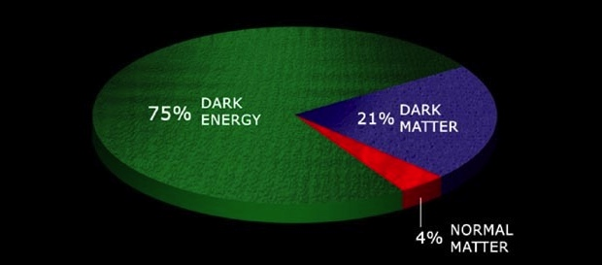
What is the physics of cosmic acceleration?
Dark Energy or modification of General Relativity?
    If Dark Energy, is it Λ (the vacuum) or something else?
      What is the DE equation of state parameter w and (how) does it evolve? (For Λ, w=−1.)
70%
26%

Slide 9
What can we probe?
JF, Turner, Huterer
Growth of
Density
Perturbations
Geometry: Distances, Expansion rate vs. Redshift
Expansion History Growth of Structure
Require both to distinguish Dark Energy from Modified Gravity. Aiming toward %-level measurements of geometry & structure.

Slide 10
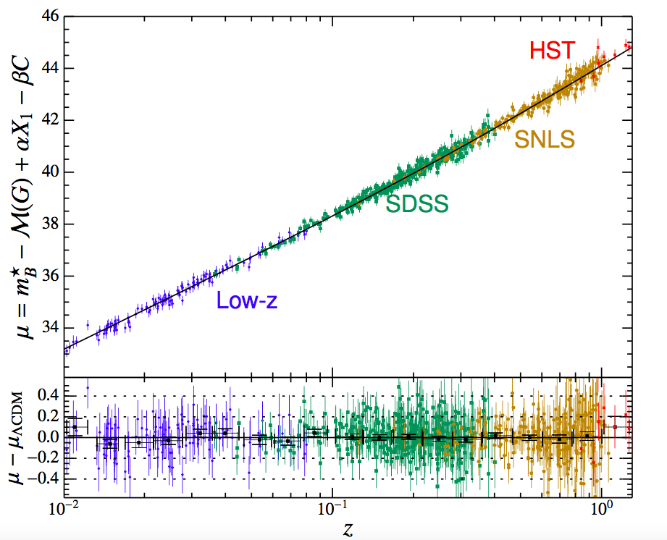
Supernova Ia Hubble Diagram
Joint Lightcurve Analysis (JLA)
Betoule, et al 2014
740 supernovae
Distance modulus (log distance)
Percent-level distance determination
33 SNe
redshift

Slide 11
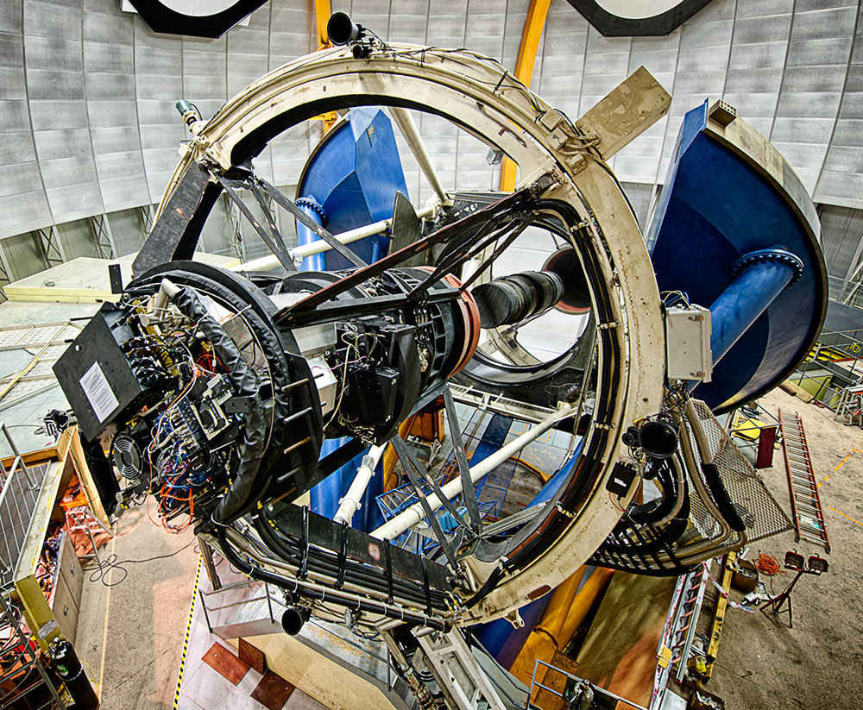
The Dark Energy Survey
Probe origin of Cosmic Acceleration:
  Clusters, Weak Lensing, Galaxy clustering, Supernovae
• Two multicolor surveys:
− 300 M galaxies over 5000
sq deg, grizY to 24th mag
− 3000 supernovae (27 sq deg)
New camera for CTIO Blanco 4m telescope
− DECam Facility instrument
• Survey started Aug. 2013
− Now in 5th of 5 seasons, 105
nights per season (Aug-Feb)
DECam on the CTIO Blanco 4m
International collaboration led by FNAL;
DOE+NSF support

Slide 12
DES Year 1 Cosmology Analysis: 3x2
Compare & consistently combine three 2-point correlation function measurements:
  Angular clustering: autocorrelation of 660,000 luminous red galaxies in 5 redshift bins
  Cosmic shear weak lensing: shear correlation of 26 million galaxy shapes in 4 redshift bins
  Galaxy-galaxy lensing: correlate red galaxy positions (foreground lenses) with source galaxy shear
Fully blind analysis, 10 papers released Aug. 3
SPT
region
SV area previously
analyzed

Slide 13
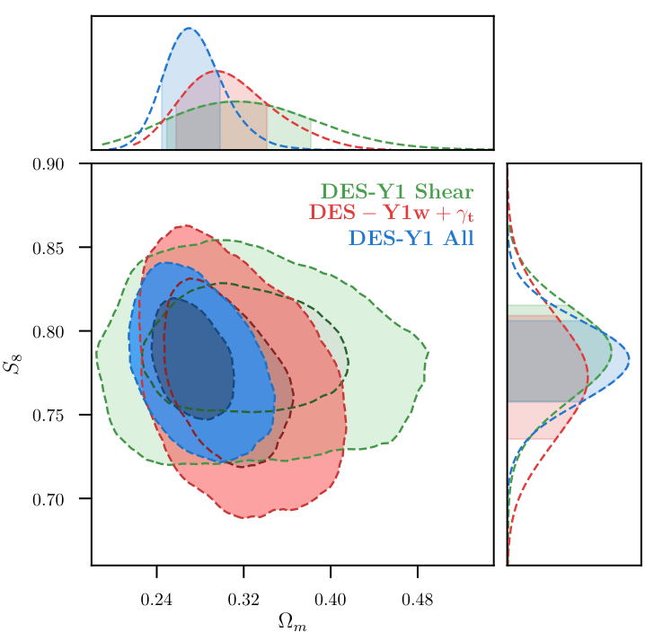
Multi-Probe Constraints: ΛCDM
DES Year 1 results:
  Weak Lensing Cosmic Shear
  Galaxy-galaxy lensing+galaxy clustering
  Detailed modeling of covariance between probes
Amplitude of clustering
Density of matter
DES Collaboration 2017
S₈=σ₈(Ω_{m}/0.3)^{0.5}

Slide 14
Comparison of DES Y1 with Planck: low-z vs high-z in ΛCDM
DES and Planck constrain S₈ and Ω_{m} with comparable strength!
Differ in central values by >1σ, but consistent according to Bayesian evidence
DES final analysis will include 4x Y1 data and additional probes (clusters, supernovae)
Amplitude of clustering
S₈=σ₈(Ω_{m}/0.3)^{0.5}
DES Collaboration 2017

Slide 15
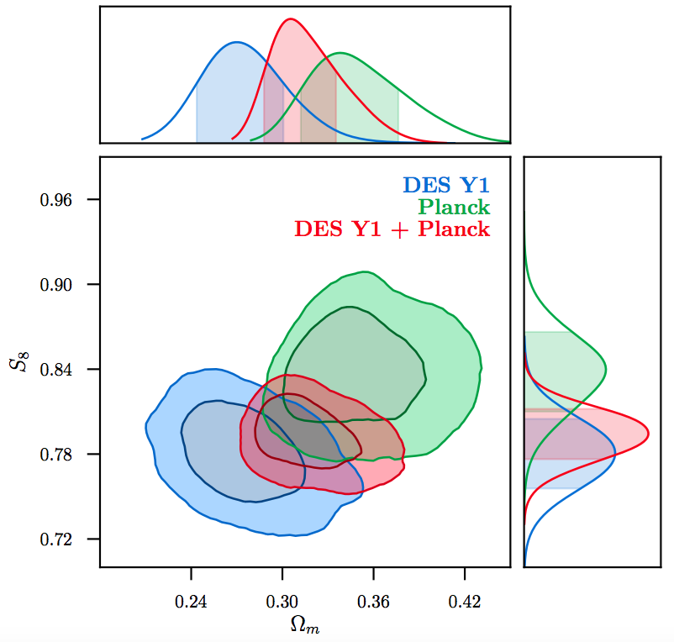
Comparison of DES Y1 with Planck: low-z vs high-z in ΛCDM
DES and Planck constrain S₈ and Ω_{m} with comparable strength!
Differ in central values by >1σ, but consistent according to Bayesian evidence
DES final analysis will include 4x Y1 data and additional probes (clusters, supernovae)
Amplitude of clustering
S₈=σ₈(Ω_{m}/0.3)^{0.5}
DES Collaboration 2017

Slide 16
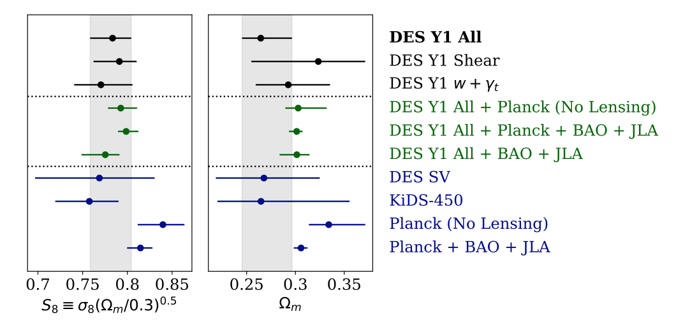



Combine multiple data sets: ΛCDM
DES Collaboration 2017
Combined constraints:

Slide 17
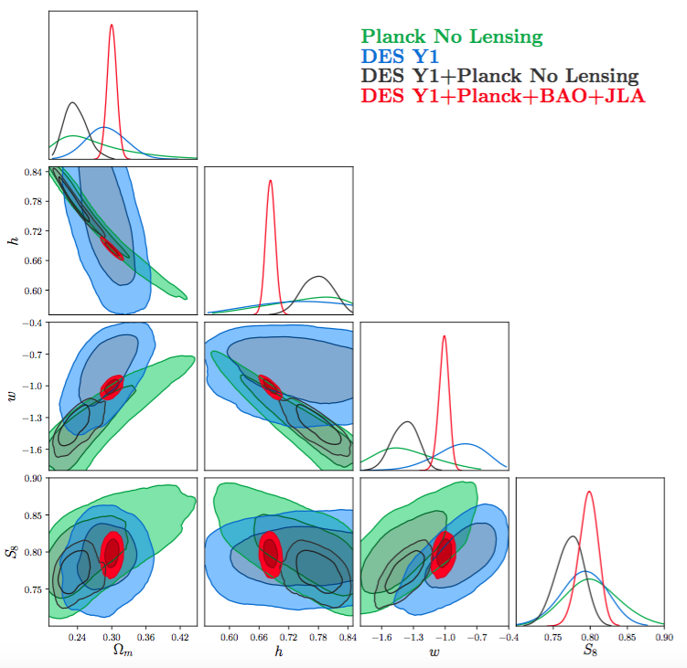

Combine multiple data sets: wCDM
Combine to achieve very stringent parameter constraints:
Haven’t yet tested model with time-varying w
DES Collaboration 2017

Slide 18
Where do we go from here? Y3-Y5 analyses
5000 sq. deg. with increasing depth
Galaxy Clusters
  Tens of thousands of clusters to z~1
Weak Lensing
  Shape measurements of ~200 million galaxies
Galaxy Clustering
  ~300 million galaxies to z ~ 1
Supernovae
  3000 well-sampled SNe Ia to z ~1
Strong Lensing
  ~30 QSO lens time delays
  Arcs with multiple source redshifts
Cross-correlations
  Galaxies, WL x CMB lensing
DES forecast
T. Eifler, E. Krause

Slide 19

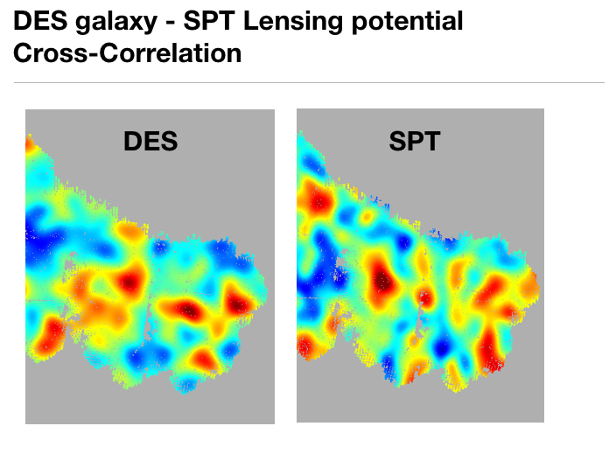
DES Galaxies X CMB Lensing
DES galaxies associated with projected mass partly responsible for CMB lensing
Additional cosmological information in this cross-correlation
SZ Spectrum
galaxies
CMB lensing
low-𝜆 (20-50)
med-𝜆 (50-70)
high-𝜆 (>70)
Giannantonio, Fosalba, Cawthon et al (earlier DES SV data)

Slide 20
Constraining Growth Function of Perturbations
Forecast
S. Bocquet
Powerful test of ΛCDM and GR
(complements Redshift Space Distortions)

Slide 21
What new techniques, technology, or data enabled this?
Technology: DECam on the Blanco: highly efficient, red-sensitive CCDs (LBNL), wide-field imager (3 sq. deg., 570 megapixels) w/ excellent optical design on 4m telescope: unprecedented survey power (depth x area)/time. 525 nights awarded in exchange for facility instrument.
Techniques: control systematics of photo-z’s; new weak lensing shape methodologies; model complex covariance matrices, test with realistic N-body simulations.
Data: DES Y1, extensively vetted for systematics; NCSA-led production system for data management, augmented by collaboration-produced value-added catalogs for analysis.

Slide 22
Meaning & Impact
Measurements from galaxy surveys now rival precision of CMB for certain cosmological parameters (and exceed it for some others): compare low- and high-z Universe to obtain complementary constraints (break parameter degeneracies).
DES Y1 consistent with Planck CMB in context of ΛCDM. Quite remarkable for simple 6-parameter model.
DES Y1 in combination with Planck, BAO, JLA SN provide most stringent constraints on ΛCDM parameters to date.
Precision will increase with larger data sets (Y1→Y3→Y5) and by using more probes (clusters, SNe, CMB cross-correlations), enabling tests of more complex models (w₀w_{a}CDM, modified gravity), and eventually will be even better with LSST, DESI, Euclid, WFIRST.

Slide 23
Extra Slides

Slide 24
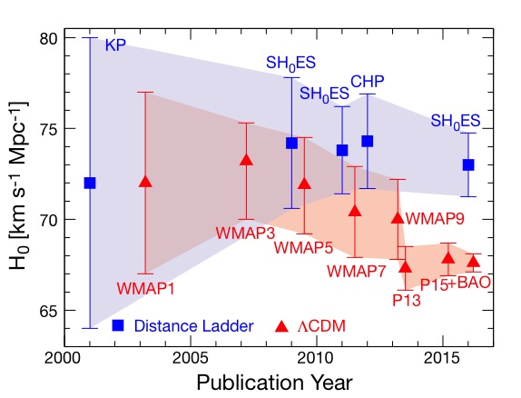
H₀: CMB vs. Local Measurements
CMB results assume ΛCDM model
3.4σ discrepancy

Slide 25
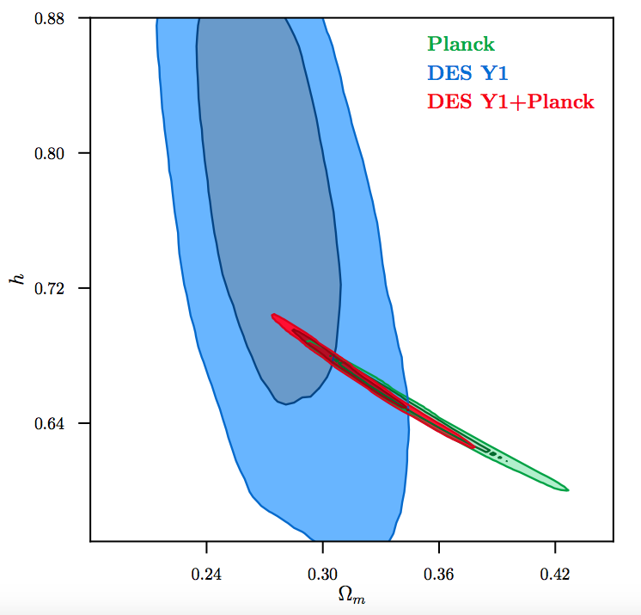
What about H₀?
DES 3x2 doesn’t constrain H₀ on its own
DES ΛCDM constraint on Ω_{m} combined with Planck shifts h up by >1σ from Planck central value, toward but not reaching local H₀ values
DES Collaboration 2017

Slide 26
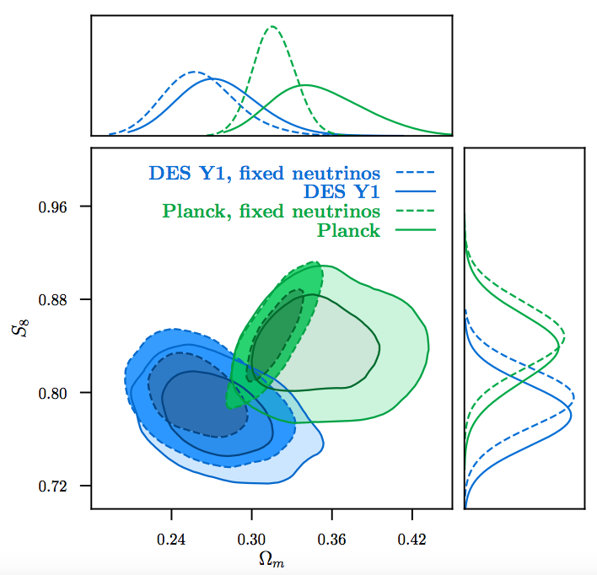
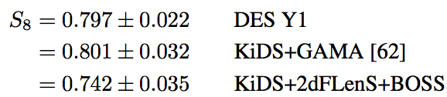
What if we fix neutrino mass?
Hold neutrino mass at 0.06 eV (lower limit from oscillation experiments)
DES 3x2 still consistent with Planck in ΛCDM
DES Collaboration 2017

Slide 27
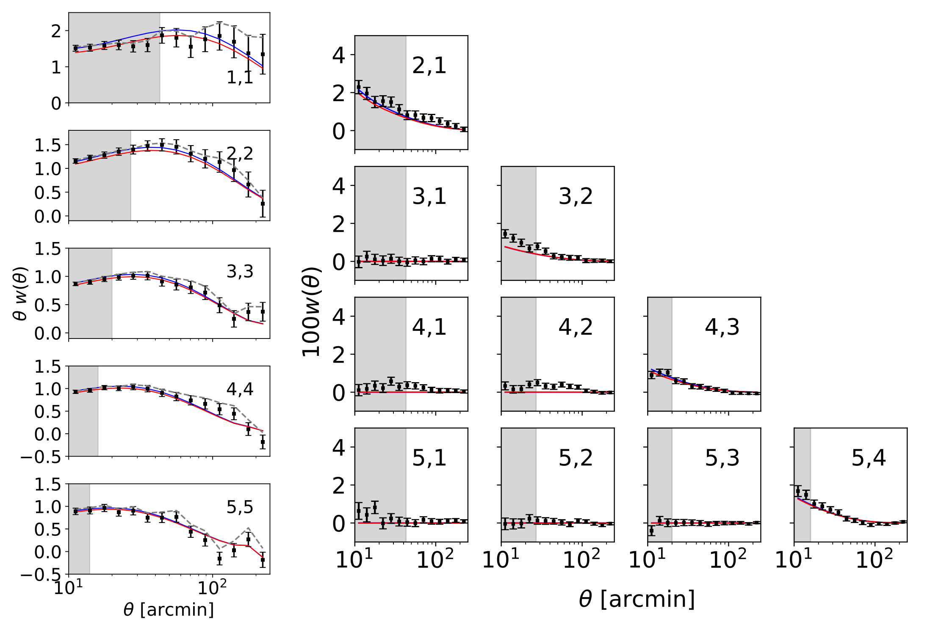
DES Y1 Galaxy Clustering
Elliptical galaxy spectrum
Elvin-Poole, et al

Slide 28
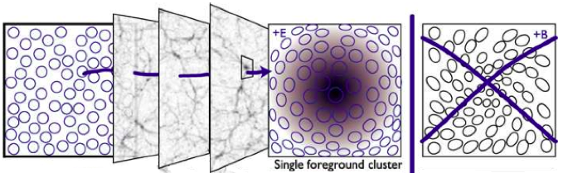
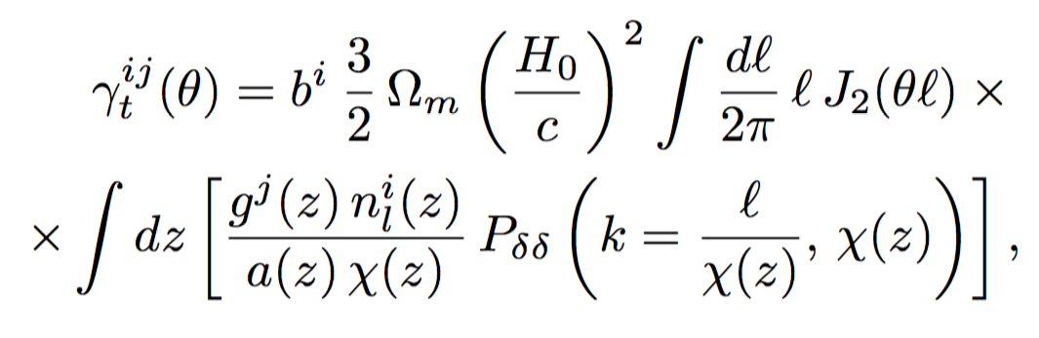
Galaxy-Galaxy Lensing
Measurement of the tangential shear of background (source) galaxies around foreground (lens) galaxies.
28

Slide 29
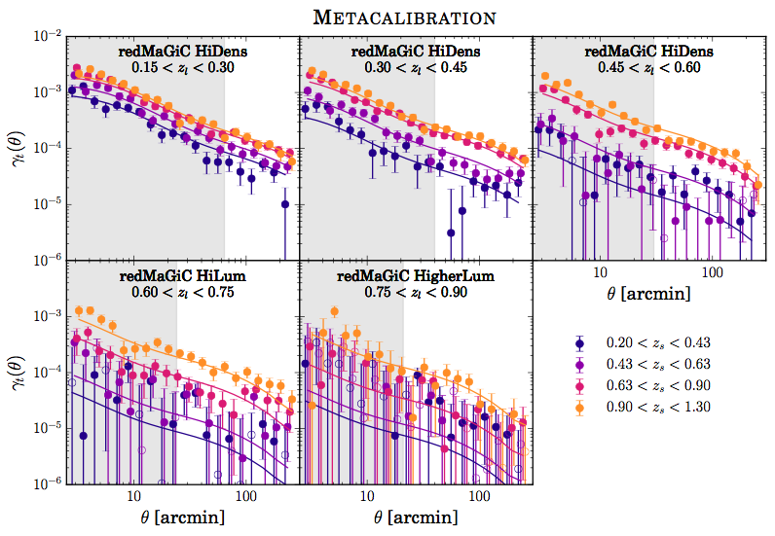
Prat, et al
29

Slide 30
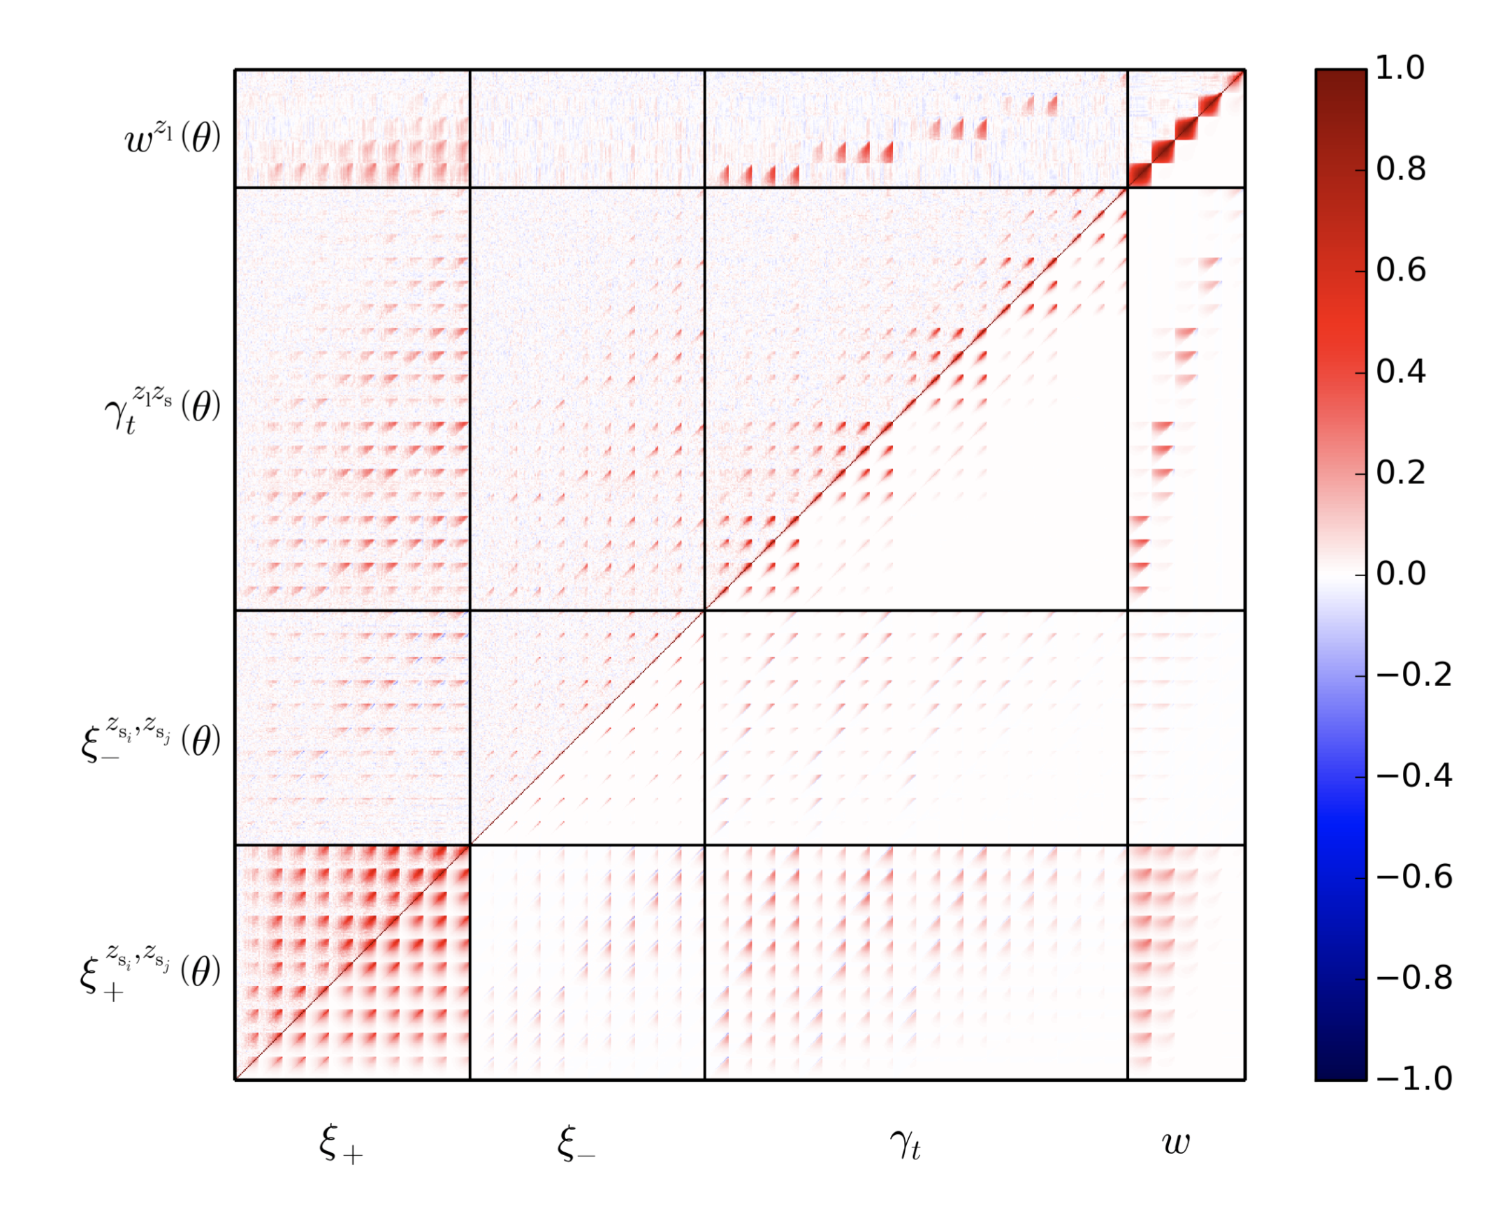
Covariance Matrix
Krause, et al
Mocks
Theory

