Slide 1
The Dark Energy Survey
Josh Frieman
DES Project Director
Fermilab and University of Chicago
cell: 847-274-0429
More details in DES Special Session 335 at 2 pm today
DVDs and Fact Sheets available here
Press and additional material also on-line at:
http://www.fnal.gov/pub/presspass/press_releases/2012/DES-201212-images.html

Slide 2
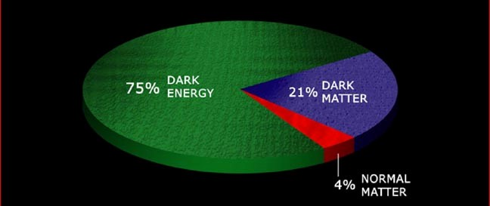
Dark Energy
The expansion of the Universe is speeding up.
What is causing cosmic acceleration?
Dark Energy or modification of Gravity theory?
If Dark Energy, is it the cosmological constant or not?
New surveys required to address these questions

Slide 3
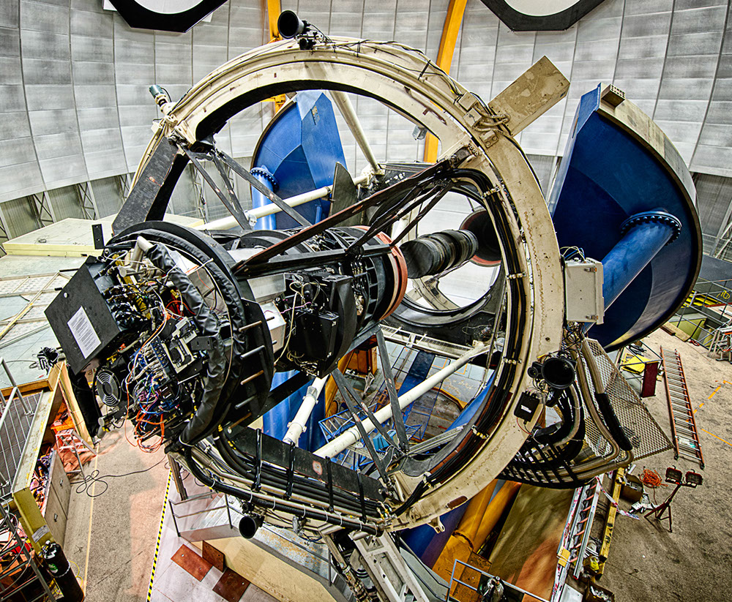
The Dark Energy Survey
Survey project using 4 complementary techniques:
I. Counts of Galaxy Clusters
II. Weak Gravitational Lensing
III. Large-scale Structure
IV. Supernovae
• Two multiband imaging surveys:
300 million galaxies over 1/8 sky
4000 supernovae (time-domain)
• New 570 Megapixel Dark Energy
Camera on the Blanco 4-meter
Survey 2013-2018 (525 nights)
Premiere facility instrument for
astronomy community
DECam on the Blanco 4m at Cerro Tololo InterAmerican Observatory

Slide 4
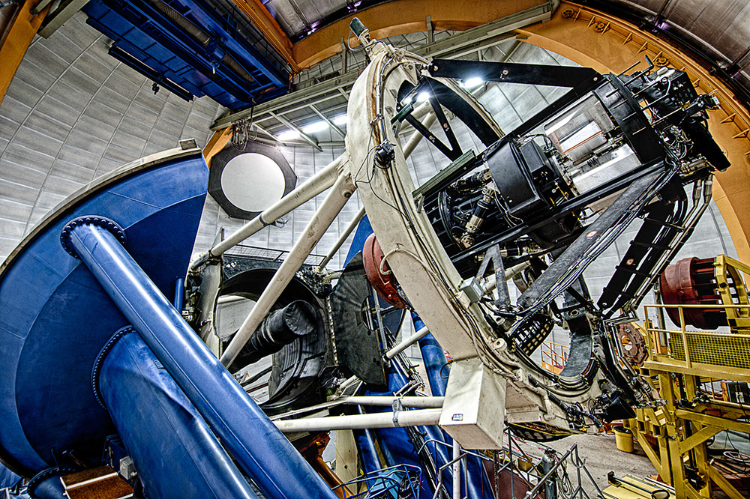
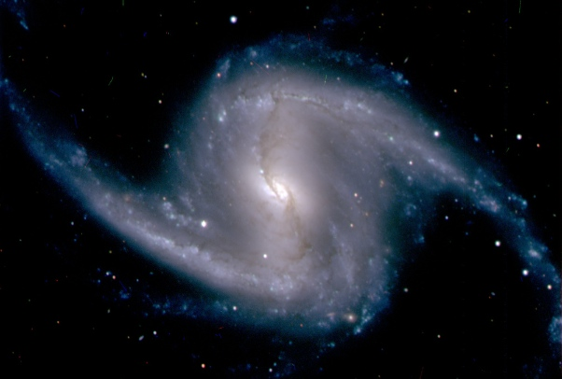
DECam First Light
September 12, 2012
Instrument has been commissioned and tested since then. Successful Test Phase wrapping up in February. Camera produces excellent images.

Slide 5
First Supernova Discovered by DES
Nov. 7 Dec. 15
Supernova of type Ia at redshift z=0.2 confirmed at AAO.

Slide 6
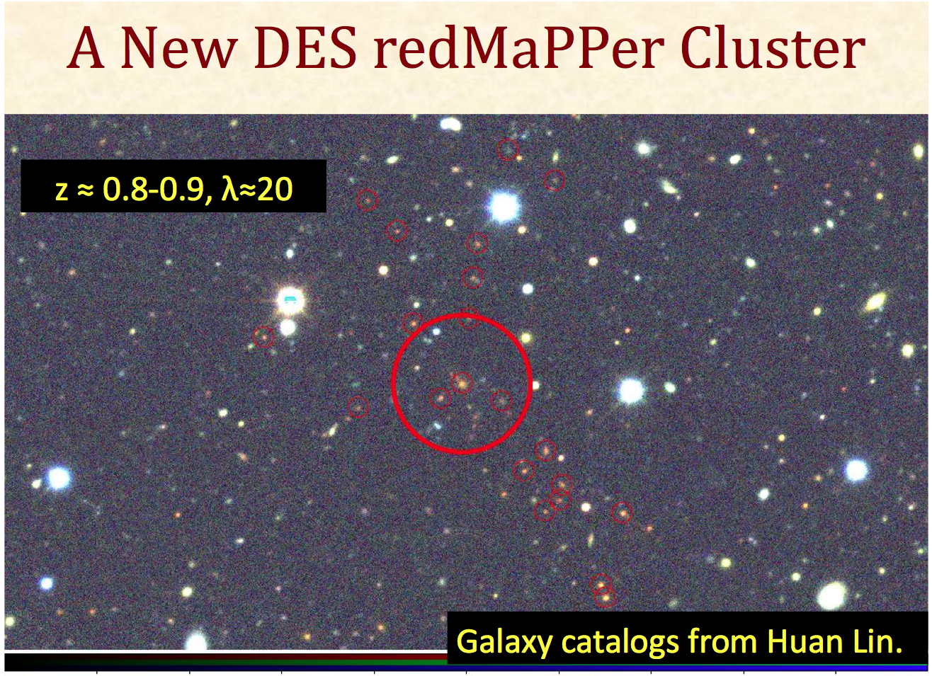
High Redshift Cluster Discovered by DES
from DES Test Data in November

Slide 7
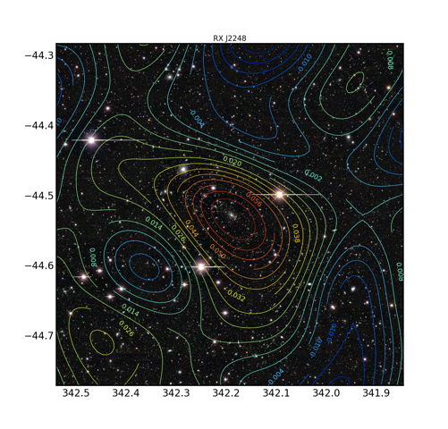
Cluster Weak Lensing
Weak Lensing measures cluster masses, which are needed to use them as Dark Energy probes
Preliminary cluster mass map (contours)from DES Weak Lensing

Slide 8
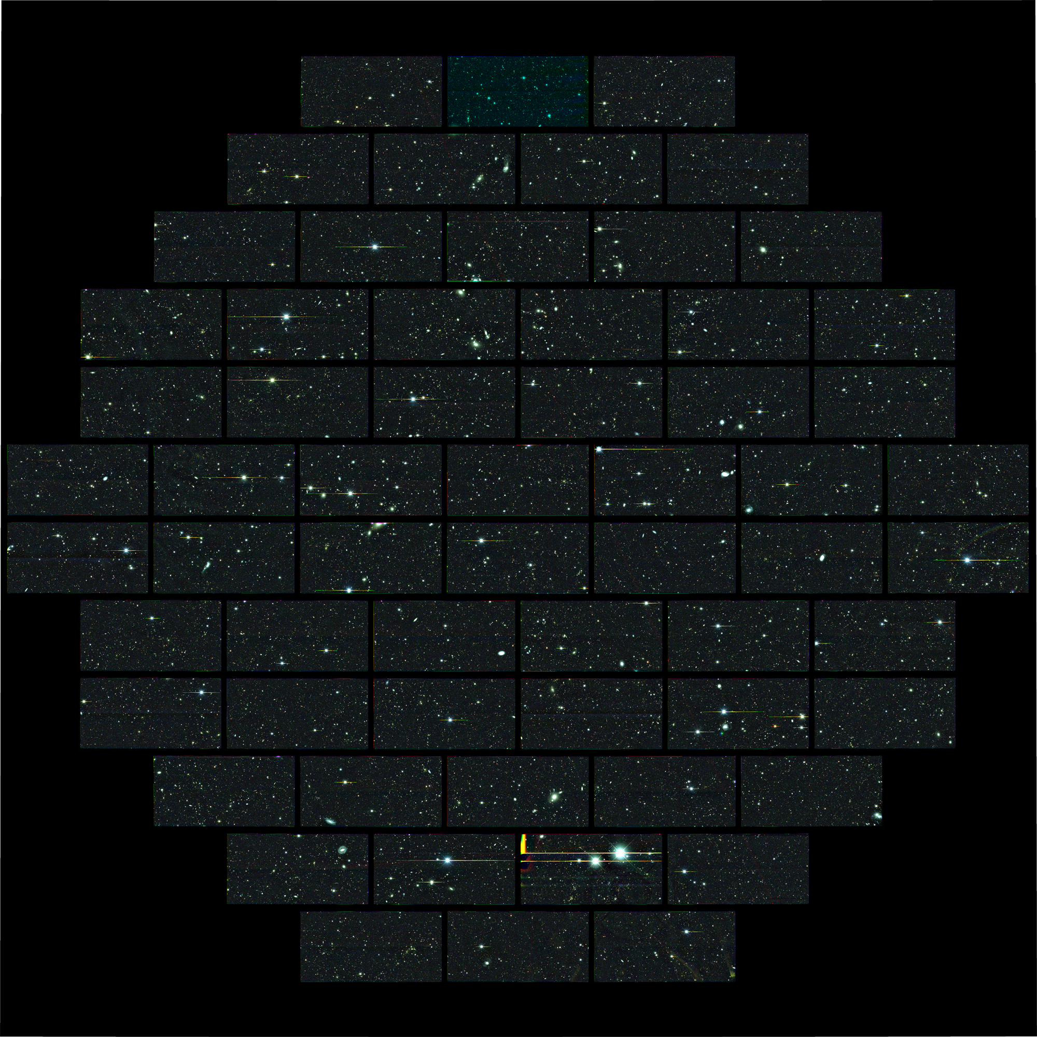
DECam
image of
one of our deep
Supernova fields
will be visited many times during the survey, resulting in very deep image

Slide 9
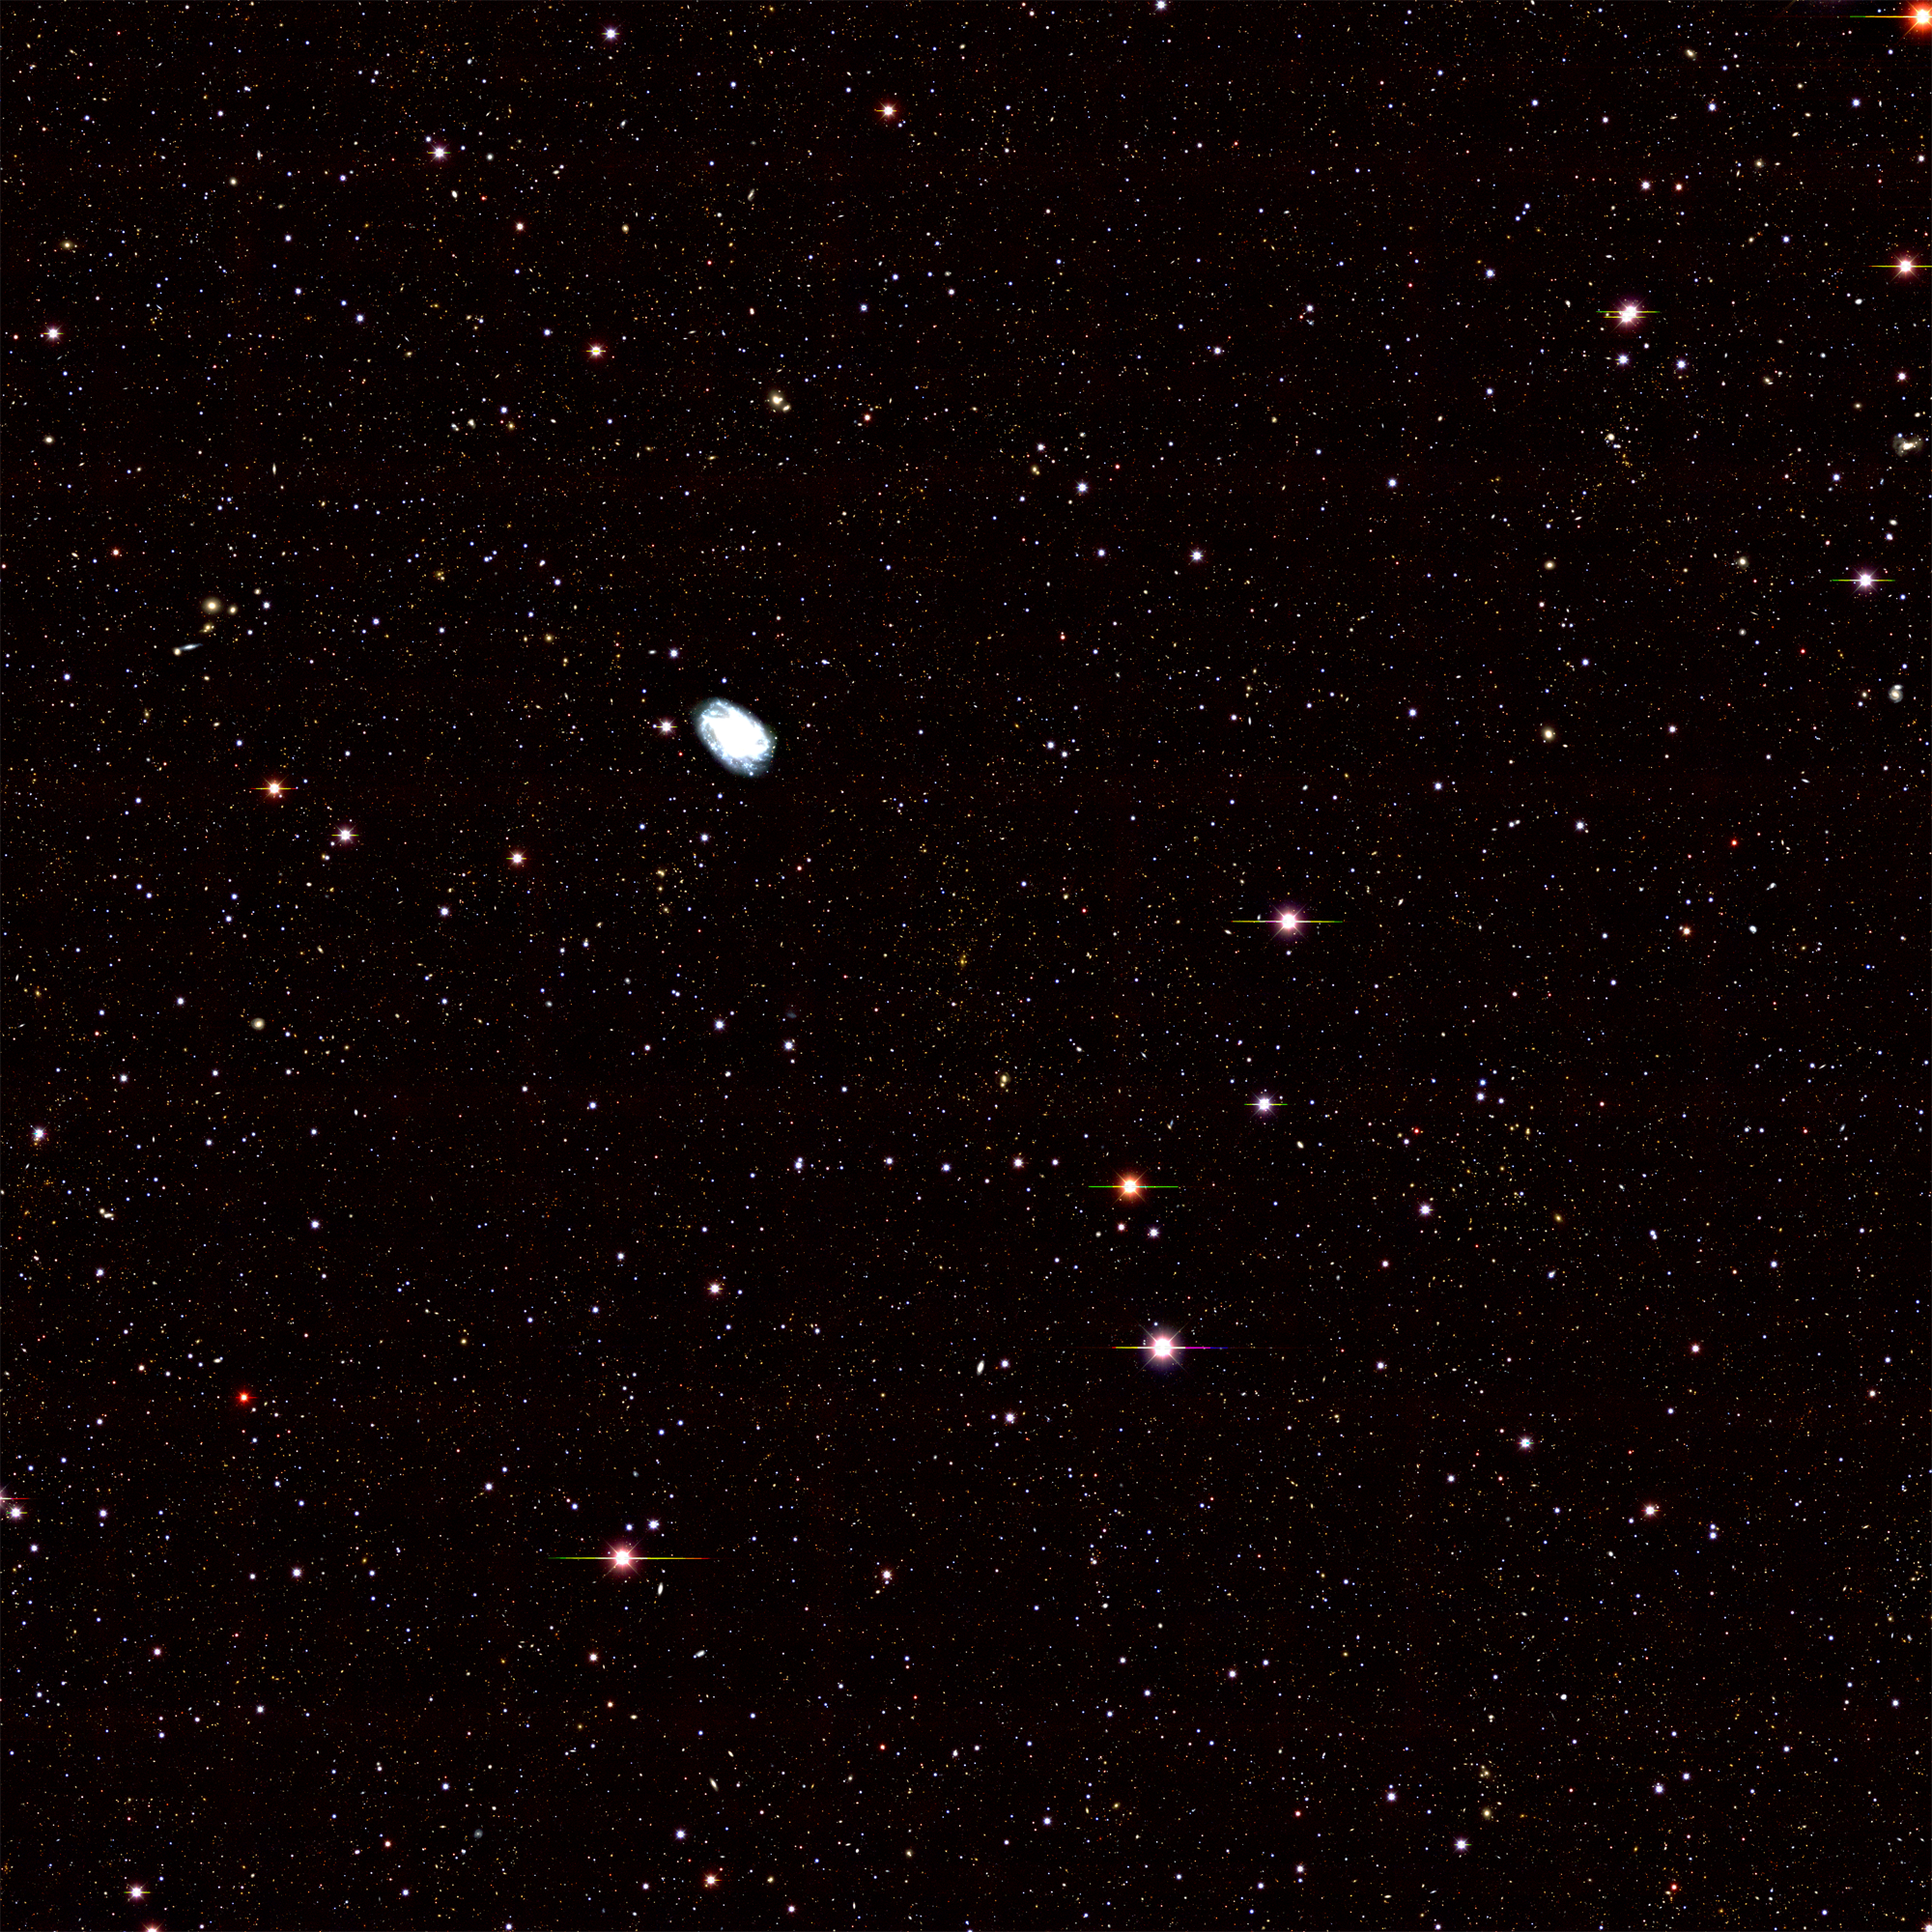
DECam 1x1degree
composite image of
cluster at redshift
z=0.32
~50,000 galaxies in this image

Slide 10
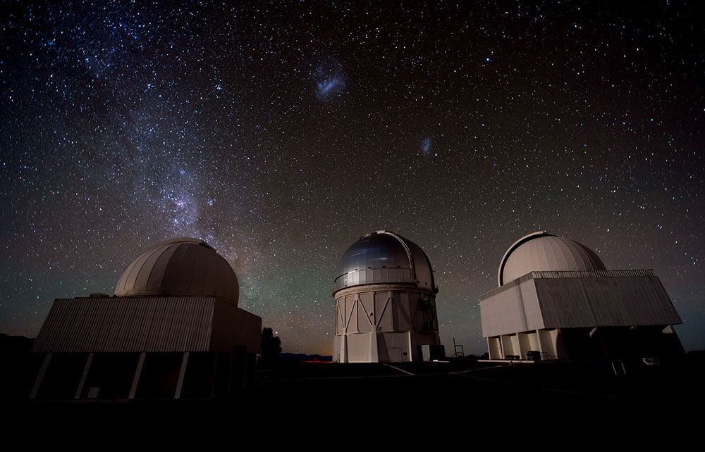
CTIO: great astronomical site with refurbished telescope and powerful new imager

Slide 11
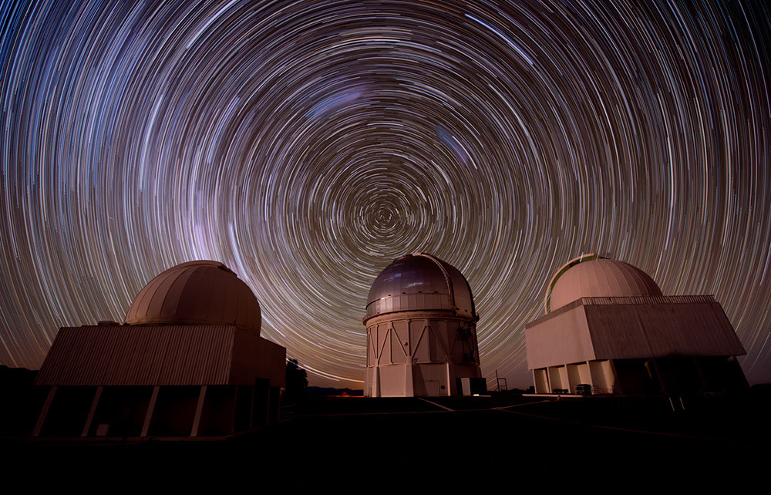

Slide 12
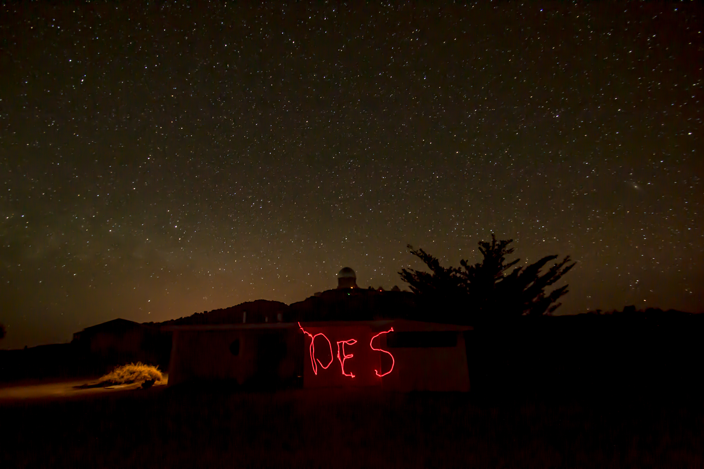
DES Test Phase wraps up mid-Feb.
Astronomy community will use DECam full time through Aug.
Early DES science results from Test Phase later this summer
DES Survey starts Sept. 2013 (seasons run Sept-Feb)
First Dark Energy results ~late 2015

