Slide 1
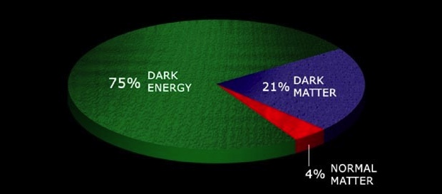
DES and the
Fermilab Dark Energy Program
Josh Frieman
DOE Cosmic Frontier Program Review
September 17, 2013
70%
25%

Slide 2
Probing Dark Energy
What is the cause of cosmic acceleration?
  Dark Energy (DE) or Modified Gravity?
  If DE, is it Lambda or something else?
  What is the value of the DE equation of state parameter w=p_{DE}/ρ_{DE} and (how) does it evolve?
Addressing these questions likely to have profound impact on understanding of fundamental physics
  Given high priority by P5, DETF, PASAG, Astro2010, Snowmass
Multiple, complementary methods required
Fermilab program well aligned with these goals

Slide 3
Fermilab Dark Energy Program
Dark Energy Survey (2013-2018) led by FNAL
  Stage III Dark Energy Task Force (DETF) experiment; factor ~3-5 improvement in Dark Energy precision (DETF Figure of Merit). Multiband images of 300M galaxies (5000 sq deg) and 4000 SNe. DECam on Blanco 4-m telescope at CTIO
Dark Energy Spectroscopic Instrument (DESI) (~2018-2020) led by LBNL
  Stage IV BAO+RSD experiment: 20-30M galaxy spectra to redshifts z>1 over ~15,000 sq deg. Wide-field, multi-fiber spectrograph on Mayall 4-m telescope at KPNO.
Large Synoptic Survey Telescope (~2020-2030) led by SLAC
  Stage IV imaging survey will use new 8.4-m telescope and wide-field camera on Cerro Pachon in Chile. Multiband images of ~3B galaxies (18,000 sq deg) and tens of thousands of SNe.

Slide 4
What can we probe?
Require both to disentangle Dark Energy from Modified Gravity
Distance,
expansion rate
vs.redshift
Growth of
Density
Perturbations
Weak Lensing cosmic shear Distances+growth
Supernovae Distances
Clusters Distances+growth
Baryon Acoustic Oscillations Distances and H(z)
Redshift Distortions Growth
DES,
LSST
DESI

Slide 5
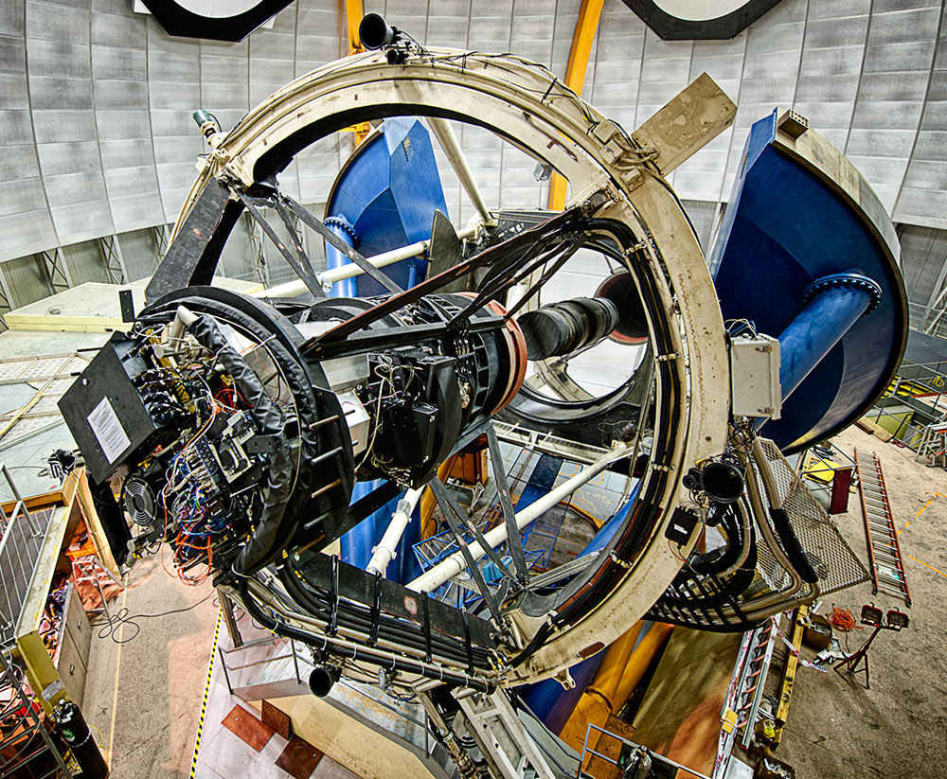
The Dark Energy Survey
Survey project using 4 complementary techniques:
I. Cluster Counts
II. Weak Lensing
III. Large-scale Structure
IV. Supernovae
• Two multiband imaging surveys:
5000 deg² grizY to 24th mag
30 deg² repeat griz (SNe)
• New 3 deg² FOV camera
on the Blanco 4m telescope
Survey 2013-2018 (525 nights)
Facility instrument for astronomy
community (DES 30% time)
www.darkenergysurvey.org darkenergydetectives.org

Slide 6
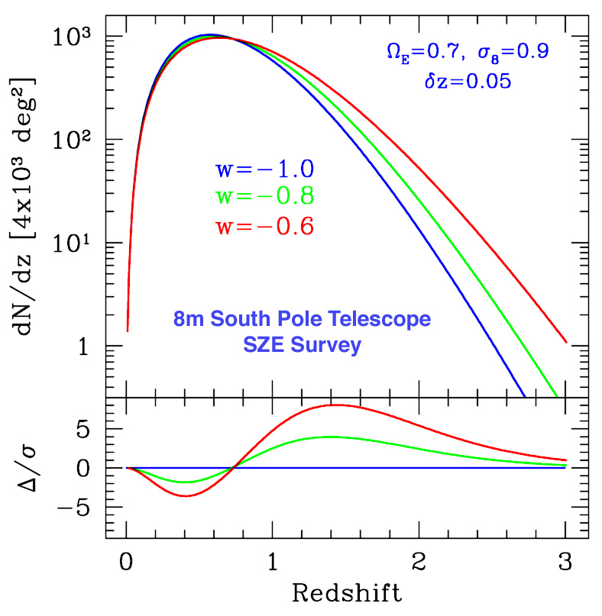
I. Clusters
  Clusters are proxies for massive halos and can be identified optically to redshifts z>1
  Galaxy colors provide photometric redshift estimates for each cluster
  Challenge: determine mass-observable relation p(O|M,z) with sufficient precision
  Multiple observable proxies O for cluster mass limits systematic errors: optical richness (DES), SZ flux decrement (SPT), weak lensing mass (DES), X-ray flux
Mohr
Volume Growth

Slide 7
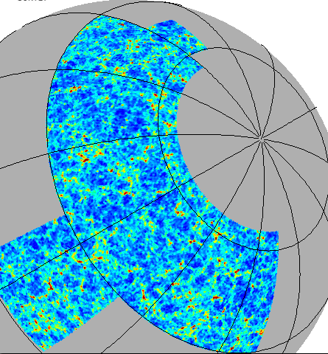
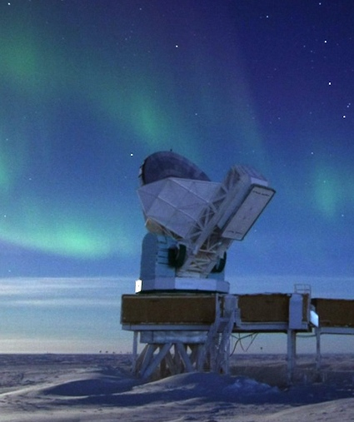
Synergy with South Pole Telescope
DES footprint:
5000 sq deg
DES survey area encompasses SPT Sunyaev-Zel’dovich Cluster Survey

Slide 8
Synergy with South Pole Telescope
SPT
survey
Area:
2500
sq deg
DES footprint:
5000 sq deg
DES survey area encompasses SPT Sunyaev-Zel’dovich Cluster Survey

Slide 9
DES-SPT Cross-correlations
Dodelson (FNAL) and DES Working Groups

Slide 10
II. Weak Lensing Cosmic Shear
Background
sources
Dark matter halos
Observer
Spatially coherent shear pattern, ~1% distortion
Radial distances depend on expansion history of Universe
Foreground mass distribution depends on growth of structure

Slide 11
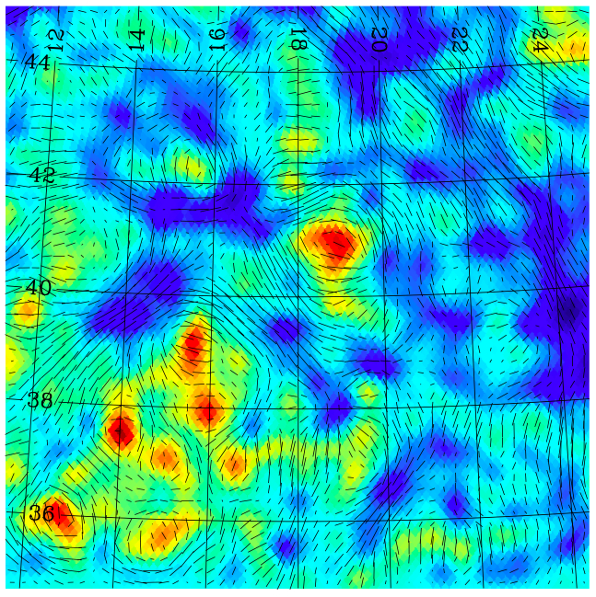
Weak Lensing Mass & Shear
Tick marks: shear
Colors: projected mass density
DES Simulation
Becker, Kravtsov, etal

Slide 12
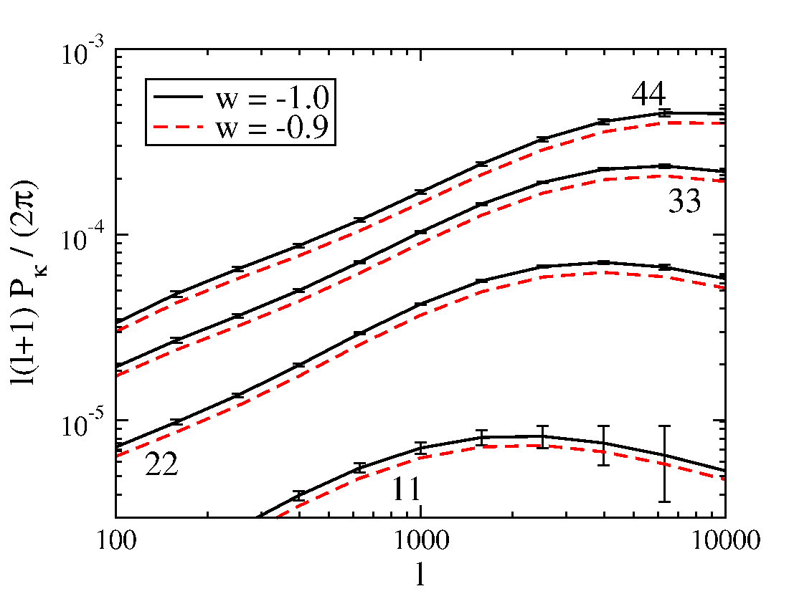
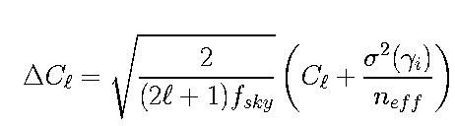

Weak Lensing Tomography
Cosmic Shear Angular Power Spectrum in
Photo-z Slices
Shapes of ~200 million well-resolved galaxies,
⟨z⟩ = 0.7
Challenges:
photo-z’s, intrinsic alignments, PSF anisotropy,
shear calibration, nonlinear+baryon P(k) effects
Extra info in bispectrum & galaxy-shear: robust
Expect n_{eff}~10/arcmin² for median 0.9” PSF
Statistical errors
shown
12

Slide 13
III. Large-scale Structure
N-body simulation from DES Barcelona group

Slide 14
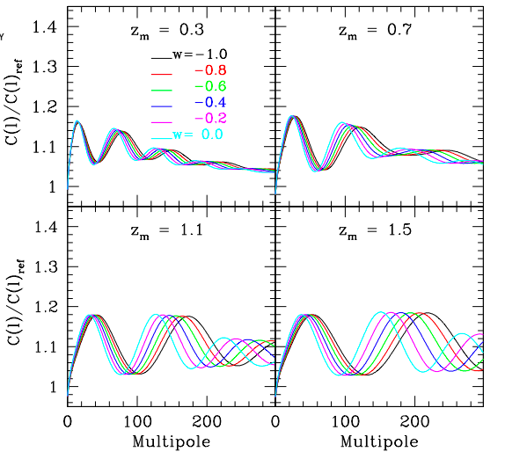
Baryon Acoustic Oscillations
Galaxy angular
power spectrum
in photo-z bins (relative to model without BAO)
Photometric surveys provide this angular measure
Radial modes require spectroscopy
(DESI)
Fosalba & Gaztanaga

Slide 15
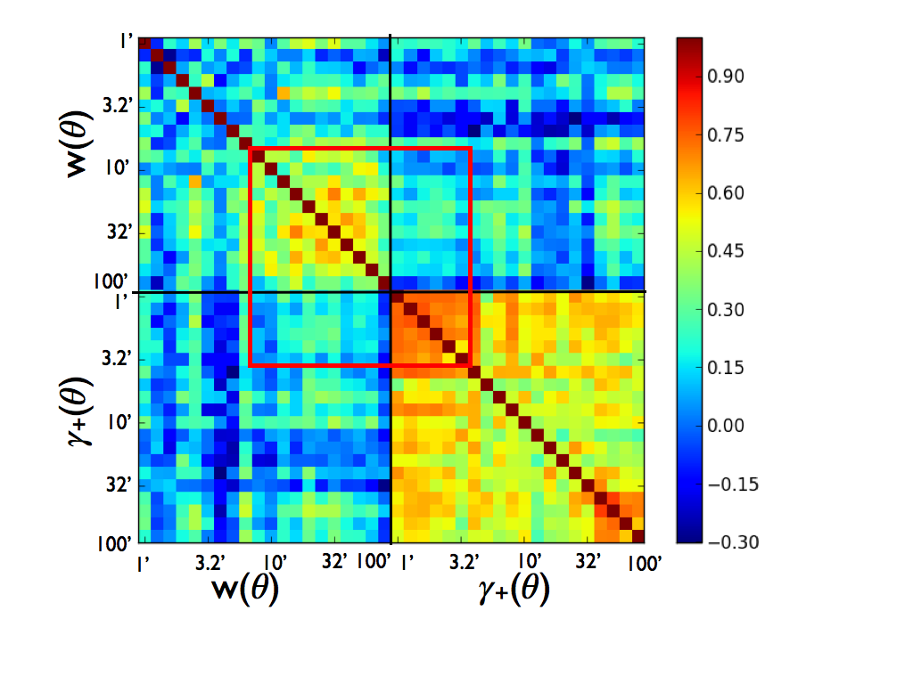
Lensing-Clustering Covariance
Dodelson (FNAL) and Theory/Combined Probes Working Group

Slide 16
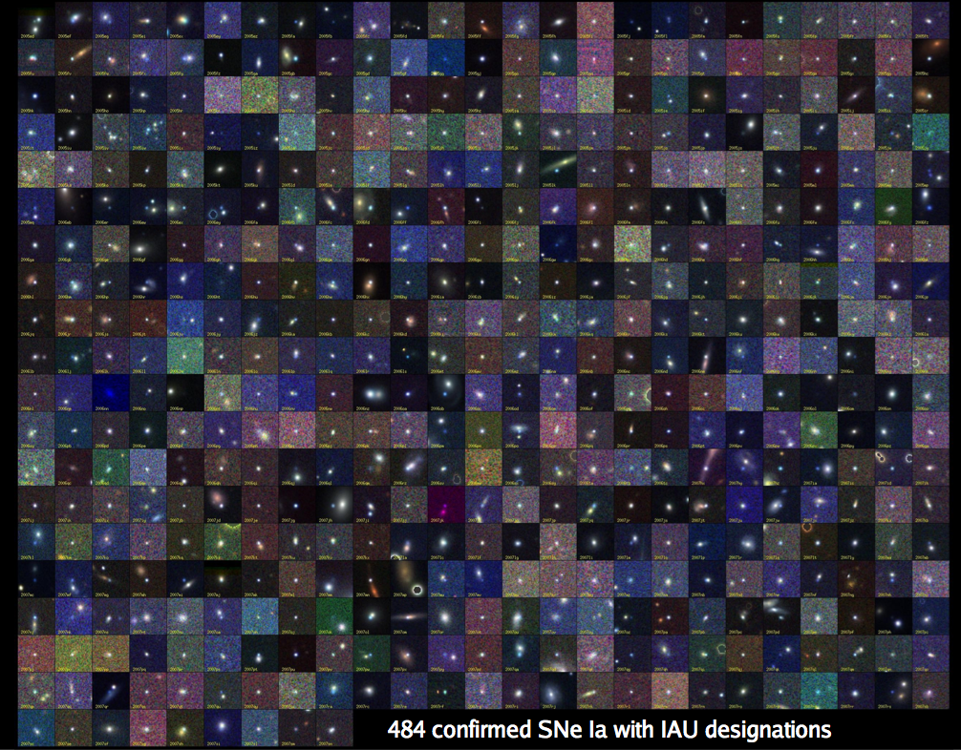
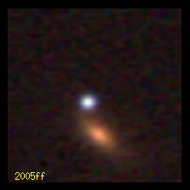
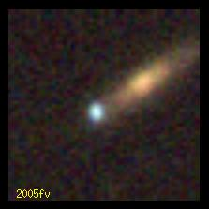
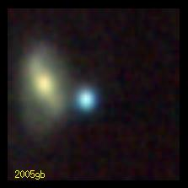
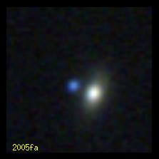
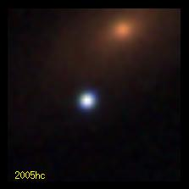
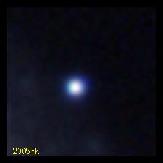
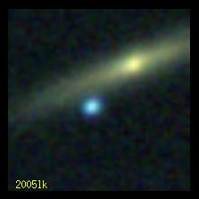
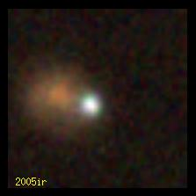
IV. Supernovae
B. Dilday
SDSS-II: 500 spectroscopically confirmed SNe Ia, >1000 with host redshifts from SDSS-III

Slide 17
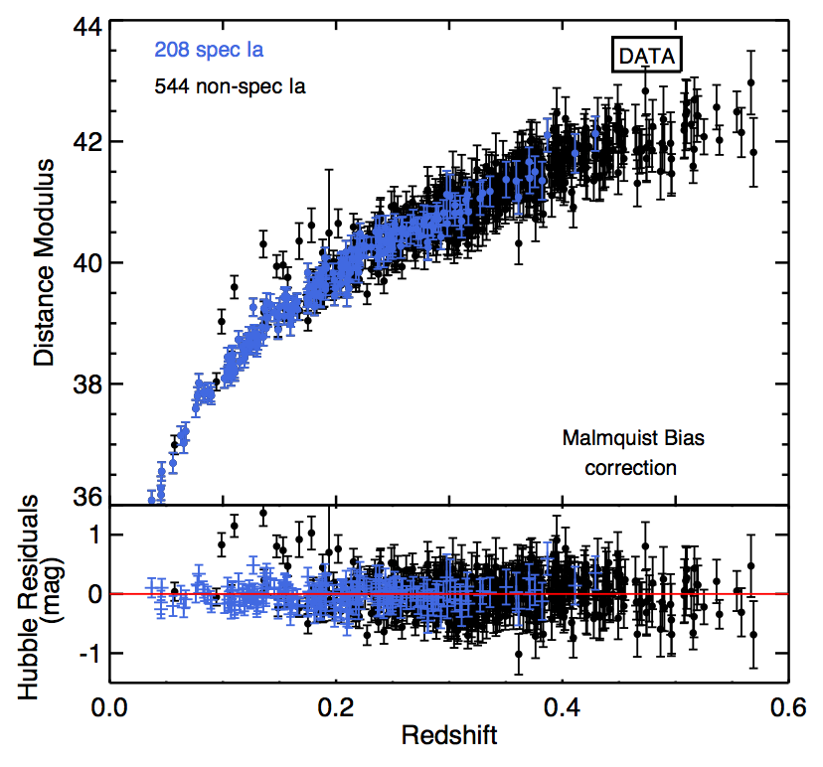
Photometric SN Cosmology
Hubble diagram of SNe Ia: spectroscopic plus those classified photometrically that have host-galaxy redshifts
DES will have host redshifts, plus SN spectra for a subsample
SDSS Results
Campbell, etal

Slide 18
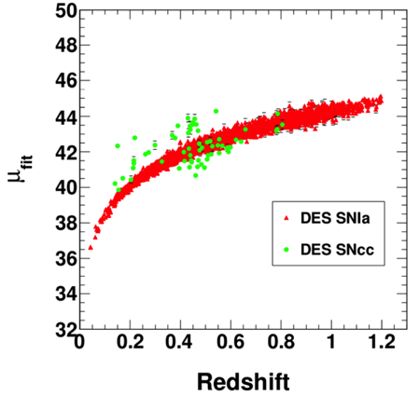
Photometric SN Cosmology
Hubble diagram of SNe Ia: spectroscopic plus those classified photometrically that have host-galaxy redshifts
DES will have host redshifts, plus SN spectra for a subsample
DES Simulations
Core-Collapse
SNe
(contaminants)
SNe Ia
Distance modulus (log distance)
SDSS Results
Bernstein, etal

Slide 19
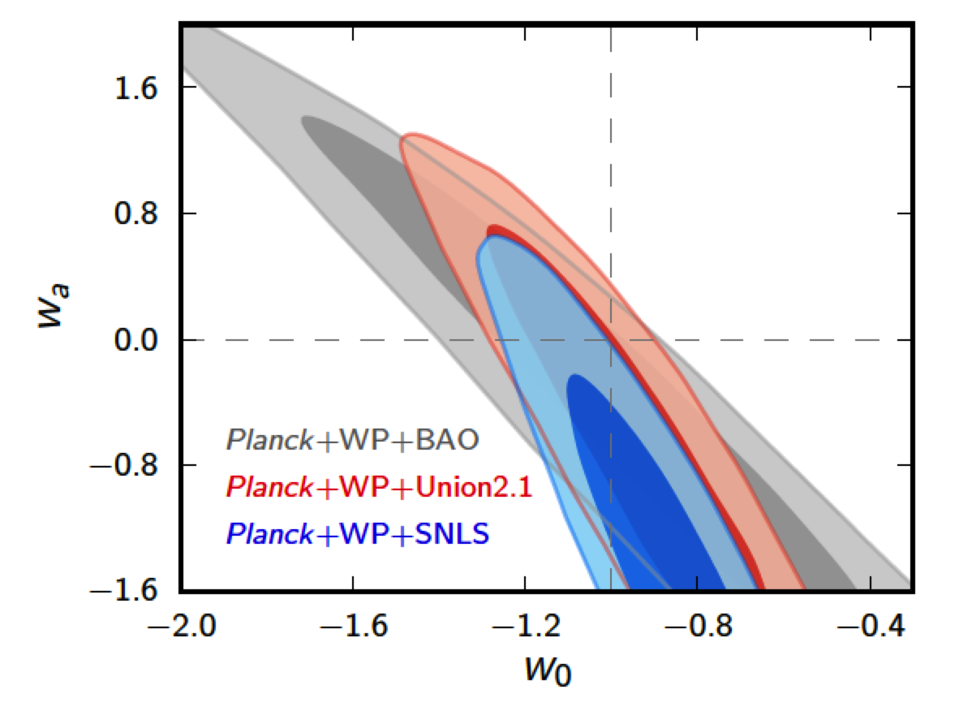
DES Science Summary
Galaxy Clusters
  ~100,000 clusters to z>1
  Synergy with SPT, VHS
Weak Lensing
  Shape & magnification measurements of 200 million galaxies
Baryon Acoustic Oscillations
  300 million galaxies to z = 1 and beyond
Supernovae
  30 sq deg time-domain survey
  ~4000 well-sampled SNe Ia to z ~1
Current Constraints on DE EOS Equation of State
Ade, et al

Slide 20
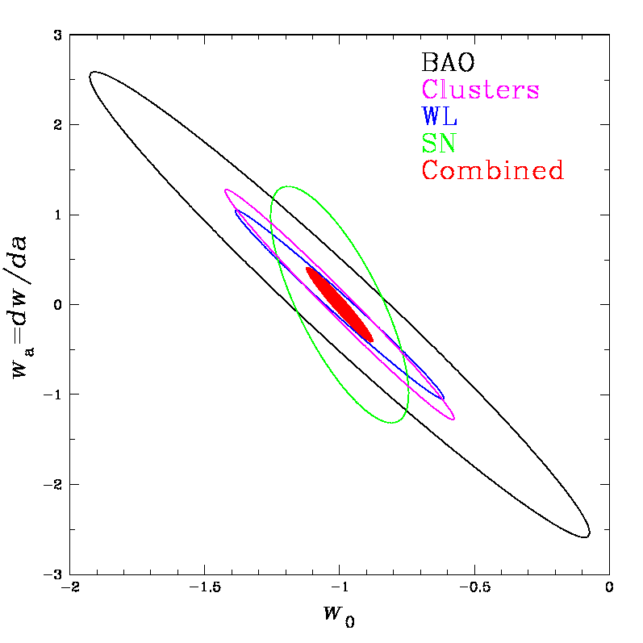
DES Science Summary
Galaxy Clusters
  ~100,000 clusters to z>1
  Synergy with SPT, VHS
Weak Lensing
  Shape & magnification measurements of 200 million galaxies
Baryon Acoustic Oscillations
  300 million galaxies to z = 1 and beyond
Supernovae
  30 sq deg time-domain survey
  ~4000 well-sampled SNe Ia to z ~1
Forecast Constraints on DE EOS Equation of State
DES
Ade, et al

Slide 21
DES Science Summary
Galaxy Clusters
  ~100,000 clusters to z>1
  Synergy with SPT, VHS
Weak Lensing
  Shape & magnification measurements of 200 million galaxies
Baryon Acoustic Oscillations
  300 million galaxies to z = 1 and beyond
Supernovae
  30 sq deg time-domain survey
  ~4000 well-sampled SNe Ia to z ~1
Forecast Constraints on DE EOS Equation of State
DES
Ade, et al

Slide 22
















DES Collaboration
Funding from DOE, NSF, foreign
funding agencies, and DES
institutions
Fermilab, UIUC/NCSA, University of Chicago,
LBNL, NOAO, University of Michigan, University of Pennsylvania, Argonne National Laboratory, Ohio State University, Santa-Cruz/SLAC/Stanford Consortium, Texas A&M
UK Consortium:
UCL, Cambridge, Edinburgh, Nottingham, Portsmouth, Sussex
ETH Zurich
LMU
Ludwig-Maximilians Universität
Spain Consortium:
CIEMAT, IEEC, IFAE
Brazil Consortium
200+ scientists
CTIO

Slide 23
Project Structure & Timeline
3 Construction Projects:
  DECam (led by Fermilab; DOE support)
  Data Management System (NCSA-led; NSF support)
  CTIO Facilities Improvement Project (NSF/NOAO)
NOAO Blanco Announcement of Opportunity 2003
Camera construction 2008-11; CD4 June 2012 (on-time, under budget)
New Prime Focus Cage with corrector installed May 2012
First light with DECam on telescope: Sept. 12, 2012
Commissioning: August-October 2012
DES Science Verification: November 2012-Feb. 2013 (raw data public)
Survey operations begun: Aug. 31, 2013 (105-night seasons Sept-Feb)
Community observing with DECam since Dec. 2012

Slide 24
Fermilab Leadership Roles in DES
DECam Project Management, Design, Engineering, Construction, CCD Testing & Packaging, Integration, Installation, Commissioning Flaugher, Merritt, Diehl, Estrada, Gutierrez, Kent
Image Simulations & Testing Lin, Kuropatkin
DES Project Management Frieman, Kron, Diehl (Peoples)
Survey Strategy Annis, Kent, Nielsen
Calibration Tucker, Kent, Wester
Data Management Yanny, Buckley-Geer
DECam Maintenance & Operations Diehl
Analysis Computing framework Buckley-Geer, Dodelson
Science Working Groups Buckley-Geer, Dodelson, Lin, Marriner, Yanny
Operations Construction

Slide 25
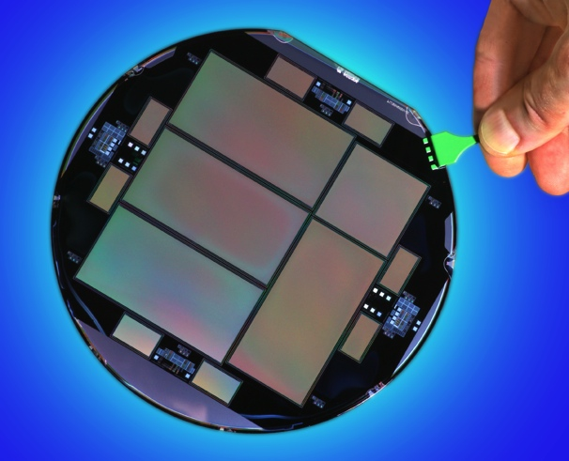
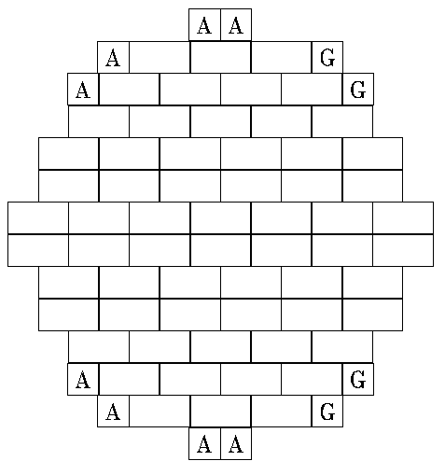
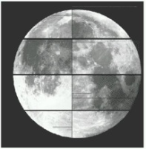
DECam CCDs
62 2kx4k fully depleted CCDs: 520 Megapixels, 250 micron thick, 15 micron (0.264” pixel size)
12 2kx2k guide and focus chips
Excellent red sensitivity for high-z galaxies
Developed by LBNL, packaged and tested at FNAL
Total 570 Megapixels
2.2 deg

Slide 26
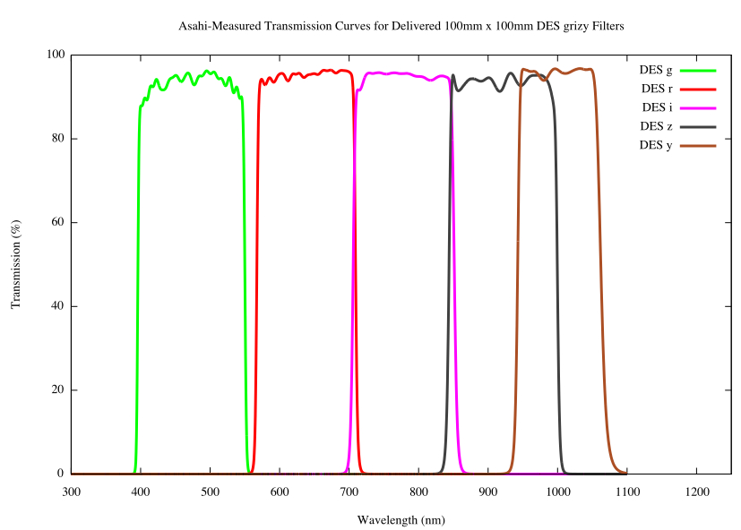
DECam CCDs
62 2kx4k fully depleted CCDs: 520 Megapixels, 250 micron thick, 15 micron (0.264” pixel size)
12 2kx2k guide and focus chips
Excellent red sensitivity for high-z galaxies
Developed by LBNL, packaged and tested at FNAL
Total 570 Megapixels
g r i z Y
2.2 deg

Slide 27
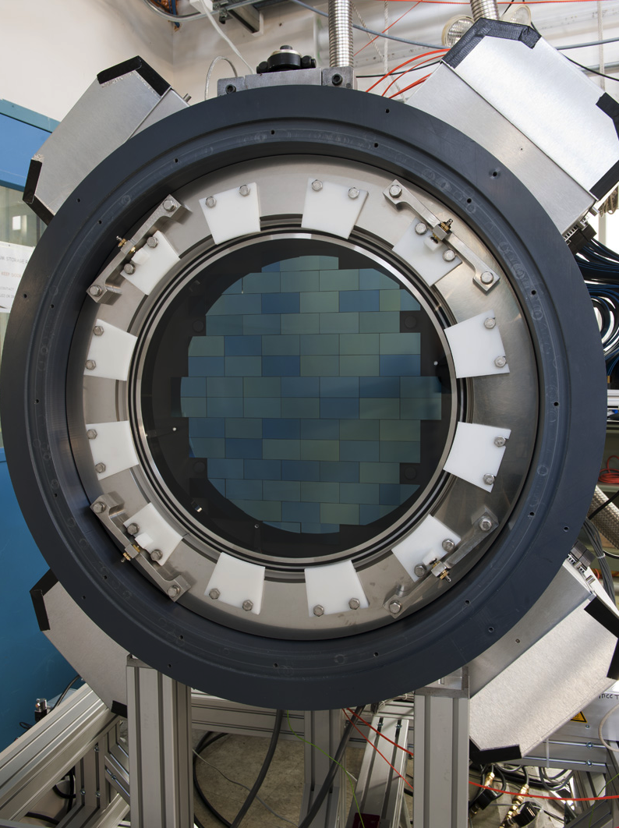
570-Megapixel
DECam
Imager
built by FNAL

Slide 28
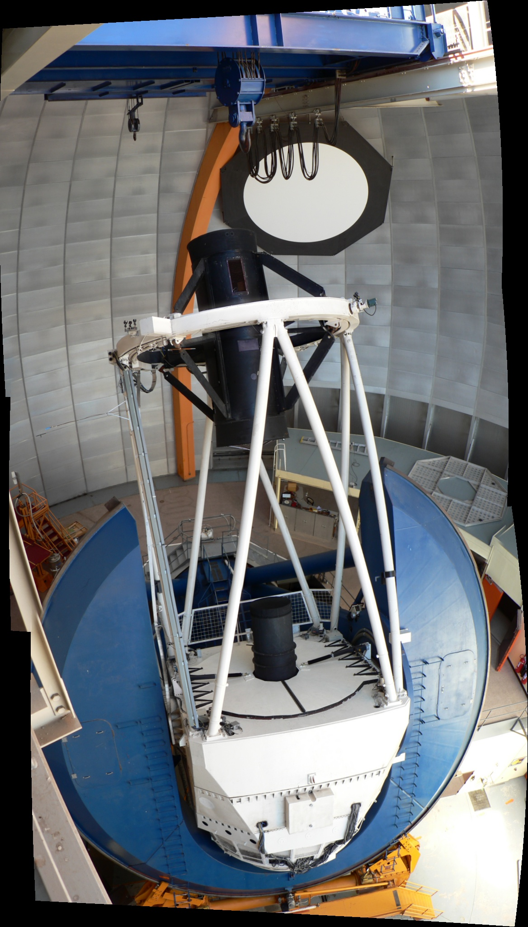
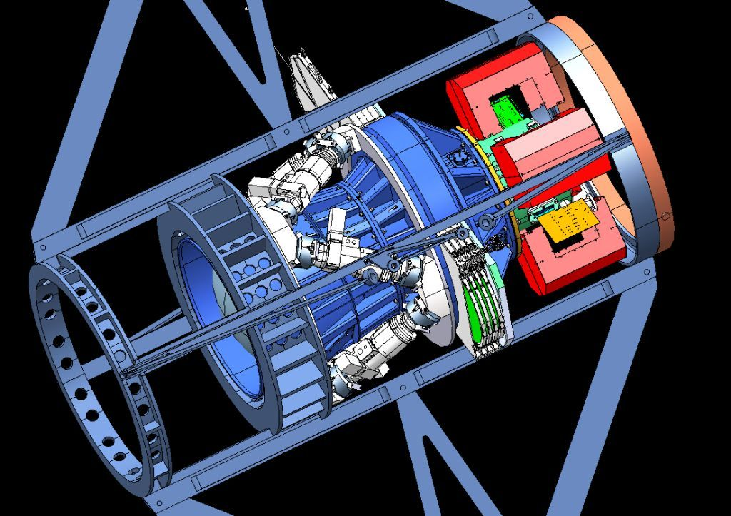
Dark Energy Camera
Mechanical Interface of DECam Project to the Blanco
CCD
Readout
Optical
Corrector
Lenses
Hexapod: optical alignment
Filters &
Shutter

Slide 29
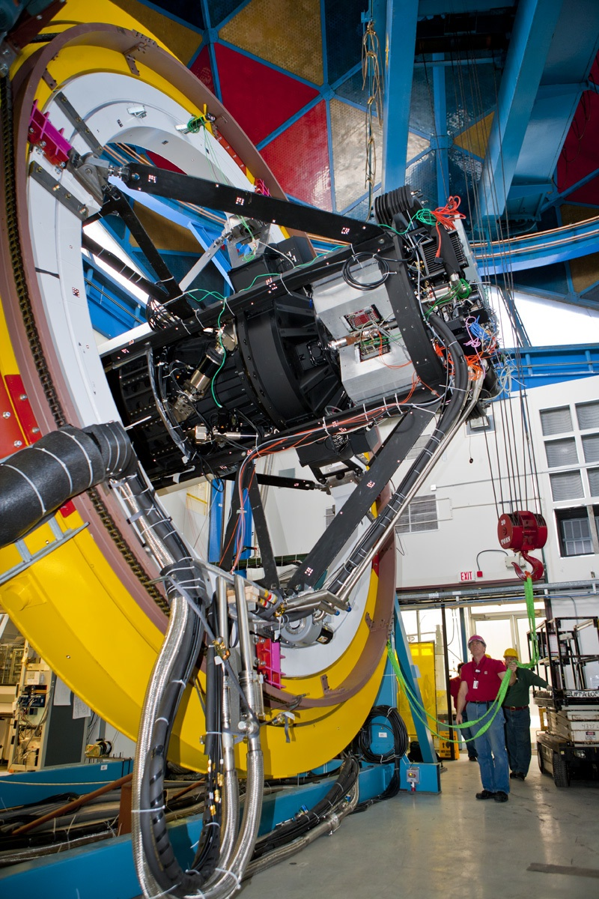
Dark Energy Camera
DECam mounted on
Telescope Simulator
at Fermilab in early 2011
Mechanical Interface of DECam Project to the Blanco
CCD
Readout
Optical
Corrector
Lenses
Hexapod: optical alignment
Filters &
Shutter

Slide 30
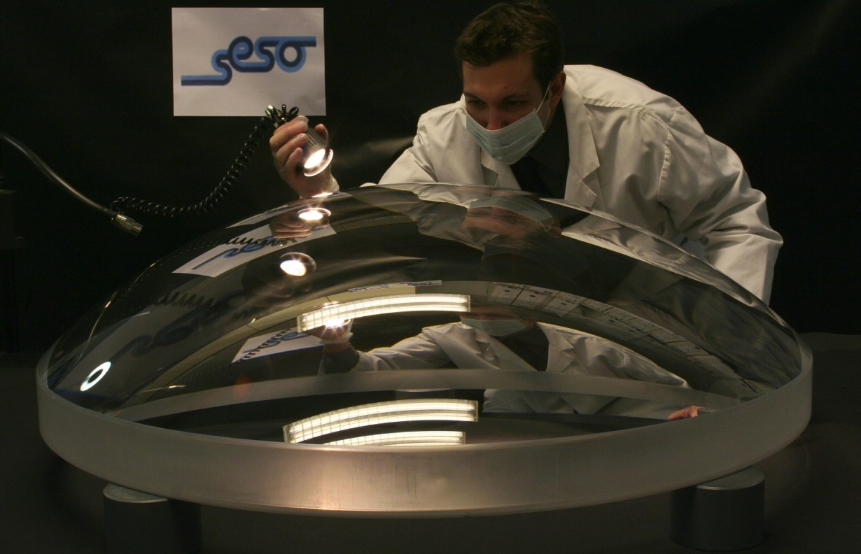
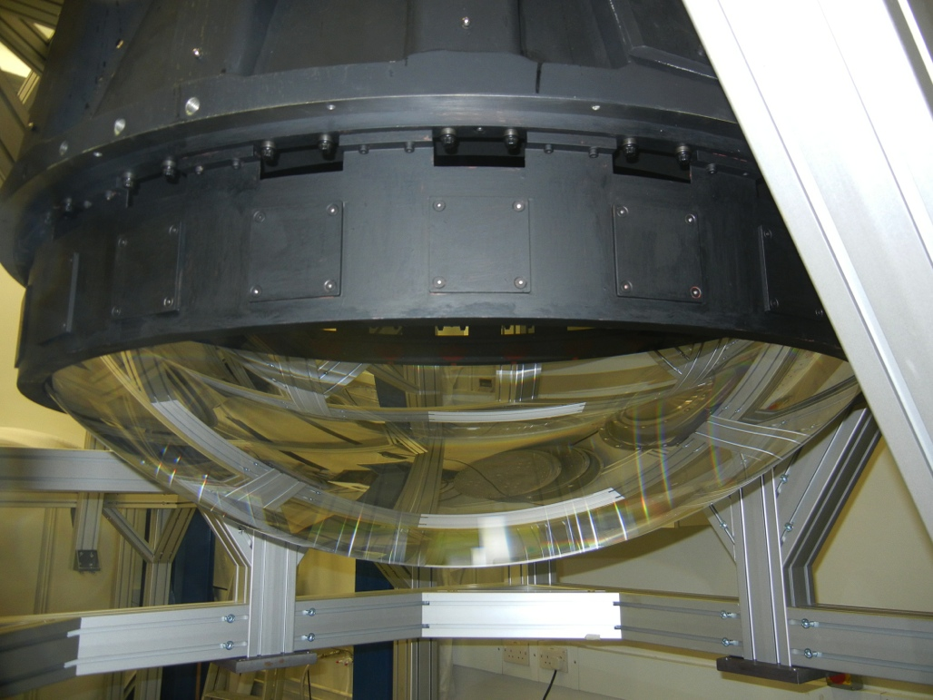
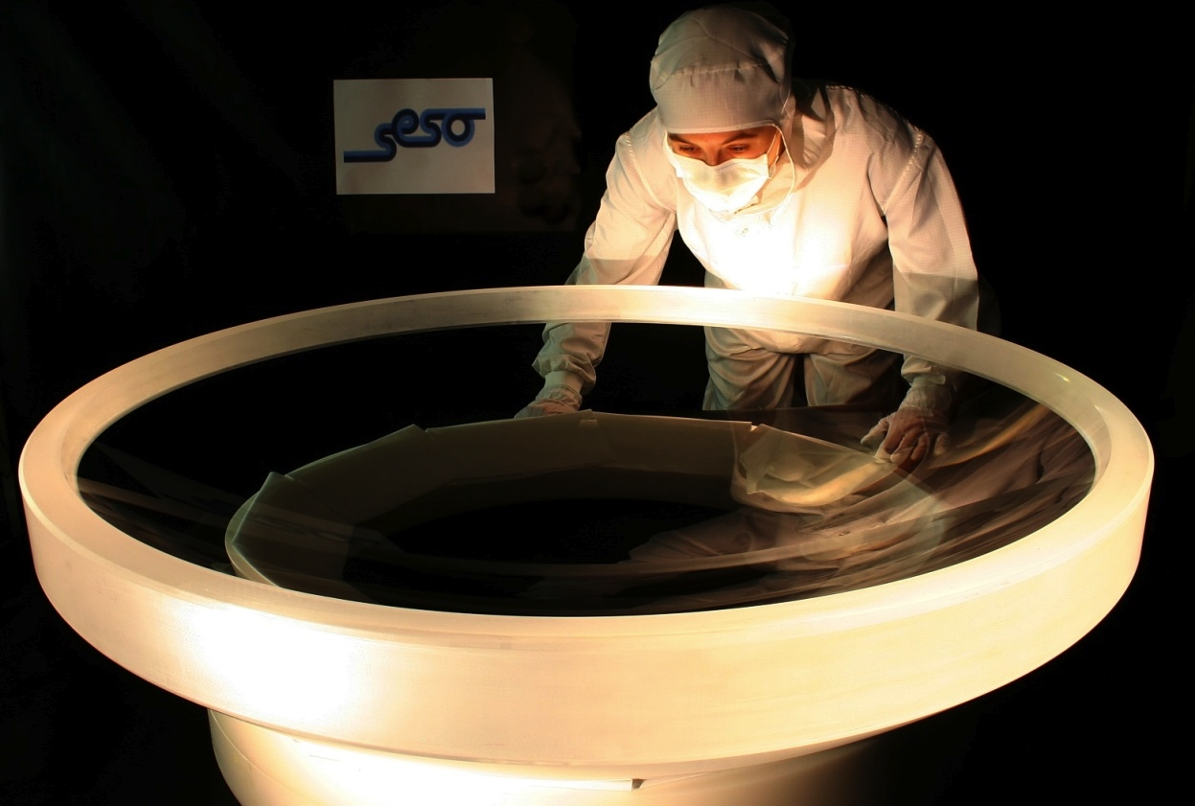
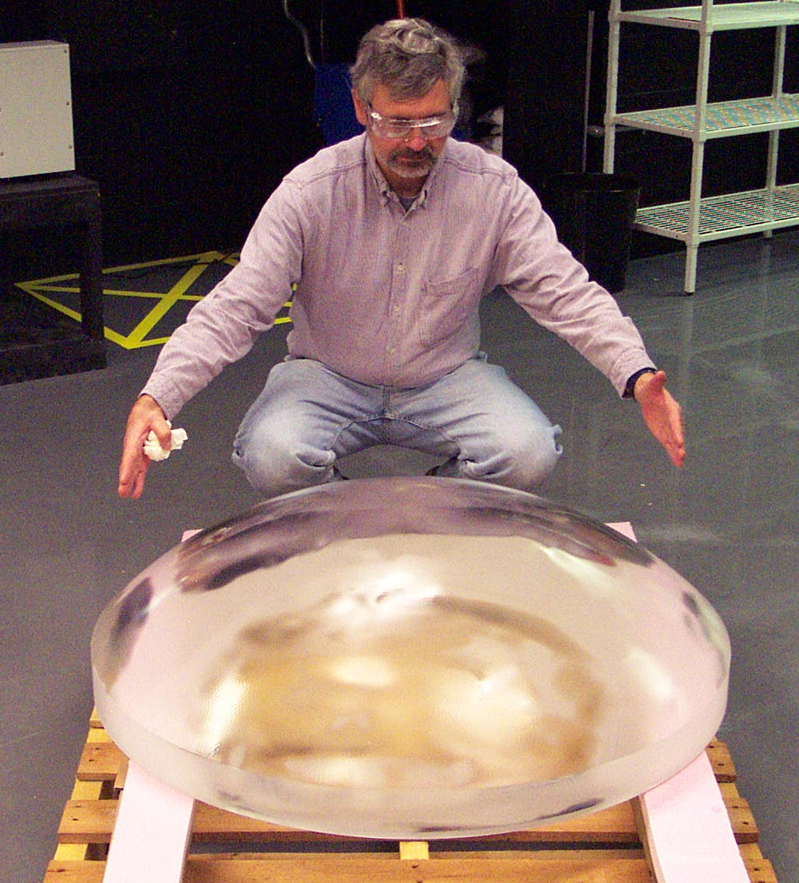
C1 Corrector Lens
S. Kent

Slide 31
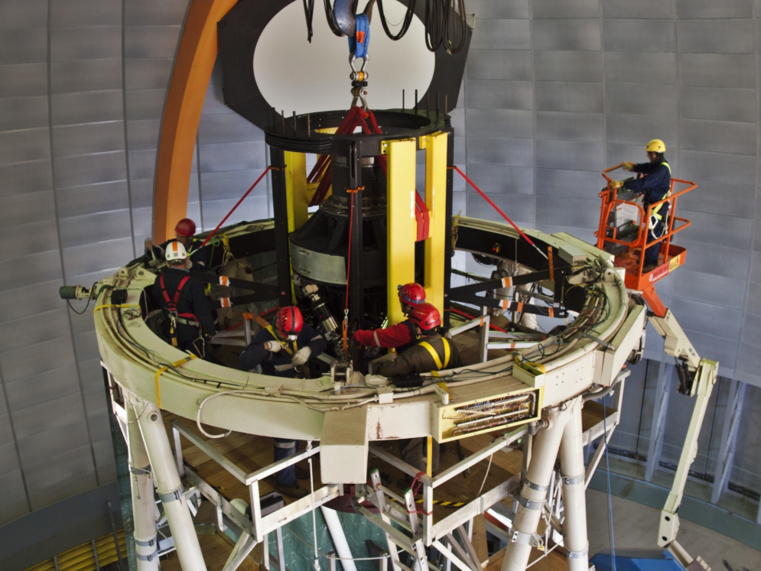
Prime Focus Cage Installation
Early May 2012
early May 2012

Slide 32
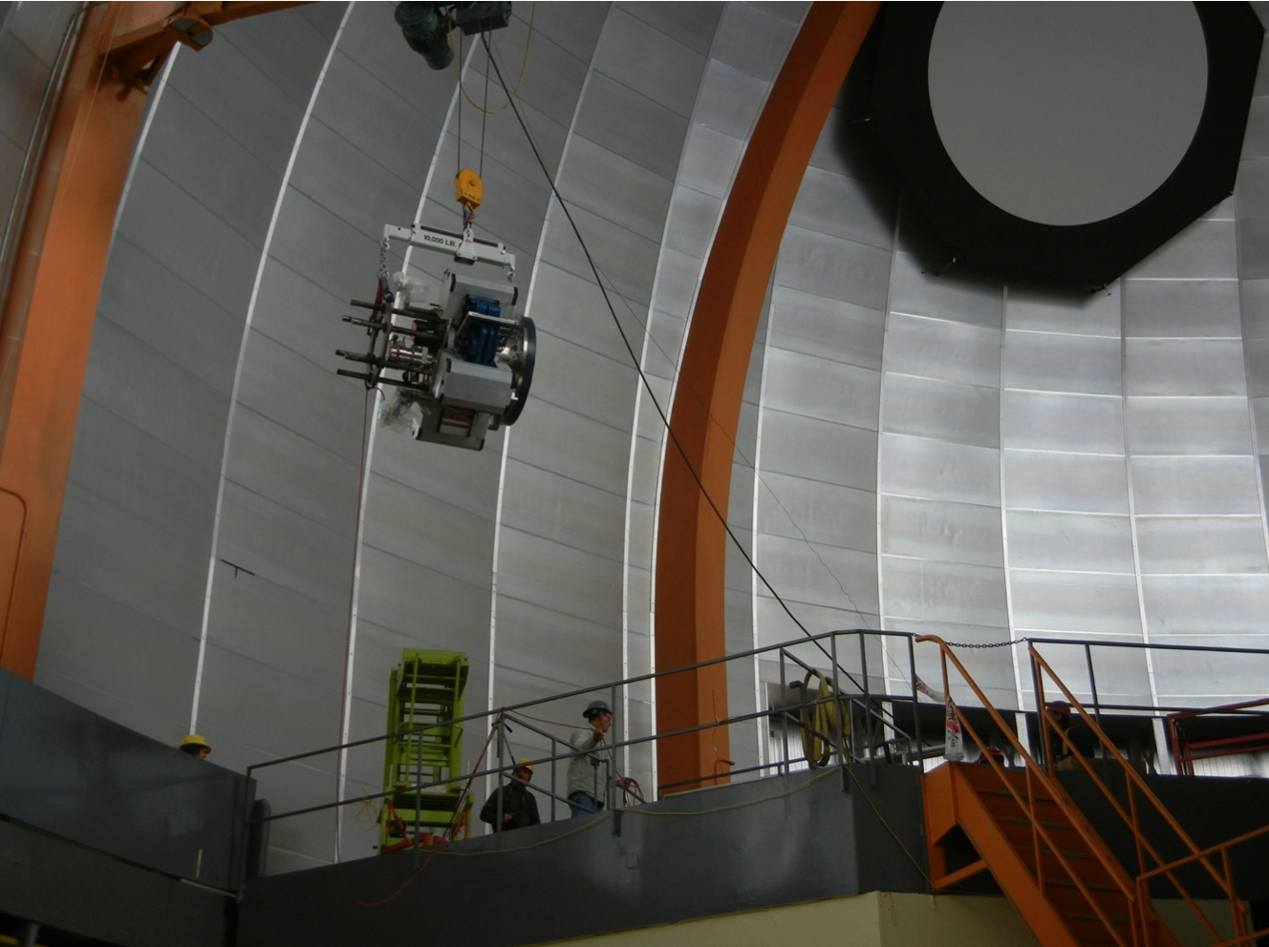
Imager Installation
August
2012

Slide 33
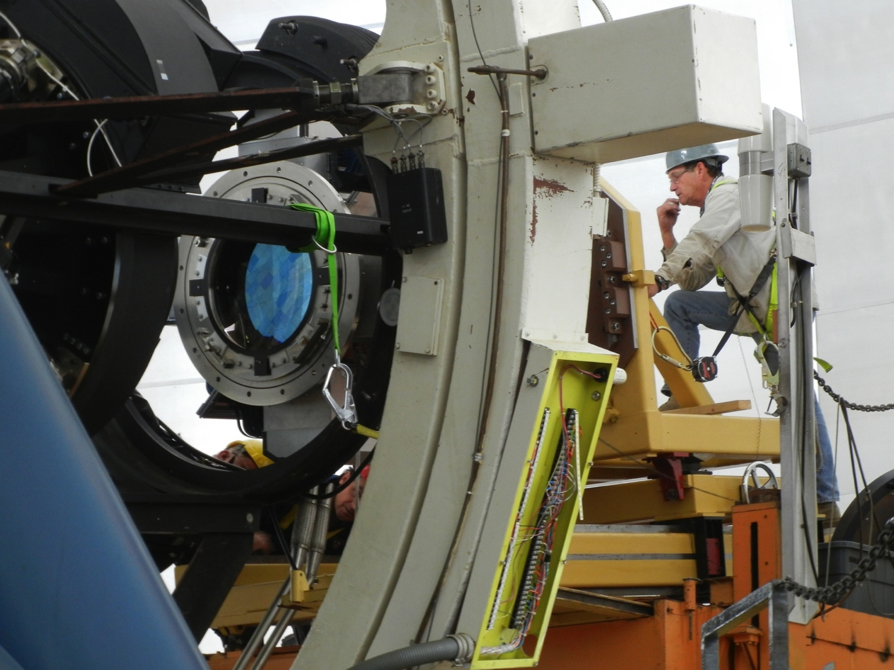
Imager Installation
August
2012

Slide 34
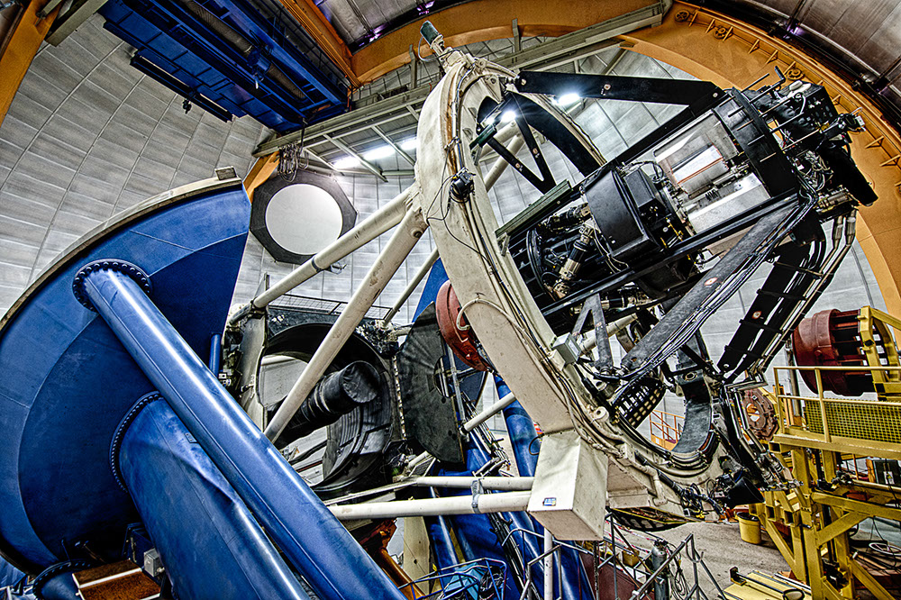
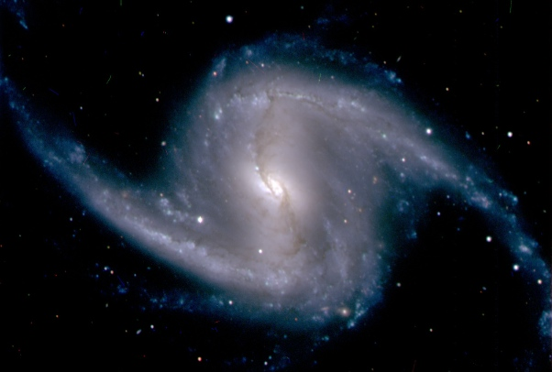
DECam First Light
September 12, 2012
Covered in 258 publications in 36 countries, plus Jay Leno’s monologue

Slide 35
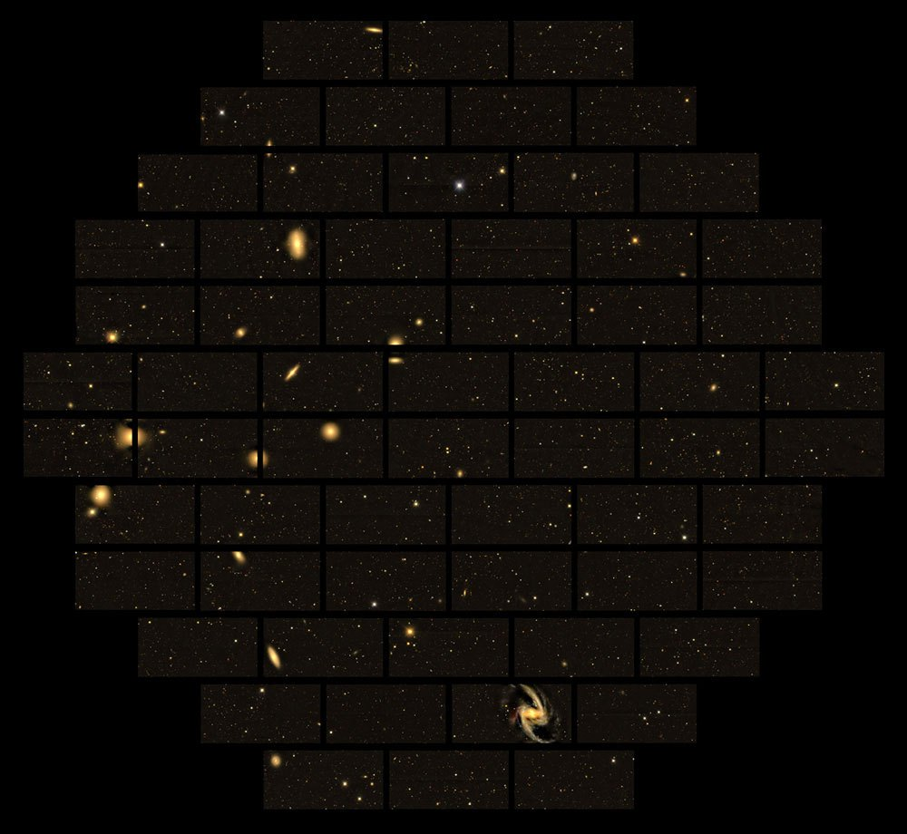
First Light Images
Fornax Cluster
0.8” images recorded within first few nights of first light

Slide 36
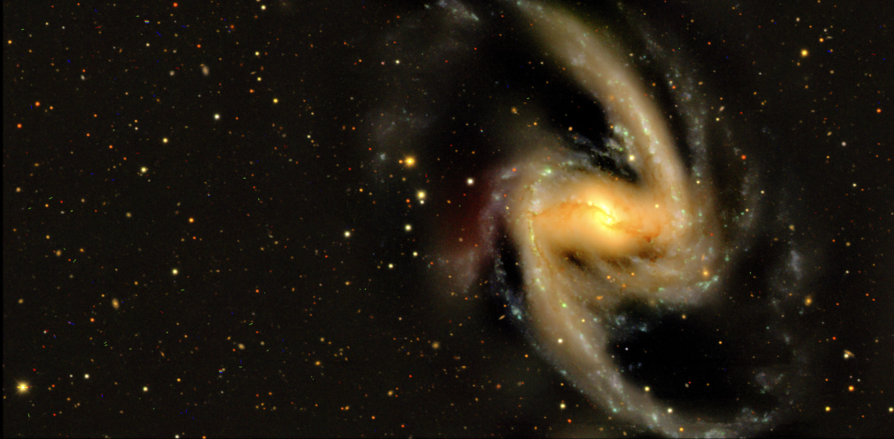
First Light Images
NGC 1365
NGC 1365 in Fornax image from a single CCD

Slide 37
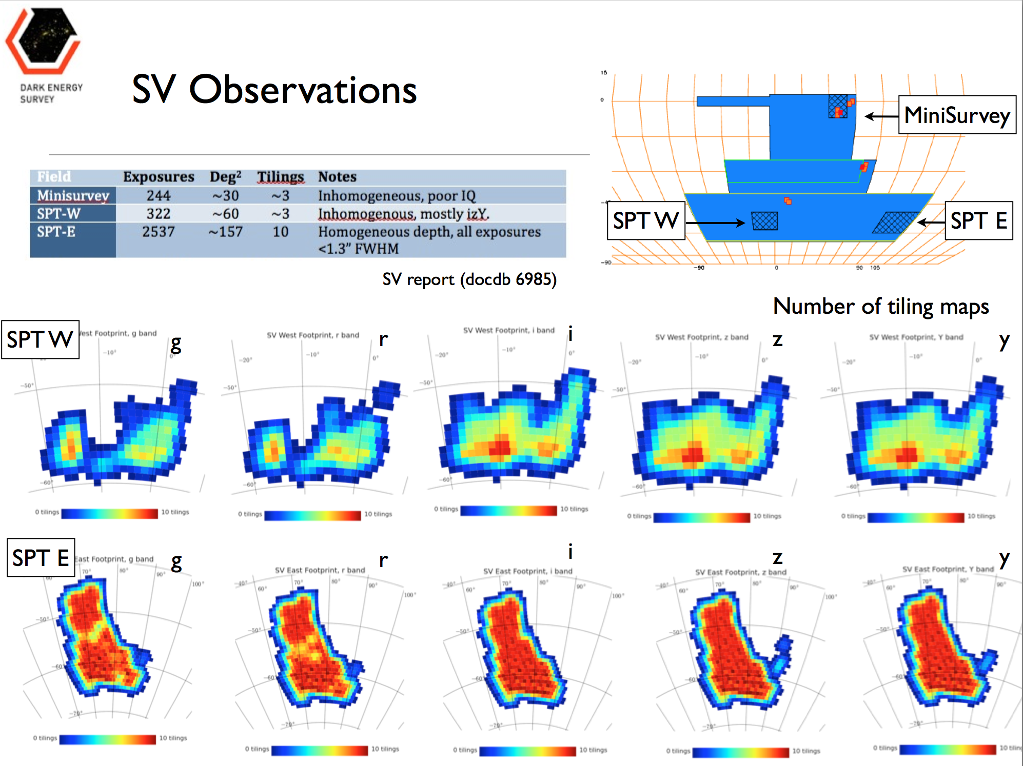
Led by G. Bernstein, K. Honscheid
Nov. 2012-Feb. 2013

Slide 38
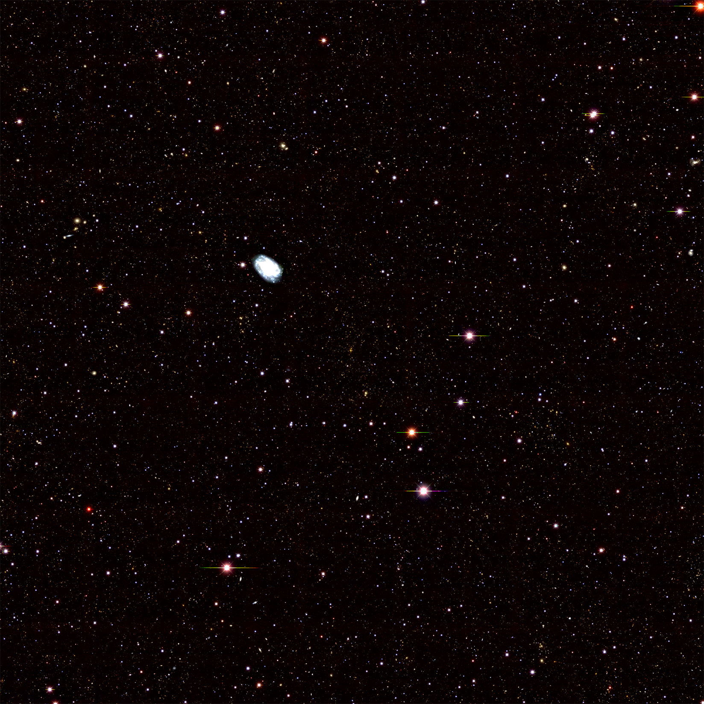
DES SV 1x1deg
grizY co-add image of SPT
cluster
z=0.32
~50,000 galaxies in this image

Slide 39
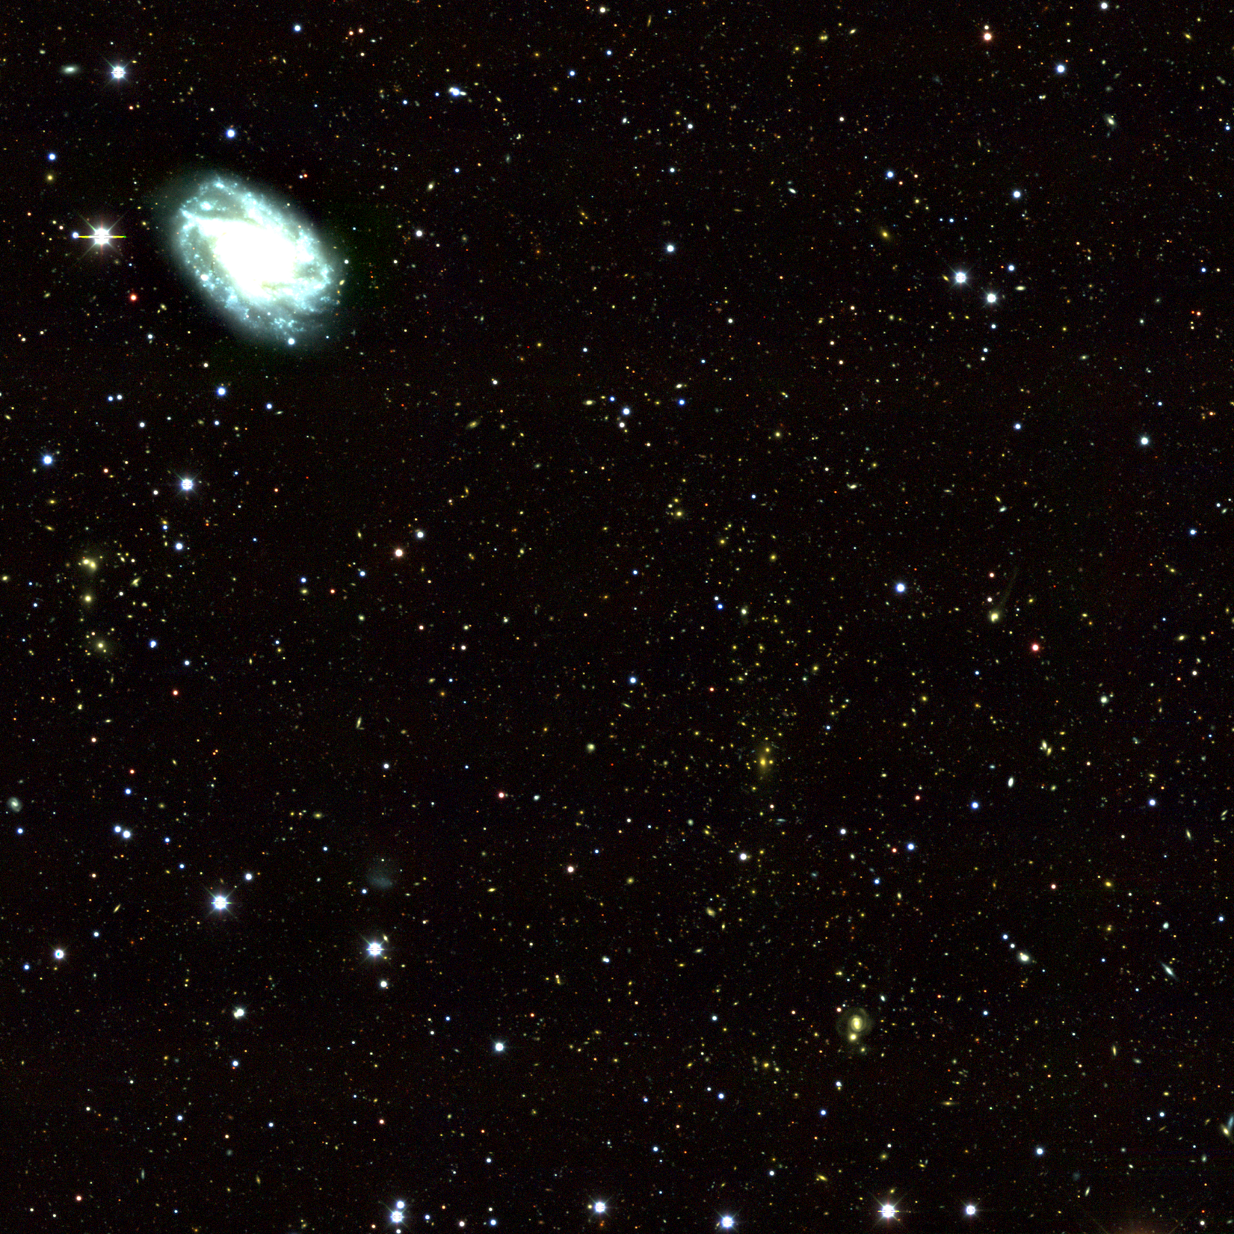

Slide 40
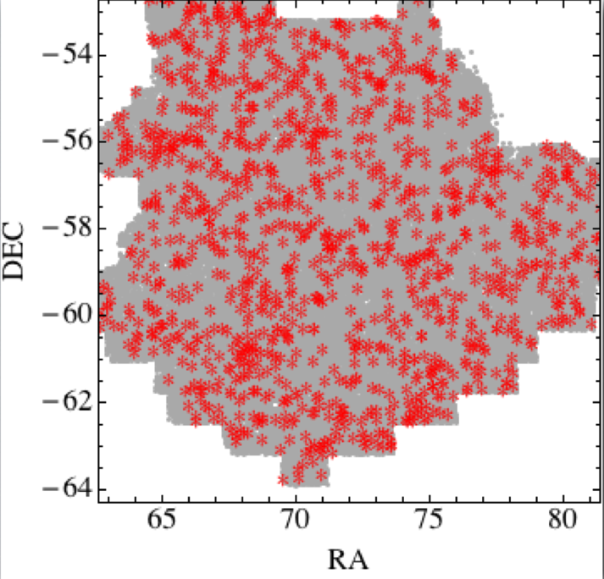
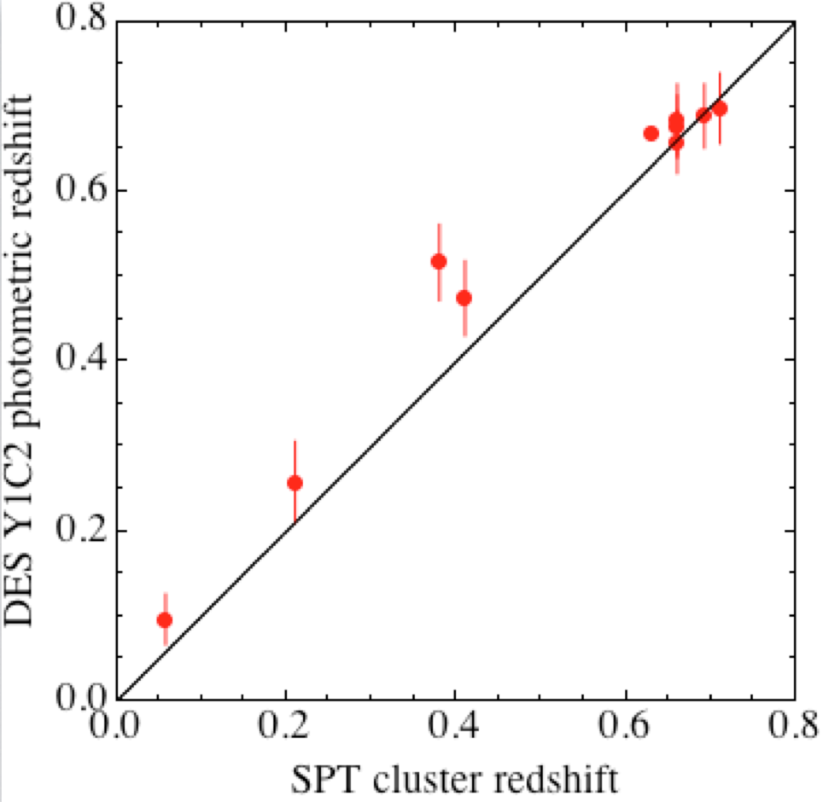
Identifying Clusters in SV
Voronoi Tesselation method M. Soares-Santos, FNAL

Slide 41
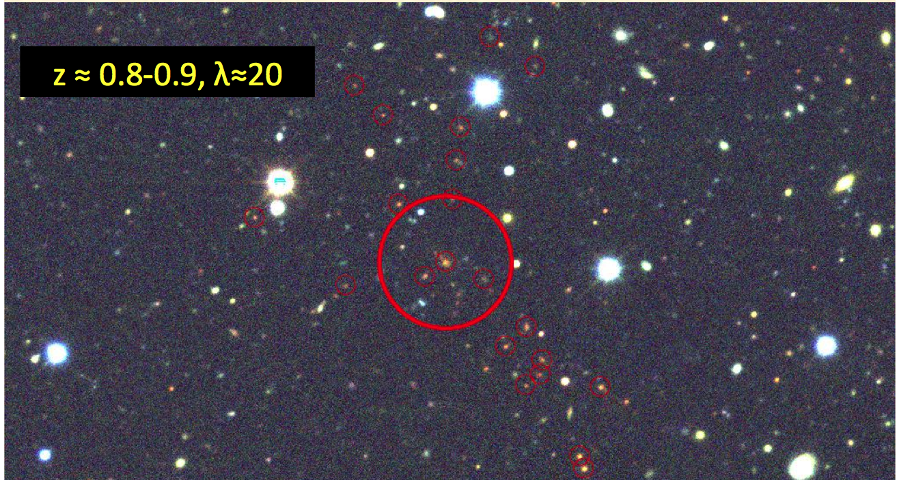
High Redshift Cluster
discovered by DES
from DES Science Verification data in November
E. Rykoff, SLAC

Slide 42
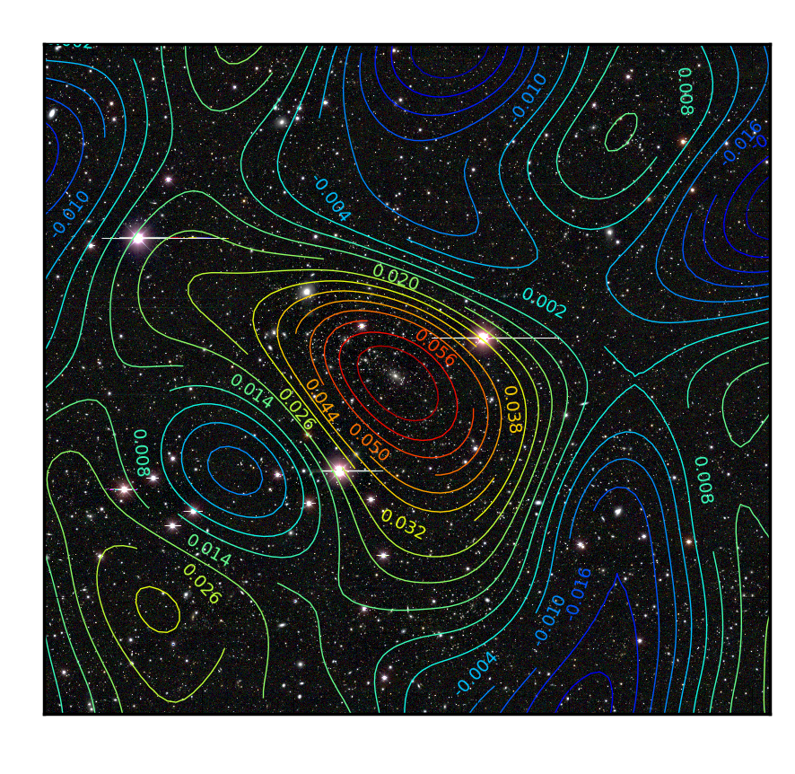
DES Cluster Weak Lensing
Stacked (statistical) Weak Lensing cluster shear profiles will calibrate cluster mass-observable relations
Preliminary cluster mass map from DES Science Verification data (OSU group)

Slide 43
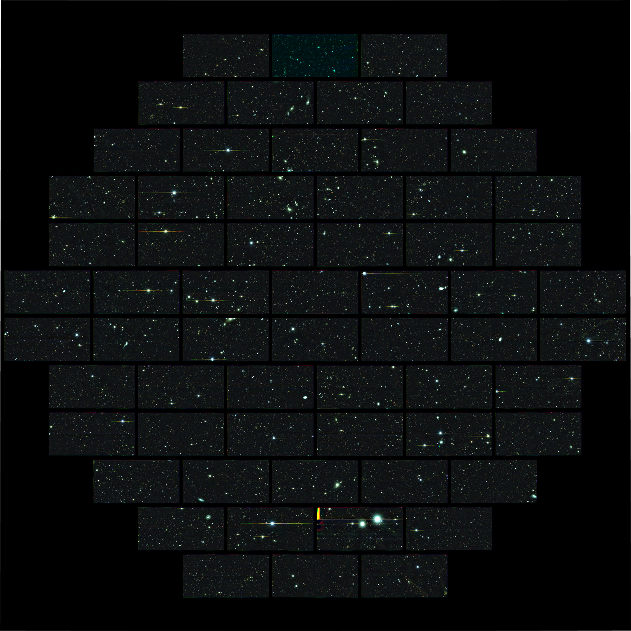
DES SV
composite
image of deep
SN field
will be visited many times during survey, resulting in very deep co-add

Slide 44
First Confirmed SNe from DES
Nov. 7 Dec. 15
SN Ia at z=0.2 confirmed at AAO (100 nights awarded to OzDES for spectroscopic follow-up of SN fields)

Slide 45


Slide 46


Slide 47

DES High-redshift SN candidate

Slide 48



Strong Lens Time Delays: new probe of Dark Energy
Strong Lens Candidates in DES SV
Snowmass White Paper (Treu, etal). DES/FNAL: Buckley-Geer, etal

Slide 49



DES starts
Aug. 31, 2013

Slide 50
Dark Energy Spectroscopic Instrument
New Stage-IV Experiment
  5000-fiber, wide-field spectrograph to be built for the 4-m Mayall telescope at KPNO
  20-35M galaxy redshifts to probe Dark Energy via Baryon Acoustic Oscillations and Redshift Space Distortions
  Recommended by Community Dark Energy report (Rocky-III, 2012)
  fill the operational time gap between DES and LSST (and before Euclid), ~2018-2020
  rich scientific program: dark energy, inflation, neutrino mass hierarchy
Led by LBNL (you will hear details tomorrow)
Fermilab is part of the collaboration, building on DES experience and capitalizing on infrastructure developed for DES.

Slide 51
Fermilab Contributions to DESI
Project management:
  DESI Steering Committee: Flaugher, Kron
  Inst. Rep and Chair of Spokesperson Search Committee: Flaugher
  Leading development of Science Requirements: Kent
  L2 manager for the Corrector Barrel: Gutierrez
  L2 co-manager for Integration and Testing: Flaugher
Technical:
  CCD packaging and testing: Estrada
  Corrector barrel: Gutierrez
  On-line software: Buckley-Geer
  Simulation framework for trade studies: Nord
  Software analysis framework: Dodelson

Slide 52
DESI CCD Packaging
& Testing at Fermilab
Fermilab has constructed a CCD packaging station for DESI
52

Slide 53

Corrector Barrel conceptual Design
DESI lenses will be mounted and aligned in the barrel using the proven techniques from DECam; white arrows show direction of installation and the room for alignment pins.
C1
ADC1
ADC2
C4
C2
C3
FP

Slide 54



Corrector Design studies at FNAL
Hexapod flange is located at the CG of the system. Finite element studies show the deflections for various design options.
Goal is to minimize weight while meeting stiffness requirements. This is for a 3/16 inch thick shell with preloaded bolts.
Hexapod flange
FEA result for 3/16” shell
FEA result for 3/8” shell

Slide 55
LSST @FNAL
Engagement in science in the context of the Dark Energy Science Collaboration (DESC)
Leading Software Working Group in DESC with an eye towards building a set of tools
Running project tools on Open Science Grid
Exercising Project Software with an eye towards becoming a Level 3 Software Center
Available for CCD Testing

Slide 56

LSST Software Framework
Builds on cosmoSIS (DES Analysis Framework)
Working with DESC science WG’s to define requirements (built after developing use cases)
Requires integrating scientists in collaboration with computing professionals
Dodelson, et al

Slide 57
Concluding Remarks
DES project made great progress in last 3 years
  DECam completion on-time, under budget
  Successful installation, commissioning, Science Verification
  Data Management processing & serving data to collaboration
  Successful start of survey operations & science analysis
Over next 3 years, DES will take next step in understanding the nature of dark energy, with FNAL scientists in key operational & scientific roles.
Combination of Fermilab technical, scientific expertise and infrastructure with strengths of partner institutions (national labs, Universities) enables this kind of project.
Fermilab participating technically and scientifically in next-generation Dark Energy experiments (DESI, LSST), building upon the expertise developed for DES.

Slide 58
Extra Slides

Slide 59

Blanco Telescope at CTIO
Excellent astronomical site in Chilean Andes:
Good seeing: ~0.75” median for site
High, dry: high percentage of clear, photometric nights
CTIO operated by National Optical Astronomy Observatory with funding from NSF Astronomy Division
Blanco 4-meter telescope

Slide 60
DES Structure & Management
DES MOU between NOAO, Fermilab, and NCSA lays out institutional responsibilities and commits them equally to (a) successful deployment of DECam on the Blanco and (b) science goals of DES. DECam System (=Camera+Community Pipeline) delivered & accepted in exchange for 525 Blanco nights. Directors of these 3 institutions (or their delegates) form the DES Council.
Construction:
DES Project comprised DECam Project (DOE/led by Fermilab), CTIO Facilities Improvement Project (NSF/NOAO), and DES Data Management Project (NSF/NCSA).
Operations:
DES Project/collaboration operates the DES experiment, with support from DOE, NSF, and foreign & institutional partners.
NOAO operates and maintains DECam and the Blanco for DES and the community; DES/Fermilab supports DECam maintenance.

Slide 61
DES Organization
Chart for Operations
DES Project/Collaboration Office
J. Frieman, Director
R. Kron, Deputy Director
T. Diehl, Operations Systems Scientist
Project Office reports to
Council & to DOE-NSF
Joint Oversight Group
Management Committee
(Collaboration Affairs)
Director chairs
Institutional Reps
Executive Committee
(Operations)
Director chairs
Operations Leaders
Publications Board
K. Honscheid
Speakers Bureau
R. Miquel
Calibration Systems
D. Tucker
Calib. Steering Group
S. Kent
DES Observing Systems
J. Annis, B. Flaugher, W. Merritt, T. Diehl
Membership Committee
D. Gerdes
Collaboration Mtg. Steering Committee
S. Bridle
DES Data Management
D. Petravick
B. Yanny
Science Verification Team
G. Bernstein,
K. Honscheid
Education/Public Outreach
J. Bernstein
Science Committee
O. Lahav
Science Analysis Computing
E. Buckley-Geer
DECam Operations Support
A. Walker, T. Diehl, D. DePoy, N. van der Bliek
11 Science Working Groups

Slide 62
DES Science Working Groups
Science Committee
O. Lahav
Supernovae
M. Sako (Penn)
B. Nichol (Portsmouth)
Galaxy Evolution
R. Wechsler (Stanford)
D. Thomas (Porsmouth)
Quasars
P. Martini (OSU)
R. McMahon (Cambridge)
Strong Lensing
E. Buckley-Geer (FNAL)
M. Makler (CBPF)
Clusters
C. Miller (Michigan)
J. Mohr (Munich)
Large-scale Structure
E. Gaztanaga (Barcelona)
W. Percival (Portsmouth)
Weak Lensing
B. Jain (Penn)
S. Bridle (UCL)
Simulations
G. Evrard (Michigan)
A. Kravtsov (Chicago)
Photo-z
H. Lin (FNAL)
F. Castander (Barcelona)
Milky Way
B. Yanny (FNAL)
B. Santiago (Brazil)
Theory
S. Dodelson (FNAL)
J. Weller (Munich)
FNAL scientists
co-leading 4 of 11
Science Working
Groups

Slide 63
Recent DES Reviews
May 2012 DOE-led Review: called for major project replan, backed by the 3 MOU institutions
Aug. 2012: DES replan & response presented. Replan identified shortfall in support for DES Data Management (DESDM) operations at NCSA. Reviewers and agencies endorsed replan.
Dec. 2012: NCSA submitted supplemental request to NSF AST for DESDM ($830K supplement to $8M 5-year grant).
April 2013: Directors’ Review
May 2013: DOE-NSF Review of Operational Readiness plan:
  “The DECam is working well and almost all performance goals and specifications were met during commissioning.”
  recommended “in strongest possible terms” that NSF approve the supplemental request for DESDM. “This is the most pressing issue for the success of DES.”
  “Planned operation costs are reasonable.”
  “DES team has a viable plan for beginning the survey in September 2013”.
July 2013: DESDM Supplemental proposal funded

