Slide 1
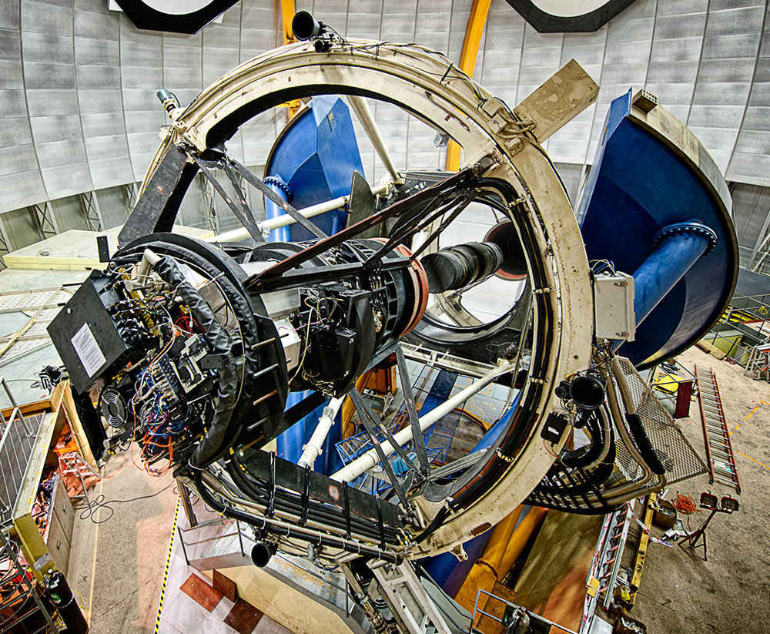
The Dark Energy Survey
Probe origin of Cosmic Acceleration:
  Distance vs. redshift
  Growth of Structure
• Two multicolor surveys:
− 300 M galaxies over 5000
sq deg, grizY to 24th mag
− 3000 supernovae (27 sq deg)
New camera for CTIO Blanco 4m telescope
− DECam Facility instrument
• Survey started Aug. 2013
− Finished 4 seasons, 105
nights per season (Aug-Feb)
DECam on the CTIO Blanco 4m
www.darkenergysurvey.org

Slide 2
DES Dark Energy Probes
Galaxy Clusters
  Tens of thousands of clusters to z~1
Weak Lensing
  Shape measurements of ~200 million galaxies
Galaxy Clustering
  ~300 million galaxies to z ~ 1
Supernovae
  3000 well-sampled SNe Ia to z ~1
Strong Lensing
  ~30 QSO lens time delays
  Arcs with multiple source redshifts
Cross-correlations
  Galaxies, WL x CMB lensing
DES forecast
T. Eifler, E. Krause

Slide 3
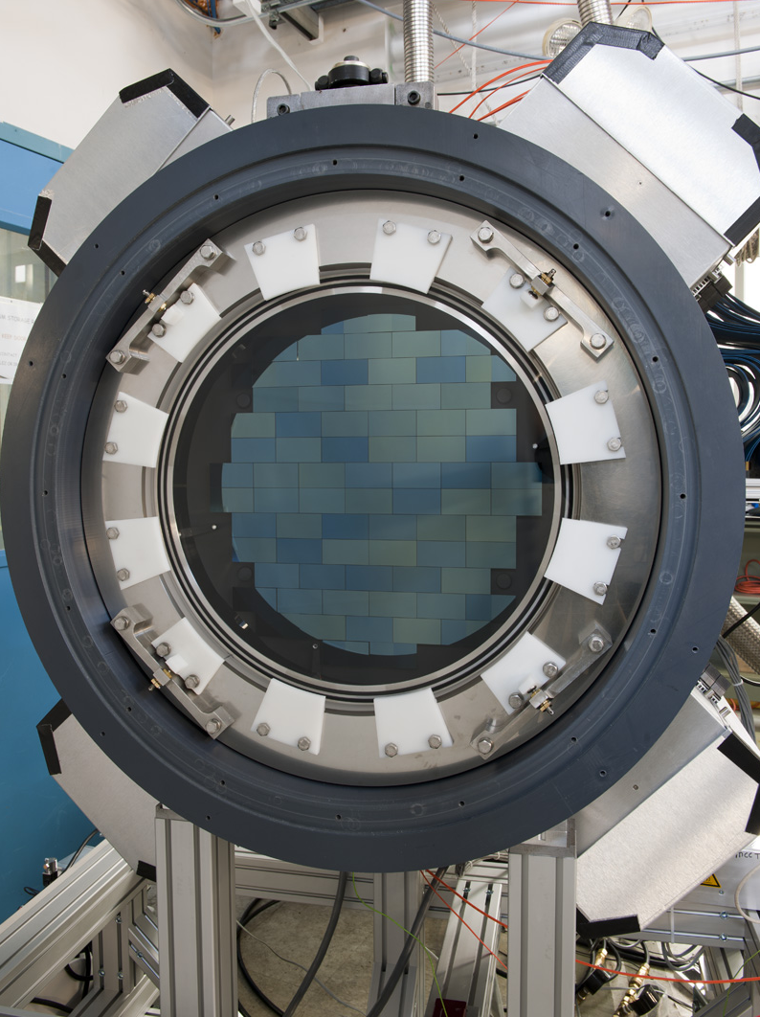
570-Million pixel
Dark Energy Camera
3 sq. deg. FOV

Slide 4
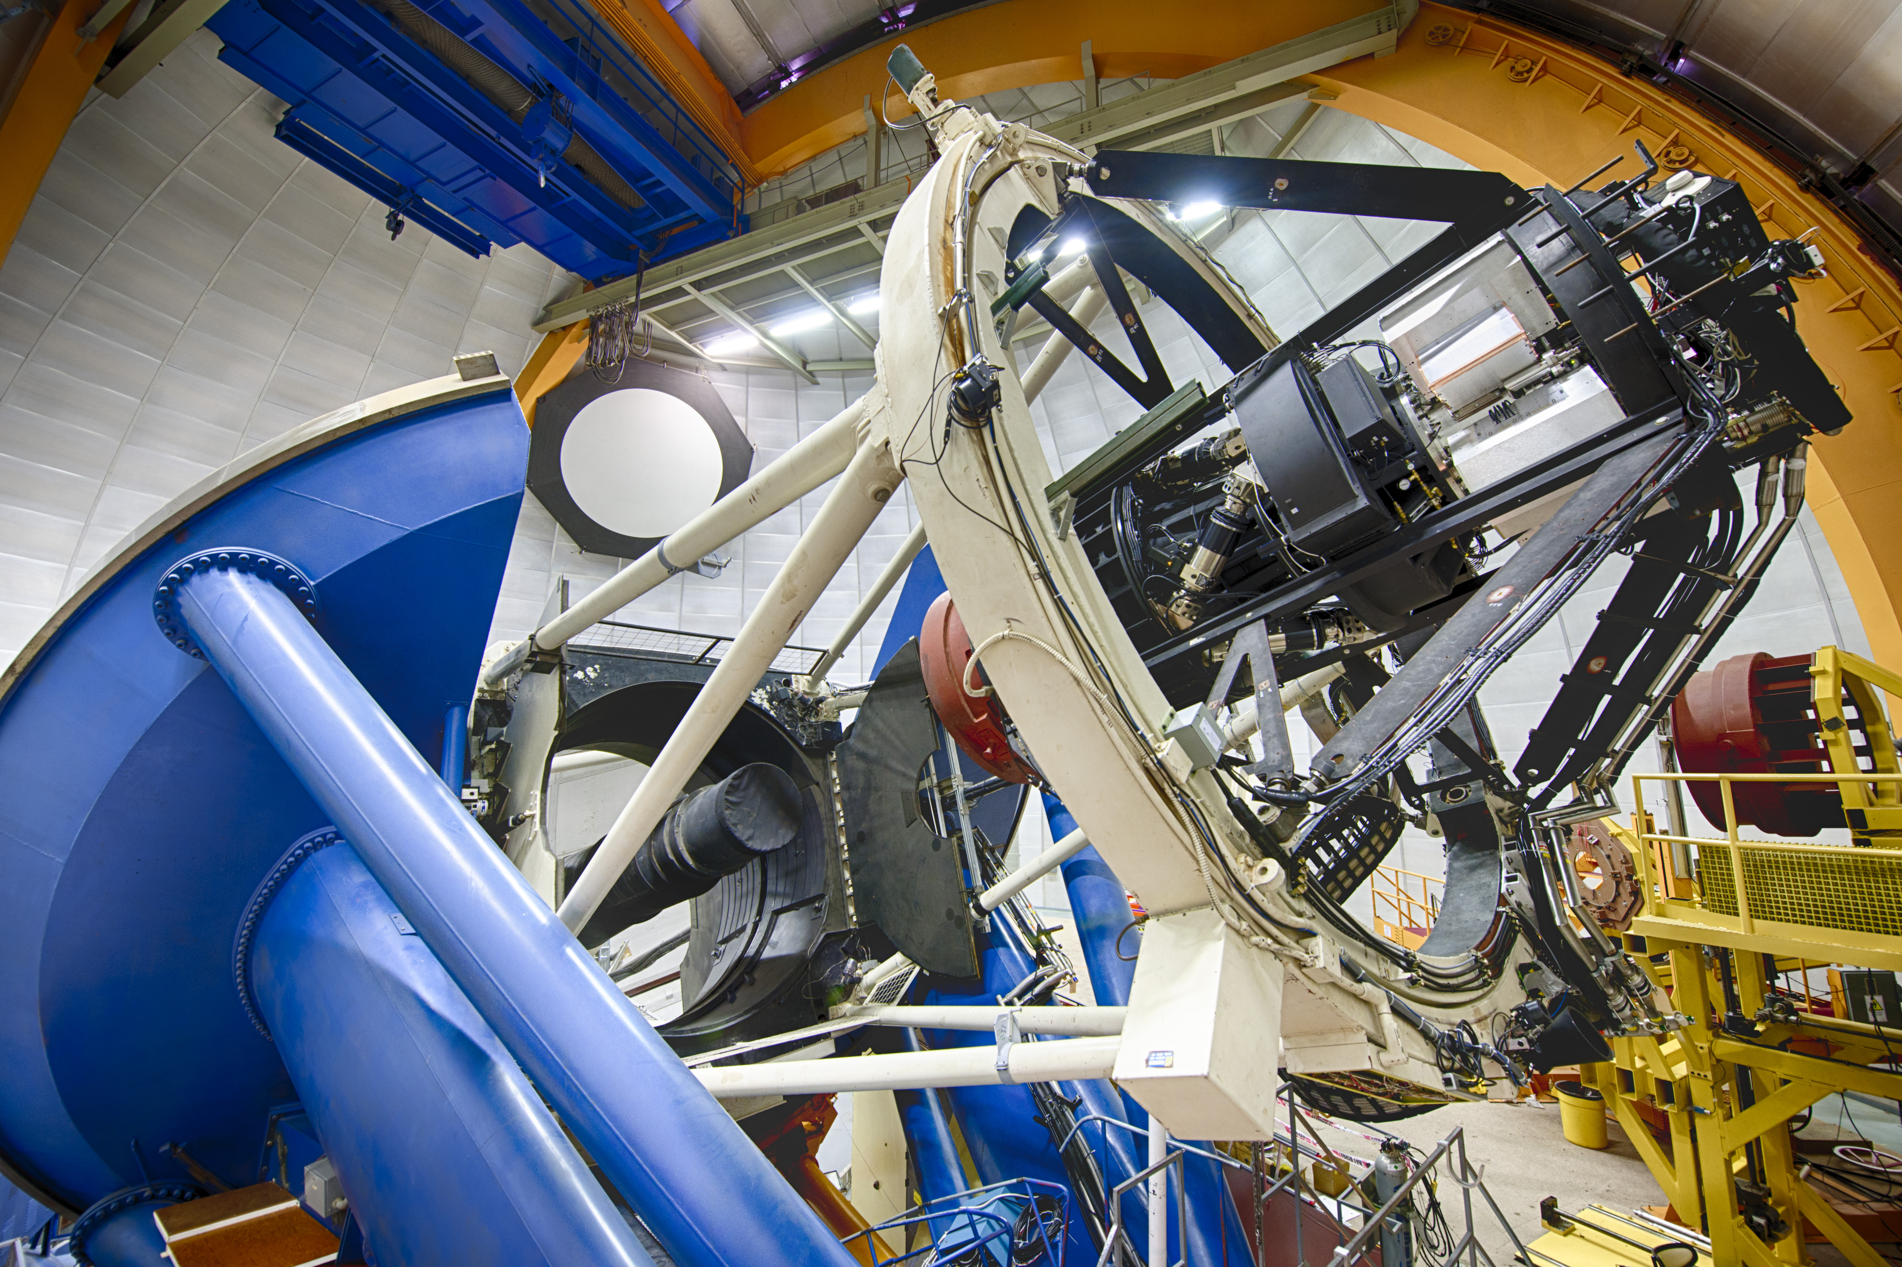
Dark Energy Camera on the Blanco Telescope

Slide 5
DES Year 1 Cosmology Analysis
Compare & consistently combine three 2-point correlation function measurements:
  Angular clustering: autocorrelation of 660,000 luminous red galaxies with excellent photo-z’s, in 5 redshift bins
  Cosmic shear weak lensing: shear-shear correlation functions from 26 million galaxy shapes in 4 redshift bins
  Galaxy-galaxy lensing: correlate red galaxy positions (foreground lenses) with source galaxy shear
SPT
region
SV area previously
analyzed

Slide 6
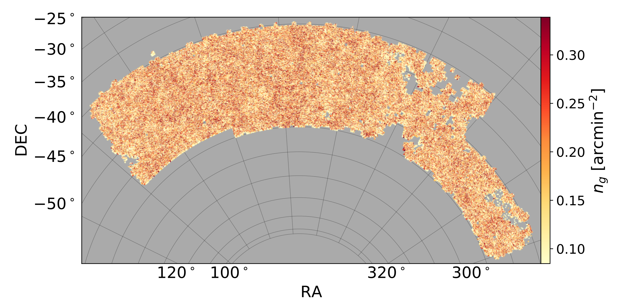

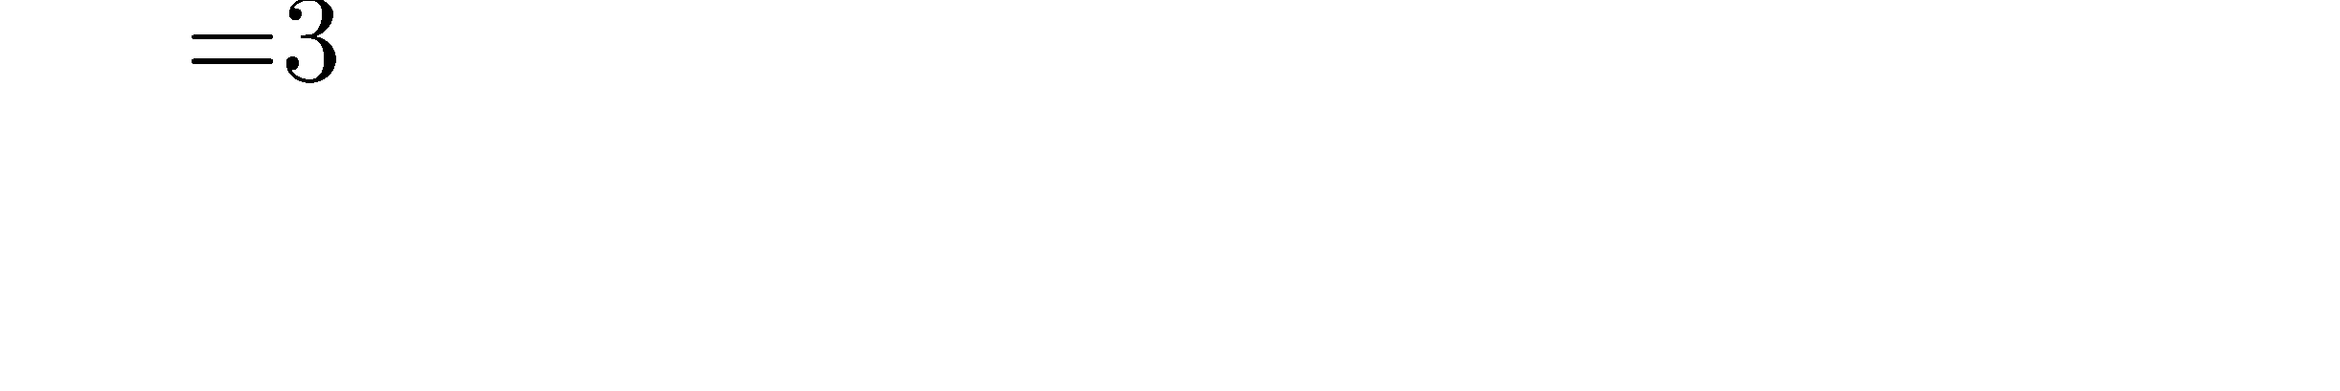
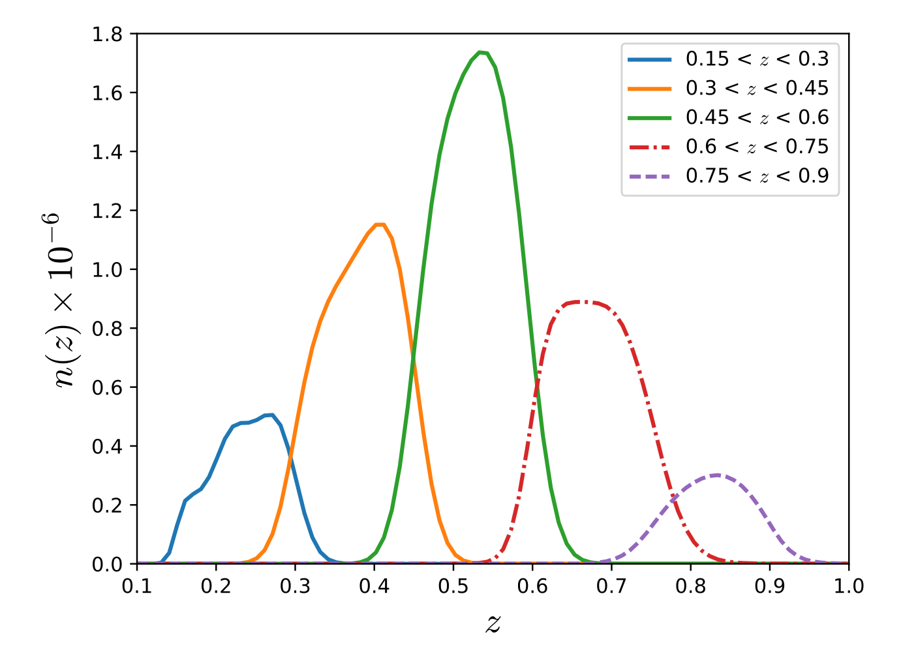
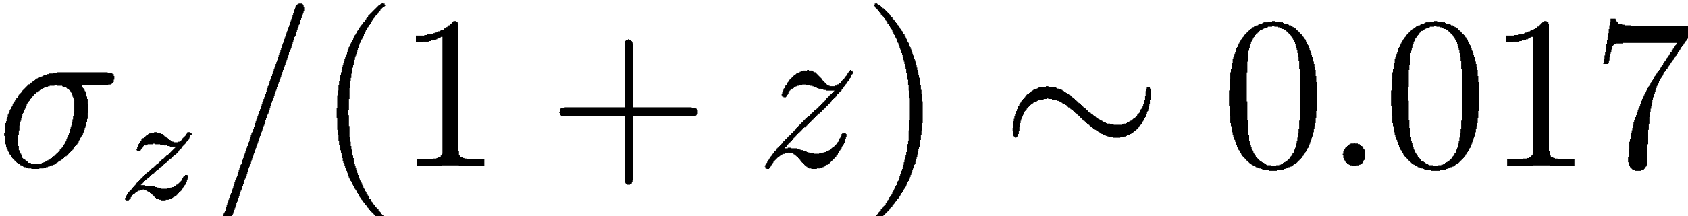

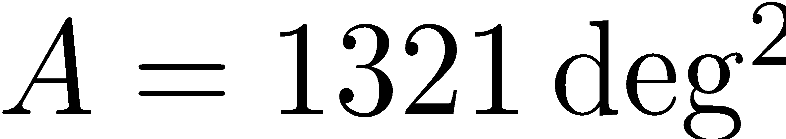
Galaxy Clustering for combined probes
J. Elvin-Poole, M. Crocce, A. Ross, et al.

Slide 7
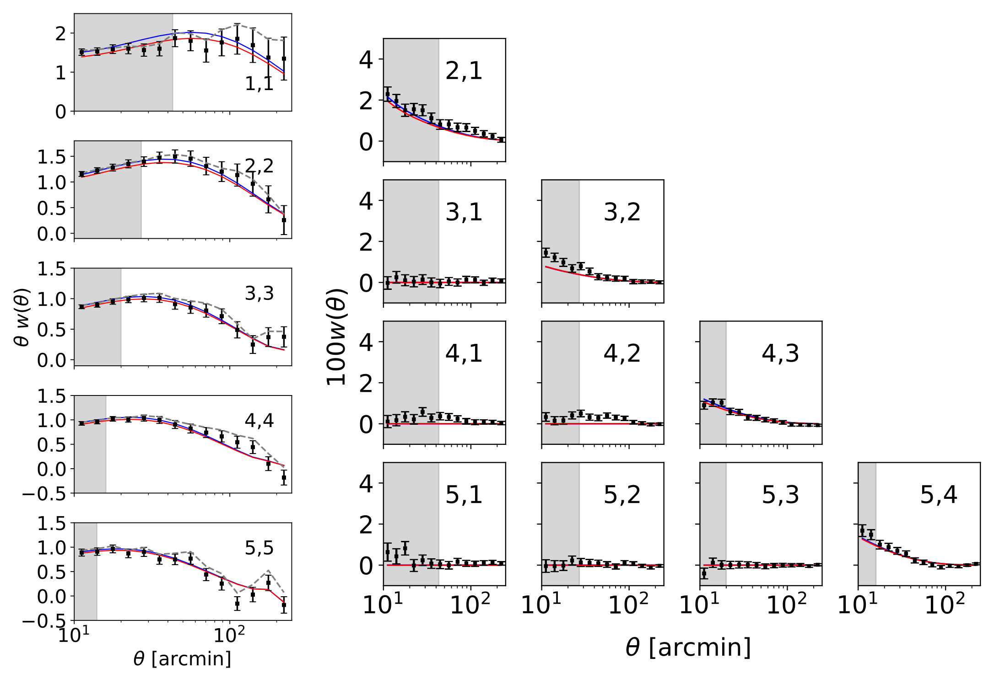
Galaxy Clustering
Elliptical galaxy spectrum

Slide 8
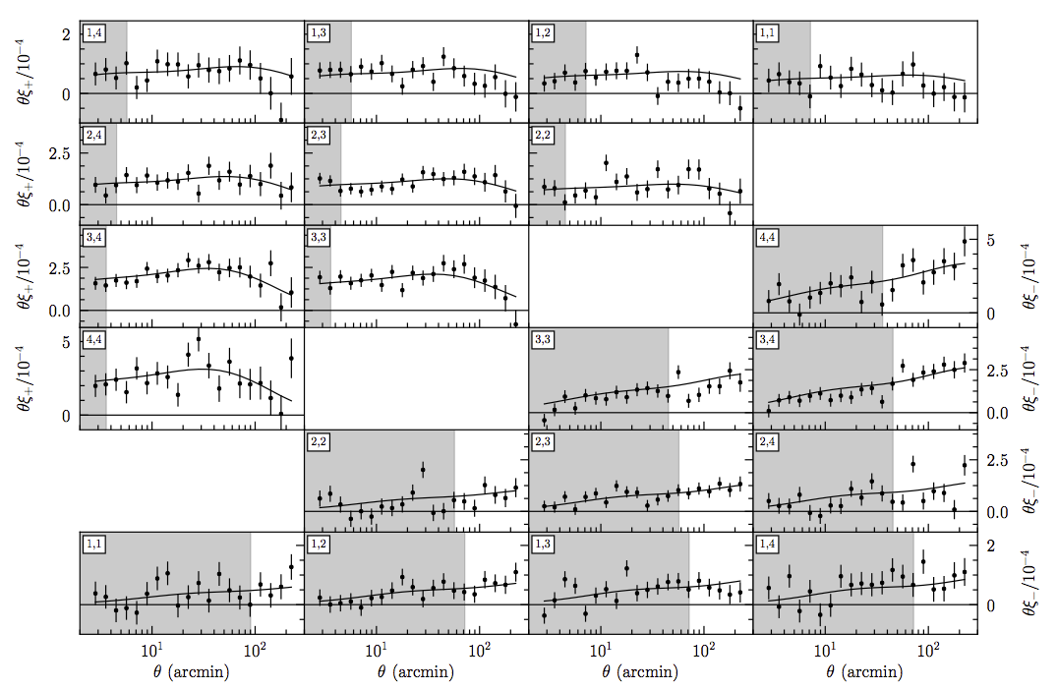
Total S/N = 26.8
8

Slide 9
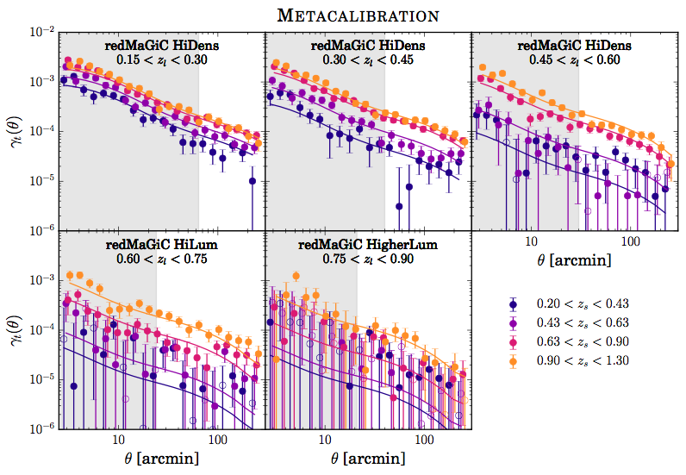
9

Slide 10
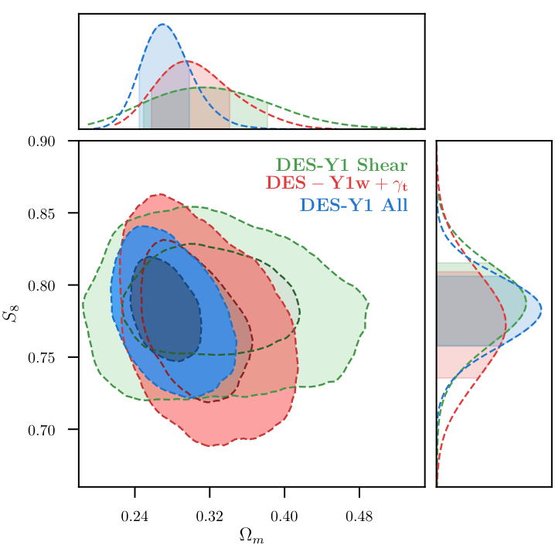

Multi-Probe Constraints: LCDM
DES-Y1 weak lensing: factor ~2 increase in constraining power
marginalized 4 cosmology parameters, 10 clustering nuisance parameters, and 10 lensing nuisance parameters
consistent (R = 2.8) cosmology constraints from weak lensing and clustering in configuration space
joint analysis constrains
DES Collaboration 2017

Slide 11
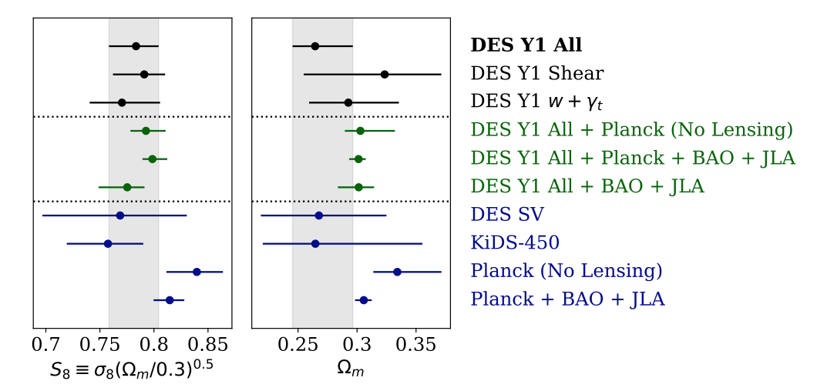
Multi-Probe Constraints: LCDM
(all data sets reanalyzed with DESY1 parameter + prior choices)
DES Collaboration 2017

Slide 12
Comparison of DES 3x2 with Planck CMB: low-z vs high-z in ΛCDM
DES and Planck (here without CMB lensing) constrain S₈ and Ω_{m} with comparable strength
Differ in central values by >1σ, in same direction as for KIDS
Bayes factor (evidence ratio):
R=P(DES,Planck | ΛCDM)
P(DES | ΛCDM)P(Planck | ΛCDM)
=4.2
“Substantial” evidence for consistency in ΛCDM

Slide 13
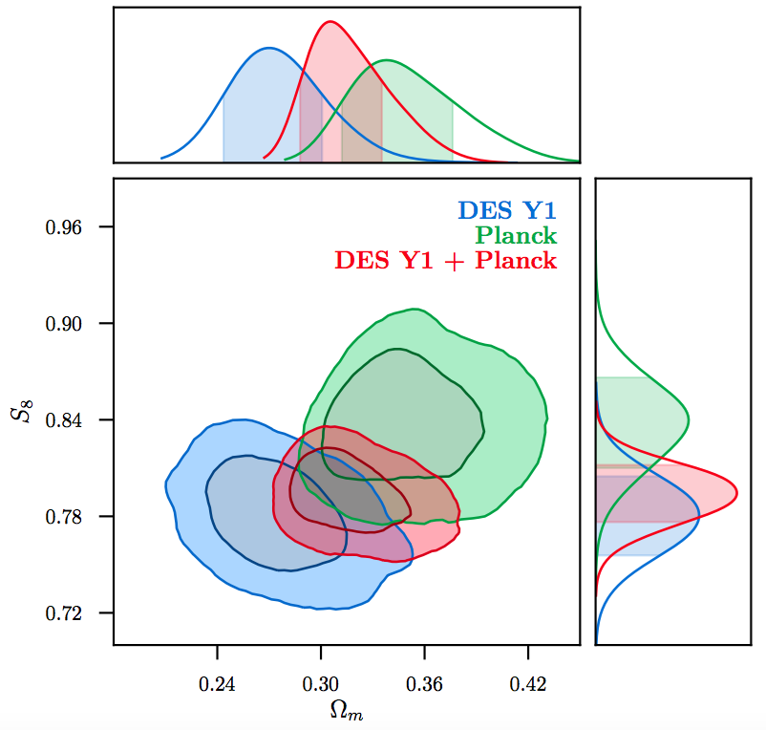
Combination of DES 3x2 with Planck CMB: low-z vs high-z in ΛCDM
DES and Planck (here without CMB lensing) constrain S₈ and Ω_{m} with comparable strength
Bayes factor (evidence ratio):
R=P(DES,Planck | ΛCDM)
P(DES | ΛCDM)P(Planck | ΛCDM)
=4.2
“Substantial” evidence for consistency in ΛCDM
Consistency even stronger comparing Planck to multiple low-z probes: DES+BAO+JLA (SN)

Slide 14
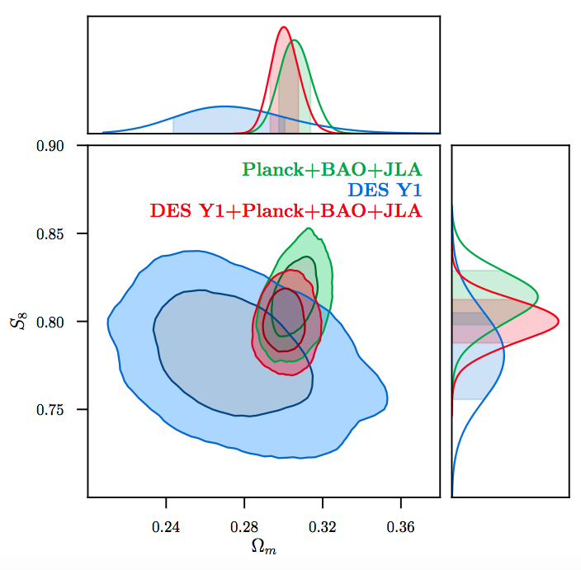



Combine multiple data sets
DES 3x2 consistent with Planck (now including CMB lensing)+BAO+JLA in ΛCDM
Combine to achieve very stringent parameter constraints:

Slide 15
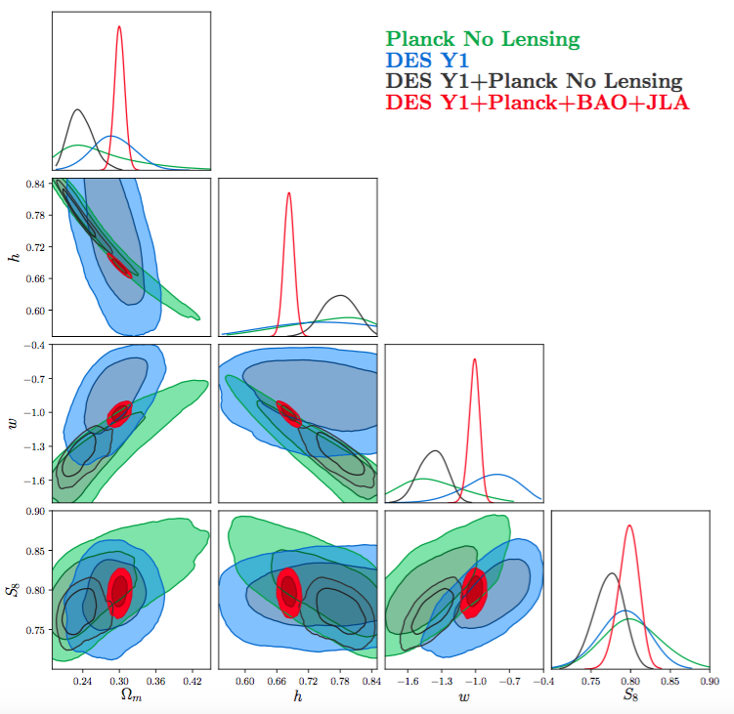

Combine multiple data sets: wCDM
DES 3x2 consistent with Planck (now including CMB lensing)+BAO+JLA in wCDM
Combine to achieve very stringent parameter constraints:

Slide 16
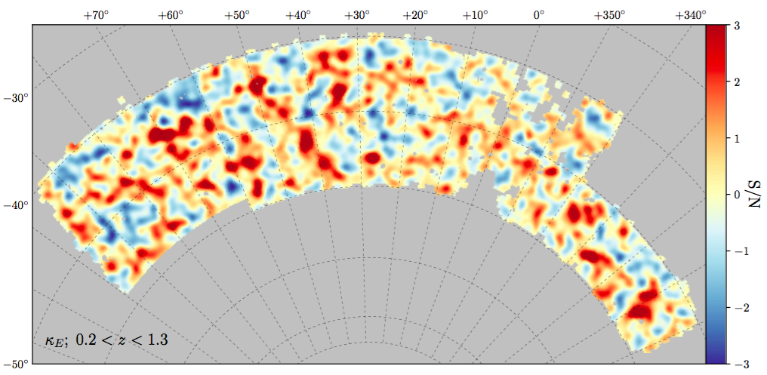
Weak Lensing Mass Map
Reconstruction based on 26 million source galaxy shape measurements from Metacalibration

