Slide 1
The Dark Energy Survey and The Dark Energy Spectrograph Josh Frieman DES Project Director
www.darkenergysurvey.org

Slide 2
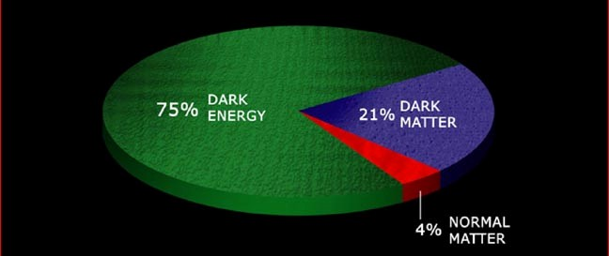
Dark Energy
What is the physical cause of cosmic acceleration?
Dark Energy or modification of General Relativity?
If Dark Energy, is it Λ (the vacuum) or something else?
What is the DE equation of state parameter w?
DES will take the next step toward these goals (Stage III)
Massive spectroscopic follow-up of DES would enable comparable advance beyond DES (Stage IV), particularly in testing DE vs modified
gravity

Slide 3
The Dark Energy Survey
Blanco 4-meter at CTIO
Survey project using 4 complementary techniques:
I. Cluster Counts
II. Weak Lensing
III. Large-scale Structure
IV. Supernovae
• Two uniform, well-calibrated multiband surveys:
5000 deg² grizY to ~24th mag
30 deg² repeat (SNe)
• Build new 3 deg² FOV camera
and Data management system
Survey 2012-2017 (525 nights)
Facility instrument for Blanco

Slide 4
The DES Collaboration
Fermilab
University of Illinois at Urbana-Champaign/NCSA
University of Chicago
Lawrence Berkeley National Lab
NOAO/CTIO
DES Spain Consortium
DES United Kingdom Consortium
University of Michigan
Ohio State University
University of Pennsylvania
DES Brazil Consortium
Argonne National Laboratory
SLAC-Stanford-Santa Cruz Consortium
Universitats-Sternwarte Munchen
Texas A&M University
plus Associate members at: Brookhaven National Lab,
U. North Dakota, Paris, Taiwan
Over 120 members
plus students & postdocs
Funding: DOE, NSF; UK: STFC, SRIF; Spain Ministry of Science, Brazil: FINEP, Ministry of Science, FAPERJ; Germany: Excellence Cluster; collaborating institutions

Slide 5
The Dark Energy Camera
570 Megapix
grizY
Excellent red sensitivity
Hexapod control of focus & alignment for image quality

Slide 6
The Dark Energy Camera
DECam mounted on Telescope Simulator at Fermilab

Slide 7
The Dark Energy Camera
DECam mounted on Telescope Simulator at Fermilab
To first approximation, DESpec would interchange the imager with a fiber-positioning system that feeds multiple spectrographs

Slide 8
DES Structure & Timeline
3 Construction Projects:
DECam
Data Management System
CTIO Facilities Improvement Project
NOAO Blanco Announcement of Opportunity 2003
DECam R&D 2004-8
Camera construction 2008-11
Final construction, testing, integration now on-going
Ship components to Chile: Sept 2010-July 2011
Installation: Jan-Oct/Nov 2011 (imager: Oct/Nov)
First light on telescope: ~Nov 2011
Commissioning: Nov 2011-Feb 2012
Science Verification: Feb/Mar 2012
Survey operations begin: Sept 2012
Expect DESpec would be similar scale project in cost & timescale, though starting with many DECam elements in place

Slide 9
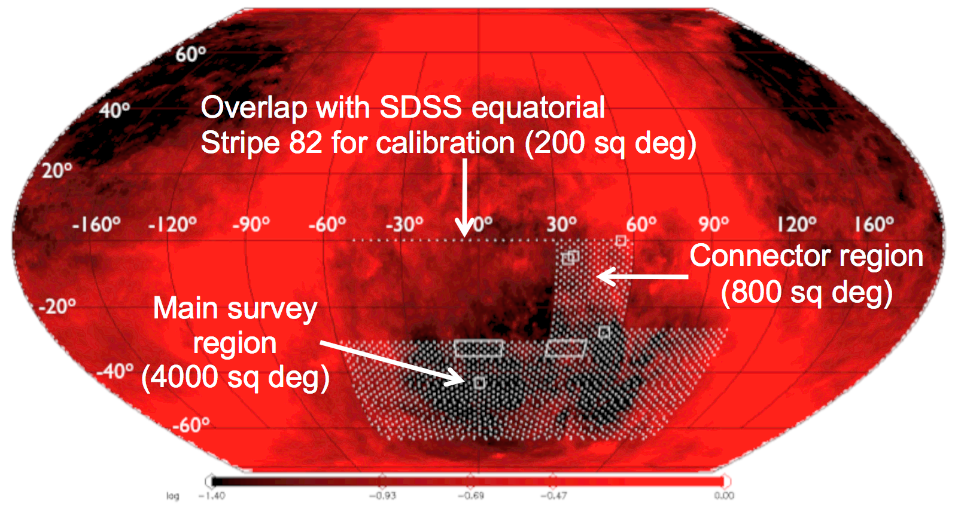
DES Observing Strategy
Sept-Feb observing seasons
80-100 sec exposures
2 survey tilings/filter/year
Interleave 5-10 SN fields in griz if non-photometric or bad seeing or time gap (aim for ~5 day cadence)
Overlap with SPT Cluster SZ survey (2500 sq deg)
Overlap VISTA VHS survey (JHK) completely: improve photo-z’s
Survey Area
5000 sq deg
Overlap with SDSS equatorial
Stripe 82 for calibration (200 sq deg)
2 tilings
3 tilings

Slide 10
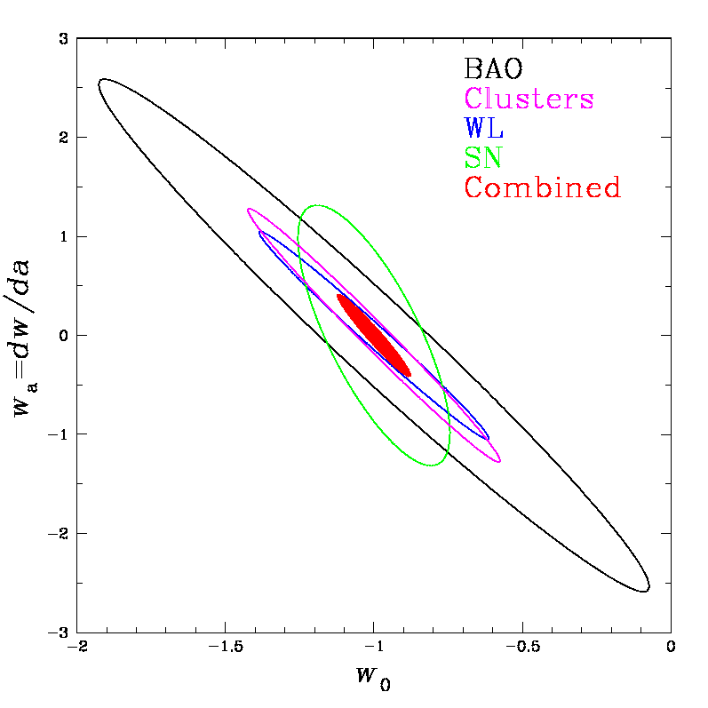
DES Science Summary
Forecast Constraints on DE Equation of State
Four Probes of Dark Energy
Galaxy Clusters
~100,000 clusters to z>1
Synergy with SPT
Sensitive to growth of structure and geometry
Weak Lensing
Shape measurements of 300 million galaxies
Sensitive to growth of structure and geometry
Baryon Acoustic Oscillations
300 million galaxies to z = 1 and beyond
Sensitive to geometry
Supernovae
30 sq deg time-domain survey
~4000 well-sampled SNe Ia to z ~1
Sensitive to geometry
Planck prior assumed
Factor 3-5 improvement over
Stage II DETF Figure of Merit

Slide 11
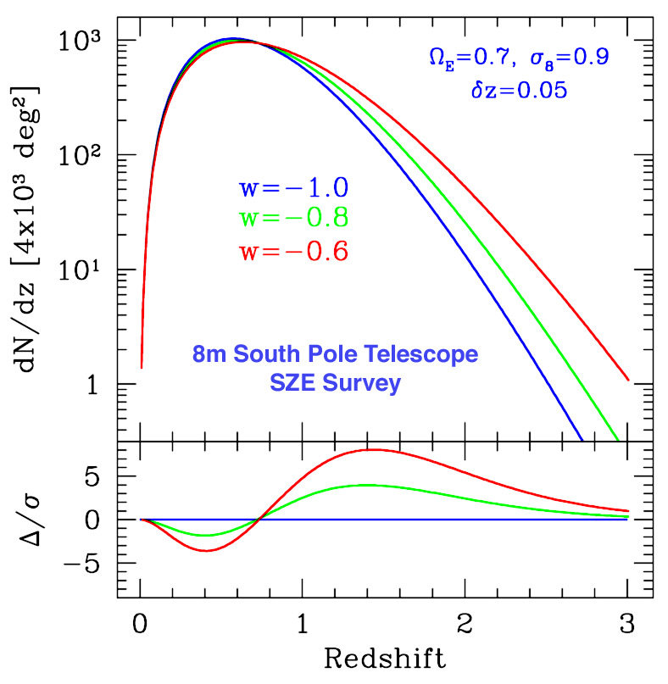
I. Clusters
Number of clusters above mass threshold
Elements of the Method:
Clusters are proxies for massive halos and can be identified optically to redshifts z>1
Galaxy colors provide photometric redshift estimates for each cluster
Observable proxies for cluster mass: optical richness (DES), SZ flux decrement (SPT), weak lensing mass (DES)
Cluster spatial correlations help calibrate mass estimates
Dark Energy
equation of state
Mohr
Volume Growth

Slide 12
II. Weak Lensing: Cosmic Shear
Background
sources
Dark matter halos
Observer
Spatially coherent shear pattern, ~1% distortion
Radial distances depend on geometry of Universe
Foreground mass distribution depends on growth of structure
Notes:
Cosmic Web – bottom up scenario – clusters then filaments then walls (membranes).
Note that filaments not well traced by galaxies & too ephemeral to emit x-rays, so lensing only way to detect.

Slide 13
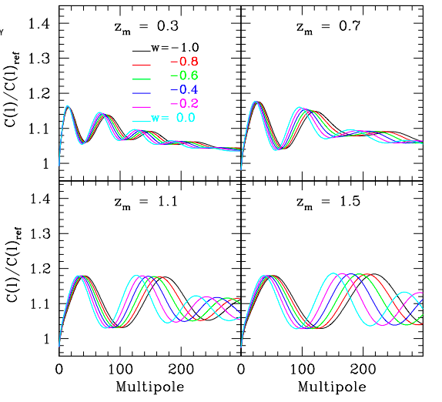
III. Baryon Acoustic Oscillations
Galaxy angular
power spectrum
in photo-z bins (relative to model without BAO)
Probe deeper than SDSS redshift surveys
Fosalba & Gaztanaga

Slide 14
Supernovae in DES
IV. Supernovae
Bernstein et al
Broader redshift range than SDSS SN
Higher S/N in red passbands than SNLS
Add NIR from VISTA VIDEO survey
Factor ~10x statistics vs. current samples

Slide 15
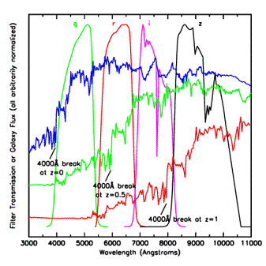
Photometric Redshifts
Elliptical galaxy spectrum
• Measure relative flux in
multiple filters:
track the 4000 A break
• Estimate individual galaxy
redshifts with accuracy
σ(z) < 0.1 (~0.02 for clusters)
• Precision is sufficient
for several Dark Energy
probes, but error distributions
must be well measured:
requires spectroscopy

Slide 16
Massive Spectroscopy of DES Targets
Would enable (see today’s talks):
Clusters: cluster spec. z’s and dynamical masses from velocity dispersions
WL: calibrate photo-z’s to reduce systematics; cross-correlate spec. lenses with photometric source galaxies; combine RSD
LSS: radial BAO (H(z)); growth fn. via Redshift Space Distortions
SNe, galaxy evolution: host-galaxy z’s and spectroscopic typing (metallicities, stellar masses) depending on S/N
All: calibrate photo-z’s directly and via angular cross-correlation

Slide 17
DESpec Concept
~4000 fiber system for the Blanco 4-m at CTIO, interchangeable with DECam, feeding ~20 spectrographs
FOV: 3.8 sq. deg. (delivered by DECam optics)
Nominal wavelength coverage: 550 to 1080 nm (blue limit set by optics)
Resolution: R~2000 feasible with single-arm spectrographs, but TBD by requirements
Use DECam optics except C5 (dewar window) and add ADC
Spectrograph design could be based on cost-effective HETDEX VIRUS. 200 spectra per 2kx4k CCD
Could use existing tested, spare DECam CCDs as detectors
Technical challenge: positioners for high fiber density
Tomorrow’s talks will cover all these technical issues and more.

Slide 18
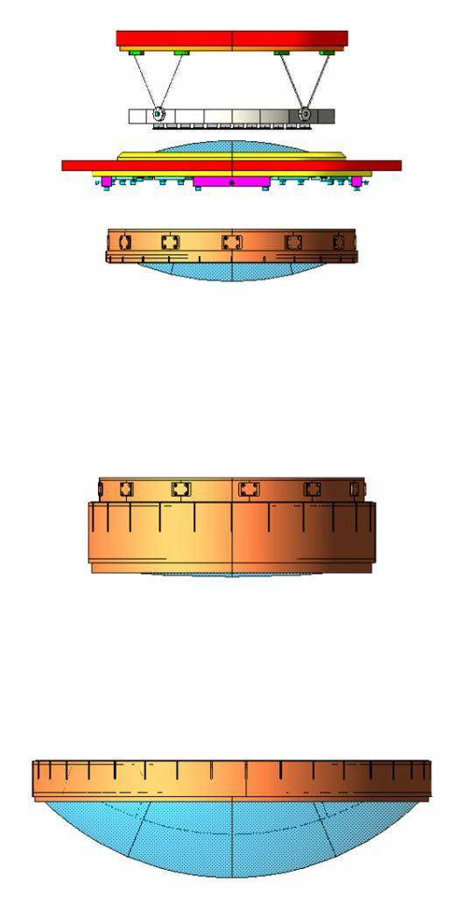
DECam Optics
Field of view: 2.2º diameter
C1, C2, C3, C5 in hand
C4 finishing coating in California
UCL leading this effort
DESpec would use same optics (except C5) & add ADC
Attachment ring
Bipods
Focal plane
C5, vacuum window
C4
Filters &
Shutter
C2 - C3
S. Kent (FNAL)
C1

Slide 19
DESpec Survey(s)
Need to carry out FoM trade studies taking into account all the probes. Following just sets the scale to factor of ~2.
Example: BAO-optimized survey covering DES footprint:
Errors in ln(P) scale as V_{eff}^{-1/2}, where
V_{eff} = (nP/(1+nP))² V_{survey}
Maximize V_{survey} to minimize cosmic variance
Choose nP~2-3 so that Poisson errors subdominant: P<2x10⁴ h⁻³ Mpc³ on relevant scales: n>(1-2)x10⁻⁴ h³ Mpc⁻³
Use color, surface-brightness, and flux selection to sculpt z distribution under this constraint: maximize V_{s} and spec. efficiency

Slide 20
DESpec Survey(s)
Example (Cf. BigBOSS): ELGs to z~1.7: ~1100/s.d. =5.5 M successful redshifts. Target ~2x that due to inefficiencies.
DESpec: 4000 fibers over 3.8 s.d.=1050 targets/s.d. per exposure. 2x17 min exposures per field to cover ELG targets for ~65% z completeness.
Cover 5000 s.d. in 2630 exposures=770 hours=110 scheduled nights assuming 75% CTIO weather, 9.5 hr nights, and ignoring overlaps.
Could focus on LRGs instead or in addition: see Jim Annis’ talk for detailed discussion. Longer exposures but more efficient targeting.
Conclusion: comparable BAO survey power per unit time to BigBOSS: trade smaller FOV vs. higher fiber density.

Slide 21
Rationales for Blanco Spectroscopy
Uniform, deep imaging catalogs from DES+VHS for targeting → enable new science beyond what redshifts alone provide (e.g., lensing cross-correlation)
Maximally enhance science reach of DES: improve all the DE methods+photo-z calibration+enable new methods (RSD, radial BAO)
Hemispheric synergy with LSST: part of a broader eventual strategy for LSST follow-up: extend to ~15,000 sq deg and/or long cumulative exposures on LSST deep-drilling fields
Excellent site: seeing, high number of useable nights yield faster (hence cheaper) survey
Lower cost & schedule risks by reusing/capitalizing on many DECam components: optics, CCDs,…

Slide 22
Caveats
NOAO does not currently have plans for an AO for major instrument on the Blanco following DECam: NSF Portfolio Review in 2012.
Need to evaluate DESpec in the global context of planned & proposed spectroscopic survey facilities: in this economic climate, should aim to complement rather than compete where possible.

Slide 23
Path Forward
DESpec a natural “upgrade” to the science capability of DES. Project could structurally follow the path blazed by DES: an international collaboration with DOE+NSF support in the US, building on the successful DES collaboration, with opportunities for new partners.
Next 2 months: White Paper laying out the science case & reference technical design motivated by science requirements.
Next ~6 months: optimize target selection for multiple DE probes, confirm with simulated spectra. Continue to build science case and collaboration.

