Slide 1
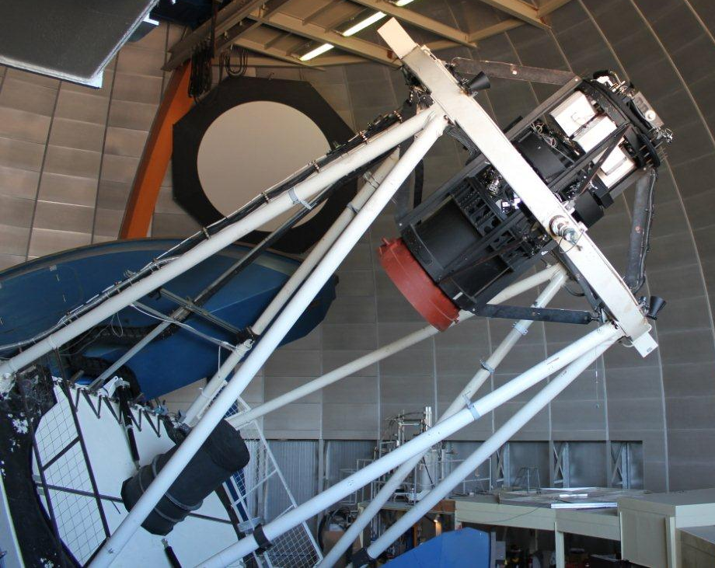
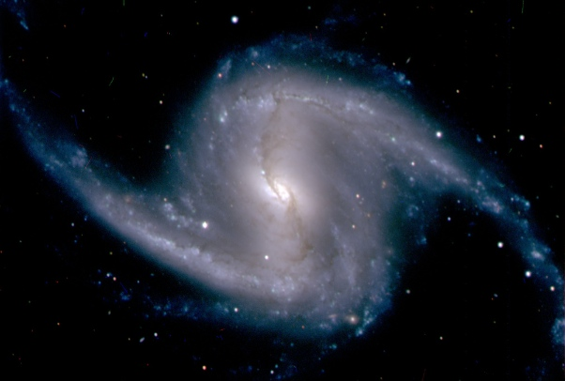
The Dark Energy Spectrograph
Josh Frieman
DES Project Director
Fermilab and University of Chicago
Fermilab PAC, October 16, 2012

Slide 2
U.S. Dark Energy Program
What is the physical cause of cosmic acceleration?
Dark Energy or modification of General Relativity?
If Dark Energy, is it Λ (the vacuum) or something else?
What is the DE equation of state parameter w?
BOSS, DES, and later LSST well designed to make major advances in addressing these questions.
The DE program would be substantially enhanced in the intermediate term by a massive galaxy redshift survey that optimally synergizes (overlaps) with the DES imaging survey and in the longer term by a larger redshift survey selected from LSST.

Slide 3
Recent Developments
Rocky III Report:
“compelling case for…wide-field spectroscopic survey”
NSF AST Portfolio Review Report:
High-multiplex, optical spectroscopy on >= 4m telescopes a critical technical capability for Cosmology & Fundamental Physics; Blanco, Mayall very well-suited
DOE approves CD-0 for mid-scale Dark Energy Spectroscopic Instrument Experiment
DECam First Light
optical corrector working well
DESpec White Paper released, workshops being held (May, Dec. 2012), R&D underway

Slide 4
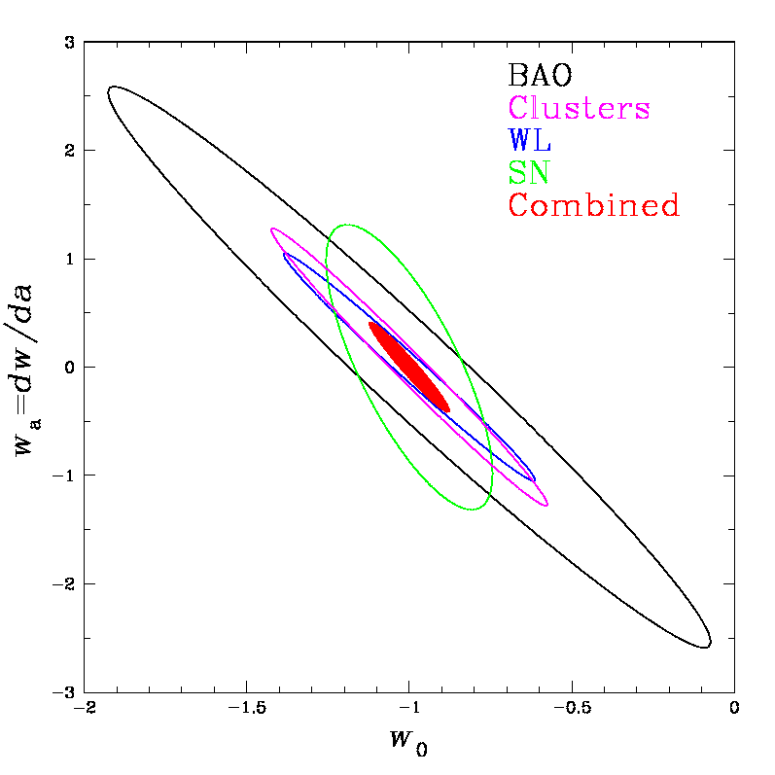
DES Science Summary
Forecast Constraints on DE Equation of State
Four Probes of Dark Energy
Galaxy Clusters
~100,000 clusters to z>1
Synergy with SPT, VHS
Sensitive to growth of structure and geometry
Weak Lensing
Shape measurements of 200 million galaxies
Sensitive to growth of structure and geometry
Baryon Acoustic Oscillations
300 million galaxies to z = 1 and beyond
Sensitive to geometry
Supernovae
30 sq deg time-domain survey
~4000 well-sampled SNe Ia to z ~1
Sensitive to geometry
DES
Planck prior assumed
Factor 3-5 improvement over
Stage II DETF Figure of Merit

Slide 5
Massive Spectroscopy of DES and LSST Targets Enables New and Improved DE Probes
Weak Lensing and Redshift-Space Distortions
Powerful test of Dark Energy vs Modified Gravity
Galaxy Clustering
Radial BAO for H(z) and improved D_{A}(z)
Photometric Redshift Calibration
Determine DES and LSST N(z) from angular correlation, improve DE constraints from all methods in the imaging surveys
Galaxy clusters
Dynamical masses from velocity dispersions, improve halo mass-observable calibration, reduce the major cluster DE systematic
Weak Lensing
Reduce systematics from intrinsic alignments
Supernovae
Reduce systematics from host-galaxy typing

Slide 6
Massive Spectroscopic Surveys in the Southern Hemisphere
8-million Galaxy Redshift Survey in 350 nights
Uniformly selected from deep, homogeneous DES imaging over 5000 sq. deg. (2018+)
23-million Galaxy Redshift Survey in 1000 nights
Uniformly selected from deep, homogeneous LSST imaging over 15,000 sq. deg. (2021+)
Deep, uniform multiband imaging from DES, LSST
Enable efficient, well-understood selection of spectroscopic targets
Photometric+Spectroscopic Surveys over same Sky
Enable powerful new science beyond what either can provide alone

Slide 7
Dark Energy Spectrograph Concept
4000-fiber optical spectrograph system for the Blanco 4m
Mohawk robotic fiber positioner
Based on Echidna system, has demonstrated requisite pitch
Feed 10 2-arm, high-throughput spectrographs
10 spare DECam CCDs (red) and 10 blue-sensitive CCDs
Fibers tile full 3.8 deg² DECam Field of View
Fiber positioner rapidly interchangeable with DECam imager
Maintain wide-field imaging capability for the Blanco
Use much of the DECam infrastructure installed on Blanco
Prime focus cage, hexapod, 4 of the 5 optical corrector elements, shutter
DESpec White Paper released Sept. 11
arXiv: 1209.2451 (Abdalla, etal)

Slide 8
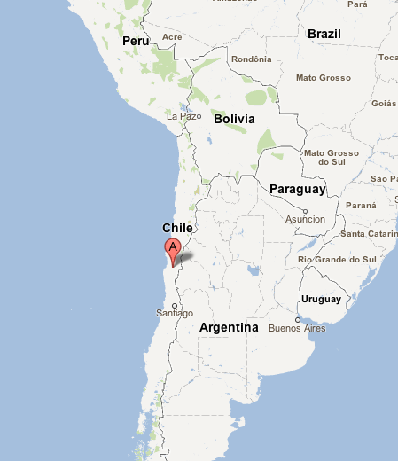
Cerro Tololo
Blanco Telescope
high, dry; excellent seeing, 80% useable nights, high fraction of photometric nights. Its advantages for photometry (DES) apply to spectroscopy (DESpec) as well, yielding fast (hence relatively cheap) surveys. Next door to LSST and Gemini.
8

Slide 9
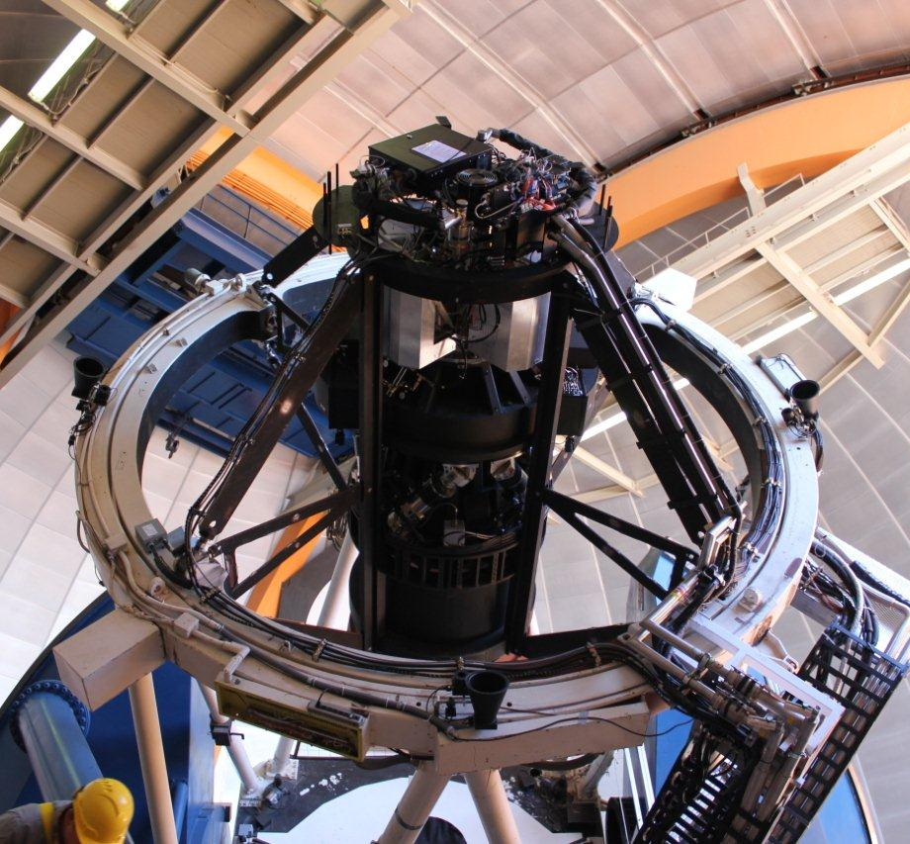
DECam
Prime Focus
Cage
Installed on
Blanco
Telescope

Slide 10
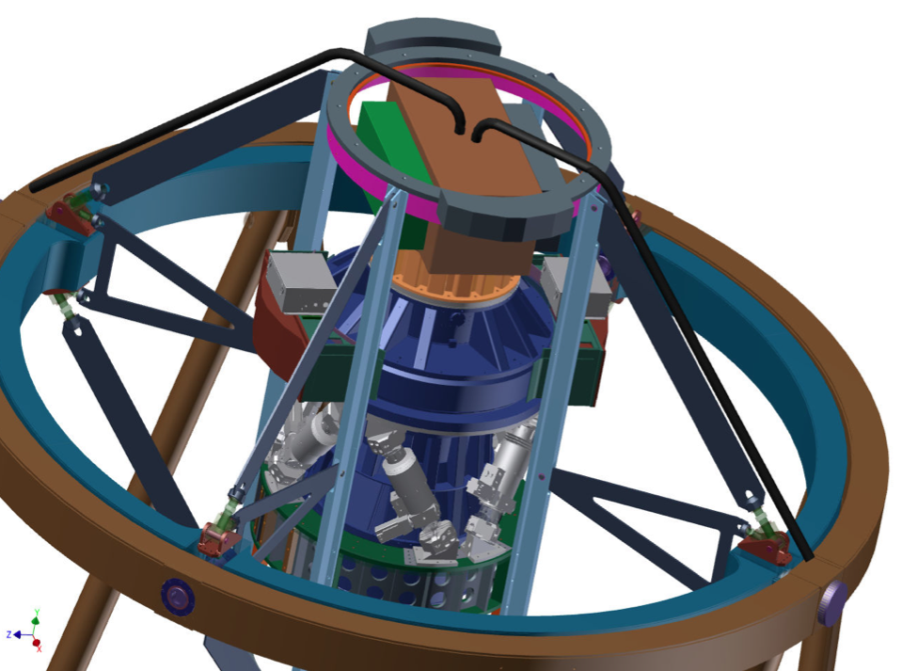
DECam
Prime Focus
Cage
Installed on
Blanco
Telescope
+DESpec
Saunders, etal

Slide 11
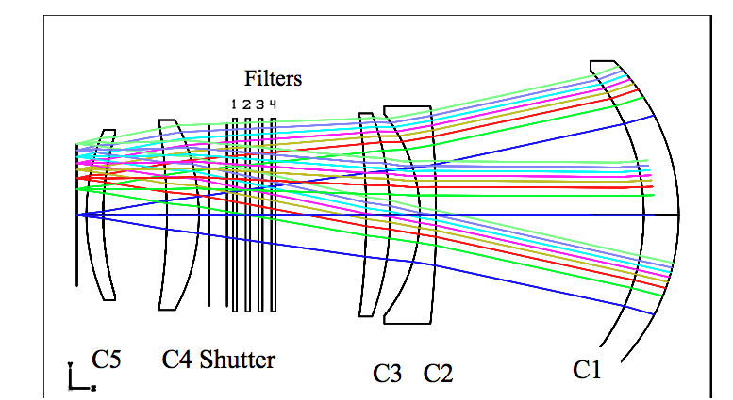
Optics
Field of View 2.2º diameter, 3.8 deg²
DECam corrector demonstrated on the telescope to deliver good image quality across FOV
Corrector was longest lead-time item for DECam
DESpec optical design still being optimized
Optical work to be done at UCL as for DECam
2 new optical elements (C5’, C6) rapidly interchangeable with C5 (DECam dewar window): maintain DECam imaging capability
DECam
C4
Filters &
Shutter
DESpec
C6
C5’
ADC
(optional)
S. Kent, W. Saunders

Slide 12
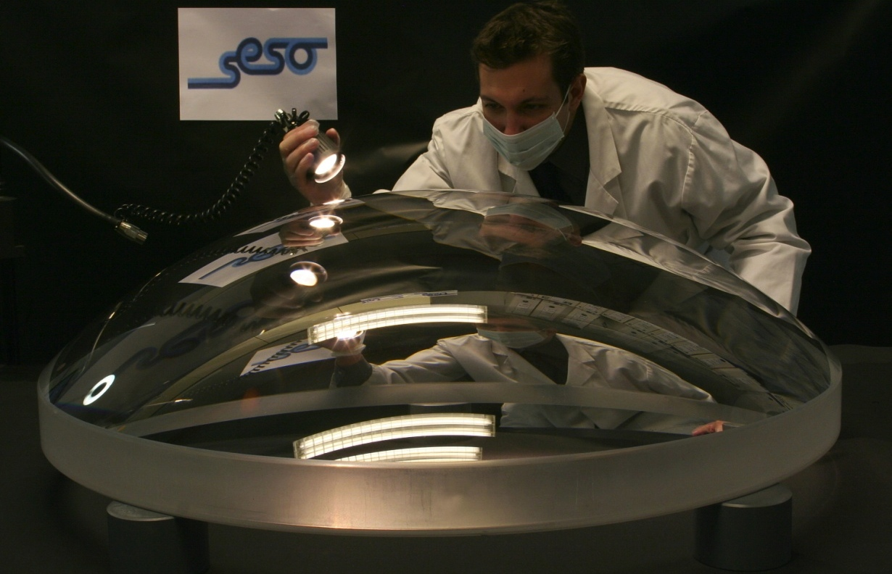
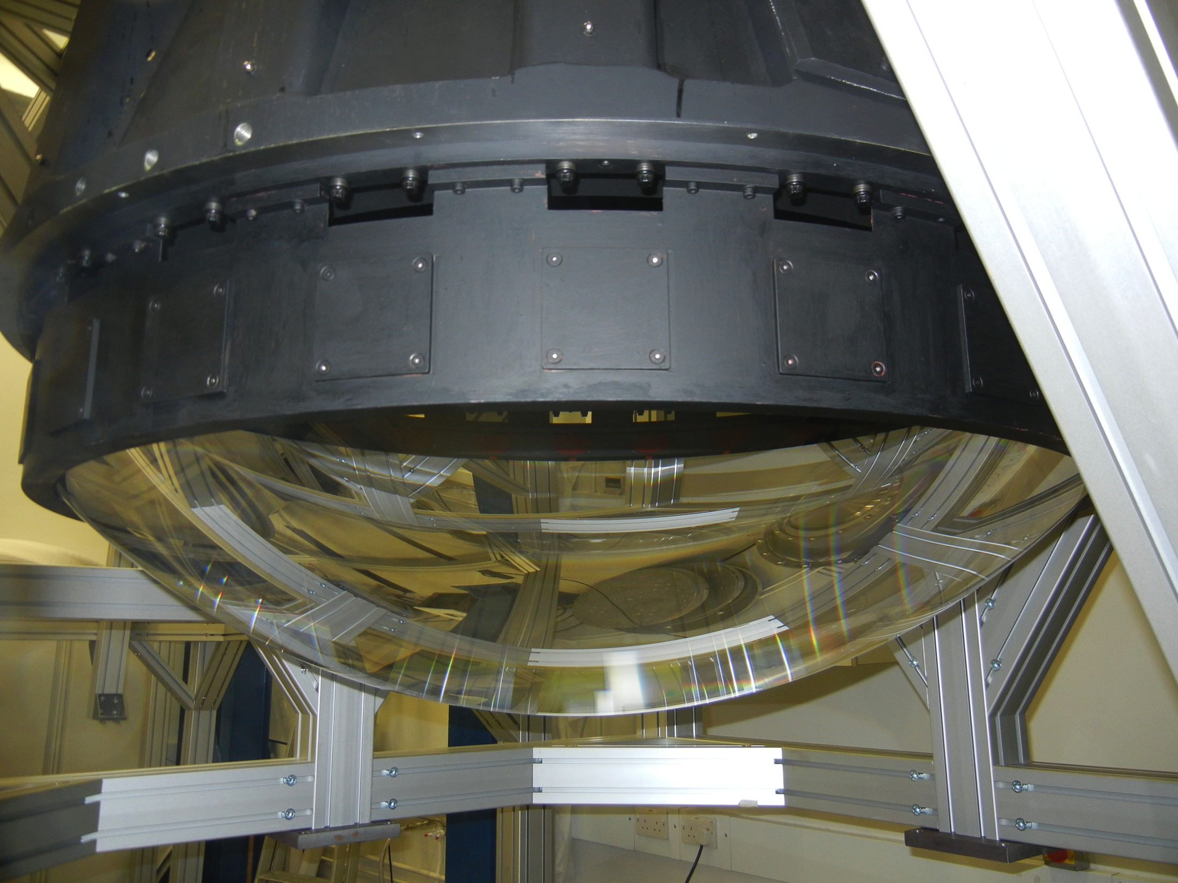
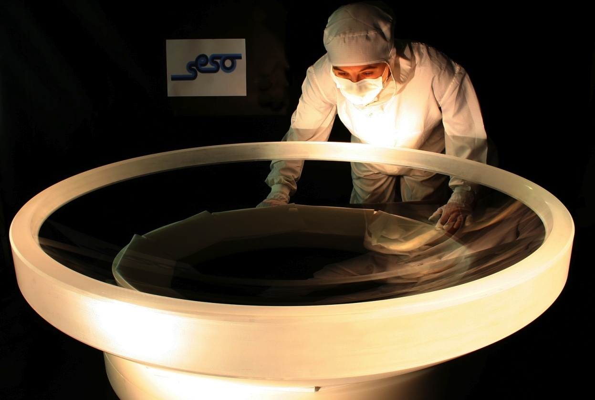
DECam/DESpec
C1 Lens
DECam optical corrector installed
on Blanco in May

Slide 13
Mohawk Fiber Positioner System
Proposed for DESpec by Australian Astronomical Observatory
R&D program described in Saunders, etal, Proc. SPIE
Derived from existing Echidna system
400-fiber system deployed on Subaru 8m telescope
Builds on R&D done for WFMOS
4000 fibers in nominal design, with tilting spine technology
6.75 mm pitch (interfiber separation)
Modular design
Actuators prototyped at AAO
15 sec reconfiguration times with position errors < 7 microns

Slide 14
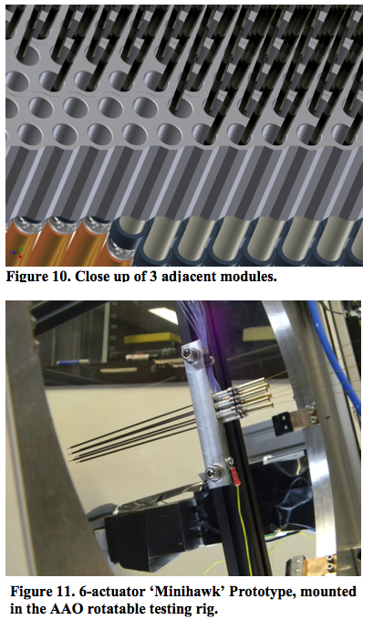
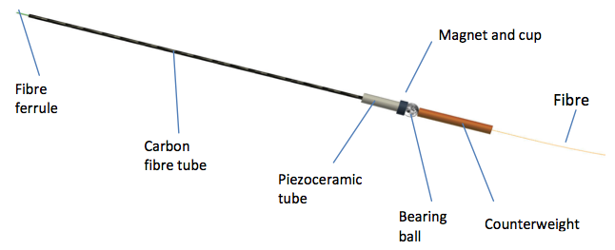
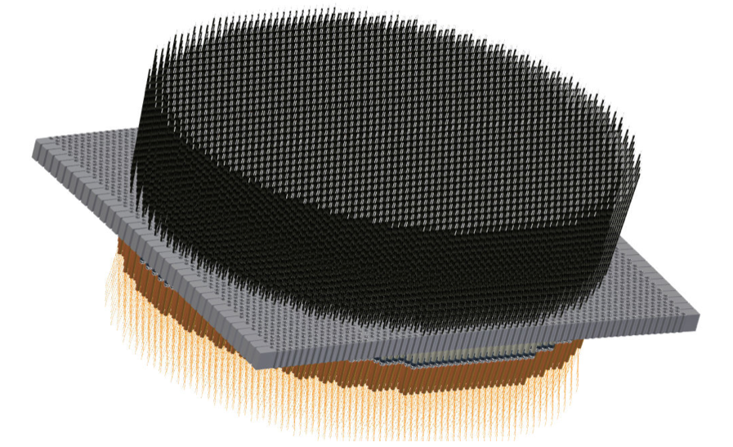
Mohawk Fiber Positioner

Slide 15
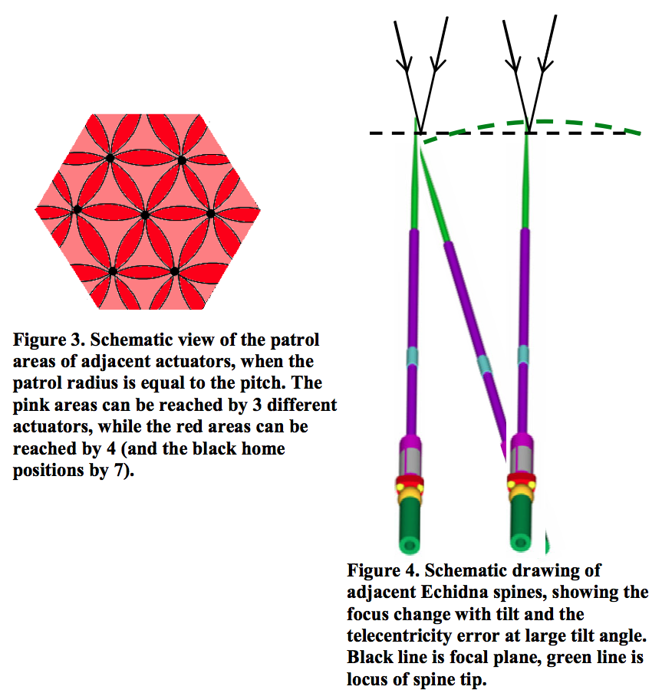
Tilting Spines
Estimated 15% throughput loss
(non-telecentricity, focal ratio degradation)
84% of potential targets observed per pointing
DESpec survey plans 2 pointings per field to achieve high completeness and target density

Slide 16
Spectrographs
Two-arm design with dichroic
400 fibers per spectrograph, 10 spectrographs, 20 CCDs
Wavelength range 480-1050 nm
−cover spectral lines over redshift range of interest
Resolution 0.228 nm
−detect/resolve galaxy lines and reduce sky contamination
Extension to UV (for Lyman-alpha BAO) under study
−preliminary optical design reaches 350 nm with good
spot size, could require 3-arm spectrographs for res.

Slide 17
growth rate
Slide from Enrique Gaztanaga

Slide 18
Weak Lensing and Redshift Space Distortions
Powerful test of Dark Energy vs. Modified Gravity
RSD from DESpec
Measures degenerate combination of growth f and bias b
Weak Lensing from DES
constrains bias, breaks degeneracy
RSD and WL over same sky
RSD, shear-shear, galaxy-shear correlations in redshift bins → RSD in multiple bias bins to reduce cosmic variance
MacDonald & Seljak, Bernstein & Cai, Cai & Bernstein,
Gaztanaga, etal, Kirk, et al (in prep)

Slide 19
Weak Lensing and Redshift Space Distortions
Gaztanaga, et al
Constraints strongest if imaging and spectroscopy cover same sky: galaxy-shear cross-correlations constrain bias

Slide 20
DES and LSST Photo-z Calibration
Angular Cross-Correlation of Photometric Survey with shallower Spectroscopic Survey
Requires same sky
coverage of imaging and spectroscopy
Photo-z systematics could otherwise limit DES, LSST Dark Energy reach
DES-BigBOSS Joint Working Group Report

Slide 21
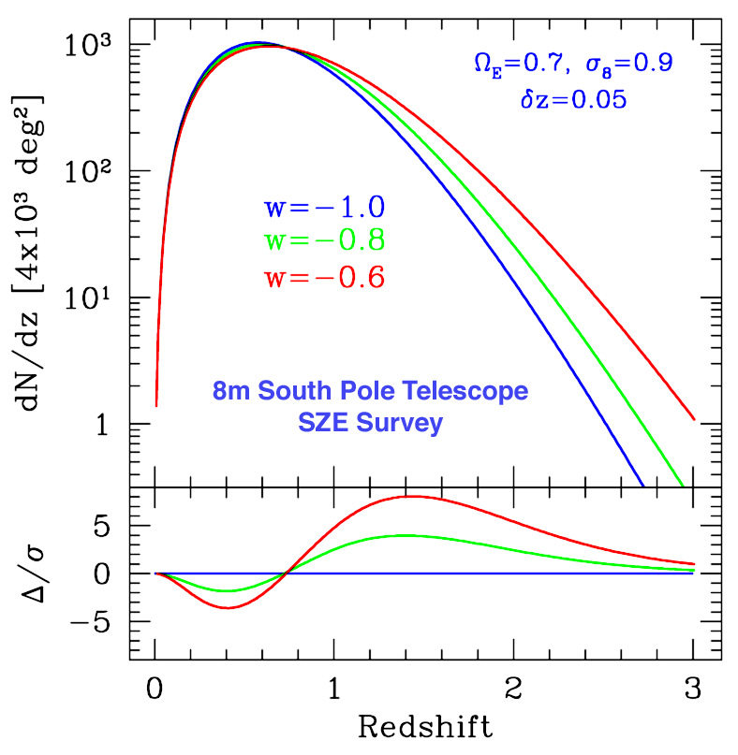
Clusters
Number of clusters above mass threshold
Spectroscopy of DES
Clusters
improve z precision, reduce
outliers
Precise estimates of cluster
membership & richness
optimize richness estimates
Cluster velocity dispersion
(dynamical mass)
calibrate mass-richness
relation: complement WL,
SZ, and X-ray estimates
Dark Energy
equation of state
Mohr

Slide 22
DETF
FOM
gain for
clusters
Slide from
Sarah Hansen

Slide 23
The Dark Energy Spectroscopic Survey
Dark Energy Redshift Survey optimized for
Baryon Acoustic Oscillations
Redshift Space Distortions
• Target DES+VHS Galaxies (from grizYJHK colors, fluxes)
6.4 million Emission Line Galaxies (to z~1.5, BAO)
1.2 million Luminous Red Galaxies (to z~1.3, RSD)
Survey Design
2 exposures each field to reach target density and high completeness (1500 successful redshifts per sq. deg.)
30-min exposures to reach requisite depth
350 survey nights with DESpec on the Blanco 4m (overheads, weather)

Slide 24
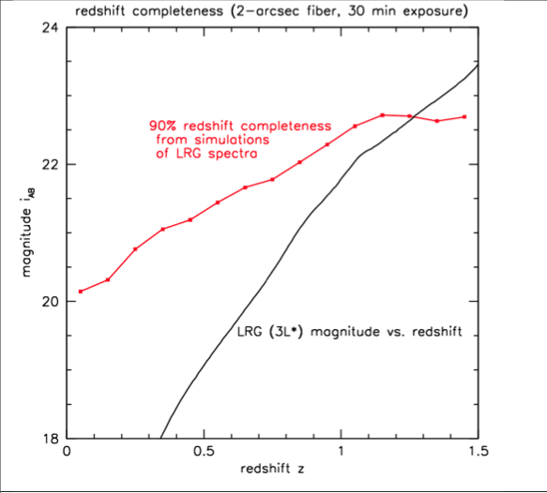
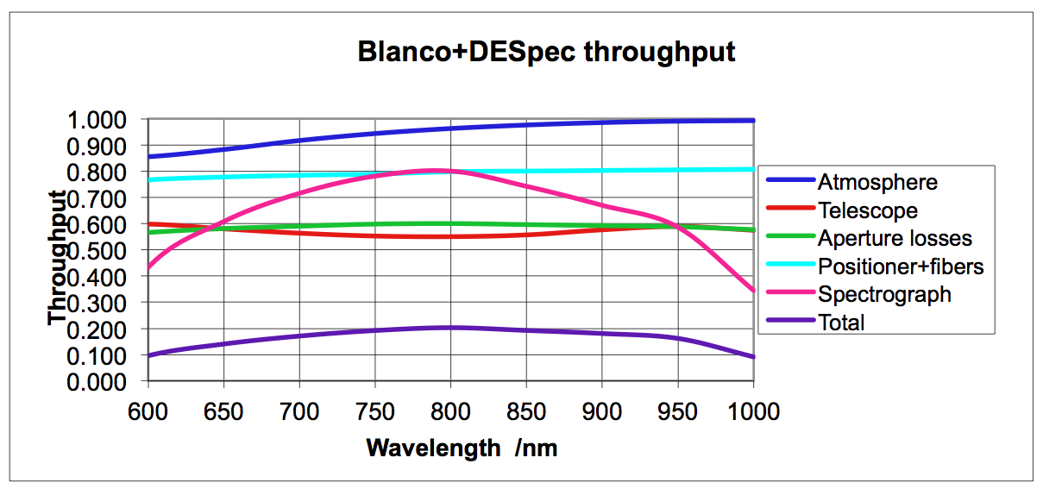
LRG Target Selection
Estimate 90% redshift success for color-selected LRG targets to redshift z=1.3

Slide 25
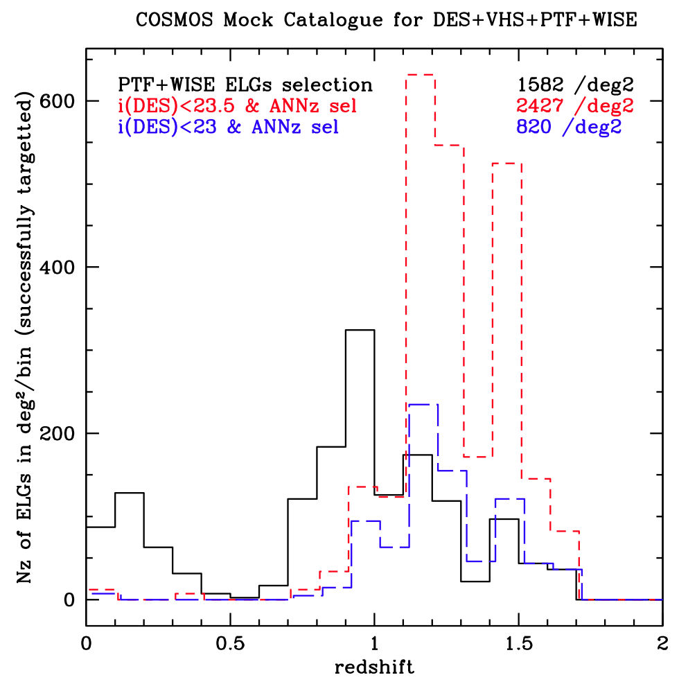
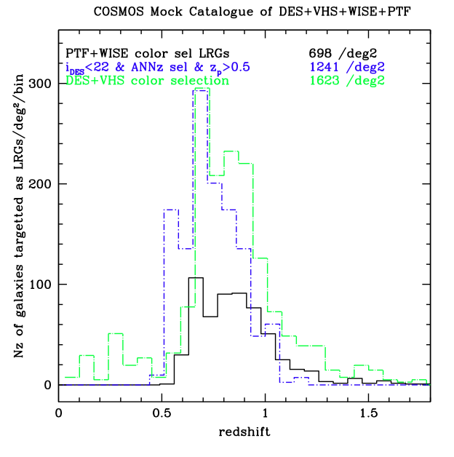
Target Selection Simulations
Deep, homogeneous parent catalogs from DES, VHS, LSST enable efficient selection and sculpting of redshift distributions

Slide 26
DESpec R&D Program
Seed funding from STFC (UK), KICP, Texas A&M, AAO, DOE (generic detector R&D at FNAL)
Fiber positioner design
Refinement & prototyping
Spectrograph/fiber run placement
Engineering studies
Optimize spectrograph design
Construct prototype
Optical design & trade studies
ADC/no ADC, UV reach, coverage vs. resolution
CCD readout electronics & mechanical design
Survey strategy simulation and optimization
Target selection, tiling, trade studies for Dark Energy and Modified Gravity constraints. Building end to end simulation pipeline.

Slide 27
DESpec and BigBOSS
4000-5000-fiber spectrographs on identical 4m telescopes
Different hemispheres, related science goals
Dark Energy reach increases with survey area
Ideally survey both North and South
Similar survey power (area/depth per unit time)
BigBOSS larger FOV, DESpec higher fiber density
DESpec uniquely covers entire survey areas of DES and LSST
Maximize synergistic science (WL+RSD) and uniform selection
DESpec reuses much of the DECam infrastructure
Cost savings and lower technical and schedule risk.
BigBOSS has wider spectral coverage than nominal DESpec
UV coverage for Lyman-alpha forest BAO
Extended UV coverage under study for DESpec: design choice
DESpec design enables continued use of DECam imager

Slide 28
Conclusions
DESpec and BigBOSS have comparable survey power
Two hemispheres better than one
By 40% for BAO
Southern hemisphere has critical advantages:
DES and LSST photometric surveys for DE synergy (WL+RSD, clusters, photo-z cal) and deep, uniform target selection (Cf. SDSS)
Synergy with other southern facilities as well (SPT, SKA, …)
If we can only do 1 hemisphere, it should be the South
DESpec capitalizes on & makes optimal use of existing, installed, tested DECam infrastructure
Reduces cost and technical and schedule risks
Fiber system interchangeable with DECam maintains Blanco imaging capability into the LSST era and provides world-class imaging plus spectroscopy facility for the astronomy community

Slide 29
Extra Slides

Slide 30
Extension to UV
Enable Lyman-alpha BAO measurements using spectra of z>2 QSOs
BOSS appears to have good Lya BAO measurements
Added value for Dark Energy constraints needs to be assessed
Preliminary optical design without ADC delivers ~25 μm spot size at 350-450 nm
satisfactory for 100 μm fibers
Differential refraction in the blue becomes a limitation for observing at zenith distances ZD > 40 deg
SDSS carried out 87% of its spectroscopy at ZD< 40 deg.
Three-arm spectrographs may be necessary to maintain desired spectral resolution over full range 350-1000 nm
Fiber losses more severe in the blue
Explore spectrograph location near the telescope

