Slide 1
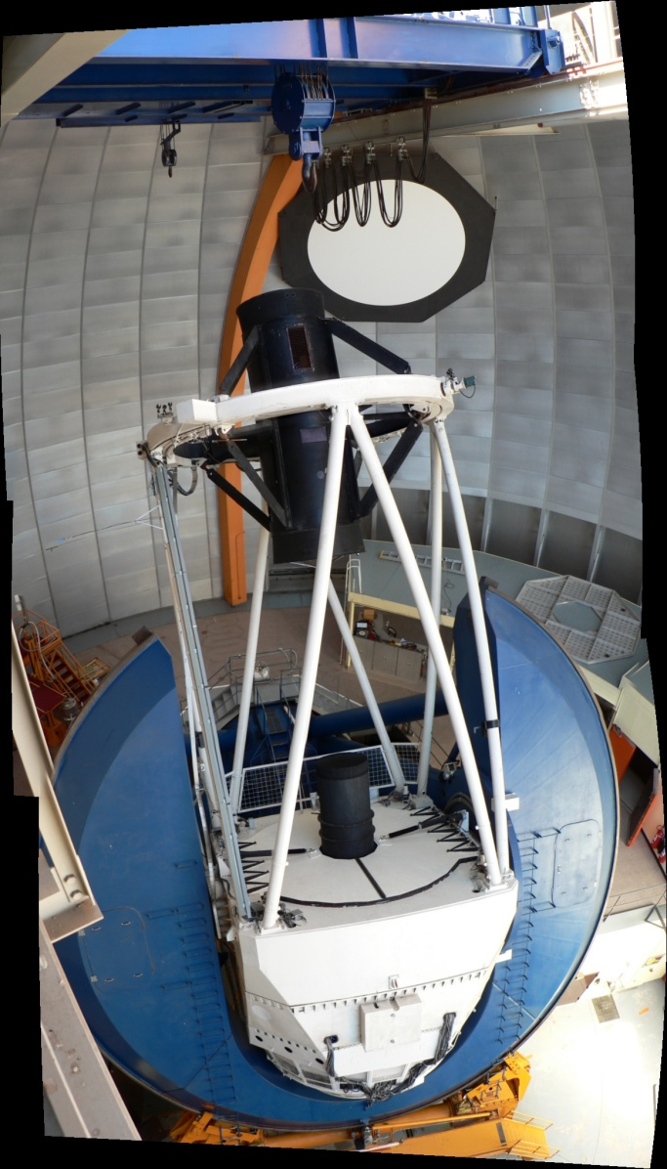
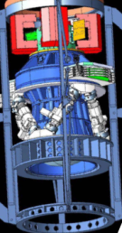
DESpec
Outline
Concept
Technical Components
  Optics
  Fiber Positioner
  Fibers & Spectrographs
  CCD & RO
Science Goals, Survey Requirements, and Technical Requirements
Tom Diehl, DESpec Meeting in London March 2011

Slide 2
Acknowledgements
Darren DePoy, Steve Kent, Brenna Flaugher, Rich Kron, Tim Abbott, Jennifer Marshall, J.-P Rheault
Risa Wechsler, Heidi Wu, Brian Gerke, Will Percival, Lado Samushia, Ofer Lahav, Josh Frieman, Julia Campa, Jiangang Hao
Matthew Colless, Guy Monnet, Rob Sharp, Scott Croom, Karl Glazebrook
Michael Seiffert

Slide 3
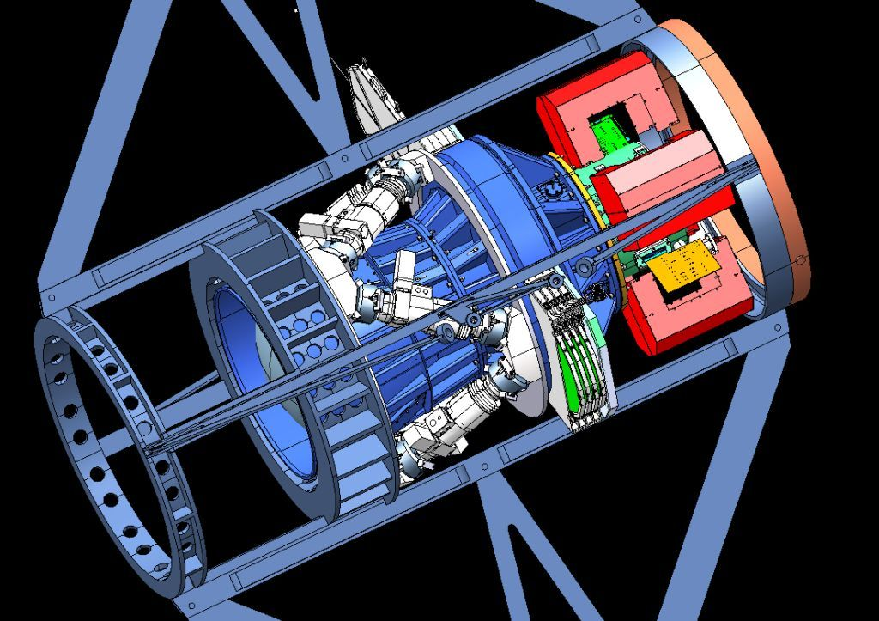
DECam => the Blanco Telescope @ CTIO
Filters
Shutter
CCD
Readout
Cage
Cartoon from
June 2008
5 Optical
Lenses
Hexapod
For alignment & focus

Slide 4
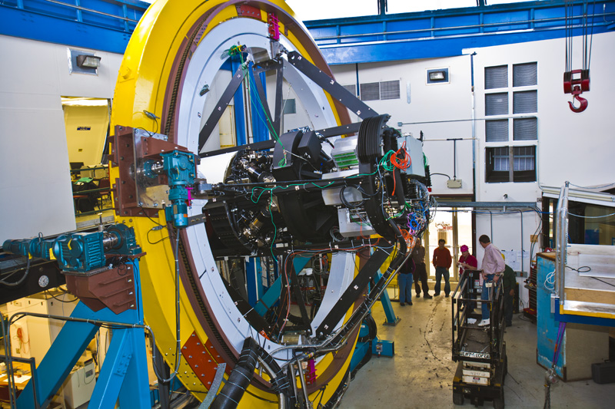
Dark Energy Camera Testing at Fermilab

Slide 5
DESpec Concept
An idea to make a significant impact on the understanding of dark energy
  Build an instrument to perform spectroscopic follow-up of targets identified in DES data, taking advantage of the DECam strengths (red-sensitivity).
  An instrument that could be inter-changeable with DECam in a reasonably short time is desired.
  An instrument that can be built at about the same cost and schedule as DECam (ready by the end of DES) is desired.

Slide 6
Main Technical Challenges
Not particularly ordered by difficulty, risk, WBS, or
amount of R&D …
Optics
Focal Plane and Fiber Positioner
Spectrographs and Fibers
CCDs & Readout

Slide 7
Estimate of Sensitivity
DePoy
Redshift determinations could be made using
  Absorption lines (takes longest) ← assumed this below
  Emission lines for some galaxies (faster)
Throughput & Sensitivity
  DECam gets us 600 photons per second from a mag 20 source in a broadband filter (Δλ/λ~0.2).
  The Δλ/λ for 150 km/s is ~0.0005 (R~2000), so mag 22.5 (20) has 0.075 (0.75) photons/sec in a resolution bin (assuming 50% throughput relative to DECam).
  Taking into account the brightness of the dark sky, and using ~1 arcsec fibers (~60 microns), the S/N is ~0.087 * T**0.5 for mag 22.5 source.
  Requires an hour for S/N of 5 for mag 22.5 (faint) galaxy.

Slide 8
# Fibers vs. # Nights
There are roughly 50M mag < 22.5 galaxies in 5000 sq-deg and there are ~2.5x that per magnitude.
It is possible to arrange ~4000 fiber positioners on the DECam focal plane using an 0.7 cm pitch.
For example: 1000 nights, 8 setups per night, and F=0.7 yields ~22M 1-hr spectra. 4-5 esposures per “tile”.
Or: 2630 exposures over 110 nights and eff’t of 75% for E.L.G. => 5.5M targets
Intelligent algorithms, which maximize the number of observed objects, result in a higher yield.

Slide 9
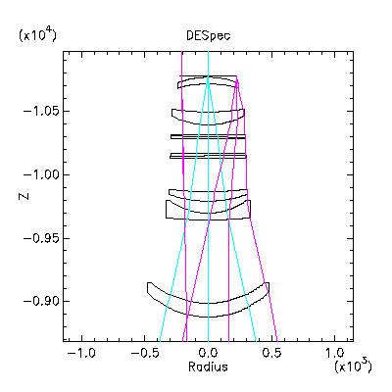
DESpec Optics
This work was done by Steve Kent
Reuse the DECam optics (focal ratio f/2.9)
The DECam Dewar needs its window (C5) as the cover, providing opportunity to use a new optical window for DESpec. Move it a little closer to the nominal FP because of ADC.
The DESpec optics require an atmospheric dispersion corrector to remove the prismatic effect of the atmosphere. There is space (236 mm) in the F-C.S. slot for this plus the shutter.
FP FoV has Radius = 225.54 mm

Slide 10
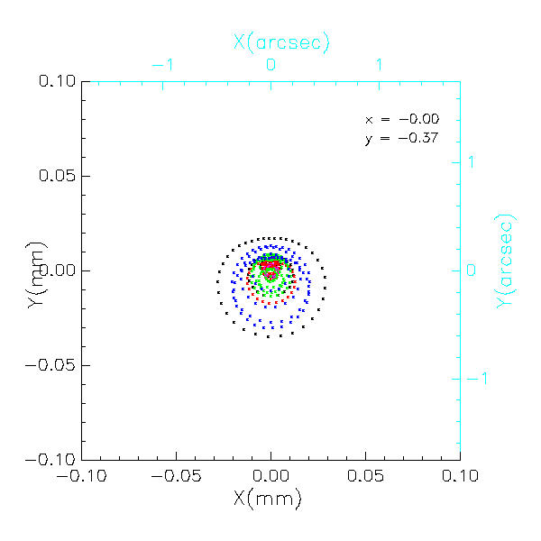
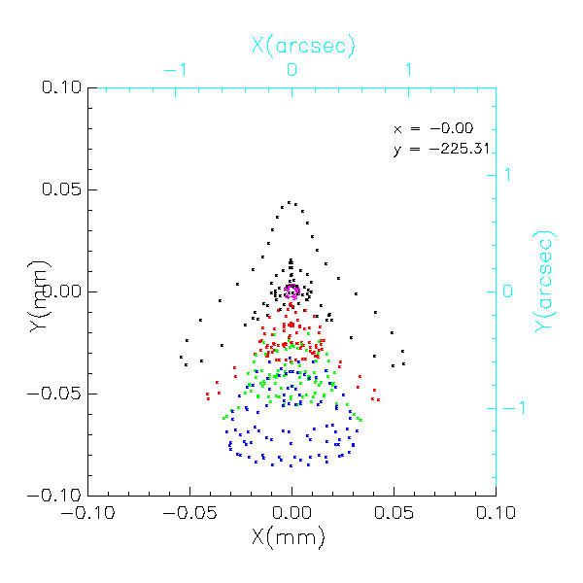
Spot Size
S.Kent Aug. 2010
Good spot size for 550 < λ < 1080 nm
  The achromatic DECam optical design won’t allow both the blue side and the red side into a spectrum.
At zenith angle = 55 deg (though it’s independent of ZA)
  The ADC works
  The best focus (FWHM) is at the center and is 0.4”.
  The worst is at the edge, where the FWHM is 0.9” (~50 microns). SK calls this “lateral chromatic”.

Slide 11
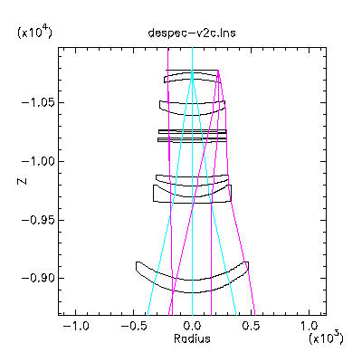
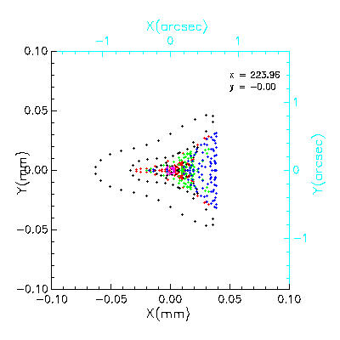
Spot Size [2] ADC Variant
S.Kent Nov. 2010
Improved performance by putting some slight curvature into the first and last surfaces of the ADCs.
  Still maintains good focus (FWHM) at the center and is 0.4”.
  The worst is still at the edge, where the FWHM is 0.63” (~34 microns).

Slide 12
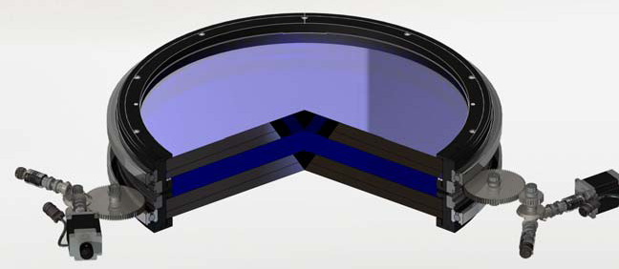
Atmospheric Dispersion Compensator
Example
The WYIN ADC has diameter 635 mm. The prisms are rotated using a pair of encoded stepper motors.
Two prisms each made from two wedge-shaped pieces of different glass materials.
Issues include optical alignment and position (movement) tolerance and backlash
Cementing the pieces together must be done “nicely”.

Slide 13
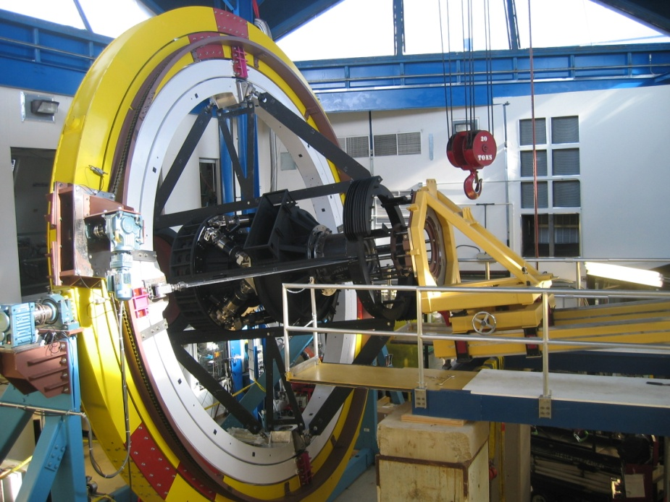
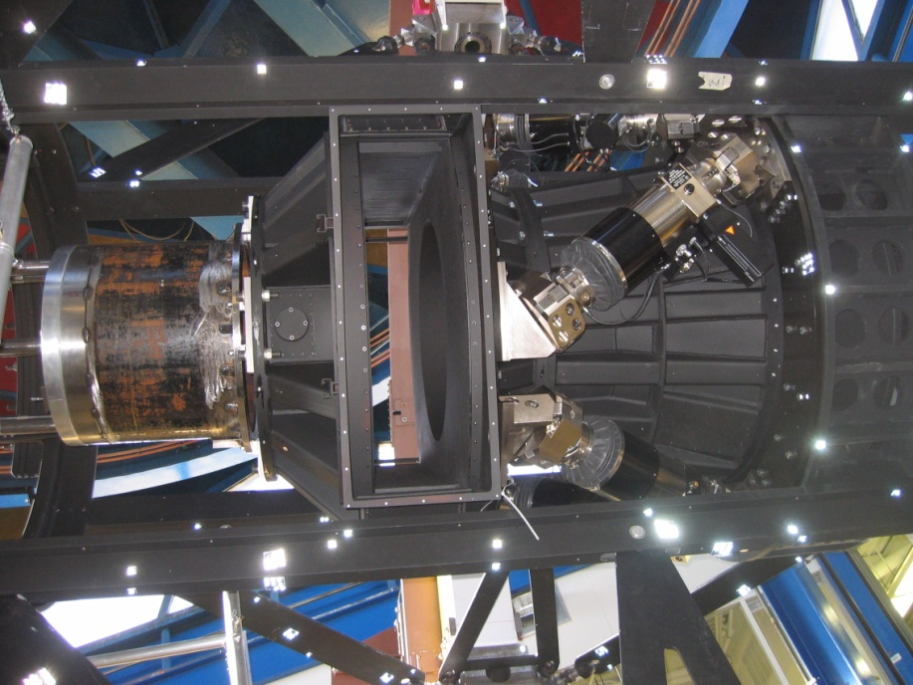
Filter-Changer/Shutter Slot
The slot is 900 mm tall and 236 mm wide. See DECam drawing 436803.
The shutter is 55 mm wide, not including the bolt heads.

Slide 14
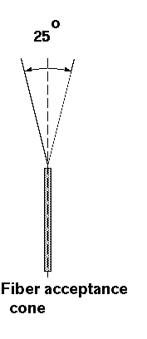
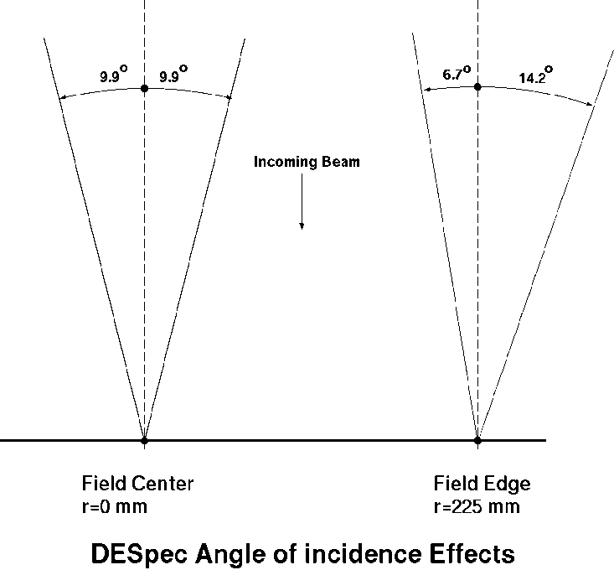
Almost Telecentric
Small deviation from normal incidence at outer radius
The focal plane is almost but not quite telecentric (3.8 deg tilt at the edge, 0 deg at center)
At nominal F/2.9 the convergence angle of the light is 19.7 deg center (20.9 deg @ edge).
Typical fibers can accept light in 25 deg cone
To get optimal performance one could tilt the fibers out as they go out in radius (SDSS) otherwise some light loss.
Steve Kent. Oct. 2010

Slide 15
Fiber Positioners
Typical Specifications
  Premium on small (7 mm) spacing between actuators (pitch)
  ± 0.14” (± 1/2 pixel on DECam) position accuracy corresponds to ±7.5 um.
  60” target separation is ~3.2 mm spacing between fiber tips
  Fast reconfiguration time: 5 minutes or less
  Targeting efficiency!
  Maximum throughput, highly reliable …
There are plenty of well-developed concepts and operating examples: twirling posts (WFMOS & Lamost), Spines (Echidna), Pick & Place fibers (AAΩ), Plug Plates (SDSS)
And some novel devices in R&D: StarBugs

Slide 16
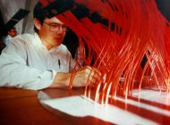
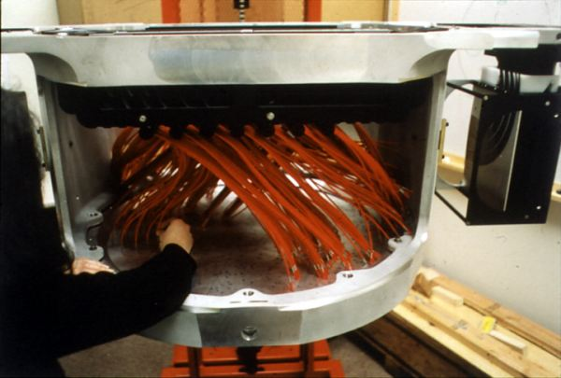
Plug Plate
Plates are prepared in advance by drilling holes in the imaged locations of targets
A person plugs fibers from a harness into the plate and an illumination trick is used to determine which fiber is in which hole
A plate is useful only for one configuration

Slide 17
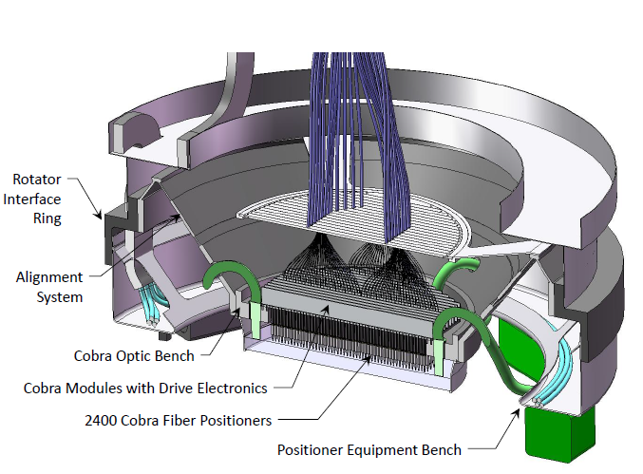

Example “Twirling Post”
WFMOS “Cobra”
Here, a FP with 2400 “Cobras”, a “twirling post” with a rotating fiber. Two axes of rotation
M. Seiffert (JPL) presentation at P.U. 11/09
Fiber
Patrol Radius

Slide 18
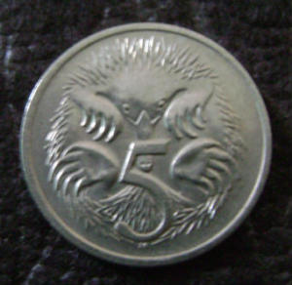
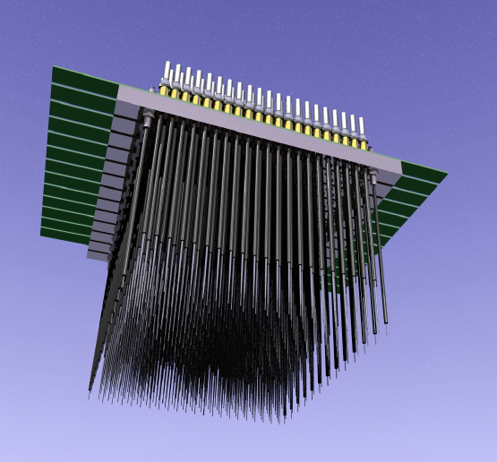

Example “Spines”
FMOS Echidna on the Subaru
Echidna: an Australian marsupial with flexible spines
Also an operating fiber-positioner from AAT with ~400 fibers.
Spines pivot from mounts near the bases
Naturally handles a varying target density because the tips are small
<~10 minute configuration time
Also was a wfmos proto

Slide 19
Echidna Spine
7 mm pitch is available
Adjustable length about 16 cm
Patrol radius ~ 7 mm
Positioning accuracy < 10 microns is already achieved
Improved configuration time.
<5 minute configuration time set mainly by the amount of time it takes to scan a camera over the face of the array and measure position of fiber tips
Picture from
Graham Murray (Durham)

Slide 20
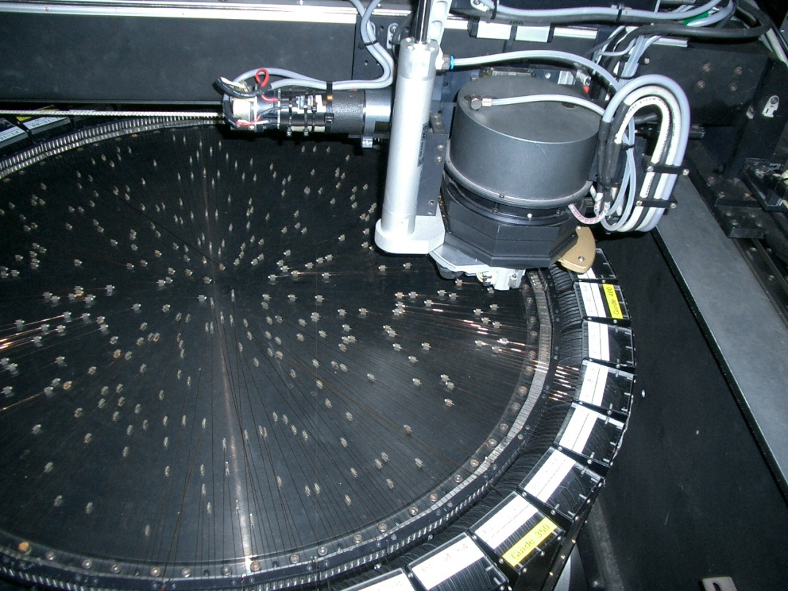
Example Pick & Place Robot
AAΩ is a 492-fiber spectograph at Prime Focus of AAT
A robot picks up each fiber and places on the FP.
Looks like there is a 45 deg mirror on the end of each fiber.
Takes a long time to configure a plate.
They use two plates, observe on one, configure the next

Slide 21
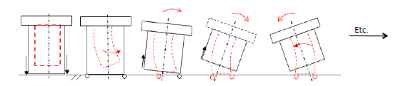
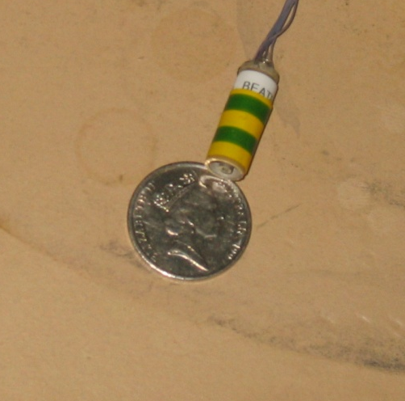
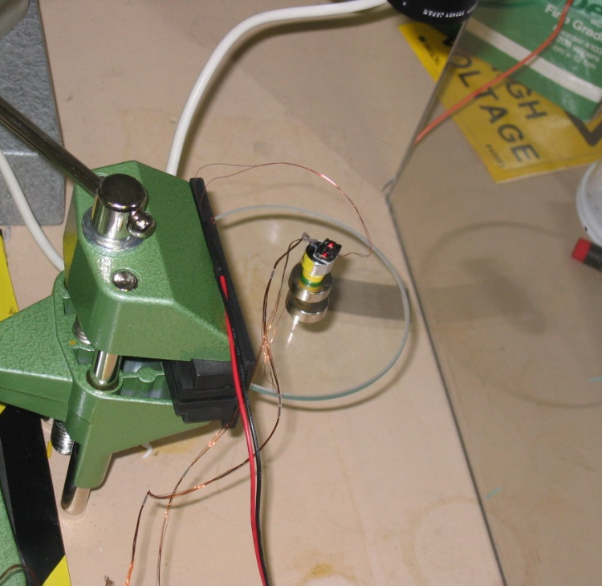
Example StarBugs
Magnetic buttons secure a “walking” robot that carries a fiber on the FP.
  Lift & step motion, footprint < 10 mm. Can even vary payloads.
  Fast configuration. All fibers can move at the same time w/ speed ~1 mm/s.
  Relatively cheap. Can work on a curved FP (not one of our problems)
  Probably limited to 1000 to 1500 on our FP at this time with sep. > 180”

Slide 22
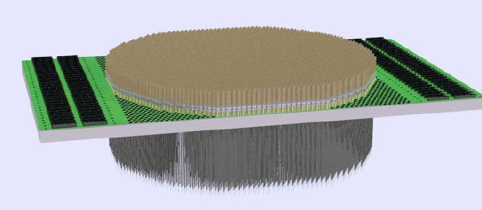
Some Comparisons
Plug Plates are more costly but less technical risk
Pick and Place Robots cannot be scaled up past about 500 fibers in a cramped focal plane due to fiber crossover and space problems
Starbugs needs R&D to make them smaller. Present size allows 1000 to 1500 on the Focal Plane (FP).
Twirling Posts need R&D to make them smaller. Present size allows 1000 to 1500 fibers on the FP. I believe the R&D is ongoing.
Echidna-like spines will allow ~4000 fibers on the FP
R&D would better quantify light-loss at the edge of the FP, fiber density, and controls software to minimize configuration time.

Slide 23
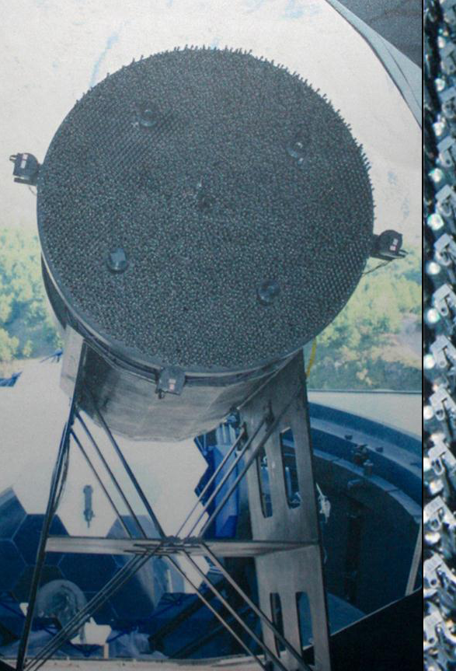
More Fiber Positioner Components
Fiber Positioner Support Plate or module
Control Electronics
Guide and Focus CCDs and algorithm
Camera to measure the present fiber position during configuration - backlight the fibers and a backup system (Roger S.)
These should not be ignored as we move to better specify the design
LAMOST

Slide 24
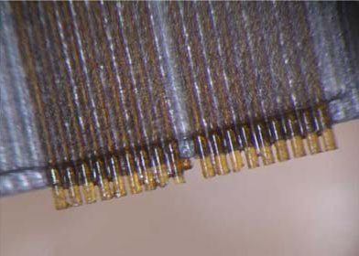
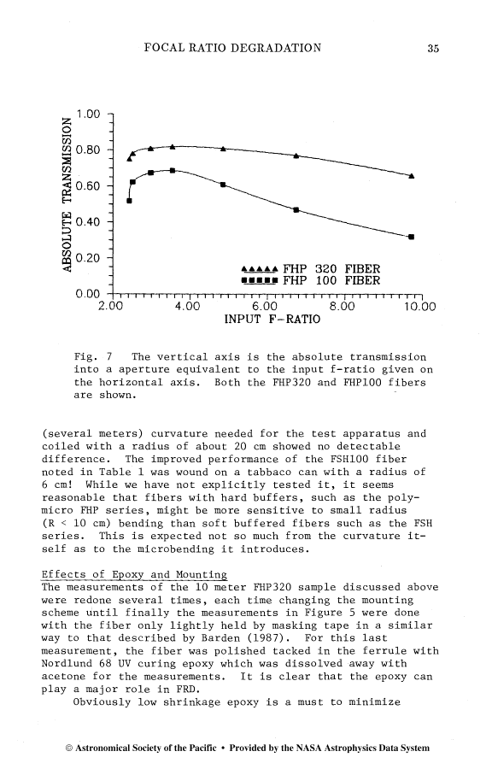
Spectrographs & Fibers
F/3 is ideal for injecting light into low-cost high-efficiency fibers (see Fig below-right) & will present minimal FRD (Murphy et al., SPIE 2008)
An inexpensive F/3 example is the 1-arm VIRUS, being mass-produced by Texas A&M for HET or the MUSE for VLT.
Each spectrograph will handle ~200 fibers. Need about 20 spect’s.
R&D needed for trades & tests with prototypes
Ideas: more resolution, 1-arm vs 2-arm spectrographs, 2 different resolutions, separate fibers for green & red bands, … need science definition
Ramsey (1988)

Slide 25
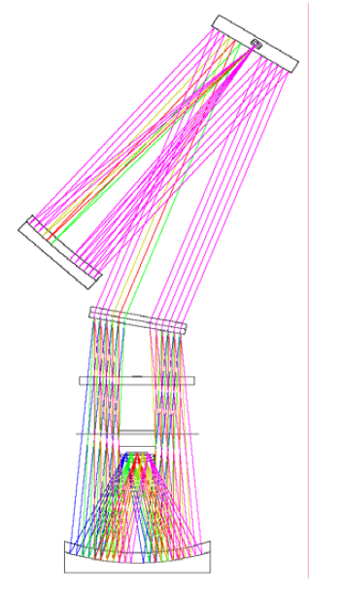
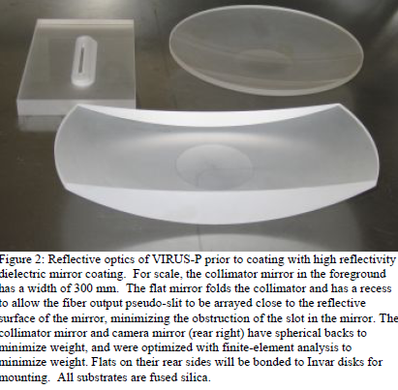
Example: VIRUS Spectrograph
Jennifer Marshall will talk about these in more detail
Compact, inexpensive, high throughput optics.
Holographic disperser (VPH)
R~1000
Hill et al. (2006)
VIRUS Optics. Linear array of
Fibers is out of page.

Slide 26
CCDs & R.O.
The red-sensitivity of the imaging survey suggests we use DECam-like CCD’s
Arrange the spectrum along the long axis of the 2kx4k device, R~2000.
The number of systems (~20) depends on # fibers per spectrograph.
LBNL CCD has high red response
CCD & Read Out electronics seem straightforward. The DECam CCD & R.O. would work well for this.
  At 100kpix/s we could have 2 to 2.5 electrons RO noise
We are doing R&D to take that to < 1 e- but not needed here?

Slide 27
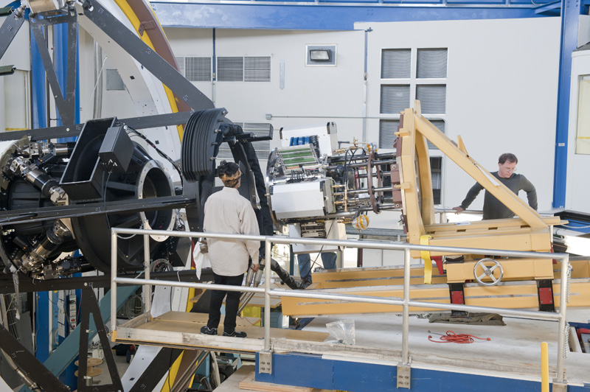
Interchangeable w/ DECam
To install DESPec 1st stow DECam off-telescope
  We are providing hardware to install/remove DECam as part of that project (see right)
Then pick up DESpec, and using similar hardware, install it on the end of the barrel.
In reverse, either store DESpec on the telescope or produce a convenient way to connect/disconnect the fibers.
We bring this into the design ab initio so that the process can be done quickly and easily.

Slide 28
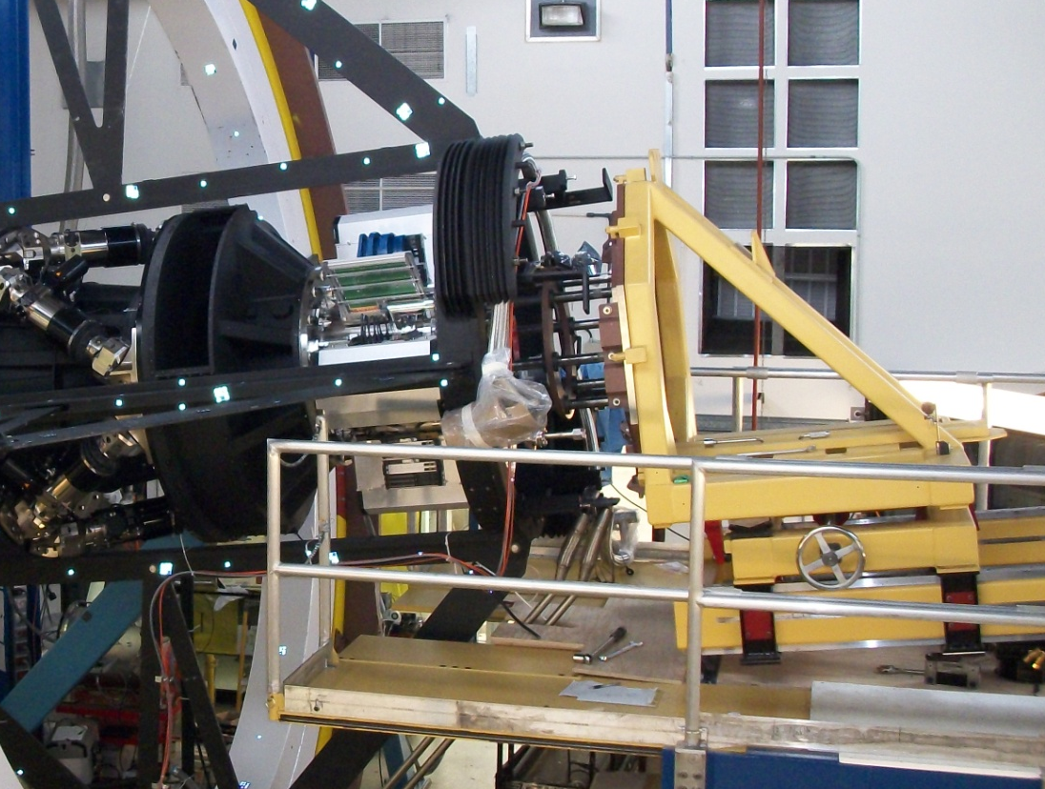
Imager Removal

Slide 29
Connection Between Design Concepts and Requirements
It has been useful to us to maintain basic feasibility and demonstrate it through examples.
We haven’t made any technical choices, though we have some assumptions that we are holding (loosely) as constraints.
In early development of the idea we want to explore the scope of technical possibilities and to provide feedback to the development of the science case.
We will have to document how the technical requirements are based on the survey and science requirements
and describe how technical risk effects the probability of meeting the science goals.

Slide 30
Survey Reference Design
Survey Requirements
Mag <22.5 w/ S/N > 5 (R~2000) in 60 minutes or less
Wavelength Range
  550<λ<1080
Fiber Positioner
  22M targets
Spectrographs (lower R to higher R) Need to specify
  150 km/sec resolution => masses for some LRGs
  S/N for weak emission lines
  Separate OH lines for good sky-subtraction
  O2 emission line separation
Technical Requirements
Optics
  DECam Corrector (3.8 sq-deg) with freedom at C5
  Requires an A.D.C.
Fiber Positioner
  4000 fibers
  <~5 minutes/configuration
  7 micron pointing accuracy
  Various components
  Weight limit?
Spectrographs
  1-arm, Red-sensitive CCD
  200 fibers per CCD
  R~2000
CCD & RO

Slide 31
Summary
Technical Challenges but No Show Stoppers!
  DES Optics limit the wavelength to ~550 to 1080 nm. We need an ADC.
  A fiber positioner is a very complex machine. Multiple options include “twirling posts”, flexible spines (like small marsupials), and little walking R2D2’s. There are trade-offs.
  Spectrograph, CCD, and Readout seem straightforward.
I’ve mentioned three kinds of requirements here: science requirements, survey requirements, and technical requirements. Possibly also constraints.

Slide 32
Trades

Slide 33
Table
 |  | Source
Field of View | 3 sq-deg | Constraint
550<λ<1050 |  | Partially constrained
Resolution
ADC
Dlam/lam=.5*(4000)*15microns*/(2F*1.5/um)=
1080-550=530 nm range with 815 in middle
~1000 resolution elements
Dl/l = .53/530

Slide 34
FRD & Throughput vs. F Ratio
Tested focal ratio degradation and throughput vs input focal ratio and output focal ratio for various diameter fibers.
Bigger fibers => more throughput.
Concludes F/3 to F/4 is ideal.
F/3
F. Ramsey, “Focal ratio degradation in optical fibers of astronomical interest” ,
Proceedings of the Conference Fiber Optics in Astronomy, 1988.

Slide 35
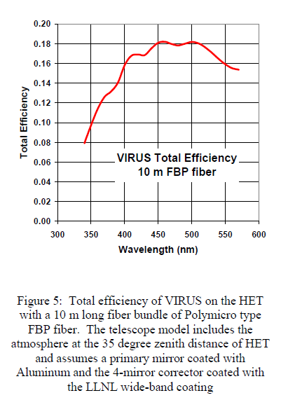
Spectrograph Throughput
Hill et al. (2004)
18% Includes everything, the whole system, including the sky
  ε(fiber)=0.68 to 0.88
  ε(atmosphere and telescope) = 0.3 to 0.5
  ε(CCD&Spectrograph) = 0.25 to 0.40
Start with T = 0.18. Dividing out the atmosphere factor and using an LBL CCD takes our throughput to >50% relative to DECam.

Slide 36
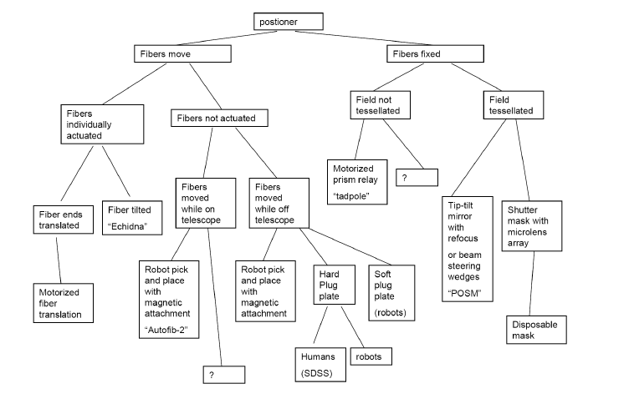
Fiber Alternative Decision Tree
M. Seiffert (JPL) presentation at P.U. 11/09

Slide 37
References
A. E. Evrard et al., Astrophys.J.672:122-137,2008.
M. White, J.D. Cohn, and R. Smit, to be published in MNRAS (2010). Arxiv/1005.3022.
R. E. Angulo et al., MNRAS 383, 755 (2008)
L. Ramsey, Proceedings of the Conference Fiber Optics in Astronomy, Tucson, AZ Apr. 11-14,1988.
J.D. Murphy et al., Proc. SPIE Vol. 7018, 70182T (2008).
J.G. Hill et al., Proc. SPIE Vol. 5492, 251 (2004).
J.G. Hill et al., Proc. SPIE Vol. 6269, 93 (2006).

