Slide 1
Spectroscopic Reference Design Options
D. L. DePoy
Texas A&M University

Slide 2
Notional DESpec unit spectrograph specs
550-1000nm coverage using DES 2Kx4K CCD
Roughly 4 pixels per resolution element (R~1760 at 775nm; 0.11 nm/pixel dispersion)
~4000 individually targetable fibres

Slide 3
No metal has been cut (the cuts are not even designed!)
Could use 2 pixels per resolution element
Resolution ~4000 rather than ~2000
Could “assign” some fibers to fixed geometry bundle
For clusters or other “closely packed” targets
Could use “fiber bundle” IFUs instead of single fibers
Rotation curves of galaxies or higher throughput

Slide 4
Higher resolution
Need longer focal length camera
Or finer grating
Better image quality from camera
“line spread function” <30 microns
However, typical galaxy velocity dispersions are ~150 km/sec
Could split beam into blue and red “arms”
Cost would rise for spectrographs

Slide 5
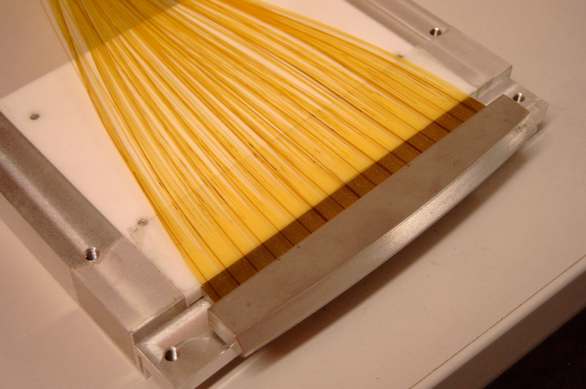
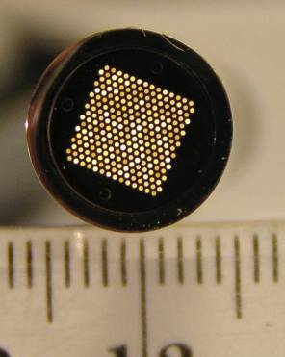
Fiber bundles
Could allocate some fibers to IFU
IFU input
IFU output
Kelz et al., 2006, SPIE 6273-121;
Murphy et al., 2008, SPIE 7018-104; Soukup et al., 2010, SPIE 7735-180

Slide 6
Fixed fiber bundles
Closely packed targets may require many exposures
Currently roughly 1 fiber per 2 arcminute diameter patch on the sky
If target density is higher, will require multiple exposures
Galaxy clusters may have 10-100 objects per arcminute

Slide 7
Fixed fiber bundles
Could allocate fixed pattern to central field
~3 exposures for 100% coverage of area
~1600 fibers for 1 sq. arcminute
Assumes 1.5 arcsec fiber
~8 additional spectrographs
Limit would be to carpet entire focal plane in fixed configuration
~17 million fibers
70,000 spectrographs
Project cost would be high

Slide 8
Hybrid approach
Use small “IFUs” instead of single input fibers
Each positioner has a bundle of N fibers
N*size = field-of-view of each IFU
e.g. ~15 arcsec field, 1.5 arcsec fibers
~50% fill factor
Roughly 50 fibers per IFU
Rotation curves for every galaxy larger than ~few arcsec
Need ~50 times as many spectrographs
~750 spectrographs
Already building 200 for HETDEX
Other combinations possible of course

Slide 9
Summary
Many options still open
Need to allow science goals to drive instrument choices
Should coordinate science ideas with changes in instrument design

