Slide 1
Status of the Fermilab Cosmic Program
Josh Frieman
Fermilab PAC Meeting
Jan. 16, 2020

Slide 2
Goals of the Cosmic Science Program
What is the nature of dark matter?
  Direct detection expts, indirect, colliders, astrophysical (surveys)
Why is the expansion of the Universe accelerating?
  Dark energy surveys
What are the properties of neutrinos?
  CMB, surveys
Was there a primordial epoch of inflation and, if so, what physical mechanism drove it?
  CMB, future surveys
What are the most effective cosmic probes to address these questions?
  Detector R&D
How do we bring the community and data together to best implement & combine these probes?
  Cosmic Physics Center

Slide 3

Fermilab Cosmic Strategic Plan (FY19 PEMP Notable satisfied)
Grow
Cosmic Microwave Background (inflation, neutrinos)
  SPT 3G lead operations → CMB Stage 4 major roles
Dark Matter Detection
  Axions: lead lab ADMX, develop Quantum sensors for next-gen expt
  Sub-GeV DM:
    SuperCDMS construction, operations; R&D at NEXUS
    Skipper-CCD R&D and deployment; scale-up to 10kg
  Discontinued LZ effort, project deliverables completed
  Concept & motivation for accelerator-based experiments & engineering/coordination support for DarkSide/LAr
Cosmic Surveys (dark energy, dark matter, neutrinos)
  DES → LSST operations (small but critical role in DESI ops)
  R&D toward next-gen spectroscopic survey (LDRD)
Astro Theory program w/ growing focus on cosmic neutrinos
Cosmic Physics Center to provide connectivity and serve users
Cosmic activities flow from P5 drivers and from our core capabilities and synergize with other lab activities (Quantum, Neutrino, Energy...)
Consolidate
Transition

Slide 4
Cosmic Frontier at FNAL
Dark Energy
Dark Matter
CMB
Dark Energy | Fermilab roles | Fermilab Capabilities
DES | Project (DECAM) management, operations management, calibration, science, collaboration leadership, computing, data management | Detector test, assembly & integration at SiDet; survey design & ops, data mgmt.; project mgmt
DESI | Detectors, corrector support, science, online Database, fiber to target translation | Detector test, assembly at SiDet; survey design & ops
LSST | Dark Energy Science framework, survey operations & strategy, data management | Survey ops and computing infrastructure
aa
Dark Matter | Fermilab roles
SuperCDMS | cryogenics, electronics, operations, calibration, data analysis/science, project management | Precision assembly, cryogenic engineering, underground test facility (NEXUS), project mgmt
LZ | TPC engineering, process control, science | Cryogenic and process control engineering
ADMX | RF cavity development, operations management, science | RF engineering test & assembly, quantum sensors, high-field magnets, ops mgmt
Skipper CCD | dark matter search (SENSEI), R&D for applications to dark matter/neutrino expt’s & large scale surveys | Expertise in skipper CCD’s, detector packaging at SiDet, underground test facility
CMB | Fermilab roles
SPT 3G | Camera design, cryostat fabrication, detector packaging, testing, integration | Detector testing, assembly, integration at SiDet, operations mgmt., detector electronics, project mgmt
CMB S4 | R&D, cryostat design, electronics, module assembly/testing, cost/schedule development
4
Notes:
Add SENSEI

Slide 5
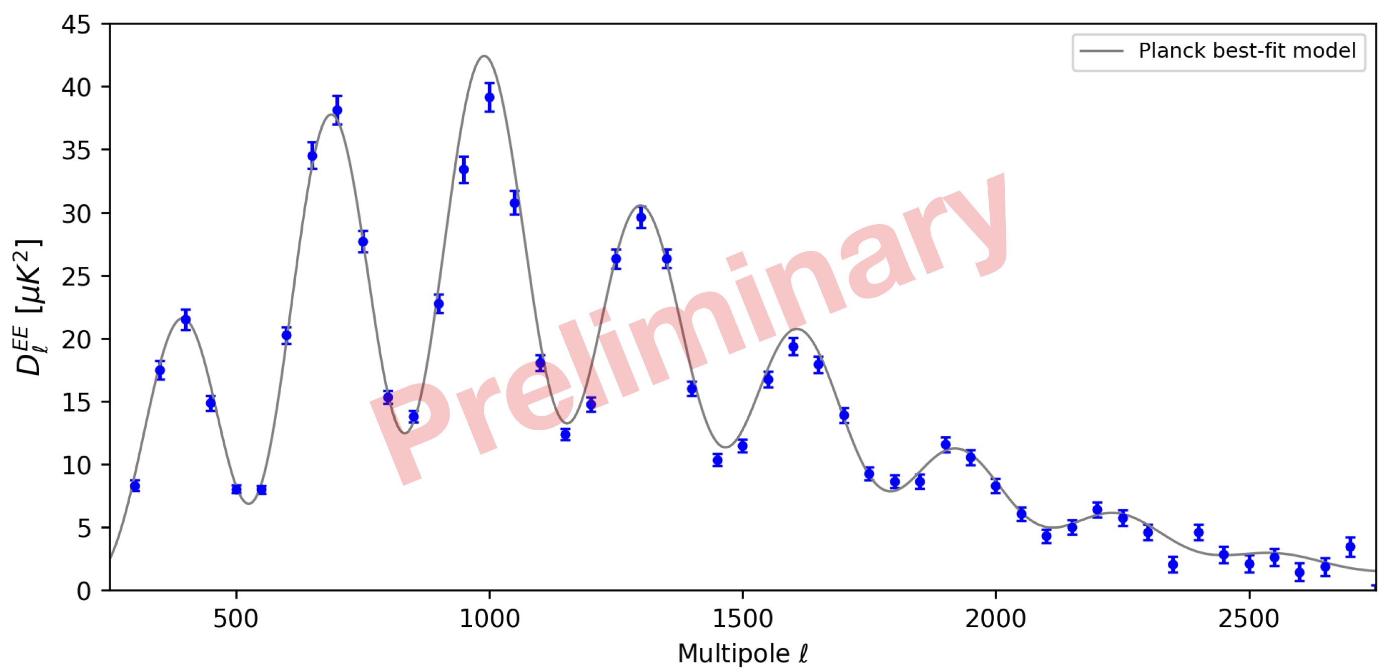
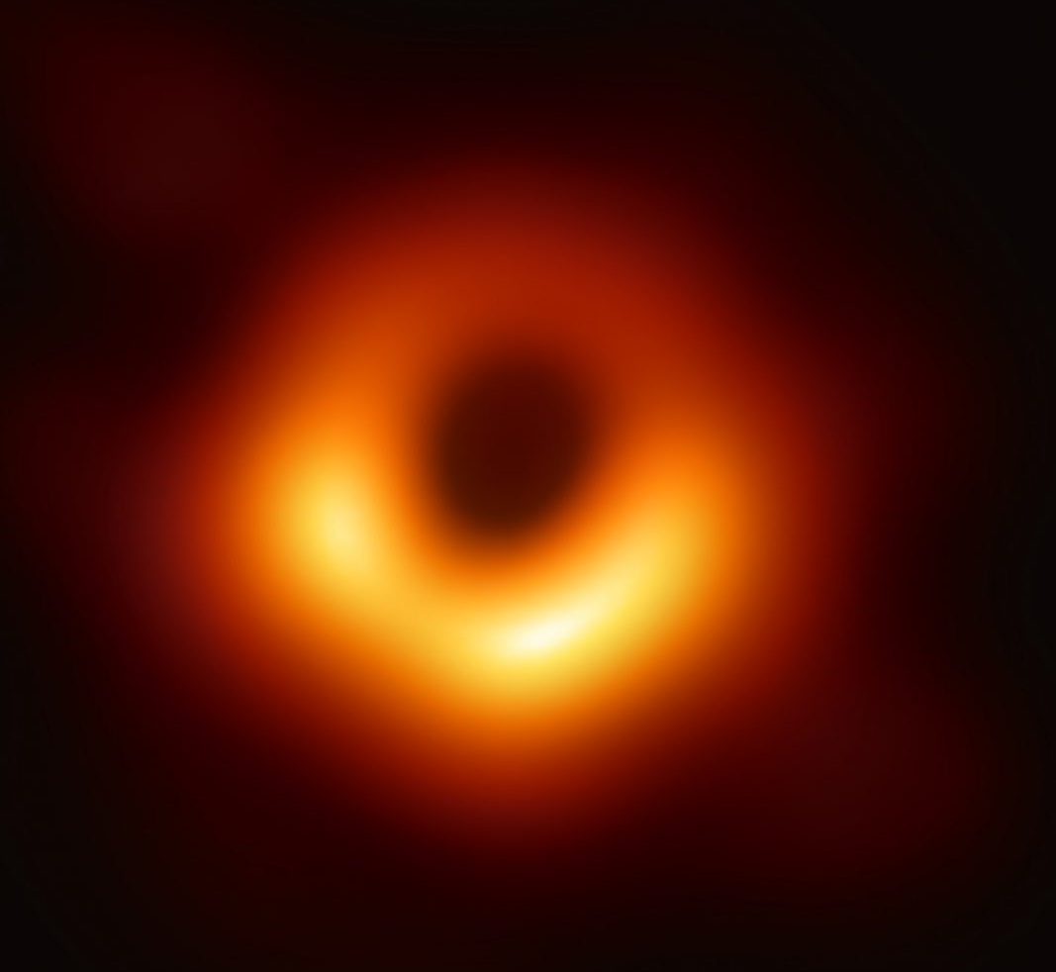
CMB: Recent Accomplishments
  SPT-3G completed first year of operations at full sensitivity.
  SPT-3G will continue to observe until 2023, with Fermilab leading operations.
  SPT part of Event Horizon Telescope BH imaging
  Multiple results from SPTxDES
Congratulations to Sasha Rahlin and Brad Benson on 2020 Breakthrough Prize !
Preliminary analysis of 6 mos. of SPT-3G data; already the most sensitive measurement of E mode power spectrum for 1000 < l < 1700
Black Hole imaged by EHT
5
1/16/20
Notes:
PICO -> PNL, DAMIC-> Uchicago (no darkside)

Slide 6
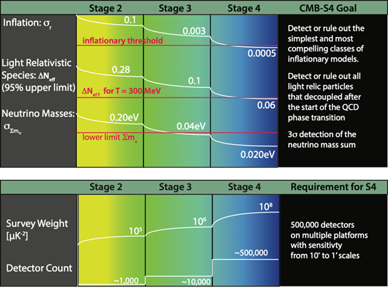
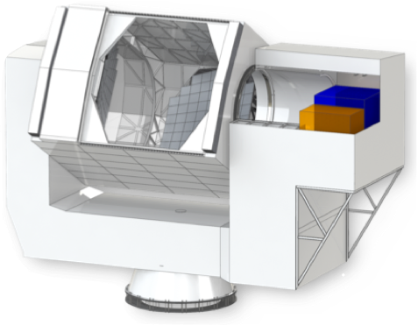
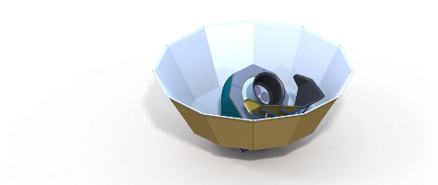
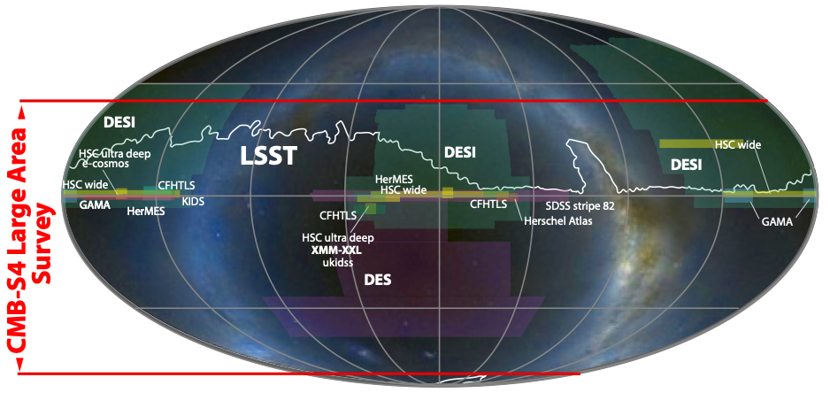
CMB-Stage 4 Experiment
Deep, wide Neff and Legacy Survey (Atacama): 2 x 6m telescopes targeting ~60% of sky with 240,000 detectors over 6 bands.
Ultra-deep “r” survey (South Pole) : 18 x 0.55m small refractor telescopes targeting ≥ 3% of sky with 150,000 detectors over 8 bands and a dedicated de-lensing 6m telescope with 120,000 detectors.
7-year survey
6m large telescopes,
e.g., like Simons Obs.
18 x 0.55m small
telescopes (3 per cryostat),
e.g., like BICEP Array
Could change to
9 Pole, 9 Chile if r prev. detected
1/16/20
e.g., BICEP Array

Slide 7
CMB-S4 Status
Endorsed by P5 and many committees
Plan is roughly equal DOE and NSF scope, TPC 600M$ including 30% contingency
Received CD-0 July 25, 2019!
Working toward CD-1 in summer 2021, CD-2 ~’22, CD-3 ~’23, early ops start ~’26
Science Case and Project Plan submitted to Astro 2020 Decadal Survey July 2019
  Precursor to MREFC, Presentation to Committee requested Feb. 4, 2020.
Lead Lab Process
  Letter with Charge and instructions sent to SLAC, LBL and ANL in Dec. 2019
    Instructions: Lead/Host Lab must have plan to engage resources at all the labs
    10 page proposal and presentations to be posted by Jan. 31.
    Team visits to Germantown Feb. 14 and 18.
    Decision in early March
Fermilab, UChicago and ANL comprise the “ANL CMB Consortium”
  ANL very committed to making CMB-S4 a success, will be “lab-wide” (not in ANL HEP)
  John Carlstrom, Jim Kerby, Brenna Flaugher are the core leadership team
  Red Team Review Jan. 21
1/16/20
Cosmic Frontier Update

Slide 8
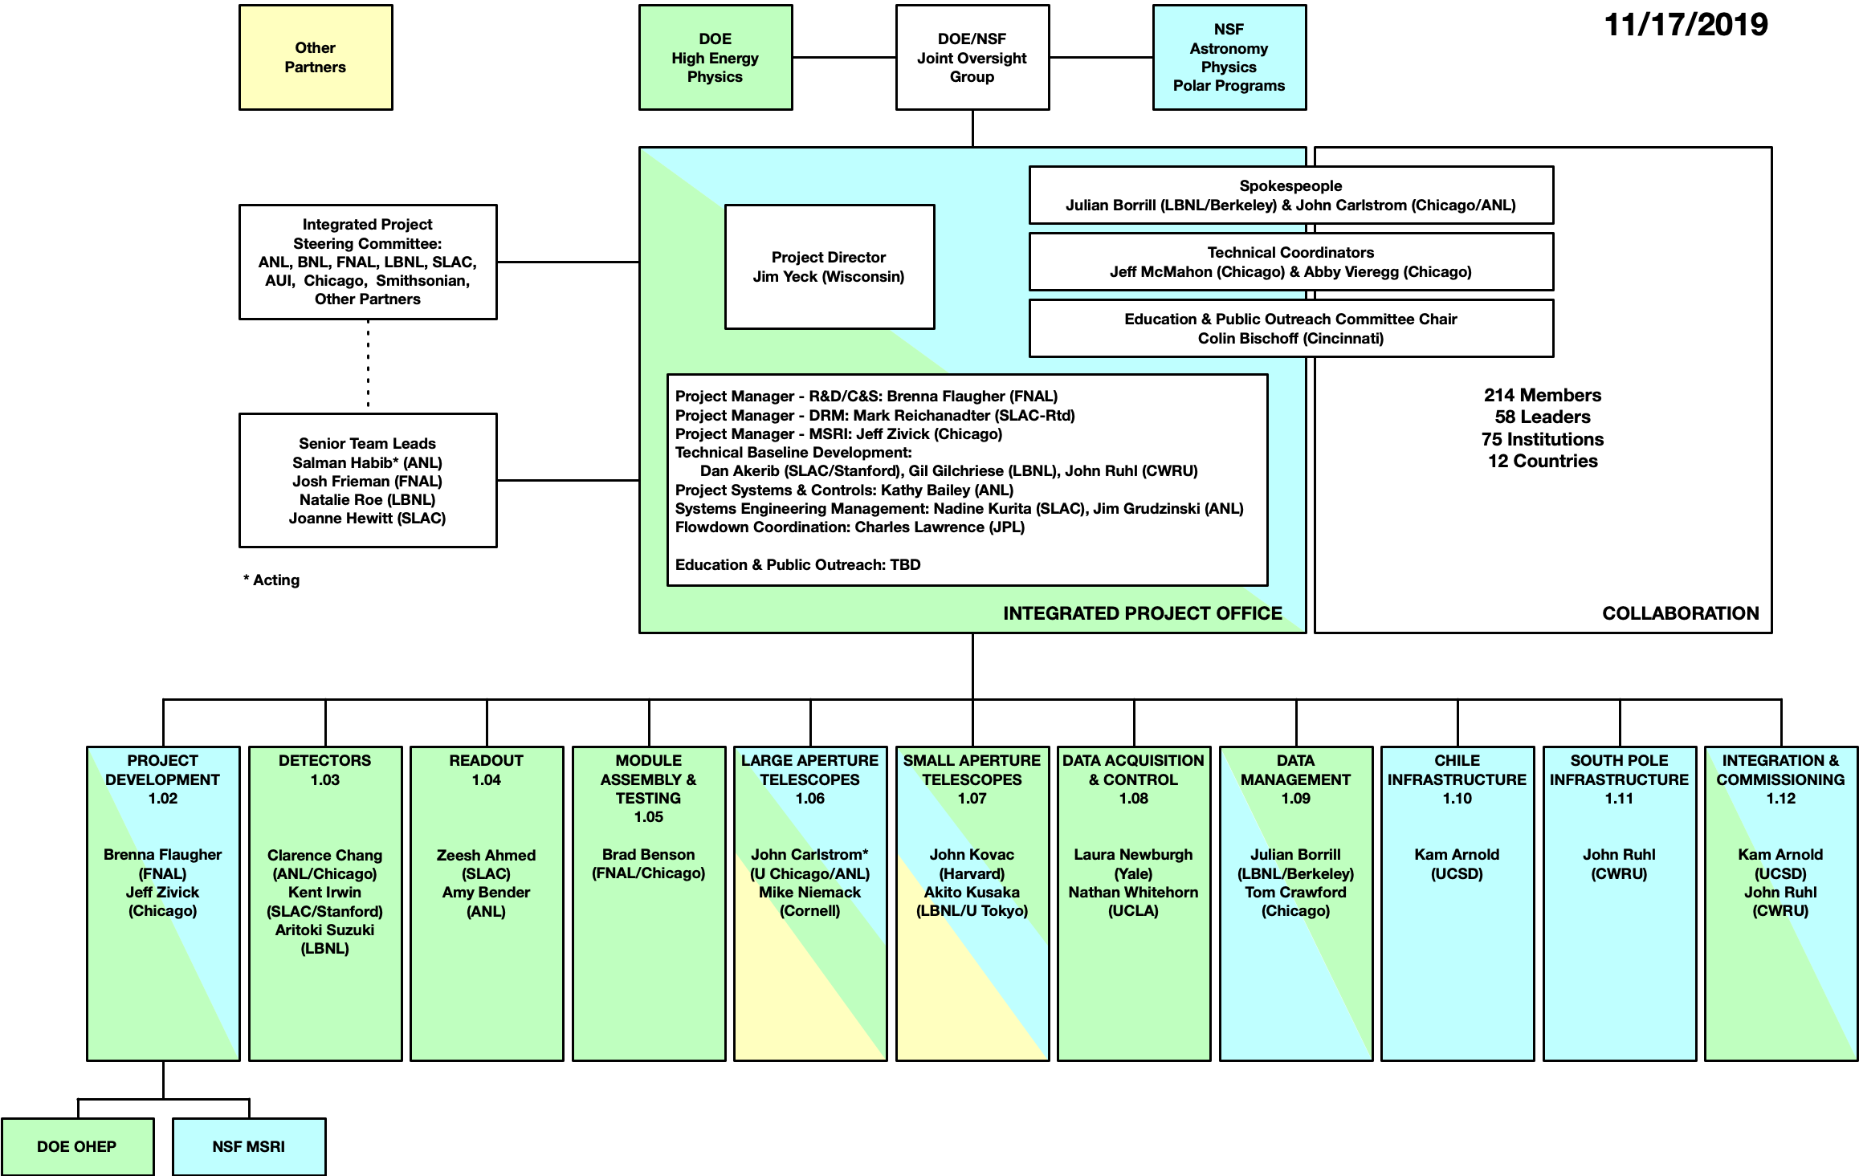
CMB-S4 Project Organization
Jim Yeck has been serving as Director for past ~ 3 years, will transition out after LL decision
Integrated Project office to jointly manage NSF and DOE Scope
Steering Committee of Lab Directors
L2 managers assigned Summer 2019, engage technical experts from across the community
Fermilab scope: Module Assembly and Testing, Brad Benson L2 manager
  Recent hire – Oct. 2019: Wilson Fellow Adam Anderson
  Schramm postdoc Fellow Kirit Karkare coming in Fall 2020
Josh Frieman – FNAL Senior Team Lead
Brenna Flaugher – R&D and Cost/Schedule manager, member of CMB-S4 Governing board and Speakers board
1/16/20
Cosmic Frontier Update

Slide 9
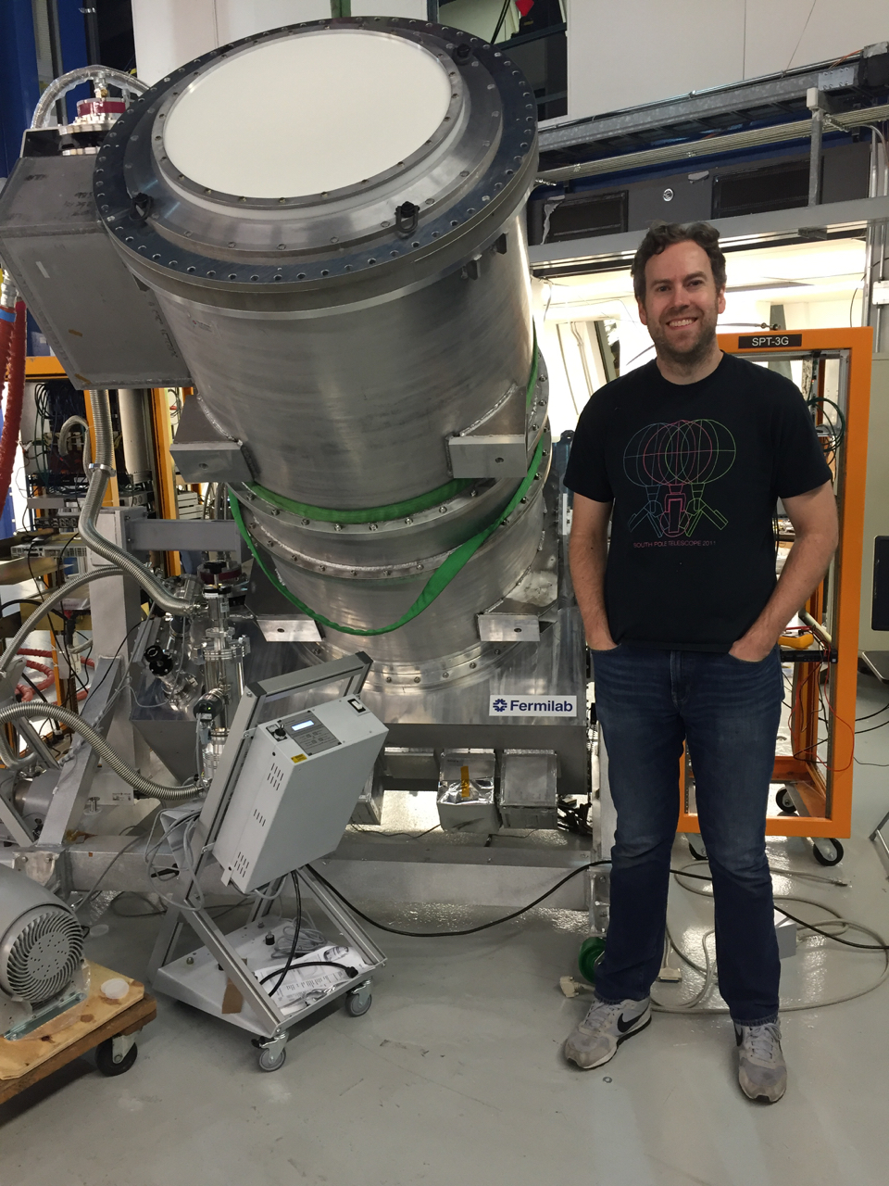
FNAL roles in CMB-S4 capitalize on our strengths
Core Capabilities & Experience
  Leadership of SPT–3G detector testing, integration, cryostat design, operations
  Project management expertise and infrastructure
  Cryogenic Engineering
  Technical facilities:
    SiDet – wirebonding, precision assembly, integration and testing
    IERC cryogenic lab will house multiple dilution fridges for CMB S4
Strong/growing connections with U Chicago and ANL
  History of close collaboration on SPT-3G and CMB-S4
  Combined expertise in project leadership, science, engineering and operations well matched to needs of CMB-S4; working closely to move it forward
  Joint FNAL/UC positions will provide cost-effective growth to lead this program
Strong working relationships with other labs and universities:
  Complementary strengths, e.g., detector fab at other labs will feed FNAL testing.
1/16/20
Cosmic Frontier Update

Slide 10
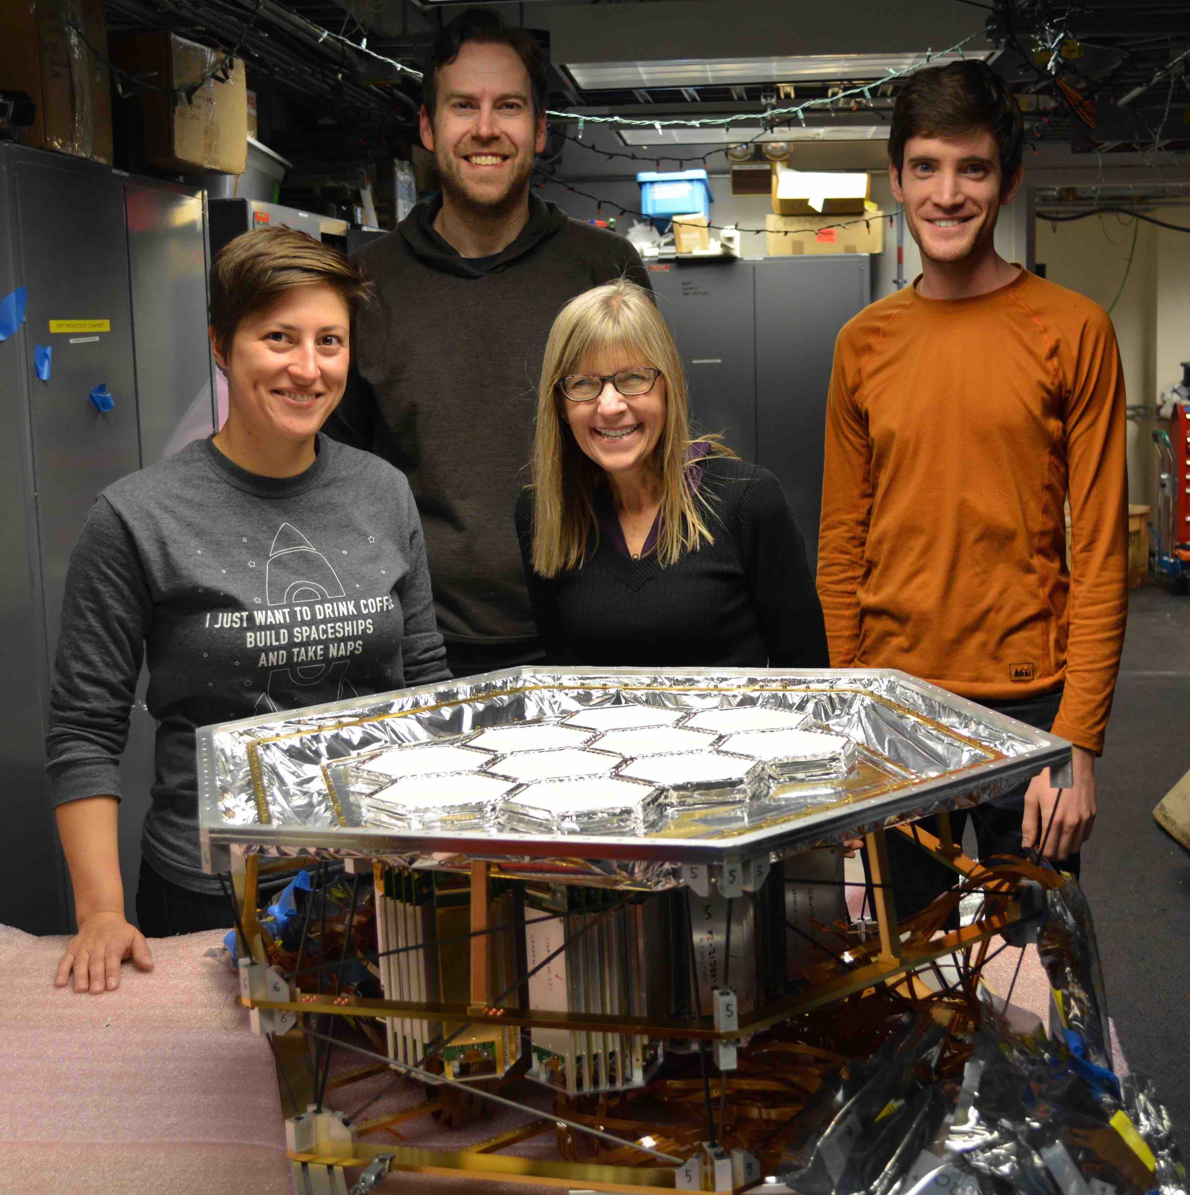
Potential FNAL Roles in CMB-S4 Project are being realized
Project management:
  Experience managing large HEP projects, coordinating multi-lab, multi-university efforts.
Detector module packaging:
  Experience from CDF, D0, CMS, DES, DESI, SPT-3G.
Detector testing and characterization:
  Experience from DES, SPT-3G, DESI. Leverage sub-Kelvin test-beds built for SPT-3G detector & readout development; cryo facilities in IERC; synergy with Quantum (similar technology and infrastructure).
Cryostat Integration:
  Experience with DES, SuperCDMS, SPT-3G. IERC will include lab for integration of largest CMB-S4 cryostats.
Deployment, Integration and Commissioning:
  Builds on expertise developed during project, and experience with SPT-3G, DES and DESI.
FNAL team on SPT-3G: Brad Benson, Sasha Rahlin, Donna Kubik, new Wilson Fellow Adam Anderson
1/16/20
Cosmic Frontier Update

Slide 11
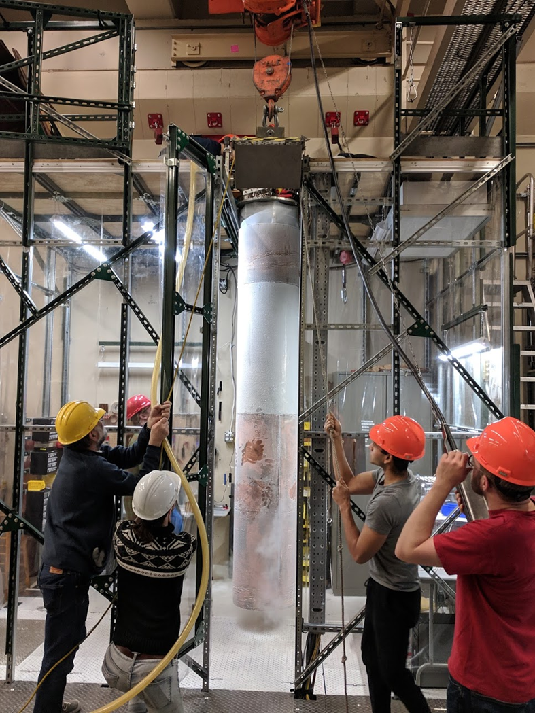
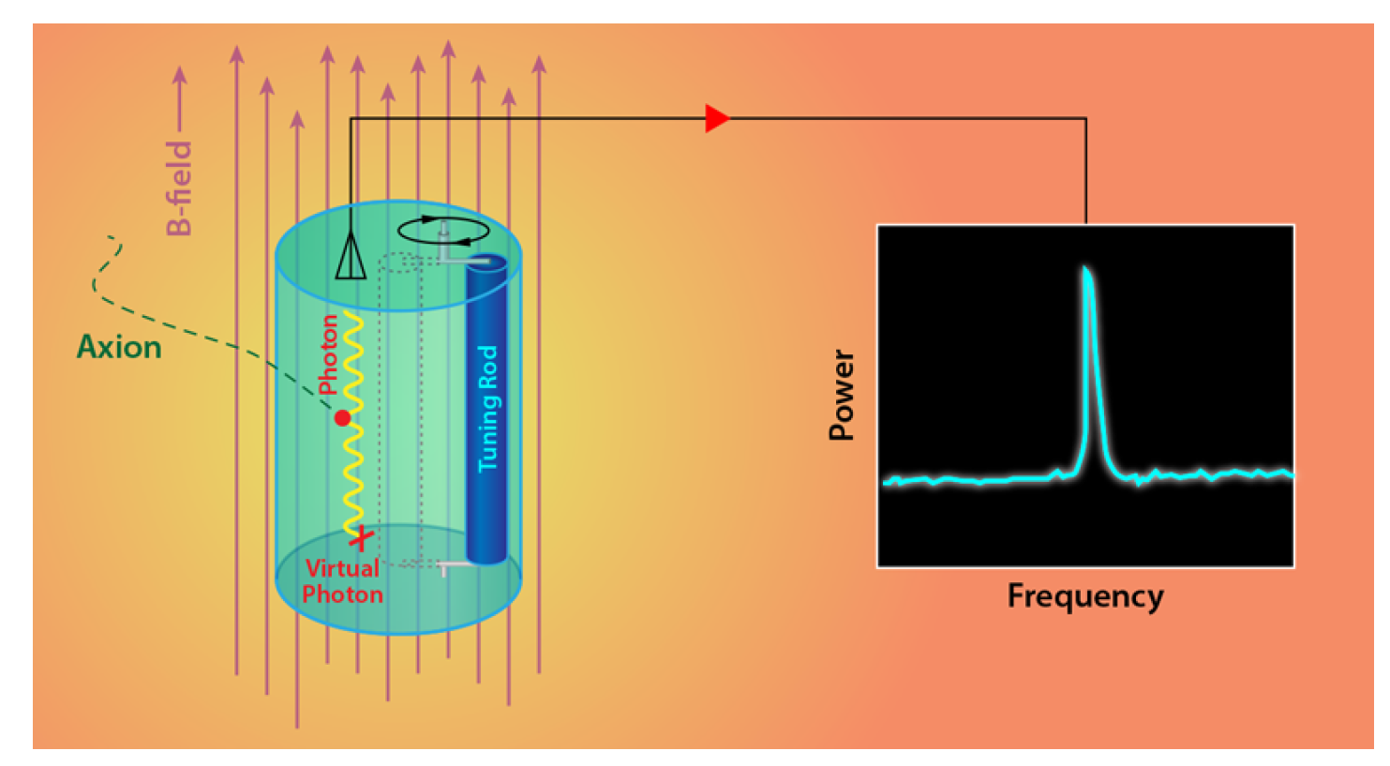
ADMX Search for Axion Dark Matter Particles
Most sensitive search for axion particles comprising galactic dark matter halo.
Use superconducting quantum sensors to search for a 10⁻²³ Watt peak in power at frequency corresponding to axion mass.
Experiment installed at U. Washington in 2013-2016. Will run through FY22.
Fermilab is lead lab.
Latest DOE operations review Oct. 3-4, 2019.
ADMX detector being pulled from magnet at end of 2018-2019 run.
1/16/20

Slide 12
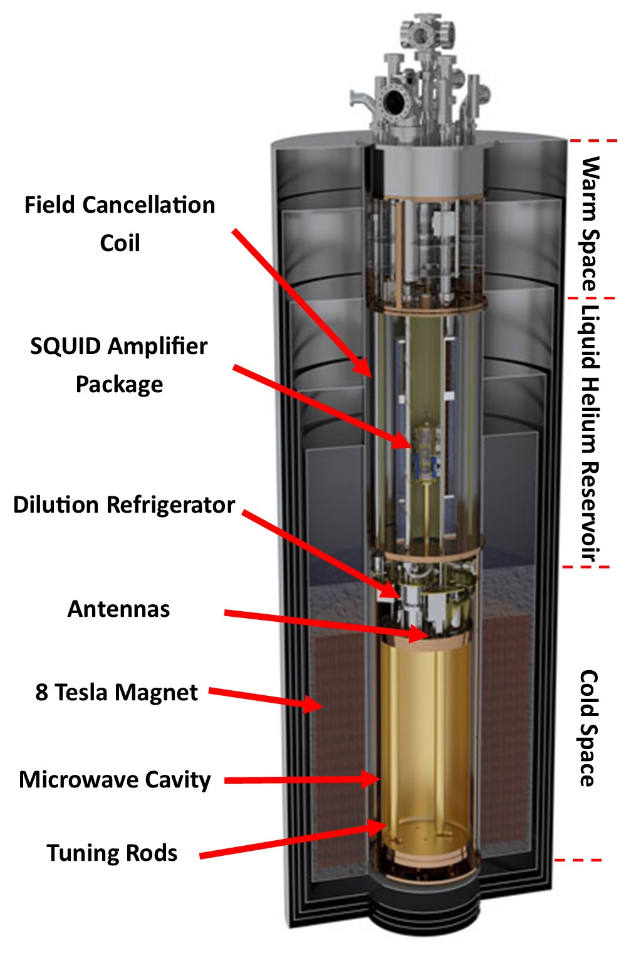
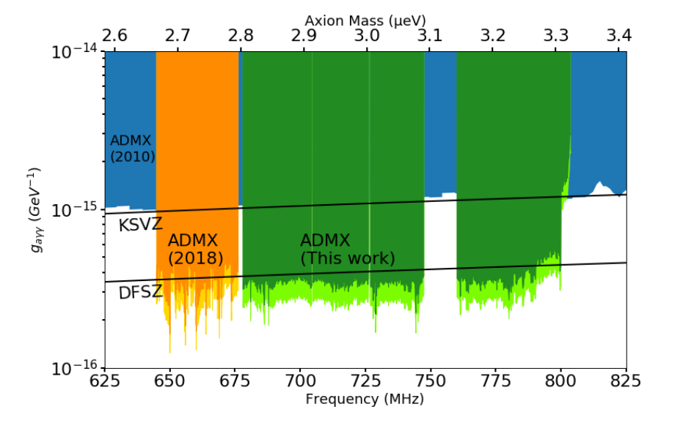
ADMX Search For Dark Matter Axions
Axions from dark matter halo convert into photons in presence of a magnetic field.
Photons detected with low noise superconducting amplifiers.
First expt. to reach sensitivity to DFSZ model.
New 2019 result extends sensitivity to higher mass (3.3 μeV). arXiv:1910.08638
1/16/20

Slide 13
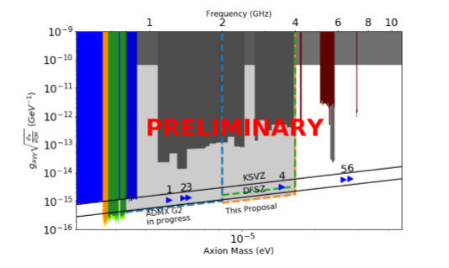
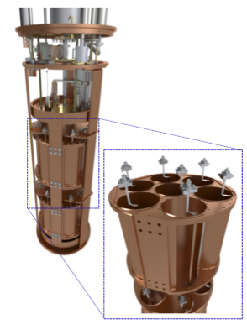
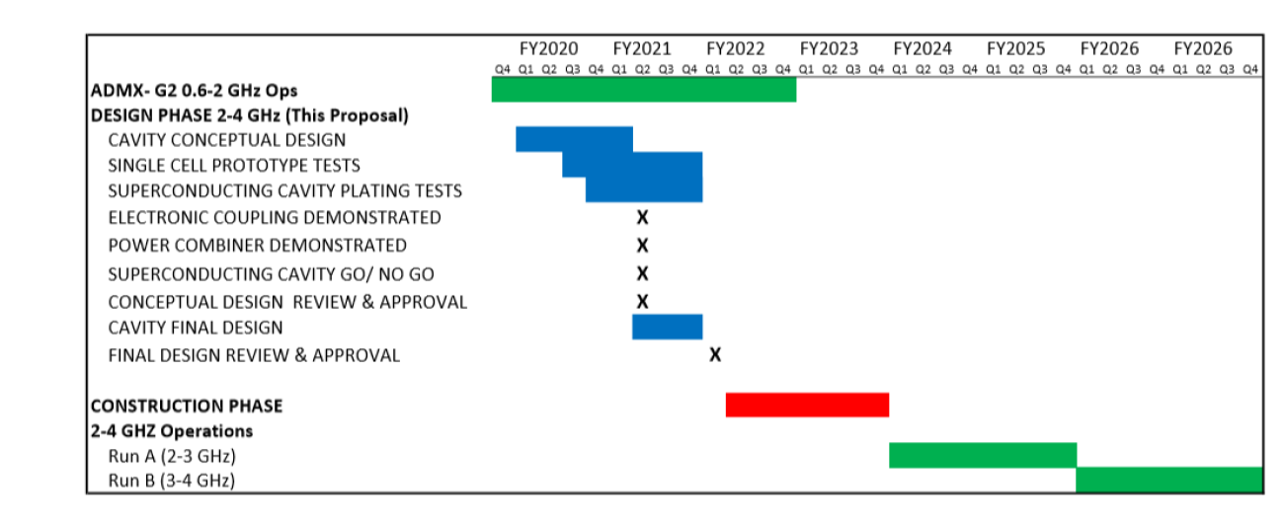
Designing Next Phase of ADMX
ADMX Dark Matter New Initiatives proposal funded in Fall 2019.
Provides $1.9M for design of next phase of ADMX (A. Sonnenschein, PI)
Design 14-cavity array for 2-4 GHz (9-17 μeV) axion search.
Test superconducting coatings and squeezed state receiver.
Study possible magnet upgrades.

Slide 14
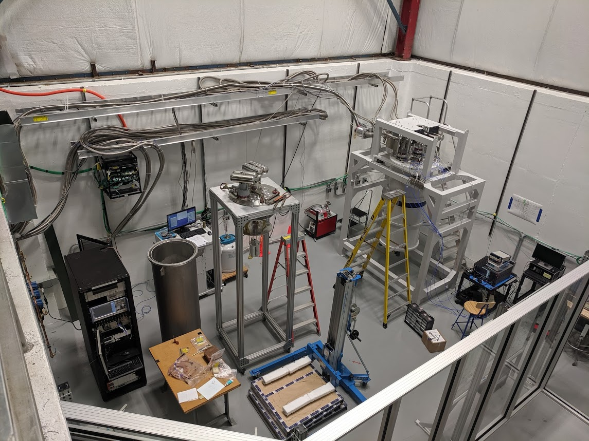
Axion Detector Lab at Fermilab:
ADMX Cavity Testing and System Integration Tests

Slide 15
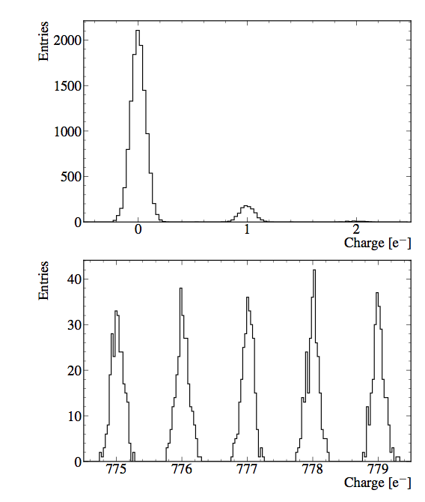
Sub-GeV Dark Matter Search with CCDs
Phys. Rev. Lett. 119, 131802 (2017)
Tiffenberg et al.
FNAL is the pioneer in the use of CCDs in direct dark matter searches since 2012 (DAMIC) at MINOS.
FNAL and LBNL collaborated in the development and demonstration of the skipper-CCD as a tool for low mass dark matter searches (2017).
SENSEI project (w/ partial funding from Heising-Simons Foundation) is deploying 100g experiment at SNOLAB this year; world-leading results published in 2019.
Oscura: DOE selected this technology for a Dark Matter New Initiatives 4-year, $4M grant to design a 10 kg, ~$10M experiment (J. Estrada, PI).
counting single
electrons
large dynamic range
1/16/20

Slide 16
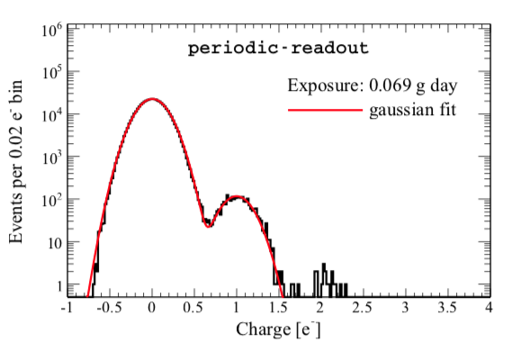
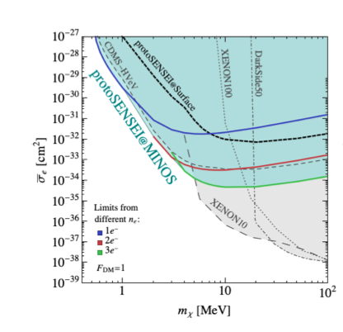
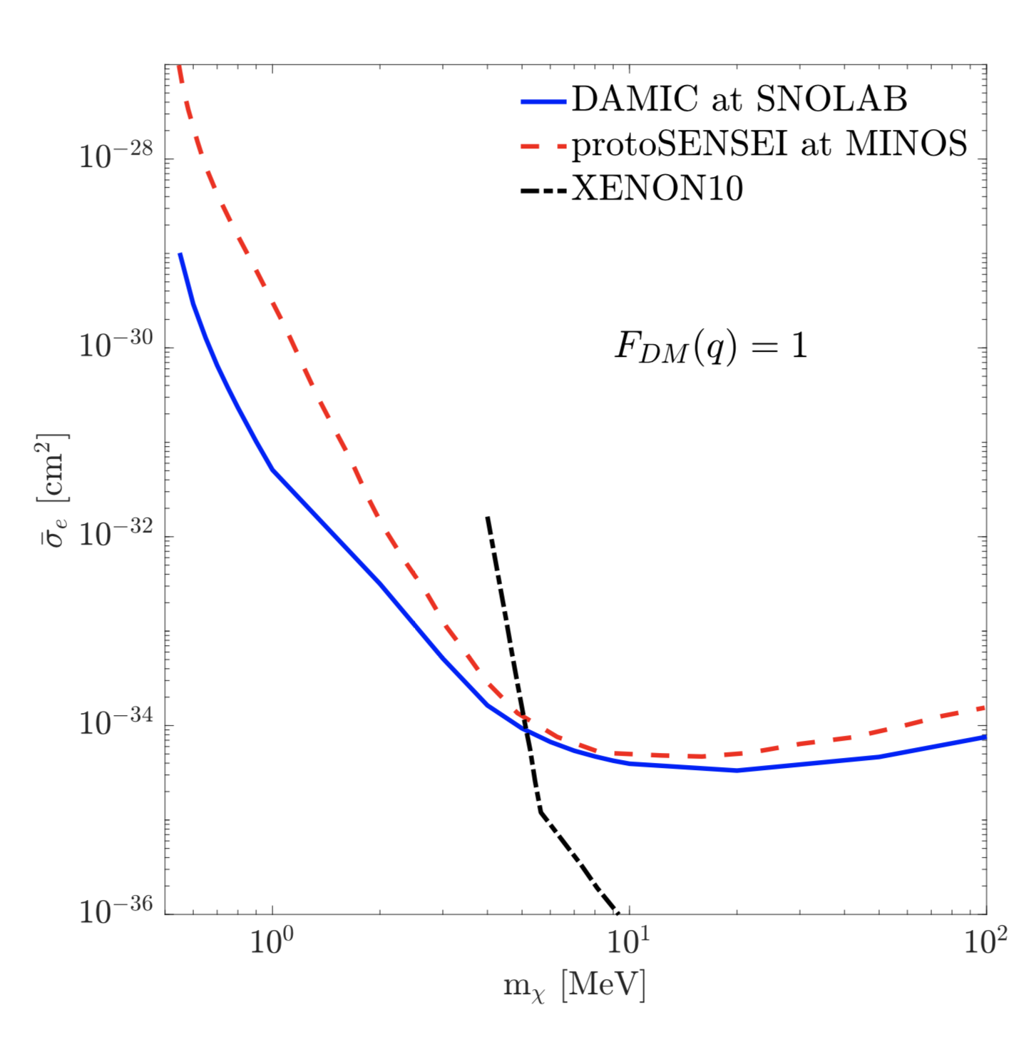
Recent Results: SENSEI, SCDMS, DAMIC
With a very small exposure at MINOS, SENSEI achieved world-leading results in e-recoil dark matter search.
SENSEI (skipper-CCD), superCDMS, DAMIC (CCD) are leapfrogging each other in the search for e-recoil dark matter. FNAL big roles here!
  PRL 122, 161801 (2019)
DAMIC has the lead; our last result with standard CCDs

Slide 17
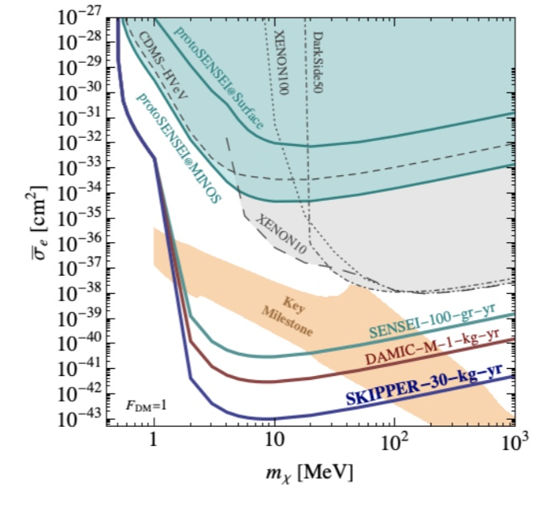
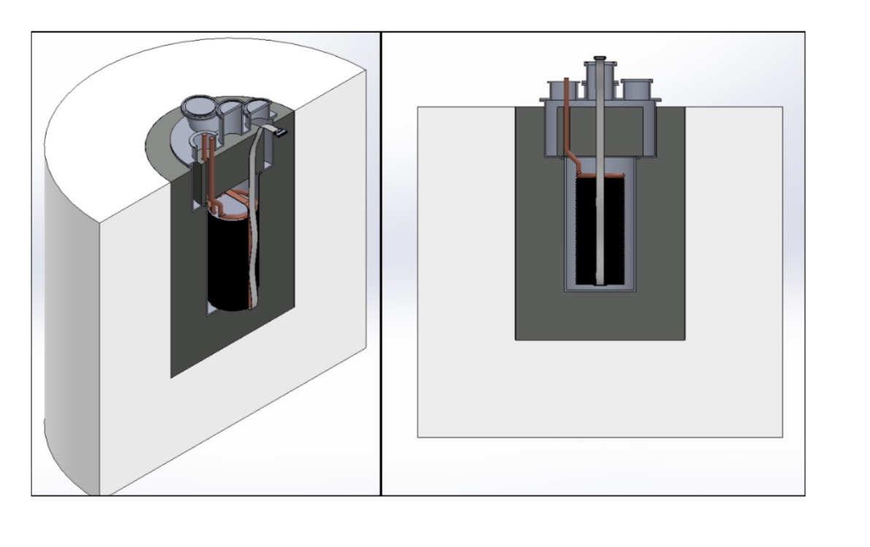
Future: SENSEI-100 → Oscura
SENSEI 2020@SNOLAB (construction now)
DAMIC-M 2024@Modane (not FNAL)
~2028-Oscura (R&D now)
The US community using CCDs for DM united under the Oscura proposal (led by FNAL). This will take the technology to its full potential. Ongoing experiments SENSEI, DAMIC, DAMIC-M are key efforts to test different technical ideas while producing world-leading science.

Slide 18
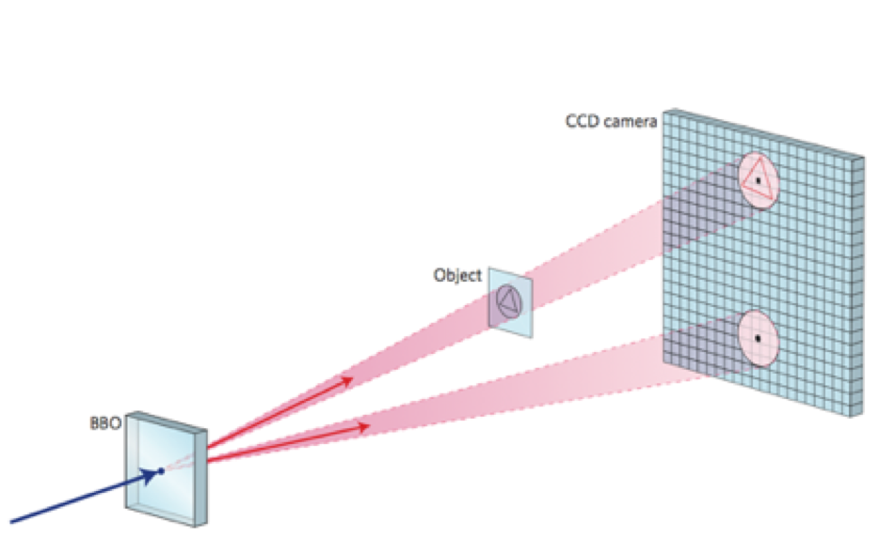
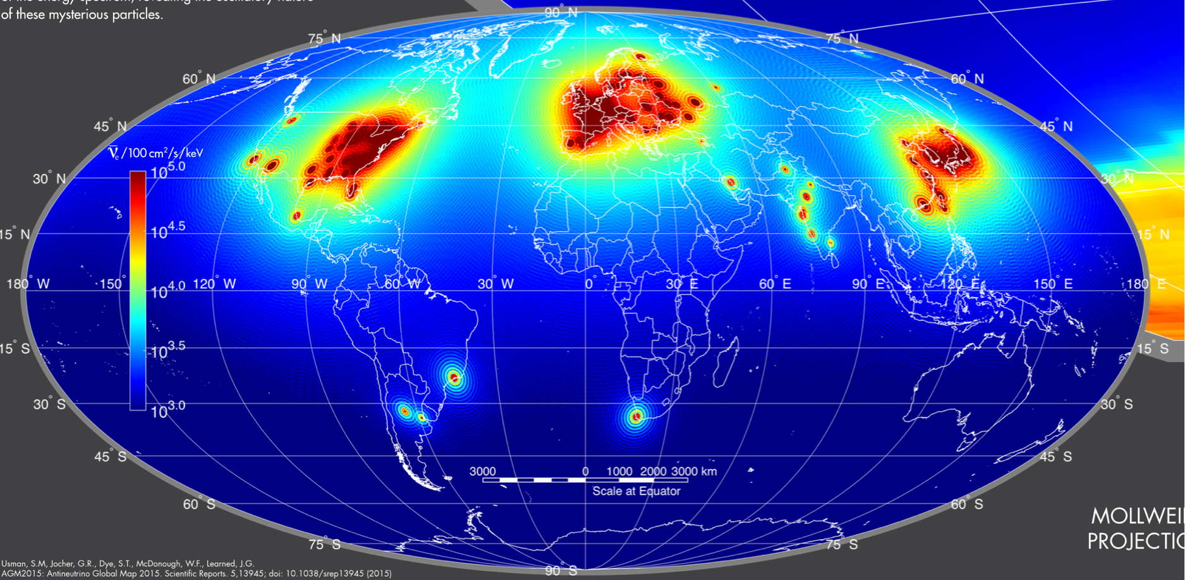
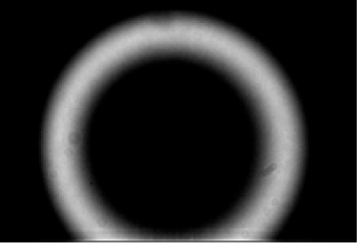
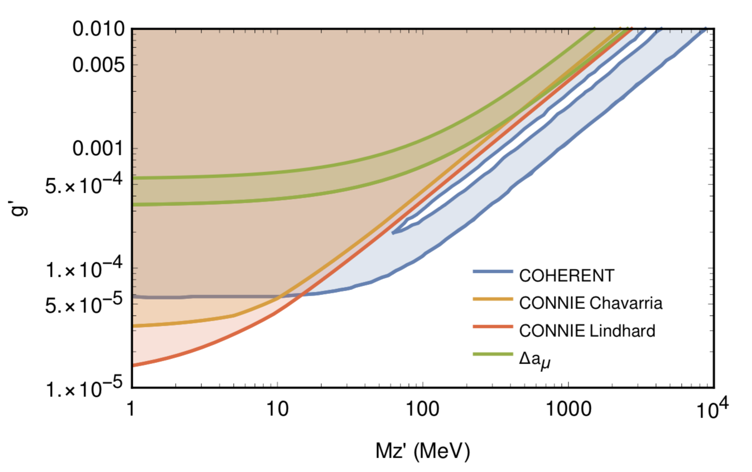
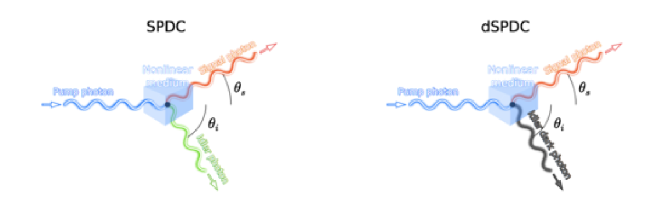
Skipper-CCD beyond DM
quantum imaging
CEvNS and beyond
ring of entangled photons @ SiDET on
skipper-CCD
CCDs next to a nuclear reactor to access new physics in the low-E neutrino sector.
CONNIE (LDRD) has been exploring this at a reactor for a few years with standard CCDs.
arXiv:1910.04951
leading search for light vector mediator by CONNIE, will get even better with skipper-CCDs.
potential new tool to search for the production of dark photons
QIS grant funding this.
Large arrays of skipper-CCDs could also be used for safeguard monitoring of nuclear reactors.

Slide 19
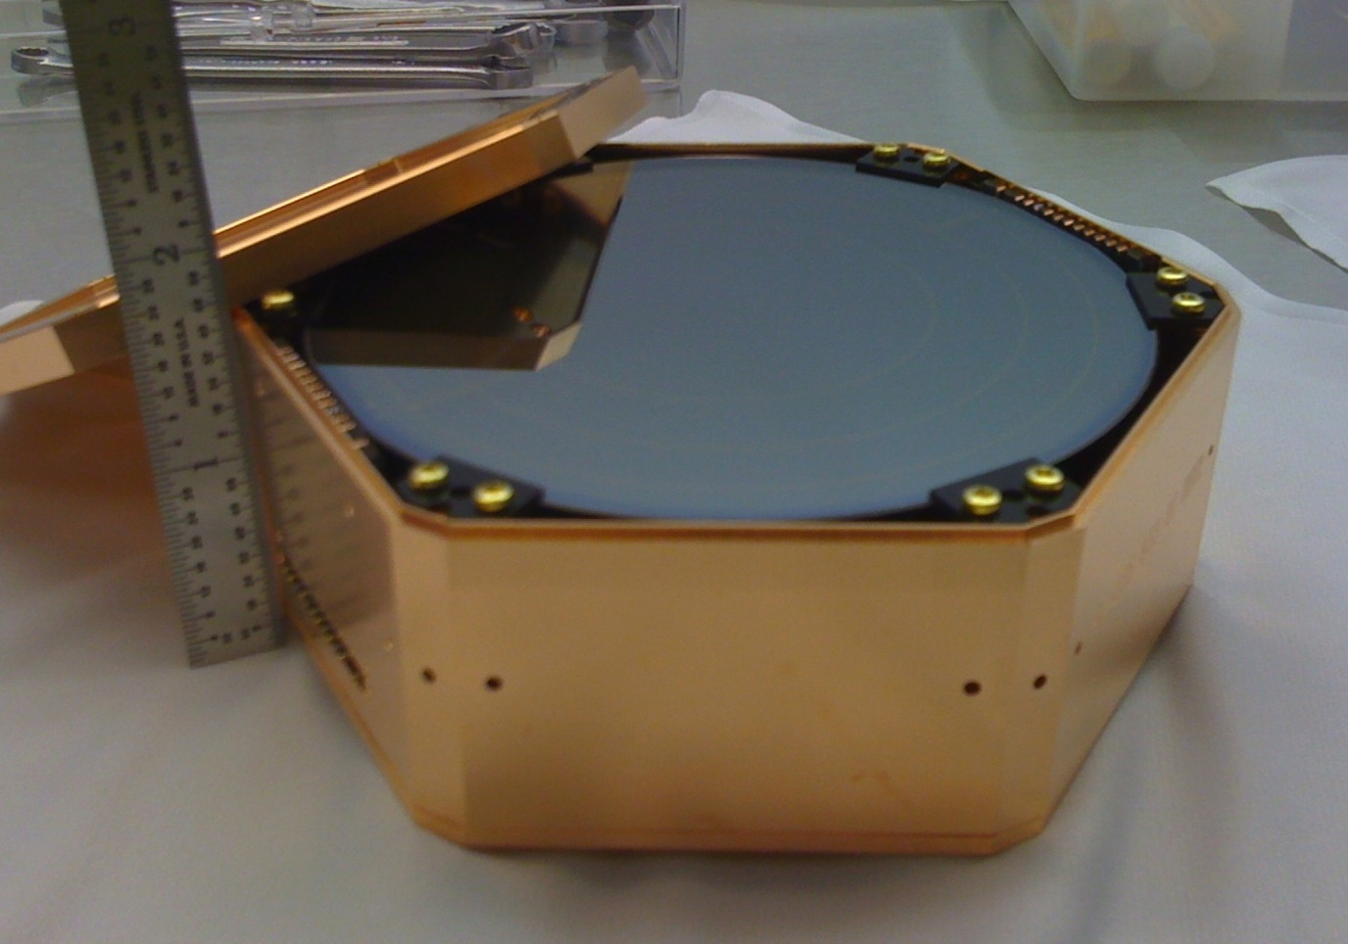
SuperCDMS SNOLAB
DAMIC
CRESST
SuperCDMS
Soudan
Will provide superb sensitivity to dark matter particles with masses in the 0.5-10 GeV/c² range with Ge and Si detectors
CDMSlite
(Soudan)
Darkside
Parameter space to be explored by SuperCDMS SNOLAB
PandaX
LUX
Xenon 1T
neutrino floor
PRD 95, 082002 (2017)
vacuum bulkhead for signals
Project led by SLAC
Install and commission at SNOLAB in 2021
First physics run in 2022
$34M DOE/NSF/Canada Project funding; ~$6M Fermilab scope
Requesting Operations support of ~$2M/year DOE, ~$1M/year each from NSF and Canada
Detectors
10 cm X 3.8 cm

Slide 20
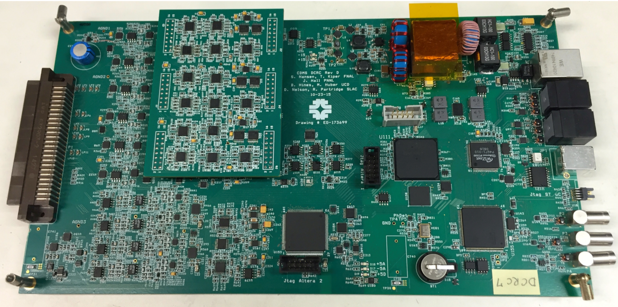
SCDMS: Fermilab Roles & Status
FNAL continuing 20 years of involvement in SuperCDMS, with leadership roles in:
  Cryogenic design and operation
  Warm electronics design and fabrication
  Calibration system design and ops
  Infrastructure and Integration
Cryogenics:
  Dilution Refrigerator working at Fermilab
  Copper cryostat (SNOBOX) vendor bid exceeded project budget/schedule
    Redesigning affordable cryostat requires reducing payload capacity from 31 detector towers to 7
    Delays project completion by 6-9 months
  Engineering design overruns
Electronics and Calibration on schedule
Infrastructure being installed at SNOLAB
Integration likely to be moved off Project to Operations to preserve Project contingency
Dilution Refrigerator
Detector control and readout card

Slide 21
Fermilab working closely with SLAC/Project
Redesign of cryostat underway, under purview of FNAL/SLAC Task Force
Must deliver on DOE/OHEP PEMP Notables for 2020:
  Present Project-vetted plan to OHEP by February 29, 2020 for completion of Fermilab project scope
  Support Project in developing and presenting an installation and commissioning plan to OHEP by January 31, 2020
  Develop Lessons Learned report for cost overruns associated with Fermilab scope of work by January 31, 2020
  Complete (re)design of the SNOBOX (Cryostat for detectors) by June 30, 2020
Chief Project Office and Divisions providing increased oversight of Fermilab cost/schedule performance and strengthened liasion with SLAC/Project.
PPD, APS-TD committed to providing priority for key FNAL technical personnel to SuperCDMS SNOLAB
Fermilab agreed to remove $390K costs from the Project to help re-build Project contingency.
  Buy-back of infrastructure, covering of technical salary, using scientists in place of technical personnel where possible
1/16/20
Cosmic Frontier Update

Slide 22
NEXUS: Sub-GeV Dark Matter and Cryogenic Detector Test Facility
Commissioned new Fermilab/Northwestern facility (NEXUS) in MINOS near-detector hall
  Dilution refrigerator in cleanroom with shielding against radioactivity
  Will install neutron scattering setup to allow kinematic determination of the nuclear recoil energy scale in detectors
  This will be the major operations focus for the SuperCDMS group at Fermilab
sub-GeV dark matter run in the next few months (see next slide)
Other cosmic frontier groups interested in using NEXUS as well
Additional resources needed in FY2020 to finish NEXUS (~$150K)
NEXUS Facility
1/16/20
Cosmic Frontier Update

Slide 23
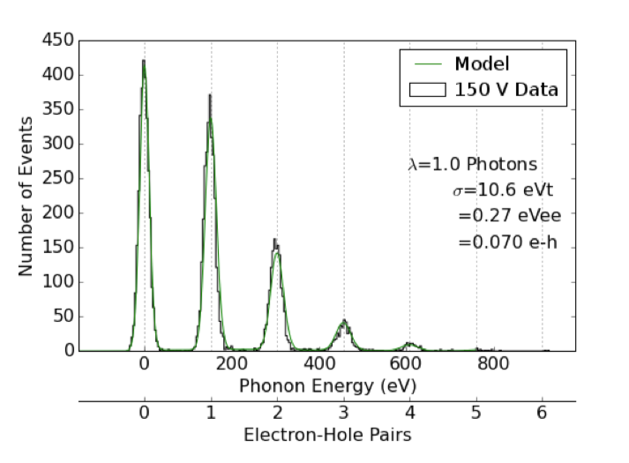
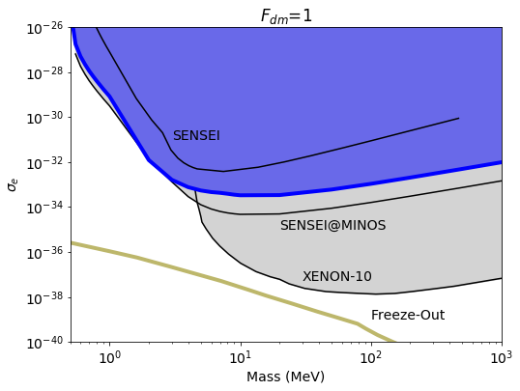
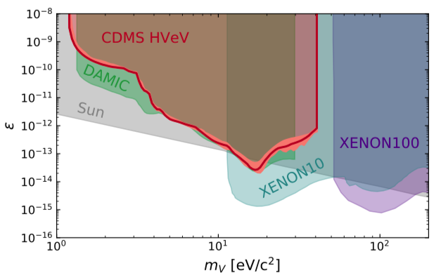
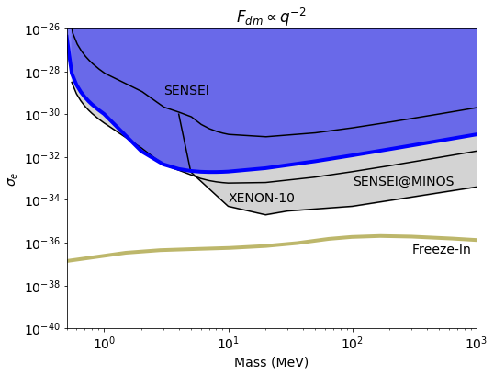
Sub-GeV dark matter searches with single-charge sensitive detectors (HVeV)
In 2018, SuperCDMS demonstrated world-leading dark matter sensitivity with a prototype Si detector that measured single e/h pairs.
SNOLAB Ladder Lab
“future home”
Surface running
of prototype Si device constrained
dark photons
and electron-scattering dark matter
F_{DM} ⍺ q⁻²
Laser calibration data
Surface
SuperCDMS 2018
F_{DM} = 1
SuperCDMS 2018
Competition, but also synergy with SENSEI program
Surface
SuperCDMS 2018
PRL 121.051301
PRL 121.051301
Anticipating substantial improvements in sensitivity with detectors run at NEXUS
1/16/20
Cosmic Frontier Update

Slide 24
Timeline for SuperCDMS Activities
Activity | FY19 | FY20 | FY21 | FY22 | FY23 | FY24 | FY25
SNOLAB Project
SNOLAB Detector Testing and Calibration
SNOLAB Operations and Science
Sub-GeV Detector Development
Sub-GeV Science at NEXUS
Sub-GeV Science with upgrades at SNOLAB
Together, SuperCDMS SNOLAB and HVeV detectors comprise a dark matter direct detection program to cover the mass range from 1 MeV to 10 GeV!
1/16/20
Cosmic Frontier Update

Slide 25
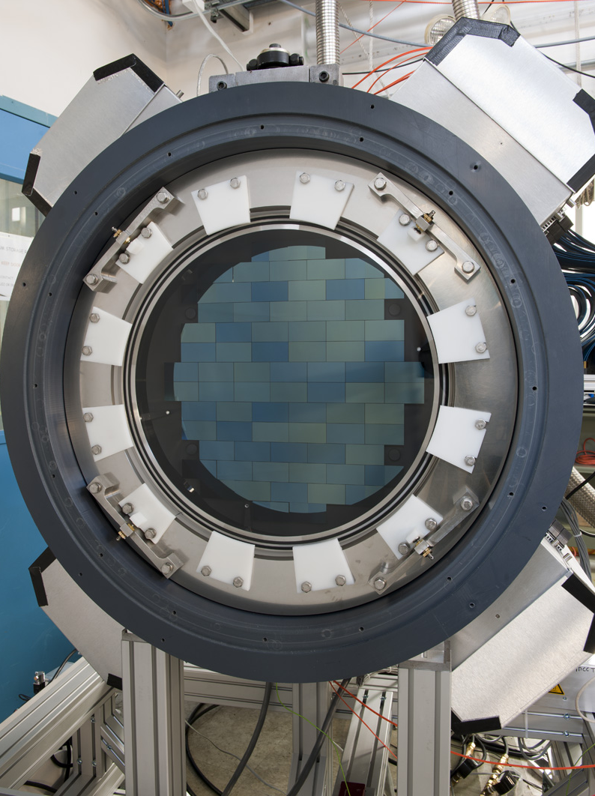
Dark Energy Survey
Cosmic imaging survey to probe physics of the
dark Universe
  Six-year survey of 300 million galaxies completed early 2019
  570-Megapixel Camera built at Fermilab for DES, also used for other discoveries (e.g., 12 new moons of Jupiter)
Science Highlights
  Over 250 science publications to date
  World-leading constraints on dark energy & cosmology from Y1 data
  Discovered 17 new ultra-faint, dwarf satellite galaxies surrounding our Milky Way, providing strong constraints on models of dark matter
  Discovered optical explosion accompanying gravitational waves seen by LIGO from collision of 2 neutron stars 130 million years ago
  Major cosmology results from first 3 years of data expected 2020, to be followed by final results from full survey
Survey Operations efforts migrating to DESI, LSST
1/16/20
Cosmic Frontier Update

Slide 26
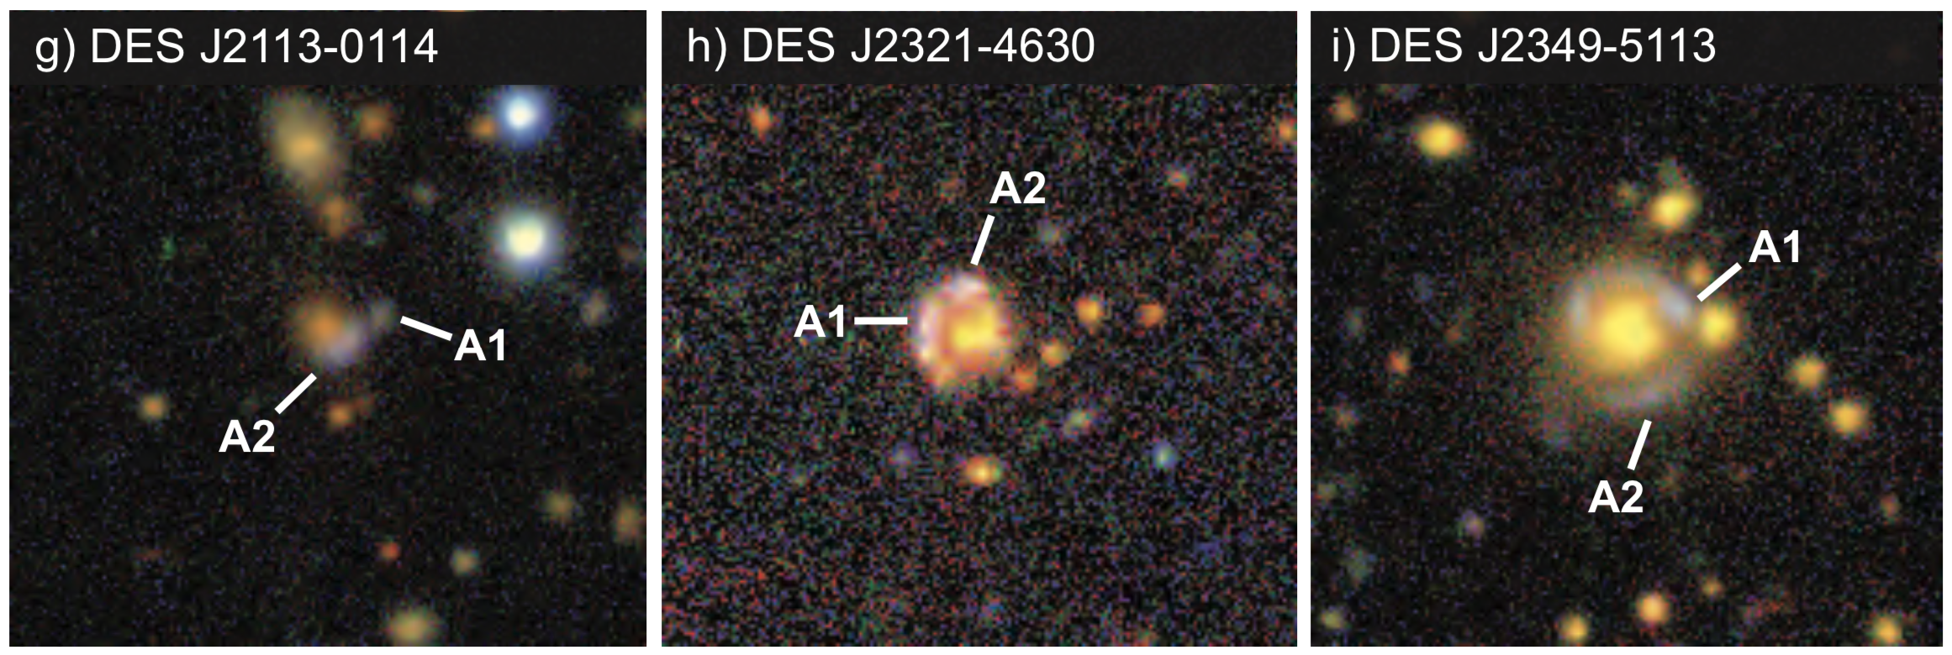

Dark Energy Survey: Recent Highlights
Precise Measurement of expansion rate from DES strong lens time-delay system (Shajib, etal 1910.06306)
  H₀=74.2+2.7⎼3.0 km/sec/Mpc disagrees with Planck CMB in CDM
Discovery of Nine Strong Lensing Systems (*Nord, et al 1911.02162)
Discovery of Diffuse Light in Galaxy Clusters (*Zhang, et al 1812.04004)
First measurement of H₀ from Dark Standard Siren from DES and LIGO/Virgo (*Soares Santos, *Palmese, et al 1901.01540)
*denotes FNAL scientists
$$Λ$$
1/16/20
Cosmic Frontier Update

Slide 27
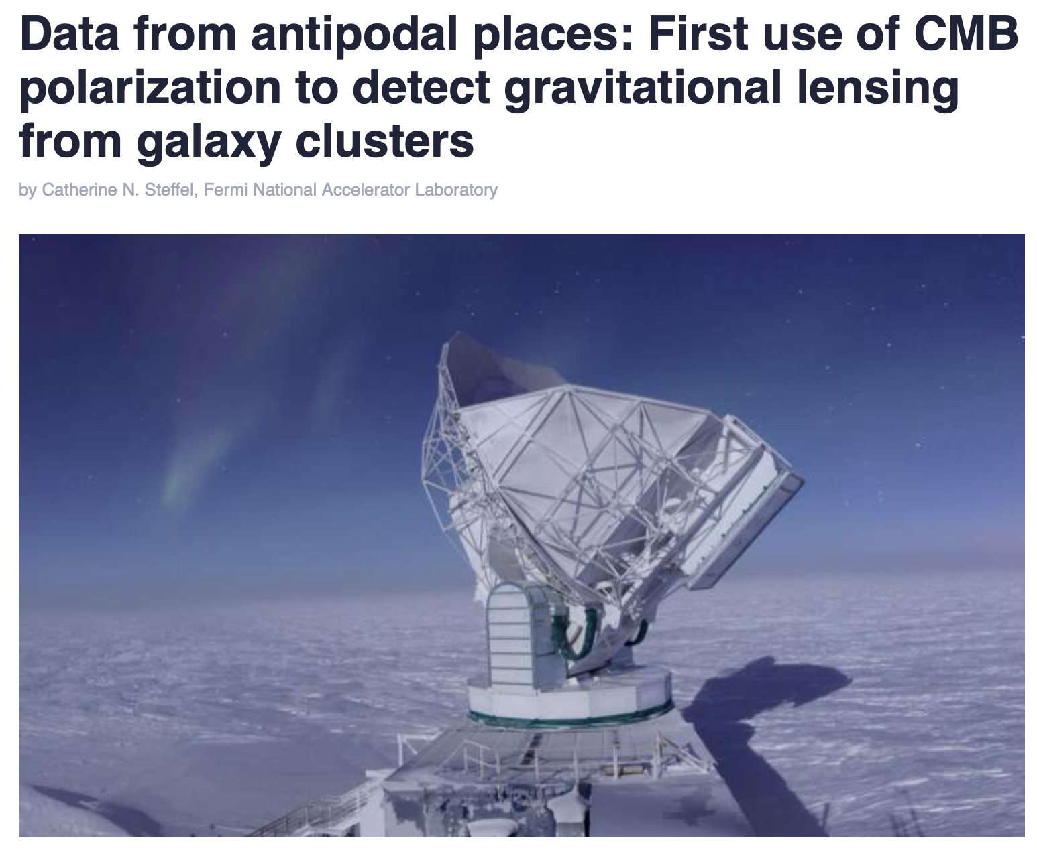
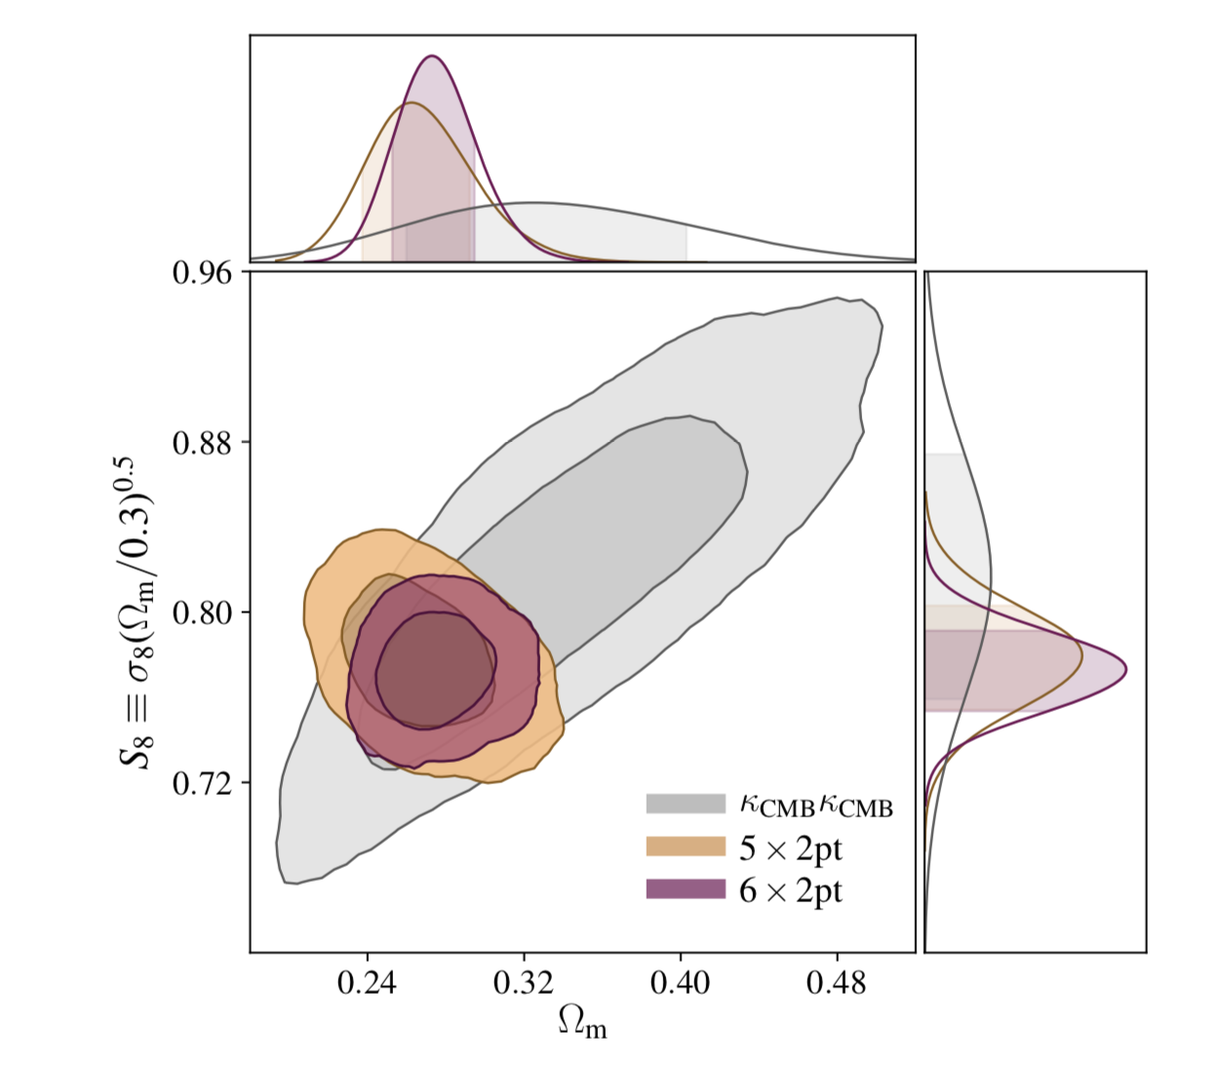
Survey Synergy: SPTxDES Joint Analysis Results
    DES Collaboration, PRD, 100, 023541 (2019)
First cosmological constraints from joint analysis of DES and SPT data, reducing systematics and maximizing cosmological information
  Raghunathan, et al, PRL, 123, 181301 (2019)
  Phys.org article featuring Fermilab’s Brad Benson at the Pole: https://phys.org/news/2020-01-antipodal-cmb-polarization-gravitational-lensing.html
27
1/16/20
Notes:
PICO -> PNL, DAMIC-> Uchicago (no darkside)

Slide 28
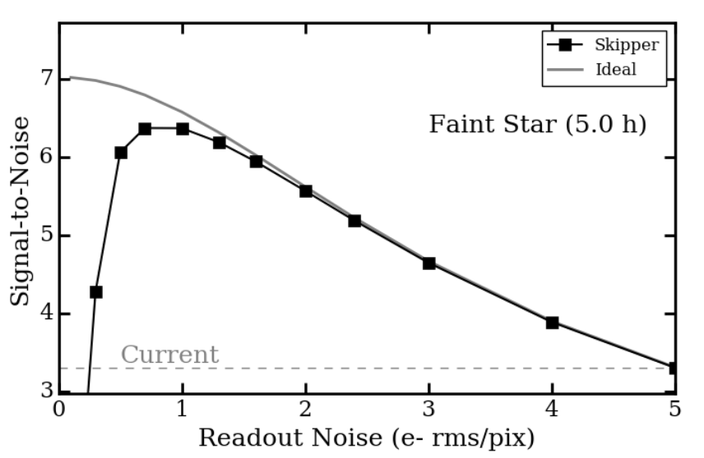
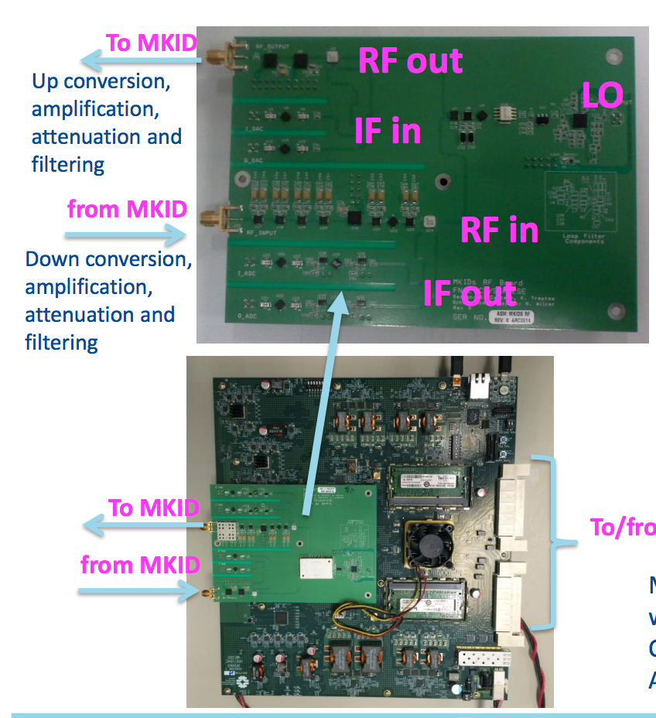
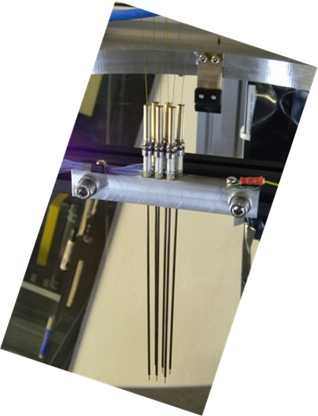
Detector R&D for the Cosmic Frontier
  Advance R&D on new technologies for future large cosmic surveys and CMB experiments
  Advance detector and readout technical development for CMB-S4
  Advance R&D of detector technologies for next-generation dark matter experiments
10k pixel readout system for MKID detectors, (optical or CMB), benefitting from RF control experience at the Lab
Optical fiber positioner (prototype)
28
1/16/20
Cosmic Frontier Update
Notes:
New MKID made at Chicago,

Slide 29
Cosmic LDRD & Other Related Grants
LDRD Efforts:
  Scintillating Bubble Chambers: superheated argon for low-mass WIMP and CEvNS detection
  Pixel-configurable CCD’s for cosmological applications
  Development of Microwave Readout Electronics for Massively Multiplexed Arrays of TES
  Cryogenic photon sensors for the low mass frontier
  10 kg skipper-CCD development for next gen dark matter/neutrino experiments
  MKIDs sensors for optical and near-IR
  Dark Matter as Sterile Neutrino Search Satellite: Cubesat to look for the 3.5 keV line
  Deep Learning Algorithms
QuantiSED/Dark Matter New Initiatives:
  Qubit single photon detection for axion searches (QuantiSED)
  Skipper CCD’s for quantum imaging (QuantiSED)
  Design of next phase of ADMX to search for axions in 2-4 GHz range (DM New Initiatives)
  Design of OSCURA, a 10-kg Skipper CCD dark matter experiment (DM New Initiatives)
DOE R&D Grant for CMB-S4 detectors and readout development
DOE Early Career:
  Microwave Single-Photon Sensors for DM Searches and Precision Neutrino Measurements (2018)
  Towards table-top neutrino detectors: A 10 kg Skipper-CCD experiment (2018)
DOE Late Career: Office of Science Distinguished Scientist Fellow Award
29
1/16/20
Cosmic Frontier Update
Notes:
Should we add Eric Dahl and Hugh’s LDRD?

Slide 30

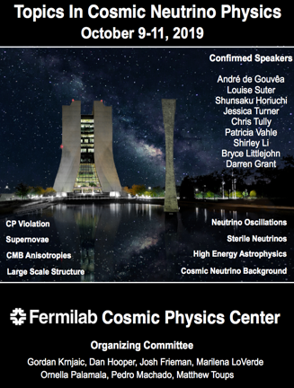
Cosmic Physics Center (CPC)
The CPC aims to serve the growing cosmic user community, following the successful Fermilab models of the LHC Physics Center and the Neutrino Physics Center:
  roughly 100 annual on-site Cosmic users
  over 700 Cosmic users of Fermilab computing facilities
Host and modestly support visiting scientists and students to
  formalize and expand hands-on training opportunities in hardware and detector development, building on successful relationships with South American Universities that send students to the lab for extended periods (usually with their own funding)
  enable joint analysis and cross-correlation of cosmic experiments such as DES and SPT-3G, LSST and CMB-S4 to make the tightest cosmological constraints
  develop a consistent framework for combining multiple probes of dark matter (collider, direct, indirect, astro) to optimize the future dark matter detection program
  develop a coherent framework for constraining neutrino physics through multiple probes through the Cosmic Neutrino Initiative
Host targeted workshops to accelerate the pace of research
Develop and strengthen the cosmic synergies between Fermilab and local institutions to realize the tremendous potential of the Chicagoland cosmic community
Not funded as explicit task under Cosmic Research: rebranding visitor & seminar funds

Slide 31
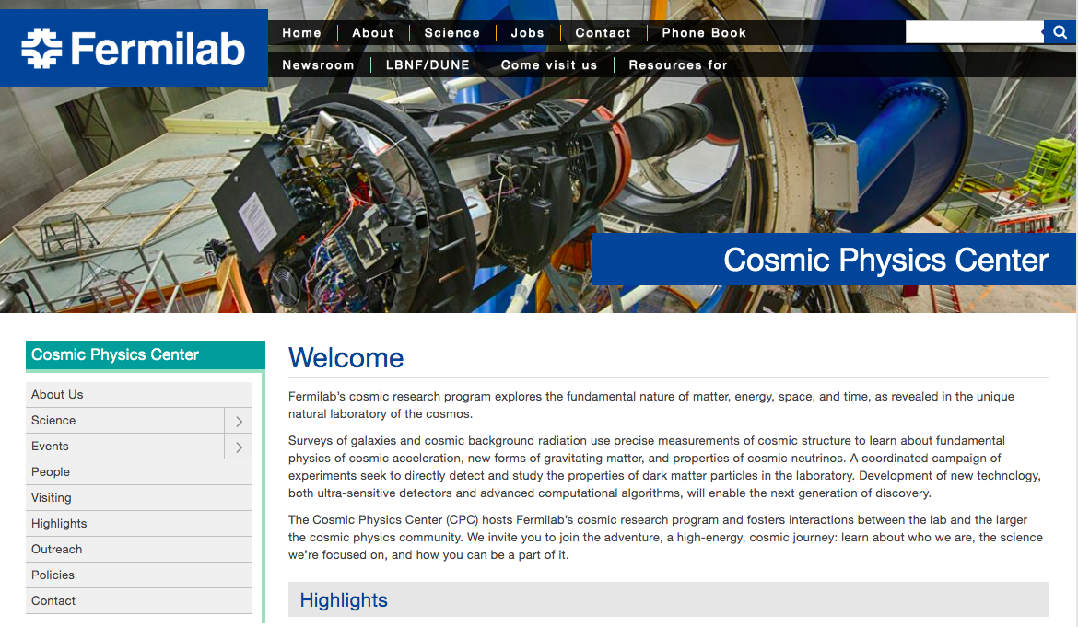
Cosmic Physics Center
https://astro.fnal.gov

Slide 32
Conclusion
Cosmic Frontier Strategic Plan delivered last Feb., implementation underway, satisfied 2019 FNAL PEMP Notable.
FNAL growing its technical expertise and management roles in CMB-S4, building from SPT-3G experience and the lab’s core capabilities. Prepared to work with other labs and universities to make it a success.
Sub-GeV Dark matter program progressing well with DM New Initiatives. Laser focus on making SuperCDMS a success.
DES entering the heart of its cosmology analyses; small roles in transition to DESI operations; growing roles in LSST operations.
Cosmic Physics Center did a soft launch this year, amalgamating visitor & seminar programs, initiating targeted workshops, with plans to expand the efforts in coming years based on community and agency feedback.

