Slide 1
New Insights into Type Ia Supernova Explosions from Large-Scale Simulations
Don Q. Lamb
DOE ASC Flash Center
University of Chicago
Computation Institute Review
University of Chicago
27 April 2010

Slide 2
Key Flash Center Personnel
Dongwook Lee
Paul Rich
Klaus Weide
Guohua Xia
John Norris
Yuenjin Kim (Graduate Student)
Daan van Rossum
Jim Truran
Director: Don Q. Lamb(UofC and CI Senior Fellow)
Associate Director: Anshu Dubey (UofC and CI Fellow)
CS/Applications Group (Leader: Anshu Dubey, UofC and CI Fellow)
Shawn Couch
Chris Daley
Norbert Flocke
Jonathan (“Brad”) Gallagher
Shravan Kumar
Scientific Analysis and Visualization Group (Lead: Mike Papka, ANL and CI Senior Fellow)
Randy Hudson
Astrophysics and High-Energy Density Physics (Lead: Don Lamb, CI Senior Fellow)
Benedikt Diemer (Grad Student)
Carlo Graziani
George (“Cal”) Jordan

Slide 3
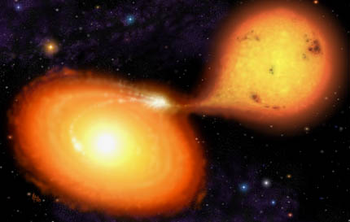
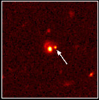
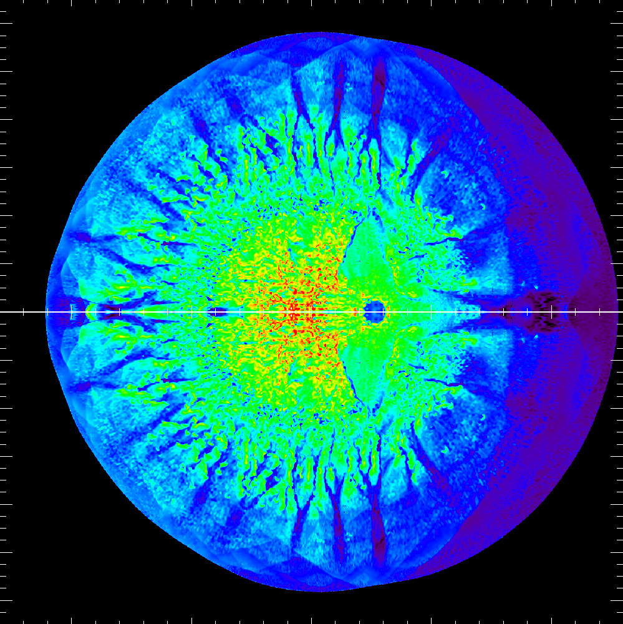
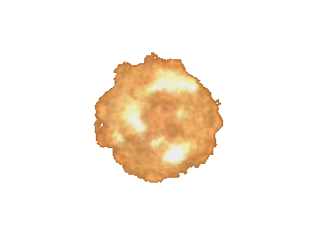
What Are Type Ia Supernovae?
Image copyrighted by Mark A. Garlick
Image credit P. Garnavich/CfA
Accretion
Stellar binary in which main
sequence star transfers
mass onto white dwarf
Radioactive decay of ⁵⁶N
heats expanding gas and
makes explosion visible
Lightcurve
Free expansion of star
Radioactive decay of
nickel heats the ejecta
This causes the ejecta to
glow, which makes the
supernova visible
>10⁸ yr
Nuclear energy
powers the explosion
~seconds
Smoldering
Subsonic convection
in core of white dwarf
Heat transport is by
electron conduction
Flame
Nuclear burning initially due to
laminar flame
Buoyancy—driven turbulence
increases nuclear burning rate
Transition from deflagration to
detonation occurs, causing the
star to explode
~1000 yr
Ignition
Notes:
Lightcurve image is a Hubble (Wide Field and Planetary Camera 2) image of SN 1997cj.

Slide 4
Type Ia Supernovae
Supernova Cosmology Project

Slide 5
Type Ia Supernovae
Peak luminosities
of most Type Ia SNe
are similar -- making
them excellent
“cosmic yardsticks”
Supernova Cosmology Project

Slide 6
Calibration Using Empirical Correlation Between Peak Brightness and Duration
Peak brightnesses of Type
Ia SNe vary by roughly
1 mag = factor 3
Using empirical correlation
between peak brightness
and duration, variation can
be reduced to about 15%

Slide 7
Past and Future of the Universe

Slide 8
Problem and Approach
Problem
Astronomers must be able to calibrate Type Ia supernovae as
“standard candles” to better than 1% in order to determine whether
dark energy varies with age of the universe to 10%
Most scientists in the field believe this will require a much better
understanding of Type Ia supernovae
Approach
We are doing large, multi-physics, multi-scale simulations of Type Ia
supernovae to understand them better
We use FLASH, a highly capable, fully modular, fully extensible
adaptive mesh refinement (AMR) code (which allows us to effectively
effectively resolve a star the size of the Earth to cells 5 miles on a side
using 10¹⁰ grid points) – plus Phoenix and Sedona (two highly capable
radiation transfer codes)
We are confronting the results of these simulations with high-quality
light curves and spectra obtained by the SDSS-II Supernova Survey
team and their collaborators

Slide 9
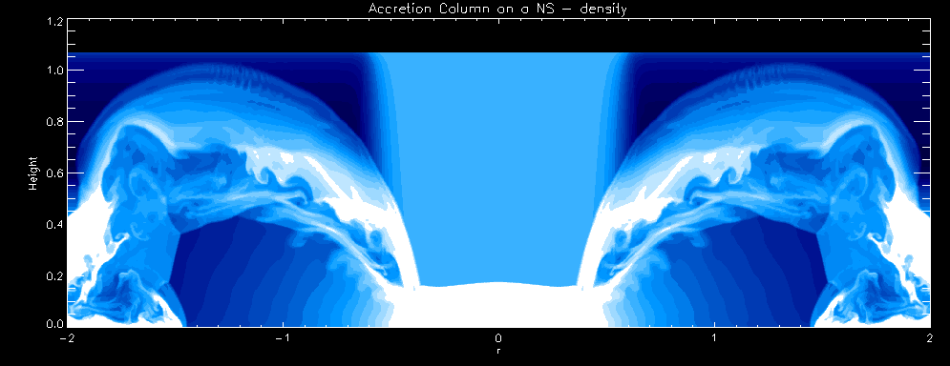
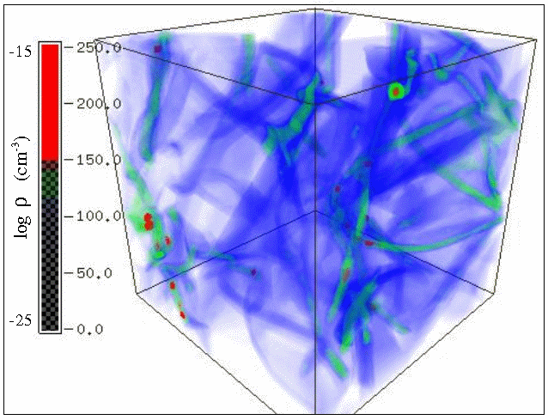
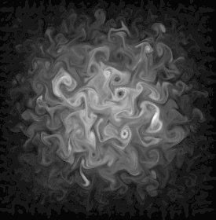
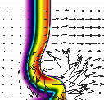
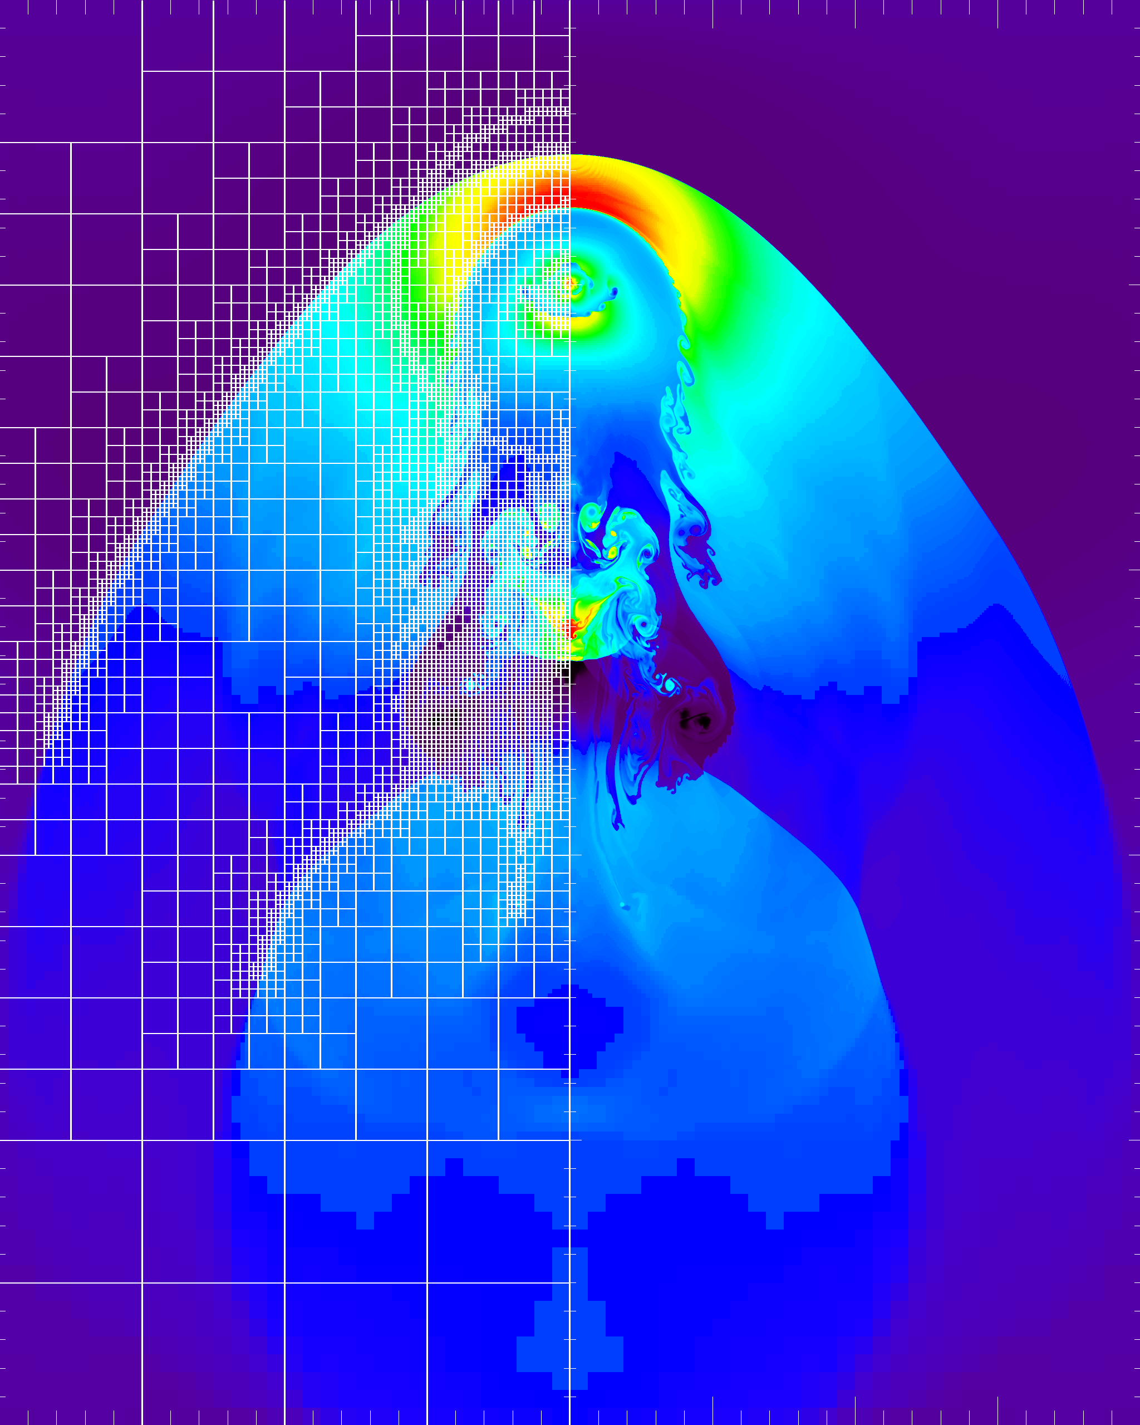
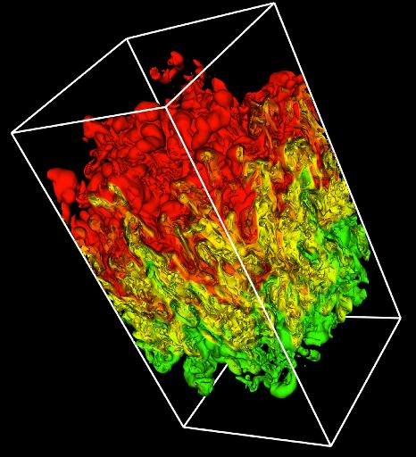
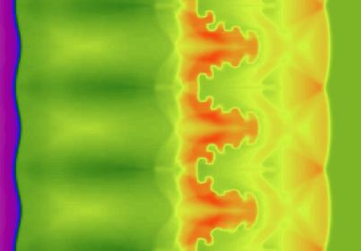
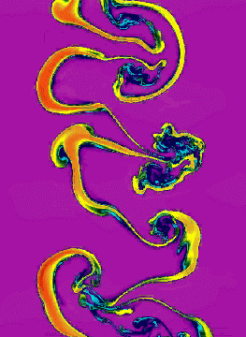
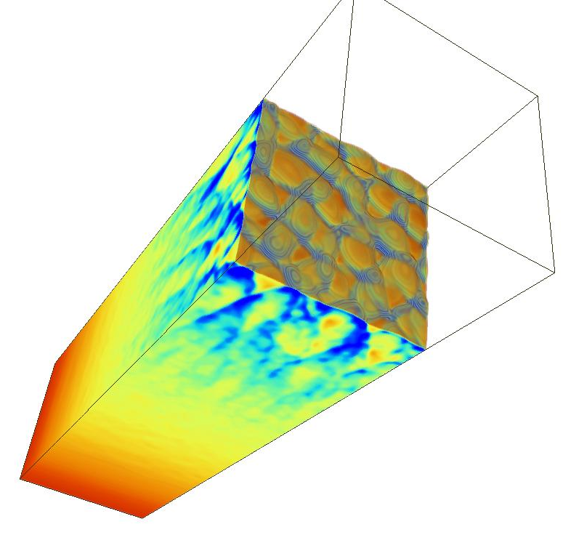
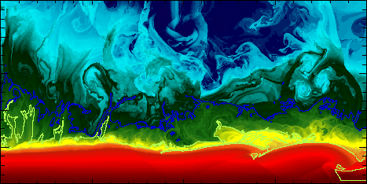
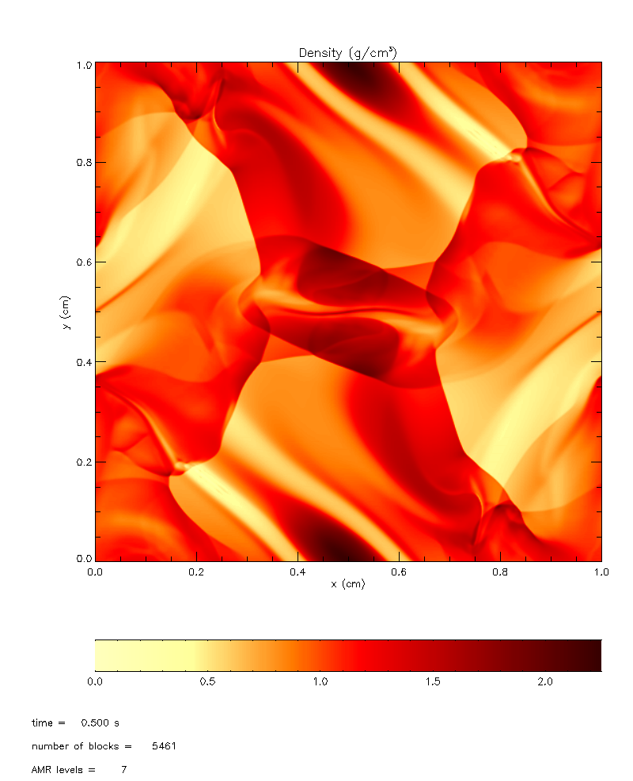
FLASH capabilities span a broad range…
FLASH
Parallel, adaptive-mesh refinement (AMR) code
Originally designed for compressible reactive flows
Can solve a broad range of (astro)physical problems
Incompressible Navier-Stokes solver with embedded boundaries and fluid-structure interactions is being added
High-energy density physics capabilities are being added to make FLASH an open code for academic HEDP community
Portable: runs on many massively-parallel systems
Scales and performs well up to 160K processors
Fully modular and extensible: components can be combined to create many different applications
Rigorous verification and software development processes make development possible while FLASH is being used for production
Shortly: Relativistic accretion onto NS
Flame-vortex interactions
Compressed turbulence
Type Ia Supernova
Gravitational collapse/Jeans instability
Wave breaking on white dwarfs
Laser-driven shock instabilities
Intracluster interactions
Nova outbursts on white dwarfs
Rayleigh-Taylor instability
Helium burning on neutron stars
Orzag/Tang MHD
vortex
Magnetic
Rayleigh-Taylor
Cellular detonation
Richtmyer-Meshkov instability

Slide 10
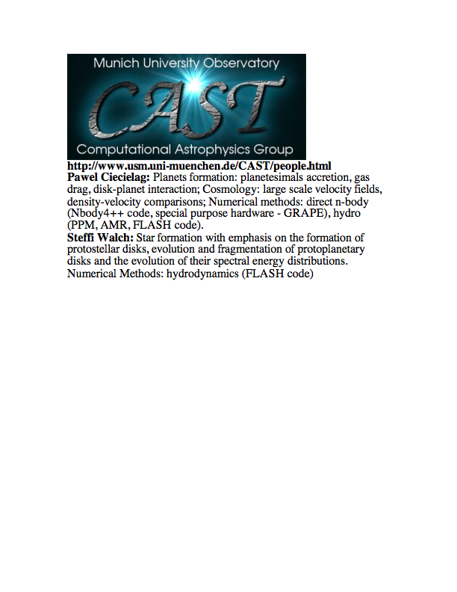
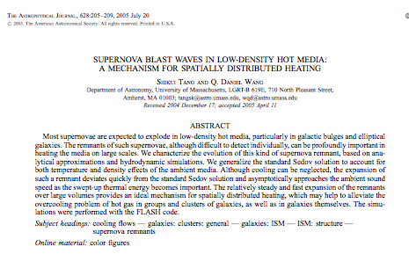
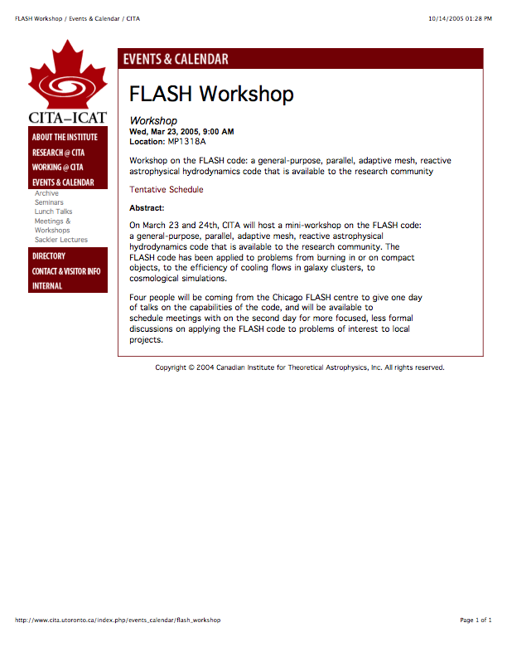
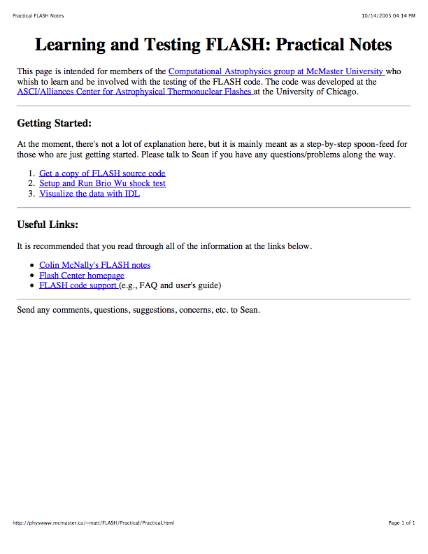
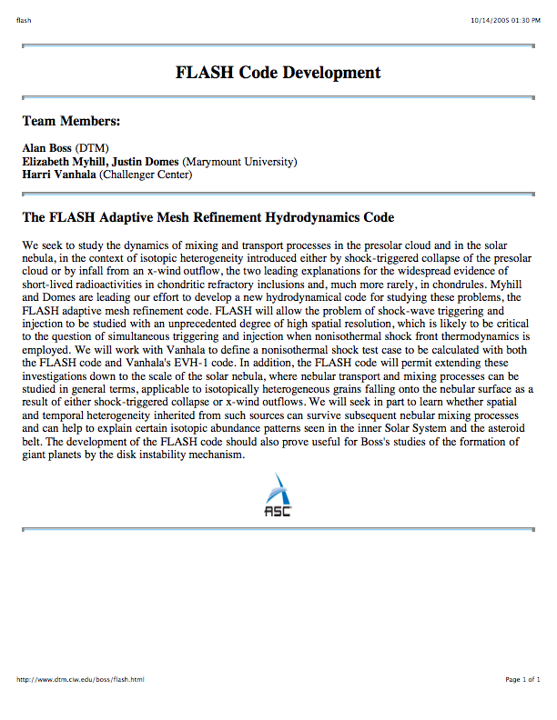
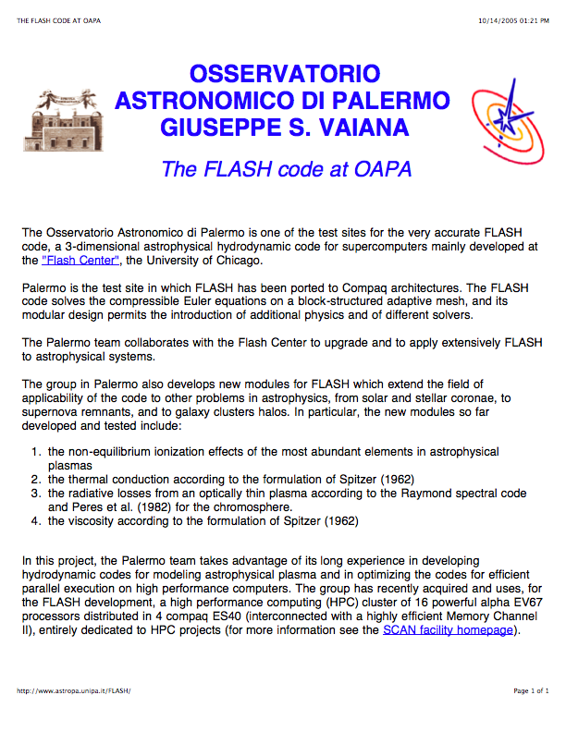
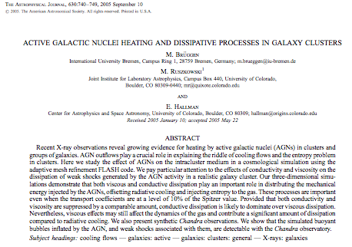
…FLASH is being used by groups throughout the world
Germany
US
Canada
FLASH is being used by over 700 scientists around the world to do simulations in astrophysics, cosmology, computational fluid dynamics, high-energy density physics, plasma physics... ; to do scaling studies, software development, etc.; and was a key acceptance test for the IBM BG/P at ANL
Canada
US
Italy
Germany
Netherlands
Monthly Notices of the Royal Astronomical Society
Volume 355 Issue 3 Page 995 - December 2004
doi:10.1111/j.1365-2966.2004.08381.x
Quenching cluster cooling flows with recurrent hot plasma bubbles
Claudio Dalla Vecchia¹, Richard G. Bower¹, Tom Theuns^{1,2}, Michael L. Balogh¹, Pasquale Mazzotta³ and Carlos S. Frenk¹
UK

Slide 11
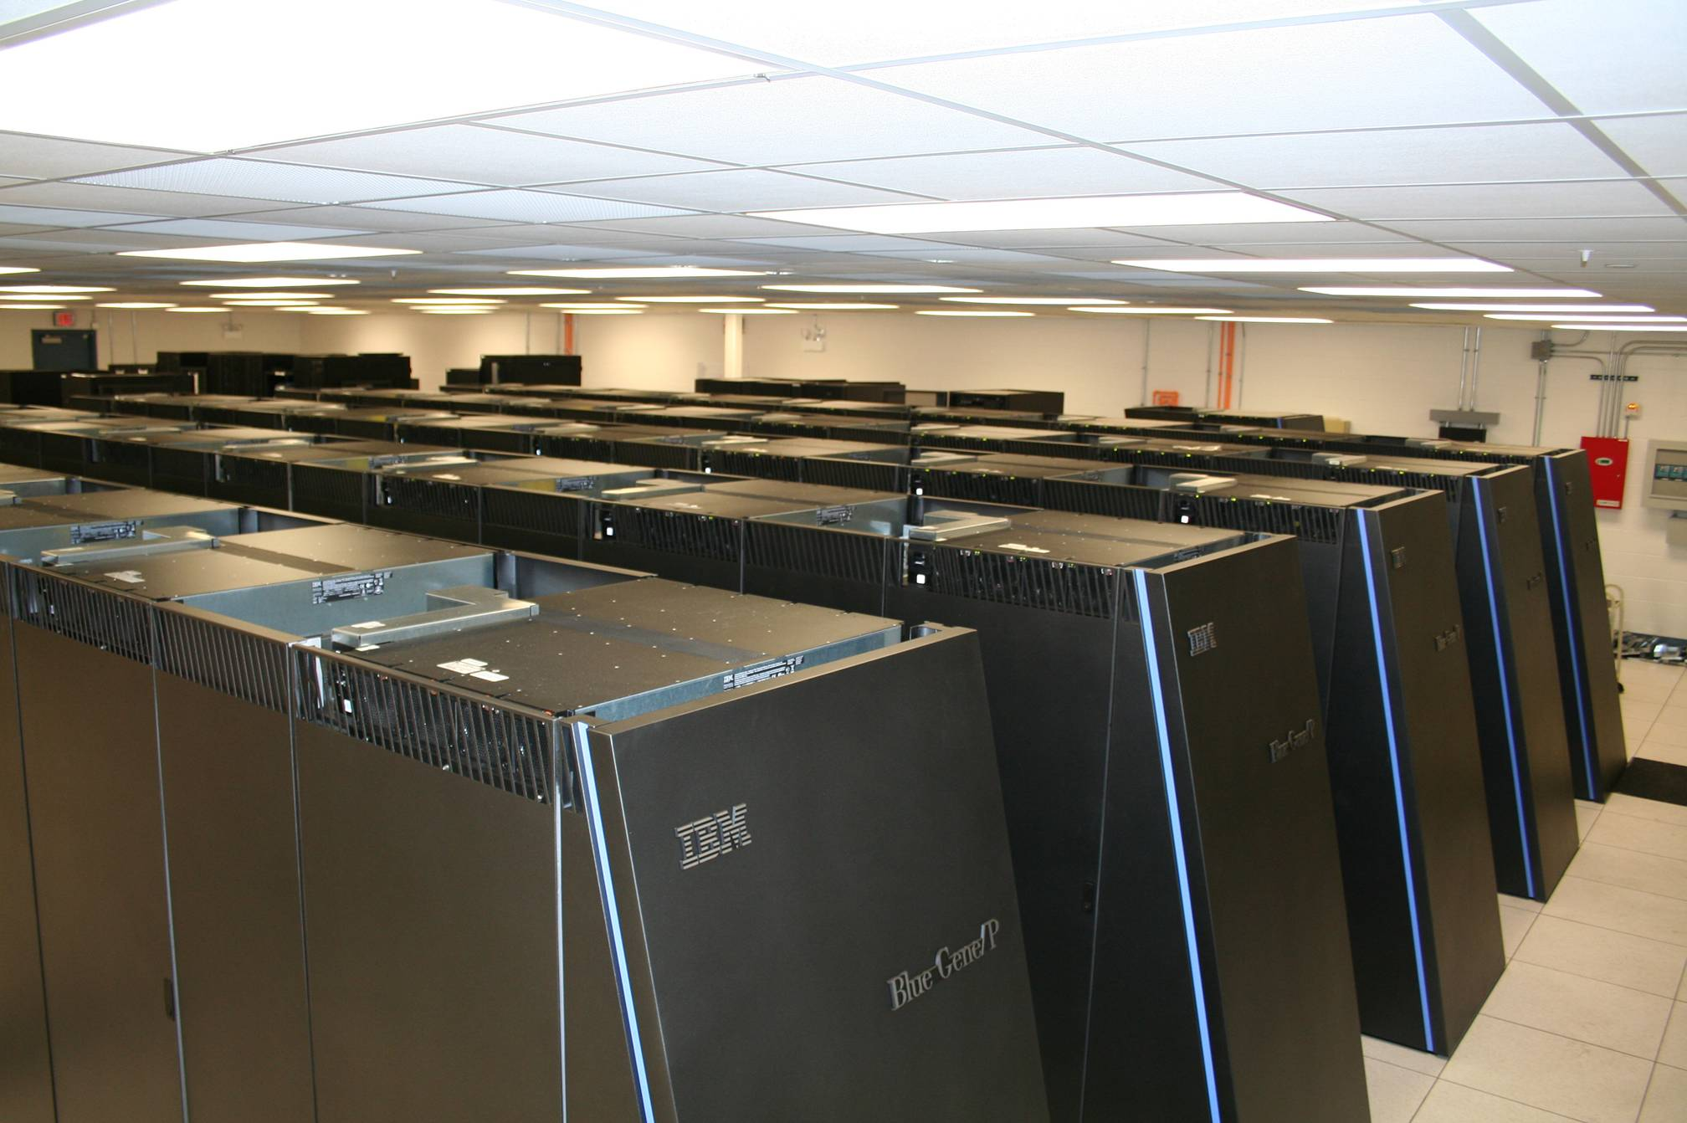
Computational Demands of Type Ia Supernova Simulations
Large-scale, 3D simulations of explosion phase of Type Ia supernovae require ~100-300K CPU-hrs on Intrepid at ALCF; radiation transfer phase requires similar resources
Each large-scale, 3D simulation generates ~ 20-60 TB of data
0556 TF IBM Blue Gene P System
Flash Center used 80 M CPU-hrs on Intrepid at ALCF awarded under DOE
Office of Science INCITE program the past two years; we expect to use a
similar amount this year
We generated ~ 3 PB of data the past two years; we expect to generate a
similar amount this year

Slide 12
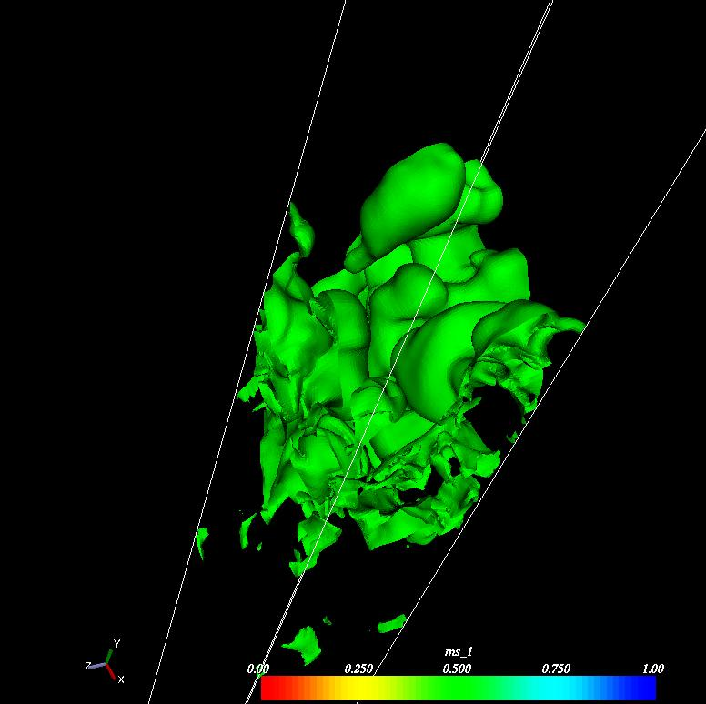
Key Physical Process Not Fully Understood: Buoyancy-Driven Turbulent Nuclear Burning
Nuclear flame is ~ 0.1 mm thick while resolution of best whole-star simulations is 8 km – a factor of 10¹⁰ larger!
A model of the nuclear flame is therefore essential
The burning rate – and thus the result – depends on the model
The correct model to use is controversial
Verification simulations we have done and continue to do on ALCF IBM BG/P are answering this question
Zhang et al. (2007); Townsley et al. (2008)

Slide 13
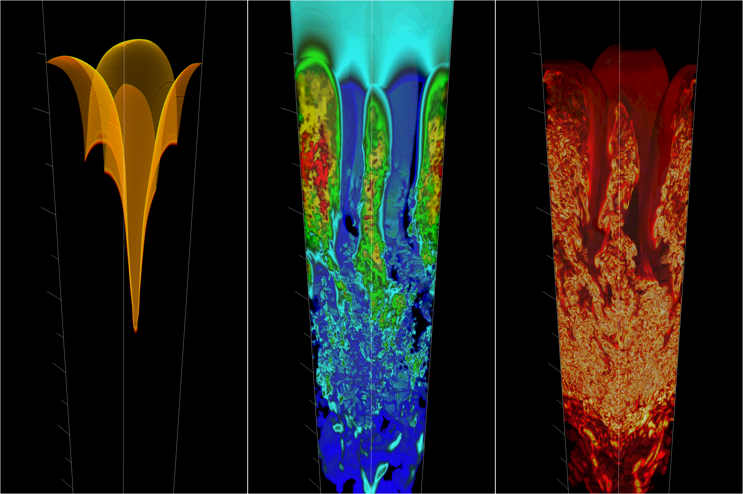
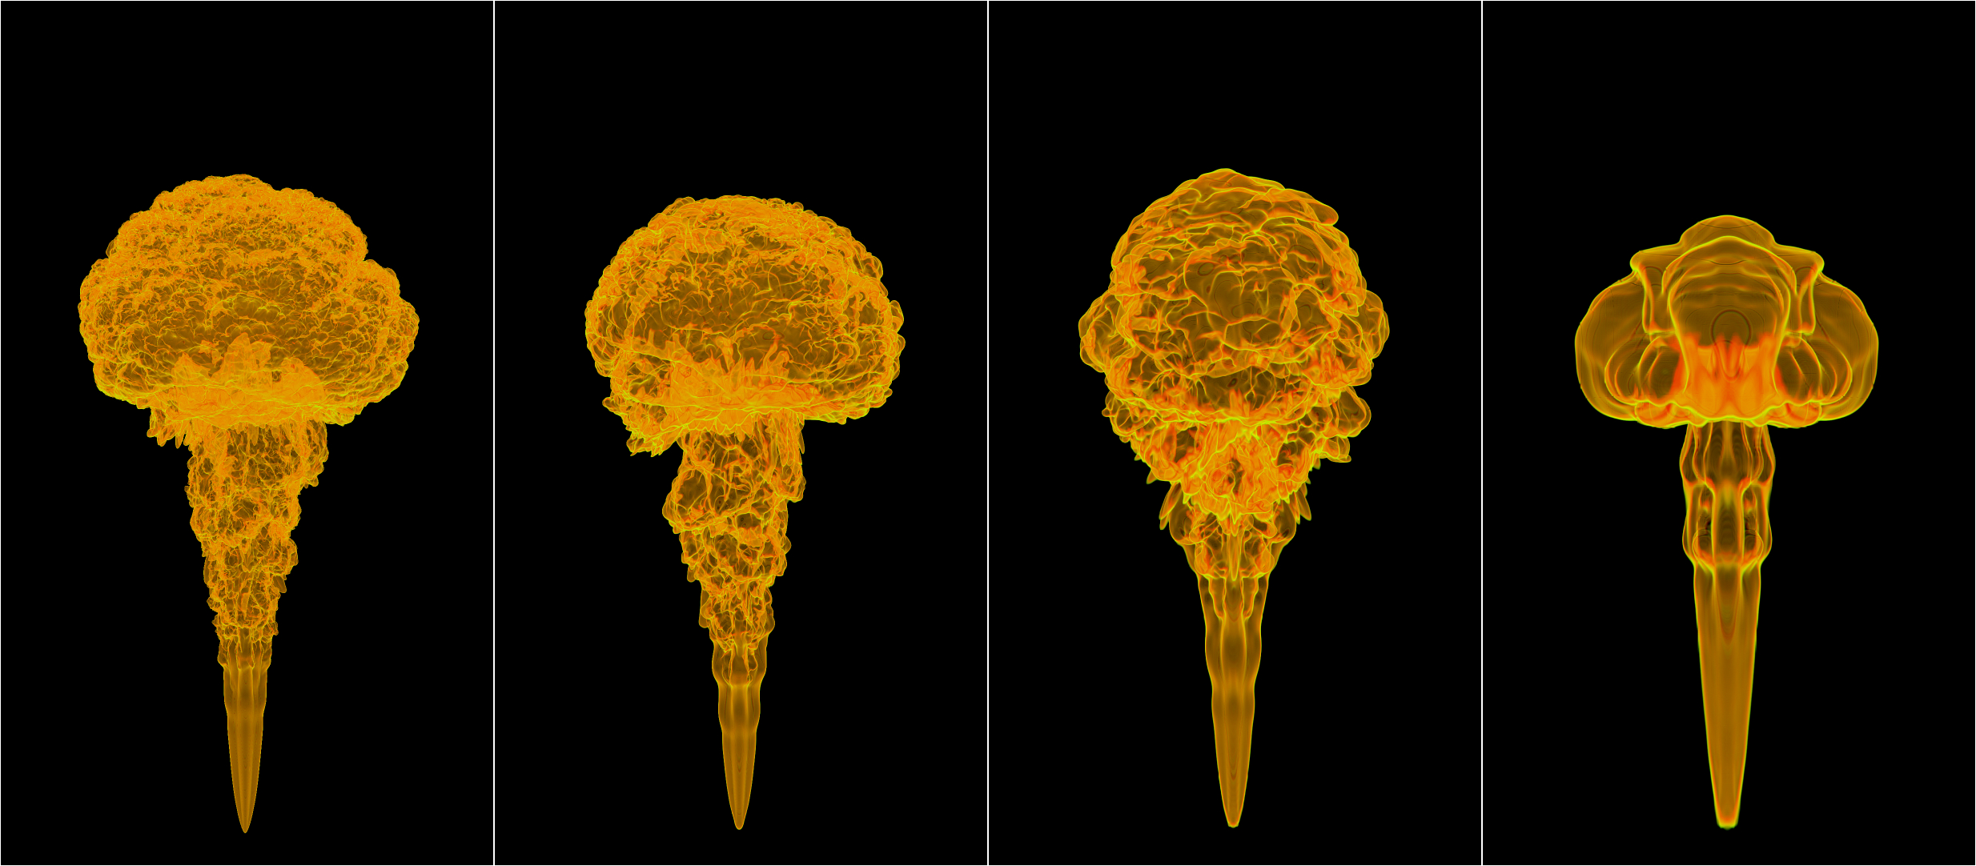
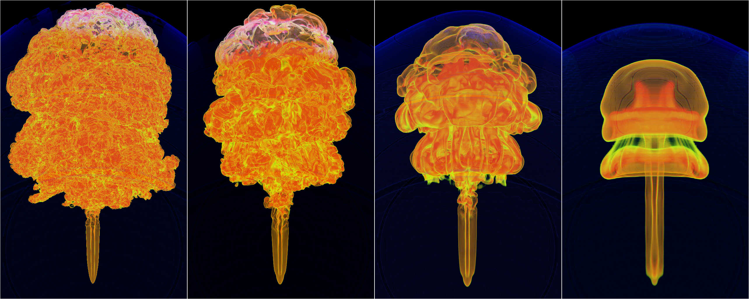
3D Verification Simulations of Buoyancy-Driven Turbulent Nuclear Combustion
Flame Bubble in Rectilinear
Domain at Constant g and ρ
Initially Planar Flame
In Rectilinear Domain
at Constant g and ρ
Flame Bubble
in White Dwarf Star

Slide 15
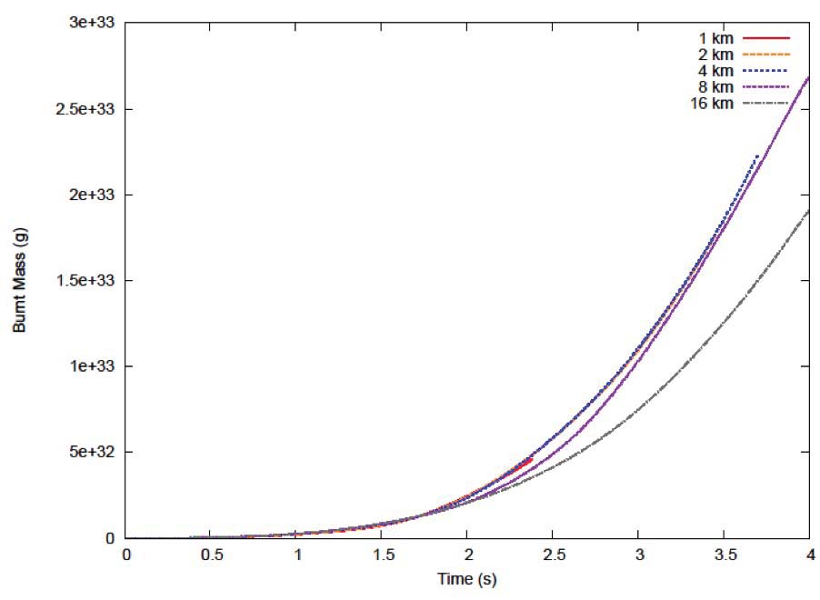
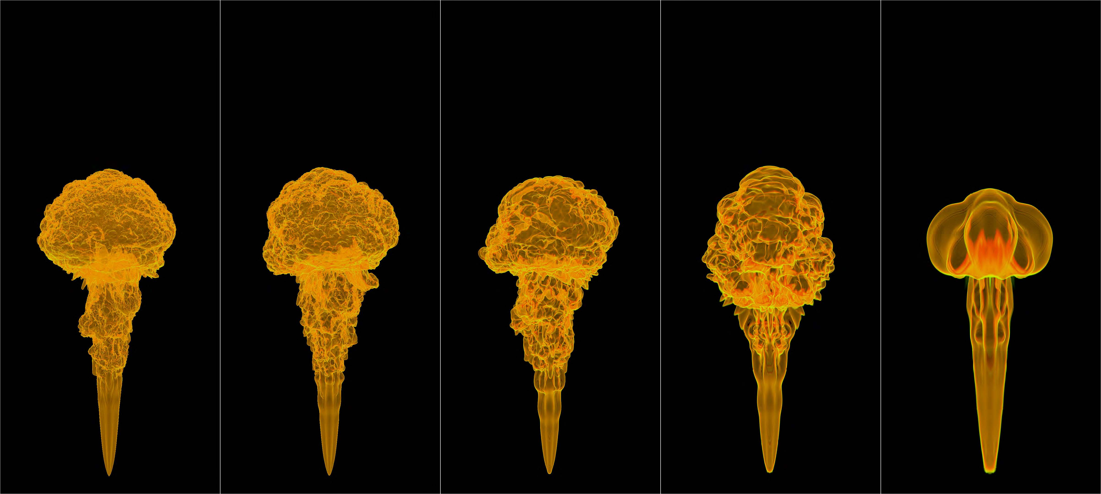
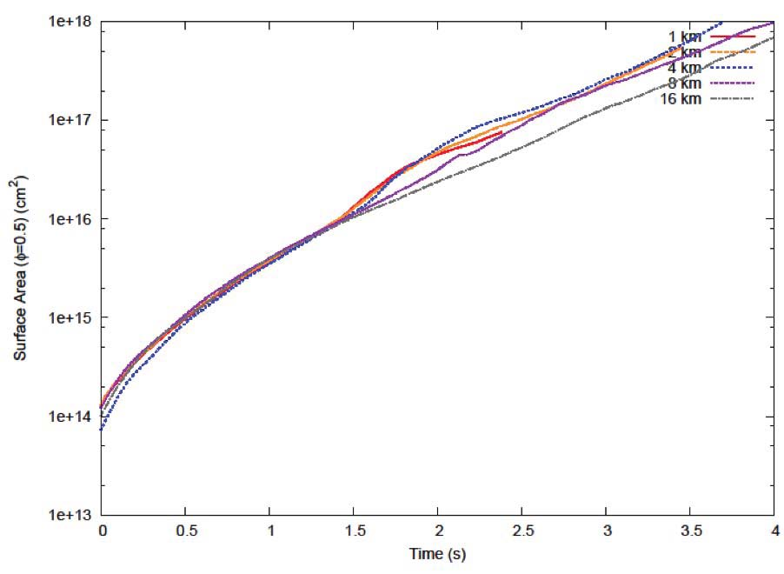
Resolution Study of Flame Bubble
in Rectilinear Domain at Constant g and ρ
1 km
2 km
4 km
8 km
16 km
16 km

Slide 16
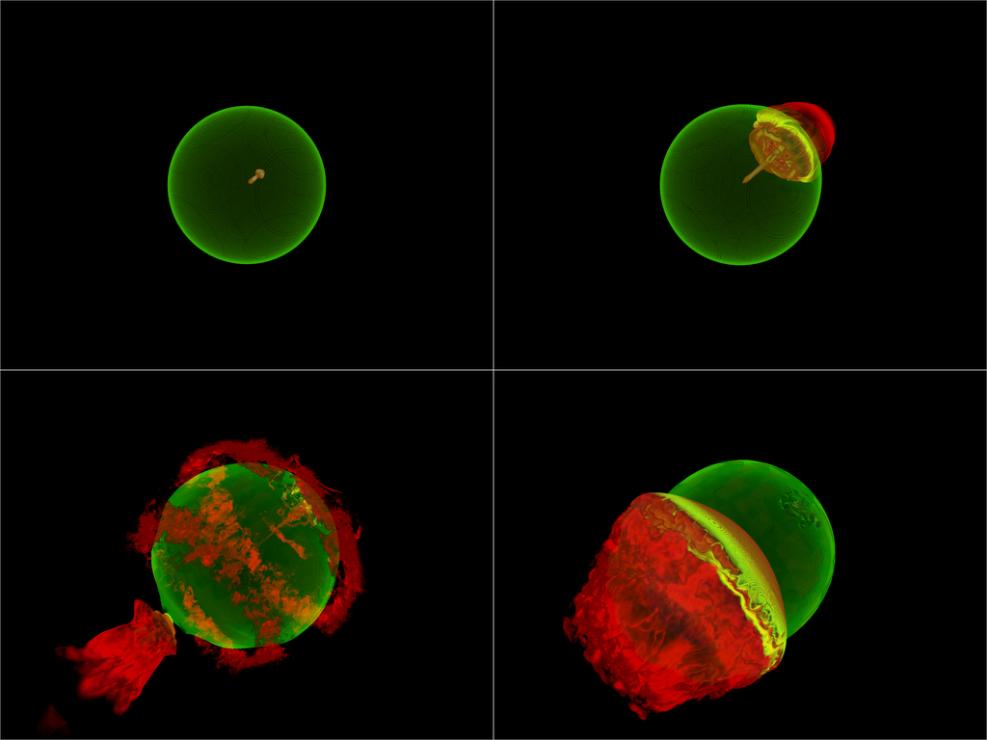
3D Simulations of GCD Model for Single Ignition Point

Slide 18
Detonation Conditions Are Robustly Produced by Inwardly Directed Jet
GCD model is only model so far
in which detonation occurs
without being put in by hand

Slide 19
Global Validation of Light Curves and Spectra Predicted by GCD Model
Comparison of U, V, B, R light curves predicted by GCD model and obs. of Type Ia
Supernova SN 2001el
Comparison of spectra predicted by GCD model and obs. of Type Ia supernova SN 1994D
Light curves and spectra
agree with observations
Kasen and Plewa (2006)

Slide 20
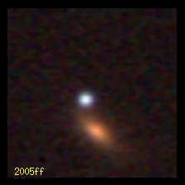
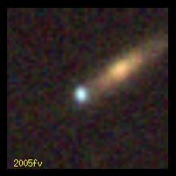
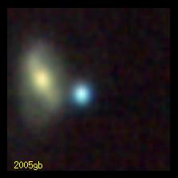
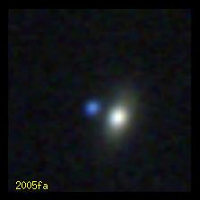
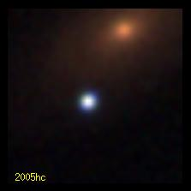
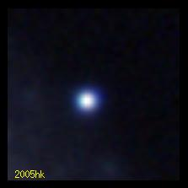
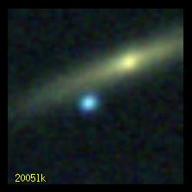
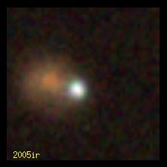
Partnership with SDSS-II Supernova Survey to Validate Type Ia Supernova Models
SDSS-II Supernova Survey has spectroscopically identified more than
500 Type Ia supernovae, and obtained high-quality light curves and
spectra for many of them (Holtzman et al. 2009, Kessler et al. 2009)

Slide 21
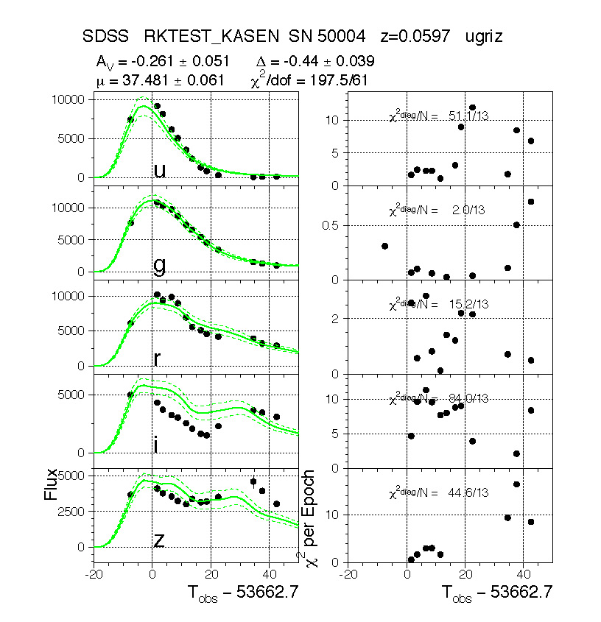
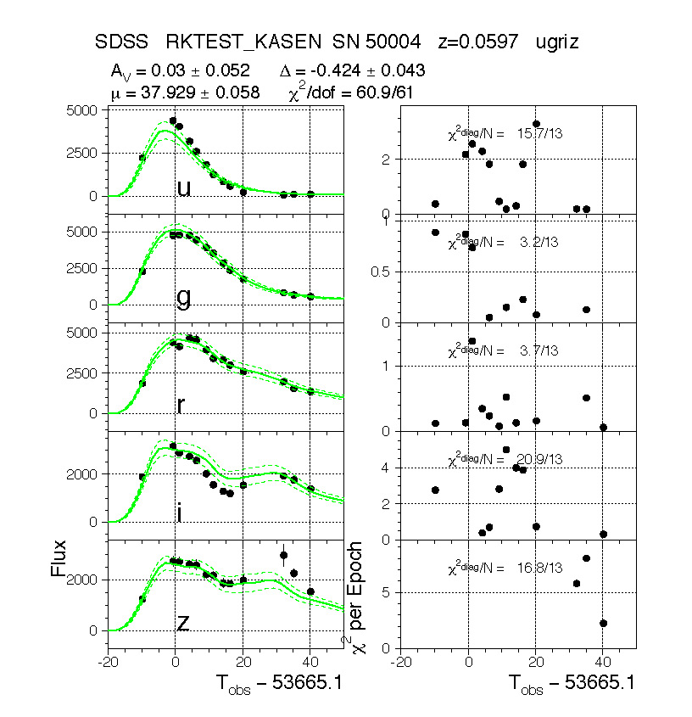
Systematic Validation of Type Ia Supernova Models Is Underway

Slide 22
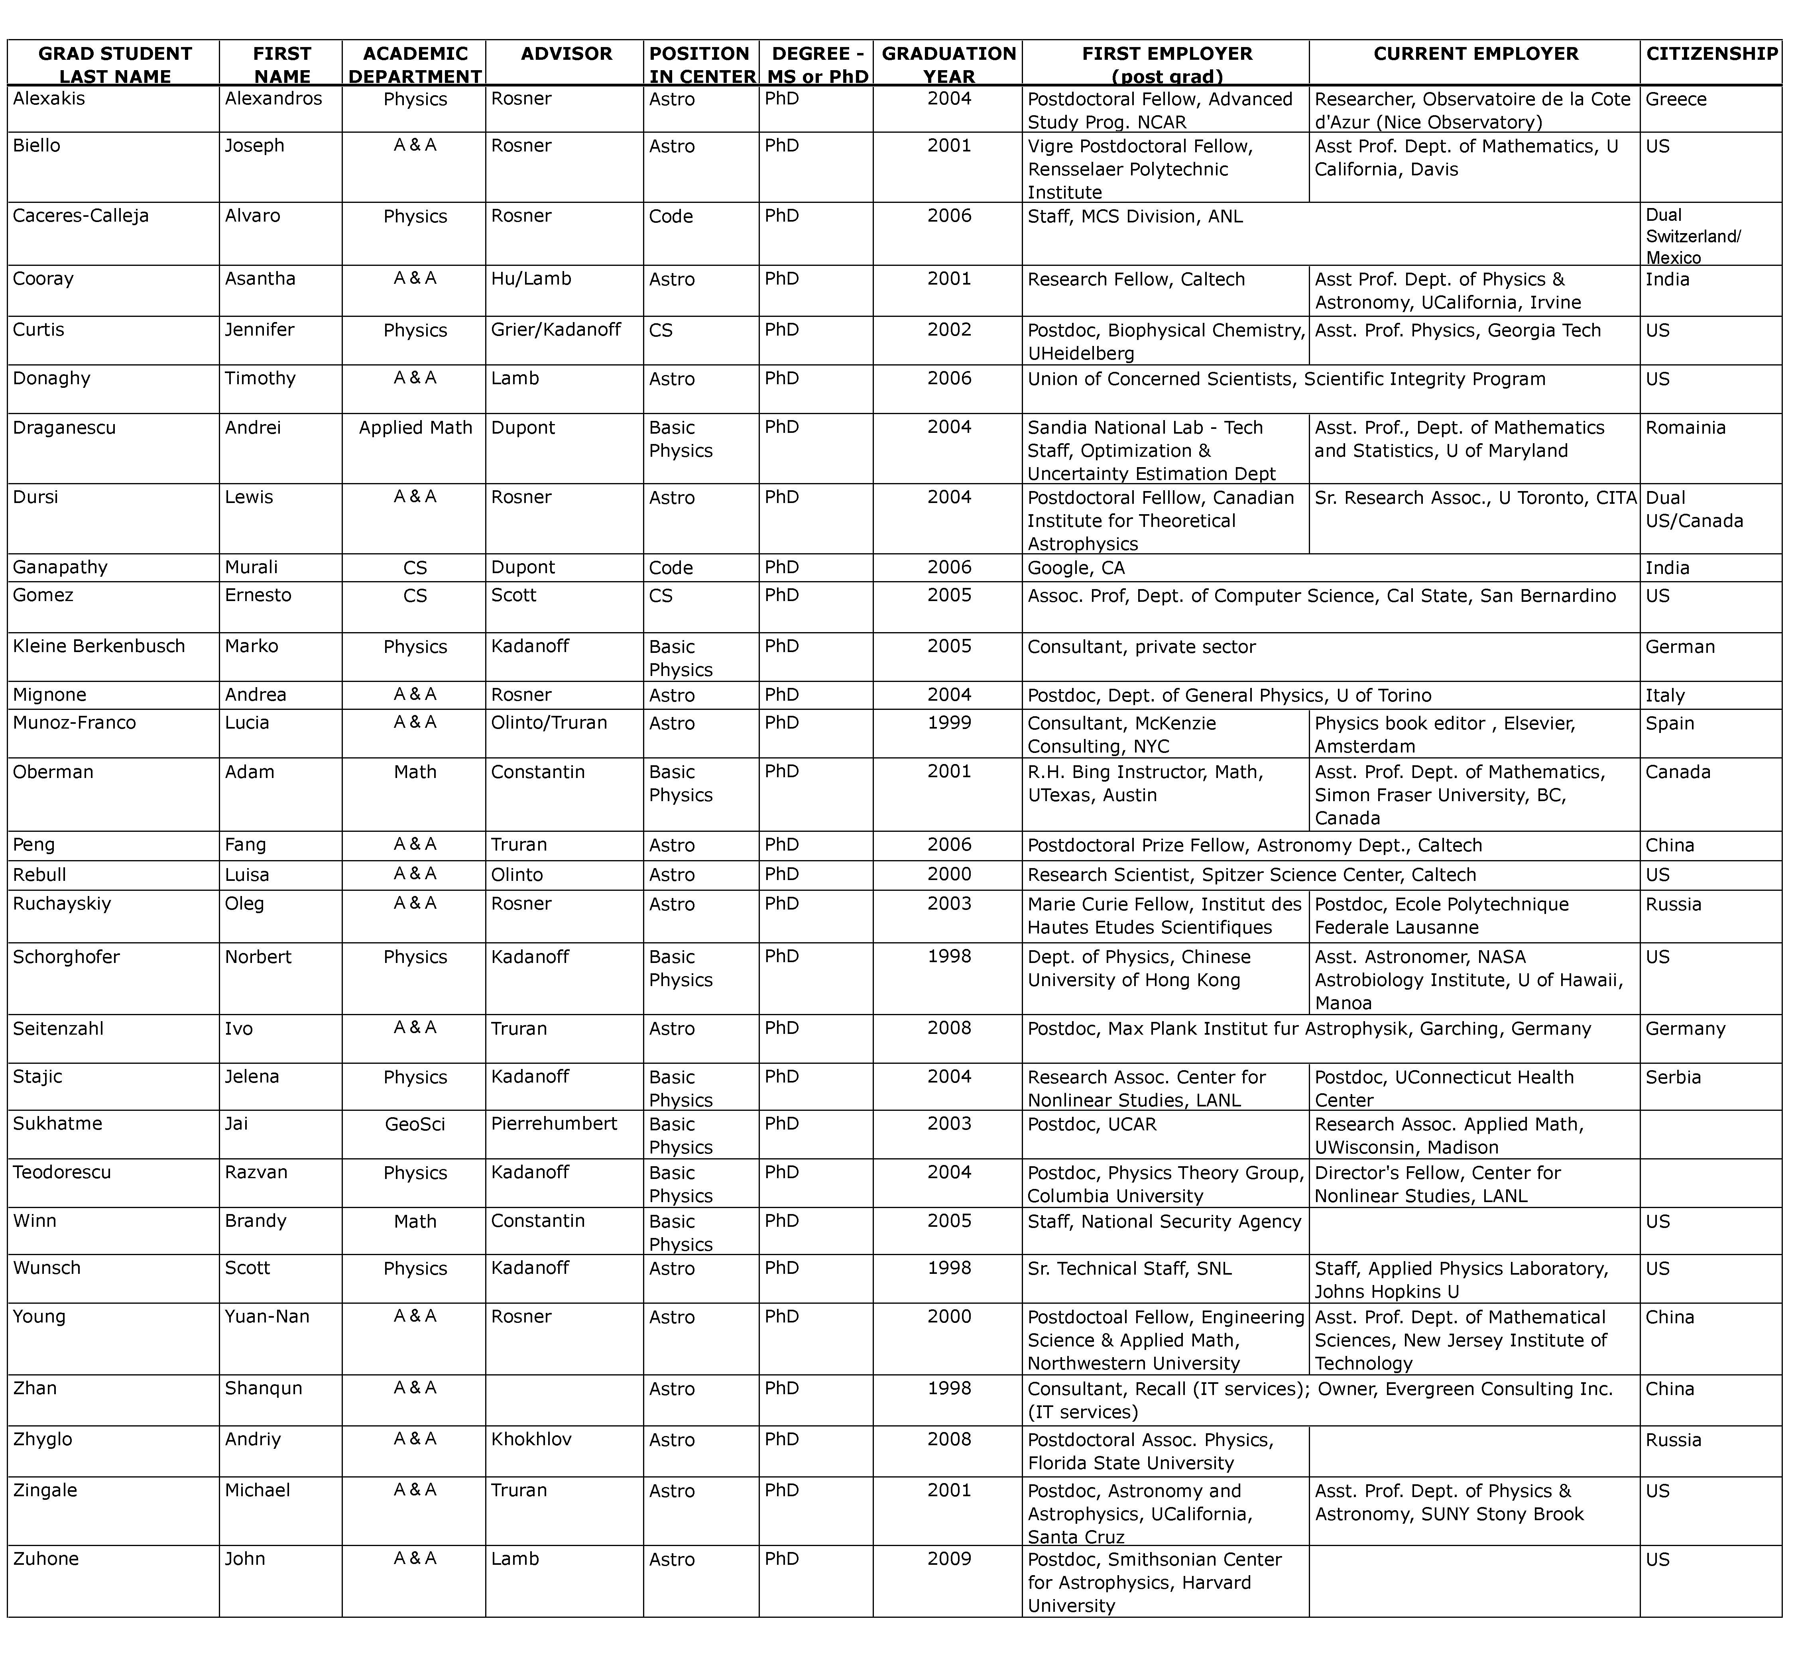
Our student legacy
Two key FLASH developers have won Presidential Early Career Awards in Science and Engineering (Paul Ricker and Michael Zingale)

Slide 23
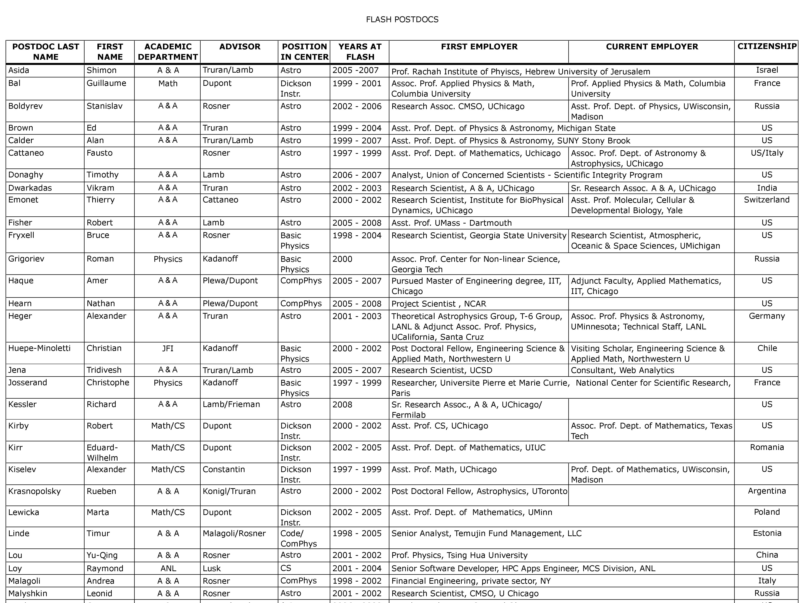
Our postdoc legacy…

Slide 24
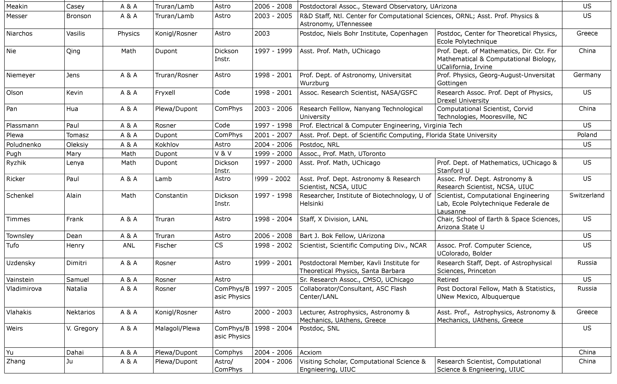
…our postdoc legacy (continued)
Twenty-four Flash Center postdocs
now hold faculty positions

Slide 25
Importance of the CI to the Flash Center
Facilities
Major Flash Center grants are administered by the CI (NSF Cyber- infrastructure PetaApps blood flow project and NSF Physics at the Frontier MHD project)
Flash Center is a participant in the CI Petascale Active Data Store (PADS)
CI hosts 40 Terabytes of data and the analysis tools for world’s largest compressible turbulence simulation that the Flash Center carried out
CI maintains some of the Flash Center’s infrastructure (Ellipse cluster, FLASH repository, tape backups)
Personnel
Ian Foster (Director of the CI) and Rick Stevens (a previous Founding Director of the CI) are members of the Flash Center
Don Lamb (Director of the Flash Center), Anshu Dubey (Associate Director of the Flash Center and CS/Applications Group Leader), and Mike Papka (CS/Scientific Data Analysis and Visualization Group Leader) are members of the CI
Expertise
CI provides interdisciplinary expertise and a home for Flash Center projects that don’t fit well in Astronomy & Astroophysics (e.g., blood flow)
CI facilitates collaborations and interactions with experts at ANL
CI research in data analysis, visualization, work flow, etc., used by Flash Center

Slide 26
Conclusions
The Flash Center has conducted – and continues to conduct – an extensive study of several key physical processes in Type Ia supernovae that are not fully understood, using high-fidelity 3D simulations
The Center has carried out a series of high-fidelity, 3D, whole star simulations of Type Ia supernovae in order to understand them better
They led to the discovery of the “gravitationally confined detonation” (GCD) model of Type Ia supernovae -- the only model so far that detonates without the detonation being put in by hand
The Center has begun comprehensive, systematic validation of all current Type Ia supernova models – the only group so far to do so
The CI is a critical resource for the Center

